Slide 1
COP-21
Committee on Earth Observation Satellites
WGClimate and SIT Team
SIT-30 Agenda Item #4
CEOS Action / Work Plan Reference – N/A
30th CEOS SIT Meeting
CNES Headquarters, Paris, France
31st March – 1st April 2015

Slide 2
CEOS Coordination in preparation for COP-21 - N. Bériot from the Ministry of Ecology and Sustainable Development will participate and present on how COP-21 will be organized
Background – UNFCCC and importance of COP-21
Opportunities for CEOS
Audit of CEOS materials for promotion
Presentation of selected materials for promotion
Strategic Messages
Actions moving forward

Slide 3
Background – UNFCCC and importance of COP-21
The United Nations Framework Convention on Climate Change (UNFCCC) is an international environmental treaty to "stabilize greenhouse gas concentrations in the atmosphere at a level that would prevent dangerous anthropogenic interference with the climate system“; defined to be total warming of under 2 ºC
Conferences of the Parties (COPs) are annual meetings to assess progress and consider legally binding agreements of greenhouse gas emissions, currently the Kyoto Protocol
Importance of COP-21 - the objective of COP-21 is to achieve a legally binding and universal agreement on climate (greenhouse gas emissions), commonly referred to as the Post-Kyoto Protocol
Thus, COP-21 serves as a focal point for climate change, mitigation and adaptation, and sustainability – the largest in 20 years
Formal CEOS-CGMS interaction with COP is reporting to the Subsidiary Body on Scientific and Technological Advice – Research and Systematic Observations (SBSTA-RSO)

Slide 4
Opportunities for CEOS
Events leading up to COP-21.
CEOS Roundtable at Le Bourget (aka Paris Air Show 15-21 June)
Joint presentation at ‘Our common future under Climate change’ conference 7-10 July in Paris
Formal input to COP-21.
CEOS-CGMS WGClimate invited to report to SBSTA-43 on progress of space observing system contributions to meeting protocol
Similar to prior input – 20 page report due by early October
Propose content on ECV inventory cycle and Climate Monitoring Architecture Case Studies on Decision Support
Opportunities at side events at COP-21.
Promotional materials - items for consideration in next slide

Slide 5
Audit of CEOS materials for promotion
Re-use of existing material.
Architecture for Climate Monitoring from Space
Strategy for Carbon Observations from Space
Climate Brochure and Video produced for Climate Symposium
EO Handbook – Climate Update
Architecture for Climate Monitoring from Space – Case Studies
NASA Hyperwall – Content from Climate Symposium
Creation of new material.
CEOS promotional bookmark
CEOS – contributions from WG/VCs (see next page)

Slide 6
Audit of CEOS materials for promotion
Virtual Constellation and Working Group potential inputs for COP-21
Need to develop 1-2 into an impactful story…if we use…
[OCR-VC] | [Pending IOCCG meeting in early March]
ACC-VC | Highlight the future GHG Constellation
OST-VC | Highlight sea level efforts
OSVW-VC | Long time series of SWV, extreme events
P-VC | Data from TRMM, Megha-Tropiques and GPM
SST-VC | Long time series of SST
WGISS | Integration of space and non-space data for climate
WGDisasters | Hydrometeorological hazards
WGCV | Validation of e.g. terrestrial products
WGCapD | Training support, webinars, SRTM

Slide 7
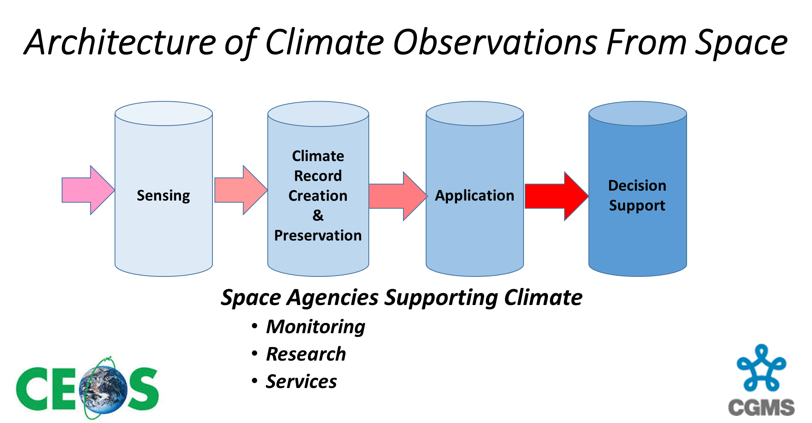

Slide 8
Strategic Messages for discussion
Satellite observations provide vital support
for future action on climate mitigation and adaptation; (All pillars)
Systematic satellite observations are an indispensable tool for measuring, reporting and verification (MRV) in the framework of REDD+, Reducing Emissions by avoiding Deforestation and forest Degradation in developing countries; (Pillar 4)
Space Agencies worldwide are working together through CEOS and CGMS to enhance and sustain their major contribution to the Global Climate Observing System, to support the work of UNFCCC parties; (All pillars)
Satellite Observations have enabled major advancements to Climate Science and Models and are a key component of the IPCC assessments; (Pillar 1)

Slide 9
Strategic Messages for discussion
Satellite observations are increasingly
seen as key elements in mitigation – through monitoring of REDD+ and other land use change –
and in adaptation, in particular in disaster risk reduction. (Pillar 4)
Research satellites are providing new insights into climate change process and helping improve climate models; (Pillar 1)
Use of a Free and Open data policy will ensure that developed and developing countries have equal access to the latest information; (GEO?)
A set of Essential Climate Variables (global multi-year data sets) based on the definition of the Global Climate Observing System has been developed; (Pillar 3)
Climate Services incorporating satellite observations and models are being developed to support regional and local climate adaptation. (Pillar 4)

Slide 10
Way forward on Strategic Messages
SIT Team proposes to develop a text with input from appropriate space agency fora (CEOS, IAA etc.)
Should CEOS consider a formal action?

