Slide 1

CEOS Work Plan 2015-2017
Committee on Earth Observation Satellites
CEOS Executive Officer Team
Agenda Item 3
CEOS SIT Technical Workshop
CNES, Paris
31st March to 1st April 2015

Slide 2



Slide 3
Timeline
Oct/Nov 14
Nov 14
Late Feb 15
Mid Mar 15
30 Mar 15
Updated Priorities
MilestoneChanges
Refinement
Concurrence
CEOS-28
v0
V0.5
Pre-V1
V1.0
Status
Updates
Add/Remove
Objectables
Validation
Plenary
Outcomes
Revise
Rationale
CEO Team
Chair Team
WGs/VCs/AHTs
WGs/VCs/AHTs
CEO Team
Princpals
(Virtual Endorsement)

Slide 4
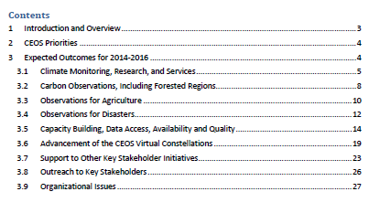
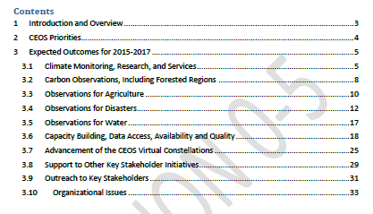
Key Changes – Focus Areas
WAT-1: Development of a CEOS response to the GEOSS Water Strategy.

Slide 5
Key Changes
Climate Monitoring, Research and Services
CMRS‐5: Contributions to the Global Framework for Climate Services (GFCS) | CMRS-11: Analysis report on implications of new climate change treaty
CMRS‐6: Report to UNFCCC Subsidiary Body for Scientific and Technological Advice‐ Research and Systematic Observation (SBSTA‐RSO) at COP‐20 | CMRS-10 : CEOS-CGMS Report on Progress to SBSTA-43

Slide 6
Key Changes
Carbon Observations, including Forested Regions
CARB‐1: Updated Global Baseline Data Acquisition Strategy for GFOI | CARB-8: Implementation of agreed actions in response to CEOS Strategy for Carbon Observations from Space
CARB‐2: Initial version of Space Data Services Strategy for GFOI
CARB‐6 Endorsed CEOS Strategy for Carbon Observations from Space
Consistent with
Plenary decision
Items will also be tracked individually

Slide 7
Key Changes
Observations for Agriculture
AGRI‐1: Updated Acquisition Strategy for GEOGLAM | AGRI-4: Acquisition Strategy for GEOGLAM
 | AGRI-5: Data Services Prototypes and Lessons Learnt Report
 | AGRI-6: Common Data Sharing Strategy for JECAM

Slide 8
Key Changes
Observations for Disasters
DIS‐1: Strategy for preparing the 2015 WCDRR and the post‐Hyogo Framework for Action (HFA2) | DIS-7: Implementation of Endorsed Strategy for participation in the 2015 WCDRR
DIS‐2: Proposal for Recovery Observatory | DIS-9: Readiness of Recovery Observatory for Activation
DIS‐3: Data Acquisition Plan in support to DRM Pilots | DIS-10: Implementation of Data Acquisition Plan in support to DRM pilots, data coordination for GNSL supersites
DIS‐5: Revised Geohazard Supersite Selection Process and decision on new proposed Supersites | DIS-11: Proposal for a landslides DRM pilot
DIS‐6: Web client to facilitate joint catalog search and access to Supersite data | DIS-12: Report on survey of donors for post-2016 operation of a Recovery Observatory
 | DIS-13: Report on follow-on actions to DRM Pilots

Slide 9
Key Changes
Data Access
DATA‐1: CEOS OpenSearch Best Practices Guideline Document | DATA-3: Assessment of Technical Architectures for Supporting Operational Programs
 | DATA-4: Development of the Recovery Observatory Infrastructure
 | DATA-5: CEOS Data Stewardship Best Practices Guideline documents
 | DATA-6: Linking WGs and VCs to Information Systems and Services Resources

Slide 10
Key Changes
Virtual Constellations
 | VC-20: Revised Terms of Reference for LSI-VC
Items from implementation
plan will be added in
next update

Slide 11
Key Changes
Outreach to Key Stakeholders
OUT‐6: Updated CEOS website | OUT-7: Special Data Applications Report
OUT‐3: CEOS Database
update survey and release
of online version
CB-10: CEOS Database update survey and release of online version
OUT‐5: Provision of ECV
Inventory Tools
CB-11: Provision of ECV
Inventory Tools

Slide 12
Key Changes
Organizational Issues
ORG‐1: First Version of the new CEOS Three‐Year Work Plan (this document). | ORG-7: Refreshed Terms of Reference for Working Groups
ORG‐2: Process Paper for CEOS Working Groups | ORG-8: Assessment of implementation of Guiding Documents
ORG‐3: Process Paper for CEOS New Initiatives
ORG‐6: Terms of Reference for WGDisasters

Slide 13
Phew …
… So how can we track all this?
ENTER www.ceos-deliverables.org

Slide 14
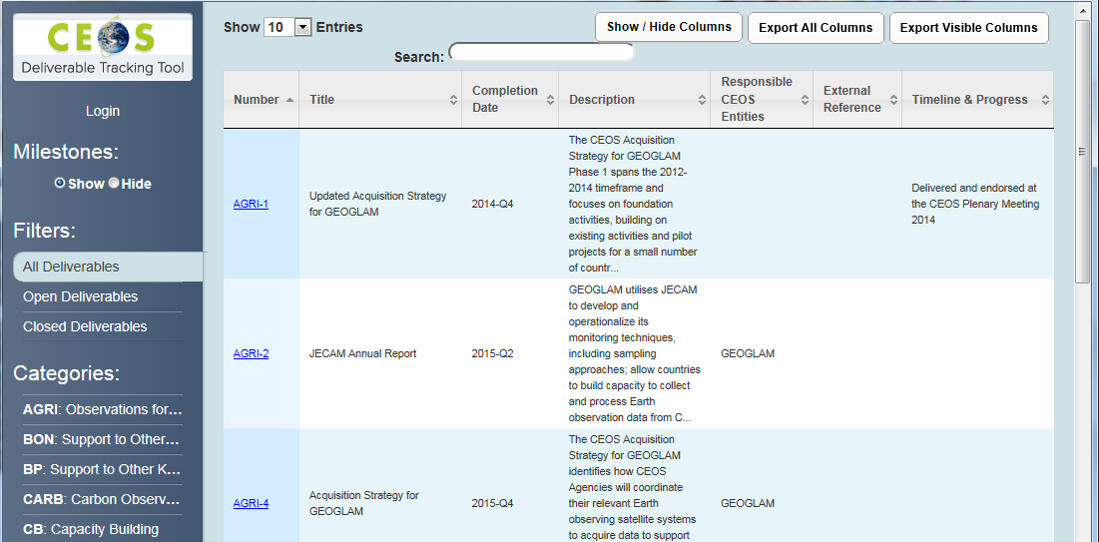

Slide 15
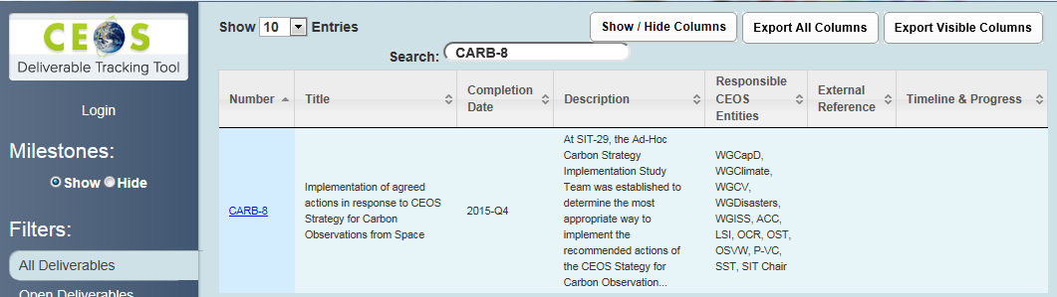

Slide 16
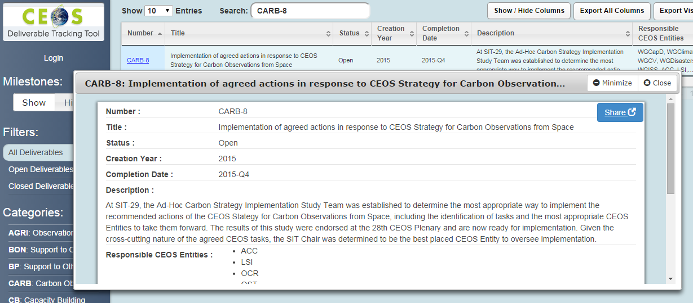

Slide 17
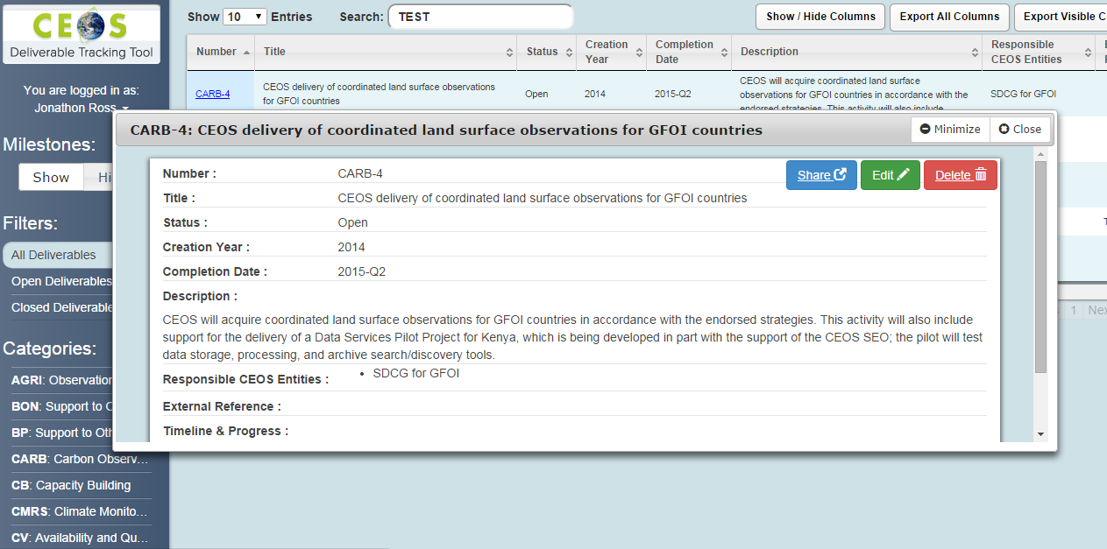

Slide 18
Frequently Asked Questions
Deliverable Tracker
Who needs to update the information?
Responsible Entities – Typically WG Chairs, VC Co-Leads, Ad-Hoc Team Leads
When does it need to be updated?
Suggest monthly, at least quarterly.
And when something significant (positive or negative) occurs.
How can we learn this new system?
Following SIT-30 you will be advised when the system is ‘live’. We suggest that logging on then and providing a current status for all of your items is a good start. We will monitor this and remind you. We propose this as a SIT ACTION.
Who do we talk to for support?
Content – The CEO Team.
Functionality/technical – The SEO Team.

