Slide 1
CEOS Ad Hoc Working Group on GEOGLAM
Side Meeting
George Dyke
CEOS SIT-29
CNES, Toulouse, France
8th April 2014

Slide 2


Presentation Overview
Side Meeting agenda
Implementation status of the CEOS Acquisition Strategy for GEOGLAM Phase 1
Way forward to CEOS Plenary
In response to Plenary action 27-17:
Reference action SIT-28-34

Slide 3
Side Meeting Objective
Brief update on the status of the CEOS Acquisition Strategy for GEOGLAM Phase 1, and outcomes from the recent GEOGLAM-CEOS Co-Community meeting in Rome (27th-28th February)
Update on GEOGLAM
Update on Space Data Management System
Proposed way forward to CEOS Plenary

Slide 4
Side Meeting Agenda
Five Minutes Each On:
  Status update on the CEOS Acquisition Strategy for GEOGLAM Phase 1, and outcomes from the GEOGLAM-CEOS Co-Community meeting (G Dyke)
  Update on GEOGLAM (M Deshayes)
  Update on the Space Data Management System and GEOGLAM applications (B Killough)
40 Minutes Discussion:
  Open discussion of the strategy and way forward to CEOS Plenary
  CEOS participation in the JECAM Science Meeting, 21st-23rd July 2014, Ottawa
5 Minutes Wrap-up and Adjourn

Slide 5
Timeline
November 2014: CEOS Acquisition Strategy for GEOGLAM Phase 1 endorsed by Plenary (action to report implementation at SIT-29)
27th-28th February: GEOGLAM-CEOS Co-Community meeting at ESA/ESRIN
SIT-29: Report on Strategy implementation
CEOS Plenary: Update to CEOS Acquisition Strategy for GEOGLAM planned
Q4 2014 / Q1 2015: Update to GEOGLAM IP anticipated

Slide 6
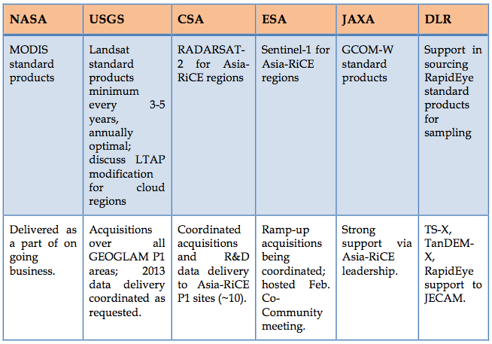
Primary Data Stream Implementation
Status summary from Plenary through SIT-29
Status

Slide 7
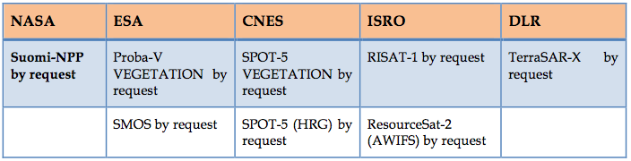
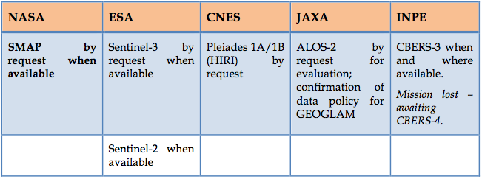
Secondary / Potential Data Streams
Status summary from Plenary through SIT-29
No GEOGLAM-specific requests received
JECAM using many data streams
ALOS 50m mosaics released
  25m and ALOS-2 anticipated
JECAM access to Pleiades discussed at Co-Community meeting

Slide 8
JECAM Status
JECAM is formally the R&D component of GEOGLAM
  40 sites globally
CEOS has been formally supporting JECAM since 2011
CEOS support is helping to grow the JECAM network
  Success story!
JECAM Annual Report recently released
  Using a wide variety of CEOS agency data streams for R&D and applications development
Agencies invited to participate in the JECAM Science Meeting
  21st-23rd July, Ottawa, Canada (Side meetings 24th-25th)

Slide 9
GEOGLAM and SDMS Updates
Update on GEOGLAM (M Deshayes)
  Update on the Space Data Management System and GEOGLAM applications (B Killough)

Slide 10
Proposed Way Forward to Pleanry

Slide 11
Way Forward Items for Consideration
Reporting on progress towards the GEOGLAM Implementation Plan
  Including feedback on the role of CEOS and CEOS agency data streams in the execution of the Plan, “lessons learned”
  Plan to have early results of Asia-RiCE crop team Phase 1A for Plenary
Realization of GEOGLAM governance, confirmation of resources, and capacity for GEOGLAM Phase 2
  Including plans to leverage initiatives like the EC’s SIGMA, and Sentinel-2 for Agriculture
  Many GEOGLAM activities with national mandates, but coordination layer not always clear, formal (vis-à-vis GFOI for example)

Slide 12
Way Forward Items for Consideration
Should CEOS seek representation in GEOGLAM governance?
  As a key stakeholder, modeled after the CEOS Co-Lead of GFOI
Coordination of resources being promoted by G-20 governments in support of agriculture
  Ensuring alignment and leverage of space agency contributions
Next update of the GEOGLAM Implementation Plan
  Expected Q4 2014 or Q1 2015
  Impetus for escalation of CEOS support?

Slide 13
Conclusions
Currently, main CEOS contribution is in support of JECAM and phase 1A of Asia Rice Crop Technical demonstration sites
Operationally (~2017-18), CEOS agency data streams will play a fundamental role in GEOGLAM
CEOS needs to:
  Understand the role it can play as GEOGLAM progresses
  Encourage GEO to advocate on behalf of its flagships
  Evolve its strategy to reflect the evolution of GEOGLAM, to reflect lessons learned, and to be commensurate with GEOGLAM development, coordination, and maturity
SIT-29 Action:
  CEOS ad hoc Working Group on GEOGLAM to work with the GEOGLAM community to develop an update to the CEOS Acquisition Strategy for GEOGLAM for endorsement.
  Due: 28th CEOS Plenary, 29th-30th October 2014, Tromsö, Norway

