Slide 1
CEOS Plan for Participation to World Conference on Disaster Risk Reduction (WCDRR)
Chu Ishida
JAXA
CEOS Action 27-10
CEOS SIT-29 Meeting, Agenda 19
CNES, Toulouse, France
9th-10th April 2014

Slide 2
27th Plenary Decision
27th CEOS Plenary (Nov 2013, Montreal) endorsed proposed 2015 World Conference on Disaster Risk Reduction (WCDRR) Task Team (WTT) to define and implement CEOS participation in WCDRR and contribution to HFA2.
Action item 27-10: JAXA to propose a way forward for the 2015 World Conference on Disaster Risk Reduction (WCDRR) by SIT29 (Apr 2014, Toulouse)

Slide 3
WTT teleconference and meeting
WTT teleconference#1, Jan 23, 2014
  discussed objectives, scope, membership, schedule of WTT
  development of short-list of useful contacts (e.g. UNISDR regional offices, WCDRR officials) was suggested
  discussed strategies for WTT/HFA2
  preparation of IDRC abstract was agreed
WTT teleconference#2, February 17, 2014
  development of meeting schedule for CEOS participation was agreed
  UNISDR expectations for space agencies were discussed
  development of CEOS key messages to convey to major meetings was agreed
  development of voluntary commitments was discussed
WGDisaster 1st meeting, Mar 17-19, 2014
  WTT report was made.
  CEOS key messages for WCDRR were revised.

Slide 4
WTT Outline
WTT Objectives:
  define and implement CEOS strategy to position space based DRR in post-2015 Hyogo Framework (HFA2)
  plan side events, exhibition and materials to present Space Agencies’ DRR activities at WCDRR
WTT Approach:
  simple strategies to position space based DRR in HFA2 through the Regional Platforms and Intergovernmental Preparatory Committee (PrepCom) meetings.
  close coordination with UNISDR, CEOS Agency’s governments, and local hosts (Cabinet Office of Japan, Ministry of Foreign Affairs and Sendai City) , Asian Disaster Reduction Center (ADRC) and International Research for Disaster Reduction (IRDR)

Slide 5
WTT Outline (cont’d)
Members:
  Interested members from CEOS Agencies and other related organizations. Initial members are;
  Ivan Petiteville(ESA. WGDisaster Chair)
  Stephane Chalifoux (CSA, Vice-Chair)
  Francesco Gaetani (GEO)
  Philippe Bally (ESA)
  Andrew Eddy (ESA)
  Steven Hosford (CNES)
  Brent Smith (NOAA)
  Stephen Ward (JAXA)
  Chu Ishida (JAXA, WTT Lead)
Schedule:
  January-March: prepare WCDRR strategy
  April: present CEOS WCDRR strategy at SIT-29
  November: report progress of WCDRR implementation at CEOS Plenary
  March: participation to WCDRR

Slide 6
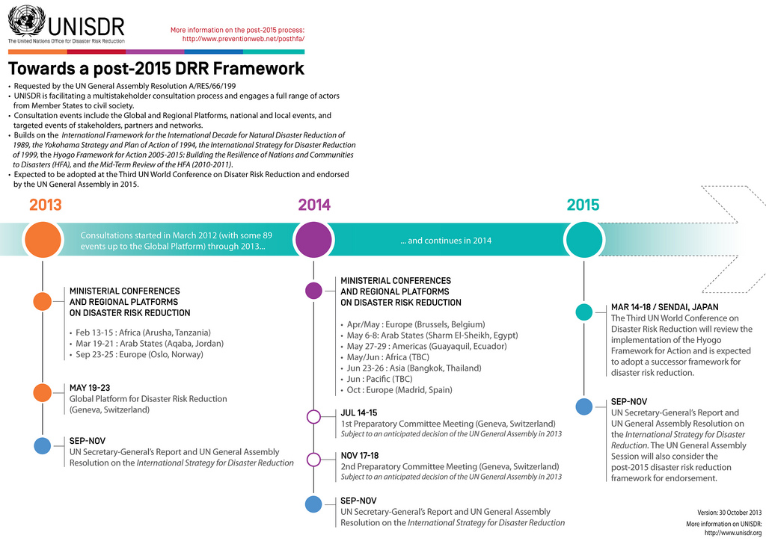
We are already at mid point
in HFA2 consultation.
ESA Attended

Slide 7
WCDRR and Post HFA
Expected Outcome of WCDRR
A) the post‐2015 framework for disaster risk reduction
B) the voluntary commitments of stakeholders
C) the political declaration
Guiding principles for post HFA, additional from HFA
1. Sustainability of development and resilience
2. Natural and technological hazards
3. International legal obligation and safeguard for prevention and reduction of disaster risk
4. Further cooperative efforts for trans‐boundary and global characteristics of risk drivers
5. Availability of open source and open access science-based risk information and knowledge
Ref: Proposed Elements for Consideration in the Post2015 Framework for Disaster Risk Reduction
by the UN Special Representative of the Secretary General for Disaster Risk Reduction, UNSIDR 17 Dec 2013

Slide 8
Regional platform and Preparatory Committee meetings for HFA2
Month | Post-HFA | Asia Pacific | Europe/Africa | America
Mar 2014 |  | ACDR2014 Mar 4-6, Tokyo (JAXA attended)
April |  | Central Asia and south Caucasus, April ISDR Asian Partnership (IAP) Apr 22-24, Bangkok
May |  |  | Africa regional, May 5-8, Nigeria | Americas regional , May 27-29, Equador
June |  | Pacific regional, June 204, Fiji 6th AMCDRR ministerial level June 23-26, Bangkok | Arab states, June 10-12, Egypt Europe, Ministerial June/July (tbc)
July | 1st Prep Committee July 14-15, Geneva
August |  |  | IDRC, Aug 24-28, Davos
October |  |  | European Forum for DRR, Oct
Nov | 2nd Prep Committee Nov 17-18, Geneva
Jan 2015 |  | IRDR symposium Jan 14-16, Tokyo
Mar | 3rd WCDRR, Mar 14-18, Sendai
JAXA will attend
SANSA will attend
JAXA will attend
Pre-conference,
side event and exhibition
are planned
Abstract submitted,
WTT will attend
WTT will attend
WTT will attend
JAXA will attend
WTT will attend, side event and exhibition are planned

Slide 9
Way forward for WCDRR
Positioning satellite observation in the HFA2
actively participate in the regional platforms and PrepCom if possible (key meetings are being identified)
work through governments and international organizations
develop CEOS key strategic messages (a draft was developed)
lobby on key UNISDR people on HFA2 (key UNISDR persons are being identified)
Promoting understanding on satellite applications for DRR
plan and organize satellite workshops (side events) and exhibitions at major meetings
JAXA in cooperation with ADRC will organize a satellite workshop (Pre-conference meeting ) and exhibition at the 6th Asian Ministerial Conference on Disaster Risk Reduction (AMCDRR, June 22-26, Bangkok)
WTT plans to organize side event and exhibition at the WCDRR (March, Sendai)

Slide 10
Progress so far (1/3)
- meeting with key people -
Meeting with local hosts (Cabinet Office and Ministry of Foreign Affairs) in September and December
Meeting with Prof. Koike for IRDR symposium (Jan 2015, Tokyo) in December
Meeting with ADRC in December for ACDR2014 in December
Meeting with UNISDR Mr. Pedro Basabe, Senior Program Officer, at GEO Summit in January. He suggested;
  work with IRDR
  develop recommendation in close cooperation with UNOOSA, COSPAR and WMO, etc.
Mr. Higuchi, JAXA VP, meeting with UNISDR Ms. Margareta Wahlstrom, Special Representative for SG for DRR, and Mr. Neil McFarlane, Chief, Regional Programs and DRR Coordination in Jan 2014. They discussed;
  JAXA and CEOS interest in positioning satellite EO in HFA2
  Possibility of satellite workshop at June Asia Ministerial Disaster Reduction Conference (AMDRC)
  Space agency commitments for WCDRR
Meetings with Japan UNISDR representative, Dr. Matsuoka in Jan 2014

Slide 11
Progress so far(2/3)
- Japan National Preparatory Meeting -
1st Japan National Preparatory Meeting, Feb 10, Tokyo
organized by Cabinet Office with Members from universities and related organizations from JAXA, ADRC, JICA, Red Cross, Japan Public Broadcasting, Fire Agency, representative of Prefectures affected by East Japan Great Earthquake, observers from related ministries
three view points to compile Japanese inputs to HFA2 were discussed
  national inputs for HFA2
  sharing knowledge and experience of Japan, particularly East Japan Great Earthquake
  transmission of recovery from the East Japan Great Earthquake and promotion of the regional industry
IRDR symposium (Jan 2015, Tokyo, organized by Prof. Koike) was proposed to input recommendations to HFA2 from international research communities.
Mr. Yamamoto, Executive Director of JAXA, voiced satellite contribution for DRR and emphasized importance of communications and coordination with end users and disaster authority organizations.
Mr. Natori, ADRC Director, reported ADRC activities which include Sentinel Asia.
Fast compilation of inputs was suggested by the Chair. Next meeting is in April.

Slide 12
Progress so far(3/3)
- ACDR 2014 -
The Asian Conference on Disaster Reduction (ACDR) 2014 was held in Tokyo, March 4-6, 2014, by ADRC and Cabinet Office of Japan, and UNISDR.
150 participants from 28 countries
Four thematic sessions were held:
  HFA progress and challenges towards Post-HFA
  Strengthening local capacity for DRR
  Human resource development and training
  Utilization of space technology for DRR

Slide 13
Summary of ACDR
Session 4: Utilization of Space Technology for DRR
Enhance utilization of satellite images for DRR. The presentations from Asian Institute of Technology (AIT), Japan Aerospace Exploration Agency (JAXA), Philippine Institute of Volcanology and Seismology (PHIVOLCS), ADRC, and Ministry of Disaster Management and Relief of Bangladesh showed how space technologies have contributed to strengthening DRR efforts in the region and becoming integral part of the national DRM systems. The utilization of satellite images enhances early warning systems and useful in identifying, assessing, and monitoring risks, by providing unique capabilities. The conference recommended that prospects for wider utilization of these technologies must be explored to benefit more ADRC member countries, specifically through Sentinel Asia. It is also recommended that the use of space technology is integrated in HFA2.
Ensure effective utilization of space technologies. The conference recognized that satellite images are complementary to other data and information sources and need to be integrated to existing DRM systems. The conference also noted that satellite imagery need to be easily accessible in timely manner and readily usable by the DRM organizations and end users covering all aspects of disaster cycle; early warning, risk reduction, emergency response and recovery. Additionally, the conference called for active support of ADRC member countries in Sentinel Asia through Emergency Observation Request (EOR) and using satellite maps for more improved planning, implementation, and monitoring of DRR activities.

Slide 14
6th AMCDRR
6th Asian Ministerial Conference for Disaster Risk Reduction,
24-26, June 2014, Bangkok
Issues to be addressed:
  Enhance resilience at local (sub-national) levels
  Increase public investments for disaster and climate risk management to protect development gains
  Strengthen the engagement of private sector - Public-Private Partnership for DRR
Outputs:
  A declaration on DRR and HFA implementation 2014-2015
  Formal inputs by the region on the draft HFA2 document
  Compilation of sound practices in Asia and the Pacific
Satellite workshop and exhibition (registered in cooperation with ADRC)
  Pre-conference and side event on space-based DRR to discuss issues and recommendations to input to the conference
  Exhibition on space-based disaster and climate risk management at Market Place

Slide 15
CEOS Main Strategic Messages
- Satellite EO and Disaster Risk Management -
Main strategic messages for WCDRR/HFA2 has been developed.
The messages will be used for lobbying at major meetings.
5 Key Strategic Messages:
  1. Satellite EO data complements other data sources but provides unique information.
  2. Satellite data needs to be transformed into a higher-level information that can be more readily applied by end-users.
  3. Satellite data contributes on all scales, from global, through regional, to local issues.
  4. Space agencies want to cooperate with major stakeholders to identify the most critical users’ needs and to establish a plan for a sustained and coordinated response to those needs.
  5. User community representatives have an important role to play in the identification of priorities for space agency attention and must stay engaged throughout implementation and operation of the resulting programmes

Slide 16
CEOS Voluntary Commitments
The proposed template :
brief narrative of deliverables (300 words); specify what goal it is meant to address (prevention, reduction or "resilience"); indicate level at which the commitment is made (local, national, regional or global); specify targets; specify indicators; specify means of verification; and specify timeframe.
Schedule:
There is no stated deadline to make a commitment. Commitments can be formulated at Regional Platforms and subsequently declared and recognized at the World Conference or they can be declared after the World Conference. Commitments will be kept in a database.
CEOS voluntary commitments
WTT drafted a text which includes;
1. Close Collaboration with major stakeholders - Long-term Plan in
response to HFA2
2. Full cycle of DRM support at global and regional/local scales

Slide 17
Useful documents
“International Collaboration of Space Agencies to Support Disaster Risk Management using Satellite Earth Observation”, Input Paper prepared for the Global Assessment Report on Disaster Risk Reduction 2015,
Proposed Elements for Consideration in the Post-2015 Framework for Disaster Risk Reduction by The UN Special Representative of the Secretary-General for Disaster Risk Reduction, 17 December 2013
Second Announcement 3rd World Conference on Disaster Risk Reduction 2015, January 2014

Slide 18
Summary
WCDRR Task Team (WTT) developed short lists of key people and key meetings, and drafted CEOS main strategic messages and CEOS voluntary commitments.
WCDRR/HFA2 is a long UN process and regional consultations on HFA2 already started.
CEOS needs to lobby through governments and international organizations for the regional platforms and Preparatory Committee meetings.
Side-events and exhibition at key meetings need to be planned to promote understanding on satellite capabilities for DRR.

