Slide 1
Geohazard Supersites and Natural Laboratories
Jörn Hoffmann, Klaus Schmidt
German Aerospace Center (DLR)
CEOS SIT-29 Meeting
CNES, Toulouse, France 9th-10th April 2014
The CEOS Supersite Coordination Team:
Simona Zoffoli, ASI
Steven Hosford, CNES
Christine Giguère, CSA
Jörn Hoffmann, DLR (Chair)
Wolfgang Lengert , ESA
Kazuo Umezawa, JAXA
Shizu Yabe, JAXA
Francis Lindsay, NASA

Slide 2
Background
The GEO Geohazards Supersites Initiative
Aims at enriching our knowledge about geohazards by empowering the global scientific community through collaboration of space and in‐situ data providers and cross‐domain sharing of data and knowledge
Primarily through providing easy and free-of-charge access to comprehensive satellite and ground-based geophysical data sets derived from different sources and different disciplines

Slide 3
Past CEOS decisions
2012 Plenary approved process for Supersite selection
Plenary accepted Hawai’i as Permanent Supersite
Plenary tasked Supersites Coordination Team (SCT) to coordinate CEOS contributions and facilitate coordinated access to data
SCT agreed on making metadata for data provided to Supersites accessible through standard web services (CSW)
Plenary accepted Iceland as Permanent Supersite
Plenary delegated to SIT-29 the ability to exceptionally accept Supersites reviewed by April 2014.
Plenary tasked WG Disasters to recommend optimal process within CEOS to accept new Supersites (Action 27-18)
2014 SCT accepted Sinabung as Event Supersite

Slide 4
For decision today
Accept Marmara Sea / North Anatolian Fault Zone as Permanent Supersite and commit data resources
Accept Mt. Etna volcano as Permanent Supersite and commit data resources
Accept Mt. Vesuvius / Campi Flegreii as Permanent Supersite and commit data resources
CEOS Principals to accept proposal to streamline CEOS acceptance procedure

Slide 5
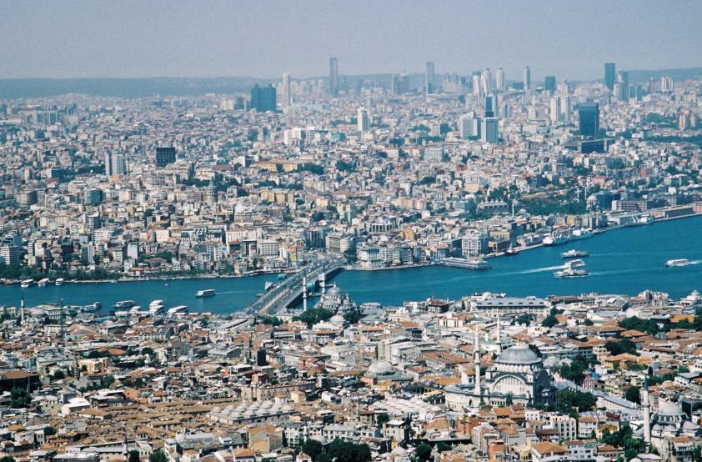
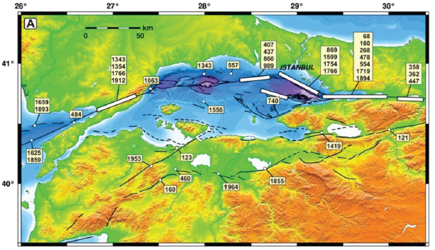
Marmara Sea / North Anatolian Fault Zone
Major earthquake hazard in Istanbul metropolitan area
Core Team organized around MARSITE Project (EC-funded)
First fault zone Supersite

Slide 6
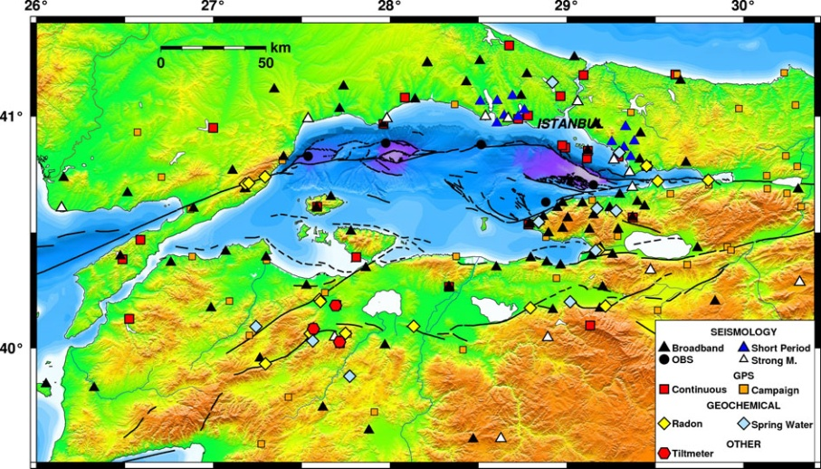
Marmara Sea Supersite: Resources
Available in situ data:
Seismic
CGPS (Real-time / NRT)
Hydrological
Weather
…

Slide 7
Marmara Sea Supersite: for decision
SIT accepts the Supersite Proposal and agrees to support it by making available data according to the request in the proposal and up to the limits listed below.
SIT requests that the Supersites Coordination Team inform the PoC for the Supersite of this decision and the procedures of ordering and accessing the data
Indicative data resources committed
CEOS intends to to support this Supersite with these resources:
(ASI) 150 scenes/yr by end 2016 COSMO/Skymed
plus 400 past acquisitions. TBC
(CNES) tbd SPOT-5
tbd Pleyades
(CSA) 160 scenes/yr by end 2016 Radarsat-2
(DLR) 250 scenes by end 2016 TerraSAR-X
plus 550 past acquisitions
(ESA) complete archive ERS-1, -2, Envisat any available acquisition Sentinel-1, -2
(JAXA) tbd ALOS-2, ALOS-1, J-ERS
(NASA) any available acquisition EO-1
tbd ASTER
Draft – to be confirmed

Slide 8
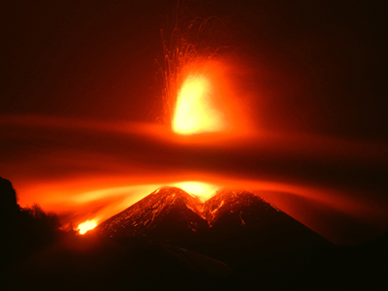
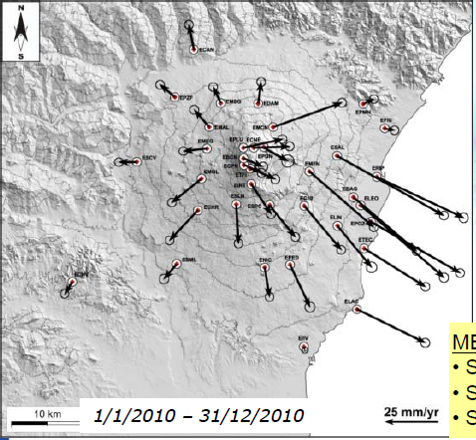
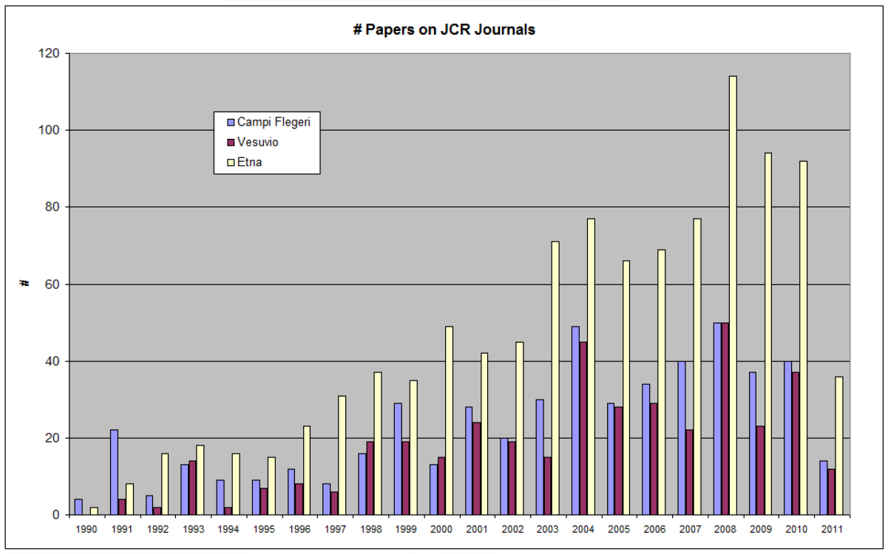
Mt. Etna volcano
Poses hazard to surrounding communities
Most scientific publications/volcano

Slide 9
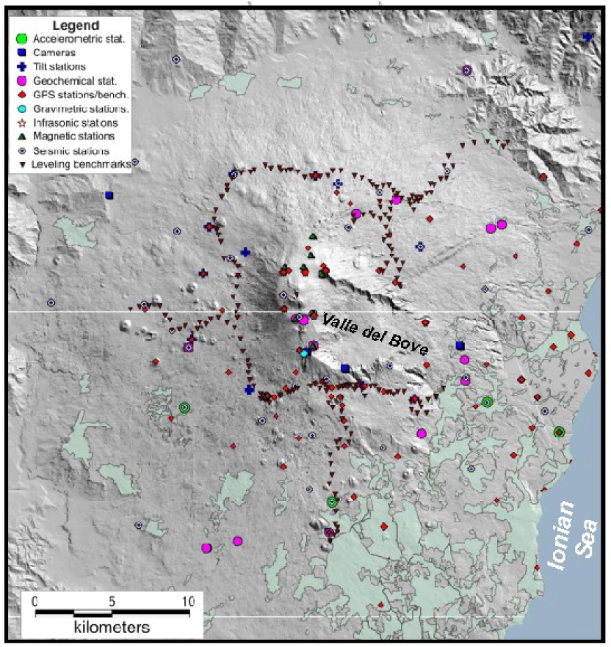
Mt. Etna volcano: Resources
Available in situ data:
Seismic
CGPS
Gravity
Infrasound
Tilt
Magnetic
Leveling
Cameras
…

Slide 10
Mt. Etna volcano: for decision
SIT accepts the Supersite Proposal and agrees to support it by making available data according to the request in the proposal and up to the limits listed below.
SIT requests that the Supersites Coordination Team inform the PoC for the Supersite of this decision and the procedures of ordering and accessing the data
Indicative data resources committed
CEOS intends to to support this Supersite with these resources:
(ASI) 150 scenes by end 2016 COSMO/Skymed
plus 350 past acquisitions. TBC.
(CNES) 1 coverage per year Pleyades
(CSA) 30 scenes/yr by end 2016 Radarsat-2
(DLR) 130 scenes by end 2016 TerraSAR-X
plus past acquisitions
(ESA) complete archive ERS-1, -2, Envisat 110 acquisitions per year Sentinel-1
any avaliable image Sentinel-2, -3
(JAXA) 16 scenes/ yr by end 2016 ALOS-2
tbd ALOS-1, J-ERS
(NASA) 44 images/yr ASTER
22 images/yr EO-1 (Hyperion)
Draft – to be confirmed

Slide 11
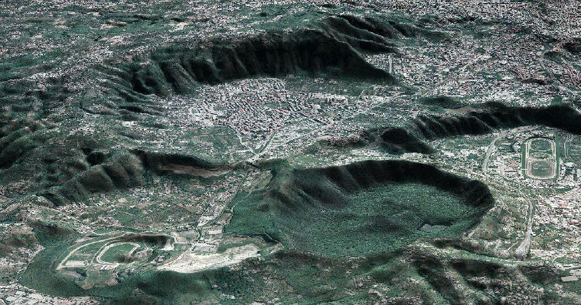
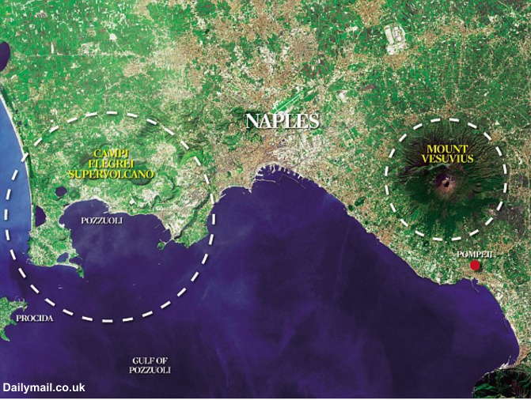
Mt. Vesuvius volcano / Campi Flegreii
Actively deforming caldera
Poses hazard to large population

Slide 12
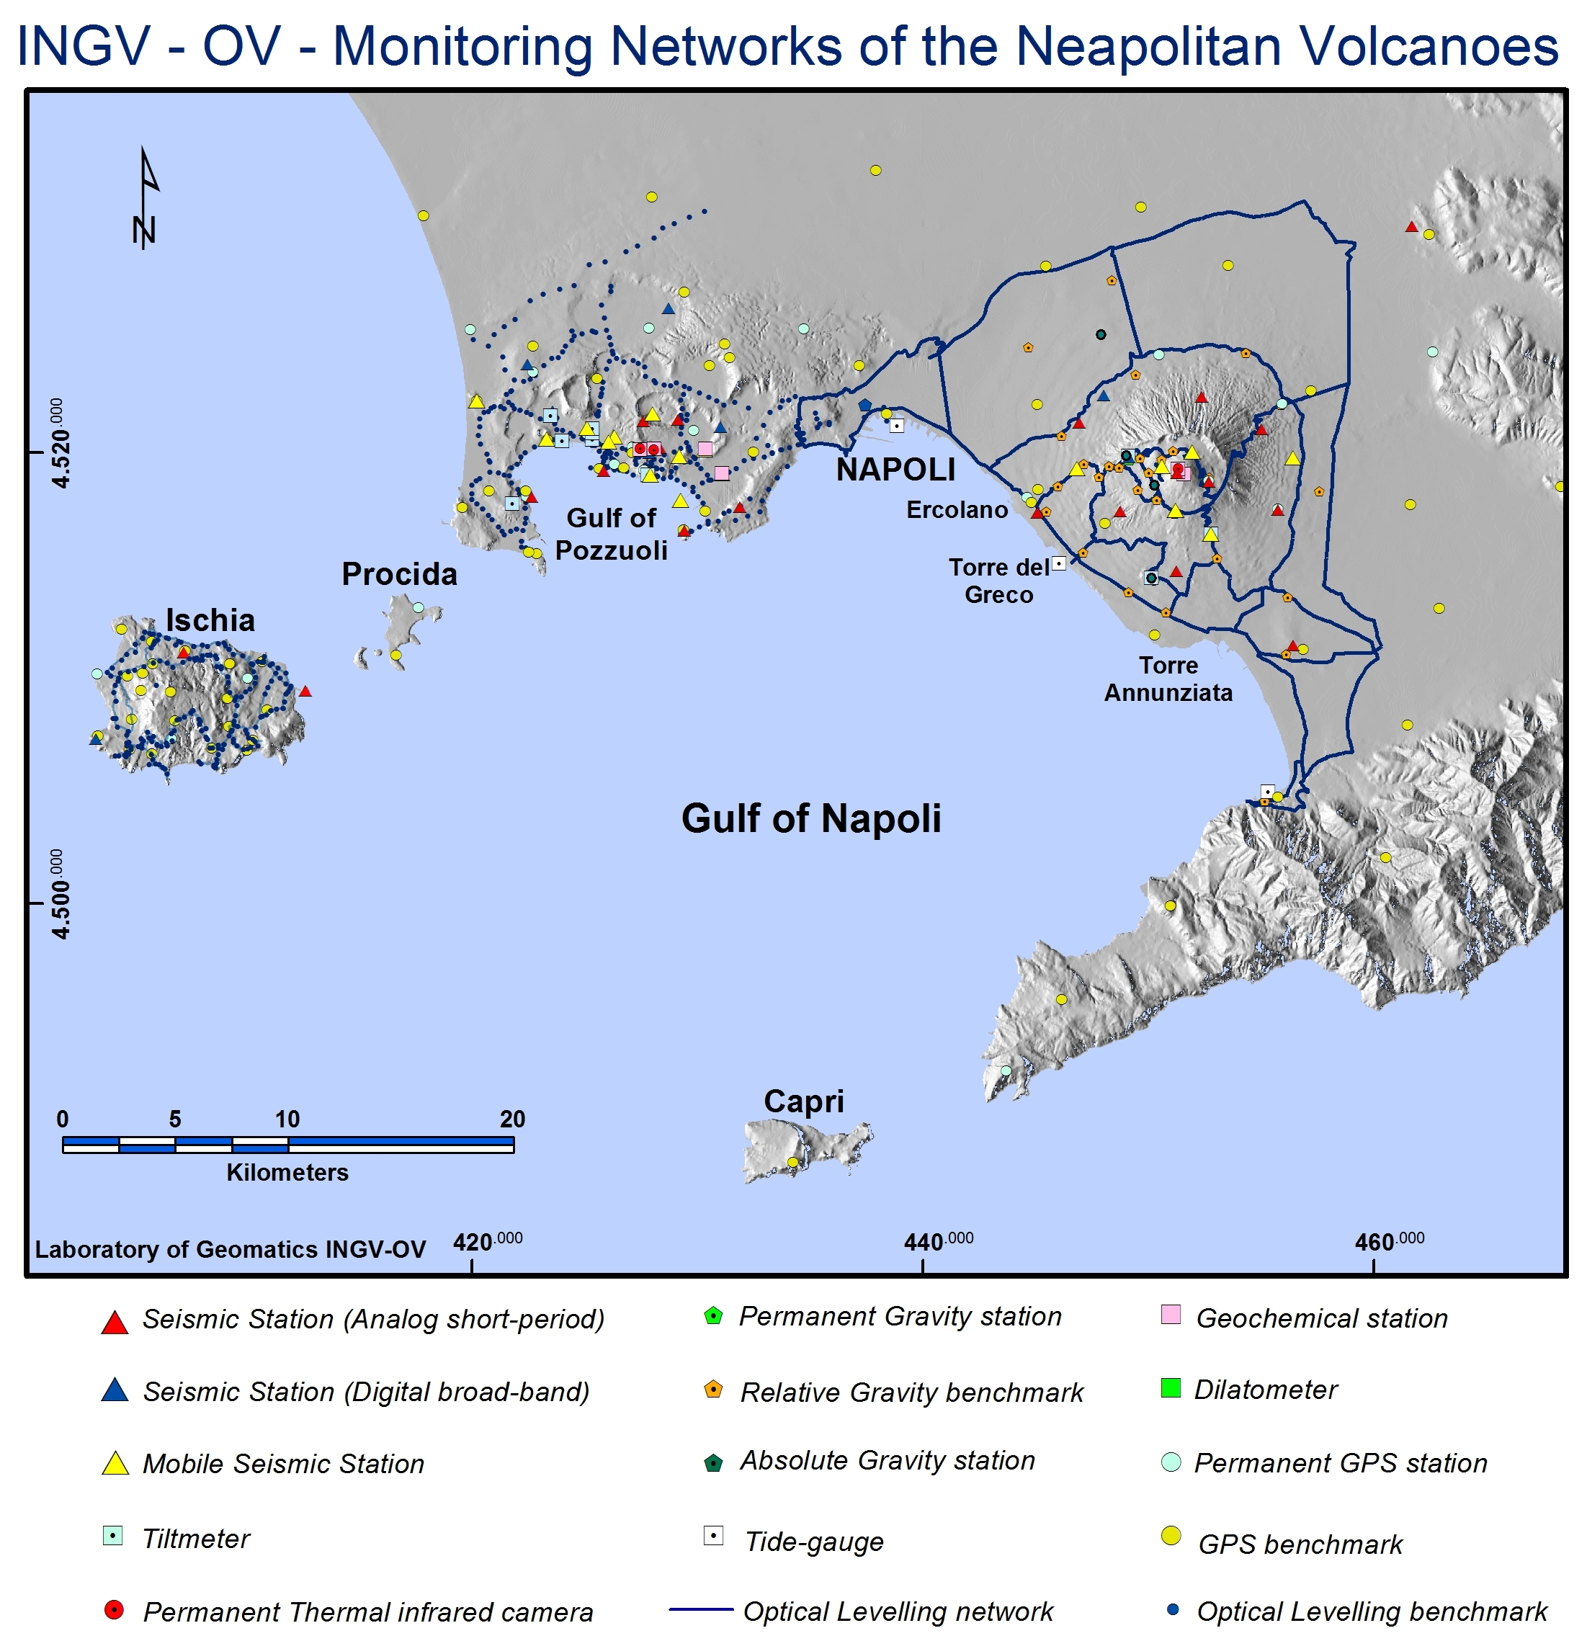
Mt. Vesuvius / Campi Flegreii: Resources
Available in situ data:
Seismic
CGPS
Gravity
Infrasound
Tilt
Magnetic
Leveling
Cameras
…

Slide 13
Mt. Vesuvius / Campi Flegreii: for decision
SIT accepts the Supersite Proposal and agrees to support it by making available data according to the request in the proposal and up to the limits listed below.
SIT requests that the Supersites Coordination Team inform the PoC for the Supersite of this decision and the procedures of ordering and accessing the data
Indicative data resources committed
CEOS intends to to support this Supersite with these resources:
(ASI) 150 scenes by end 2016 COSMO/Skymed
plus 200 past acquisitions. TBC.
(CNES) 1 coverage per year Pleyades
(CSA) 30 scenes/yr by end 2016 Radarsat-2
(DLR) 130 scenes by end 2016 TerraSAR-X
plus past acquisitions
(ESA) complete archive ERS-1, -2, Envisat 100 acquisitions per year Sentinel-1
any avaliable image Sentinel-2, -3
(JAXA) 20 scenes/ yr by end 2016 ALOS-2
tbd ALOS-1, J-ERS
(NASA) 44 images/yr ASTER
22 images/yr EO-1 (Hyperion)
Draft – to be confirmed

Slide 14
Permanent Supersite selection
Current process for Permanent Supersites
Supersite Nomination (scientist / teams of scientists)
using standard proposal based on existing Agency standards
Recommendation by Scientific Advisory Committee (SAC)
Recommendation by CEOS Supersites Coordination Team (SCT)
includes details on data contributions planned
Approval by CEOS SIT and Plenary
SAC confirms successful setup
Regular review
Are Supersites actively exploited? Are they the right ones?
Every 2 years
Notes:
Supersites proposals will be in SOAR format – Scientific and Operational Applications Research (CSA Standardformat, auch von DLR bereits verwendet)

Slide 15
Motivation 2 change
At CEOS Plenary (2013):
Some Agencies wanted to take decisions for new Supersites at lower level, e.g. SIT or even SCT itself. This aims at efficiency.
Other Agencies wanted to maintain the final decision for CEOS support at Plenary level. This aims at obtaining sufficiently strong commitment.
→ Plenary tasked the WG Disasters to “Make a recommendation on the optimal process within CEOS for approval of new Supersites” (Action 27-18)
Notes:
Supersites proposals will be in SOAR format – Scientific and Operational Applications Research (CSA Standardformat, auch von DLR bereits verwendet)

Slide 16
Permanent Supersite selection
Proposed changes to process for Permanent Supersites
Supersite Nomination (scientist / teams of scientists)
using standard proposal based on existing Agency standards
Recommendation by Scientific Advisory Committee (SAC)
Recommendation by CEOS Supersites Coordination Team (SCT)
includes details on data contributions planned
Acquisition and provision of data may start in anticipation of formal approval with volunteer Space Agencies.
Approval by CEOS SIT and or Plenary (whichever comes next)
Confirmation of SIT approval by Plenary (if applicable) → e.g. as part of a WG-D report.
SAC confirms successful setup
Regular review
Are Supersites actively exploited? Are they the right ones?
Every 2 years
Notes:
Supersites proposals will be in SOAR format – Scientific and Operational Applications Research (CSA Standardformat, auch von DLR bereits verwendet)

Slide 17
Proposed modifications: Summary
Permanent Supersites or NL may be accepted by SIT or Plenary
Data contributions may be made immediately following positive recommendation by SCT
No change proposed for Event Supersites
Note:
WG Disasters proposes to transfer all SCT responsibility to Data Coordination Team.

