Slide 1
CEOS Ad Hoc Working Group on GEOGLAM Update
CEOS 3-Year Work Plan Section 3.3, AGRI-1, AGRI-2
George Dyke
CEOS SIT-29
CNES, Toulouse, France
9th-10th April 2014

Slide 2


Presentation Overview
Implementation status of the CEOS Acquisition Strategy for GEOGLAM Phase 1
JECAM status
Way forward to CEOS Plenary
In response to Plenary action 27-17:
Reference action SIT-28-34

Slide 3











CEOS ad hoc WG for GEOGLAM M.O.
CEOS agencies actively supporting
Monthly management telecons
Coordination of the GEOGLAM-CEOS Co-Community meetings
Coordinate and formulate CEOS strategy for GEOGLAM support

Slide 4
Timeline
November 2013: CEOS Acquisition Strategy for GEOGLAM Phase 1 endorsed by Plenary (action to report implementation at SIT-29)
27th-28th February: GEOGLAM-CEOS Co-Community meeting at ESA/ESRIN
SIT-29: Report on Strategy implementation
CEOS Plenary: Update to CEOS Acquisition Strategy for GEOGLAM planned
Q4 2014 / Q1 2015: Update to GEOGLAM IP anticipated

Slide 5
CEOS Acquisition Strategy for GEOGLAM
The CEOS Acquisition Strategy for GEOGLAM Phase 1 was endorsed at the 2013 CEOS Plenary
  In response to the GEOGLAM IP
The objective of the Strategy is to provide the minimum space data required to address the requirements of GEOGLAM Phase 1
The approach to Strategy development was to define target data products, map those to requirements, and identify relevant data streams
  Primary, Secondary, and Potential data streams
Phase 1 includes 20 countries, and total crop lands of approximately 1.3 million km²
2014 implementation actions identified for each data stream

Slide 6
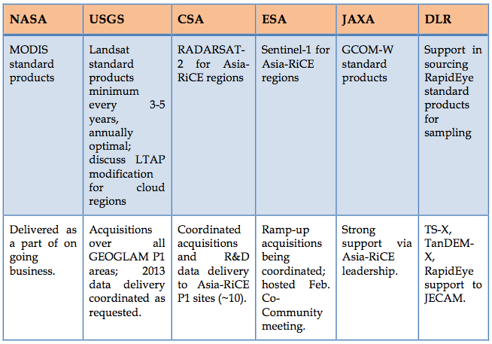
Primary Data Stream Implementation
Status summary from Plenary through SIT-29
Status

Slide 7
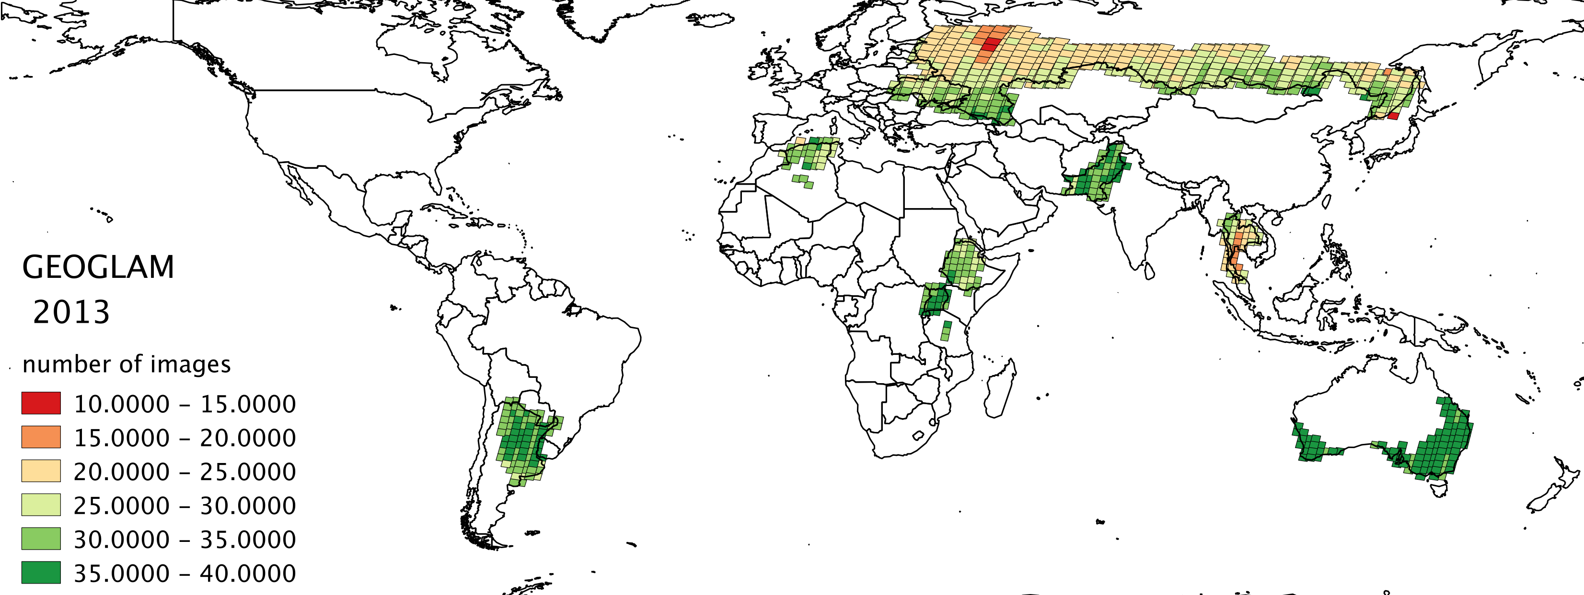
CEOS Ad Hoc WG on GEOGLAM Update
Total GEOGLAM Landsat-7 and Landsat-8 Images in 2013

Slide 8
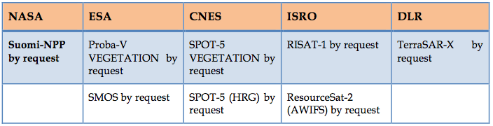
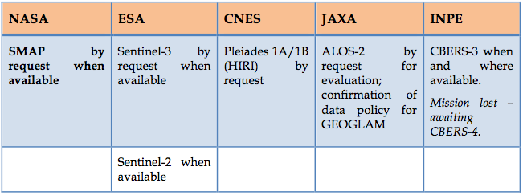
Secondary / Potential Data Streams
Status summary from Plenary through SIT-29
No GEOGLAM-specific requests received
JECAM using many data streams
ALOS 50m mosaics released
  25m and ALOS-2 anticipated
JECAM access to Pleiades discussed at Co-Community meeting

Slide 9

JECAM Status
JECAM is formally the R&D component of GEOGLAM
  40 sites globally
CEOS has been formally supporting JECAM since 2011
CEOS support is helping to grow the JECAM network
  Success story!
JECAM Annual Report recently released
  Using a wide variety of CEOS agency data streams for R&D and applications development
Agencies invited to participate in the JECAM Science Meeting
  21st-23rd July, Ottawa, Canada (Side meetings 24th-25th)

Slide 10
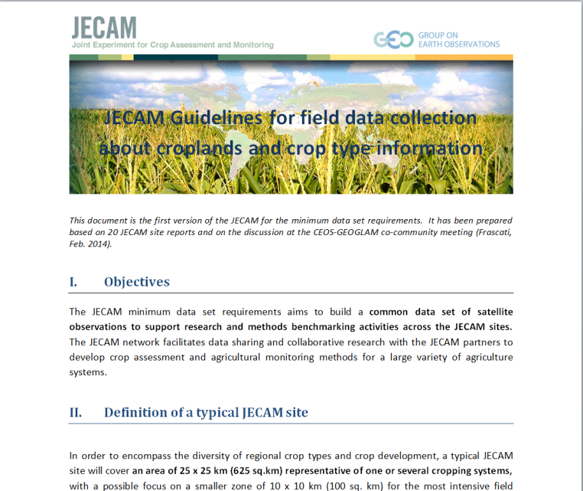
JECAM Proposed Way Forward Phase 2
Better coordinating in-situ and satellite data for sharing across sites
Define and create minimum in-situ and EO datasets
  Subset of JECAM sites TBD (able, willing and representative)
  Medium to High Res Imagery data sets(i.e. RapidEye; Landsat, Sentinel 1&2, Radarsat 2, TerraSAR-X, MODIS, etc TBD)
  In-situ data sets (create standards – Defourny)
  Open data licenses to share between all JECAM sites
  Find data management solution (discovery, access)
Identify 4-5 JECAM sites for the CEOS SEO “Cloud” computing prototype (a.k.a. SDMS)

Slide 11
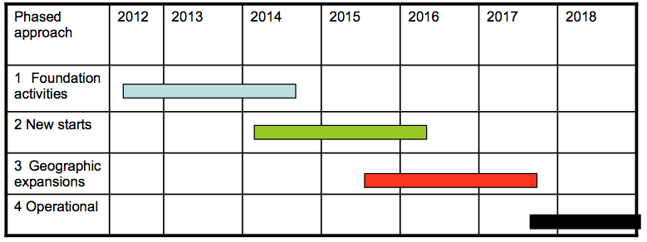
GEOGLAM Phase 2 Scope of Changes
Increase the number of countries
  Addition of smaller “at-risk” countries
  Possible addition of selected wall-to-wall countries for Asia-RiCE from 2015
  Increase the size of sampling regions
Expand its use of mission data by utilizing new mission datasets
  e.g. Sentinel-1A, -2A, -3A, SPOT-7, ALOS-2, GPM-Core, and SMAP
  Utilisation of mission archives for crop mask products
Continue and refine development of sampling strategies
Investigate methods for data management and distribution
  Need for “GEOGLAM data policy”?
Improve the accuracy,
reliability, robustness,
and efficiency of the
products

Slide 12
Way Forward Items for Consideration
Reporting on progress towards the GEOGLAM Implementation Plan
  Including feedback on the role of CEOS and CEOS agency data streams in the execution of the Plan, “lessons learned”
  Plan to have early results of Asia-RiCE crop team Phase 1A for Plenary
Realization of GEOGLAM governance, confirmation of resources, and capacity for GEOGLAM Phase 2
  Including plans to leverage initiatives like the EC’s SIGMA, and Sentinel-2 for Agriculture
  Many GEOGLAM activities with national mandates, but coordination layer not always clear, formal (vis-à-vis GFOI for example)

Slide 13
Way Forward Items for Consideration
Should CEOS seek representation in GEOGLAM governance?
  As a key stakeholder, modeled after the CEOS Co-Lead of GFOI
Coordination of resources being promoted by G-20 governments in support of agriculture
  Ensuring alignment and leverage of space agency contributions
Next update of the GEOGLAM Implementation Plan
  Expected Q4 2014 or Q1 2015
  Impetus for escalation of CEOS support?

Slide 14
Conclusions
Currently, main CEOS contribution is in support of JECAM and phase 1A of Asia Rice Crop Technical demonstration sites
Operationally (~2017-18), CEOS agency data streams will play a fundamental role in GEOGLAM
CEOS needs to:
  Understand the role it can play as GEOGLAM progresses
  Encourage GEO to advocate on behalf of its flagships
  Evolve its strategy to reflect the evolution of GEOGLAM, to reflect lessons learned, and to be commensurate with GEOGLAM development, coordination, and maturity
SIT-29 Action:
  CEOS ad hoc Working Group on GEOGLAM to work with the GEOGLAM community to develop an update to the CEOS Acquisition Strategy for GEOGLAM for endorsement.
  Due: 28th CEOS Plenary, 29th-30th October 2014, Tromsö, Norway

Slide 15
Backup Materials

Slide 16
CEOS Ad Hoc WG on GEOGLAM Update
Activities Since CEOS Plenary 2013
Coordination with Primary data stream providers
  e.g. Landsat, Sentinel
Coordination with BlackBridge/RapidEye via SEO and DLR
Coordinated access to CEOS agency PPP mission data for JECAM and R&D
  CSA, DLR, CNES, JAXA
Ongoing coordination with the GEOGLAM community on implementation of Phase 1 and scoping of future Phases

Slide 17
CEOS Ad Hoc WG on GEOGLAM Update
Activities Since CEOS Plenary 2013
RADARSAT-2 support for 7-10 JECAM sites and Asia-RiCE Phase 1A Technical Demonstration Sites
Working with SEO to define an SDMS pilot for Selected Asia-RiCE Phase 1A Technical Demonstration Site
ESA/ESRIN hosted a CEOS-GEOGLAM Co-community Meeting in February
  Discussed the implementation of GEOGLAM Phase 1, Phase 2 scoping, and the 2014 activities
Ongoing Landsat-7 and Landsat-8 acquisitions in 2013-2014 over GEOGLAM countries as a part of ongoing operations
  Acquiring up to 41 images for each path-row with mostly good levels of cloudiness (the “worst” best cloud cover was 18%)

Slide 18
Data Services Prototypes for GEOGLAM
The SEO is working directly with JECAM (Ian Jarvis and Peirre Defourny) to develop a data services prototype for several JECAM Test Sites. The features of this prototype will include ...
  Password protected (secure) access for JECAM science users with the ability to share data and tools across test sites within the guidelines of any license agreements.
  Dedicated storage for current datasets, including those purchased commercially.
  Download / Upload and Cloud Computing capabilities for analysis
  Data archive search and discovery using COVE. Links to archives from Landsat, Radarsat (coming soon), RapidEye (coming soon), TerraSAR-X, TanDEM-X, SPOT, Pleaides.
The SEO is working directly with the Asia-RiCE team (Shin-ichi Sobue, RESTEC and Yves Crevier, CSA) to develop a data services prototype for Indonesia. The features of this prototype will include ...
  Password protected (secure) access for Indonesia Asia-RiCE science users.
  Dedicated storage for 35 Radarsat-2 images, provided by CSA.
  Cloud computing processing capability to allow JAXA to run SAR processing tools on remote servers for enhanced performance.

Slide 19
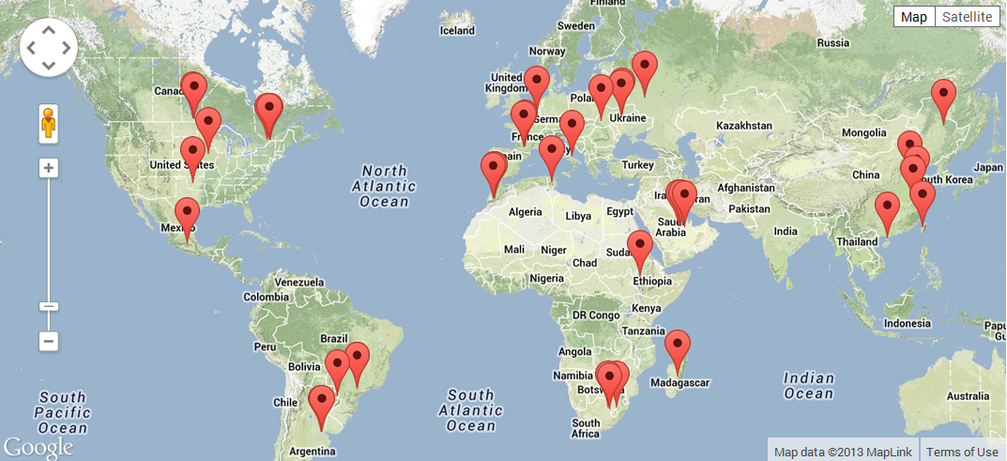
JECAM Annual Report Highlights
JECAM activities are being undertaken at a series of study sites which represent many of the world’s main cropping systems
Over 30 sites currently exist or are in development. Several new sites are associated with EC FP7 SIGMA Project.

Slide 20
JECAM Annual Report Highlights
CEOS Support - JECAM Data Requests (2013)

Slide 21
JECAM Summary Phase 1
JECAM Summary Phase 1
JECAM has become the foundation of the R&D component of GEOGLAM
  JECAM requirements are now considered GEOGLAM requirements
2013 Annual Report in preparation for March delivery prior to SIT 29
  23 sites reporting
  State of the science for ag monitoring (Crop Area, Crop Cond, Yield Forecast, Soil Moisture, Mgmt Practices)
  This is a rich set of scientific results, produced by expert teams around the world, in a wide variety of geographic settings and cropping systems, available for sharing and definition of ‘best practices’
  Provides clear indication of the impact of CEOS support

