Slide 1
Title
Name Organization CEOS SIT-28 Meeting
Hampton , Virginia, USA Date

Slide 2
Contents
General update on GFOI
2013 Global Baseline Data Acquisitions implementation report
Endorsement of the 2014 Update of the Global Baseline Data Acquisition Strategy for GFOI
Endorsement of Space Data Services Strategy for GFOI
2014 outlook
Future of the Ad-hoc SDCG

Slide 3
General update on GFOI

Slide 4
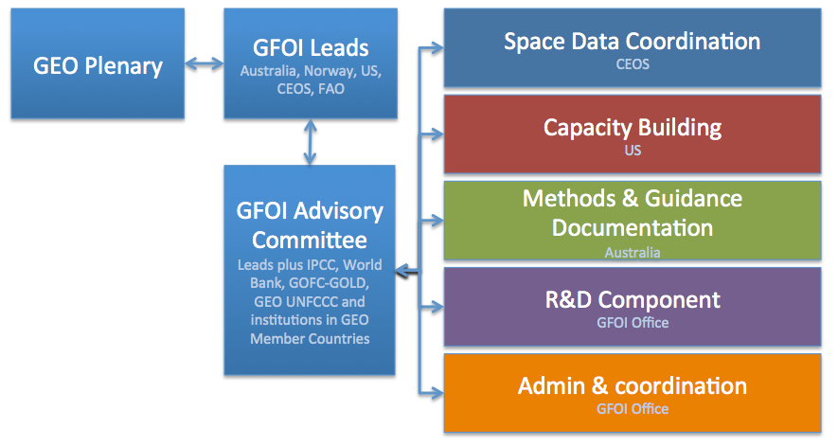
Update on GFOI
CEOS represented on the GFOI Leads group and Advisory Committee
Stephen Briggs, ESA

Slide 5
Progress since SIT-28
First version of the Methods and Guidance developed and published at GEO-X Plenary
Key GFOI deliverable for countries, in addition to space data
2014 update of the Global Baseline Data Acquisition Strategy and the Space Data Services for GFOI.
Continued Capacity Building workshops by SilvaCarbon in S America and first regional workshops held in SE Asia and Africa
GFOI Project Office established and staffed in Geneva – Leads propose to move the Office to Rome, embedded in FAO HQ
GFOI Review of Priority R&D Topics published - to address common challenges like data interoperability and degradation

Slide 6
Promoting GFOI
Uptake by countries with National Forest Monitoring Systems is the priority
SDCG Country Days have been leading the way in engaging countries – supplemented by SilvaCarbon workshops
An Australian-ESA side event at SBSTA-38 promoted the Methods and Guidance Documentation to negotiators for REDD+ at UNFCCC.
Norway funding promo videos to explain the GFOI objectives
https://www.youtube.com/watch?v=Hhb_Ed8sLOs

Slide 7
Promoting GFOI

Slide 8
2013 Global Baseline Data Acquisitions Implementation Report

Slide 9
Your Ad-hoc SDCG for GFOI
SDCG Exec:
Co-chairs: USGS (John Faundeen ➔ Gene Fosnight), ESA (Frank Martin Seifert), NSC (Ake Rosenqvist)
SEC: Govt. Australia (Stephen Ward, George Dyke & Matthew Steventon)
Very active participation of:
CNES – Steven Hosford
CONAE – Laura Frulla
CSA – Yves Crevier
DLR – Helmut Staudenrausch
GEOSEC – Osamu Ochiai
GFOI Office – Simon Eggleston
INPE – Ivan Barbosa
JAXA – Masanobu Shimada
NASA/SEO – Brian Killough
Changes since SIT-28 in Green

Slide 10
Global Strategy: Context & Process
Coordination of satellite data supply is fundamental to GFOI objectives and supports all countries’ participation in reporting
CEOS Strategy for GFOI has 3 Elements, coordinated by SDCG:
Element 1: A baseline, coordinated global data acquisition strategy involving a number of ‘Core data streams’ that can be used free-of-charge and openly for GFOI purposes. This will involve global, systematic and sustained wall-to-wall acquisitions of forested areas
Element 2: Coordinated strategies for national data acquisitions including historical coverage characterization, impartial data needs assessment, and data delivery.
Element 3: Data supply in support of the GFOI R&D activities, including in support of: the science studies assisting the development and evolution of the Methods and Guidance document for GFOI

Slide 11
Baseline 2013: Objectives Reminder
Promote the systematic and sustained wall-to-wall acquisition of Space Data of forested areas
Aims to provides the default consistent time-series of forest observation data for all countries without specific technical requirements, heritage or data preference
Guarantee the minimum consistent, quantitative, and wall-to-wall forest observation data necessary for all interested countries to engage in MRV development in support of UNFCCC reporting

Slide 12
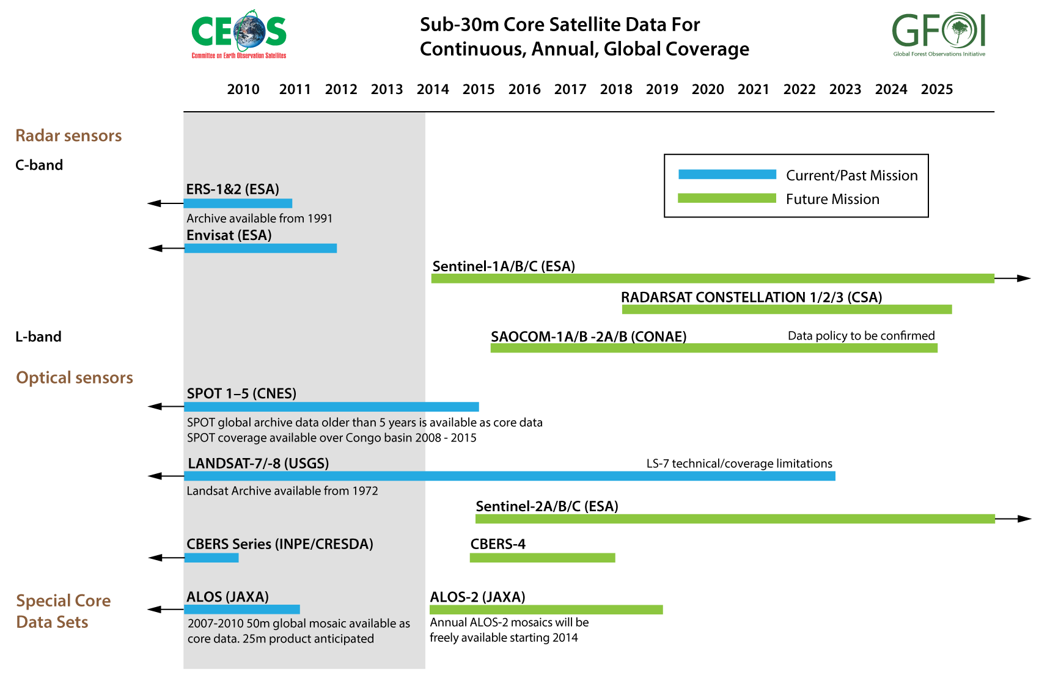
Global Baseline Core Satellite Data

Slide 13
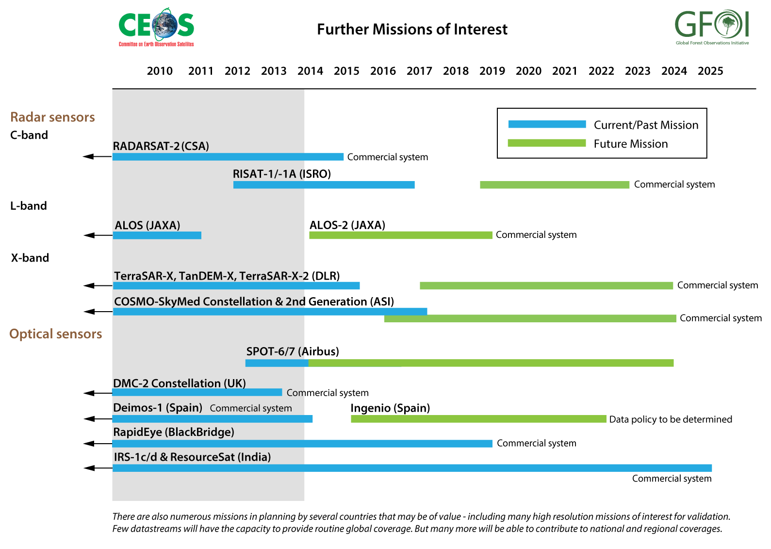
Global Baseline Contributing Satellite Data

Slide 14
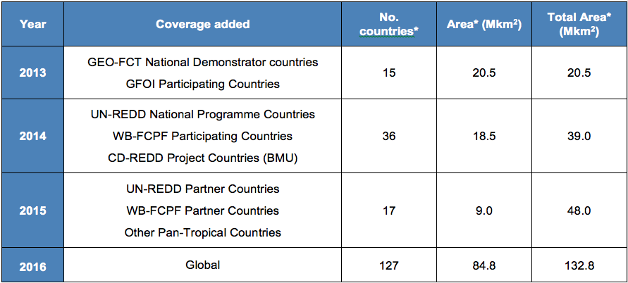
Baseline 2013: Expansion Scenario

Slide 15
Baseline 2013: Coverage Summary
15 GFOI countries for 2013 are covered by 2216 Landsat scenes
Over 30 images are available for most path-row or on average one image every two weeks
40% of the best path-row images have close to zero clouds
70% of the best path-row images have cloud cover better than 3%
90% of the best path-row images have cloud cover better than 10%
But –
The “worst” best image (path 102; row 63) in Indonesia was 42.42% cloud covered
The next “worst” best image (path 10; row 5) in Panama/Colombia was 41.08% cloud covered

Slide 16
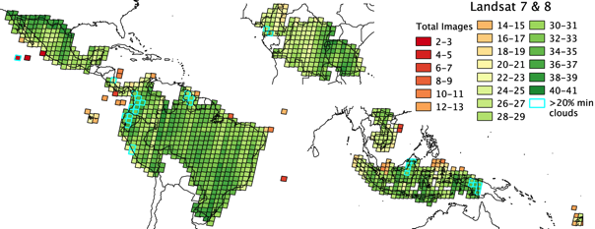
Baseline 2013: Landsat Coverage
Notes:
15 GFOI countries for 2013 are covered by 2216 Landsat scenes
Over 30 images are available for most path-row or on average one image every two weeks
40% of the best path-row images have close to zero clouds
70% of the best path-row images have cloud cover better than 3%
90% of the best path-row images have cloud cover better than 10%
But –
The “worst” best image (path 102; row 63) in Indonesia was 42.42% cloud covered
The next “worst” best image (path 10; row 5) in Panama/Colombia was 41.08% cloud covered

Slide 17
Baseline 2013: Coverage Summary
The 2013 requirement for cloud free data cannot be met solely with Landsat data
For all but a few path-rows, it should be possible to get cloud free estimates of the Earth’s surface using more than one image
i.e. cloud free mosaics
The inclusion of the Sentinel-2 and CBERS satellites should show a corresponding improvement, once data from these sensors becomes available
Even with more optical sensors, some persistently cloudy locations will exist where multiple dates of images in themselves will be not be sufficient to yield cloud free looks at the Earth
Other methodologies, such as SAR, will be required

Slide 18
Endorsement of the Global Baseline Data Acquisition Strategy 2014 Update

Slide 19
Global Strategy: Context & Process
2011 CEOS Plenary endorsed the three-element CEOS Strategy for Space Data Coverage and Continuity in Support of GFOI and the establishment of the ad-hoc Space Data Coordination Group for GFOI
SIT-28 endorsed The Global Baseline Data Acquisition Strategy for GFOI (Element 1)
SDCG undertakes to report annually on the acquisitions results and to update the strategy to reflect latest requirements, mission status etc for SIT endorsement. At SIT-29 we seek endorsement of the 2014 update to the Global Baseline Data Acquisition Strategy.

Slide 20
Global Baseline Strategy
Core data stream concept agreed in 2011 and prevails
provide data, at medium resolutions or finer, free-of-charge and openly shareable for GFOI purposes, consistent with being available in support of any country’s information requirements
sustained and long-term capacity in coverage, processing and distribution which is consistent with the large (global) scale data requirements of the GFOI.
Landsat-7, Landsat-8
Sentinel-1A/B, Sentinel-2A/B
CBERS-4
RCM
(SAOCOM-1 series)
NASA, USGS, ESA, China, Brazil, Canada, (Argentina)
Notes:
Global coverage – Landsat-7/8 [2012+], Sentinel-1A/1B [2014+], Sentinel-2A/2B [2015+], RCM [2018+]
Regional Focus and Gap Filling – CBERS-4 [2015+] (South America, South and Southeast Asia, Africa), SAOCOM-1A/1B [2016+] (Pan-tropical)

Slide 21
Core Data Stream Roles
GLOBAL COVERAGE | REGIONAL FOCUS AND GAP FILLING
Landsat-7/-8 [2012+] Sentinel-1A/-1B [2014+] Sentinel-2A/-2B [2015+] RCM [2018+] | CBERS-4 [2015+] (South America, South- and Southeast Asia, Africa) SAOCOM-1A/-1B [2016+] (Pan-tropical)

Slide 22
Contributing Data Stream Roles
RapidEye, SPOT, RADARSAT-2, ALOS-2, TerraSAR-X/TanDEM-X all have important capabilities
Relevant to national-level coverage and gap-filling as data supply allows.
Coordination under Space Data Services Strategy for GFOI (nationally focused Element 2 Strategy, more shortly)
ALOS 50m annual global mosaics recently made available free and open, and represent an important “special core data set”
Release of 25m and ALOS-2 mosaics anticipated mid-2014
ALOS/ALOS-2 BOS ensures sustained annual global coverage
SPOT 1-5 archived data >5 years old available free and open. Special access to recent data over the Congo Basin.

Slide 23
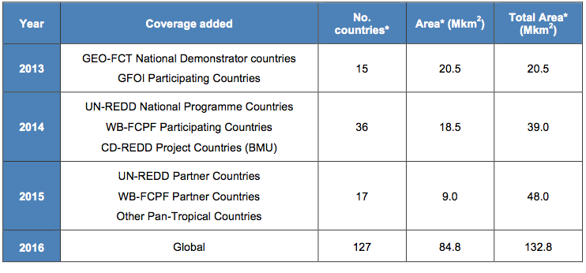
Phasing
Notes:
BMU stands for German Ministry of Environment

Slide 24
Global Baseline: Main Updates for 2014
Adjustments based on mission status and launch date changes
Landsat-8 launch; CBERS-3 failure; CBERS-4, Sentinel-1A, Sentinel-2A, and ALOS-2 launch dates
ALOS mosaic and SPOT archive availability
Refinements of Landsat coverage assessment based on operations
Refinements to Sentinel expected coverage assessment based on development
References and linkages to the Space Data Services Strategy where appropriate
Summary of 2013 implementation, and detailing of 2014 implementation plans
Scoping of 2015 and 2016+ implementation plan

Slide 25
Global Baseline Data Acquisition Strategy
Global Baseline Strategy implementation commenced successfully in 2013
Strategy updated with revised implementation plan for 2014
Communicable & defensible
Provides ongoing community confidence that the organisational and technical capacity will exist to support reporting of all countries
Core data stream (& Contributing data stream) agencies have been engaged throughout the process and subscribe
Seeking endorsement of CEOS SIT (@ SIT-29) for the updated Strategy

Slide 26
Endorsement of Space Data Services Strategy for GFOI

Slide 27
Space Data Services Strategy
Element 2: Coordinated strategies for national data acquisitions
Designed to address the fundamental national information requirements for GFOI
National-level complement to the Global Baseline Strategy
Developed in consultation with 17 countries at SDCG and SilvaCarbon meetings
Provides a GFOI Space Data Services ‘menu’ for countries to choose from in support of their national forest monitoring systems’ needs

Slide 28
Space Data Services Menu
1. Regional GFOI Space Data Workshops (USGS/SilvaCarbon)
Leveraging SilvaCarbon in Africa, South America and Asia
2. Impartial National Space Data Needs Assessments (SDCG and SEO)
Service to individual governments seeking to establish their MRV strategies and the role of space data therein
3. National Historical Coverage Reports (SDCG and SEO)
By request, assessment of what satellite data exist for a given country or region for past years to support establishment of reference levels
4. Ensured On-going Coverage (SDCG and Core Data Stream providers)
Tailored support to ensure on-going national baseline acquisitions (Element 1)
5. Satellite Data Discovery, Assembly and Delivery (SDCG, SEO, and CDS providers)
Support to core data handling and delivery
6. Cloud Storage, Processing and Analysis of Satellite Data (SDCG, SEO, FAO)
Collaboration with FAO and SEO on data delivery and processing infrastructure contributed by Norway

Slide 29
Space Data Services Implementation Roles
SDCG: On-going coordination, linkages between contributors
SEO: Service and tool development (e.g. SDMS), other pilot projects
SilvaCarbon: Coordination of workshops in Americas, Africa, and Asia
GFOI Leads/Office: Over-arching coordination between all four components of GFOI (Space Data, MGD, R&D, Capacity Building)
FAO/UN-REDD and World Bank/FCPF: In-country capacity and heritage in support of the development and delivery of the Services
Countries: Defining requirements, development and delivery feedback
Data Providers: Provision of standard products in alignment with data policy and terms

Slide 30
Space Data Services Milestones
SDCG-5, Feb 2014: Confirmation of the Strategy with agencies and coordination with GEOGLAM in a joint session
SIT-29: Seeking endorsement of the Strategy
GFOI Leads, July 2014: Review architecture, approach, and prototypes
May-Sept 2014: Engagement with 2-3 countries on piloting of Space Data Services
SDCG-6, Oct 2014: Review status of pilot Services
CEOS Plenary, Oct 2014: Implementation status update, seeking feedback and confirmation of continuing mandate for SCDG

Slide 31
Space Data Services Strategy for GFOI
National-level complement to the Global Baseline Data Acquisition Strategy (Element-1)
Developed in consultation with countries, contributing CEOS agencies, and in-country actors like FAO and the World Bank
Initial implementation roles and resources identified
Implementation plan for 2014 ready for execution; plans for 2015 and 2016+ scoped
2014 candidate pilot countries (2-3) have been identified
Seeking endorsement of CEOS SIT (@ SIT-29) for the Strategy

Slide 32
2014 Outlook

Slide 33
2014 Outlook: Global Baseline
Continuing ramp-up towards global coverage by 2016
Adding 19 countries, 18.5 Mkm²
Landsat-7 and Landsat-8 will continue to be the main providers during 2014
Optimisation of Landsat LTAP acquisition strategy continues
Continuing development (by NASA/USGS) of WELD global mosaics
Launch of new data streams: Sentinel-1, ALOS-2, CBERS-4
Ramp-up of these missions to operational is expected to conclude in 2014 (ALOS-2) and 2015 (Sentinel-1A and CBERS-4)

Slide 34
2014 Implementation: Space Data Services
Development of prototypes for each of the six GFOI Space Data Services and prototyping of their value with a number of countries
In depth engagement with 2-3 countries, focused on trialling the delivery of the Services, in the months before SDCG-6.
“Country Day” at SDCG-6 to seek feedback on the pilot services, and detailed follow-up from SDCG-6 on pilot service delivery and optimisation
Pilot version of a Space Data Management System (SDMS) to be developed by the SEO in collaboration with FAO and UN-REDD to prototype the relevance and effectiveness

Slide 35
SDMS Pilot Project Plan
United Nations FAO (Food and Agriculture Organization) Forestry Department, KSAT (Kongsberg Satellite Services), NASA’s CEOS Systems Engineering Office (SEO), and AMA (Analytical Mechanics and Associates, Inc.) are partnering to develop and demonstrate a prototype Space Data Management System (SDMS).
The 8-month effort (Dec 2013 through July 2014) will develop an operational prototype SDMS focused on 3 pilot countries: Ecuador, Tanzania and Uganda.
Successfull completion of this pilot project is expected to lead to a 3-year development supporting up to 16 REDD+ countries.

Slide 36
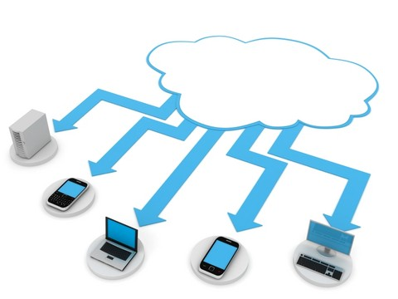
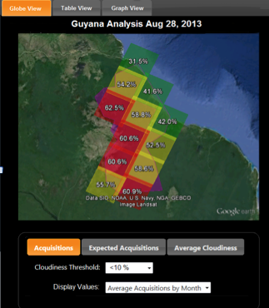
What are the SDMS features?
A dedicated cloud-based architecture to store, process and access space-based Earth observation data.
Country-specific datasets for rapid access, processing and product development.
Country-specific secure access to open datasets and purchased commercial datasets.
Coverage analysis tool to analyze historical archives and identify and select relevant scenes for processing or download.
Pre-processing tools and algorithms for advanced product development.
Potential links to forest cover mosaics and deforestation products.
Modular approach to allow expansion to multiple countries and the addition of new features.
Web-based functionality that is sensitive to low bandwidth.
Consideration of alternative delivery approaches such as local computers for countries without internet or mobile devices.
Cloud Computing
Coverage Analyzer

Slide 37
2014 Implementation - ACTIONS
SIT-29 Actions:
Core data stream providers (USGS, ESA, INPE/CRESDA, CSA, CONAE) to work with SDCG to implement the global baseline data acquisition strategy for GFOI in 2014.
SDCG to work with the SEO, contributing agencies, FAO/World Bank to develop prototypes of the six space data services for GFOI (including the SDMS), and perform an in-depth pilot with 2-3 countries.
SDCG to define and develop the third Element of the CEOS Strategy for GFOI (acquisitions for R&D) for presentation and endorsement at SIT-30.

Slide 38
Future of the ad hoc SDCG for GFOI

Slide 39
SDCG Next Steps
The CEOS Strategy for Space Data Coverage and Continuity in Support of GFOI contains three Elements
Element 1, Global Baseline: 2014 continuing implementation
Element 2, National Services: 2014 pilot implementation
Element 3, Acquisitions for R&D: 2014 develop strategy for SIT-30
CEOS Plenary -
Global Baseline implementation update
Space Data Services pilot update
Request continuing mandate for ad hoc SDCG

Slide 40
SDCG Future
2013 CEOS Plenary agreed to continue operation of ad hoc SDCG for GFOI
SDCG has been extremely busy with the strategy development and implementation
Takes CEOS & GEO a step closer to delivering to individual governments
Ongoing discussion about moving closer to GEOGLAM, but questions remain
The overall multi-mission acquisition and interoperability strategy needs to be optimised – CEOS needs a view and a plan, reflecting available capacity

Slide 41
SDCG
Thanks for your attention!

