Slide 1
WGISS
Richard MORENO CNES
CEOS SIT-29 Meeting
CNES, Toulouse, France 9th-10th April 2014

Slide 2
Summary
Recovery Observatory
Technology Exploration
Synergy VCs & WGs
CEOS Opensearch
CWIC status
IDN

Slide 3
Recovery Observatory
WGISS will participate to the development of Recovery Observatory infrastructure
If the proposal is endorsed by SIT-29
Experience return from KALHAITI project
Wish to imply for the specification :
Users needs from WGdisasters
All WGISS agencies
Wish to re-use existing elements (systems, libraries, code, software)
From CEOS (WGISS + WGDisasters) agencies
E.g. : Opensearch, CWIC & FedEO

Slide 4
Technology Exploration
Topics that will be addressed next week during WGISS-37 hosted by NASA
Big data and services
Presentations from INPE, ESA, NASA, ROSCOSMOS, CNES
Cloud computing
Presentations from CNES, ESA , Russian Space Systems
Semantics
Presentations from NASA, CNES
Visualization
Presentations from NASA, Hunagi
Authentication
Presentations ESA, NASA, GEOSS, CNES

Slide 5
Synergy VCs & WGs
VCs
All VCs have been contacted to make an intervention
WGCV
Joint meetings every 2 years up to Sept 2012
Participation of WGISS chair to a part of WGCV meeting on April 2014
There is no current shared topics
No joint meeting foreseen on short term
WGDisasters
Recovery Observatory
Supersites
WGClimate
ECVs

Slide 6
CEOS opensearch
The 1st document : "OpenSearch GeoSpatial and Temporal Extensions” OGC 10 032r6
Comment phase is now closed ; and WGISS comments have been taken into account
The 2nd document : “OpenSearch Extension for Earth Observation” OGC 13 026
OGC comment phase will start soon
WGISS will provide comments on this document
A “CEOS Best practice document” has been initiated
https://docs.google.com/document/d/1InG8QbltCaOVnLLFDxvzXS8ke3DjZFn8btIzD5eSZME

Slide 7
CWIC
CWIC is providing access
to over 1900 data collections, most Geoss Data Core
with over 70+ million granules from NASA, USGS/LSI, NOAA/GHRSST, INPE, and CCMEO (new name for CCRS).
Other data partners developing access to their data through CWIC include ISRO, AOE, and NOAA (to their new system access mechanism).
ROSCOSMOS announced plans in late 2013 to become a CWIC data partner.

Slide 8
IDN
It is important that all agencies feed the IDN with information about their data collections
CNES has begun populating the IDN with datasets.
JASON 2 geophysical products
POLDER Atmosphere collection (POLDER 1 and 2)
SPOT Multi (SPOT 1-4).
The CEOS Water Portal now uses IDN as a remote catalog service and has begun creating IDN records for all the datasets (+2,000).

Slide 9
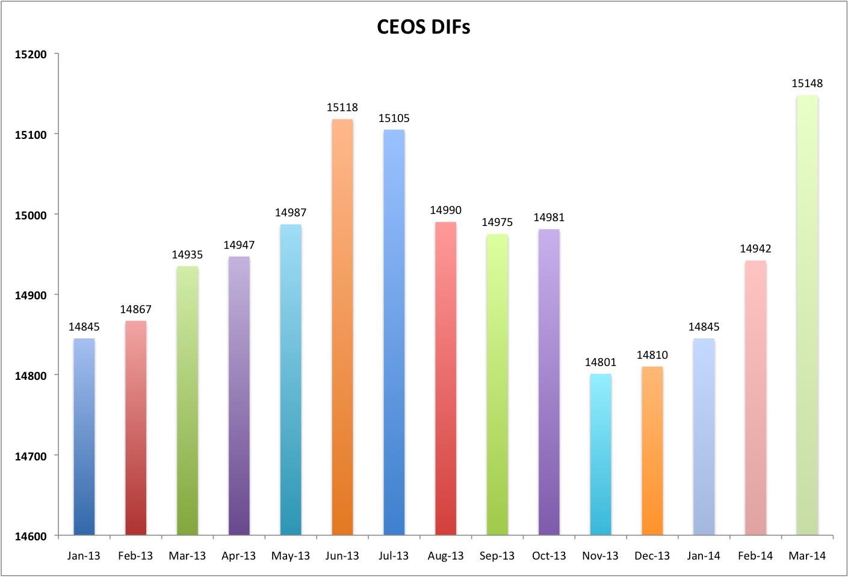
IDN

