Slide 1
WGCV issues for SIT decision/information
Satish Srivastava (CSA), WGCV Chair
Albrecht von Bargen (DLR), WGCV Vice-Chair
Eric Arsenault (CSA), WGCV Secretariat
Niall Origo (NPL), QA4EO Secretariat
CEOS Action / Work Plan Reference CEOS SIT-29 Meeting
CNES, Toulouse, France 9th-10th April 2014

Slide 2
Presentation Outline
For decision:
WGCV / SST-VC Joint Detailed Plans for two Projects (CEOS Plenary Action 27-21)
For information:
Highlights and Outcomes of WGCV-37

Slide 3
CEOS 27th Plenary – Action 27-21
CEOS 27th Plenary – Montreal, Nov. 2013
Action 27-21
WGCV to develop and recommend detailed plans for the way forward on:
SST Comparison Campaign (Project 1), and;
SST Operational Validation Project (Project 2).
Due Date: Mid-March 2014

Slide 4
Project 1: SST/LST Comparison Campaign Introduction and Background
Cal/Val sensor comparison campaign in support of SST and LST measurements from space (support action for VC-SST and WGC)
(follows similar highly successful Tuz Golu campaign for surface reflectance and
Miami 3 (2009) for SST (10 global participants) using QA4EO guidelines
Proposal
4th of ~5 yearly (‘Miami’ 1,2,3) WGCV comparisons for radiometers including black bodies
Phase1 (2014-2015): Laboratory based vs. SI traceable standards (radiometers and black bodies) (Land and Ocean applications)
Phase 2A (2014 – 2018): Series of ship/ocean based radiometer campaigns
Phase 2B (2015 – 2017): Field-based calibration of radiometers
Participation open to all
Background
Essential Climate Variables Sea Surface Temperature (SST) and Land Surface Temperature (LST) are both dependent on global satellite observations of surface emitted thermal radiation
Heritage long-time series of data from multiple sensors exists
New sensors soon to be launched e.g. Sentinel 3, JPSS-1
International comparisons are essential to provide confidence in data, test innovation and facilitate capacity building and training

Slide 5
Project 1: SST/LST Comparison Campaign Introduction and Background (continued)
ESA has agreed to provide funding to support the organisation, logistics and analysis of the comparison (For all phases 1 through to 2B)
It will require:
CEOS member agencies to support the participation (travel/subsistence ~2-3 wks) and instruments transport of appropriate Cal/Val teams from their region of influence.
For Phase 2A, this will require radiometers to be deployed on ships for a few months (no cost for ship but for radiometer transport).
For Phase 2B, this will require support for radiometers and personnel (travel/subsistence ~2 wks) for appropriate teams from their region of influence to be deployed) to a field-site potentially in Namibia.
Benefits to CEOS agencies:
Knowledge to remove and correct instrument biases enabling harmonised global satellite Cal/Val
Potential to learn and improve from peer interactions
Establishment of best-practises for instrument and product Cal & Val

Slide 6
Project 1: SST/LST Comparison Campaign
Current Status
Phase 1 & 2 (A/B) Initial planning started
Invitation to participate to be drafted and sent by May 2014, requesting inputs on:
Options on preferred dates for Laboratory calibrations
Types of instrumentation to be used, Field of View, special operational needs, etc.
Intent and options for ship based comparison (Phase 2A)
Intent and options for Land based Field campaign (Phase 2B)
Detailed protocol developed during summer 2014 to facilitate organisation uncertainty evaluations, etc.
Lab-based comparison of late 2014/Spring 2015:
radiometers & blackbodies vs. SI traceable standards – range of ambient conditions
External common radiometer view of water body (SST radiometers)
External view of Land targets (LST radiometers)

Slide 7
Project 1: SST/LST Comparison Campaign
Current Status
Phase 2A Ship based comparison
Set of ongoing comparisons of pairs of radiometers (start in 2014)
Longer time to complete: 3 to 5 years duration
Database will be constructed to collect results
Protocol developed to ensure consistent processes
Phase 1: water based comparison will provide quick early results
This allows much more detailed scientific evaluations but longer time for results.
Phase 2B Land surface Temp field campaign
To be organised in collaboration between CEOS WGCV: IVOS & LPV and potentially LSI-VC (2015).
Field campaign chosen to look at different terrain & temperatures and include sampling strategies.
Namibia is a potential site with nearby snow and desert terrains
Will lead to best practises as well as results for satellite validation

Slide 8
Project 2: SST (pilot) ‘Operational Validation Project’ Proposal
Background:
For SST validation (Operational and Climate) require network of high performance drifting Ocean Buoys for continuous monitoring of Ocean Temps, in addition to Ship borne radiometers analogous to ‘test-sites’ such as Aeronet and new LandNET
Key part of strategy to bridge ‘data gaps’ between sensors for climate
White paper drafted by VC-SST, GHRSST, WGCV-IVOS detailing background available
Existing networks not sufficient in number for necessary coverage
Perform a study, funded by ESA, to evaluate what is achievable in terms of accuracy and relative benefits of both improved Ocean Buoys: performance and number and similarly for Ship borne radiometers in the context of Satellite derived SST products and CDRs
Lead to a potential future proposal to CEOS agencies based on an update of the existing white paper with more rigorous cost-benefit analysis.

Slide 9
Plenary Action 27-21: WGCV Request for Decision
WGCV requests the following decisions from SIT in response to CEOS Plenary Action 27-21 :
Approval to proceed with Project 1 (SST Comparison Campaign) as presented
Approval to proceed with ESA funded feasibility study for Project 2 (SST Operational Validation)

Slide 10
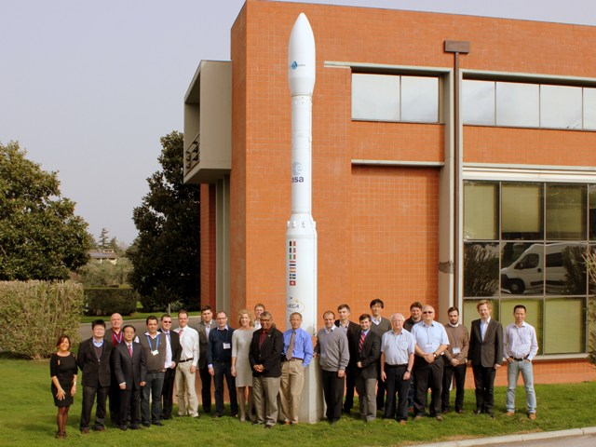
WGCV-37 Highlights and Outcomes
Summary and Main Outcomes of 37th WGCV Plenary:
Hosted by European Space Agency (ESA) at ESRIN
in Frascati, Italy, Feb 17-20, 2014
36 delegates from 24 organizations
Special Focus:
Collaborations between VCs and WGCV
Presentations by SST, AC, and LSI and discussion on potential collaborations (i.e WGCV-IVOS and SST proposal for calibration campaign)
please visit www.ceos.org/wgcv
Action: WGCV subgroups to further identify areas where WGCV can contribute to cal/val activities of VCs, and other WGs (by WGCV-38, Sept/Oct 2014).
Collaboration with WMO/GSICS (Global Space-based Inter-Calibration System)
Presentation by GSICS and discussions on potential interaction with WGCV.
Action: WGCV subgroup Chairs to identify and prioritize specific activity areas for interaction with GSICS. (by WGCV-38, Sept/Oct 2014).

Slide 11
WGCV-37 Highlights and Outcomes
WGCV and WGISS Interactions – Participation from WGISS Chair (R. Moreno). All outstanding WGCV/WGISS joint action items were addressed.
WGCV and GEO Interactions – Participation from GEO Secretariat (O. Ochiai). Update on GEO activities and priorities for 2014 along with potential areas where WGCV can contribute in terms of cal/val support.
Cross Cutting Activities
Special sessions were also held to discuss topics of interest to many subgroups and agencies (cross-cutting themes), including:
QA4EO | Cloud Masking | Reference Solar Irradiance Spectrum
CORE-CLIMAX | Global DEM | Sentinel-2 Radiometric Uncertainty Tool
Maturity Matrix | SnowPEX | NORS Ground-Based Observations program
Discussions held on CEOS 3yr Work Plan Comprehensive outcome phased into CEOS work plan objectives
Discussion on Carbon Task Force Report (remote presentation)

Slide 12
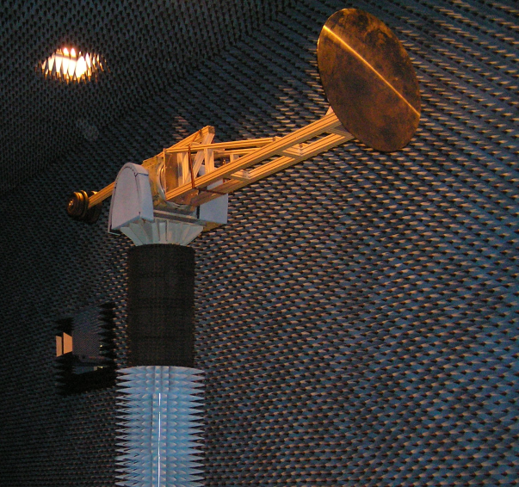
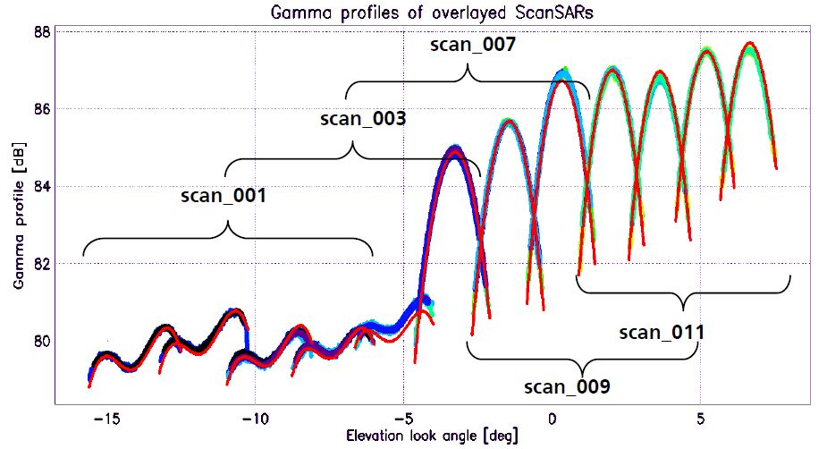
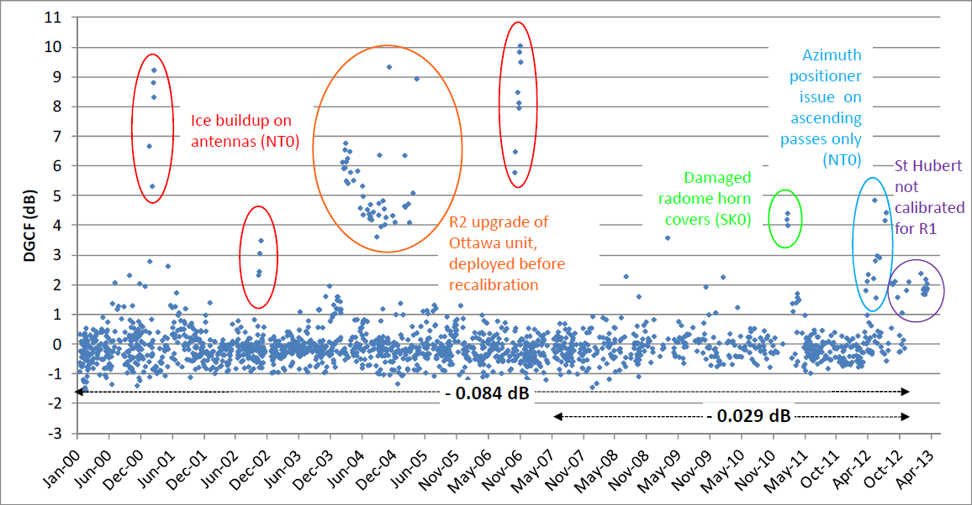
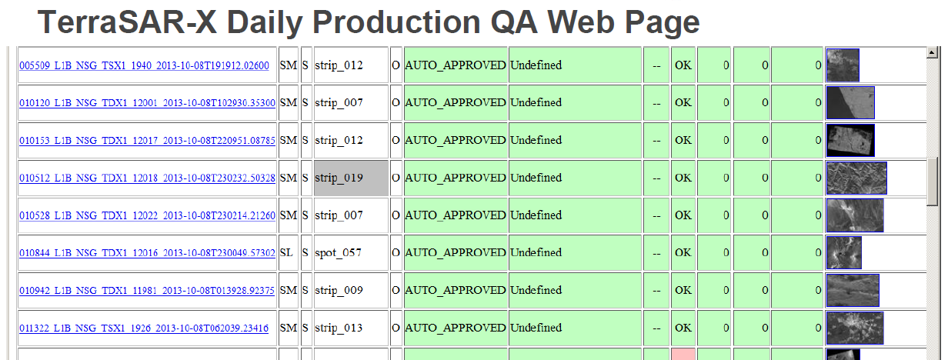
WGCV Activity Status
QA4EO Elements in Operational SAR Missions
Requirements specification
(well-defined quality indicators)
Reference standards (calibration targets)
QA-processes:
Commissioning phase
Long-term system monitoring
Systematic
product QA

Slide 13
WGCV Activity Status RADCALNET (formerly LANDNET) Prototype Project
Kick-off by Members of WGCV-IVOS in January 2014
Prototype project: with initially 3 sites ‘network’ based on existing agencies experience and an additional new 4th site to be added in ~1 yr
Project demonstration phase 2 yrs
ESA, AOE-CAS, CNES, NASA, NPL
Draft project handbook- defining protocols: measurements, QA, Formats, communication methods- look to complete by June 14
Single portal for data collation and result delivery
Processing of surface results to Satellite via common network processing method to complement individual site methods
New sites and sensors encouraged at end of 2yr prototype phase
Initial main objective: to provide calibration reference measurements for Sentinel 2, Landsat 8, SPOT 5, GF1 & similar
Coordinated Site data collection: satellite and Ground to start April/May 14.
Comparison/harmonization of individual sites ground measurements to start Spring 15.

Slide 14
WGCV outlook
2014-2016 Vice Chair position
Candidacy presentations on behalf
NASA: Dr. Kurtis Thome (NASA/GSFC)
NRSCC: Prof. Chuanrong Li (CAS/AOE)
Nomination during WGCV-38
WGCV-38
to be hosted in the USA from Sept 29th to Oct 3rd 2014
Venue location TBD

Slide 15
- BACKUP SLIDES -

Slide 16
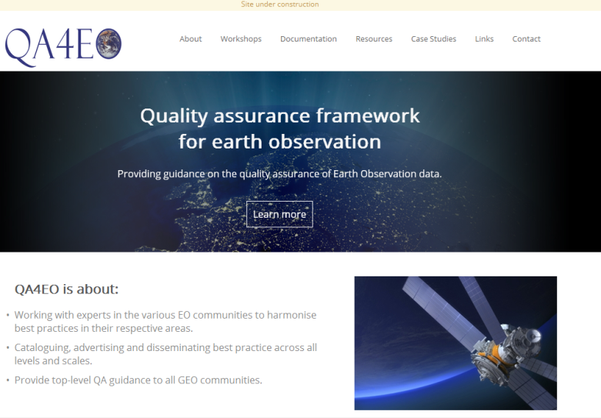
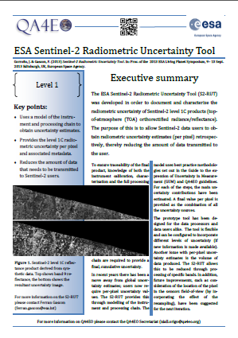
Progress/next steps:
New-look website (http:www.QA4EO.org)
Will look to produce an interactive flow diagram
to aid users to navigate and select guidelines
Establishment of concept and template for case study
based promotion of Cal/Val/QA to different audiences
Encourage more examples from CEOS agencies
Promote wider uptake amongst CEOS agencies, WGs and VCs & expand its scope for GEO
Encourage regular reporting from CEOS agencies on QA4EO consistent activities
Visibility of QA4EO concept in activities e.g comparisons
Work with GEO secretariat for outreach to SBAs
Developed generic downloadable poster as community resource
For presentation at wide range of conferences
Establish a reporting template to help ‘self assessment of Cal/Val QA based on concepts of ‘maturity matrix’
UKSA and NPL-CCM offer to continue to provide support for
QA4EO secretariat.

Slide 17
WGCV Activity Status RADCALNET (formerly LANDNET) Prototype Project
Need for a joint effort to build a harmonised CEOS Cal/Val network for “Land imagers” by establishing robust traceable links between existing instrumented calibration sites with coordinated outputs to provide users with consistent harmonised trusted calibration data
Final goal:
A network of 5 to 10 operational calibration sites distributed over the world providing sensor tailored calibration coefficients
Systematic ground and atmospheric characterization
‘Light’ ground instrumentation (total cost: 100 to150 k$)
‘Automated’ and maintained instrumentation
Consistent SI traceable instrumentation calibration
Consistent documented measurement protocol and analysis
Open access of Site measurements to all interested agencies following initial demonstration phase

