Slide 1
OSVW-VC Update
Co-leads: Paul Chang (NOAA), Julia Figa-Saldaña (EUMETSAT), BS Gohil (ISRO)
CEOS SIT-29 Meeting
CNES, Toulouse, France 9th-10th April 2014

Slide 2
Activity Update
Sustained operations
ASCAT on METOP-A and METOP-B operating nominally
OSCAT on OceanSat-2 discontinued operations
ISRO already has a gap filler OSVW mission (ScatSat) approved and scheduled for a late 2015 launch
NASA RapidScat mission on the International Space Station scheduled for an early June 2014 launch
Bridging with the IOVWST
IOVWST 2014 annual meeting in June 2014, planning an OSVW-VC side meeting to discuss the OSVW-VC TOR draft
Specific working groups will be kicked-off on Climate wind CDRs and Data Standards
Outreach and training
Satellite winds and waves marine forecaster training workshop conducted in December 2013 with the South African Weather Service as part of the outreach and training effort
Optimization of the OSVW constellation
Updated scatterometer missions outlook figure and started an analysis of the overall local time coverage from the constellation

Slide 3
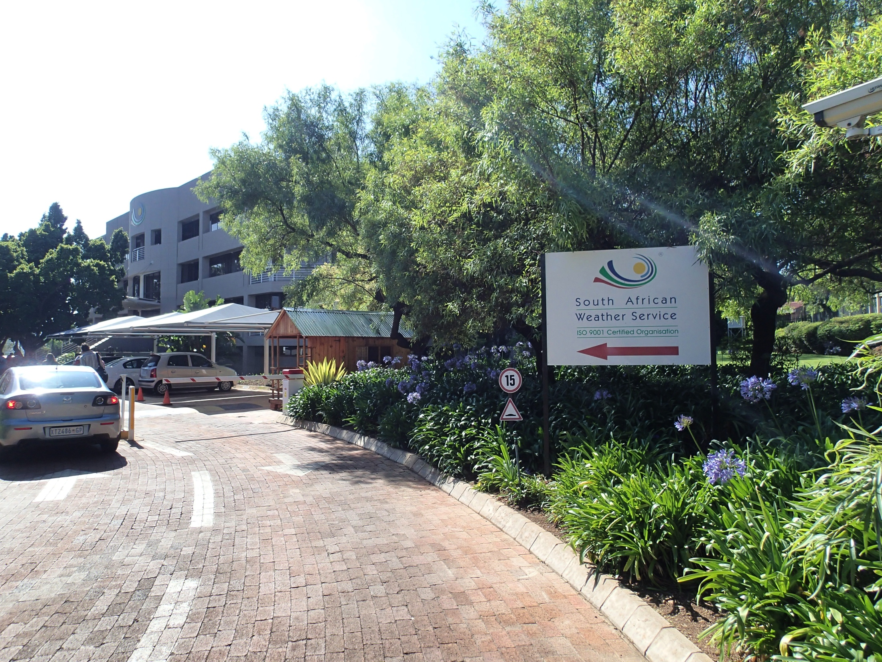
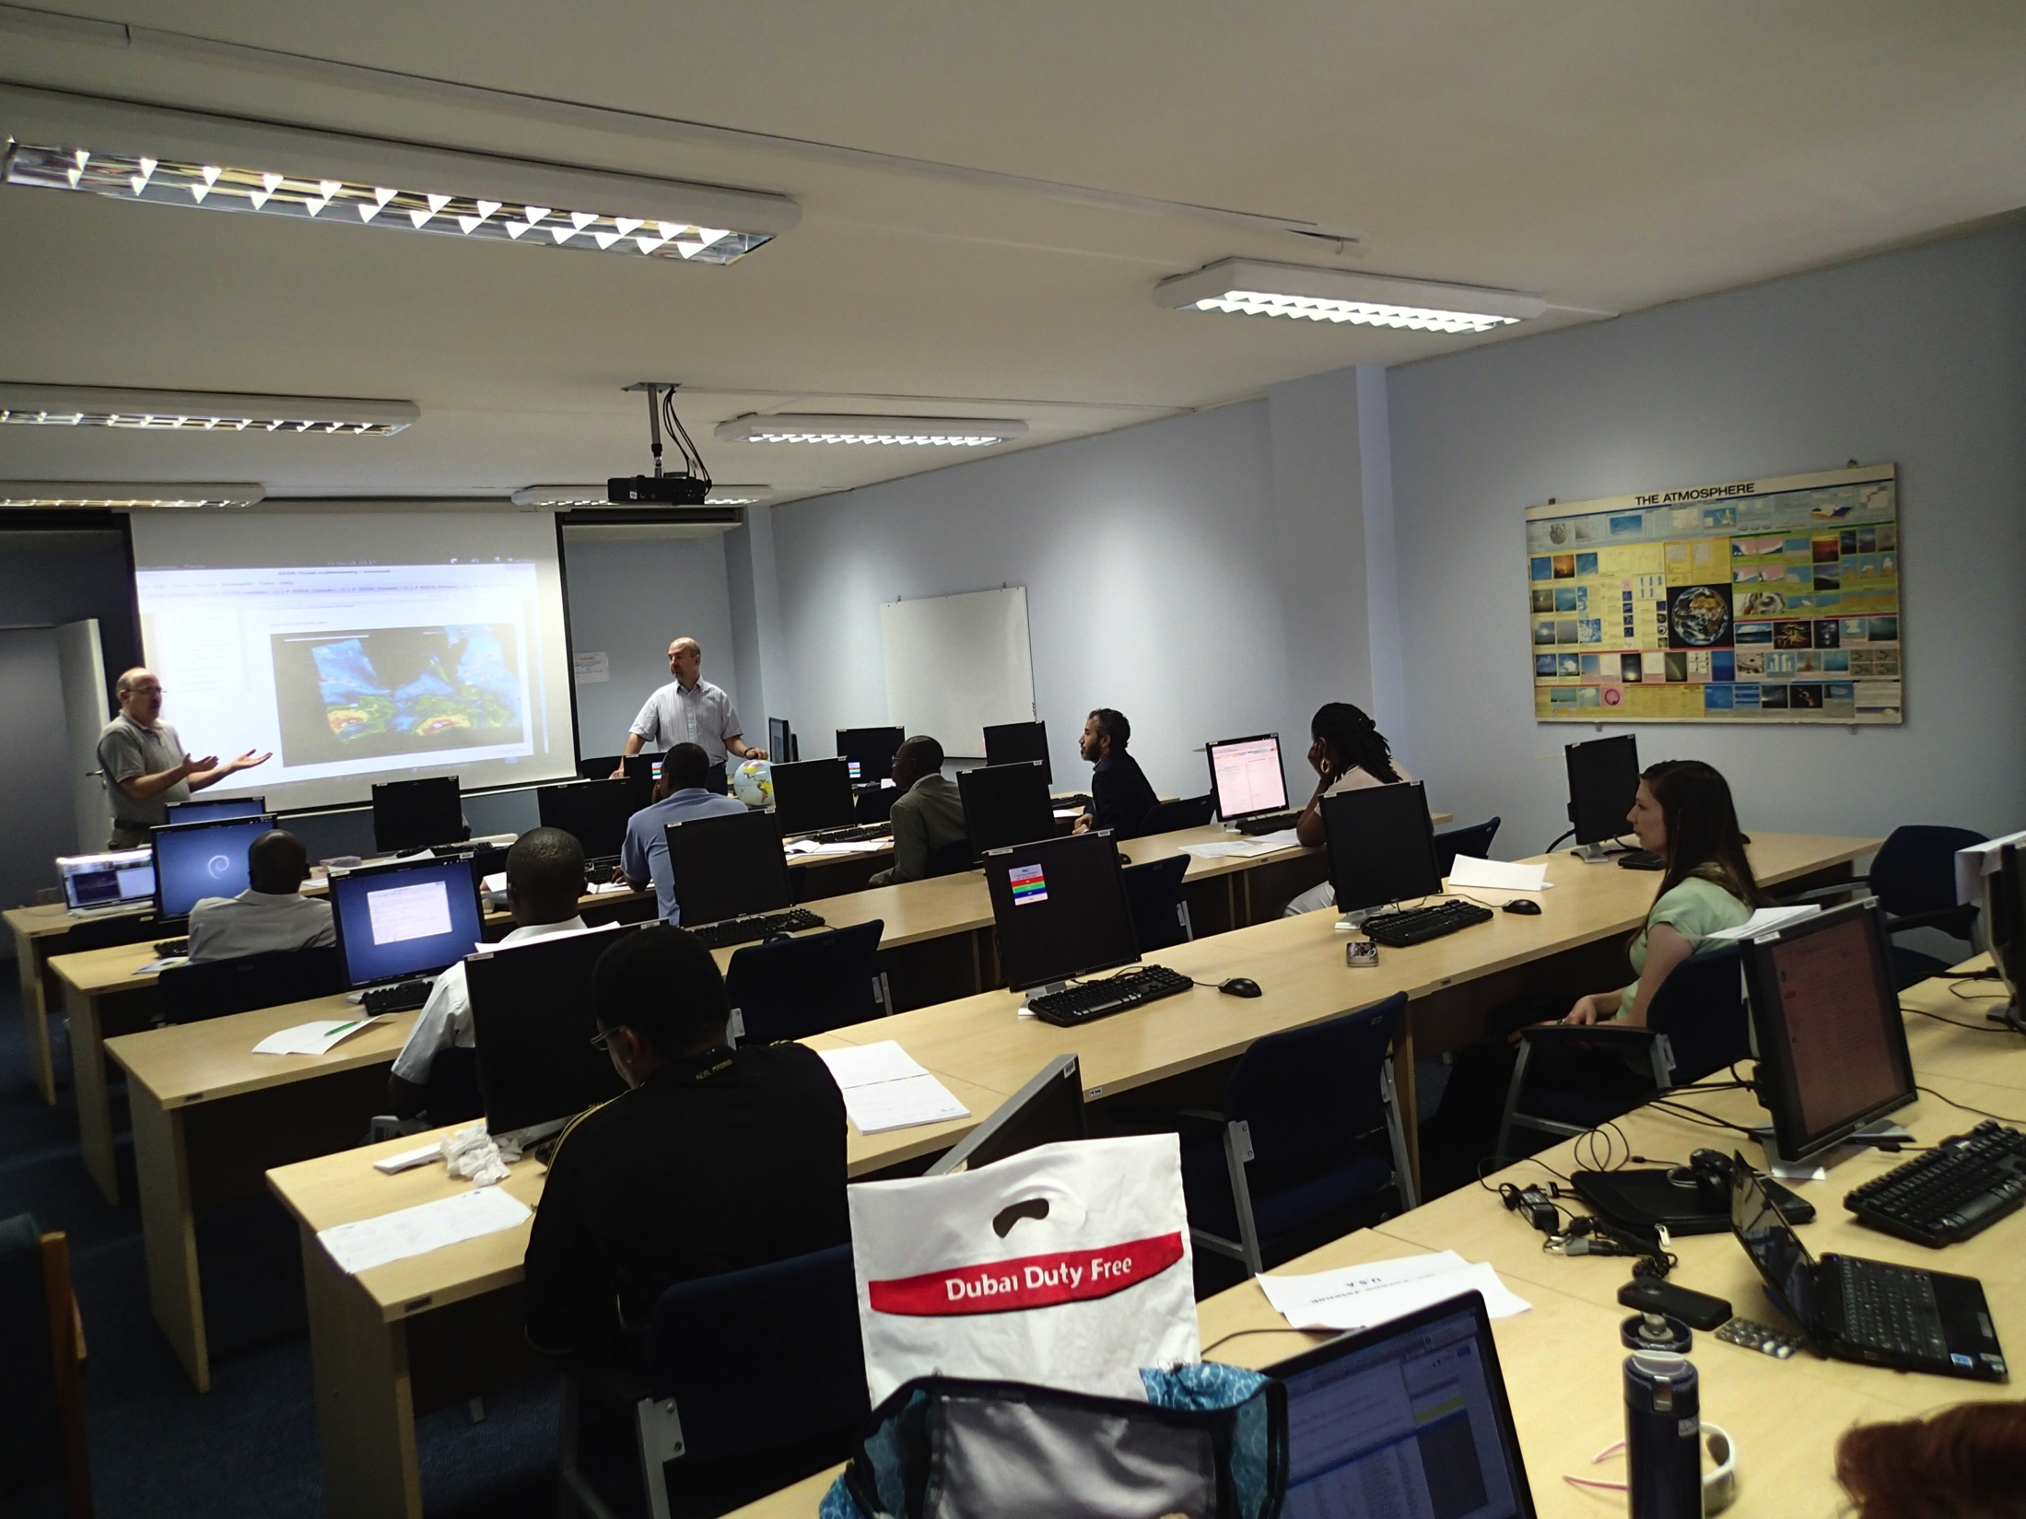
Training and Outreach
Satellite wind and waves training course for marine forecasters
Organized and conducted by NOAA (NESDIS and NWS), EUMETSAT and South African Weather Services (SAWS) in Pretoria, South Africa – December 2013
Students were marine forecasters from several countries within Africa
Hands-on used of satellite winds and waves in an integrated way with other weather forecast data (integrated view)
Notes:
FY2014 accomplishments to date. You are not restricted to just this one slide. Feel free to use slides you provided for the STAR / SOCD monthly reports since November 2013 (start of the FY2014 reporting period) here if you wish.

Slide 4
Launch
10
11
12
13
14
15
16
17
18
19
20
21
22
23
24
10/06
METOP-A Europe
METOP-C Europe
C-band
METOP-B Europe
Post EPS Europe
06/99
QSCAT USA
03/04
Oceansat-2 India
Oceansat-3 India
SCATSAT India
HY-2A China
HY-2B China
HY-2C China
CFOSAT China/France
Ku-band
RapidSCAT USA
Meteor-M N3 Russia
Meteor-MP 3 Russia
Combined C- and Ku-band
GCOM-W2 Japan/India/USA
GCOM-W3 Japan/India/USA
FY-3E China
FY-3G China
Scatt operational series India
Design Life
Extended Life
Design Life
Extended Life
Proposed
Operating
Approved
Jan2014

Slide 5
Launch
10
11
12
13
14
15
16
17
18
19
20
21
22
23
24
01:30
GCOM W2/3
No scatterometer missions confirmed within the 0 – 6 h Descending Node Crossing period – what is the impact on scatterometer wind daily coverage for given locations?
What is the impact for the different applications?
01- 03
03 - 05
06:00 HY-2 A/B/C
06:00 FY-3E/G
06:00 SCATT O.S.
05- 07
DESCENDING NODE CROSSING TIME
07:00 CFOSAT
07- 09
09:30 PS
09:30 EPS-SG
09- 11
10:30 SCATSAT
11- 13
12:00 OceanSAT 2/3
12:00 Meteor M/MP
Design Life
Extended Life
Design Life
Extended Life
Proposed
Operating
Approved
Jan2014

Slide 6
Issues, concerns and on-going activities
The discontinuation of OSCAT operations and the current unavailability of HY-2A winds in NRT has a significant impact on short term weather forecasting applications
Continue pursuing engagement of other OSVW mission owners to participate in the VC and IOVWST (i.e., China and Russia) and advocate for open and timely data access, as well as for open scientific exchanges and cooperation
Will try through increased participation in CGMS, such as at the upcoming International Winds Working Group meeting in June 2014
Continue to advocate for long-term international commitment to a sustained global vector winds constellation to support short-term weather forecasting and warning and long-term earth system forecasting and monitoring,
The mission chart suggests numerous missions over the next decade but only a few of these are part of sustained programs. OSVW is not yet a parameter that so far has driven atmosphere nor ocean operational applications to the same extent as, e.g., SST or atmospheric sounding for operational Earth observing programs. But an optimum coordination and exploitation of the coming high number of OSVW missions within the next decade presents an opportunity demonstrate the impact of the data and raise its priority to drive operational applications.
Continue outreach and training efforts, in order to improve the utilization of data streams and advocate for sustained and coordinated OSVW missions in the future

Slide 7
A word on OSCAT
ISRO has announced the discontinuation of services of the Oceansat2 scatterometer, albeit after near completion of its intended mission life of five years. Scatterometer on Oceansat2 was ISROs first active Microwave payload and was providing regular and timely surface wind data services to the international community. This payload has won many laurels for ISRO from various quarters both at home and abroad and leaves an important gap in data coverage for near real time applications such as weather forecasting.
The OSVW-VC thanks ISRO, particularly NRSC, SAC and ISTRAC teams, for the successful establishment of the automated ground segment chain, using Svalbard as the data download station to meet the demanding near-real-time data requirements from the international operational meteorological user agencies

