Slide 1
P-VC Status and Issues WG and VC Session – VC Focus
Riko Oki Steven Neeck
P-VC Co-Leads
CNES, Toulouse, France 9-10 April 2014

Slide 2
Status
Reminder of 3-year outcomes
P-VC Data Portal and links to CEOS Water Portal
WA-01-C1_3 Phase 1 – “link only” interface
WA-01-C1_4 Phase 2 – “query/results/order based” interface
Precipitation ECV support – Response to GCOS Action A-8 - Ensure continuity of satellite precipitation products (Deliverables #1, #2, #3, #4, #5 )
Deployment of GPM phase constellation satellites and maintaining continuity with TRMM
Advocacy of post-GPM phase P-VC

Slide 3
Status (cont.)
Accomplishments since SIT-28
P-VC Data Portal
Phase 1 of P-VC Data Portal completed (WA-01-C1_3)
Phase 2 of P-VC Data Portal implementation underway (WA-01-C1_4)
Analyst hired
Data Portal Phase 2 study (function and architecture) prepared and submitted to Co-Leads
Precipitation ECV support – Response to GCOS Action A8
GCOM-W1/AMSR2 L2 data publicly available (Deliverable #1)
GCOM-W1/AMSR2 and TMI/AMSR-E intercalibration update
Megha-Tropiques/SAPHIR L2 data publicly available (Deliverable #1)
CEOS P-VC Microwave Imager Availability White Paper Update completed (Deliverable #1)
X-Cal WG meetings at CNES Toulouse Space Center (France) and CSU (USA) as well as weekly videocons (Deliverables #2, #3, #4, and #5)
GPM Precipitation Processing System processing L1 and L2 data products (Deliverables #2, #3, #4, and #5)

Slide 4
Status (cont.)
Accomplishments since SIT-28 (cont.)
Deployment of GPM phase constellation satellites and maintaining continuity with TRMM
GPM Core Observatory launched and in commissioning phase
TRMM extended through 3Q2017 by 2013 NASA Senior Review
Advocacy of post-GPM phase PVC
CEOS P-VC Microwave Imager Availability White Paper Update completed
GPM FO meeting held on sidelines of 2013 PMM Science Team meeting and Integrated Global Precipitation and Clouds mission concept workshop at NASA GSFC
Planning for 5th P-VC Workshop
November 2014, Tsukuba, Japan (on sidelines of 7th IPWG Workshop)

Slide 5
Status (cont.)
Accomplishments since SIT-28 (cont.)
P-VC ToR completed
P-VC engagement with WGs
WGCV-36
WGISS-35 (planning to remotely participate in upcoming WGISS-37)

Slide 6
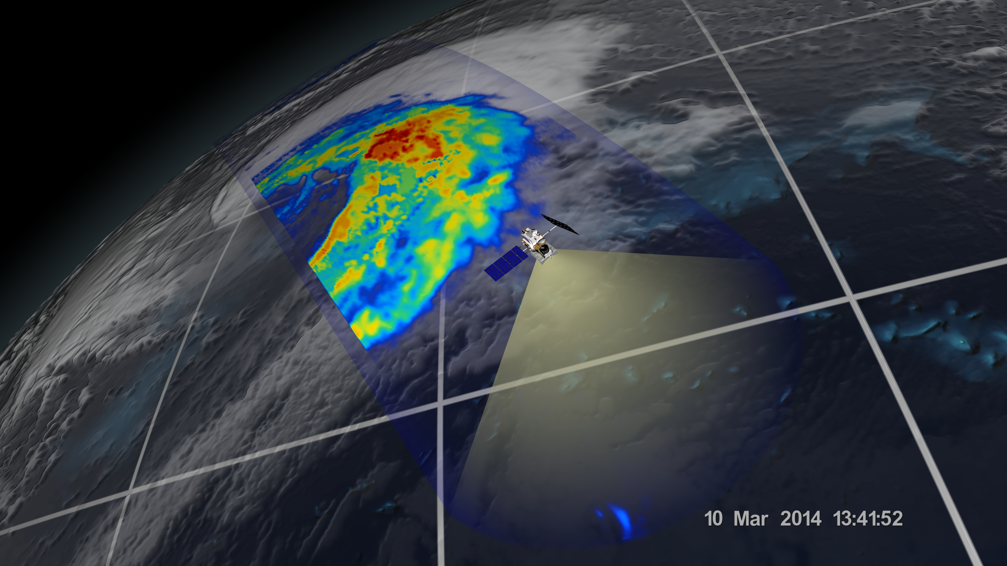
GPM “First Light” Images - GMI
This is the first visualization of precipitation data collected by the GPM Microwave Imager (GMI). The image shows rain rates across a 885 kilometer wide swath of an extra-tropical cyclone observed off the coast of Japan on March 10, 2014. Red areas indicate heavy rainfall, while yellow and blue indicate less intense rainfall. The upper left blue areas indicate falling snow.

Slide 7
GPM “First Light” Video - GMI
http://www.youtube.com/watch?feature=player_embedded&v=APkt5-mGutU

Slide 8
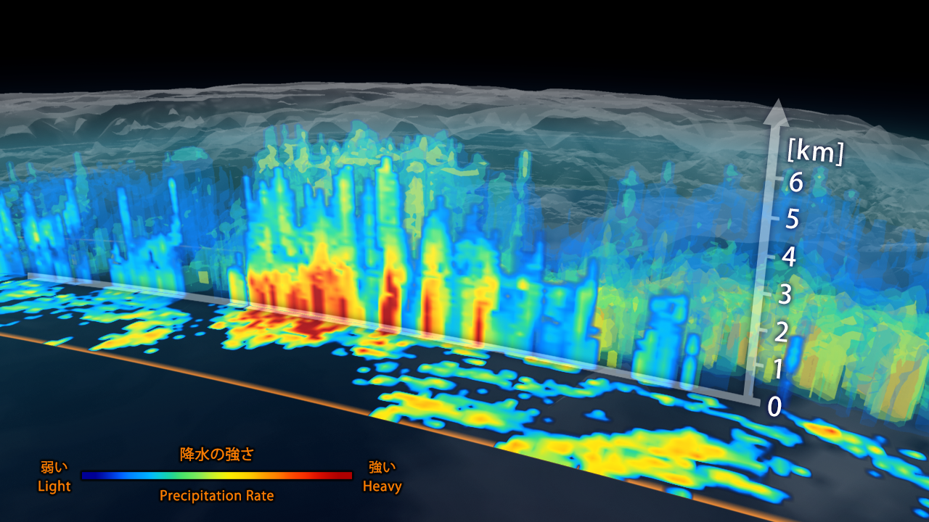
GPM “First Light” Images - DPR
This is the first data visualization of the three-dimensional structure of precipitation collected by GPM’s Dual-frequency Precipitation Radar (DPR). The image shows rain rates of a vertical cross-section approximately 7 kilometers high through the same extra-tropical cyclone observed off the coast of Japan on March 10, 2014. Red areas indicate heavy rainfall while yellow and blue indicate less intense rainfall.

Slide 9
GPM “First Light” Video - DPR

Slide 10
Issues
Systemic lack of participation by some countries, such as Russia and China
Potential Microwave Imager coverage gaps (e.g. post-GCOM-W1 and post DMSP)

Slide 11
Backup

Slide 12
Response to GCOS Action A8 - Ensure continuity of satellite precipitation products
Deliverables
Sustainment and enhancement of constellation of satellites carrying microwave radiometers (both imagers and sounders) and moderate inclination satellite carrying microwave imager and precipitation radar.
Well characterized and stable Level 1B calibrated, geolocated brightness temperature (Tb) products from each PC radiometer.
Inter-calibrated brightness temperature (Tc) products by applying the GPM core observatory reference standard.
Precipitation retrievals using physically based a-priori database constructed from combined radiometer/radar measurement.
Global monthly PDF of precipitation intensity based on the above.

Slide 13
Advocacy of post-GPM phase PC
Potential Microwave Imager (MI) shortfall in post-GPM era
Initiate of GCOM-W2 development with objective to provide AMSR2 measurement continuity with GCOM-W1 (JAXA)
Initiate development of Microwave Imager (MWI) for METOP SG (EUMETSAT)
Develop and implement approach to obtain FY-3 MWRI data on a routine and timely basis (EUMETSAT, NOAA, NASA)
Develop and implement approach to obtain Meteor M N2 MTZVA data on a routine and timely basis (EUMETSAT, NOAA, NASA)
Develop a timeline for development and deployment of the geostationary PATH radiometer (NASA)
Light and solid precipitation measurements at high latitudes
Conduct concept study of light/solid precipitation measurement capability in the ACE Cloud Profiling Radar (NASA)
GPM FO
Conduct concept study of GPM FO mission (JAXA, NASA) including potential broadening to an integrated global precipitation and clouds mission concept

Slide 14
X-Cal Working Group
X-Calibration Working Group (X-Cal WG)
International working group (in coordination with WMO CGMS/GSICS) to develop a consensus reference standard for cross-calibration of microwave radiometers to produce uniform global precipitation products within a consistent framework.
Fourteen WG meetings held since 2007
14th WG meeting, August 22, 2013 at CSU, Fort Collins, CO, USA
NASA, JAXA, CNES, ISRO, INPE, CONAE, NOAA, NRL, EUMETSAT, JMA, UKMET, Universities from the U.S. and Asia participate (WGCV/MSSG invited since January 2008)
Discovered/Fixed Problem in TMI (ca. 2K p-p), implemented fix in V7 algorithm
Implementation of L1C intercalibration processing (conical imagers and sounders) including calibration constants for pre-launch Precipitation Processing System (PPS)
Instrument liaisons for 9 contemporary passive microwave instruments
http://www.gpm-x-cal.info/
14

Slide 15
Participation
Lead Agencies:
Japan – JAXA: Riko Oki, oki.riko@jaxa.jp & USA – NASA: Steven Neeck, steven.neeck@nasa.gov
Space Agency Participants:
France - CNES: Philippe Veyre, veyre.phillipe@cnes.fr
India - ISRO: K. Kumar, director@sac.isro.gov.in
Brazil - INPE: Carlos Frederico Angelis, angelis@cptec.inpe.br
Europe - ESA: Michael Rast, michael.rast@esa.int
China – NSMC/CMA: Lu Naimeng, lunaimeng@nasmc.cma.gov
Russia – ROSHYDROMET: Vasily Asmus, asmus@planet.ittp.ru
USA - NOAA: Ralph Ferraro, ralph.r.ferraro@noaa.gov
USA - Naval Research Laboratory: Ian Adams, ian.adams@nrl.navy.mil
Europe - EUMETSAT: Johannes Schmetz, Johannes.Schmetz@eumetsat.int
Germany - DLR: Martin Hagen, martin.hagen@dlr.de
Canada - Canadian Space Agency: Luc Brule, Luc.Brule@asc-csa.gc.ca

Slide 16
Participation (cont.)
Other Agency Participants:
France – LEGOS-OMP/CNRS: Remy Roca, remy.roca@lmd.jussieu.fr
Canada – Environment Canada: Paul Joe, paul.joe@ec.gc.ca
User Community Representatives:
CGMS-IPWG: Paul Kucera, pkucera@ucar.edu, Nai-Yu Wang, nai-yu.wang@noaa.gov
GEWEX: Chris Kummerow, kummerow@atmos.colostate.edu
WCRP/IGWCO: Rick Lawford, lawford@umbc.edu
GCOS: Adrian Simmons, Adrian.Simmons@ecmwf.int
Peter Bauer, Peter.Bauer@ecmwf.int
Phil Arkin, parkin@essic.umd.edu

Slide 17
U.S. P-VC Co-Lead Team
Steven Neeck/NASA HQ
Ramesh Kakar/NASA HQ
Arthur Hou/NASA GSFC
Gail Jackson/NASA GSFC
Bob Adler/ University of Maryland Baltimore County
Erich Stocker/NASA GSFC (SEO POC, Data Systems)
Scott Braun/NASA GSFC (Visualization POC)
Chris Kidd/University of Maryland
Ralph Ferraro/NOAA
Joe Turk/JPL
Ian Adams/NRL
Chris Kummerow/Colorado State University

Slide 18
Japan P-VC Co-Lead Team
Riko Oki, JAXA
Masahiro Kojima, JAXA
Kinji Furukawa, JAXA (SEO POC, Data Systems)
Keizo Nakagawa, JAXA
Misako Kachi, JAXA (Visualization POC)
Toshiaki Takeshima, JAXA
Kengo Aizawa, JAXA
Keiji Imaoka, JAXA
Kazuo Umezawa, JAXA
Yukari Takayabu, University of Tokyo
Toshio Iguchi, NICT
Ken’ichi Okamoto, Osaka Prefecture University
Toshio Koike, University of Tokyo
Jun Matsumoto, Tokyo Metropolitan University
Kazuhiko Fukami Public Works Research Institute
Yoshiaki Takeuichi, Japan Meteorological Agency
Yoshiyuki Chihara, Ministry of Education, Culture, Sports, Science and Technology

