Slide 1
VC and WG deliverables
Steven Hosford
CEOS SIT-29 Meeting
CNES, Toulouse, France 9th-10th April 2014

Slide 2
Overview
Before – various “threads” in work on deliverables to GEO
CEOS Work Plan
VC 2015 GEOSS deliverables
VC data access initiative
Proposed approach

Slide 3
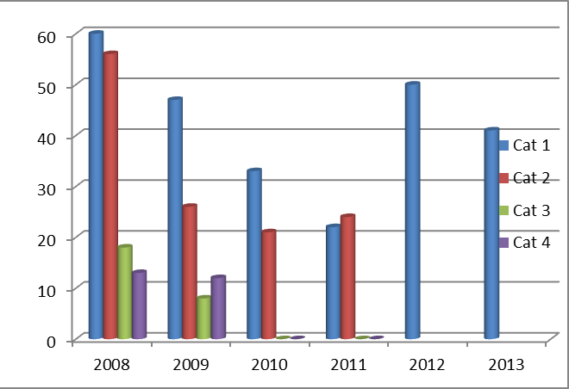
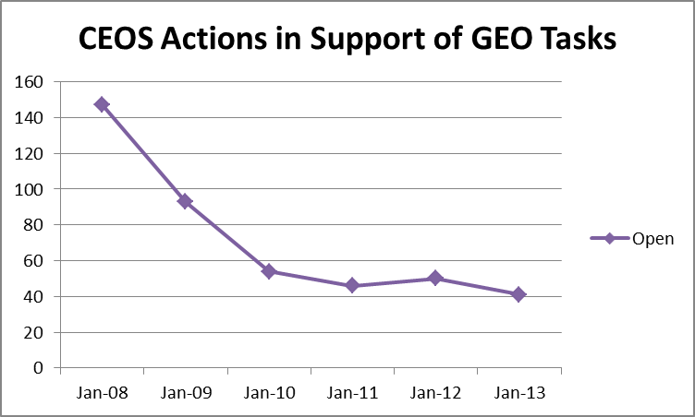
Actions 2008-2013

Slide 4
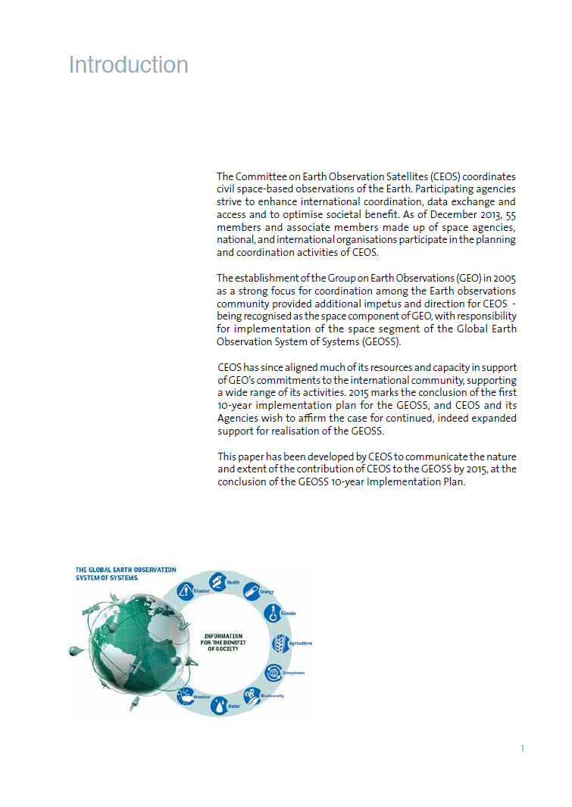

Slide 5
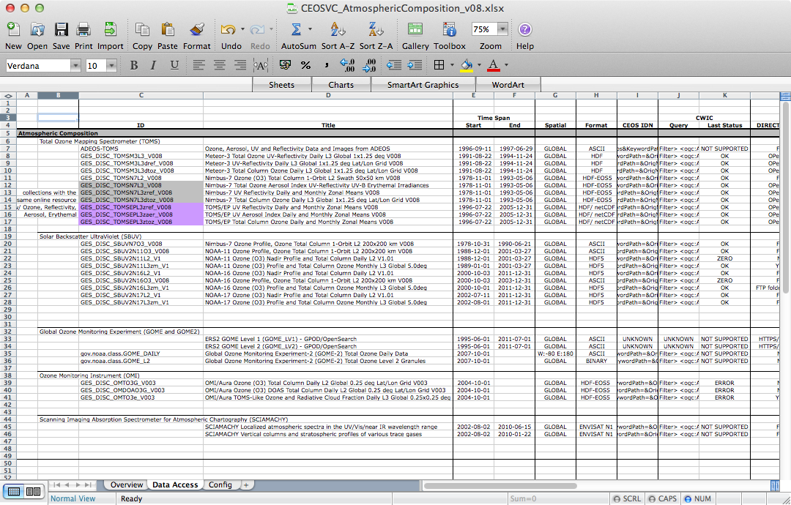
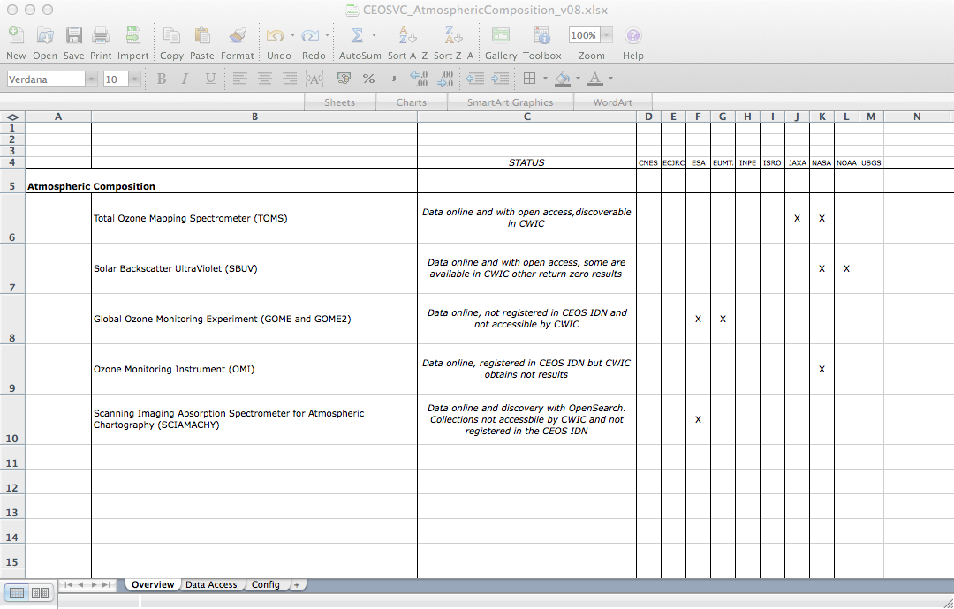
VCs Data Access Study
Principle data collections were identified for each VC
Each collection was tested in terms of:
geospatial and temporal scope
format
data discovery
data access
5

Slide 6
Proposed approach
CEOS Work plan
WG activities
VC activities
2015 GEOSS
deliverables
Post-2015
Work Plan
VC Data access
… other ...
CEOS 3 year
Work Plan

