Slide 1
CEOS Working Group and New Initiatives Process Papers
Kerry Ann Sawyer
CEOS Executive Officer
CEOS Plenary Action 27-4
CEOS SIT-29 Meeting
CNES, Toulouse, France
9th-10th April 2014

Slide 2
Overview
CEOS Working Group Process Paper
CEOS New Initiatives Process Paper
This Presentation for Information
DECISION will be taken under Session 5, Agenda 20

Slide 3

Justification
CEOS does not have a formal “tactical” process document for CEOS Working Groups or new CEOS Initiatives. A Process Paper does exist for Virtual Constellations, so a similar output is needed for Working Groups and New Initiatives. Many CEOS Members have expressed a desire for additional details regarding the processes by which new Groups or new work are proposed and endorsed by CEOS.
CEOS Plenary Action 27-4: “Prepare a process paper(s) with the support ”of a writing team, for: (a) CEOS Working Groups; and, (b) for guidance on proposals for new CEOS initiatives. (Interest expressed by Mark Dowell, Marie-Josèe Bourassa, Ivan Petiteville, Brian Killough, and Steven Hosford
  Actionee – CEO, in consultation with CEOS SEC
  Due Date – SIT-29 YAY!!! DUE DATE MET

Slide 4
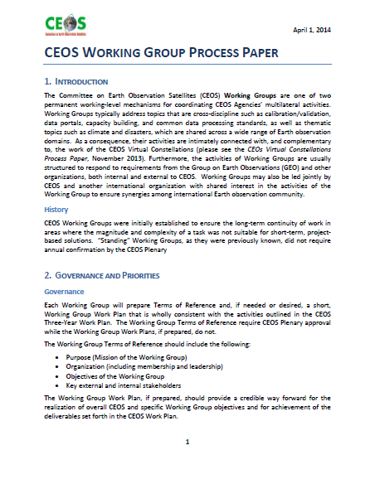
CEOS Working Group Process Paper
Introduction
  History
Governance and Priorities
  Governance
  Priorities
Working Group Organization
  Leadership
  Membership
  Structure
Execution of Activities
  Reporting
Proposing a New Working Group
Working Group Evolution

Slide 5
Key Highlights – Working Group
Process Paper
Governance
Working Group Terms of Reference: REQUIRED – Plenary approval
  Wholly consistent with activities outlined in the CEOS Three-Year Work Plan
Working Group Work Plan: OPTIONAL – no Plenary approval
Priorities
Working Groups have the ability to pursue activities in support of other entity or organization activities as secondary priority to CEOS priorities, as long as resources are available
leadership
Chair and Vice Chair with 2-year terms
Vice Chair selected by Working Group; endorsed by Plenary
  Candidates must demonstrate technical and leadership skills
  Commitment of Agency
  Consensus decision making if more than one candidate

Slide 6
Key Highlights – Working Group
Process Paper con’t
Membership
Representatives from all CEOS Agencies are invited to participate
CEOS Agencies will constitute the core membership but individuals from other non-CEOS organizations maybe invited to participate
Structure
Working Groups have the flexibility to structure themselves internally as appropriate to execute their respective activities
Will meet formally at least once per year
Reporting
Working Groups primary reporting path is to the CEOS Chair
Secondary reporting path to SIT Chair, if so delegated by CEOS Chair
Chair or designee shall report at each CEOS Plenary session on accomplishments and future plans

Slide 7
Key Highlights – Working Group
Process Paper con’t
Proposing a New Working Group
Significant interest in enhancing technical cooperation among CEOS Agencies in specific topical areas with broad international benefit
Considered a “New Initiative” (see next slide)
Working Group Evolution
By default, Working Groups shall continue their existence and do not require annual CEOS Plenary approval
Working Groups can propose to modify focus and activities at any time (to include “reconstitution”)
If the consensus of the Plenary is such that a Working Group is no longer required, the Plenary can recommend a Working Group be discontinued

Slide 8
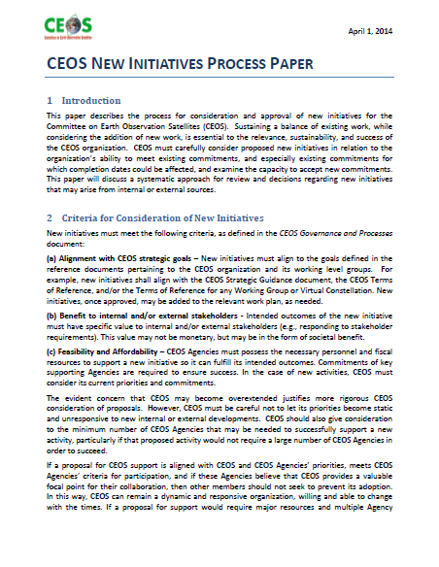
CEOS New Initiatives Process Paper
Introduction
Criteria for Consideration of New Initiatives
CEOS Support to New Initiatives
Process for Approval of New Initiatives
Annex 1: Checklist for New Initiatives for CEOS Consideration
Annex 2: Presentation of a new Initiative to CEOS

Slide 9
Key Highlights – New Initiatives
Process Paper
Criteria for Consideration of New Initiatives
Information wholly consistent with language in the CEOS Governance and Processes document, Section 3 – Decision-Making Process
Decision criteria:
  Alignment with CEOS strategic goals
  Benefit to internal and/or external stakeholders
  Feasibility and affordability
Evident concern that CEOS may become overextended which justifies more rigorous CEOS consideration of proposals while ensuring priorities do not become static and unresponsive to new internal or external developments
Key to successful proposal review lies in a good understanding of required Agency participation and resource commitments, matched against overall CEOS priorities

Slide 10
Key Highlights – New Initiatives
Process Paper con’t
CEOS Support to New Initiatives
First must understand extent and interaction of support by asking a few key questions
“CEOS support” comes in many shapes and sizes
  Major global, resource-intensive, long-term tasks requiring large number of CEOS Agencies
  Smaller-scale, short-term tasks involving small number of CEOS Agencies
  …and activities that fall somewhere in between
Process for Approval of New Initiatives
Begins with a written request to the CEOS Secretariat of the activity that is significant in nature and requires discussion and strategic evaluation by CEOS Principals
Must be sponsored or led by a CEOS entity
If approved, will become part of CEOS Three-Year Work Plan and may also be part of a WG or VC Work Plan or part of an Ad Hoc Team

Slide 11
Key Highlights – New Initiatives
Process Paper con’t
Process for Approval of New Initiatives (con’t)
Decisions will be made at appropriate meetings of decision makers as identified in Table 3-1 of the CEOS Governance and Processes document
Annex 1
Is the proposed activity appropriate for CEOS, rather than for another existing coordination group or private sector organization/association?
Is the proposed activity closely aligned with CEOS priorities, as stated in the CEOS Strategic Guidance Document and CEOS Three-Year Work Plan?
Is the proposed activity well-aligned with a sufficient number of individual CEOS Agencies’ Earth Observation priorities?
Can a sufficient number of CEOS Agencies successfully respond based on their existing technical and financial resources? (Note: a “sufficient number” of CEOS Agencies could vary widely, based on the size and scope of the proposed activity.)

Slide 12
Key Highlights – New Initiatives
Process Paper con’t
Annex 1 (con’t)
If Agencies have sufficient technical capacity and interest, are there additional policy considerations that would encourage or discourage their involvement – e.g., overarching data policies or prevailing public/private partnerships? (If no additional policy barriers exist, then support proposed activity.)
Is the proposed activity well-aligned with existing activities of CEOS, e.g. Virtual Constellations, Working Groups, or other initiatives? (If so, identify those activities and entities)
For proposed new initiatives other than the creation of Working Groups or Virtual Constellations, when is the activity/initiative expected to be completed and what are the milestones that will lead to its completion?

Slide 13
THANK YOU!!!!
Writing Team:
Steven Hosford
Brian Killough
Marie-Josèe Bourassa
Mark Dowell
John Bates
Ivan Petiteville
Reviewers:
Pascale Ultrè-Guèrard
Stephen Ward
Albrecht Von Bargen
Satish Srivastava
Christine Bognar
Mike Freilich
Brent Smith
Jane Olwoch
George Dyke

Slide 14
DISCUSSION
DECISION will be taken under Session 5, Agenda 20

