Slide 1
CEOS Virtual Constellation & Working Group
Workshop
Mon 26th March 2012
La Jolla

Slide 2
Objectives
Establish higher 2-way bandwidth between SIT and the VCs/WGs
Develop CSS recommendations in relation to VCs & WGs
Explore opportunities and obstacles to CSS recommendations
  Specifically looking at the ‘sharp end’
  Hear VCs and WGs perspectives
Establish consensus on this re-emphasis: focus on physical outputs
supporting CEOS priorities
First steps towards identifying top-down priorities that match
working realities/possibilities
  Existing activities remain important

Slide 3
Workshop content
Revisit CSS recommendations – discuss VC/WG implications
Nature of implementation support and targets
  What exactly is CEOS asking of us?
  Look to CEOS Work Plan priorities for top-down consistency & establish baseline
  Climate Architecture + CEOS Priorities with clear requirements
  Highlight examples to illustrate possibilities (SST, OCR)
  Consider known needs of GFOI, GLAM, Supersites etc..
Break
Individual VC/WG reports on opportunities, obstacles, issues for
SIT attention (5 mins)
Way forward with SIT support
  Including for existing challenges

Slide 4
CSS Recommendations & SIT Chair Response

Slide 5
CEOS Self Study
The strategic goal of the study was to inform CEOS as it goes forward,
through an analysis of lessons learned, input from CEOS members, and
assessment of current CEOS structure, achievements, and challenges,
and to provide recommendations for potential changes and potential new
initiatives for the next 3-5 years.
Individual reports on Virtual Constellations and Working Groups (and SBAs)
were core inputs – based on input from all CEOS participants

Slide 6
CSS Recommendations (1/5)
VC report
1. The Constellations are the main tool through which CEOS pursues domain-specific coordination.
Participation by key CEOS data provider agencies is not universal in the Constellation teams and
should be tackled directly.
2. Four of the seven Constellation teams are in support of ocean observations
and some prioritisation process may be needed to ensure a future balance of effort is guaranteed –
consistent with CEOS priorities. This may be provided by the engagement proposed with WGClimate
and possibly the Climate Architecture, amongst others.
3. Constellation partnerships between research and operational space agencies have significantly
strengthened the prospects for continuity of observations and this model should be taken into account
in future planning of new Constellations. The willingness to embrace a comprehensive coordination
framework through the Climate Architecture may provide a path for effective engagement of both
research and operational space agencies, and their respective coordination bodies, in Constellation
activities and objectives.
4. To realise its full potential as an implementation mechanism for the GEOSS, the Constellations
efforts should give greater emphasis to the physical results of coordination – the ‘sharp end’, such
as data products and ECVs. There is an immediate demand for such implementation support – aiding
the ECV inventory and coordination efforts of the WGClimate. This will require real resources and may
require additional membership for Constellation teams.

Slide 7
CSS Recommendations (2/5)
VC Report
5. The SST-VC has volunteered to serve as a pilot for the demonstration of the implementation partnership between Constellations and WGClimate.
6. As the Climate Architecture effort evolves from a badgeless activity to considering which existing assets and processes might be engaged or adapted in support of the functional and physical architectures, the role for the Constellations should be carefully considered.
7. The Constellations address a range of different coordination and implementation issues, reflecting the diversity of real-world challenges for CEOS in realising the space segment of the GEOSS. Any change in terms of reference or to the Constellations Process Paper should recognise the value of such diversity and not ‘over-standardise’ in a way which might restrict contribution of the Constellations to CEOS objectives.
8. The SIT process and meetings should be redesigned to identify, and escalate as appropriate, important outputs from the Constellations which have implementation implications, and to guarantee debate between Principals with supporting observation programmes.
9. It is beyond the scope of this study to consider the effectiveness of the Constellation recommendations, through CEOS, in influencing the mission budgeting and programming decisions of individual space agencies. It has been noted however that agencies need a goal to subscribe to that reflects their national policies and requirements and the Constellations have made progress this direction. Their attention to ECVs may provide a focus to which agencies and governments can subscribe and communicate back home to implement programming decisions.

Slide 8
CSS Recommendations (3/5)
VC report
10. The Constellation teams should have more direct representation on the CEOS SEC meetings to ensure that Constellation-related business stays on the management radar throughout the year. This could be via a nominated representative responsible for collating and distilling inputs from the Constellations to SEC.
11. Constellation teams have catalogued their planned outputs for the next few years in the course of this CEOS Self Study. CEOS should review this output and determine whether these achievements reflect the organisation’s ambitions. A dialogue between SIT Chair and Constellations to this end would be a logical next step.
WG & SBA report
WGISS and WGCV have changed from bottoms-up R&D arrangements to contributing to CEOS satellite arm of GEOSS; however, integrally contributing activities are still formulated largely by the WGs with much autonomy. WGs respond to Tasks and Actions assigned from SIT/CEO.
WGs lateral internal (other WGs, SBAs, VCs) and external coordination (GEO multiple Committees and Tasks, IGOS, etc.) has grown.

Slide 9
CSS Recommendations (4/5)
Synthesis Report
RECOMMENDATION #4: CEOS should develop a concise, yet complete, 5-year Strategic Plan and a schedule for review and update of future Strategic Plans. The Strategic Plan should be accompanied by appropriate Work Plans to ensure progress toward established goals. The plan should not only consider GEO Work Plan goals, but should address primary CEOS goals, and it should contain inputs from the CEOS Constellations, Working Groups, and SBA Teams.
RECOMMENDATION #9: Strengthen working relationships among Working Groups, SBA Coordinators, and VCs to support common CEOS objectives around high-level CEOS initiatives and their cross-WG/SBA (VC) synergies, rather than on a project-by-project (or even SBA-by-SBA) basis. Encourage the CEO and DCEO and other leadership as appropriate to attend WG meetings to help communicate CEOS priorities on a cross-WG and cross-SBA basis. Utilize the CEOS website more effectively for lateral CEOS communications and initiative/task coordination across Working Groups, SBAs, and VCs. Rebalance the task load to more effectively utilize and leverage existing resources.

Slide 10
CSS Recommendations (5/5)
Synthesis Report
RECOMMENDATION #13: CEOS Working Groups, Constellations and SBA Teams should address the lack of participation by providing a list of strongly desired space agencies and associates to the CEOS SIT. CEOS Principals can be made aware of their desired participation in Constellation efforts and the anticipated gain from such participation. If participation continues to be too low to sustain necessary Constellation activities, CEOS leadership should work with the WG, VC, or SBA Co-chairs to identify and address the reasons.
RECOMMENDATION #15: The CEOS Plenary and/or SIT meetings should provide sufficient time for consideration of Working Group, Virtual Constellation, and SBA Team priorities and recommendations together with strategic discussion and direction to these groups on their annual work. Working Groups, Virtual Constellations and SBA teams should be encouraged to more specifically measure and document their progress in relation to CEOS’s highest priorities. In turn, CEOS leadership should actively participate in establishing priorities for the Working Groups, Constellations, and SBA Teams by reviewing these initiatives and gathering feedback from the SEC and SIT to reach decisions.

Slide 11
SIT Team Response
Discussion paper on CSS follow up
Individual (Feb) and group (8 Mar) telcons
This workshop
SIT-27 strategy session
Improved interaction processes, SEC representation, addressing CSS recommendations
Broader effort on documentation framework relevant

Slide 12
Discussion
Is there broad support for the CSS recommendations?
  Sharp-end emphasis (inc climate architecture)
  Stronger top-down direction and target setting, aided by stronger feedback
  and support mechanisms
  More integrated approach, priority-driven
  DISCUSS

Slide 13
Nature of the Implementation Support & Targets

Slide 14


What exactly is this job you have for us?

Slide 15
Implementation targets - drivers
The CSS proposed a new documentation framework to record and monitor CEOS objectives and priorities:
  Strategic guidance document (10-12 yr outlook)
  Implementation Plan (5-7 yr outlook)
  Work Plan (3 yr outlook)
To be discussed in CSS session at SIT-27 – anticipated completion in 2013
Bottom-up must meet top-down to expedite progress – our discussion anticipates where VC and WG support will be needed
Current documents
  annual CEOS Work Plan (updated Feb 2012)
  CEOS IP for GEOSS Space Segment (updated Oct 2010)

Slide 16
Implementation targets - drivers
2012 CEOS Work Plan identifies on-going & emerging priorities
Improved coordination of space agency activities related to climate
  Updated GCOS IP Response and Satellite Supplement
  FCDR/ECV development
  Further alignment of VC objectives as building blocks of space-based
  climate information strategy and contributions to ECVs
Established CEOS-GEO priorities
  FCT/GFOI
  Carbon Strategy
  JECAM
  Data Democracy
  GCI & increased space data in the GEO DataCORE
  Supersites & DRM
  QA4EO

Slide 17
Implementation targets - drivers
Emerging CEOS-GEO priorities
  GEO-GLAM
  GEO Water Strategy
  GEO BON
Stakeholder outreach
  UNFCCC, G-8/20
  EO Handbook and MIM
  Rio+20
  Newsletter and web
Which priorities are suitably mature and with clear requirements for physical delivery and implementation outcomes?

Slide 18
Implementation targets
Priority | Status & outlook
GFOI/FCT | Pre-operational. Acquisitions handled by SDCG. Urgent need for institutional support around sample national dataset development. Also cal-val aspects of Methods & Protocols.
Climate Architecture | VC & WG support assumed. ECV coordination support needed – good mapping to the VC topics. ECV survey just starting – timely to consider delivery mechanisms.
GCI & DataCORE | Underway. Need for data discovery & access tools: CWIC, IDN, HMA, portals
Supersites & DRM | Data supply underway, PIs undertake product devt & analysis. New DRM activity in discussion.
JECAM & GEO-GLAM | JECAM underway. GEO-GLAM in planning phase and developing requirements. GEO-GLAM ‘might’ expand rapidly.
Data Democracy | New WGCapD – planning phase.
GEO Carbon Strategy | Planning phase. Implementation actions needed from 2013 to address report recommendations.
GEO Water Strategy | Planning phase. Requirements in definition.
GEO BON | Planning Phase. Requirements in definition.
Maturity

Slide 19

Implementation targets
Immediate and well defined support need for:
  Climate Architecture
  GFOI/FCT
  GCI and DataCORE
Medium-term needs anticipated for:
  Supersites & DRM
  JECAM & GEO-GLAM
Future needs expected for:
  Data Democracy
  GEO Carbon
  GEO Water
  GEO BON
The various CEOS planning documents must
assess and prioritize
  DISCUSS

Slide 20
Climate Architecture Support from VCs & WGs
WGClimate Presentation

Slide 21
WGClimate Terms of Reference
The CEOS Climate Working Group will:
  Review and assess, on behalf of CEOS, the generation of Fundamental Climate Data Records (FCDRs) and derived Essential Climate Variable (ECV) climate products supported by Member space agencies, complementary with existing entities and roles;
  Contribute to the review of compliance of satellite missions and products with the GCOS Climate Monitoring Principles and with the “Guideline for the Generation of Datasets and Products meeting GCOS Requirements” (GCOS-143);
  Identify multi-agency implementation teams for each product and review their actions, and ensure that a coherent implementation plan exists for each and every product taking full account of other pertinent international initiatives such as SCOPE-CM and science programmes;
  Make recommendations to the above teams and receive recommendations from them, for transmission to CEOS Agency Principals;
  Ensure coherence of climate product generation supported by space agencies, including with other relevant international initiatives, in particular SCOPE-CM, and);
  Undertake any other relevant activities as instructed by CEOS Chair.
Notes:
These are the revised version of the ToR.
The word “Proposed” might not be appropriate unless we want to say “proposed for discussion within this group” instead of “proposed for approval by this group”.

Slide 22
SEO
WG Climate
Facilitate implementation and exploitation of ECVs time-series
ToR
Activities…
Climate SBA
Monitor progress of Climate SBA actions.
Coordination of CEOS response to GCOS IP
Progress reporting to UNFCCC/SBSTA
WGISS
ECV Inventory
who does what
Feedback on
Priority Actions
Portals, data
access
WGCapD
Capacity Blg
Review docs
WGCV
ECV cal/val req
ECV Assessments
And Roadmaps
FCT & CTF
Virtual Constellations
Input for reporting GCOS/SBSTA

Slide 23
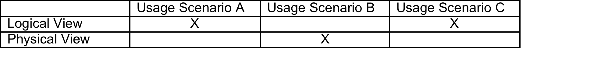
Why do we need a Climate Monitoring Architecture?
Three main "needs/usage scenarios" have emerged for a climate monitoring architecture:
  Assist in promotion of a common understanding of the implementation implications of meeting the various space-related climate monitoring requirements (e.g. from GCOS)
  To support an assessment of the degree to which the currently implemented systems meet the requirements (and the generation of an action plan to address identified shortfalls/gaps/duplication)
  To improve our understanding of the end-to-end information flows and dependencies (i.e. from sensing through to decision-making)
Notes:
23
23

Slide 24
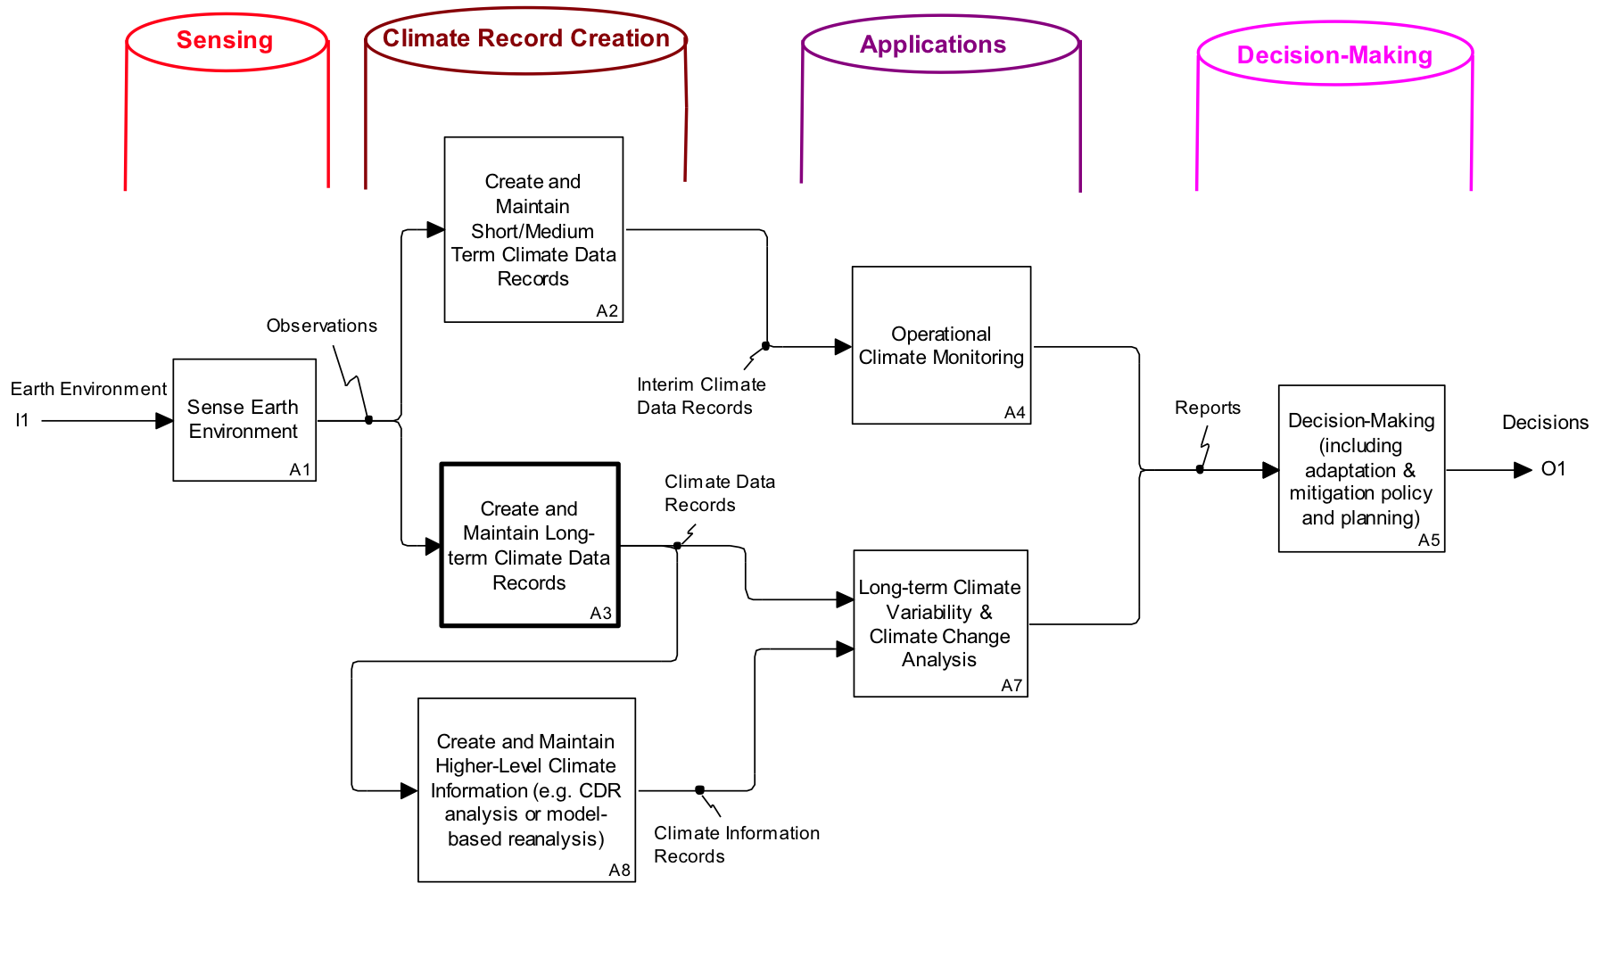
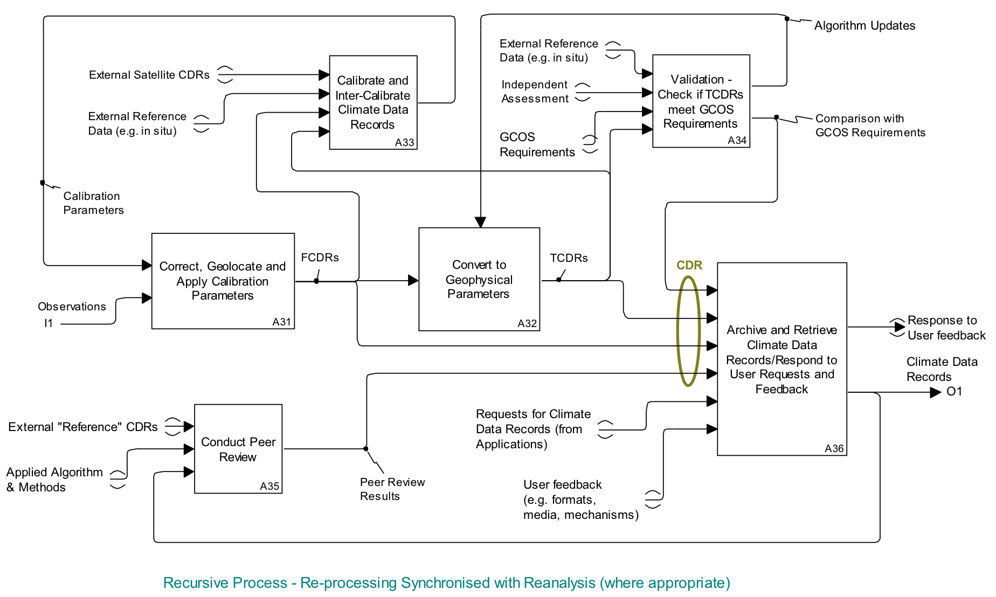
Logical representation of CMA
Traceable to GCOS Guidelines and GCOS Climate Monitoring Principles
Traceable from ECV Inventory and physical representation of Climate Monitoring Architecture

Slide 25
Way Forward
Define, Validate and Obtain Consensus on Overall Approach
Short-term
(within 2 years)
Describe Current and Planned Implementation Arrangements (ECV-by-ECV) within the Physical Architecture
Medium-term
(2-4 years)
Use the Physical Architecture to Develop a Coordinated Action Plan to Address Identified Gaps/Shortfalls

Slide 26
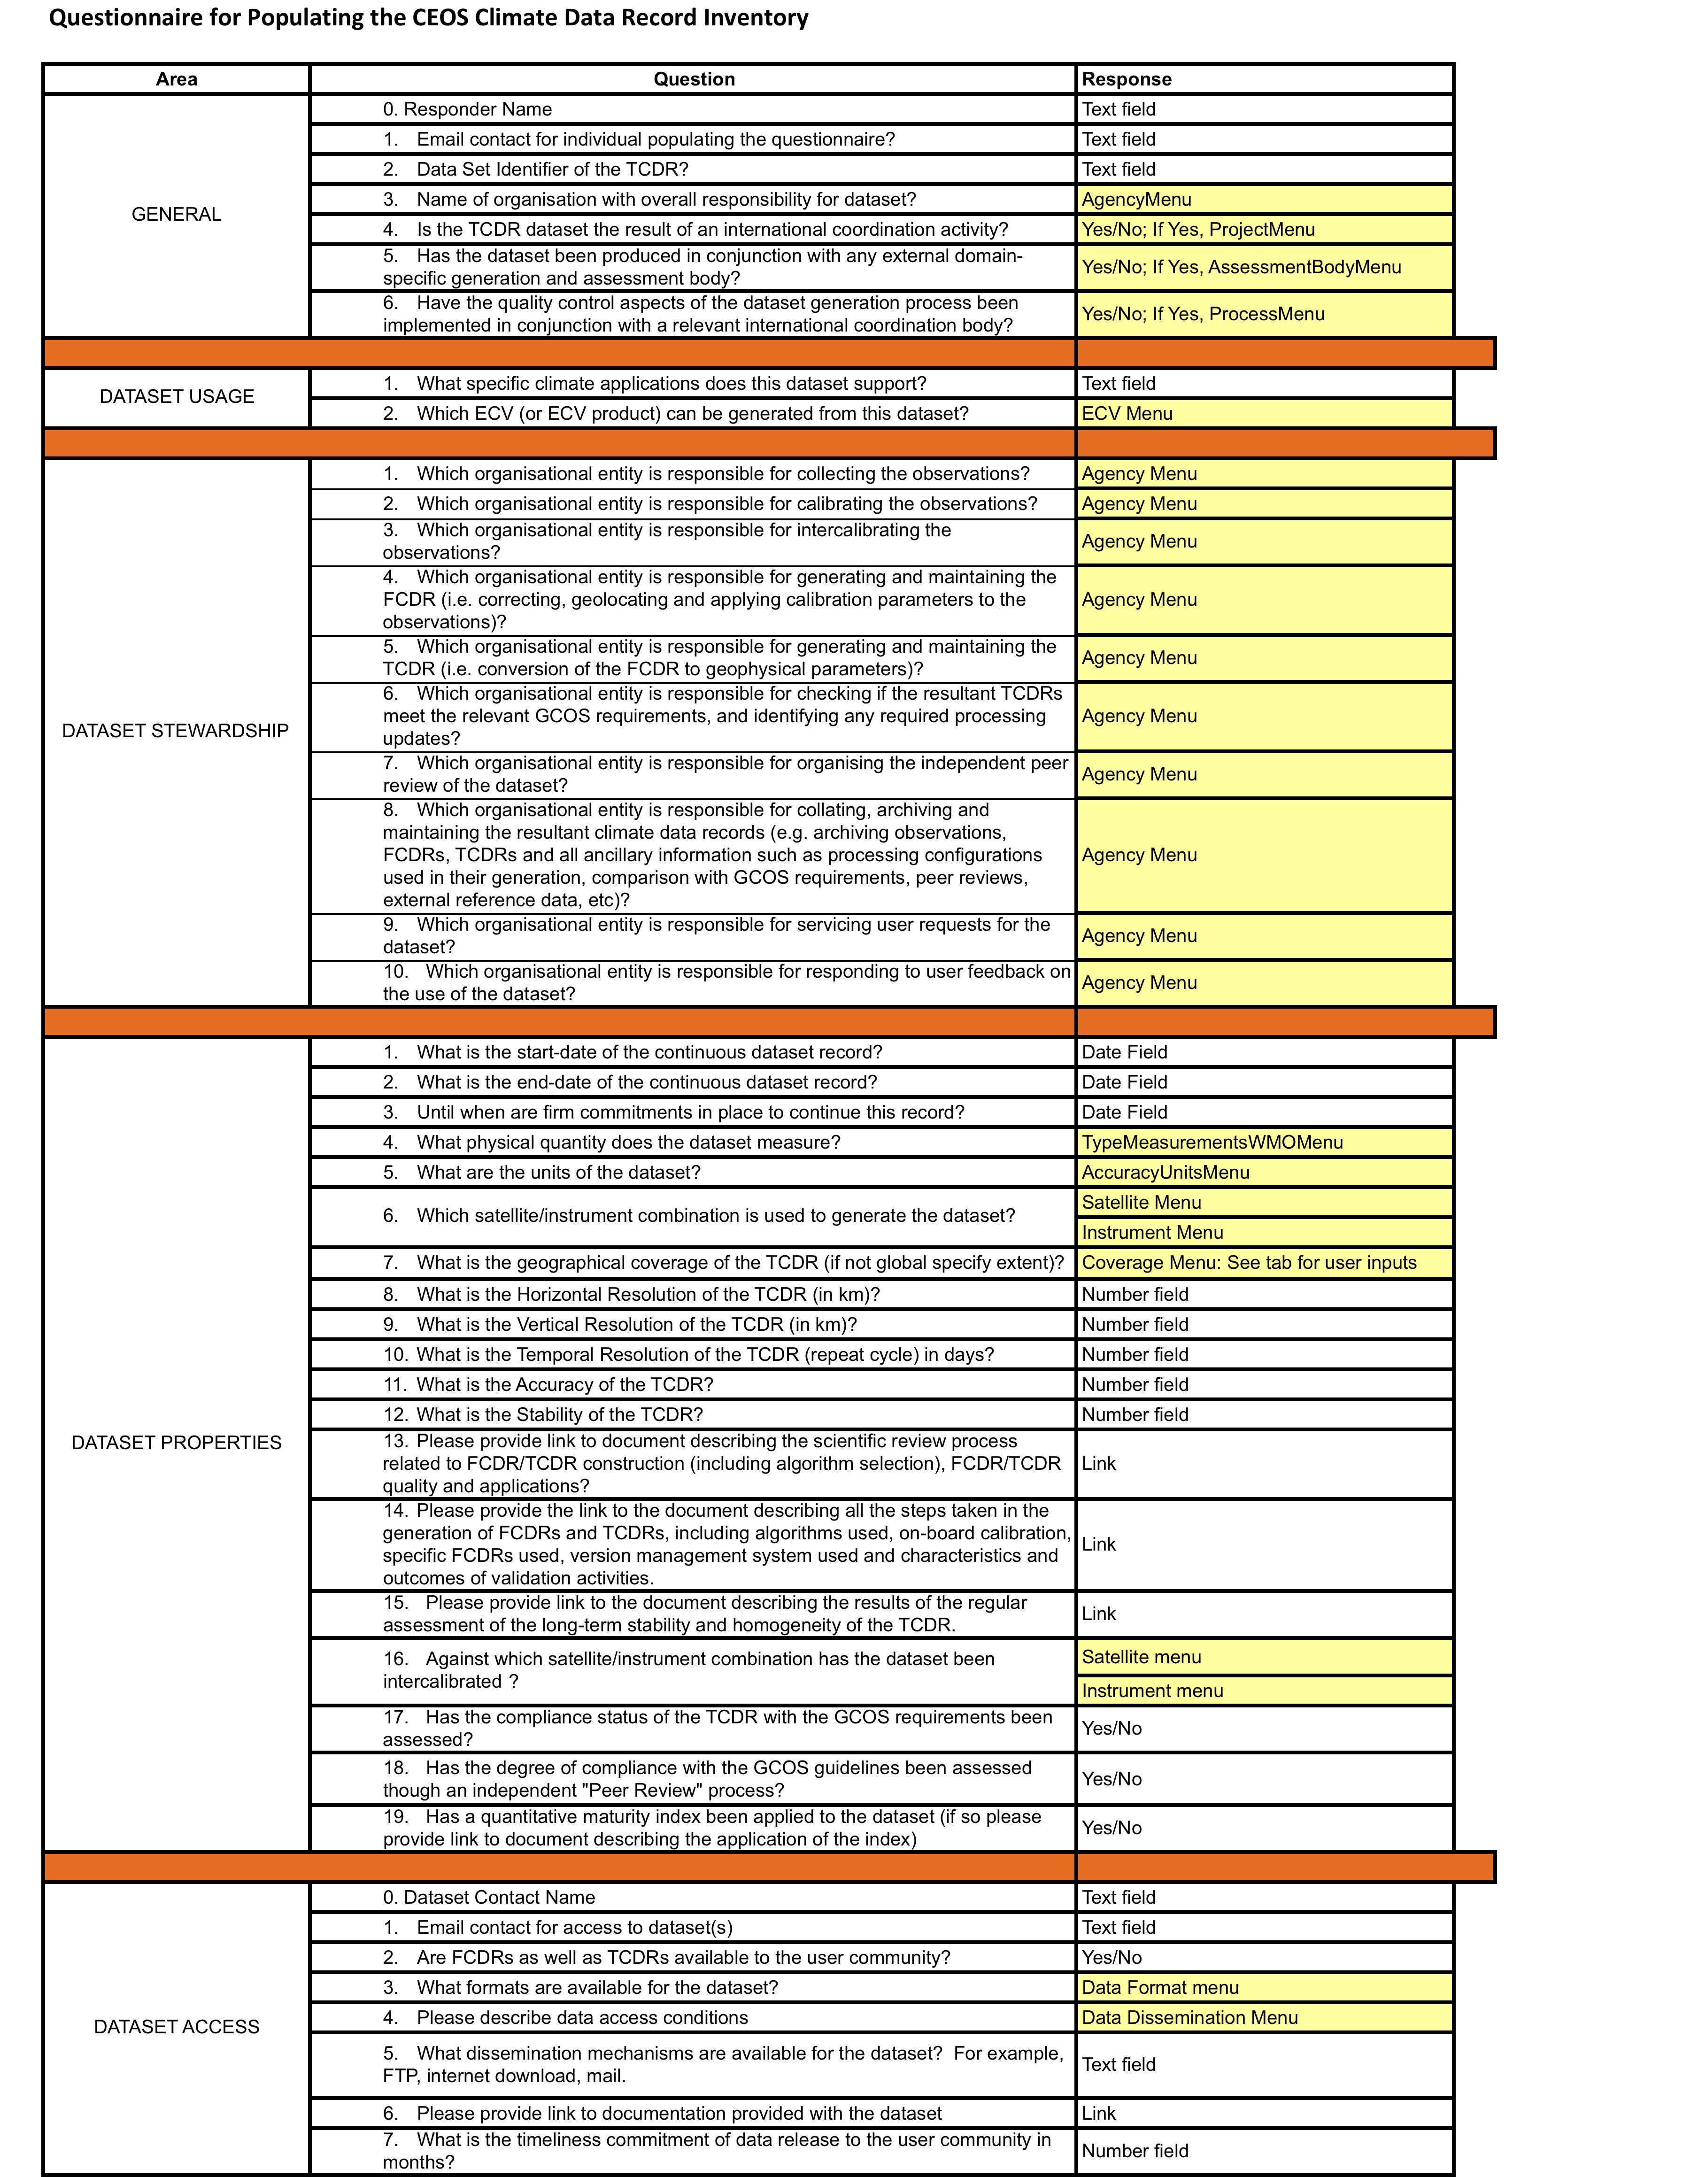
ECV Inventory Questionnaire
Joint activity with CGMS and WMO
Call released with MIM in May, responses expected by October
Questionnaire form – through a web interface.
Responses are requested at the dataset level
Addresses both existing/past missions and future/planned mission in two separate questionnaires
Areas:
  General
  Dataset Usage
  Dataset Stewardship
  Dataset Properties
  Dataset Access

Slide 27
Priorities: Output and Activities
Outputs
  Strategy document defining a climate monitoring Architecture for space based observations – with external partners (CGMS & WMO) and forming the basis for future activities
  ECV Inventory – the broad-brush perspective, foundation for the physical representation of the Architecture
  Establishing a consensus “Maturity Matrix” – to assess status of ECV CDRs and monitor progress
Activities
  ECV assessments and sustained production roadmaps – here strong link to VCs and WGs
  Outreach to modelling community
  Improving linkages between research and operational programmes

Slide 28
Support for WGClimate
CEOS VCs
  Assistance in coordinating / “encouraging” completion of questionnaires for ECV Inventory (Physical Architecture)
  Assistance in coordinating ECV assessments - including with external domain specific partners
  Development of ECV sustained production roadmaps
  Interpretation of results from ECV Inventory – gap analysis and prioritizing response
CEOS WGs
  Assistance in aspects linked to Cal/Val and QC, including assessments (WGCV)
  Optimizing exposure of results from ECV Inventory (WGISS & WGCapD)

Slide 29
WGClimate’s current VC “understanding”
VC | Relevant ECVs
SST | Sea Surface Temperature: VC plan specifically targets ECV/CDR generation. SST-VC could be used as a pilot study for ECV assessment and implementation.
OCR | Ocean Colour: VC plan specifically targets ECV/CDR generation. Very positive symbiotic relationship with IOCCG, which is in process of establishing standing WG on ECV assessment.
OST | Sea Level: Potentially excellent example combining the VC with the OST Science Team, as with OCR.
OSVW | Wind Speed & Direction: OSVW has been very focused on operational needs.
PC | Precipitation: Not currently within mandate but interested to discuss possibility.
LSI | Land Cover, FAPAR, LAI, Albedo: Not currently within mandate.
ACC | Ozone, Aerosols: ACC in process of discussing possibility of taking on Ozone ECV responsibility - currently undecided. ACC doesn't currently have adequate representation to address aerosols.

Slide 30
Scale of Effort
Our requests through SIT to CEOS member Agencies
ECV Inventory (URGENT): CEOS Agencies are asked to provided the necessary resources for the completion of the ECV Inventory in a timely manner. Questionnaires are to be compiled at the level of a single dataset (TCDR). We expect 30-40 minutes /questionnaire / dataset. The larger Agencies may have 100+ datasets.
ECV Assessments: CEOS Agencies are requested to provide adequate resources to initiate systematic assessments of ECV datasets. Where appropriate through the VCs (maybe based on identified pilots) but also through independent bodies such as WCRP for ECVs not currently covered by CEOS VCs.
ECV roadmaps for sustained product generation: CEOS Agencies are requested to provide dedicated resources for specific pilots to produce Roadmaps for sustained ECV production. A more systematic request for this topic will come following the establishment of the first rendition of the Physical Representation of the Climate Monitoring Architecture.

Slide 31
VC role with ECVs
The hope is that ECVs are compelling enough to CEOS agencies with relevant missions to influence programmatics
VCs have domain expertise to recommend climate quality standards (eg GCMPs) for sensors, cal-val etc. As well as gap filling.
Progress requires a new dynamic via SIT such that VC recommendations are heard, elevated and acted upon as far is possible in agency programmes
  This has not always been the case in the past
Original VC concept suggested a form of accreditation – whereby missions/countries are recognised as meeting criteria to be part of a certain VC
  Is this the way to go?

Slide 32
SST-VC support to ECV coordination & development
Lessons in approach
SST-VC Presentation

Slide 33
SST-VC Background
The SST-VC is implemented through the long-standing Group for High Resolution SST (GHRSST)
Since its inception in 2000, GHRSST has included not just operational, near-real time data streams, but also climate data records in its scope
A Technical Advisory Group for reprocessed data was established at the start
“Climate thinking” was factored into GHRSST Data Product Specifications (GDS) from the beginning
Data products were brought together physically and archived
Intercomparison systems were developed AND used
User feedback was solicited and acted upon

Slide 34
SST-VC Lessons Learned
Define a product specification and require its use
  Don’t be afraid of large volumes
  Use CF/ACDD-compliant netCDF-4 (within internal compression and chunking)
  Develop tools and teams to help your Producers get it into that format
  Standardize what you can – and what you can’t, standardize the container and the description of it
  Use ISO 19115-2 collection-level metadata
Make sure the operational products are archived and accessible, even if not “climate quality”
  You’ll need these to demonstrate how much better your reprocessed data sets are (or are not)
  You may need them as first guesses in your climate-quality algorithms
Define an ECV Product Framework and be inclusive (at first)
Then when you really understand the playing field…
  Define a more rigorous ECV Data Processing Framework that sets a higher standard for products to be considered vetted and community consensus climate data records
Remember you will likely need multiple climate data records
  No one product will typically be able to fill all user needs

Slide 35
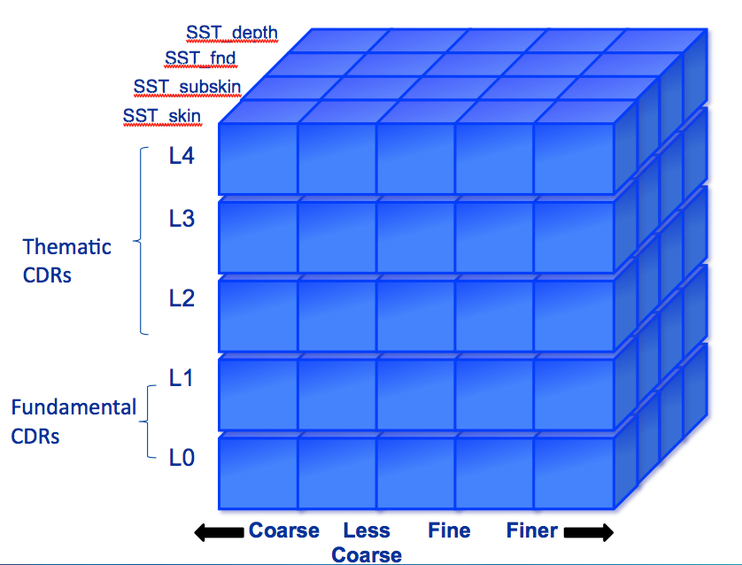
SST-VC ECV Status
GHRSST and the SST-VC current transitioning from an inclusive ECV Product Framework to a more rigorous ECV Data Processing Framework (DPF)
ECV Product Framework
NOAA CDR Program Requirements
ESA CCI Requirements
GCOS-SST and Sea Ice WG
GHRSST CDR-TAG
GHRSST GDS2
And other inputs…
+
=
SST ECV DPF

Slide 36
OCR-VC support to ECV coordination & development
Lessons in approach
OCR-VC Presentation

Slide 37
New sensors
New in situ data
New algorithms
New algorithms
New products
Algorithm intercomparison
Algorithm selection
Product generation
Data merging
New insights
Iterative Loop
Internal Evaluation
External evaluation (e.g., IOCCG)
User Feedback
Lesson Learned: Important to include periodic intercomparison, update of algorithms and reprocessing of OC-products as science progresses

Slide 38
The intangibles: the team spirit, the community engagement
The lessons learned:
Keep the user community engaged
Periodic revisit of algorithm selection process and reprocessing
- responsive system requirement
- continued and continual scientific input to system
engineering and product generation

Slide 39
GFOI/FCT Implementation Requirements
Brief presentation

Slide 40
GFOI presentation
The SDCG is dedicated to coordinated acquisition strategy to ensure capture of the necessary data
GFOI IP foresees sample national datasets for pre-operational GFOI to demonstrate kind of support countries can expect
  Data compiling, processing and delivery support needed
  18 month horizon
  LSI & WGCV LPV?
Further needs
  Evolution of FCT portal to monitor and report acquisitions and to allow data discovery – in support of SDCG++
  GFOI-branded Methods & Protocols documents could use WGCV expertise

Slide 41
GCI and DataCORE Implementation Requirements
Brief presentation

Slide 42
Main CEOS expectations w.r.t. to GCI and Data CORE
Ensure that EO data sets are easily discoverable and accessible
  Free access to the set of EO data & products catalogues
    - Ideally one-stop-shop = 1 single query to interrogate all catalogues + 1 aggregated response from all catalogues
    - Data CORE datasets easily identifiable
  Easy access to data & products (for both Data CORE and other datasets)
    - Information of Repositories’ locations and access methods to be included in “data & products catalogues”
  - WGISS to continue development of CWIC incl. interface to GCI,
  - IDN team: check catalogues & repositories URL; study inclusion of data access information easily exploitable, in GCMD records.
  - VCs and Project Teams: offer federated view for data discovery + access (similar to GEO Web Portal)
Increase awareness of potential users on the use of EO data
  Provide all necessary information related to data sets:
    - Fields of applications + examples of use, information on data quality, information on data policy
  - WGCBDD to provide information on fields of applications, articles on data use, etc
  - WGCV to work on data quality (QA4EO) and make sure information is available with data sets
  - IDN team: study inclusion of data policy information in GCMD records.
to do
to do

Slide 43
Other CEOS Priorities
Any points in relation to….
Supersites & DRM
  CEOS support to the GEO Supersites initiative is coordinated acquisition and provision of space-based data over selected sites – the supersites.
  Implementation planning under CEOS lead
    process definition for Supersite selection (May 2012)
    Definition of a process for obtaining data (May 2012)
    Initial selection of National Laboratories/Supersites (July 2012)
    Initial coordinated data set provided by CEOS (Nov 2012)
JECAM & GEO-GLAM
Data Democracy
Carbon/Water/Biodiversity

Slide 44
CSS VC report – 3 year targets
VC/WG | 3-year outcomes
ACC | Improved volcanic aviation forecasts. Updated AQ Constellation Paper. 1 or more harmonised ECV activities (starting with total ozone). Implementation of CEOS Carbon Strategy of interest.
LSI | Mid resolution guidelines document will be finalised soon. Use models will be developed in support. Re-focused LSI portal. On-going support to FCT/GFOI and JECAM.
PC | Deployment of GPM phase constellation satellites and maintaining continuity with TRMM. Advocacy of post-GPM phase PC . Possible PC portal under study.
OST | Evolution towards incorporation of surface water hydrology into OST. Looking at lakes and rivers as well – bringing in research systems (SWOT) combined with operational. Jason-3 realised and Jason-CS conceptual plan. Prepare users for new products (SAR mode, coastal products) and new technology (SWOT). Continue to ensure improved access and use of constellation products.
OSVW | Second and likely a third training workshop. Demonstration of a single point-of-access for data.
OCR | Establishment of INSITU-OCR. Report of the OCR product uncertainty

Slide 45

BREAK
15 minutes break
Resume with individual VC & WG presentations (5 mins)

Slide 46
Individual VC & WG Reports

Slide 47
VC & WG reports
Brief, ~ 5min reports following common format
  Possible targets, status
  Opportunities and obstacles
  VC needs – linkages and resources
  Highlight list for SIT
Exploratory and using examples, not binding
  Highlight issues ahead
  VC & WG scope and opportunities recognised as very different
VCs: OCR, SST, OST, OSVW, LSI, ACC, PC
WGs: WGISS, WGCapD, WGCV

Slide 48
Implementation Targets & Issues
Ocean Colour Radiometry Constellation
CEOS VC & WG WORKSHOP
26-28 March 2012
La Jolla, California, USA

Slide 49
Target
Support towards the water-leaving radiance and chlorophyll-a concentration ECVs
  IOCCG established standing ECV Working Group (September 2011); at annual meeting (28 February – 1 March 2012) identified participants and initial tasks - Co-chairs Nicolas Hoepffner (JRC, Italy) & Jim Yoder (WHOI, USA)
        Answer request from CEOS to evaluate ECVs; need for having this done in an independent, systematic and recurrent way.
        GCOS-compliant global OC ECV products are very valuable inputs for climate studies.
  International Network for Sensor InTercomparison and Uncertainty assessment for Ocean Color Radiometry (INSITU-OCR)
        Concerted inter-agency/international effort on activities relating to sensor inter-comparison and uncertainty assessment of datasets required for the OC ECV generation
        Co-leads are Giuseppe Zibordi (JRC, Italy) & Sean Bailey (NASA GSFC, USA)
        First workshop for writing team February 2012 at NASA GSFC
        Draft strategy/white paper April 2012
  Mission Requirements for Future Ocean Color Sensors – Level 1 requirements IOCCG report (Draft) – comments due 31 March 2012
  International Ocean Color Science Team Meeting – targeted for 2013

Slide 50
OCR Sensing Capacity
IOCCG Level 1 Requirements Report
External
Requirements
e.g. GCOS
International Network for Sensor Inter-comparison
and Uncertainty assessment (INSITU-OCR)
IOCCG Standing Working Group
on ECV Assessment
Roadmap for sustained OCR-ECV
production
OCR Climate Data Records

Slide 51
Target
Objective 5 of the OCR-VC Implementation Plan is "Capacity Building and Outreach”
  IOCCG Summer Lecture Series, (2-14 July 2012, http://www.ioccg.org/training/upcoming.html)
  96 applicants from 38 countries so far (16 slots)

Slide 52
Status
Current status, known schedules
  IOCCG ECV working group – seven actions identified, including develop an ECV roadmap with milestones for completion of first assessment (2-year time frame, i.e. IOCCG in 2014), establish criteria to be satisfied by OCR ECV products and recommend actions needed to ensure quality/consistency required by GCOS.
  INSITU-OCR white paper delivered April 2012
  Time series work/ECV work: Individual funded efforts are ongoing within multiple agencies for radiance and chl a data sets (polar orbiters), e.g., OCTS, SeaWiFS, MODIS-Aqua, MERIS, OCM-2, Suomi NPP VIIRS
Key players - ESA, Eumetsat, ISRO, JAXA, NASA, NOAA
Programs - ESA CCI, NASA MEaSUREs, Instrument science teams
Relevant budgets and resources in play - aforementioned list of programs
Particular issues to note
  Coordination of individual efforts among agencies
  Implementation of IOCCG Level 1 requirements report to ensure ECVs
  INSITU-OCR – experts know what to do and strategic planning underway, but will agencies support implementation?

Slide 53
Opportunities & obstacles
The role open for CEOS
  could provide the framework to establish some basic requirements for ensuring ECVs
  enable data exchange among CEOS agencies
  provide framework to ensure resources for INSITU-OCR
  facilitate collaboration on different projects producing time series of ECVs
Approach, emphasis required by the VC/WG
  VC needs to work with the CEOS agencies to agree on implementation of Level 1 requirements report to enable a long-term ocean color radiometry record
  VC needs to work with IOCCG on implementation of INSITU-OCR once strategic plan is complete and approved
  IOCCG ECV working group needs to review GCOS OC ECVs

Slide 54
Opportunities & obstacles
International Ocean Color Science Team Meeting
  Community listening session by IOCCG/OCR-VC – 23-25 April 2012 at the NASA Ocean Color Research Team Meeting (Seattle, WA, USA)
  Community listening session by IOCCG/OCR-VC – 3rd MERIS/(A)ATSR & OLCI/SLSTR Preparatory Workshop, 15-19 October 2012

Slide 55
Opportunities & obstacles
Any issues for SIT & Principals to help resolve in relation to the VC/WG
having the potential to fulfill the proposed role
Resolution of data exchange as no one agency can be expected to perpetuate ECVs
as with the remote sensing data, the INSITU-OCR is a critical component to achieving ECVs; will the agencies agree to implement this also?
Need clearer understanding of how resources (financial and manpower) may be forthcoming at individual CEOS-member agency level to support ocean color harmonization activities

Slide 56
Needs & issues for SIT attention
Skills, resources
  See previous slides
list particular concerns and issues that VCs/WGs wish to bring to
the attention of SIT & CEOS Principals in moving forward to support
CEOS implementation
  See previous slides – particularly last two

Slide 57
Implementation Targets & Issues
Sea Surface Temperature VC
SST-VC Mission: To foster the best quality SST data for applications
in short, medium, and decadal time scales in the most cost effective
and efficient manner through international collaboration, scientific
innovation, and rigor.
Kenneth S Casey (NOAA)
Craig Donlon (ESA)
CEOS VC & WG WORKSHOP
Mon 26th March 2012
La Jolla

Slide 58
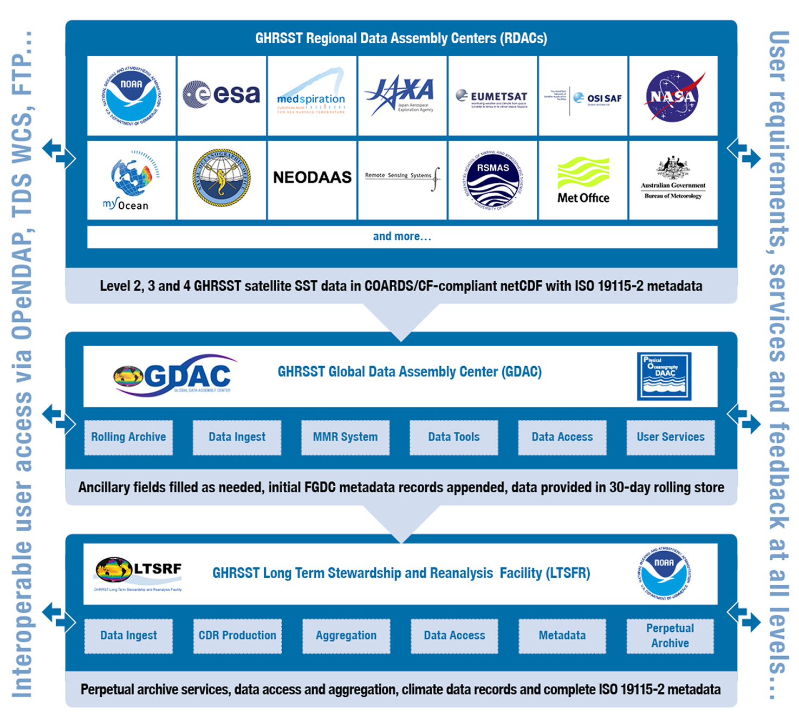

Background on SST-VC
The SST-VC is implemented through the existing Group for High Resolution SST (GHRSST)
The SST-VC is GHRSST’s formal connection to CEOS
Notes:
To understand the way the SST-VC plans to achieve its objectives, it is important to understand that it is implemented through the existing Group for High Resolution SST. The SST-VC is the formal connection between GHRSST and CEOS.
So, the SST-VC is implemented

Slide 59
Target
SST-VC Implementation Targets:
Continued support to an extensive user community with established and functional systems and services
Stronger CEOS Agency SST activities through better synergy and communication
Wider participation of CEOS Agencies in SST related activities
Better SST product and service interoperability building on the strengths of CEOS Agencies
Better data access and product applications by CEOS Agencies
Value for money to CEOS Agencies by capitalising on the already committed investments made to GHRSST
Reduced duplication of coordinating activities
A stable and secure rapid spin up of SST-VC activities.

Slide 60
Status
- Full schedule in SST-VC Implementation Plan
- Resources required mainly involve members’ time
- Main issues: travel funds and ensuring continued agency commitment
Activity | Status
1. Implement and manage the SST-VC | CEOS approved new VC at 2011 plenary; initial members appointed; 1st meeting in June in parallel with GHRSST-13
2. Minimize duplication of existing activities | Initiated through VC proposal and GHRSST
3. Develop and optimize the SST constellation | OceanObs ‘09 White Paper published, paper to be drafted
4. Develop and implement metrics for SST services, products, and users | User Requirements Document published
5. Coordinate consensus SST reference documents | GHRSST Data Specification 2.0 (GDS2) published/updated
6. Encourage timely access to products | Ongoing
7. Develop and improve the satellite SST ECV | ECV “cube” documented; SST-VC as WG Climate pilot; ECV Data Processing Framework in development; ESA SST_cci project funded and ongoing
8. Improve SST calibration, inter-calibration, and validation | Ongoing
9. Improve user feedback to CEOS Agencies | Ongoing
10. Develop training activities for satellite SST practitioners | New activity, NOAA/NODC has volunteered to lead and will present framework at first SST-VC meeting in June
11. Liaise with the other VCs | New activity, participated in precursor all-VC telecon
12. Prepare VC Implementation Plan for CEOS | Submitted to CEOS for approval at SIT-27

Slide 61
Opportunities & obstacles
Opportunities | Obstacles
CEOS can enable fuller participation in the SST-VC by CEOS Members having SST capabilities/interests | SST-VC is new and Agencies need to provide active representatives
CEOS can help ensure agency commitments are sustained over time | Sustained funding for ongoing SST-VC/GHRSST activities
CEOS can help ensure agency support for travel to coordination meetings is in place | Loss of key people leading SST-VC/GHRSST activities always a risk
Notes:
- The role open for CEOS
- Approach, emphasis required by the VC/WG
- Any issues for SIT & Principals to help resolve in relation to the VC/WG
having the potential to fulfill the proposed role

Slide 62
Needs & issues for SIT attention
Need CEOS SIT and Principals to follow words with actions
  For example: provide travel funding to CEOS coordination meetings
  For example: Agencies need to provide active, committed members to participate in the VC activities
Need CEOS SIT and Principals to help with transitions
  Remove single points of failure by supporting multiple participants at GHRSST working meetings and CEOS coordination meetings, so all expertise is not concentrated in one individual alone
  Ensure sustained support as activities transition from research to operations (and back to research as operational data streams enable new science and product development)

Slide 63
Implementation Targets & Issues
OST VC
Co-Chairs
Eric Lindstrom, NASA Headquarters
Francois Parisot, EUMETSAT
CEOS VC & WG WORKSHOP
Mon 26th March 2012
La Jolla

Slide 64
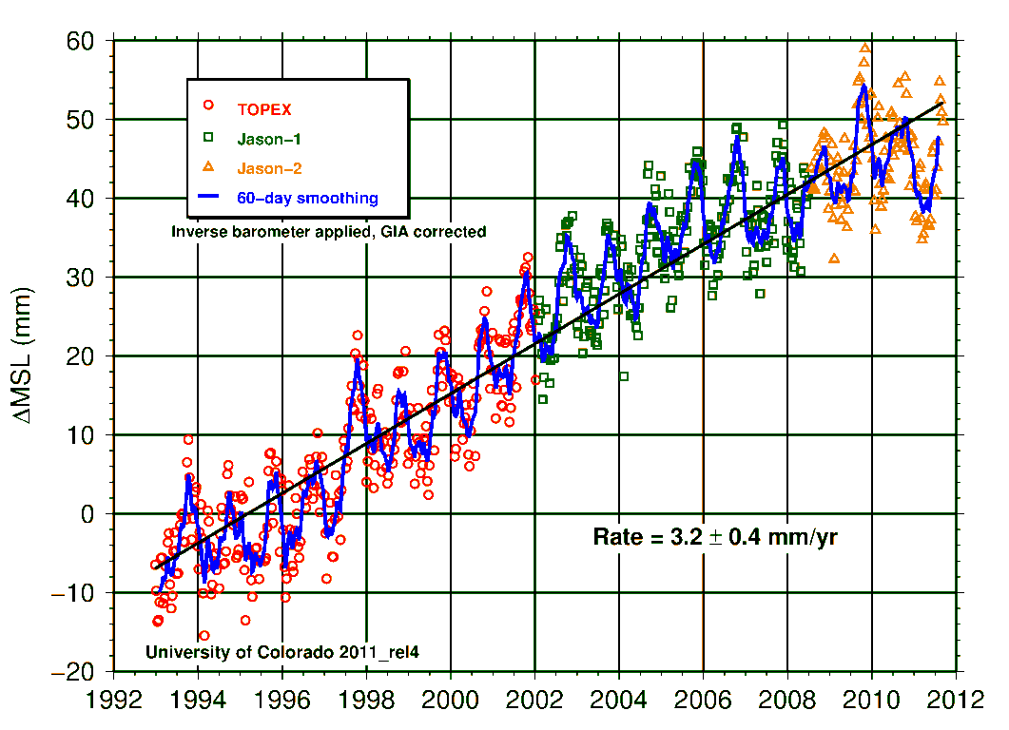
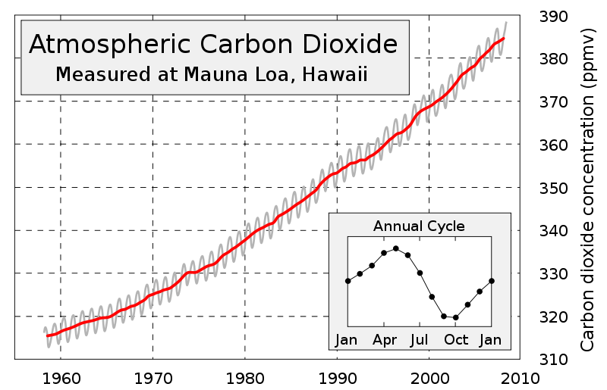


Jason Satellites – Building a Key Climate Record
Globally Averaged Sea Level Rise
Only the Jason series satellites have the sufficient accuracy for climate
Effect
rate = 3.2 mm/yr
Cause
It is only by continuity across missions that we are able to achieve this fidelity

Slide 65
Patterns of Global Sea Level Change
1993-2009 trend in Sea Level
Complex patterns of decadal sea level change reflect changes in ocean currents and storage of heat. Overlap of missions is required to keep centimeter accuracy over multiple decades
Notes:
The linear trend of sea level change during 1993-2009 computed from the data collected by T/P, Jason-1, OSTM, ERS-1, -2, and Envisat. (from Willis et al., 2010).

Slide 66
Target
Support towards the Sea Level ECV
  The primary mission of OST VC has been to monitor and promote required reference missions and complimentary altimeter missions to maintain the ~20 year time series of global sea level record from space.
  Scientific guidance for Sea Level ECV is incorporated into the “charter” of the Ocean Surface Topography Science Team (OSTST). The “charter” is the four-party agreement for the Jason-2 mission of NASA, CNES, NOAA, and EUMETSAT.
  Generation of the Sea Level ECV is a research activity broadly supported and enhanced by the work of OSTST but not currently “managed” or “documented” as an OST VC activity.
  Data systems and software tools support the Sea Level ECV include NASA PODAAC, AVISO, RADS, ….

Slide 67
Status
Current status, known schedules (attached in next slide)

Slide 68
GLOBAL ALTIMETER MISSIONS
Launch
Date
08
09
10
11
12
13
14
15
16
17
18
19
20
21
22
Reference Missions - Higher Accuracy/Medium Inclination
12/01
Jason-1 Fr./USA
Jason-3 Europe/USA
Jason-2 Europe/USA
Jason-CS Europe/USA
Complementary Missions - Medium Accuracy/Higher Inclination
3/02
Sentinel-3A Europe
Sentinel-3C/D
ENVISAT Europe
Sentinel-3B Europe
Saral/AltiKa Fr./India
HY-2A China
HY-2B China
CRYOSAT-2 Europe
2/98
GFO USA
GFO-2 USA
Broad-Coverage Mission
SWOT USA/France
Design Life
Extended Life
Approved
Proposed
Operating
fp March 2012

Slide 69
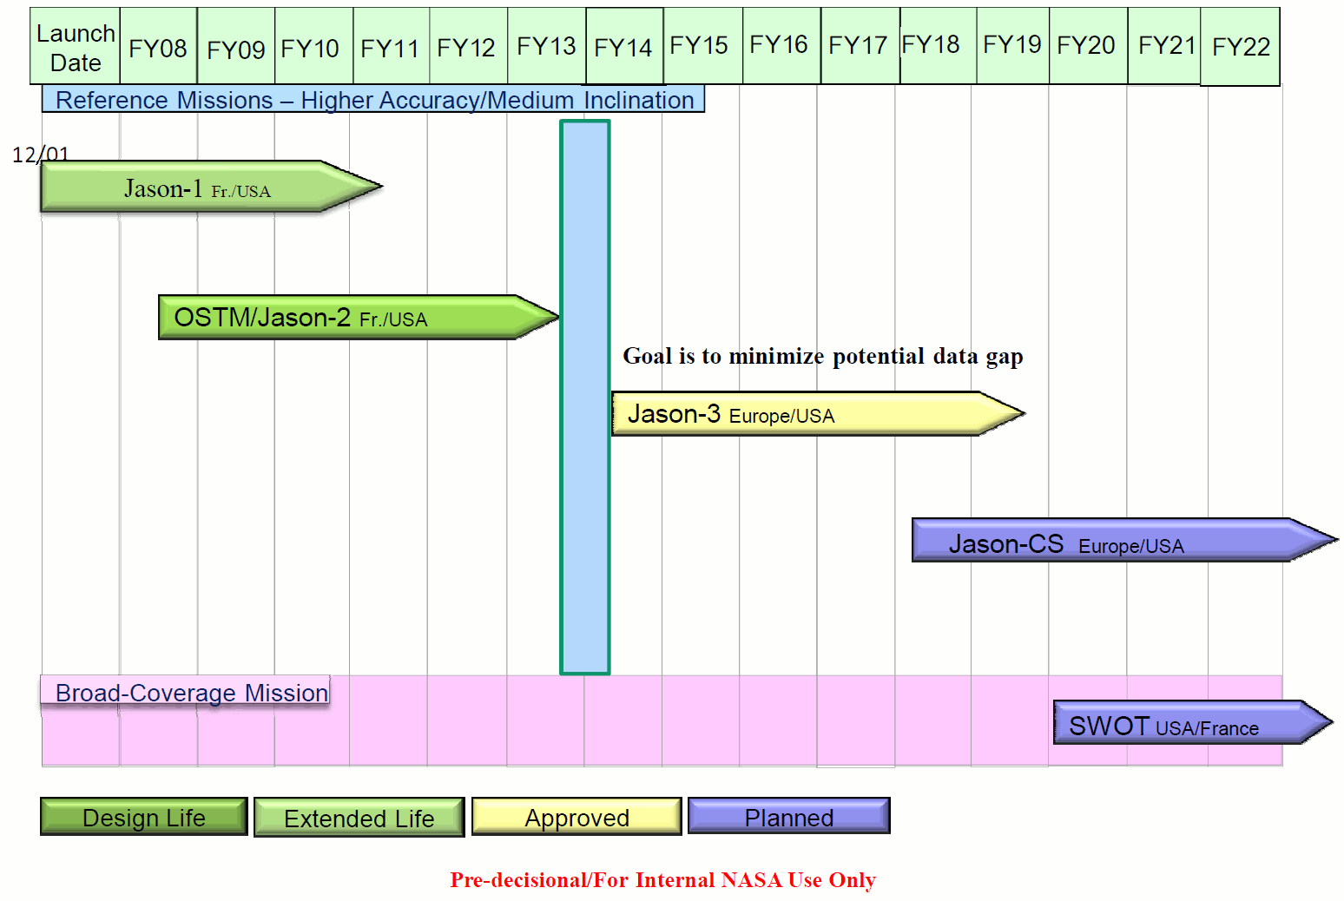
Precision Altimetry Missions
Climate Science applications require continuity and the potential for a gap will grow with any delay of Jason-3
Although Jason-2 is healthy now, solar minimum is ending and current 2014 launch requires 6.5 year Jason-2 lifetime to allow for sufficient overlap

Slide 70
Status
Key players, programs
  Reference Missions/Jason Series – NOAA/NASA, EUMETSAT/CNES, ESA
  Complimentary Missions/Other Altimeters – ESA, CNSA, ISRO
- Relevant budgets and resources in play
  NASA/CNES/EUMETSAT Ocean Surface Topography Science Team (re-compete in process in 2012 with new team in place for 2013-2016).
Particular issues to note
  OSTST meeting in October 2011 agreed in principle to OSTST taking on the role of OST Virtual Constellation.
  Need to develop implementation plan for OST VC for CEOS during 2012.
  Not all altimeter agencies are formal members/participants in OSTST (ESA, ISRO, CNSA…)

Slide 71
Opportunities & obstacles
The role open for CEOS
  CEOS can help leverage greater participation in the current OSTST
- Approach, emphasis required by the VC
  The current OST VC is a group of agency representatives who report annually on the status of altimetry missions (“the constellation”)
  It is anticipated that the new OST VC would report more frequently, address issues related to the Sea Level ECV, and precipitate constellation data and mission issues for CEOS SIT consideration.
- Any issues for SIT & Principals to help resolve in relation to the VC
having the potential to fulfill the proposed role
  How do we transform OSTST from a multi-agency funding-driven construct into a CEOS mechanism for international involvement. (analogue to GHRSST for SST)?

Slide 72
Needs & issues for SIT attention
Skills, resources
  There are ample skills, resources, and connections within OSTST to address the issues of a CEOS OST VC.
List particular concerns and issues that the VC wishes to bring to
attention of SIT & CEOS Principals in moving forward to support
CEOS implementation
  Adoption of OSTST as OST VC requires commitment from lead OSTST agencies to devote some of the current resources to OST VC administration and services.
  Adoption of OSTST as OST VC requires involvement in OSTST from agencies that fly “complimentary missions” that are not presently formal members of OSTST (OSTST meetings are open so, in some cases, this is not a matter of participation, e.g. ESA)

Slide 73
Implementation Targets & Issues
OSVW VC
Paul Chang – NOAA
Hans Bonekamp – EUMETSAT
B.S. Gohil - ISRO
CEOS VC & WG WORKSHOP
Mon 26th March 2012
La Jolla

Slide 74
Target
Support towards the Ocean Surface Vector Wind ECV and the Essential Ocean Variable (EOV)
  Continuity of OSVW data
    Consistent reprocessing of full missions
    Continuity of C-band and Ku-band measurements
    Coordination of orbit selection for future missions
  Cross-calibration/validation of ERS, ASCAT, QuikSCAT and OSCAT and other planned OSVW sensors
  Improve utilization in marine forecasting and warning services in support of the International Convention for the Safety of Life at Sea (SOLAS) and the Global Maritime Distress and Safety System (GMDSS).
  User outreach and training
    Improves utilization of available data and strengthens/builds user support for future missions

Slide 75
Status
Current status, known schedules (see also graphic on next slide)
METOP-A/ASCAT (operating nominally)
Oceansat-2/OSCAT (operating nominally)
QuikSCAT (operating non-nominal)
HY-2A/China-SOA (operating nominally)
METOP-B/ASCAT (May 2012 launch) and METOP-C/ASCAT (launch 2017+)
OSCAT Follow-On (2015 launch)
METOP-SG/ASCAT Follow-on (launch 2022+)
HY-2B/China-SOA (launch 2014) and FY3E/China-CMA (launch 2016)
METEOR-M3/Russia-ROSH/ROSC (launch 2015) and METEOR-MP3 (launch TBD)
Key players, programs
EUMETSAT, ISRO, NASA, ESA, NOAA, not yet engaged: (SOA, CMA, ROSH/ROSC)
Relevant budgets and resources in play
  Individual agency budgets which are focused on agency objectives first
Particular issues to note
  No dedicated funding to support/promote cross-platform calibration and validation toward ECV and EOV objectives at the CEOS/SIT level
  Need active engagement by China (SOA and CMA) and Russia in CEOS/SIT

Slide 76
Status
GLOBAL SCATTEROMETER MISSIONS
Launch
Date
08
09
10
11
12
13
14
15
16
17
18
19
20
21
22
C-band
10/06
METOP-A Europe
METOP-C Europe
METOP-B Europe
EPS SG Europe
Ku-band
6/99
QuikSCAT USA
OSCAT Follow-on India
Oceansat-2 India
CFOSat China/France
HY-2A China
HY-2B China
Meteor-M3 Russia
Combined C- and Ku-band
GCOM-W2, -W3 with DFS Japan/USA
FY-3E with 2FS China
Operational Series with 2FS India
Design Life
Extended Life
Extended
Design LIfe
Extended
Proposed
Operating
Approved
sw 13apr11

Slide 77
2nd and 3rd Training Courses – Use of Satellite
Wind & Wave Products in Marine Forecasting
(User Outreach and Training)
Status
Operational centers in developing countries do not typically use satellite wind & wave (SWH) products in marine forecasting
  Lack of knowledge on availability and understanding of satellite data sets
  Difficulties in accessing, displaying and manipulating satellite data sets
A 2nd training course was held 5-9 December in Oostende, Belgium at the International program on Oceanic Data Exchange (IODE) center sponsored by EUMETSAT with instructor support from NOAA, MeteoFrance and KNMI:
  The targeted students were European forecasters (mostly from the Mediterranean Sea region).
A 3rd training course will be held in May 2012 at CPTEC in Brazil sponsored by CPTEC and NASA with instructor support from EUMETSAT, NOAA, KNMI and MeteoFrance
  Focus on major South American forecast centers and researchers
  Promote knowledge on understanding and availability of wind and wave satellite datasets
  CPTEC utilizes GEMPAK/NAWIPS (NWS software platform) and is willing to support implementation in weather centers in other South American countries.

Slide 78
Opportunities & obstacles
Approach, emphasis required by the OSVW-VC
  Coordination of existing activities and advocate as appropriate for additional activities
    Planning OSVW-VC meeting during IOVWST meeting in June 2012 to engage larger OSVW community.
    Provide the international cooperation justification in helping members in seeking resources from their respective agencies
    Continue outreach and user training activities
- Any issues for SIT & Principals to help resolve in relation to the OSVW-VC
having the potential to fulfill the proposed role
Continue to promote importance and encourage engagement of CEOS activities down within respective agencies
Reach out to China (SOA and CMA) and Russia to encourage CEOS/SIT engagement with respect to their planned OSVW missions

Slide 79
Needs & issues for SIT attention
Skills, resources
We have the right people in the OSVW VC group but we want to extend to include Russia and China.
list particular concerns and issues that VCs/WGs wish to bring to attention of SIT & CEOS Principals in moving forward to support CEOS implementation
Regarding CEOS Implementation targets:
SIT should work from an agreed implementation plan (see also SIT ToR)
  The plan should not address only climate goals as the daily operational services are at least equally important if not more so (perhaps agency dependent).
  The plan should address the envisaged roles of the VCs/WGs.
Regarding implementation, the WGs can only be guiding as implementation is done
in the VC. The constellations are virtual because individual agency activities focus on agency objectives. In this sense WG cannot task but only recommend and guide.

Slide 80
Implementation Targets & Issues
Land Surface Imaging (LSI) VC
CEOS VC & WG WORKSHOP
Mon 26th March 2012
La Jolla

Slide 81
Specific Objectives
Background: The CEOS Land Surface Imaging Virtual Constellation was established through a Declaration of Intent signed by seven CEOS agencies in 2007.
Purpose: The LSI VC primary role is to promote the efficient, effective, and comprehensive collection, distribution, and application of EO data of the global land surface, especially to meet societal needs of the global population, such as those addressed by the Group on Earth Observations societal benefit areas.
Scope: The remit of LSI VC is to coordinate and focus land EO contributions from CEOS agencies supporting CEOS and GEO initiatives.

Slide 82
Target
Support towards the FCT/GFOI initiatives
  Land missions reference
  Data discoverability
  Direct data access
    Level 1 initially
Support to the JECAM/GEO-GLAM initiatives
  Land missions reference
  Data discoverability
  Direct data access
    Level 1 initially

Slide 83
Status
Current status
  Terms of Reference updated and refocused
  2012 Work Plan Developed
Known schedules
  April 2012 for TOR & Work Plan approval
  Work Plan Schedule
    Throughout CY 2012
    Annual year basis following CEOS & GEO Plenaries
Key players, programs
  Julio Dalge, INPE
  John Faundeen, USGS
Relevant budgets and resources in play
  Orthorectification Tool development (INPE)
    $70K
  Map Interface development (USGS)
    $38K
Particular issues to note
  Initial concurrence from SDCG to liaise

Slide 84
Opportunities & obstacles
The role open for CEOS
  Approval of TOR & Work Plan
Approach, emphasis required by the VC/WG
  Address CSS points through Work Plan
    No real-time data access (Oct)
    No data products provided (Oct)
    Services and tools not provided (July)
    Portal could use organizational/aesthetic improvements (Oct)
    Participation patchy (Dec)
    Radar systems not included (Nov)
  Partnership with SDCG Needed
  Outreach to FCT/GFOI and JECAM/GEO-GLAM initiatives
  Interaction with WGCV, WGISS, and WGClimate
Any issues for SIT & Principals to help resolve
  Broader support from CEOS Agencies having land-related missions

Slide 85
Needs & issues for SIT attention
Skills, resources
  Good, initial discussions with SDCG, WGCV
  Strong INPE-USGS support
    Confirmed future involvement
  Extensive mission knowledge
  Highly leveraging WGISS CWIC efforts
List particular concerns and issues that VCs/WGs
  Amount of work ahead versus the timetables perceived
  Significant interactions needed between SDCG, FCT/GFOI, JECAM/GEO-GLAM, WGCV, WGClimate, and WGISS
Specific CEOS Role for LSI Requested

Slide 86
Implementation Targets & Issues
Atmospheric Composition Constellation (ACC)
CEOS VC & WG WORKSHOP
Mon 26th March 2012
La Jolla

Slide 87
Target
Support towards the Total Ozone ECV
  ACC-7 workshop (June 2011) discussed potential harmonization of total O3 records
    Inconclusive outcome: no consensus on scientific utility of project (does the climate modeling community really need a harmonized long term total ozone data set or prefers to use different/independent data sets?)
    Useful discussions on algorithms, and error characterization of key long-term datasets
  ACC-8 workshop (April 2012) to revisit issue with more players and modelers (i.e. potential users)
    Pre-meeting discussions with key groups
    Improved potential for agreement to move forward
    Many issues remain: particularly, methodologies for combining datasets. Role of data assimilation?

Slide 88
Status
Current status, known schedules
  Individual funded efforts are ongoing across multiple agencies for total ozone data sets, e.g., SBUV, TOMS, OMI, GOME1-2, SCIAMACHY
  - Key players
  BIRA, DLR, ESA, FMI, Eumetsat, KNMI, NASA, NOAA
    - Programs
      ESA_cci, NASA MEaSUREs, Eumetsat O3 SAF, NOAA Climate Program,?, Instrument science teams,
    - Relevant budgets and resources in play
See programs, above
Particular issues to note
  Resources, manpower are serious concerns: individual agencies would need to support these increasingly collaborative efforts
  Typical funding required would be ~$250K/year per group (i.e. typical research & analysis project)

Slide 89
Opportunities & obstacles
The role open for CEOS
  CEOS could provide the framework to perform these collaborative activities by providing high-level agency direction and resource augmentation
Approach, emphasis required by the VC/WG
  ACC needs to reach a firm agreement on a path forward, recognizing the scientific utility/need (particularly from the modeling community) for a harmonized total ozone record
  ACC has other ongoing and emerging activities that shouldn’t be sidelined as a result of new CSS emphasis on product generation
    e.g., AQ constellation, volcanic ash, support to limb scattering observation coordination efforts (SPARC, IO3C)

Slide 90
Opportunities & obstacles
- Any issues for SIT & Principals to help resolve in relation to the VC/WG
having the potential to fulfill the proposed role
Need clearer understanding of how resources (financial and manpower) may be forthcoming at individual CEOS-member agency level to support total ozone harmonization activities
  E.g., augmentation to existing grants, new competitive or directed opportunities?

Slide 91
Needs & issues for SIT attention
Skills, resources
See previous slides
list particular concerns and issues that VCs/WGs wish to bring to
attention of SIT & CEOS Principals in moving forward to support
CEOS implementation
See previous slides

Slide 92
Implementation Targets & Issues
Precipitation Constellation (PC)
Steven P. Neeck, NASA
Riko Oki, JAXA
CEOS VC & WG WORKSHOP
Mon 26th March 2012
La Jolla, California USA

Slide 93
Introduction
Background: The CEOS Precipitation Constellation was established in 2007 with the participation of seven CEOS members as one of the four prototype CEOS Constellations.
Purpose: Its primary role is to establish an international framework to guide, facilitate, and coordinate the continued advancement of multi-satellite global precipitation missions.
To provide a framework for implementation and monitoring of GEO task AR-06-10 (subsequently merged into DA-07-03, AR-09-02, IN-01-C2).
Advocate and facilitate the timely implementation of the Global Precipitation Measurement (GPM) mission and encourage more nations to contribute to the GPM constellation
To sustain and enhance an accurate and timely global precipitation data record including a Fundamental Climate Data Record essential for understanding the integrated weather/climate/ecological system, managing freshwater resources, and monitoring and predicting high-impact natural hazard events.
This data record should be fit for the purpose specified by GCOS for the monitoring of Precipitation as an essential climate variable (ECV)

Slide 94
Introduction (cont.)
CEOS PC is unique in having:
  An existing constellation of precipitation sensors using TRMM as a reference for providing multiple merged multi-satellite global precipitation products for research and applications,
  An international constellation satellite mission in implementation, the Global Precipitation Measurement (GPM) mission envisioned to be a realization of the CEOS PC,
  Other existing and planned missions capable of observing precipitation.

Slide 95
Target
Support towards the Precipitation ECV
  Response to GCOS Action A8 - Ensure continuity of satellite precipitation products
    Sustainment and enhancement of constellation of satellites carrying microwave radiometers (both imagers and sounders) and moderate inclination satellite carrying microwave imager and precipitation radar.
    Well characterized and stable Level 1B calibrated, geolocated brightness temperature (T_{b}) products from each PC radiometer.
    Inter-calibrated brightness temperature (T_{c}) products by applying the GPM core observatory reference standard.
    Precipitation retrievals using physically based a-priori database constructed from combined radiometer/radar measurement.
    Global monthly PDF of precipitation intensity based on the above.
Support related to GEOS Water Strategy initiatives
  Development and implementation of PC Data Portal with interface to Water Portal.

Slide 96
Status
Current status
  2011-2013 Work Plan approved at 4th PC WS
  PC response to GCOS IP Action A8 in review
  M-T and Suomi NPP are new additions to PC
  CEOS-GEO Action WA-01-C1_3
Known schedules
  2011-2013 Work Plan
  GCOS IP Action A8 submission in mid-April
  2012 PC Data Portal schedule per WA-01-C1_3
Key players, programs
  NASA ESD Flight & Research Programs, JAXA GPM/DPR & GCOM-W1 Projects, NOAA NESDIS, CNES/ISRO M-T Projects & Joint Science Team, INPE GPM-Br, EUMETSAT Ops & LEO Programmes
Relevant budgets and resources in play
  See above programs
Particular issues to note
  ECV support centers on space-based measurements
  Resources and Subject Matter Expert (SME) support may be inadequate
  Potential MI shortfall in post-GPM era
  Light and solid precipitation measurements at high latitudes

Slide 97
Opportunities & obstacles
The role open for CEOS
  CEOS provides an essential framework for supporting both the PC’s data products and ECV and the sustainment and enhancement of the space-based primary data acquisition (PDA) systems
Approach, emphasis required by the VC/WG
  PC is at an early stage in aligning with CSS recommendations and new CEOS strategic direction
  PC Work Plans and Implementation Plan updates
  Increased interaction with WGClimate, WGCV, WGISS
Any issues for SIT & Principals to help resolve
  Resources and SMEs
  Support in promoting solutions to PDA system shortfalls/gaps
  Non-participation of CEOS members with significant space-based observing capabilities (e.g. China, etc.)

Slide 98
Needs & issues for SIT attention
Skills, resources
  See previous slide
List particular concerns and issues that VCs/WGs wish to bring to attention of SIT & CEOS Principals
  See previous slide
Specific CEOS Role for PC Requested
  See previous slide

Slide 99
Implementation Targets & Issues
WGISS
CEOS VC & WG WORKSHOP
Mon 26th March 2012
La Jolla

Slide 100
WGISS Competencies
WGISS has a great deal of experience in data and information management issues, including the appropriate use of standards, the use of compatible data formats, the quality aspects of service provision, and the use of standard software tools and terminology.
WGISS plays a fundamental role in global data sharing and the further implementation of the GEOSS Common Infrastructure. WGISS developed capabilities such as the CEOS WGISS Integrated Catalog (CWIC) and the International Directory Network (IDN) which are expected to facilitate discovery and access to the CEOS agency satellite data in GEO/GEOSS.
  The IDN is an international effort developed to assist users in locating data sets, data services, and visualizations and the largest scientific directory service in the world.
  CWIC provides a single point for discovery and access of satellite data from the CEOS agency partners.

Slide 101
WGISS has placed an emphasis on the management of EO data, the creation, improvement, and integration of information systems and information technologies, and the delivery of interoperable services. It covers web services and other internet related software technologies, grid technologies, sensor web technologies, data curation and access of data, metadata, and products commonly required across diverse societal benefit areas.
WGISS can support specific applications, working with users to understand their requirements and help them exploit the tools and services available through WGISS. Currently WGISS supports the Land Surface Imaging (LSI) Constellation by assisting the development of an LSI Constellation portal. WGISS also supports the Atmospheric Composition (AC) Constellation by coordinating the design and development of an AC Portal, the Water SBA by developing the CEOS Water portal and the Disaster SBA by addressing the use of satellites, sensors, models, and associated data products to support disaster response and risk assessment.

Slide 102
Target 1
Portal Implementation and Enhancement Support
WGISS can support CEOS initiatives for portal implementations and enhancements.
Design domain-specific portals for connecting data access and data analysis services and tools that are distributed among CEOS members
Develop portal guidelines and best practices for sharing portal implementation successes and technical components among CEOS

Slide 103
Target 1 : Status
WGISS is currently implementing the following portals, based on
requirements provided by the VCs and SBAs
  LSI Constellation Portal - supporting LSI Constellation, led by USGS, INPE, ISRO (combined budgets over $100K)
    Plans to address SEO Portal Study shortcomings
    Developing a map interface allowing direct data access
    Relies upon CWIC and IDN
  AC Portal - supporting Atmospheric Composition Constellation (ACC), led by NASA and DLR
    Improved interoperability of AC data by implementing standards
    Integration of existing tools for adding value to AC data
  CEOS Water Portal - supporting Water SBA, led by JAXA
    Aims to provide access to a whole variety of hydrological data and water relevant data scattered over the world
    Supports data integration

Slide 104
Target 1 : Opportunities & Obstacles
Opportunities
  LSI VC Portal
    Level 1 near real-time data delivery
    Future ECV, FCDR data delivery
    Upcoming launches; coordination potential (CBERS-3, LDCM, Sentinels)
  AC Portal
    Unified access to distributed AC data product web services
    Integration of CEOS agency data access and analysis capabilities to address new ACC needs
    Additional CEOS member engagement
  CEOS Water Portal
    Collaboration with Precipitation Constellation (PC) data portal
Obstacles
  LSI VC Portal
    Agency participation
  AC Portal
    Alignment of resources across CEOS members currently participating in AC Portal
    Engagement of new CEOS members

Slide 105
Target1:
Needs & issues for SIT attention
Skills, resources
  WGISS has experience in portal development, and has developed relationships with the portal partners. WGISS has knowledge and experience in refining user requirements, and in web services, internet-related software technologies, and user interfaces. WGISS also has clear understanding of the nature of remotely sensed data and approaches for applying portal technologies and data access and analysis tools within portals for enhancing the use of those data.
Concerns
  WGISS has significant experience and knowledge and from a technical point of view is ready and able to support CEOS portal initiatives. However, WGISS will need new sponsors that can provide resources (funding, active participation) in order to support additional activities.

Slide 106
Target 2
Catalogue and Data Access Technologies or Protocols
WGISS has developed capabilities such as the International Directory Network (IDN) and the CEOS WGISS Integrated Catalog (CWIC), which are expected to facilitate discovery and access to the CEOS agency satellite data in GEO/GEOSS.
The IDN is an international effort developed to assist users in locating data sets, data services, and visualizations; it is the largest scientific directory service in the world containing descriptions of over 20,000 datasets.
CWIC provides a single point for discovery and access of satellite data from the CEOS agency partners, using GEO supported standards. Current partners include NOAA, NASA, USGS, INPE, and China (AOE). CCRS and JAXA will become partners in 2012. WGISS welcomes additional CWIC partners!

Slide 107
Target 2: Status
CEOS-25 Action Items:
  25-3 CEOS agencies should work with the CEOS IDN team to
  register their data collections
  25-4 CEOS Agencies are encouraged to support the long-term
  funding necessary for the CWIC development & operations,
  and to work with WGISS to become a “CWIC Partner”
  25-5 WGISS should develop CWIC guidelines for future data
  partners to understand requirements
WGISS response to CEOS-25 actions:
  http://wgiss.ceos.org/cwic
  DIF Guide for CWIC - How to register data collections in IDN
  CWIC Client Partner Guide - Implementing Clients and Portals to access CEOS satellite data
  CWIC Data Partner Guide – How to offer satellite data for search and access through CWIC
Still need confirmation of long term funding for CWIC!

Slide 108
Target 2: Status
Over 8,000 dataset descriptions in the IDN tagged as GEOSS Data Core.
IDN and CWIC are being integrated to provide a seamless discovery and access to the CEOS community satellite data.
IDN and CWIC are being integrated with the GEOSS Common Infrastructure (GCI) to enhance the international community access to satellite data. CWIC-GEO Forum initiated by WGISS with an email list and monthly teleconferences to discuss integration issues.
NASA’s Global Change Master Directory (GCMD) develops and manages the IDN.
NOAA is supporting the CWIC development team and NASA is providing systems engineering support.
The CWIC Data Portal Prototype that demonstrates search and access to satellite data using IDN and CWIC is being developed by NASA (see demo on CWIC website http://wgiss.ceos.org/cwic)
More CWIC Data Partners are welcome!

Slide 109
Target 2 : Opportunities & obstacles
Opportunities:
  IDN
    Provides an opportunity for CEOS agencies to make their data more easily discoverable by many general and specialized portals
    Servers as the directory for satellite data within CEOS and also within GEO
  CWIC
    A tremendous opportunity to organize the satellite data from the CEOS agencies by providing improved search and access to the satellite data
    Provides an approach for any CEOS initiative or agency to publish their catalogue and/or data, and to have an interface with GCI
Obstacles:
  IDN
    CEOS agencies must register their datasets in the IDN and maintain the currency of this information over time
  CWIC
    Long term funding for CWIC must be resolved.

Slide 110
Target2:
Needs & issues for SIT attention
WGISS requests that the SIT identify which CEOS agencies have key archives of satellite data who are not yet CWIC partners and encourage these agencies to become CWIC Data Partners.
The 26th CEOS Plenary assigned the action “WGISS to engage related agencies and to lead an investigation into the opportunities and obstacles for the interoperability of HMA and CWIC, providing a report and recommendations to CEOS-26.” In order to accomplish this, WGISS needs to interact with the HMA team and needs a “technical POC” from HMA.

Slide 111
Common Issues
WGISS Organization/Structure
  Too complicated
  Too many positions/titles
Discussion within WGISS will start at the next meeting and results will be reported at the CEOS Plenary
WGISS agencies comprise a very small subset of the CEOS Plenary agencies. Additional WGISS representatives are needed to work together to facilitate the organization of CEOS community satellite data.
WGISS desires participation from all CEOS agencies, including
  ESA
  ISRO
  DLR
  CONAE
  CSIRO
  EUMETSAT

Slide 112
Working Group on Capacity Building and Data Democracy (WGCapD) Report

Slide 113
WGCapD Focus
The WGCapD will focus and unify CEOS efforts toward:
  Providing wider and easier access to Earth Observation data.
  Increasing the sharing of software tools such as the use of open source software and open systems interface.
  Increasing data dissemination capabilities, transferring relevant technologies to end users, and
  Providing intensive capacity building, education, and training. (awareness and outreach).

Slide 114
WGCapD Activity Criteria
  Value added coordination among multiple CEOS members (2 or more).
  Should involve one or more user organizations (NGO, Gov. Agency, industry, universities, regional collaborators, target audience etc.).
  Capability to measure progress through milestones, user/professional evaluations, and other follow up activities.
  Meet at least one of the 4 objectives of data democracy with preference of meeting multiple objectives.

Slide 115
WGCapD Priorities & Activities
Established CEOS-GEO Priorities
  Data Democracy
  Possibly Supersites & DRM
  Others TBD
Emerging CEOS-GEO priorities
  Possibly GEO Water Strategy
  Others TBD
Activities in support of listed priorities
  E-Learning Course
  Webinars
  DEM Development
  Capacity Building Assessment in CEOS and GEO

Slide 116
Support for WGCapD
CEOS VCs
  Subject matter experts for E-Learning courses and webinars
  More TBD
CEOS WGs
  Subject matter experts for DEM activity (WGCV)
  Integration of datasets made available by WGCapD into GCI (WGISS)
  Availability of Open Source Software Tools
CEOS Chair and SIT Chair
  Access to restricted datasets for educational purposes
  Encouraging the active participation of CEOS members in the WGCapD
  Availability of Open Source Software Tools
CEOS SBAs
  Identification of collaborative opportunities
  More TBD

Slide 117
Implementation Targets & Issues
WGCV
CEOS VC & WG WORKSHOP
Mon 26th March 2012
La Jolla

Slide 118
WGCV Specific Objectives
Sensor-specific calibration and validation -- To document and establish forums for the assessment, recommendation and implementation of current techniques and standards for pre- and post-launch characterisation and calibration.
Biogeophysical validation -- To document and establish forums for the assessment, recommendation and implementation of techniques for validation of biogeophysical parameters derived from EO satellite systems.
Meeting these objectives will include the promotion of:
  The exchange of EO data, technical information and documentation.
  The investigation of possibilities for technical coordination and cooperation for space and ground segments.
  The coordination and analysis of cal/val campaigns and programmes, optimising and sharing of available facilities, expertise and resources as appropriate.
  Agreement on common terminology and definitions.

Slide 119
WGCV Subgroups
The WGCV is supported by 6 subgroups that represent key communities / domains.
  Through their own dedicated meetings, these groups focus on issues relevant to their communities and report back through the WGCV.
  They are providing cal/val expertise, quality processes, and cal/val sites for all CEOS agencies to use.

Slide 120
WGCV Competences
One stop shop for all cal/val activities within CEOS
    Details in WGCV 5 year plan at http://www.ceos.org/wgcv/
Provide international collaboration of sensor and product cal/val
Expertise related to ground-based, airborne and satellite sensors used for the cal/val of satellite sensors
Consultants for cal/val requirements and standards
Development/identification of cal/val sites and continuing observations and intercomparison of cal/val
Quality assurance expertise to include definitions and methodologies required to establish traceable indicators for CEOS products

Slide 121
Collaboration and Communication
WGCV and subgroups strongly agree that cross coordination and collaboration is needed related to CEOS management and between VCs/WGs
WGCV and subgroup web pages are current with key information
WGCV has defined POCs and responsible subgroups for VCs and other WGs
  Need better requirement and cross communication between CEOS VCs and WGs
  Collaboration and support details discussed and actions created within WGCV and Subgroups
  Resource issues communicated with CEOS SIT/SEC/Plenary
Notes:
More VC and WG communication and email needed
Same for key task/effort support

Slide 122
WGCV to WGs/VCs
Liaison attend other WG & VC meetings and get recommendations and actions
  Formal response needed
Establish Joint Meetings
  WGISS every 18 months, WGC – new, WGCBDD – needed
  Refine joint WG efforts

Slide 123
WGCV to VCs

Slide 124
WGCV to WGs

Slide 125
How do VCs & WGs fit in the existing effort?

Slide 126
Opportunities & obstacles
The role open for CEOS
  Defining cal/val and quality process and architecture within CEOS requires the support and effort of all members
Approach, emphasis required by the VC/WG
  ECVs and Climate Modeling are great examples
  WGCV 5-year plan available
  Need requirements for efforts (liaisons)
- Any issues for SIT & Principals to help resolve in relation to the VC/WG
  having the potential to fulfill the proposed role
  CEOS specific tasks and actions to WG
  Defined joint WG/VC tasks and POCs
  $ and resources (many examples of multiple agency involvement but no way to fund efforts)

Slide 127
Needs & issues for SIT attention
Skills, resources, - list particular concerns and issues that VCs/WGs wish to bring to attention of SIT & CEOS Principals in moving forward to support CEOS implementation
For a given task, each CEOS agency that is involved in the task should provide the name of its representatives that will coordinate the task within the agency and with WGCV.
WGCV needs commitment from those CEOS agencies to provide resources (personnel and funds) to carry out the work which are involved in specific tasks.
Other Issues
    WGCV Vice Chair nominations needed
      Sept 2012 vote; Waiting for DLR response
  CEOS Showcases
    CEOS WGs and constellation involvement needed
  QA4EO
    Agency resource support for secretariat and administration being worked by UKSA/NPL
    CEOS agency support of QA4EO implementation actions
    CEOS team to enhance and implement of QA4EO process

Slide 128
Closing

Slide 129
Opportunities & obstacles
VC/WG | Opportunity | Obstacles & issues for SIT
OCR | Ocean Colour ECV/CDR generation. | Agency implementation of VC recommendations. Resources for VC business. Responsibility for in-situ aspects of ECVs.
SST | Sea Surface Temperature ECV Pilot | Agency representation & sustained support. Travel support. GHRSST participation important.
OST | Sea Level ECV – evolution of the OST Science Team (analogue to GHRSST?) | Commitment and support for capacity for VC role and business. Participation – including of complimentary mission providers.
OSVW | Wind Speed & Direction ECV, continued improvements and continuity for operational services. | Need participation of Chinese & Russian missions. Looking for clear SIT plan and definition of VC role. Need advocacy to support resources.
LSI | Land surface ECVs, GFOI support. | Agency participation – including radar systems. Multiple opportunities but limited resources. Clear direction and priority setting from SIT in context of CEOS strategy and plan.
ACC | Ozone, Aerosols ECVs | Resources a serious concern. Clear direction and justification needed to advocate for realignment of existing agency resources via the VC activities. Existing work important.
PC | Precipitation ECV, GEOSS Water Strategy - Portal | Resources. Participation. Agency implementation of gaps and VC recommendations.

Slide 130
Opportunities & obstacles
VC/WG | Opportunity | Obstacles & issues for SIT
WGISS | Portal support. Catalogue and data access in support of delivery. | Resources. Participation… and resources. Leadership.
WGCapD | Data access, education | Newly formed.
WGCV | Cal-val aspects of ECV development. Support to GFOI Methods & Protocols and datasets development. | Resources. Leadership. Direction from CEOS.
WGClimate | ECV development, Climate Architecture

Slide 131
Management Framework

Slide 132
CEOS Strategy
CEOS Implementation Plan
CEOS Work Plan
Priorities
GFOI
Carbon
GCI
Climate Architecture
GLAM
GEOBON
Supersites & DRM
Water
CEOS deliverables
Tools
Portals
ECVs
Datasets
Services
Guidelines
Management
Implementing
Space agencies
SIT
CEOS actors
VCs
WGs
Implementation needs
Standards & guidelines,
Datasets….
Programmatics

Slide 133
Management framework
New planning documentation framework for CEOS
  Integrated ‘all-CEOS’ effort on high-level initiatives and emphasis on delivery
VCs and WGs will be part of the process
  Schedule TBD
SIT team wishes to sustain 2-way dialogue with VCs and WGs
  Pre-workshops?
  Quarterly telcons with SIT Chair Team
  CEOS SEC representation
  Existing work and challenges need to be worked
Engagement and incentivisation of implementing agencies in support of CEOS outcomes like ECVs needs to be considered
  Coordination essential for big tickets like forests, food, water, carbon….
  Coordination has its limits

Slide 134
Management framework
Process and schedule for establishing priorities and VC/WG targets is TBD
Some new initiatives are expected to progress meantime
  SST ECV pilot
  OCR ECV pilot
  LSI support to GFOI etc
  Ongoing VC and WG activities
Further dialogue required for top-down strategy to meet bottom-up realities

Slide 135
Next Steps

Slide 136
Next steps
Reflect on SIT-27 discussions
  VC & WG Session Agenda content can be tuned
  Default is updated replay of today
  Strategic issues raised today can displace discussion on targets
  Any priorities?
VC & WG engagement in planning process and definition of priorities and deliverables – following CSS recommendations

Slide 137


