Slide 1
CEOS Missions, Instruments and Measurements Database
2010 Update and Development
Dr. E. Oriol-Pibernat/ESA

Slide 2
2010 Database Updates
CGMS relevant agencies involved
Improved measurement confidence and data access information
Continued coordination with WMO on information quality
Continued coordination with the SEO on data refinement, applications and sharing
Overall improved utility for gap analysis and capability assessments

Slide 3
2010 MIM Online Updates
Enhanced timeline generation tool with graphic and table export capabilities
Improved linkage to WMO GOS Dossier materials through collaboration with the SEO
Improved linkage to the ESA’s EO Portal
Enhancements to descriptive information available online
  database.eohandbook.com

Slide 4
2010 Survey
The CEOS MIM update survey will start in early May and close in early June 2010.
Updated information will be put online ahead of CEOS Plenary
  Please respond to the request for updated Agency MIM information

Slide 5
Tour

Slide 6
Screen Shots

Slide 7
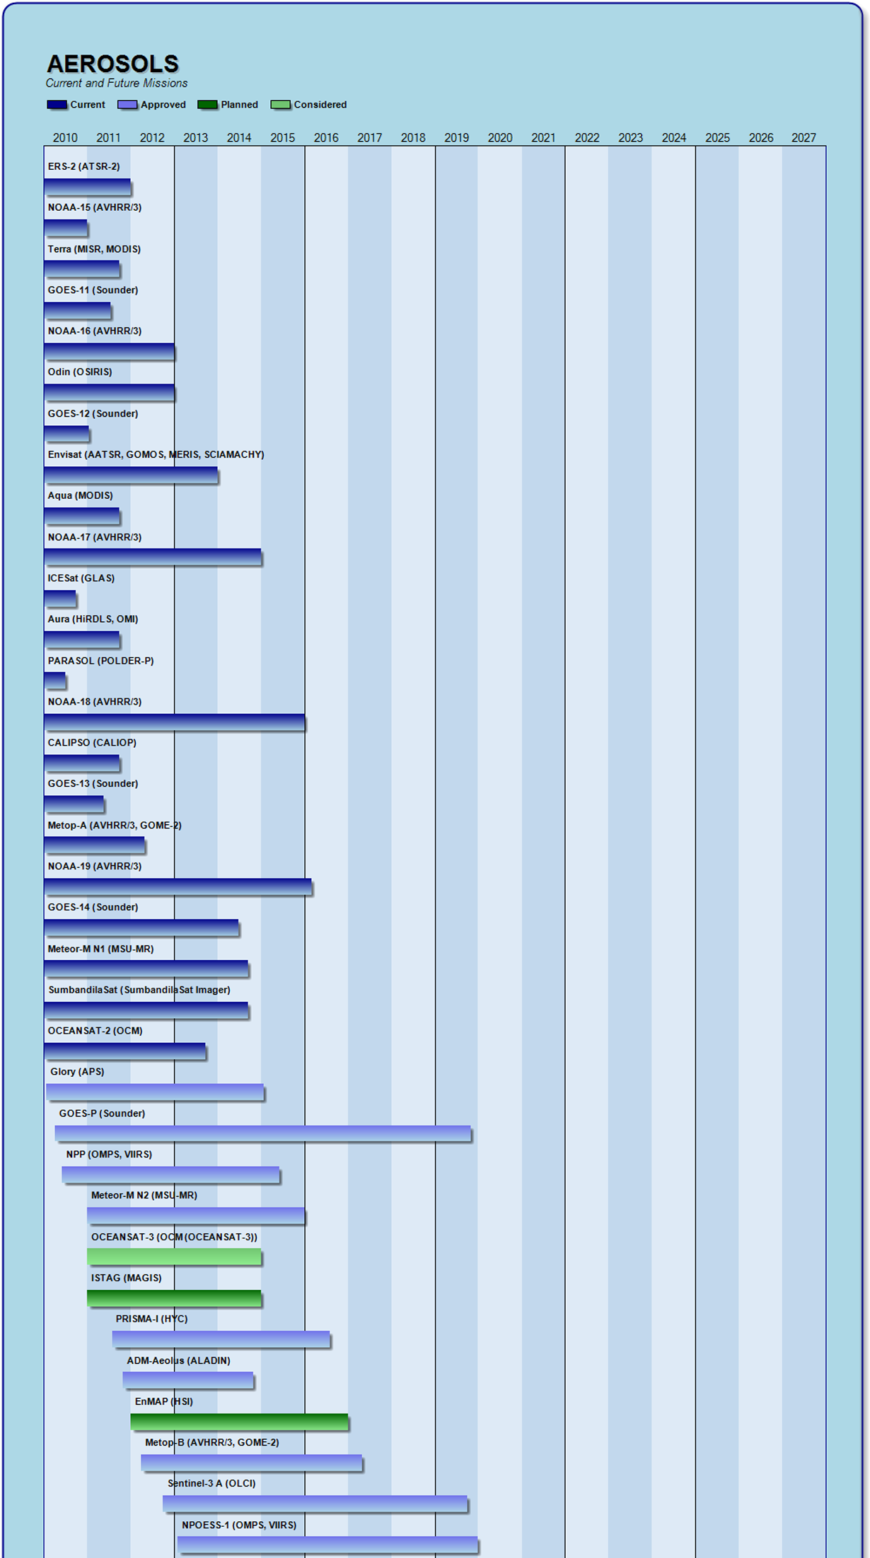
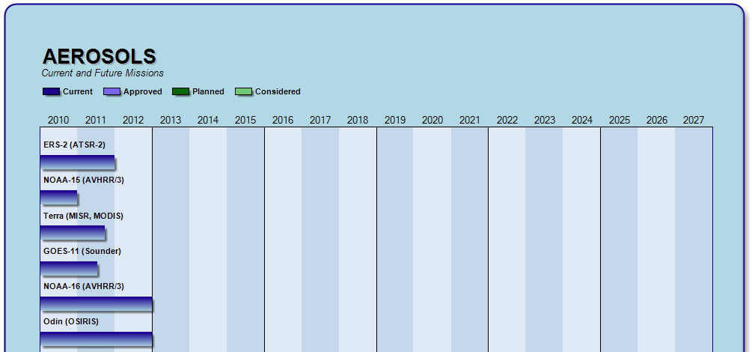
Enhanced Timelines

Slide 8
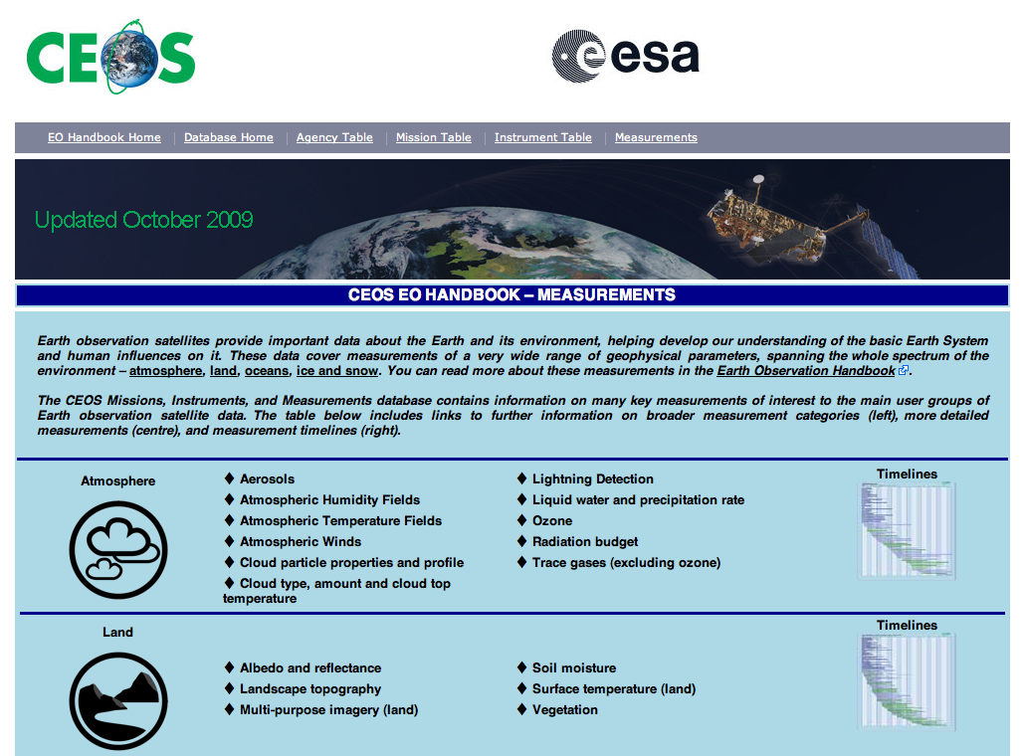
Measurements Browser

Slide 9
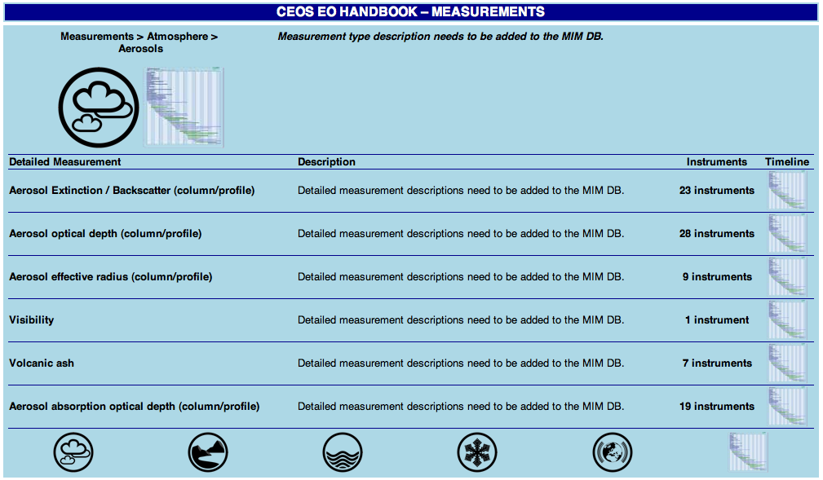
Measurements Browser

