Slide 1
SIT Technical Workshop 2024
OST-VC
Y. Faugère (CNES)
E. Obligis (EUMETSAT)
Agenda Item 9.8
SIT Technical Workshop 2024
Sydney, Australia
18th - 19th September 2024

Slide 2
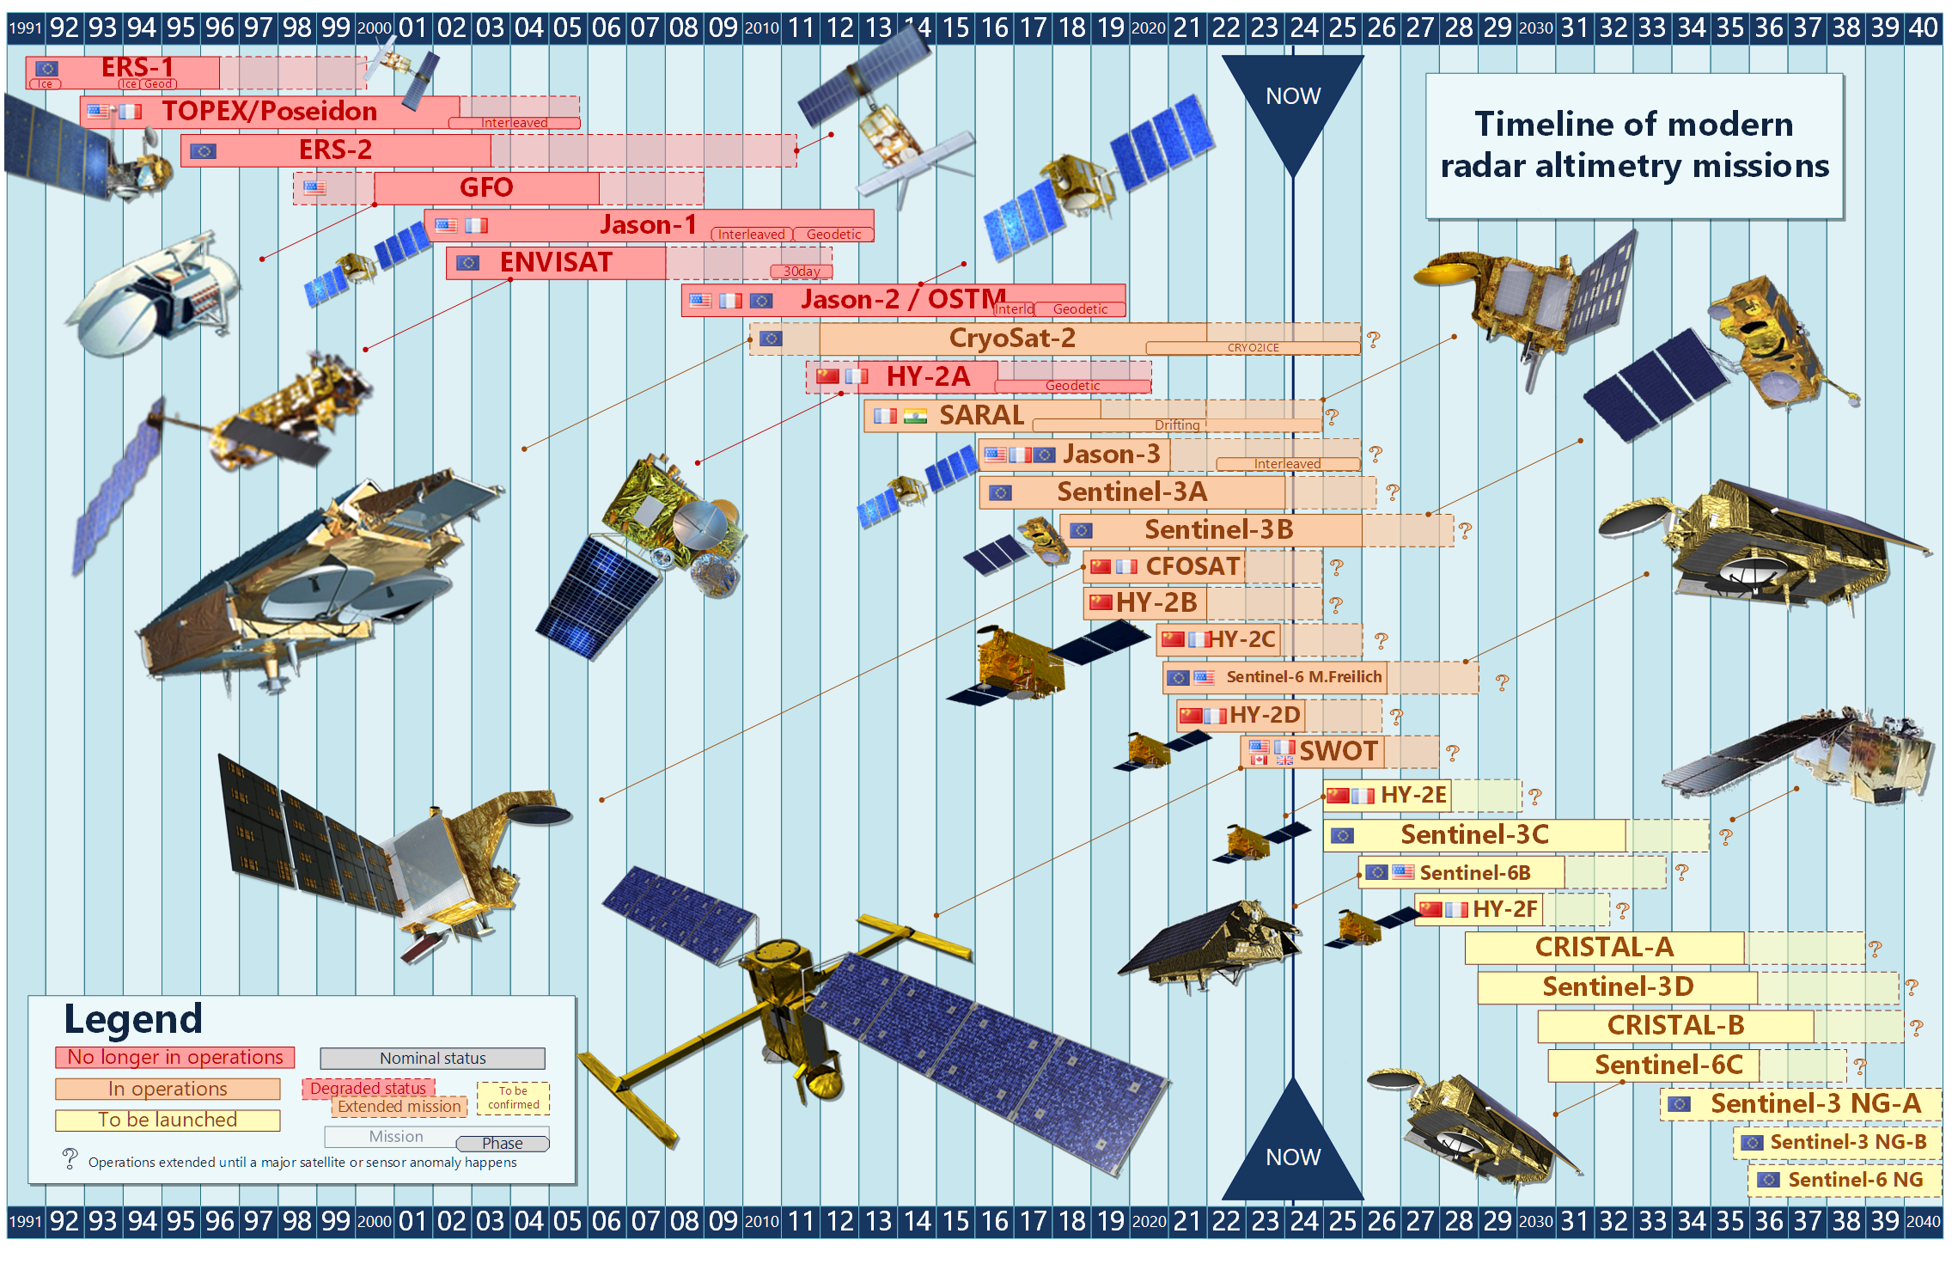
OST-VC missions timeline

Slide 3
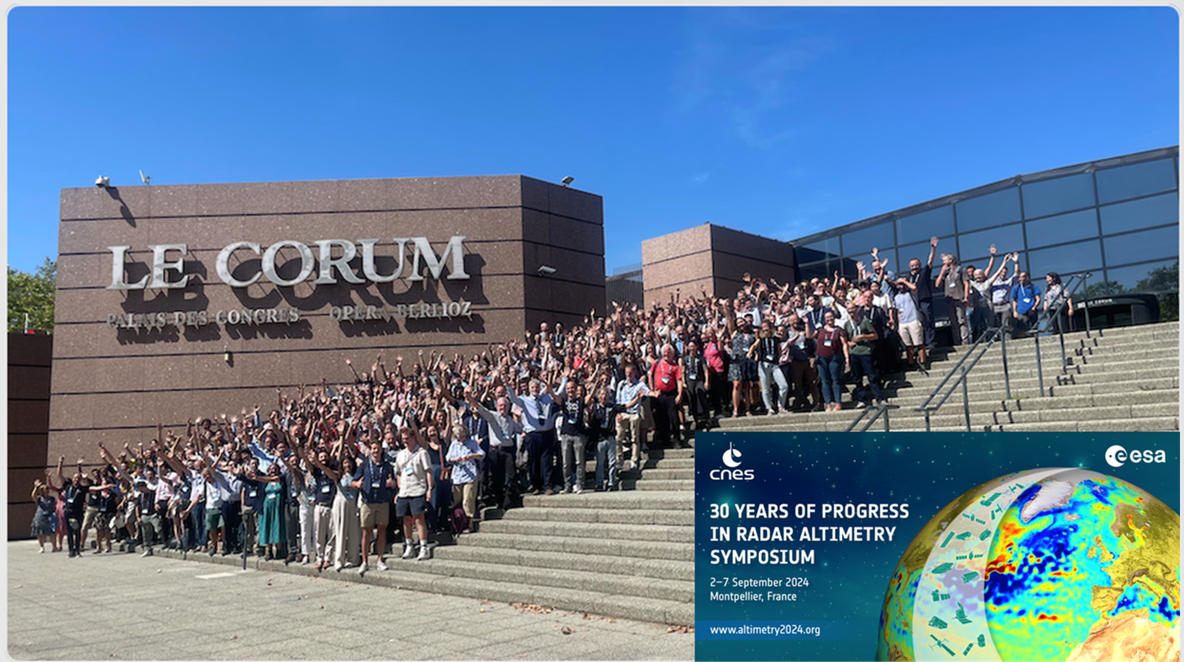
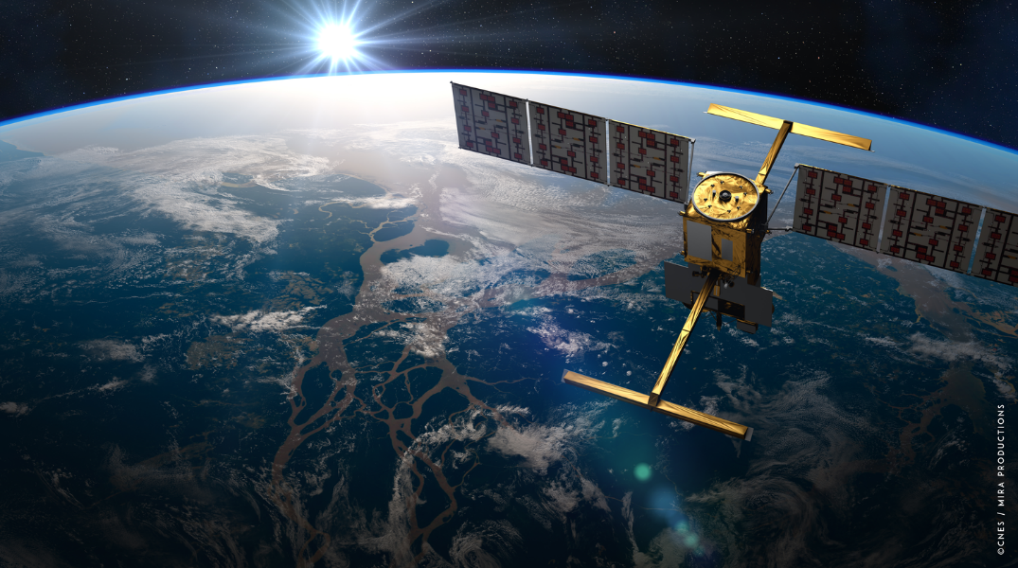
Breaking news
Launch of Sentinel-6B confirmed in November 2025
30 years of altimetry Symposium was organized by ESA and CNES, with the support of EUMETSAT, on 2-6 September
448 participants from 33 countries
Looking at the past, lessons learned, the 30 year climate data record
Future scientific challenges and open science questions
Parallel intensive Copernicus activities related to the preparation of future Copernicus Altimetry missions (Sentinel-3 C/D, Sentinel-6 B/C, Sentinel-3 Topography and Sentinel-6 Next Generation, CRISTAL)
After the success of the SWOT demonstration, it was decided in May 2024 to fly swath altimetry onboard Sentinel-3 Next Generation Topography

Slide 4
2024 OSTST calls
2024 TOSCA (CNES/EUMETSAT) call
25 received proposals
10 French supported by CNES
15 International (6 German, 2 Netherland, 1 Danish, 1 Portugal, 1 England, 1 Greece, 1 Australian, 1 Japan, 1 Chile)
Review in progress for a start on 01/01/2025
2020 NASA call
NASA: expecting proposals on October 17th

Slide 5
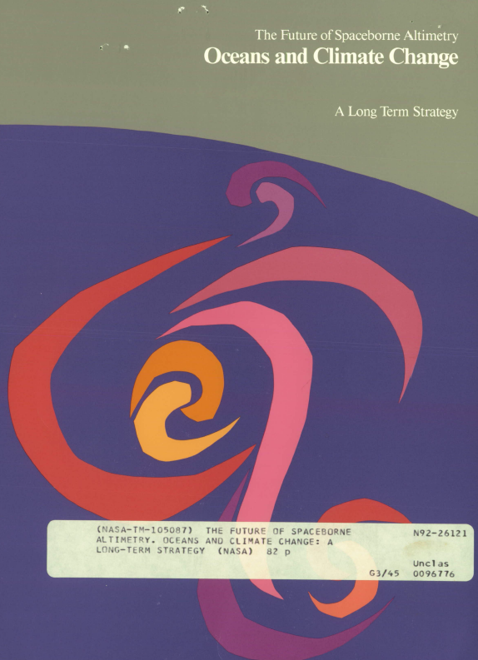
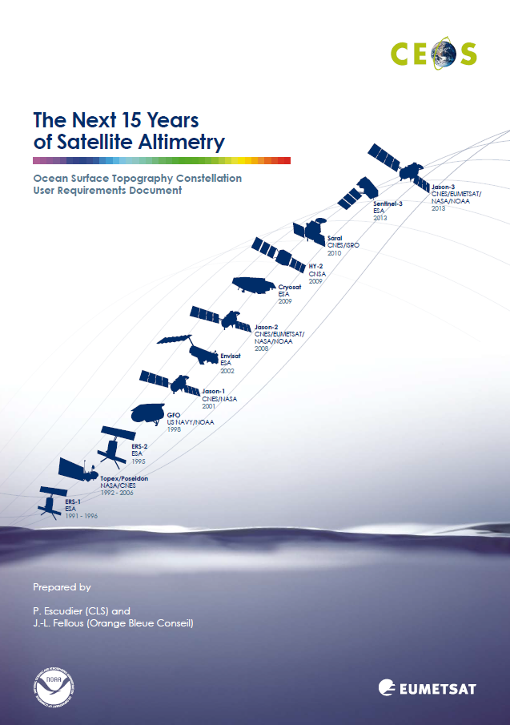
OST-VC White Paper
Update of the “Next 15 years of altimetry – OST Constellation User Requirement Document”, 2009.
“A Coordinated International Satellite Altimetry Virtual Constellation: Toward 2050”
inventory of current user needs including emerging ones
identification of gaps in the current international space constellation
Action: to deliver a first version to CEOS by Q4 2024.
1992
2009

Slide 6
Current status
Editorial team: CNES-EUMETSAT
Book captains contacted to coordinate dedicated parts in June 2023, with user needs and gaps in different areas
Ocean (S. Gille)
Sea state and surface currents (L. Aouf)
Inland waters (JF. Cretaux)
Coastal and continental shelf waters (D. Griffin)
Ice (S. Farrell)
Geodesy (F. Perosanz)
Extreme events, Weather monitoring and forecast (L. Aouf)
Climate Monitoring and Research (B. Meyssignac)
Calibration and validation (S. Labroue and JD. Desjonqueres)
End-user Applications (F. Lefevre)
Current VC (R. Sharma)
Data and service (H. Evers-King)
Technical annex (C. Martin-Puig, A. Couhert, J. Fernandes)
First version of the paper gathering the contributions sent to book captains for review in June 2024

Slide 7
Next steps
Consolidation, editing, formatting by the editorial team in progress
Review and finalization of the paper by beginning 2025, involving the OST-VC members and the OSTST project scientists
Publication by first quarter 2025

