Slide 1
CEOS Mission, Instruments & Measurements Database
2024 Update
George Dyke
MIM Database Team
Agenda Item 9.5
SIT Technical Workshop 2024
Sydney, Australia
18th - 19th September 2024

Slide 2
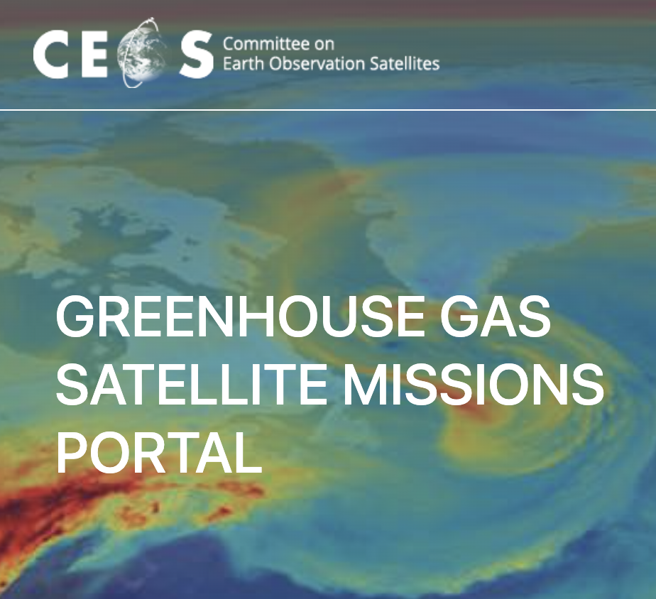
Current Status - Summary
Database online at database.eohandbook.com
2024 update survey in progress
Quarterly Reports regularly generated
Considering plans for website enhancements (visual)
Refresh of GHG mission portal database.eohandbook.com/ghg
Engaging with the broader community - OSCAR, EO Portal, etc.

Slide 3
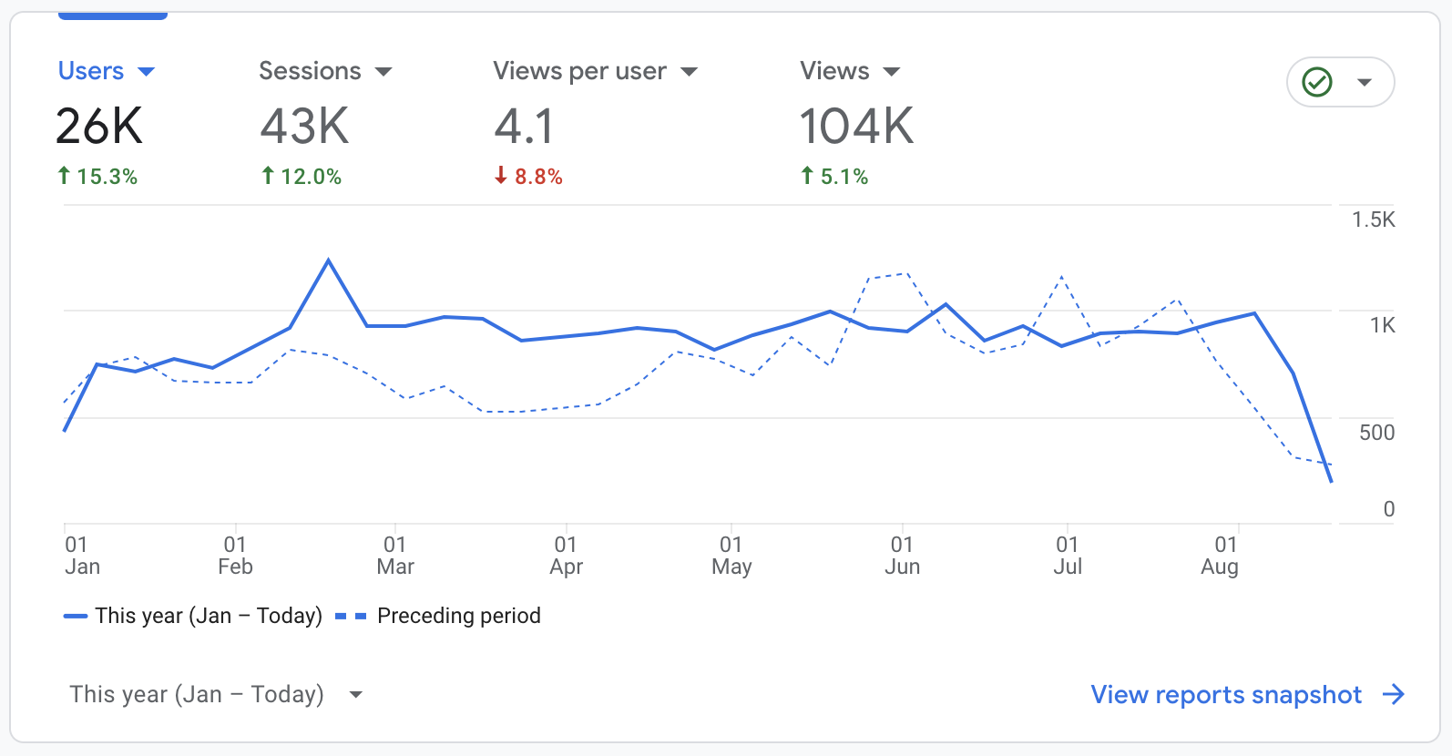
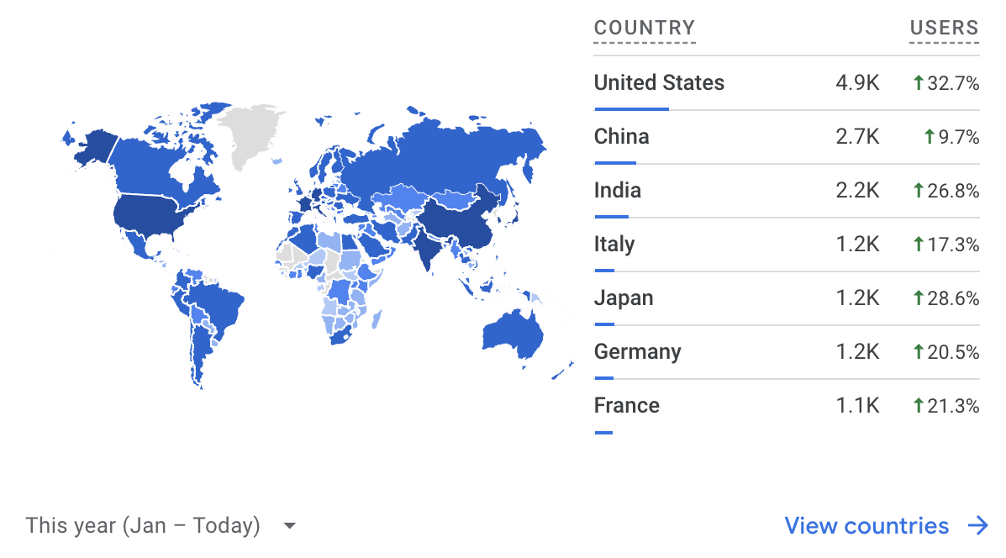
Website Audience - 2024
International audience
Users up across highest use countries
Steady and slightly increasing traffic numbers
26,000 users since January

Slide 4
2024 Survey
28/40 agencies have responded
  One partial response received (ESA)
  Four more expected (NOAA, SNSA, PTSpace, NSAU)
No response from these agencies:
  AEM, CONAE, CRESDA, NASRDA, NRSCC / CAST / CNSA, SANSA, UAE SA
  Final reminders sent on Monday
On track to release ahead of CEOS Plenary
Early Stats
240+ missions updated
4 new missions
150+ instruments updated
24 new instruments
4037 instrument - measurement pairs
Thanks to agencies and contacts for your contributions!

Slide 5
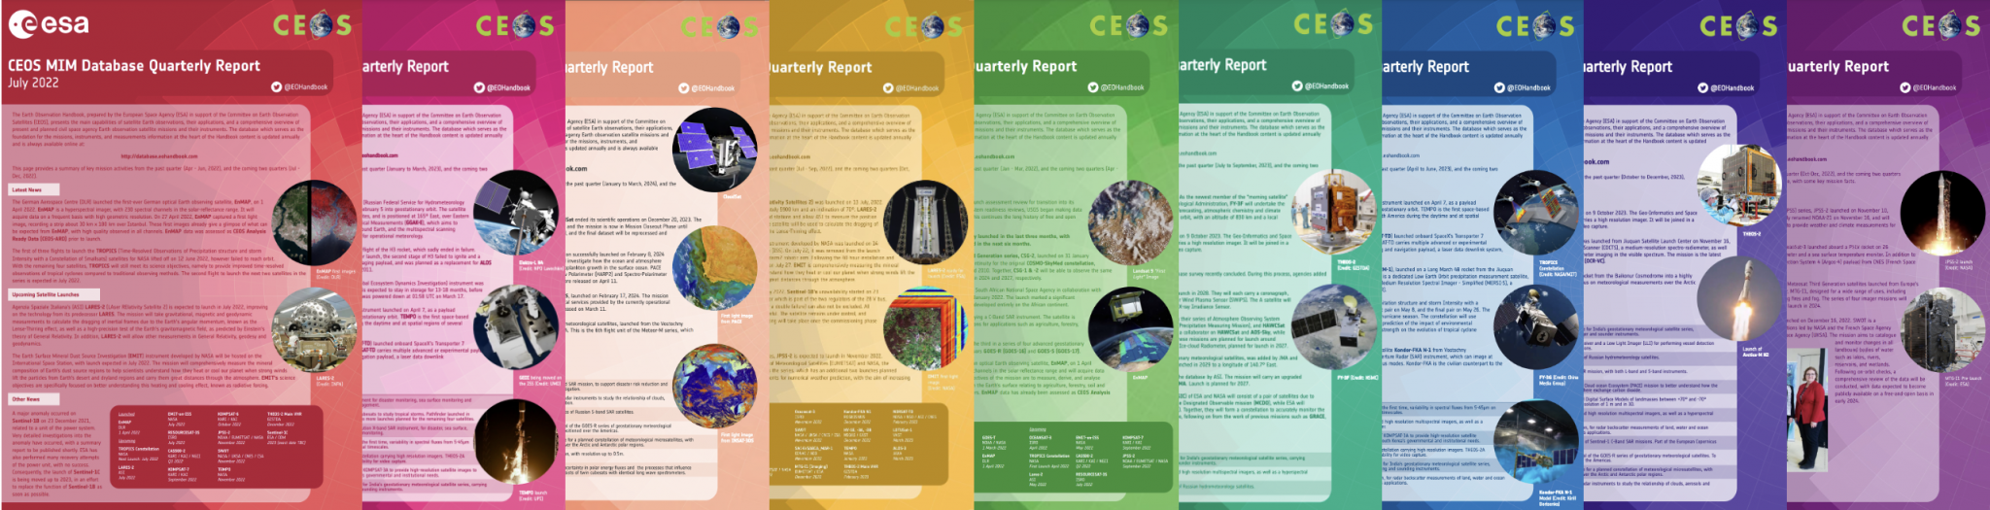
Quarterly Reports
Published once every three months
  Recent launches & mission completions
  Upcoming launches
Distributed to CEOS mailing lists & available on the CEOS website: ceos.org/mim-reports-archive
Helps lighten the load at survey time, and keep the database a current & accurate resource

Slide 6
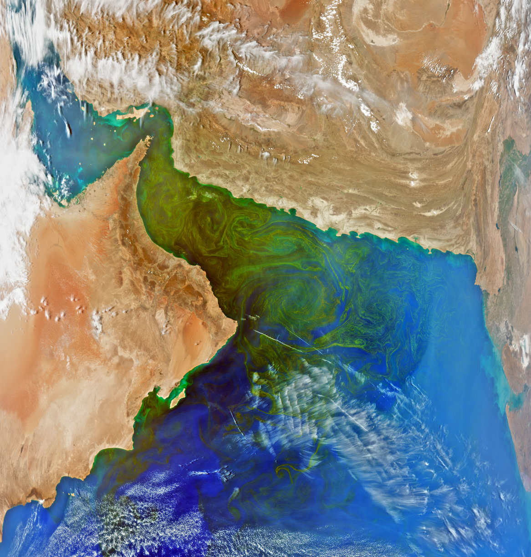
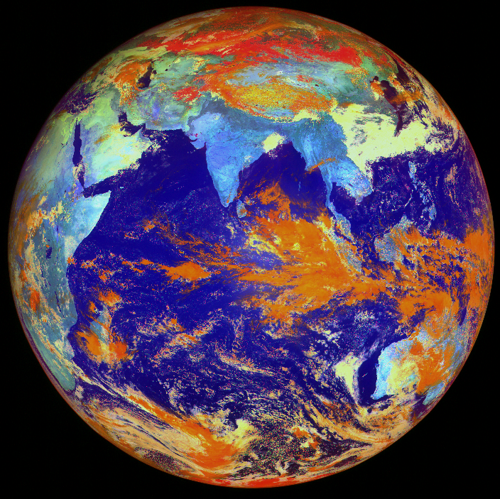
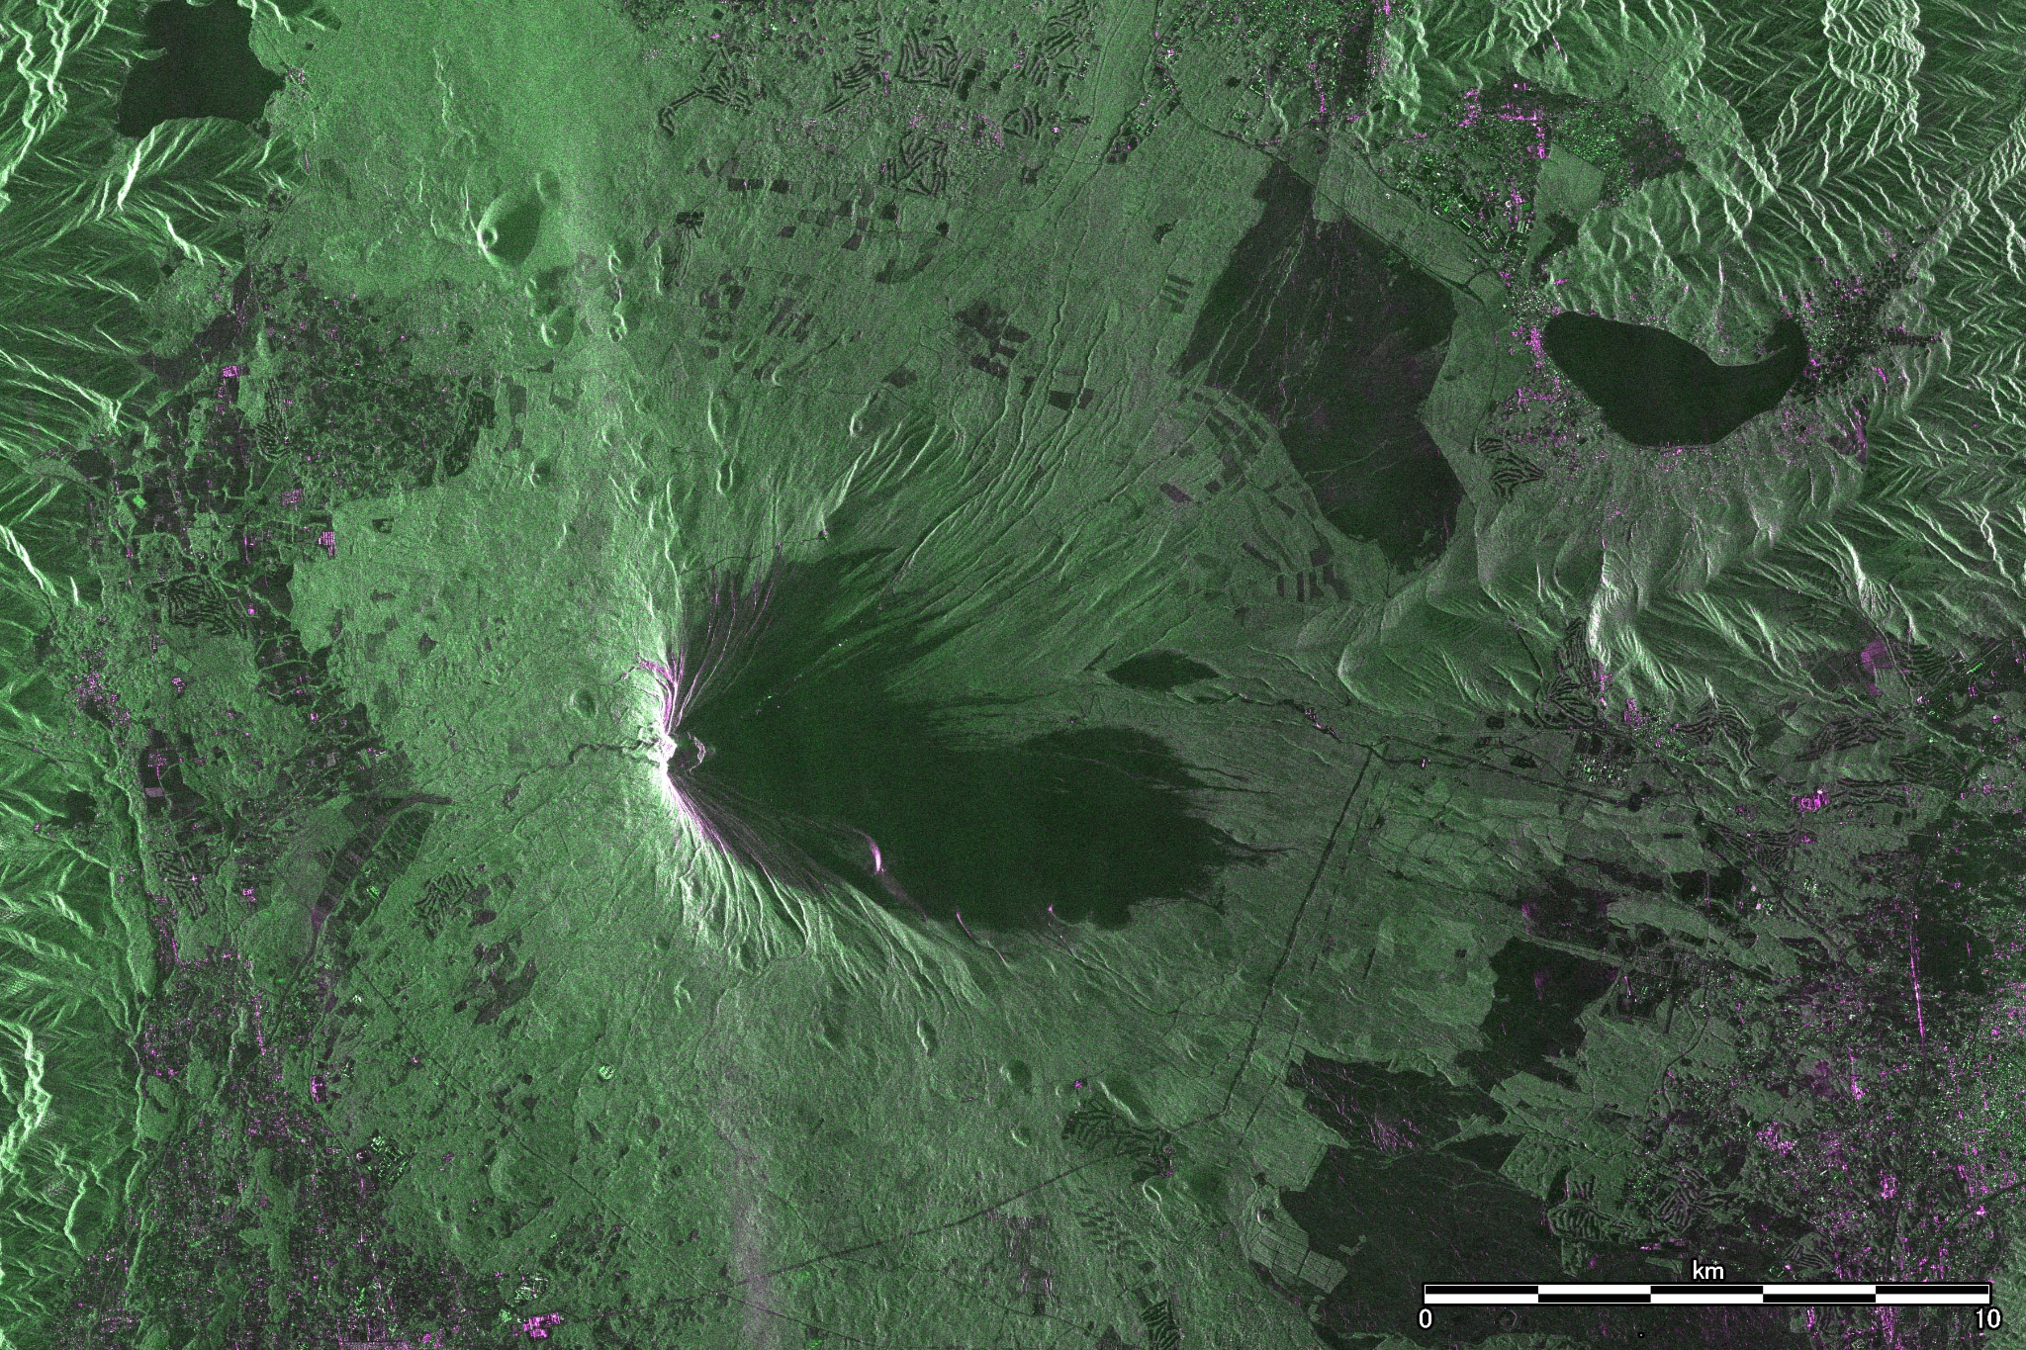
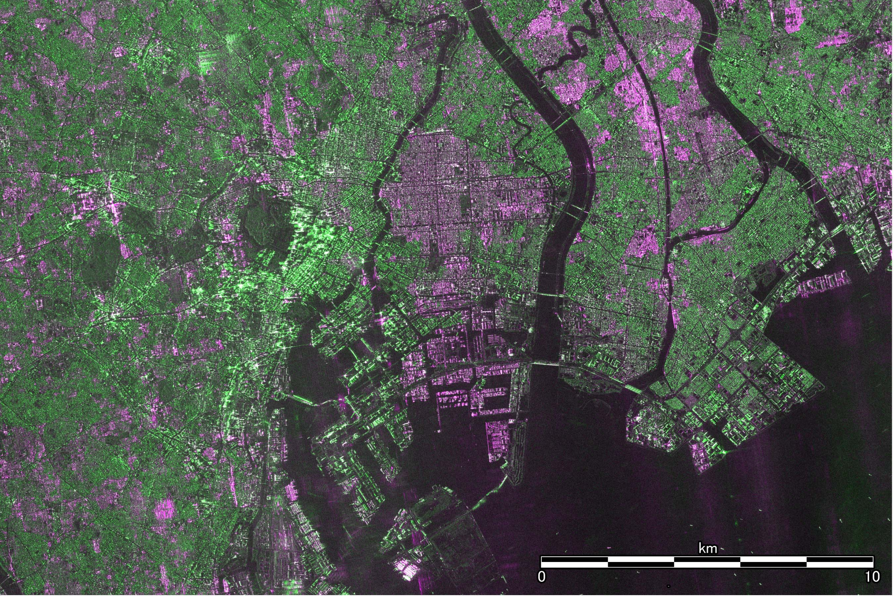
H1 2024 Launch Highlights
PACE: February 08, 2024
INSAT-3DS: February 17, 2024
Meteor-M N2-4: February 29, 2024
MethaneSAT: March 04, 2024
Resurs-P N4: March 31, 2024
WSF-M (US DoD): April 11, 2024
WorldView Legion: May 02, 2024
PREFIRE: May 25, 2024
EarthCARE: May 28, 2024
GOES-U: June 25, 2024
ALOS-4: July 01, 2024
+ Sentinel-2 C: September 04, 2024
First light image from PACE
First light image from INSAT-3DS
Mt Fuji & Central Tokyo - first images from ALOS-4

Slide 7
2024 Launches - Measurements
Parameter | # | Parameter | #
Aerosols | 11 | Surface temperature (ocean) | 3
Cloud type, amount and cloud top temperature | 9 | Atmospheric Temperature Fields | 3
Multi-purpose imagery (land) | 8 | Atmospheric Humidity Fields | 2
Sea ice cover, edge and thickness | 8 | Multi-purpose imagery (ocean) | 2
Vegetation | 6 | Gravity, Magnetic and Geodynamic measurements | 2
Snow cover, edge and depth | 5 | Liquid water and precipitation rate | 2
Albedo and reflectance | 5 | Ocean surface winds | 1
Cloud particle properties and profile | 4 | Ozone | 1
Ocean colour/biology | 4 | Trace gases (excluding ozone) | 1
Radiation budget | 4 | Landscape topography | 1
Surface temperature (land) | 3
Number of instruments measuring each parameter launched in 2024
Excludes commercial capabilities

Slide 8
Upcoming launches
Mission | Launch | Agency
NORSAT-4 | Oct 2024 | NOSA / NDRE
THEOS-2 Small Satellite | Oct 2024 | GISTDA
Ionosphera-M N1 & N2 | Nov 2024 | ROSKOSMOS / ROSHYDROMET
CSG-3 | Nov 2024 | ASI / MoD (Italy)
Sentinel-1 C | Dec 2024 | ESA / COM
Look out for the full report on Q3 2024 activity coming early October!

Slide 9
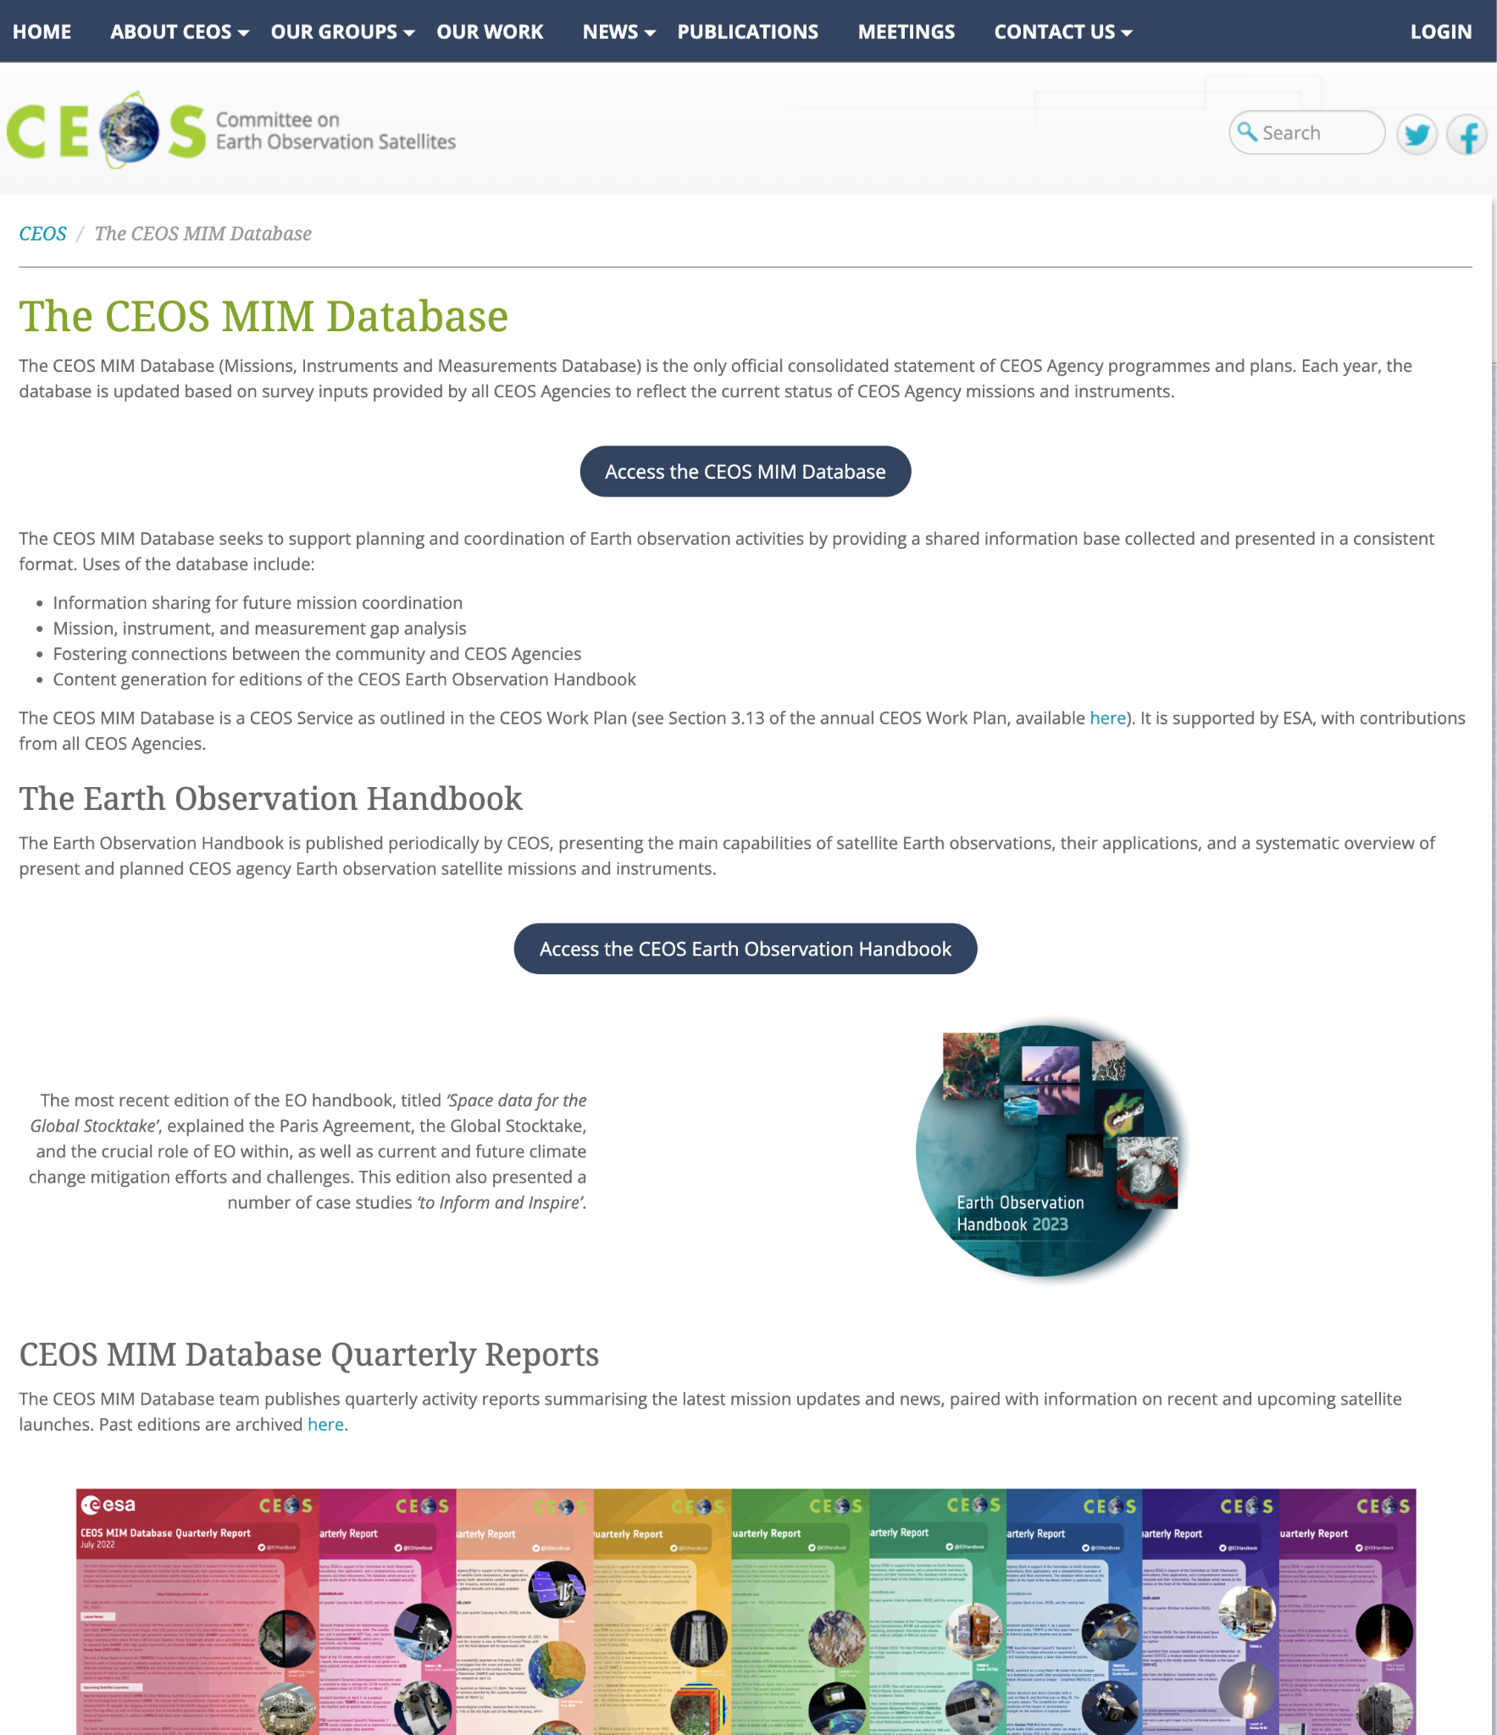
Enhancements
Added: ceos.org/mim-database/
Currently undertaking a set of visual enhancements of the current website
Improve the look, feel, and performance
Relatively modest effort but hopefully a nice refresh

Slide 10
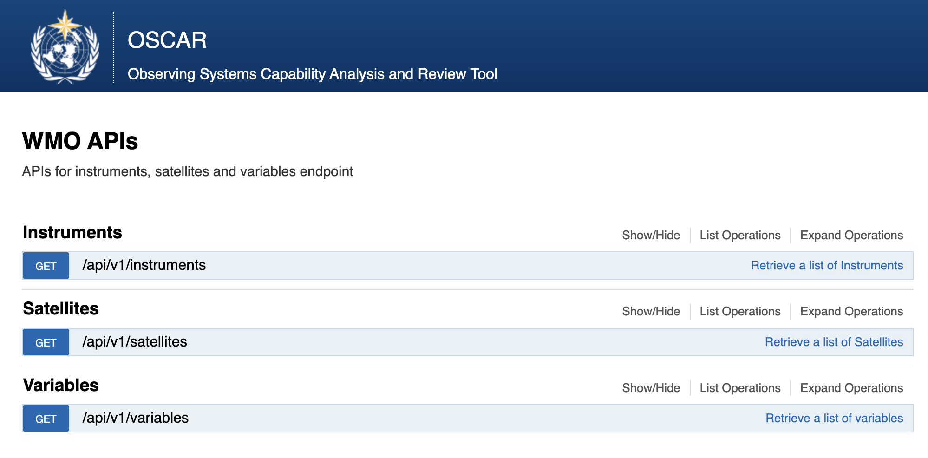
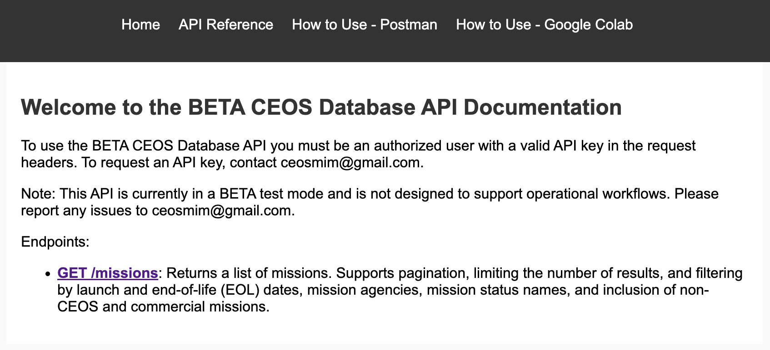
OSCAR
Clear adjacency - different mandates and constituencies
Continuing periodic correspondence with the OSCAR team
Sharing information and the updates from the quarterly report process

Slide 11
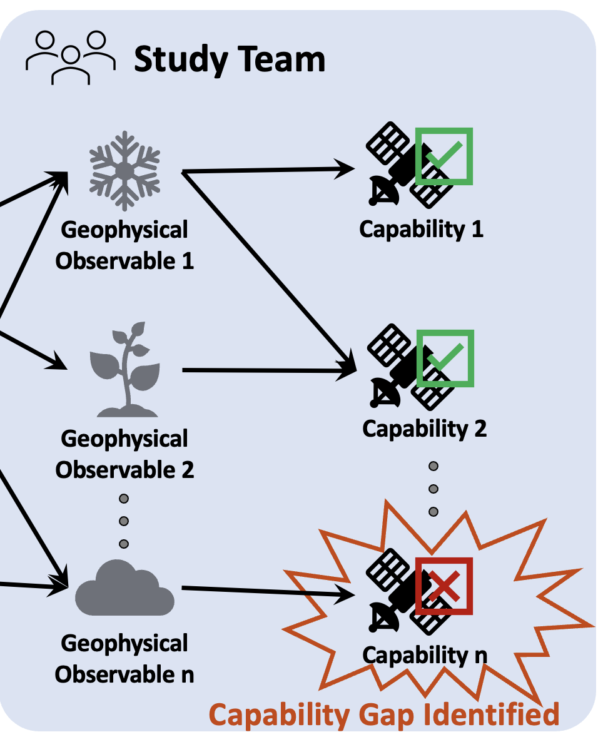
ESA Science Strategy
The Database has been the principal reference the ESA Science Strategy foundational study
Providing the ‘program of record’ - current and future planned capabilities
Similar to the role the CEOS Database played for the NASA Decadal Survey
Fulfilling its mandate: providing capabilities to undertake informed coordination decisions

Slide 12
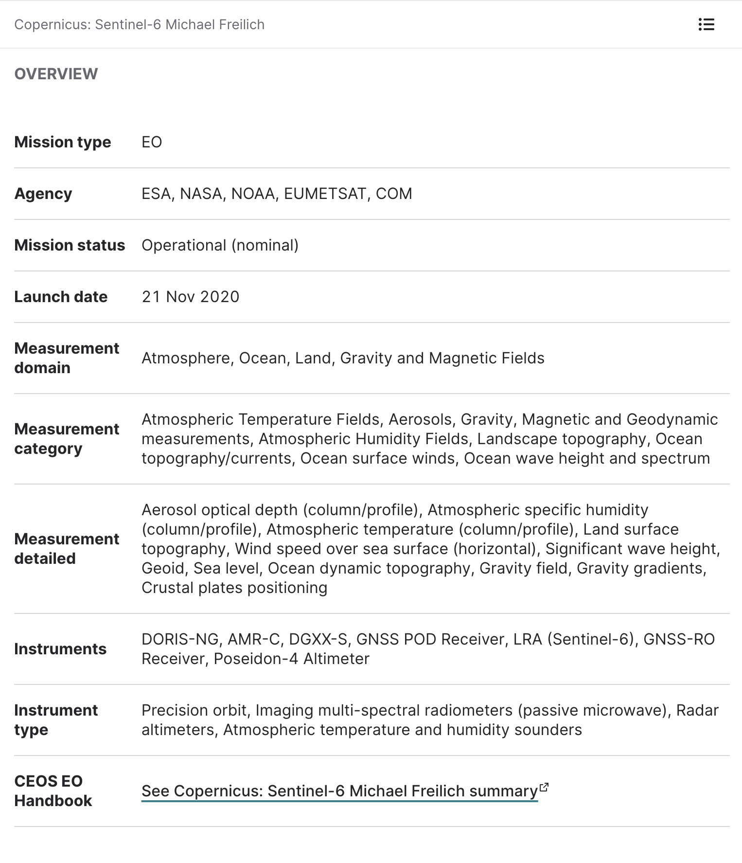
EO Portal
EO Portal metadata powered by the CEOS Database
Independant ‘sister site’ - with more in depth information about the missions, in particular spacecraft and instrument structure
Scope of EO Portal broader that CEOS Database - includes information about commercial and non-governmental missions alongside CEOS Agency missions
eoportal.org/about-eoportal

Slide 13
Thanks!
Questions welcome now, after, or via email
Thanks to agencies and contacts for your support in making this community resource possible

