Slide 1
Report on UNCCD External Request Process Progress
Toshi Kamei, SIT Chair Team
Agenda Item 9.4
SIT Technical Workshop 2024
Sydney, Australia
18th - 19th September 2024

Slide 2
Background
CEOS has supported UNCCD on SDG 15.3.1 through SEO for several years.
CEOS received a Letter of Enhanced Cooperation from UNCCD Science, Technology, and Innovation Unit on May 22, 2024.
CEOS Chair, SIT Chair, SEO, CEO followed the CEOS External Request Process Paper process and assessed the feasibility of the UNCCD requests as Step-A (Initial Consideration).
The request passed Step A assessment and advanced to Step-B (High-Level Assessment). The result was reported at SEC-322 on June 20, 2024.
JAXA SIT Chair evaluated that the request met the 5 points in Step-B, and shared the letter with CEOS principals and asked for feedback as Step-B on July 23, 2024.
CSIRO, EC, ESA, NOAA, and NASA have provided positive feedback so far.

Slide 3


About UNCCD
UNCCD: the United Nations Convention to Combat Desertification
UNCCD is a Convention to combat desertification and mitigate the effects of drought through national action programs that incorporate long-term strategies supported by international cooperation and partnership arrangements.
UNCCD is one of the three major treaties known as the Rio Conventions— alongside climate change and biodiversity.
UNCCD COP16 (Riyadh, Saudi Arabia in December 2024) will be a landmark event for accelerating action on land and drought resilience.
Designated UN Custodian Agency for SDG indicator 15.3.1 (Land Degradation)

Slide 4



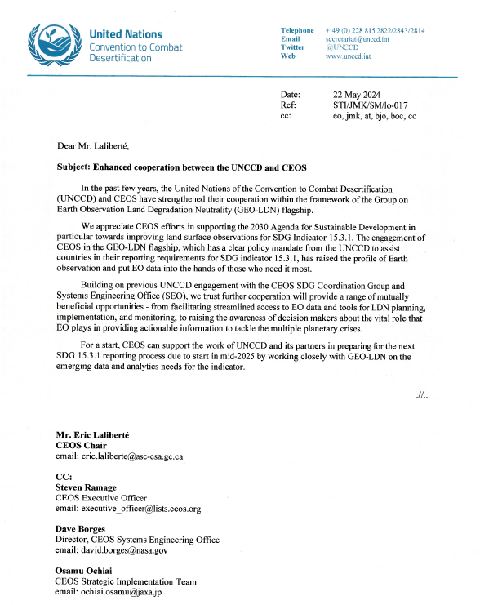
UNCCD Letter of Enhanced Cooperation
This letter highlighted the value of ongoing support activities of SDG CG, and requested additional support on several specific topics, such as standardization, biodiversity and other domains like the following requests.
Preparing for the next SDG 15.3.1 reporting process by working closely with GEO-LDN on the emerging data and analytics needs for the indicator.
Assessing the availability and suitability of land surface datasets for these geographies, by prioritizing SIDS and hyper arid areas.
Providing assessment and improved guidance on:
  Linking estimates of land condition between coarse and fine scale datasets
  Cross-calibration of historical and new satellite observations
  New and emerging datasets provided by the UNCCD to countries for reporting.
Development of OGC standards for geospatial LDN reporting indicators, building on the ARD concepts and prior work by GEO-LDN for SDG 15.3.1.
Playing a role in efforts to synergize national target setting between the UN CBD and the UNCCD LDN target-setting programme.
Providing Strategic guidance to GEO-LDN, In-kind contributions to GEO-LDN capacity development activities and collaboration on joint communications and outreach.
Participating to the UNCCD COP16 and contribute to the delivery of Action Agenda.

Slide 5
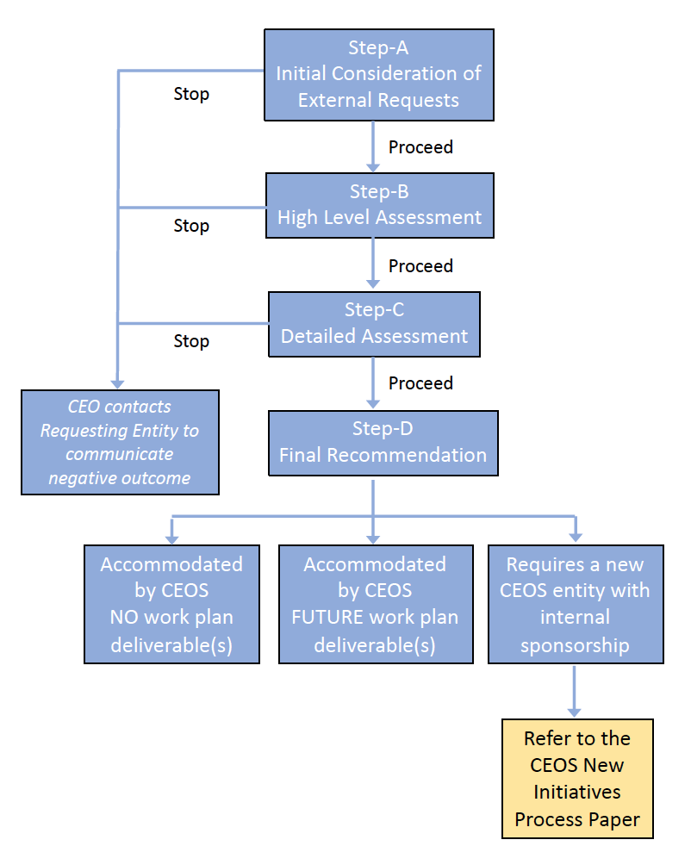
CEOS External Request Process
The CEOS defines the following process for external requests
  Step-A: Initial Consideration of External Requests
  Managed by CEO and supported by the CEOS and SIT Chairs. Is the request relevant and clear?
  Step-B: High-Level Assessment
  Managed by the SIT Chair and supported by the SEO and CEO. Assess relation to GEO and external frameworks, benefits, relevance of EO data and feasibility
  Step-C: Detailed Assessment
  Managed by the SIT Chair and supported by the SEO and CEO. Also supported by CEOS Members and entities.
  Assess specifics of CEOS Agency support, data needs and feasibility and priorities vs. commitments
  Step-D: Final Recommendation
  Accommodate in CEOS (work plan task or not), add a new CEOS entity (refer to New Initiatives Process Paper).
  CEO will contact the external requesting entity to communicate the outcome of each Step.
We are here

Slide 6
5 Points of Step-B assessment
Is there sufficient clarity in the request to perform a high-level assessment and, in particular, does it contain well-formulated requests to CEOS Agencies?
Does the request relate to the Group on Earth Observations (GEO) Work Programme or a global policy framework (e.g., UN-SDG, UNFCCC, SBSTA, GCOS, Sendai Framework)?
Is there a benefit to internal and/or external stakeholders? This value should be societal benefit but may also be monetary.
Is Earth observation data relevant to the needs of this request?
Assess the feasibility of a potential contribution from CEOS Agencies. Are the type of observations, resolution and frequency of observations compatible with the Earth observation data resources of CEOS Agencies?

Slide 7
Feedback from CEOS Principals
CSIRO, EC, ESA, NOAA, and NASA supported UNCCD’s request and provided the following feedback.
CSIRO and EC requested to discuss it at SIT-TW and Plenary in terms of CEOS’s best effort and impact on resources. NOAA also suggested discuss on the 5th point of Step-B assessment.
CSIRO and ESA have an interest in the field of desertification.
EC is already providing products to UNCCD in support of SDG 15.3.1. NASA also commented that CEOS is suited to contribute to UNCCD in SDG 15.3.1.
EC plans to participate to UNCCD COP. EC has engaged with UNCCD Sec & GEO-LDN and Andreas Brink is POC of CLMS-UNCCD.
ESA commented that the request aligns with the current CEOS chair theme of “Biodiversity”

Slide 8
Next step (Step-C: Detailed Assessment)
Before proceeding the Step-C, CEOS shall identify the Members, Associates, and CEOS entities (e.g., SEO, WG, VC, AHT) as well as potential external experts that will be involved in the Step-C.
Managed by the SIT Chair, supported by the SEO and the CEO and identified CEOS Agencies and CEOS entities as defined at the conclusion of Step-B.
The expected duration is less than 6 months
It is critical that CEOS engage with the appropriate users in the value chain to maximize the potential use and impact of the satellite data.

Slide 9
Assessment Criteria for Step-C
Which specific Agencies and CEOS entities would be involved in addressing this?
Is the proposed activity well-aligned with existing activities of CEOS (e.g., VCs, WG, or other initiatives)? If so, identify those activities and entities.
What data/information products would CEOS generate in support of this initiative/task and when would those products be needed?
Assess the detailed feasibility and affordability of the external request and its intended outcomes. CEOS Agencies must possess the necessary personnel and fiscal resources to support a new initiative so it can fulfill its intended outcomes.
Are there additional CEOS Agency policy considerations that would encourage or discourage their involvement (e.g., overarching data policies or prevailing public/private partnerships)?
Assess CEOS current priorities and commitments. Taking into consideration existing priorities and commitments, can CEOS Agencies and entities support the intended outcomes of this external request?

Slide 10
The Schedule of Process
2024
2025
2026
Sep
Oct
Dec
Apr
Sep
Oct
April
SIT-TW
Plenary
UNCCD COP16
SIT-40
SIT-TW
Plenary
SIT-41
Report on Step-B
& Proceed Step-C
Report on Step-C,
Seek Principals’ comments
& Proceed Step-D
Interim Report
Report on Step-B
& Seek Principals’ comments
Final Report
Step-B
Step-C (less than 6 month)
Step-D (less than 1 year)

