Slide 1
CEOS Carbon Roadmap Integration
Osamu Ochiai
JAXA SIT Chair team
Agenda Item 8.1
SIT Technical Workshop 2024
Sydney, Australia
18th - 19th September 2024

Slide 2
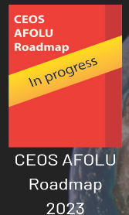
Support Carbon monitoring in all domains
CEOS Global Stocktake Strategy Paper and Global Stocktake Portal
CEOS Aquatic Carbon Roadmap
Under development!
Demonstrate the value of Earth Observation satellite datasets to support the Global Stocktake process
Summary of CEOS thematic observing strategies:
https://ceos.org/observations/
<< www.ceos.org/gst
Notes:
CEOS has been formalising its strategies for various aspects of carbon and climate in all three domains:
In 2020: Greenhouse Gas Roadmap has been agreed.
In 2021: Strategy to Support the Global Stocktake.
In 2023: Agriculture, Forestry and Other Land Use (AFOLU) Roadmap in 2023.
In 2024: Aquatic Carbon Roadmap is under development. Also an AFOLU Roadmap actions supplement.
WMO regularly engages with the implementation of the CEOS Greenhouse Gas Roadmap, through the CEOS-CGMS Working Group on Climate Greenhouse Gas Task Team. This is a key area for CEOS and WMO collaboration.

Slide 3
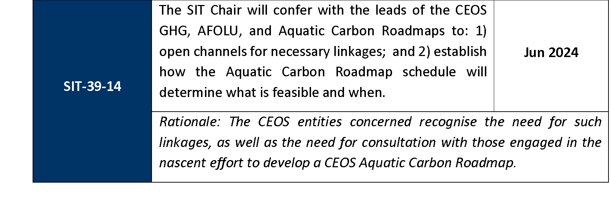
SIT-39 decision and action
GHG Roadmap being updated in 2024 - reflecting context changes like G3W and IMEO
AFOLU Roadmap actions being finalised - draft presented at SIT-39 aiming for TW
Aquatic Carbon Roadmap started, aiming for Q4 2025 finalisation

Slide 4
SIT Term Overview
2024
2025
SIT-39
SIT-TW
Plenary
Canada
SIT-40
SIT-TW
Plenary
UK
COP-30
GST STRATEGY
GST 1 LESSONS LEARNED
GST STRATEGY UPDATE
Draft
Draft & CEOS WP actions
CARBON ROADMAPS
GHG ROADMAP UPDATE
Draft
AFOLU ROADMAP ACTIONS
SIT CHAIR TO ENSURE LINKAGES NEEDED
AQUATIC CARBON ROADMAP DEVELOPMENT
IMEO & G3W
INTERFACES
PROGRESS IMEO & G3W TOPICS/challenges
GHG Best Practices
CEOS GHG BEST PRACTICES
UKSA COP-30 actions
Draft
Final
GCOS IP
CEOS RESPONSE
Mid-2025 for CEOS & CGMS
ECV INVENTORY
VERSION 5
VERSION 6
STRATEGIC TOPICS
NEW PATHWAYS/TARGETS
NEW CEOS WP ACTIONS RE GST2
IPCC TSU engagement
INTEGRATED PLANNING FOR COP & SBSTA
NATIONAL ENGAGEMENT

Slide 5
Progress to date
Two coordination calls (11 June and 24 July) featuring the leads for the 3 CEOS Roadmaps
Connecting the teams and sharing updates on progress
GHG Roadmap being updated this year
AFOLU Roadmap actions being finalised
Aquatic Carbon Roadmap outlined and being started - aim late 2025 target
Guest speaker, Richard Engelen (ECMWF) on inversion modelling

Slide 6
Issues arising… for discussion
Need more integration with the inverse modelling community
WMO G3W is a potential gateway to the policy world - there is an opportunity for us to guide G3W. Need to be aligned internally to do so with exchanges between the roadmap teams
GOOS may be helpful for the ACR effort
GHG team considering linkages needed with others in update
Potentially useful linkages via the Global Carbon Project?
Could the 3 roadmaps together study what will be needed from them in future by the inversion modelling community as a strategic endeavour?
Could WGClimate consider this?

Slide 7
Way Forward
SIT Chair team will continue to offer coordination calls among the 3 Roadmap lead teams to facilitate necessary communication
WGClimate may look at how to connect their CDR work to needs of the inversion modelling community
Ensure ACR contents reflect integration needs

