Slide 1
CEOS-ARD Strategy 2024
Ferran Gascon
ESA, CEOS-ARD Oversight Group Lead
Matt Steventon
CEOS-ARD & LSI-VC Secretariat
2024 CEOS SIT Technical Workshop
Item 9.10
19 September 2024

Slide 2
Motivations
Notes:
Easing the use of satellite EO data to reach new non-expert users and increase data uptake and use
geophysical measurements
Reduce pre-processing burden for users
Facilitate analysis in the cloud - Reduce egress and processing
Provide a first step for interoperability
Promote clear documentation of processing steps
Capitalise on space agency expertise and experience

Slide 3
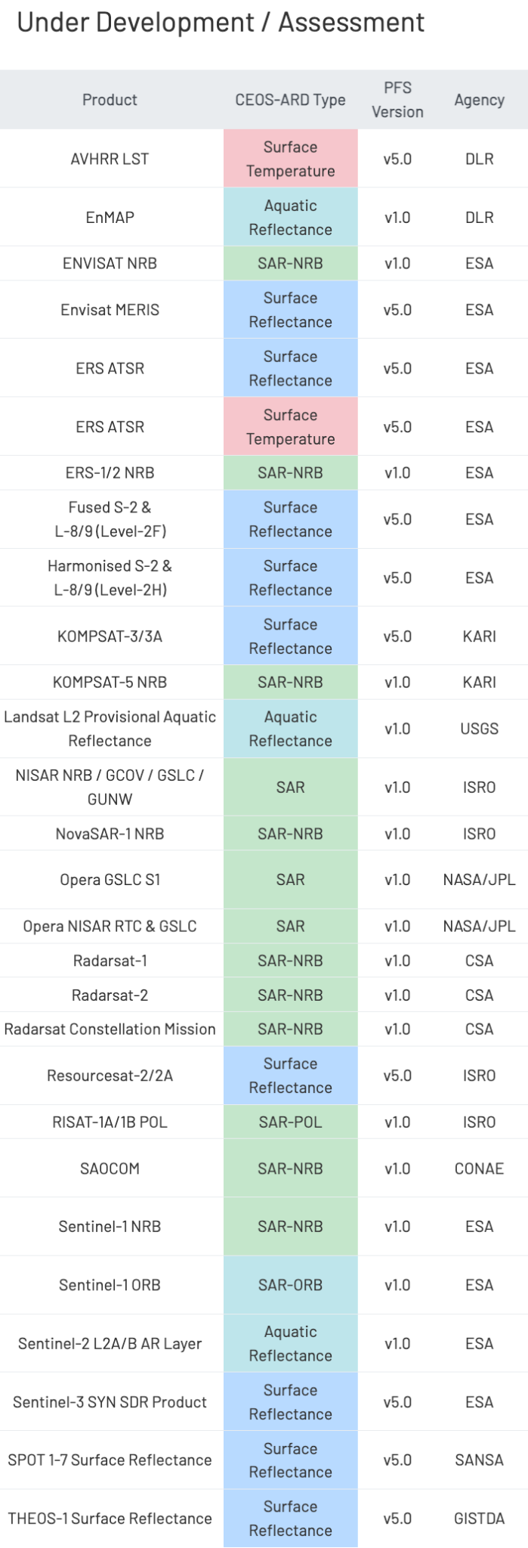
First, some updates…
Recent CEOS-ARD Endorsements
ISRO EOS-04 (RISAT-1A) NRB (Combined SAR PFS v1.0) [2 April 2024]
JAXA ALOS-2 PALSAR-2 Normalised Radar Backscatter (NRB) (Combined SAR PFS v1.0 update) [17 April 2024]
Ongoing self-assessments and peer reviews
DESIS L2A (DLR), Gaofen-1/6 SR (AIR-CAS), Opera RTC S1 Products (NASA)
Recent / Upcoming engagements on commercial providers
NSI, Tellus, Synspective, AxelSpace, Planet, EarthDaily Analytics, Catalyst
SEO trial CEOS-ARD assessments
Second commercial engagement workshop next week at LSI-VC-16 in Canberra
Esper Satellite Imagery, Geospatial Intelligence, Arlula, Eartheye Space Technologies, Descartes Labs/EarthDaily
Ongoing development of an Ocean Reflectance PFS (with OCR-VC)
Combine Optical PFS (SR, ST, AR, & NLSR) (USGS) (covered on slide 9)
Surface Reflectance Equivalence project (GA)

Slide 4
CEOS-ARD Strategy 2024
CEOS Agencies have committed to CEOS-ARD with the aims of:
Supporting the mainstreaming of satellite EO data in society through removal of user burden and data complexity.
Expanding the user base for EO data.
Ensuring continued value to users of public satellite EO programme data and information.
Increasing the amount of satellite EO data available to support the major global development agendas and priorities of CEOS (e.g., climate, sustainable development, disaster response) and the user community at large.
Enhancing quality and traceability of EO products and awareness of users to the importance of these factors.

Slide 5
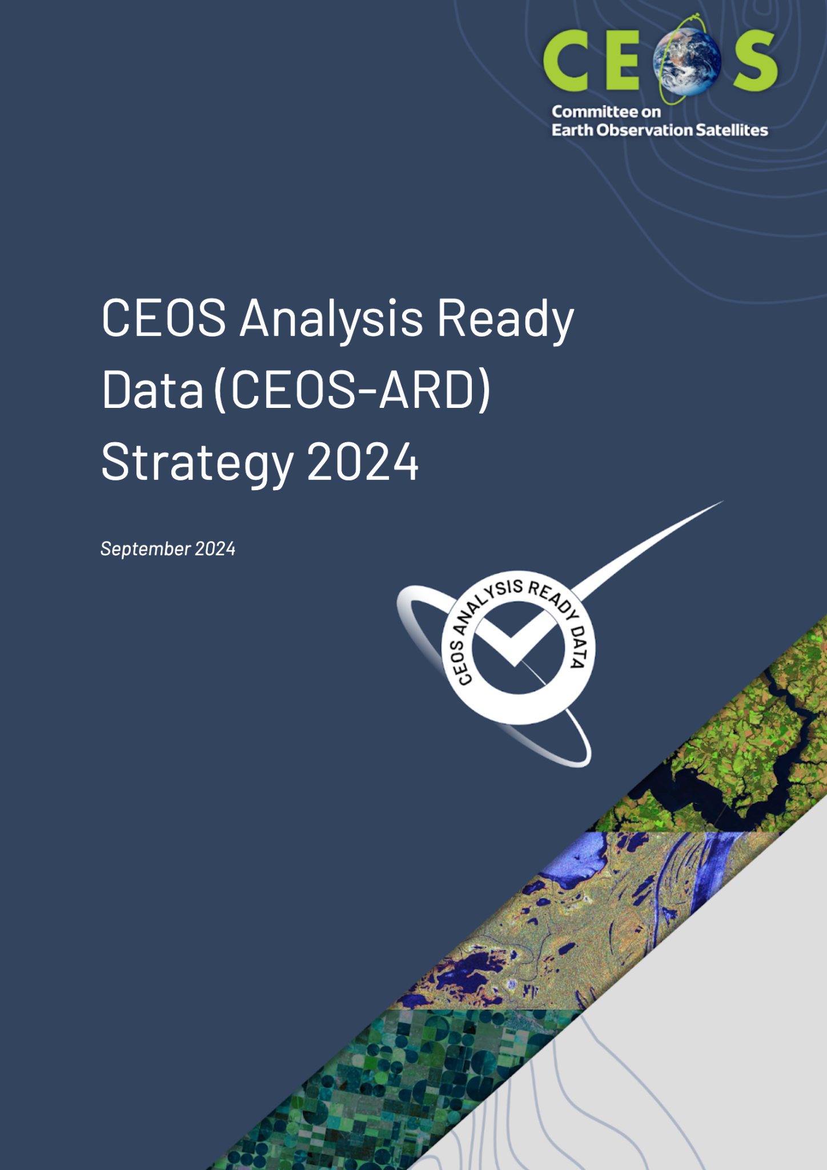
CEOS-ARD Strategy 2024
Update to past editions from 2019 and 2021
Reflect on the progress to date, take stock of future directions and needs, and confirm our strategy for the next few years
Lots happening – Strategy captures and organises all of these threads
Covers the ‘what’ and ‘why’ – ‘when’ and ‘how’ to be decided and added to future CEOS Work Plans
A broad portfolio of CEOS-ARD that is easily discovered, accessed and utilised is the ultimate goal.
Link: Draft CEOS-ARD Strategy 2024

Slide 6
CEOS-ARD Strategy 2024
The Strategy activities are categorised into six broad themes:
CEOS-ARD Availability, Product Diversity, and Representation
CEOS-ARD Framework and Specification Advancement
Discovery, Access, Utilisation, and Interoperability
Community Engagement
Research, Test Cases, and Pilot Activities
Commercial Engagement
We won’t seek to cover everything in this presentation, just some key messages and development directions… please read and comment in the document here.

Slide 7
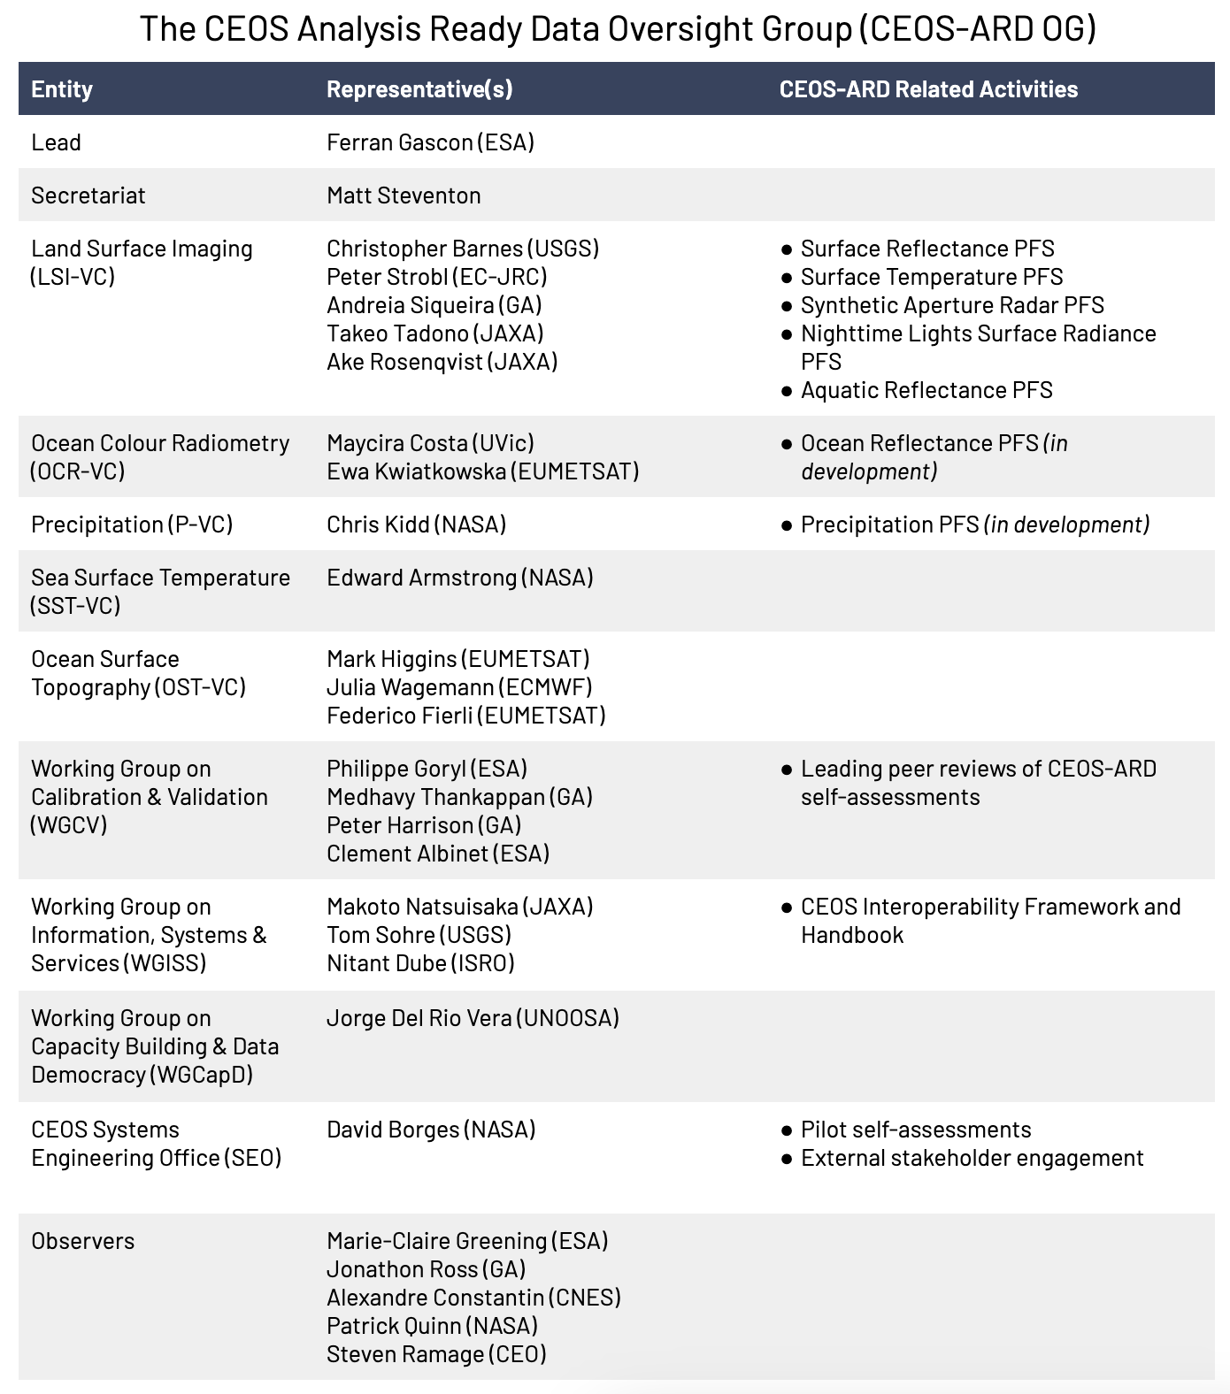
1: CEOS-ARD Availability, Product Diversity, and Representation
Firstly, thanks to all CEOS Agency supporters and contributors!
This section broadly calls on agencies to review datasets and consider self-assessments
CEOS-ARD Oversight Group available to support
And to support a strong CEOS-ARD Oversight Group with broad representation of the CEOS Virtual Constellations
Tasking VCs to consider CEOS-ARD PFS where there is user demand
Consideration of CEOS-ARD specifications at mission inception/design and archive reprocessing

Slide 8
2: CEOS-ARD Framework and Specification Advancement
CEOS-ARD GitHub
Increase community involvement, transparency, and version control, tracking of issues, etc.
Part of the CEOS Organisational account
Modularisation of CEOS-ARD Specs
‘Building blocks’
Consolidation, commonality, consistency, terminology.
Ease PFS development
Alignment with SpatioTemporal Asset Catalogs (STAC) (Discovery, Access)
Various other technical topics
Continued evolution of the specs to meet community expectations

Slide 9
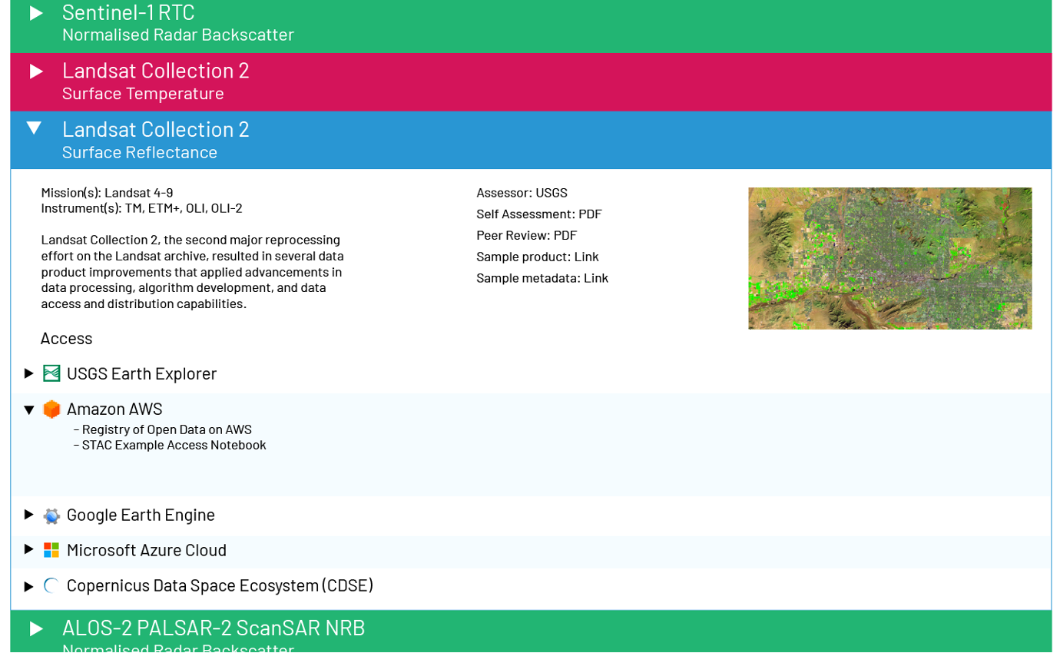
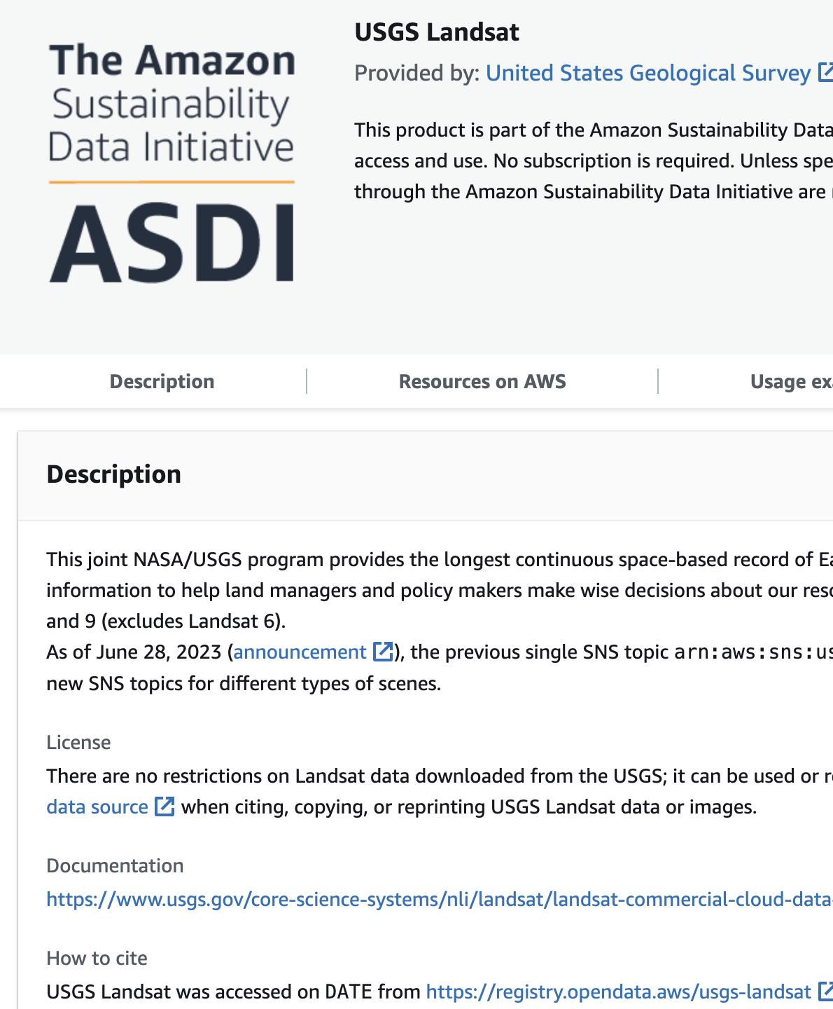
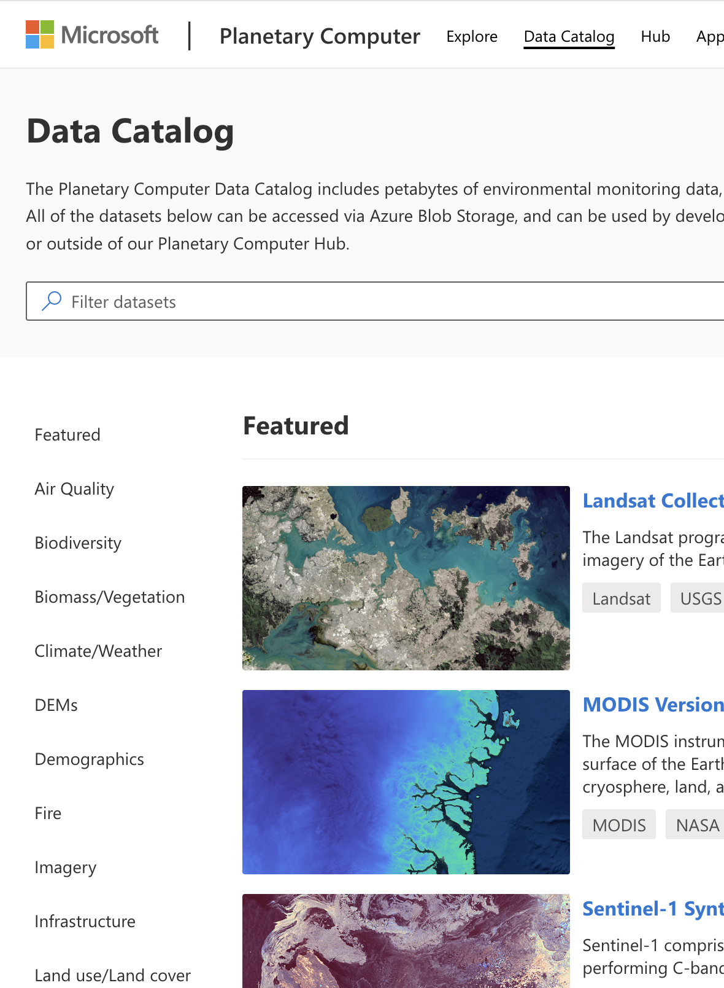
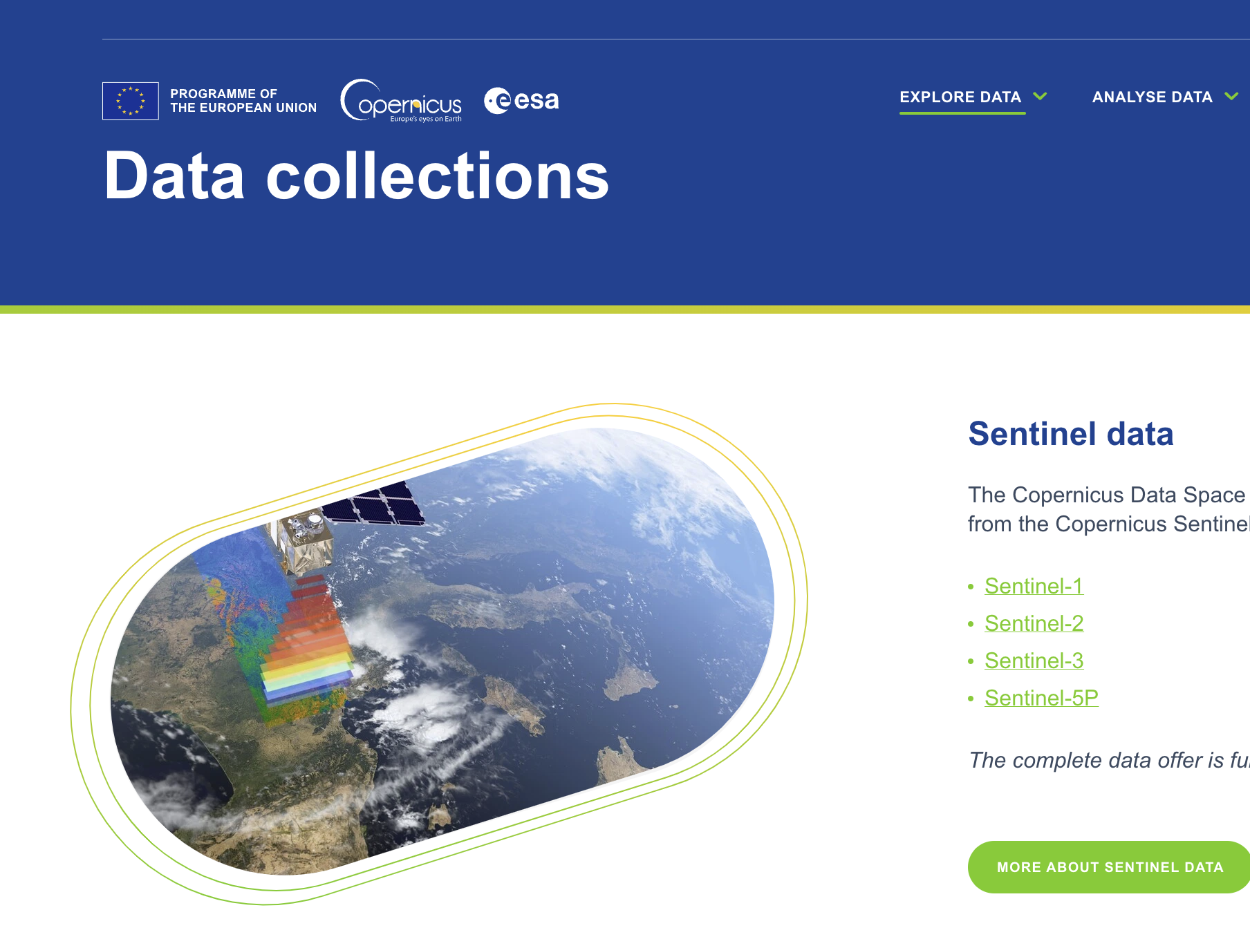
3: Discovery, Access, Utilisation, and Interoperability
Embrace the CEOS Interoperability Framework
Alignment of CEOS-ARD and SpatioTemporal Asset Catalogs (STAC)
Cloud native approaches
CEOS-ARD discoverability and branding
CEOS-ARD in the commercial cloud
Leverage existing agency relationships
Seek to establish dialogues with key data distributors and cloud operators to coherently promote CEOS-ARD via their platforms

Slide 10
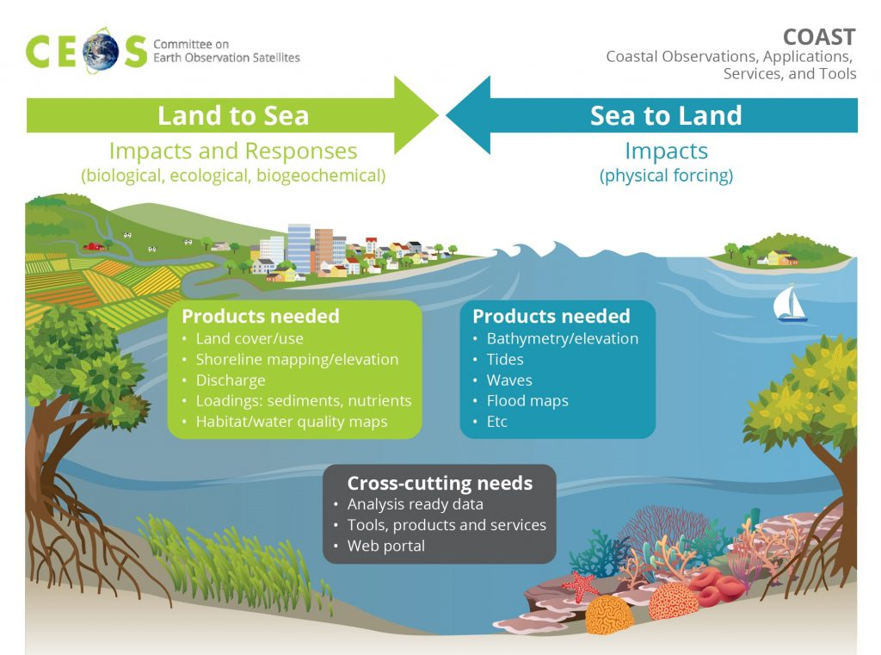
Other key items…
4.1: Monitor, guide and advise community efforts to define broader geospatial ARD standards, ensuring compatibility and consistency with CEOS-ARD
4.2: Support higher level products for CEOS priority areas
5.1: Support and use the CEOS Analytics Lab as a key platform for pilot studies of CEOS-ARD and interoperability
Working with other CEOS entities to explore opportunities for pilots and feedback
6.1: CEOS-Industry ARD workshops alongside key CEOS meetings
6.2: Conduct trial CEOS-ARD self-assessments with commercial data

Slide 11
A word on standards…
Over a year of Joint OGC-ISO ARD SWG teleconferences
Pace of progress incompatible with the expectations, deadlines, and processes imposed upon it.
SWG has experienced multiple core challenges that include:
a lack of distinct progress on a geospatial ARD standard
insufficient diversity in contributors
inadequate consensus among active contributors.
Proposal to strategically pause the Joint OGC-ISO ARD SWG activities has been tabled
It does not question the importance and relevance of the ARD concept
Due to rapid technological development, current efforts to define ARD broadly would benefit greatly by shifting from a standards approach to a more open source specification approach.
Allows agile development on an unrestricted timeline which can be reintroduced to OGC and ISO standards processes after it has been iteratively improved, implemented, and has seen adoption by real-world user communities and data providers.
To ensure that diverging, and conflicting, standards development efforts do not proceed prematurely, both the OGC and ISO aspects of the Joint SWG should be suspended for now, allowing this agile and open source specification effort to mature
With the CEOS-ARD Strategy we seek to maintain leadership of the satellite Earth observation Analysis Ready Data concept through CEOS-ARD, which should serve as the basis for more formal standards at the appropriate time.

Slide 12
Conclusion
This is just a small selection of what we need and want to do next – see Strategy doc for all the details
Looking for endorsement of the 2024 CEOS-ARD Strategy at CEOS Plenary to reaffirm the direction
We are planning a significant refresh of our approach to CEOS-ARD specifications seeking to improve consistency and community participation
WGISS support critical to discovery, access, utilisation, and interoperability aspects.
WGCV support to peer reviews likewise crucial and very much appreciated.
This is an ambitious collection of work and we need more interested and motivated agency folks to join us
We hope the Strategy makes the development plans, requirements, and overall direction of CEOS-ARD clear and approachable

Slide 13
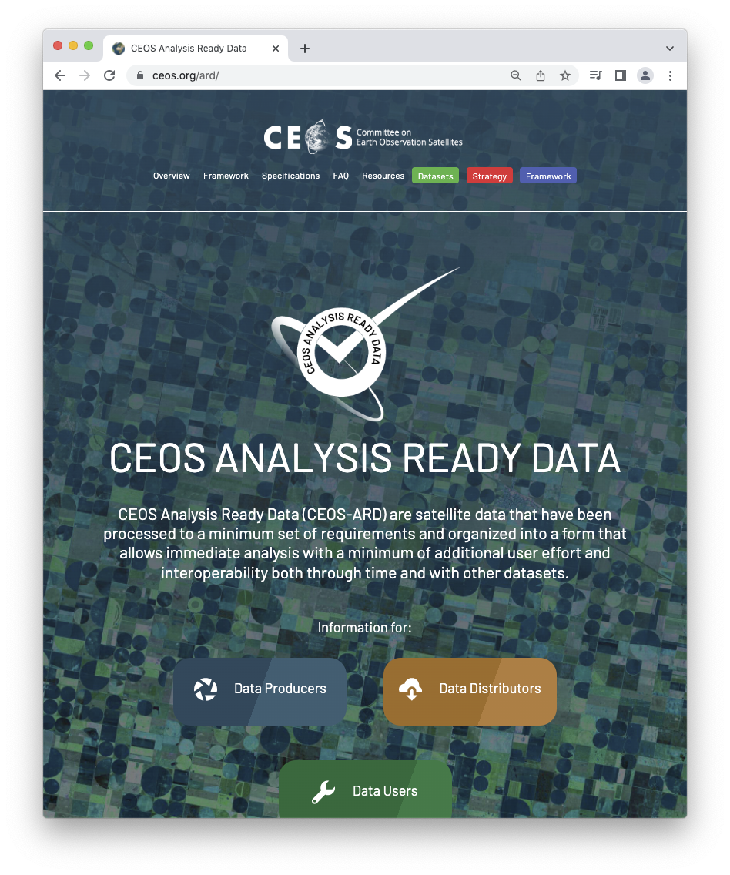
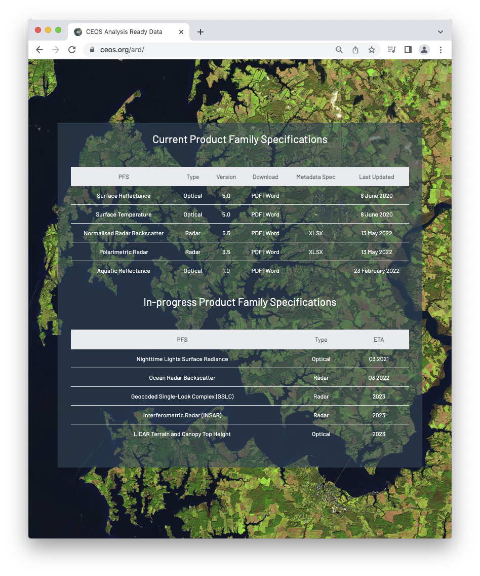
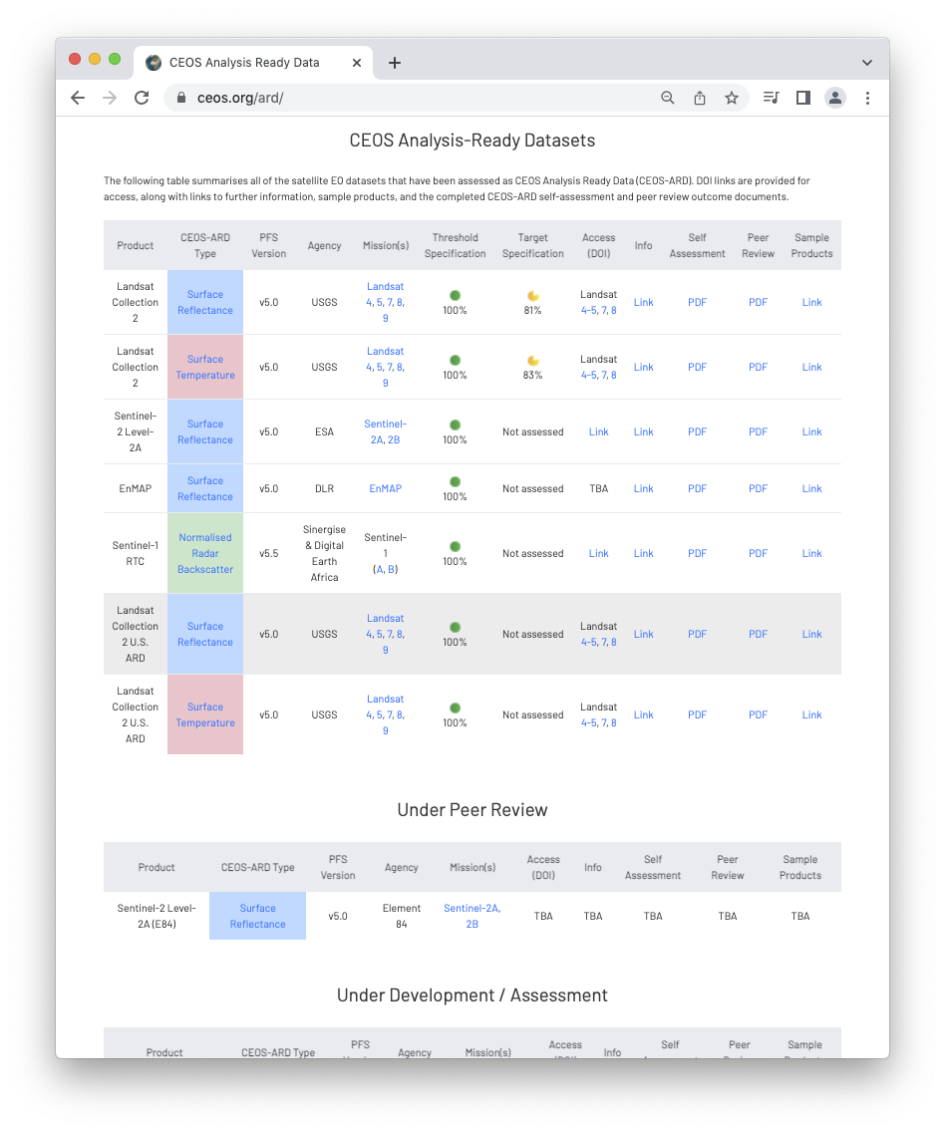
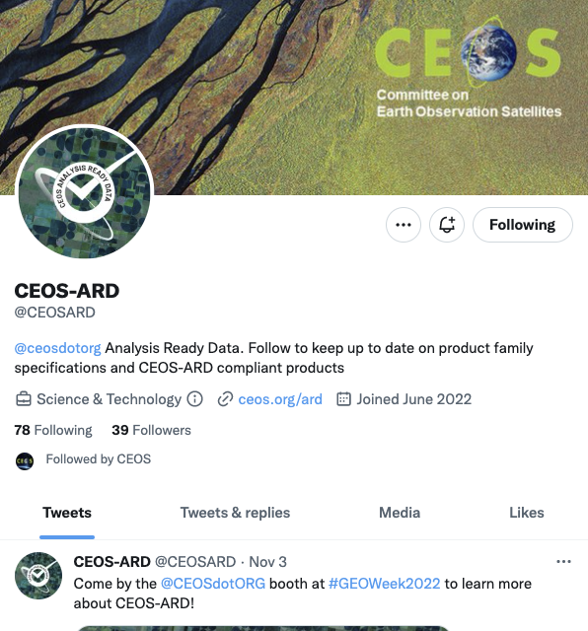
More information
ceos.org/ard
CEOS-ARD GitHub
CEOS-ARD Newsletter Sign-up
Past issues: https://ceos.org/ceos-ard-newsletter/
https://twitter.com/CEOSARD
Contacts:
Ferran.Gascon@esa.int
matthew@symbioscomms.com

Slide 14
Thank you!

