Slide 1
SIT Technical Workshop 2024
Precipitation Virtual Constellation (P-VC)
Chris Kidd, NASA/GSFC
Takuji Kubota, JAXA
Agenda Item 8.1
SIT Technical Workshop 2024
Sydney, Australia
18th - 19th September 2024

Slide 2
P-VC goals
Main P-VC goals:
Maintain and enhance the precipitation constellation
Integrate new satellites and sensors
Develop and refine retrieval schemes
Validate precipitation products
Support from CEOS for:
current missions, including continuation of precipitation-capable missions beyond end-of-life (where practical) and for mitigation strategies where necessary;
planned new missions (such as AMSR-3, AOS/PMM, CIMR, JPSS-4, etc);
development of a long-term strategy for a viable and sustainable precipitation constellation, including new and emerging technologies;
maintaining, expanding and exploiting (not directly funded) global ground validation (e.g. USA, Europe, S.Africa, S.America, Japan, S.Korea, India, Australia, etc).

Slide 3
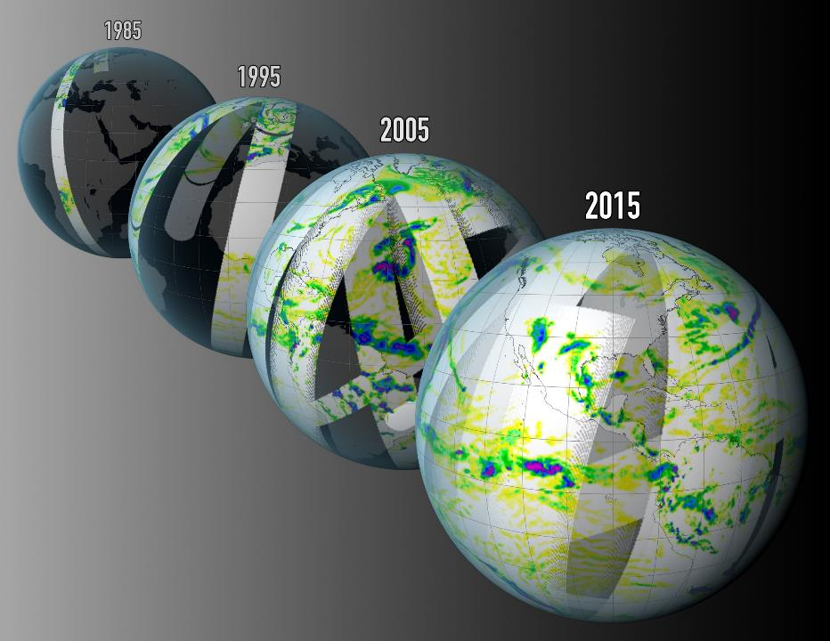
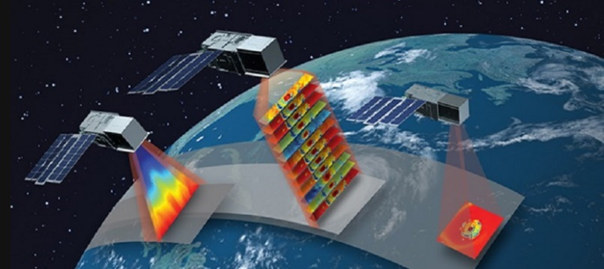
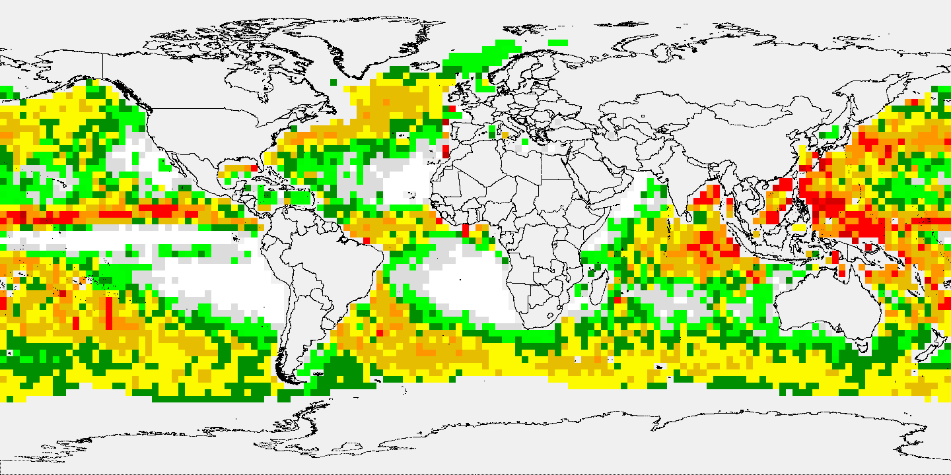
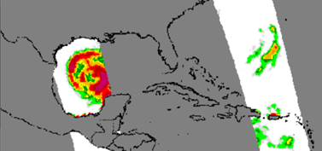
P-VC outline
International Precipitation Working Group (IPWG) meeting recommendations highlights (For Discussion)
Passive microwave radiometer continuity (For Discussion)
Precipitation CEOS-ARD (For Information)
Nimbus-7 SMMR 1978-1987
NASA/MIT TROPICS mission 2021-present
PRPS-SMMR
Mean annual1984
H. Allen 1980-08-08 06:18 UTC
PRPS-TROPICS
August 2021
Ensuring consistency of precipitation products through continuity of sensors and processing systems
GPROF-GMI

Slide 4
IPWG meeting, Tokyo, 15-18 July 2024
The 11th Workshop of International Precipitation Working Group (IPWG-11) was hosted by JAXA at the Tokyo Institute of Technology, Tokyo, 15-18 July 2024
A total of 136 attendees from 16 countries presented 52 oral papers and 68 posters.
Working groups and focus groups met to discuss and put forward recommendations.

Slide 5
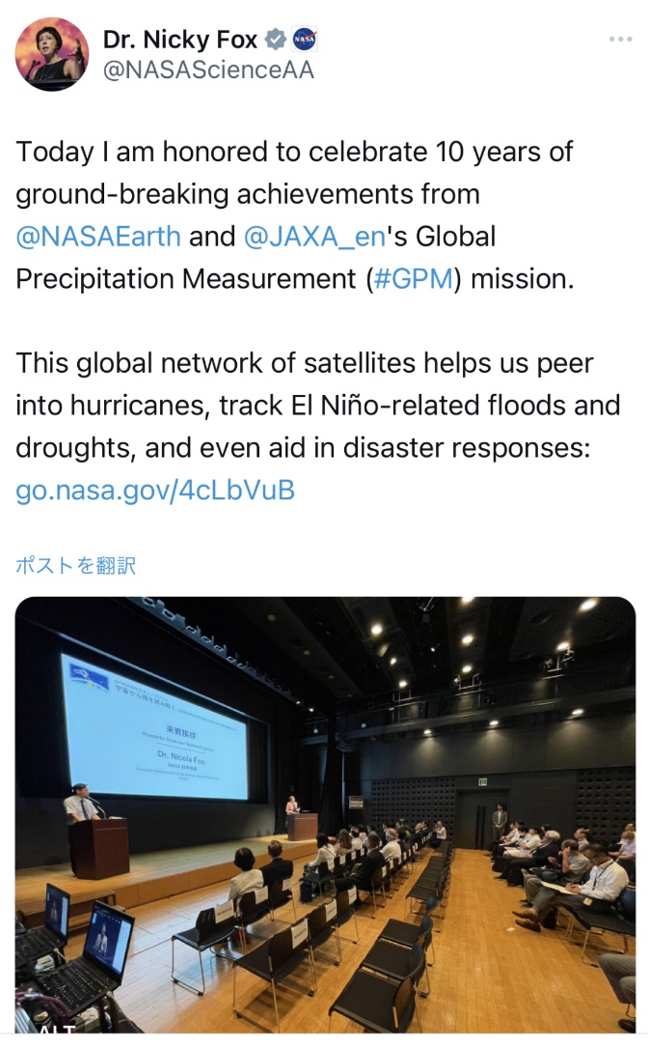
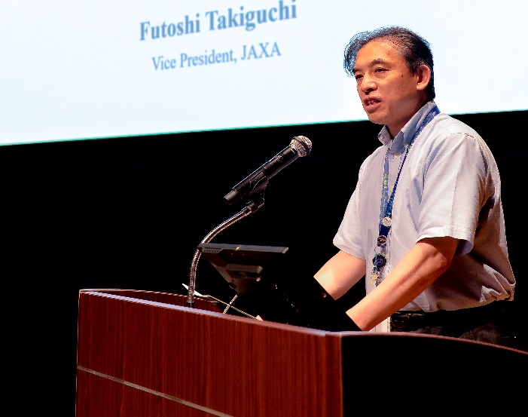
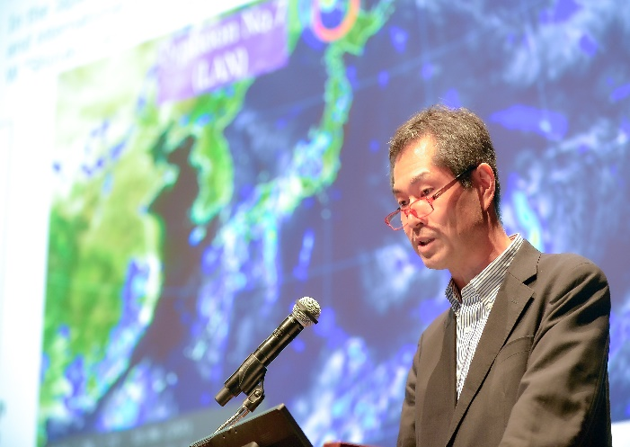
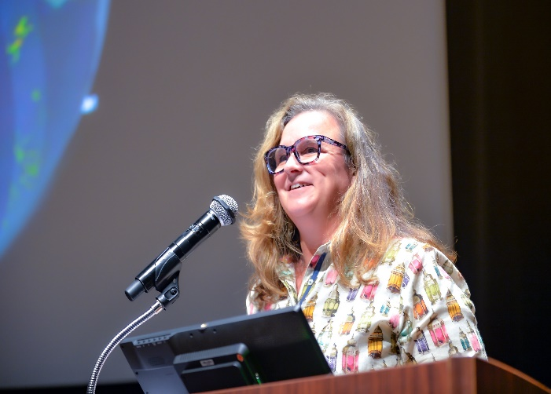
GPM 10th Anniversary Symposium
The GPM 10th Anniversary Symposium “Unraveling precipitation from satellites” was hosted by JAXA and held at the Marunouchi Hall and Conference Centre, Tokyo, and online on 19th July 2024 .
https://www.eorc.jaxa.jp/GPM/event/gpm10th/index_e.html
447 participants (174 on-site, 273 online)
Videos are available on the JAXA HQ YouTube channel.
Opening：https://www.youtube.com/watch?v=MqNWrZ8AX2g
Part 1：https://www.youtube.com/watch?v=M3Efuk1NQbQ
Part 2：https://www.youtube.com/watch?v=qlTH2SR24yY
Mr. Futoshi Takiguchi (JAXA Vice President)
Dr. Hironori Maejima (JAXA)
Dr. Nicola Fox (NASA HQ)
Dr. Karen M. St. Germain (NASA HQ)
pic.x.com/bl84hwkxby

Slide 6
IPWG WG recommendation highlights
The precipitation constellation – future directions
Maintain continuity of microwave imagers and promote future passive microwave sensors
A high quality low-inclination sensor for the intercalibration of the constellation (GMI-quality or better) – critically important for emerging small/cube-sat sensors.
Precipitation-specific OSSEs required to establish minimum sensor requirements, wide channel selection including low frequencies (background information and supercooled liquid water) and dual-polarization sub-mm wave frequencies, e.g. 166 GHz.
Study orbital configurations to maximise temporal sampling which should be as complementary as possible: studies should include baseline configurations plus ‘added value’.
Similar recommendations in NOAA Technical Report NESDIS No. 159
(doi: 10.25923/r2sf-sz28)

Slide 7
IPWG FG recommendation highlights
GEO-Ring is important for IPWG activities: need to fill historical gaps over the Indian Ocean coverage; 4-km/30-minute (or better) needed; minimum of Vis/WV/IR; globally uniform gridding with zenith angle correction, sensor intercalibration, parallax correction, and geolocation.
Support space-borne cloud and precipitation radars with dual frequencies, e.g. W and Ku/Ka, especially W band with swath (for light precipitation/snowfall)
Better definition of uncertainties: Tools are readily available, but guidance as to what is required, and which applications actually use uncertainties.
Standard tools need developing for cal/val, geolocation, quality control etc. necessary for pre-processing of both agency and commercial data.
Foster international collaboration for global snowfall estimation to establish and sustain satellite observations with adequate spatial and temporal resolutions together with coordination in collecting snowfall reference data (in-situ, ground-based and spaceborne radar observations)

Slide 8
The Precipitation constellation
Current PMW configuration
1 radar, 5 imagers, 6 sounders:
GPM DPR
GPM GMI
GCOM-W AMSR2
DMSP-F16/17/18 SSMIS
MetOp-B/C MHS
NOAA-19 MHS
NOAA-20/21/NPP ATMS
TROPICS-03/05/06 TMS
ISS COWVR/TEMPEST
FY-3G PMR & MWRI-RM
Recent Precipitation-related launches
DoD WSF-M1 11 April 2024
10.85-89.0 GHz (6 freq/18 channel)
EarthCARE 29 May 2024
Cloud Profiling Radar 94 GHz Doppler
tomorrow.io -S1 & -S2 16 August 2024
tomorrow.io microwave sounder (89-204.8 GHz)
(commercial development of TROPICS TMS)
Arctic Weather Satellite 16 August 2024
precursor to EUMETSAT EPS-Sterna
50-325 GHz 19 channel radiometer.
10th anniversary
20th anniversary
15th anniversary

Slide 9
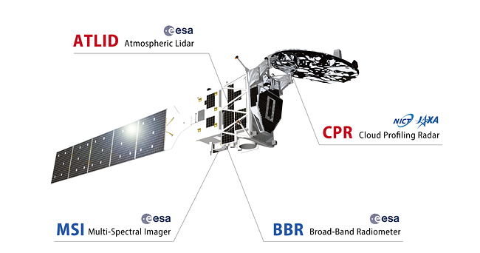
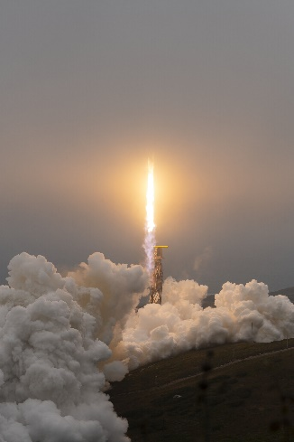
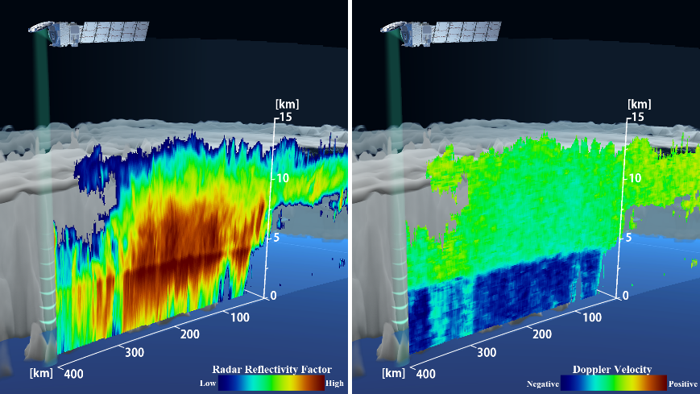
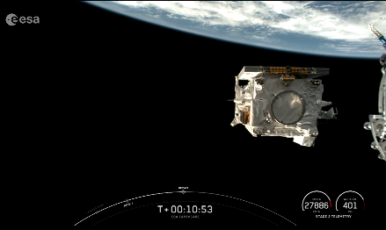
ESA/JAXA EarthCARE mission
The joint ESA/JAXA Earth Cloud, Aerosol and Radiation Explorer (EarthCARE) observes clouds, aerosols, and radiation on a global scale to improve the accuracy of climate change predictions.
JAXA and NICT have developed Cloud Profiling Radar (CPR) with doppler capability.
It was the world's first spaceborne W-band (94GHz) radar with doppler capability.
The CPR can provide observations of not only cloud but also snowfall and light rainfall.
EarthCARE was launched on 29 May at 00:20 CEST on a Falcon 9 rocket from the Vandenberg Space Force Base CA, US.
Measuring cloud by the CPR: first images on 27 June released by JAXA/NICT/ESA
Spacecraft deployment (SpaceX/ESA)
(c) ESA - S. Corvaja
https://global.jaxa.jp/press/2024/06/20240627-1_e.html

Slide 10
Satellite precipitation measurements
Fundamentally, any satellite measurement is only as good as the
directness of the observation-parameter relationship.
Passive microwave radiances received are a result of the interactions with cloud and precipitation-sized particles – therefore much more direct than visible/infrared.
Frequency selection is constrained by physics (interactions with hydrometeors) and by frequency allocation (to avoid RF interference).
Passive microwave sounders are designed for temperature and moisture profiles, not precipitation per se: they strongly attenuate with clouds and precipitation – and do not penetrate the tops of storm clouds.
Passive microwave imagers are designed to see through to the surface: attenuation affected by frequency of observation and size/phase of hydrometeors (liquid or frozen)

Slide 11
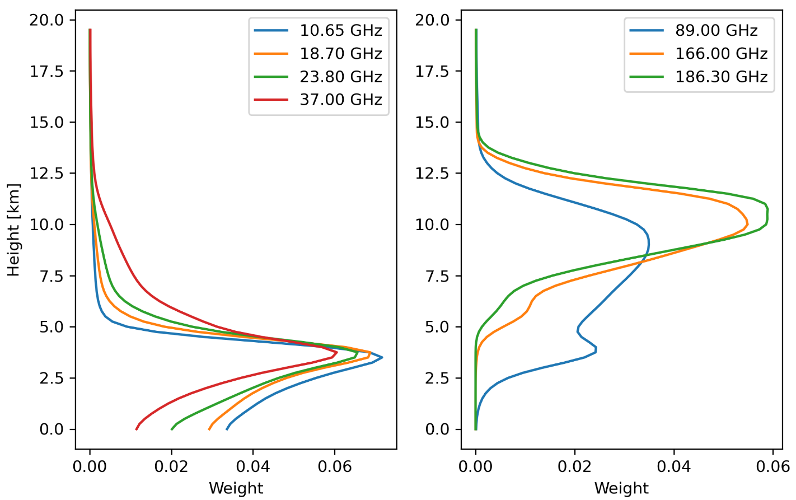
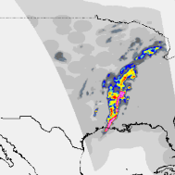
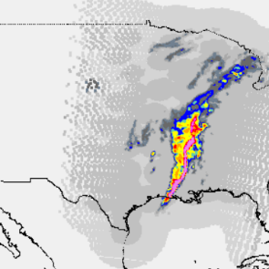
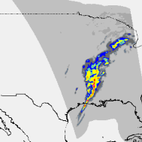
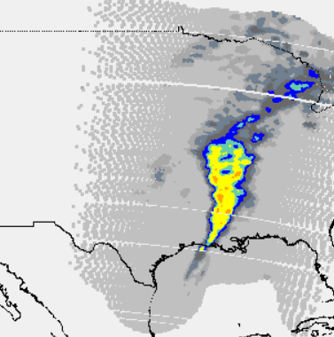
At-surface or atmospheric precipitation?
Atmospheric microwave weighting curves
2022-03-30_19:40UTC
2022-03-30_20:32UTC
low
frequencies
high
frequencies
MRMS radar
MRMS radar
10-89 GHz
91.655
-204.8 GHz
FL
GPROF-AMSR-2
PRPS-TMS V04-01
It is complicated - no such thing as a typical profile!
10-37 GHz have greatest sensitivity over the liquid precipitation region
89 GHz and above are primarily sensitive over the cloud ice region

Slide 12
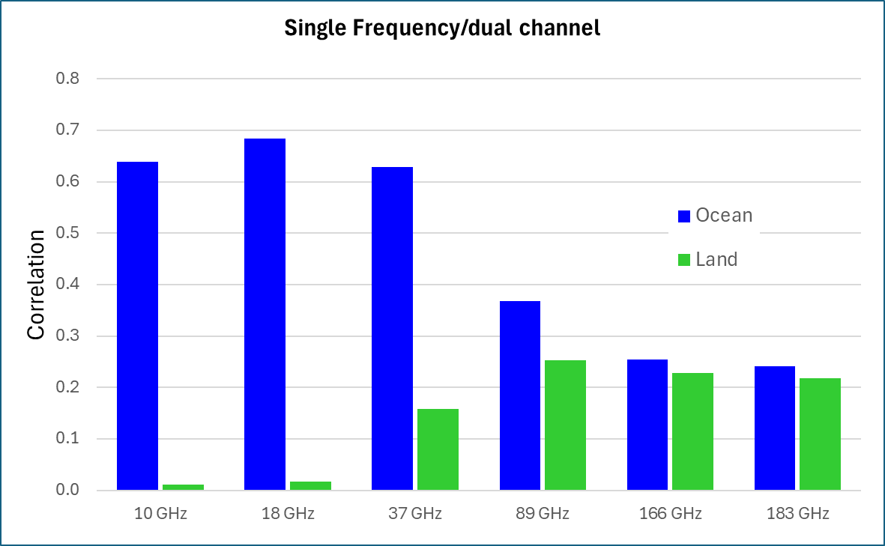
Q: Which are the best performing single frequencies?
LF channels are best over water
The 18 GHz alone performs nearly as well as the all-channel combination (red dashed-line).
HF channels ‘better’ over land
but poorer overall performance of HF channels over land indicative of more complex background surface.
*Based on a 10-year GMI/DPR matched dataset, select 10 months/year for the database and 2 months/year for the retrieval – 750M database entries.
10 GHz
18 GHz
37 GHz
89 GHz
166 GHz
183 GHz
(24 GHz channel omitted due to no polarization)

Slide 13
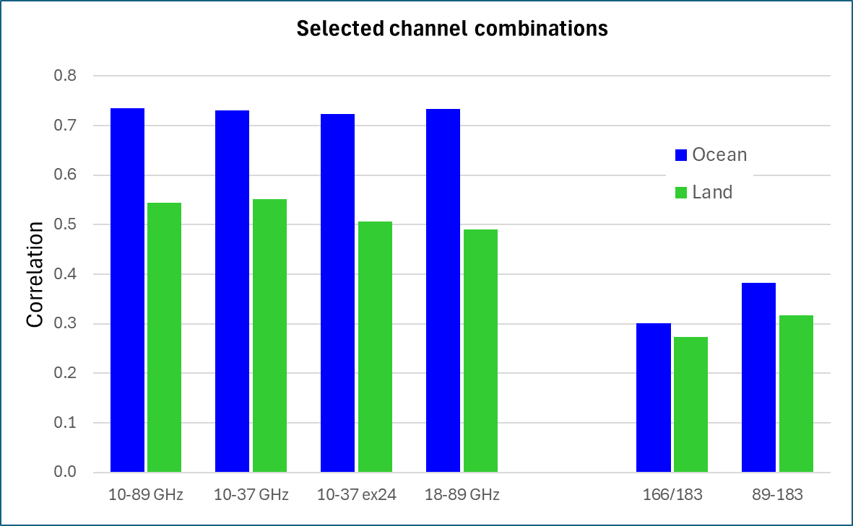
Low vs high frequency combinations?
Q: Which are the best performing combinations of frequencies?
Oceans: combinations of LF channels perform best (with/without the 10 or 89 GHz). The ‘sounder’ 89-183 retrievals perform poorly in comparison.
Over land even the LF combinations outperform the HF retrievals.
However, the inclusion of HF channels is crucial at detecting and retrieving light rainfall and snowfall.
10-89 GHz
10-37 GHz
10-37 ex24
18-89 GHz
166/183 GHz
89-183 GHz

Slide 14
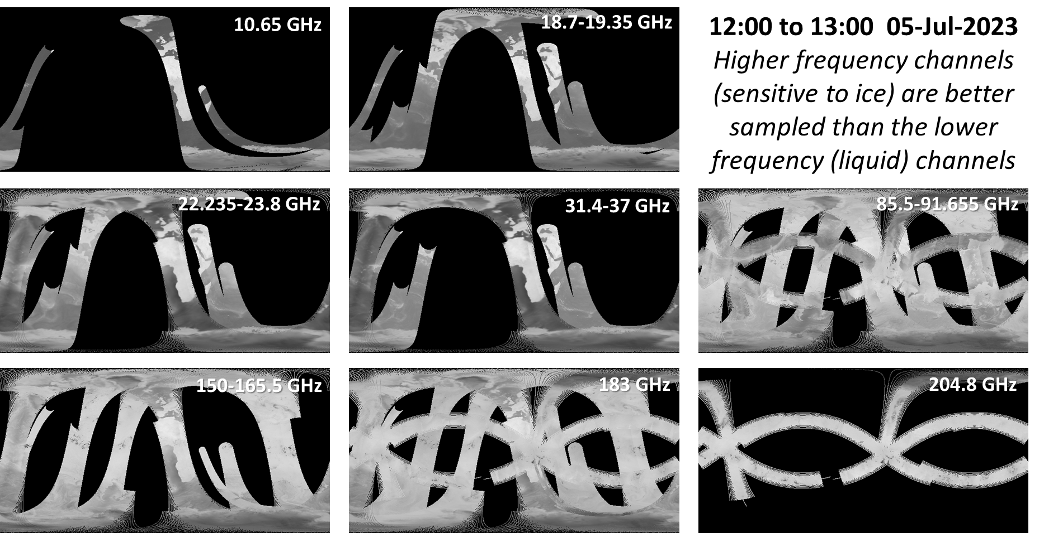
1-hour Global Coverage by PMW frequency

Slide 15
Upcoming precipitation-related missions
JAXA GOSAT-GW
AMSR3 (passive microwave imager) 6.9-183 GHz – better NEDT, RFI protection and high frequency channels for light rainfall and snowfall
tomorrow.io
TMS (radars & passive microwave sounders) 89-204.8 GHz – constellation of 6 & 18 cubesats
EUMETSAT-EPS
MWI (passive microwave imagers) 18.7-183.31 GHz
MWS (passive microwave sounders) 23.8-229 GHz
ICI (passive microwave conically scanning) 183.31-664 GHz
AWS (passive microwave sounders) 50-325 GHz
NOAA
Quicksounder (passive microwave sounder – ATMS) 23.8-183.31 GHz
ATMS on JPSS-4/JPSS-3 (passive microwave sounders) 23.8-183.31 GHz
NASA/JAXA/international partners
AOS (radar & passive microwave sounders) 89?-325 GHz (still under study)
ESA
CIMR (passive microwave imager(s)) 1.4-37 GHz
Over the next 8-10 years:
1+6 precipitation radars
3 PMW imagers
5+18 PMW sounders

Slide 16
Precipitation constellation: Conclusions
A common theme amongst many reports are:
i) passive microwave imagers provide more direct measures of precipitation than passive microwave sounders (which sense temperature and moisture).
ii) the continuity of a high quality, wide frequency passive microwave radiometer is critical for intercalibration.
iii) better temporal sampling is necessary to capture the variability of precipitation (particularly important for sub-daily accumulations)
iv) good spatial resolution is crucial for resolving (convective) precipitation (89 GHz on ATMS is 32x32 km, on GMI it is 3x5 km)
There is a paucity of low frequency passive microwave observations that are critical for accurate retrievals over both ocean and land.
No commercial providers plan to provide low frequency observations

Slide 17
ARD for Precipitation – for information
Current “satellite precipitation products” are generally overseen by agencies/organisations and are in standard formats– primarily netcdf, HDF, (some in grib or BUFR) – all designed to be analysis-ready (and inter-operable).
There is a large user community using the current precipitation products (>300M product downloads over the 10 years of GPM)
But:
Need to ensure consistency of products into the future – and between products.
To set a standard for new (or reprocessed) products to aspire to.
Start at Level 2 and Level 3 data levels – precipitation products

Slide 18
Analysis Ready Data for Precipitation
Directions/roadmap:
Stage 1 – poll of existing precipitation products to highlight similarities and differences – e.g. naming conventions, terminology, units, ‘depth’ of metadata
Stage 2 – assessment of current products with current ‘standards’ in the meteorological and climatological communities.
Stage n – NASA PPS Version 8 – (anticipated) last GPM version (2026) provides an opportunity to generate products with standardised terminology and metadata.

Slide 19
Precipitation product contents (Level 3)
IMERG:
float precipitation(time, lon, lat) ;
string precipitation:units = "mm/day" ;
string precipitation:long_name = "Daily mean precipitation rate (combined microwave-IR) estimate. Formerly precipitationCal." ;
string precipitation:coordinates = "time lon lat" ;
precipitation:_FillValue = -9999.9f ;
GSMaP:
{
FILE_CONTENTS {
group /
group /Grid
dataset /Grid/Latitude
dataset /Grid/Longitude
dataset /Grid/gaugeQualityInfo
dataset /Grid/hourlyPrecipRate
dataset /Grid/hourlyPrecipRateGC
dataset /Grid/observationTimeFlag
dataset /Grid/orographicRainFlag
dataset /Grid/reliabilityFlag
dataset /Grid/satelliteInfoFlag
dataset /Grid/snowProbability
dataset /Grid/surfaceType
}
}
CMORPH:
short cmorph(time, lat, lon) ;
cmorph:standard_name = "lwe_precipitation_rate" ;
cmorph:long_name = "CMORPH-2 High Resolution Global Precipitation Estimates" ;
cmorph:units = "mm/hr" ;
cmorph:missing_value = -999s ;
cmorph:valid_min = 0s ;
cmorph:valid_max = 32767s ;
cmorph:scale_factor = 0.01f ;
cmorph:add_offset = 0.f ;
cmorph:coordinates = "time lat lon" ;
HSAF
float rr(xc, yc) ;
rr:long_name = "rainfall rate" ;
rr:units = "mm/h" ;
rr:coordinates = "lon lat" ;

Slide 20
Precipitation ARD - actions
Continue poll of current satellite precipitation products at Level 2 (instantaneous, full resolution) and Level 3 (gridded).
Draw up common criteria for satellite precipitation products, including naming/terminology conventions (e.g. ‘precipitation’ vs ‘rain’/’snow(fall)’), geolocation reporting (e.g. grid box vs grid point), time/date (e.g. include calendar dates/format).
Identify missing parameters: e.g. a common measure of uncertainty.
Liaise with meteorological national/international agencies (WMO, NOAA-NWS, etc) and organisations (RMetSoc, AMS, etc) to provide an overview of best practices and standards.

Slide 21
Questions/discussion?

