Slide 1
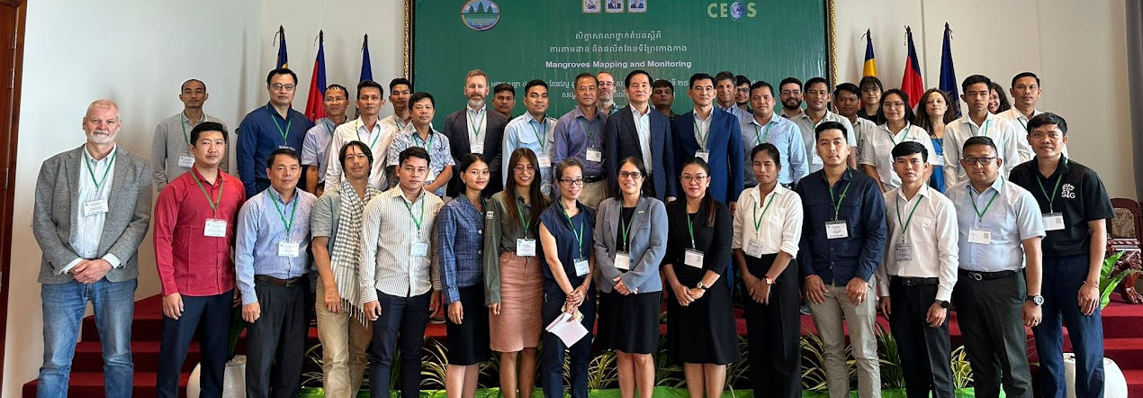





AREAS OF IMPACT FROM CEOS
1. Mangroves mapping and carbon estimation using global datasets
2. Biomass estimation and improving emission factors using space data
PILOT COUNTRIES WITH RESULTS
Latin America: Paraguay, Guatemala
Southeast Asia: Cambodia, Laos, Thailand
Africa: Gabon
Pacific Islands: Vanuatu, Fiji

Slide 2
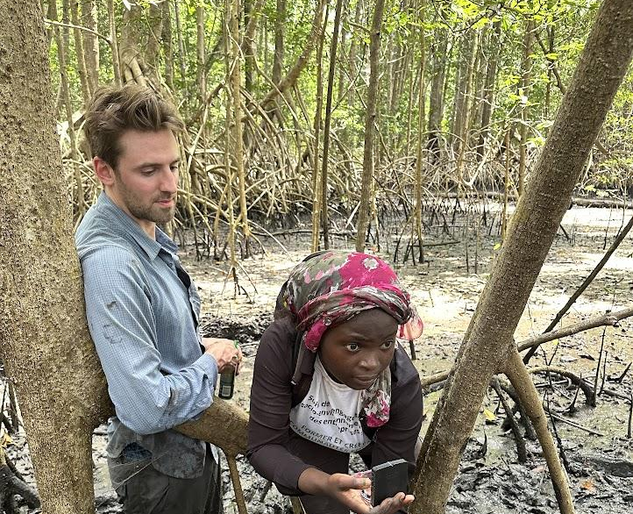

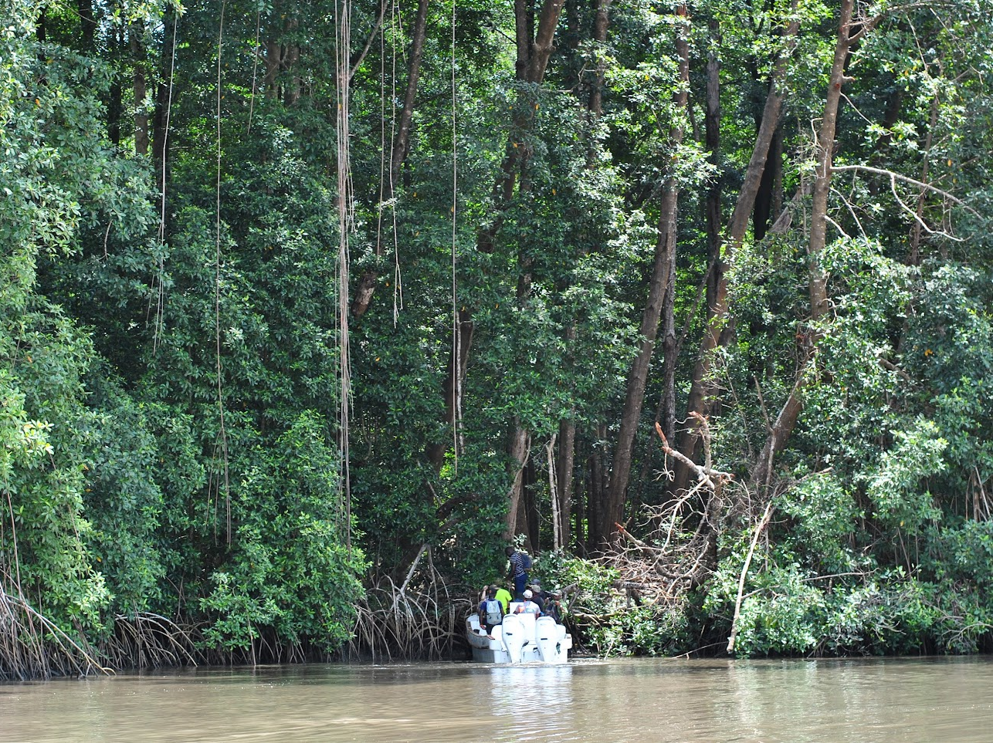
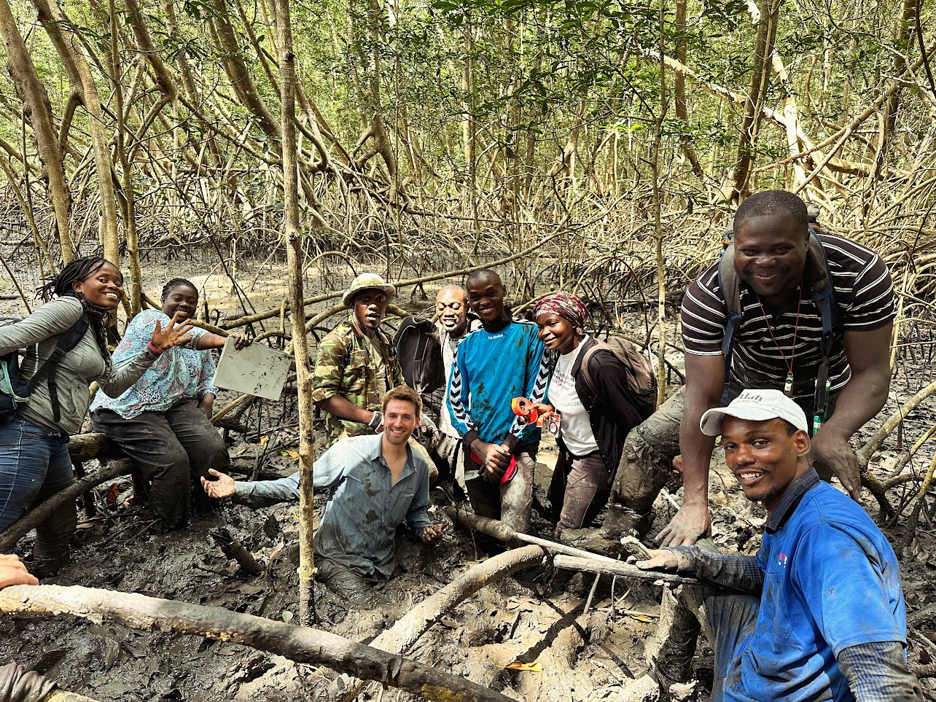
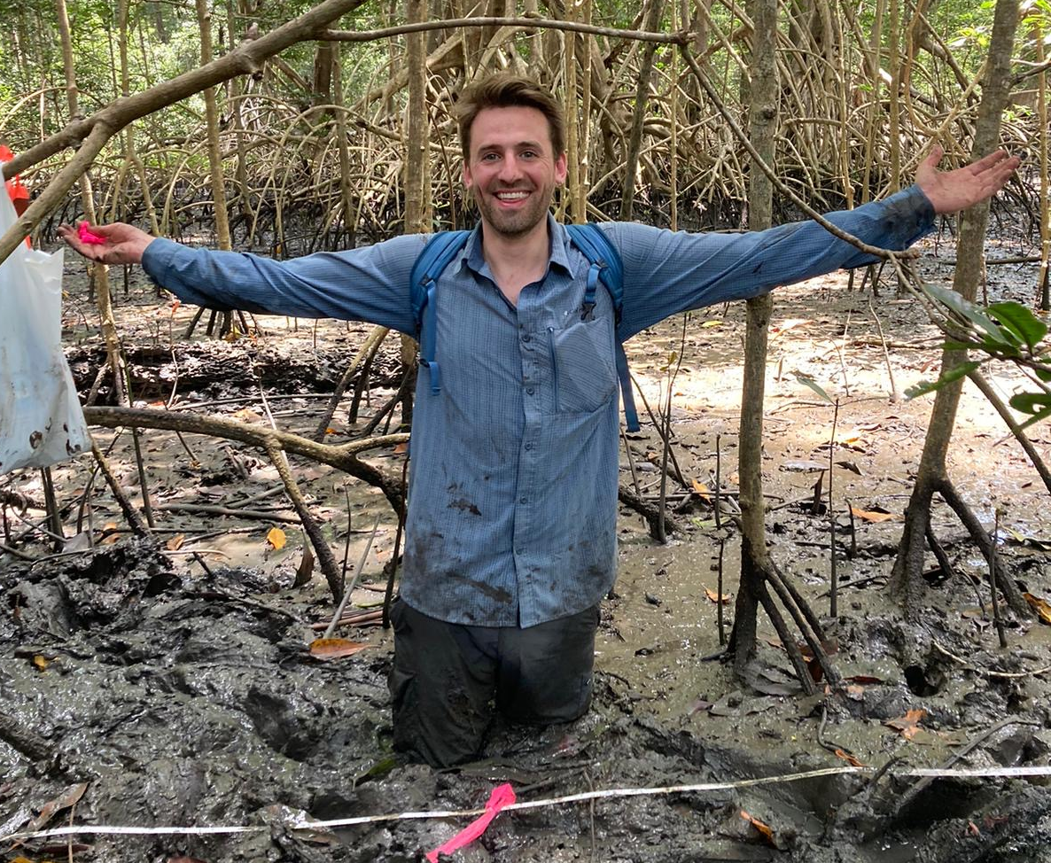
MANGROVES – Mapping and carbon estimation
Technical challenges:
Reporting using land cover classifications
Blue Carbon vs REDD+ carbon markets
Voluntarily carbon markets (financing)
Mangroves extend (seagrass, marshes, etc)
Below ground biomass (methodologies, cost, time, restoration, etc)
CEOS contribution:
1. Global datasets of mangrove extend, mangroves height and carbon sinks.
2. Integration of AD and EF, including most carbon pools

Slide 3


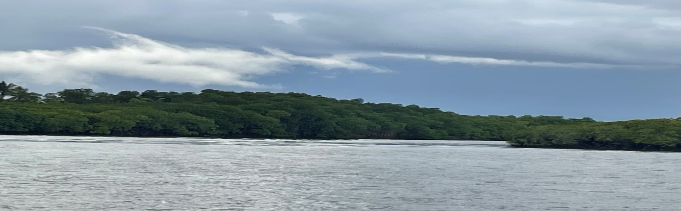
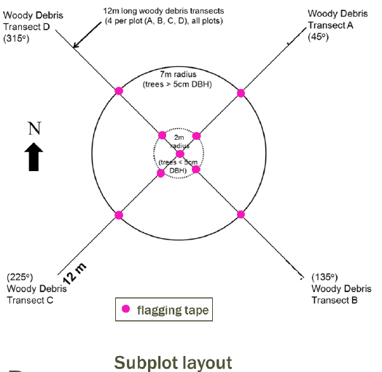
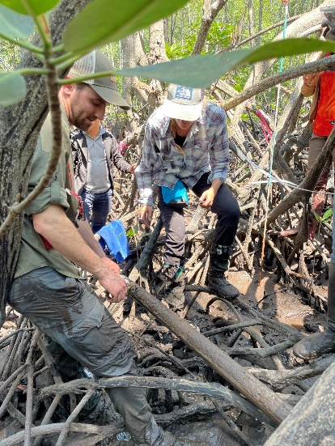
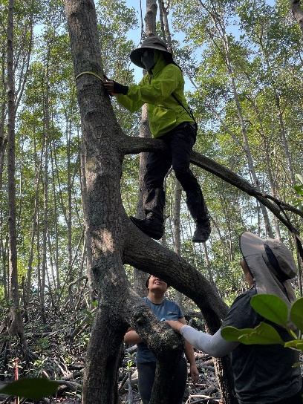
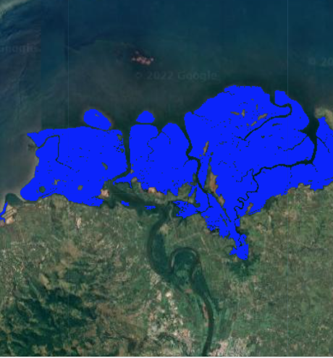
MANGROVE WORKSHOP OUTLINE
1. Background: Role of mangroves in carbon storage, sequestration, emissions. Disproportionate impact. Unique characteristics. REDD+ vs. Blue Carbon.
3. Field surveys: Use SWAMP protocol to measure C stocks in 4 pools – AGB, BGB, soils, downed woody debris. Cross-plot or linear design. Data processing to compute MgC/ha.
2. Remote sensing component: EE scripts & GUIs to map extent, canopy height, & estimate AGB and carbon (calibrated with field data).
4. Integration: How to combine RS and field data into emissions estimates (REDD+). Unbiased map areas. Approaches and tiers.
Lola Fatoyinbo
Notes:
For REDD+ we need to know both the spatial extent of mangroves (AD) and the amount of carbon/ha (EF) to estimate emissions. We do both in our workshops.
Field surveys with partners from SWAMP, CIFOR, Academia.

Slide 4

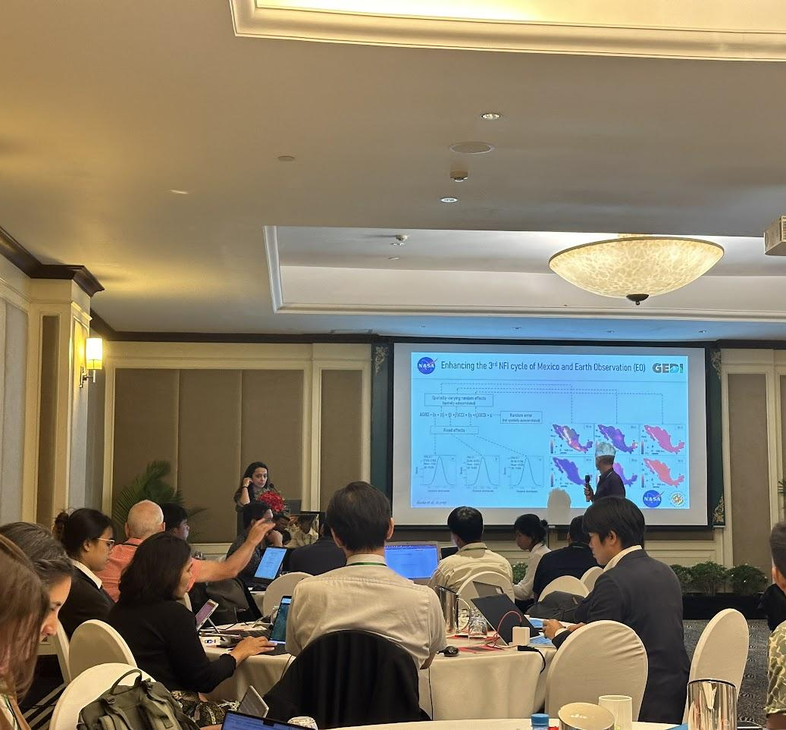
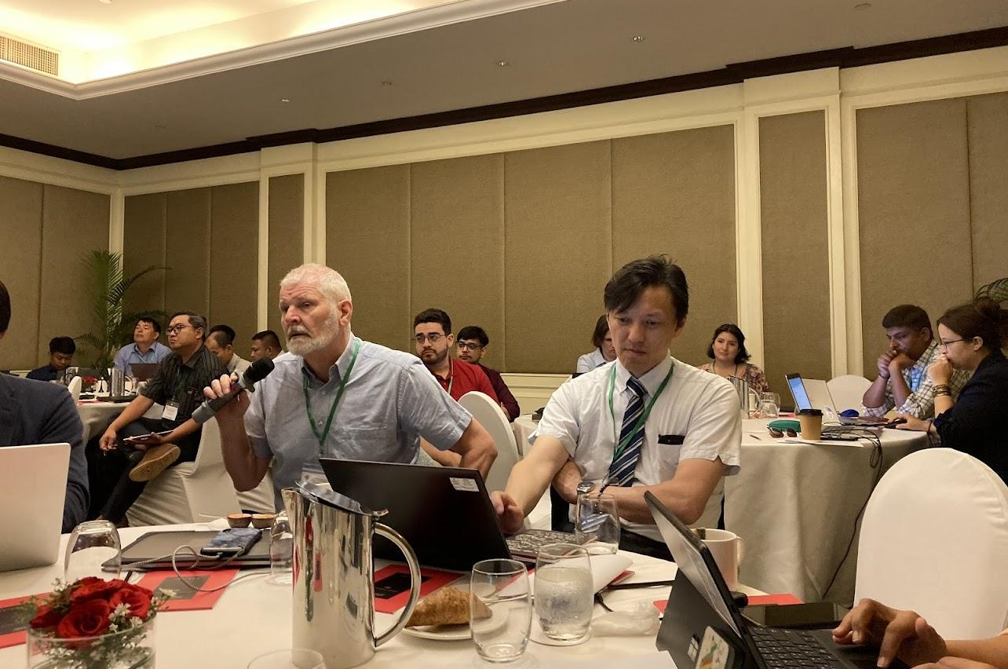
Technical Challenges
Accuracy: Biomass maps may not always accurately represent the actual biomass content of an area. Variability in vegetation types, density, and structure can also lead to uncertainties in biomass estimates.
Spatial and Temporal Resolution: The resolution of biomass maps may need to better capture small-scale changes or variations in carbon stocks. Biomass maps may not adequately capture temporal changes, either.
Incomplete Coverage: Biomass maps may only cover some regions uniformly.
Conversion Factors and Biomass Equations: Estimating carbon emissions from biomass requires converting biomass estimates into carbon content using conversion factors. These factors can vary depending on vegetation type, age, and environmental conditions.
BIOMASS estimation and improving emission factors
using space data

Slide 5
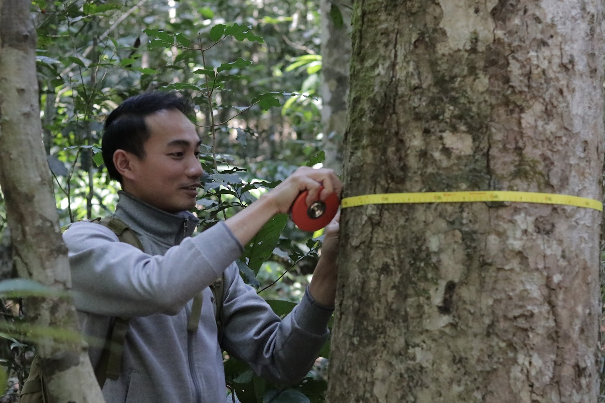
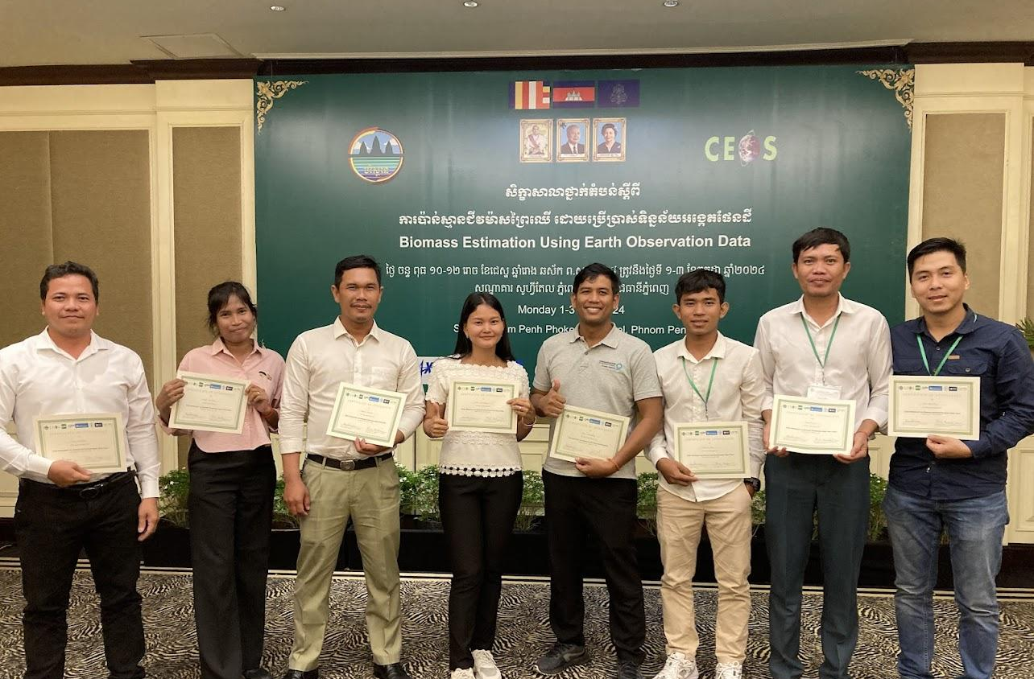
Uncertainties and Validation: Biomass mapping techniques and carbon estimation methods are associated with uncertainties. Validating biomass maps and carbon stock estimates on the ground can be challenging, especially in remote or inaccessible areas.
Policy and Reporting Requirements: The UNFCCC requires robust, accurate, and verifiable data for reporting carbon emissions. Biomass maps may only sometimes meet these requirements, mainly if uncertainties in carbon stock estimates are significant or data quality needs improvement.
CEOS contribution:
1. Customized data from University researchers using NFI from countries
2. Scripts and training to consistently use the data for two or more NFI cycles

Slide 6
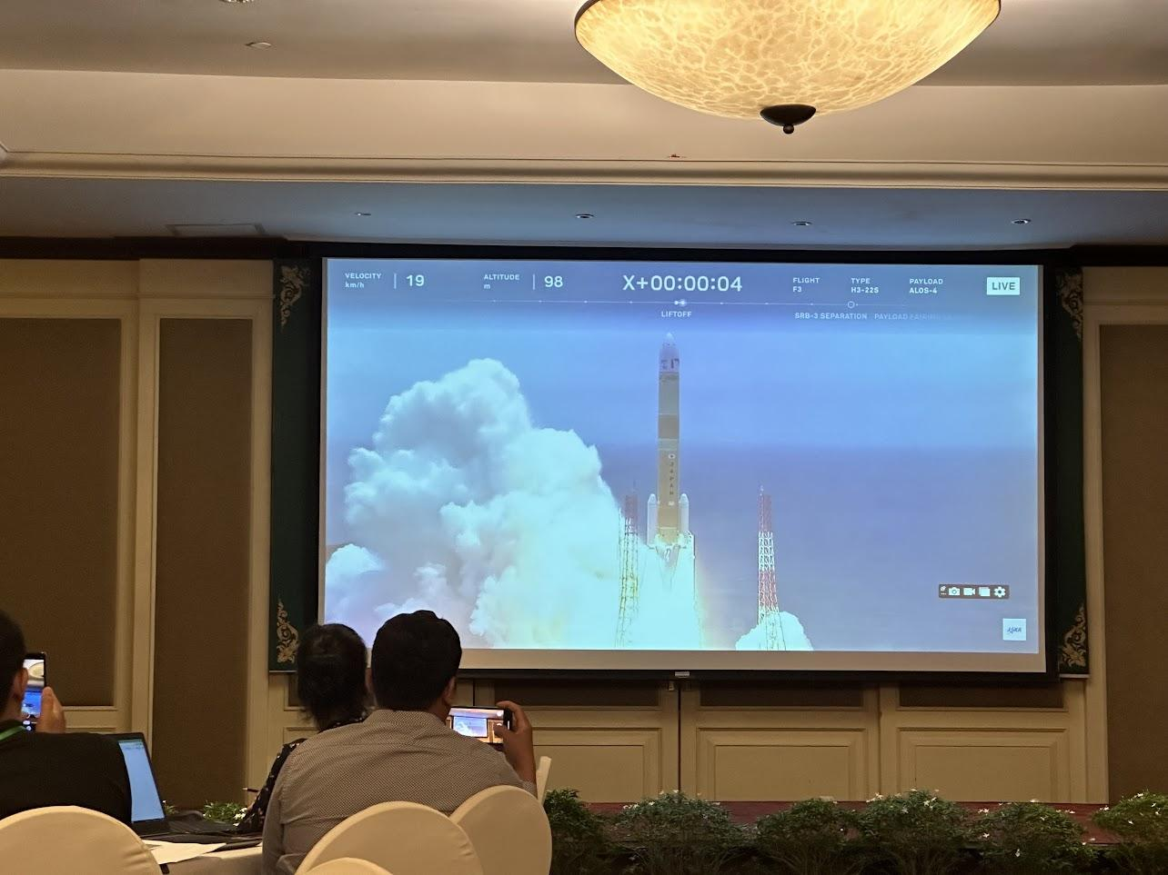
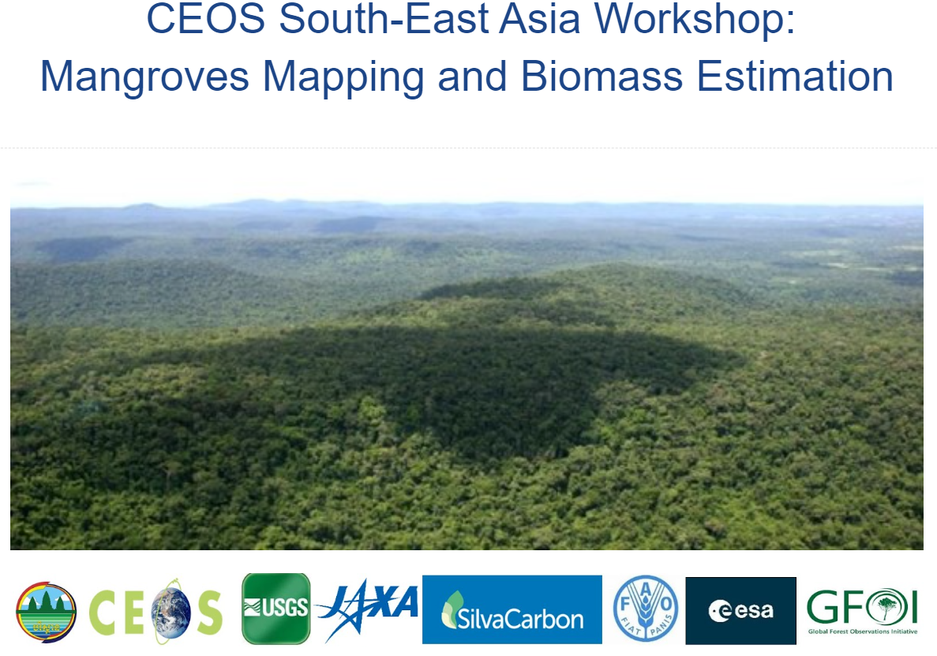
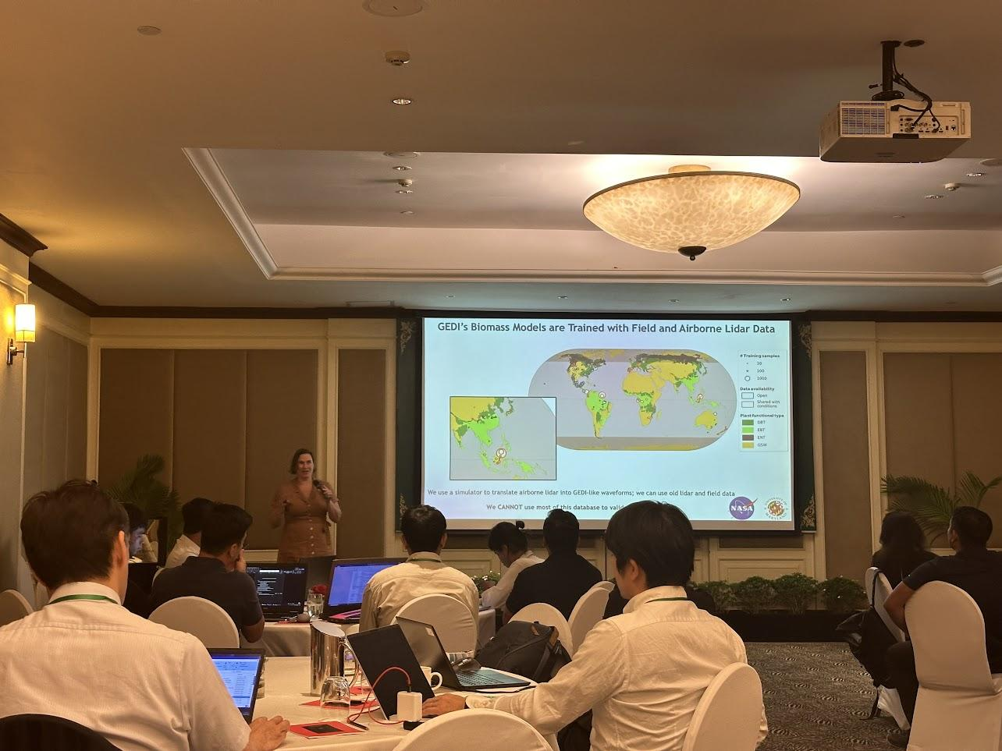
https://bit.ly/3VZ4QAZ

Slide 7
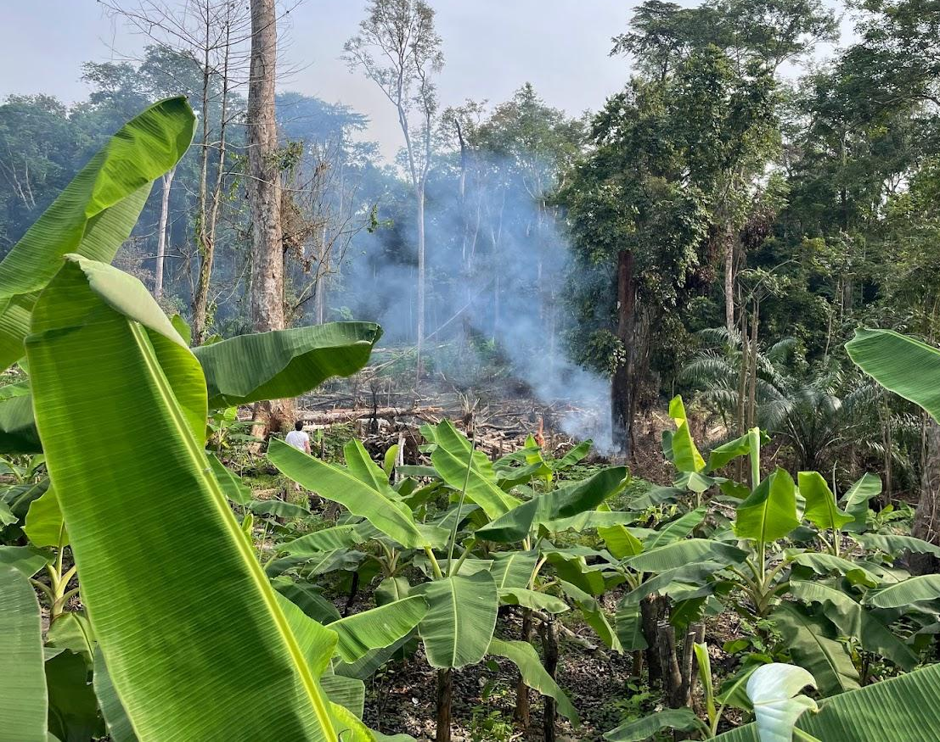
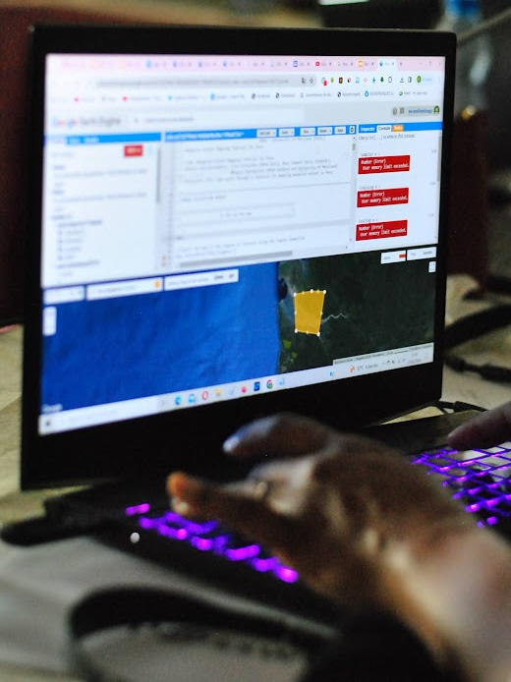

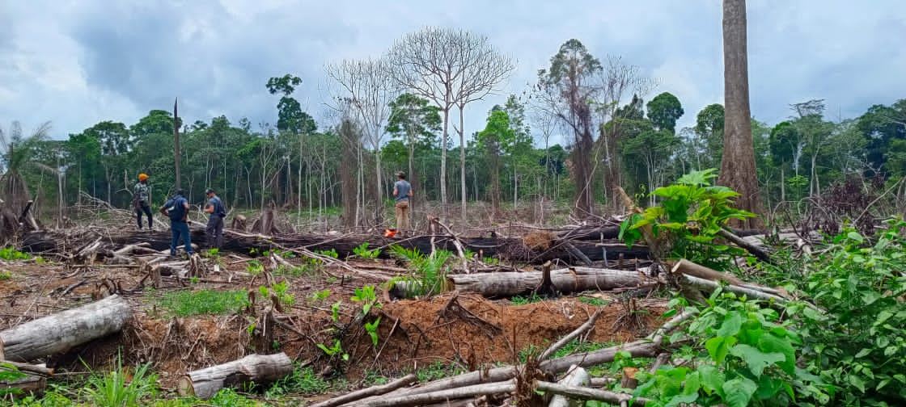
DEFORESTATION ALERTS
GABON

Slide 8

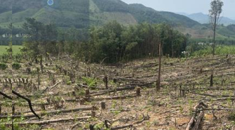
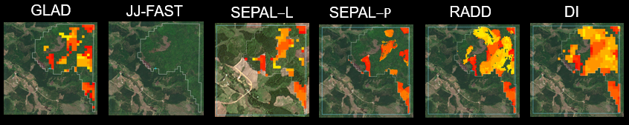
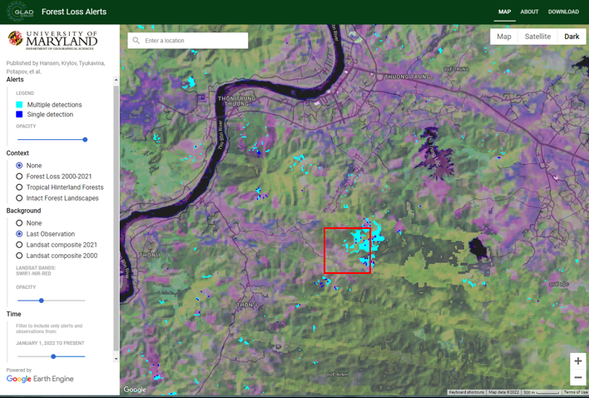
Deforestation Alerts WORKSHOP OUTLINE
1. Background: The importance of NRT monitoring and its benefits. Country presentations on current status & goals.
3. Field visit to deforestation site: On-the-ground observation of a recent deforestation event, with known drivers and timing.
4. Comparison of space-based system alerts for field site: What alert systems see from space and when they see it.
2. Comparison of the technical specifications of multiple systems by developers: spatial and temporal resolution, sensors used, strengths & weaknesses, etc.
5. Implementation: Review of guiding principles, how systems complement each other, challenges. Discussion of how to integrate NRT Alert Systems into countries’ NFMS.
Notes:
Our workshops are constantly evolving, as is the topic. I will show a brief overview here of what we have done recently (late February).
It’s meaningful to participants to see a deforestation site on the ground & then to look at the alert pixels and timing afterwards.
NRT= Near Real Time.

Slide 9
New SilvaCarbon Area 2025
Forest Fires Prediction and Monitoring
Visual Identity [running title]

Slide 10


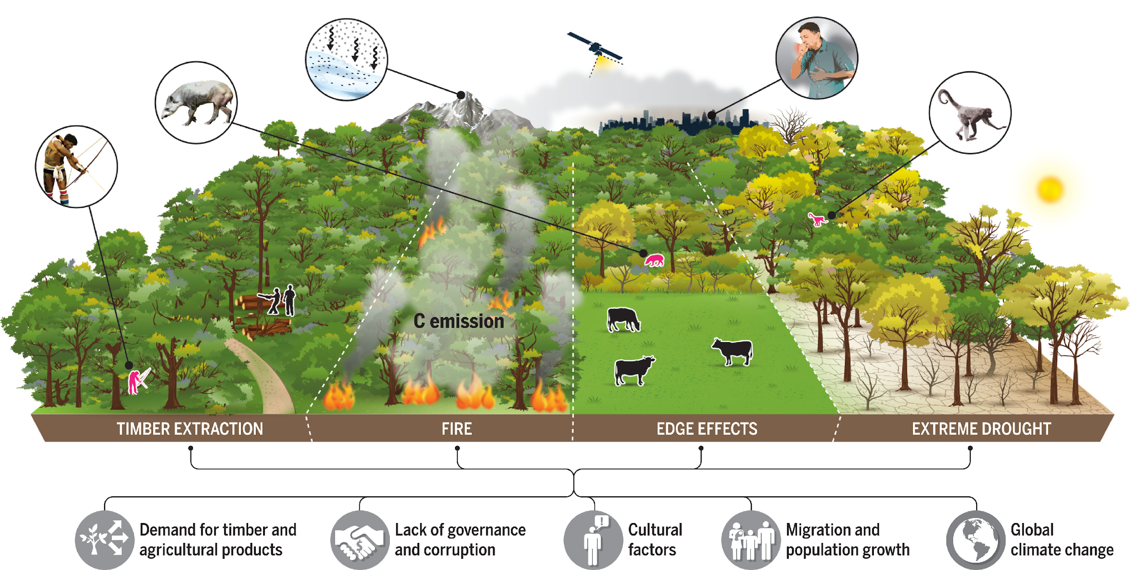
Degradation – REDD+
Degradation:
Changes within the forest that negatively affect the structure or function of the forest stand or site and therefore reduce the capacity of the forest to supply products and/or services. With respect to REDD, degradation specifically refers to a reduction in carbon density.
Source: The drivers and impacts of Amazon forest degradation | Science

Slide 11

2025 Uptake of Global Datasets Timeline
1. Fire Prediction: Latin America – Regional
2. Biomass estimation and improving EF with RS data: Southeast Asia – Regional
3. Mangroves mapping and carbon accounting: Africa – Regional
4. Deforestation Alerts: Pacific Islands - Regional
General SilvaCarbon (Actual):
Cambodia, Vietnam, Thailand, Philippines, Laos, Bangladesh, Nepal, Indonesia
General SilvaCarbon (Actual):
Fiji, Vanuatu, Papua Guinea, Solomon Islands
General SilvaCarbon (Actual):
México, Guatemala, Honduras, El Salvador, República Dominicana, Costa Rica, Panamá, Colombia, Ecuador, Perú, Paraguay
General SilvaCarbon (Actual):
Zambia, Ethiopia, Gabon, DRC, ROC, Cameron
US GEO International Activities

Slide 12
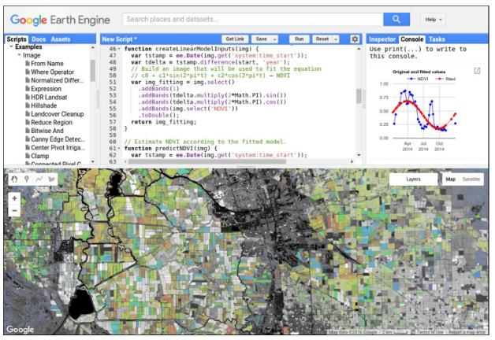
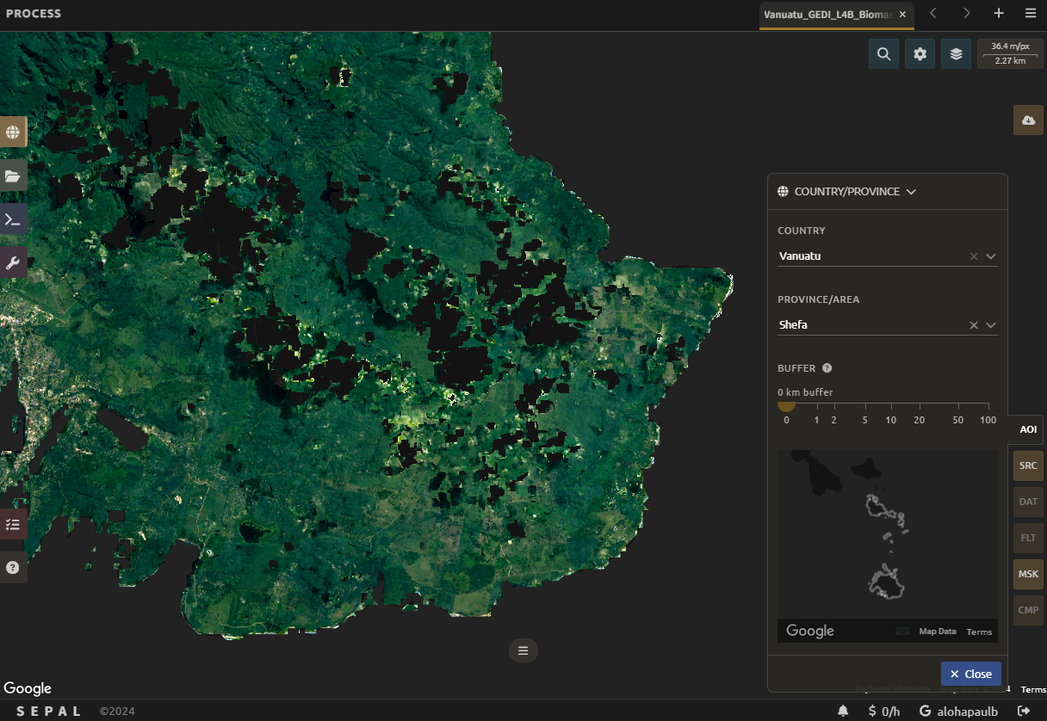


How Do We Access & Process Satellite Data with Openly Available Tools?
(A) Google Earth Engine – requires coding in JavaScript
(B) SEPAL – has a graphical user interface, quicker to learn, similar capabilities

Slide 13







Thanks for your attention
Sylvia Wilson – USGS National Land Imaging Program
snwilson@usgs.gov

