Slide 1
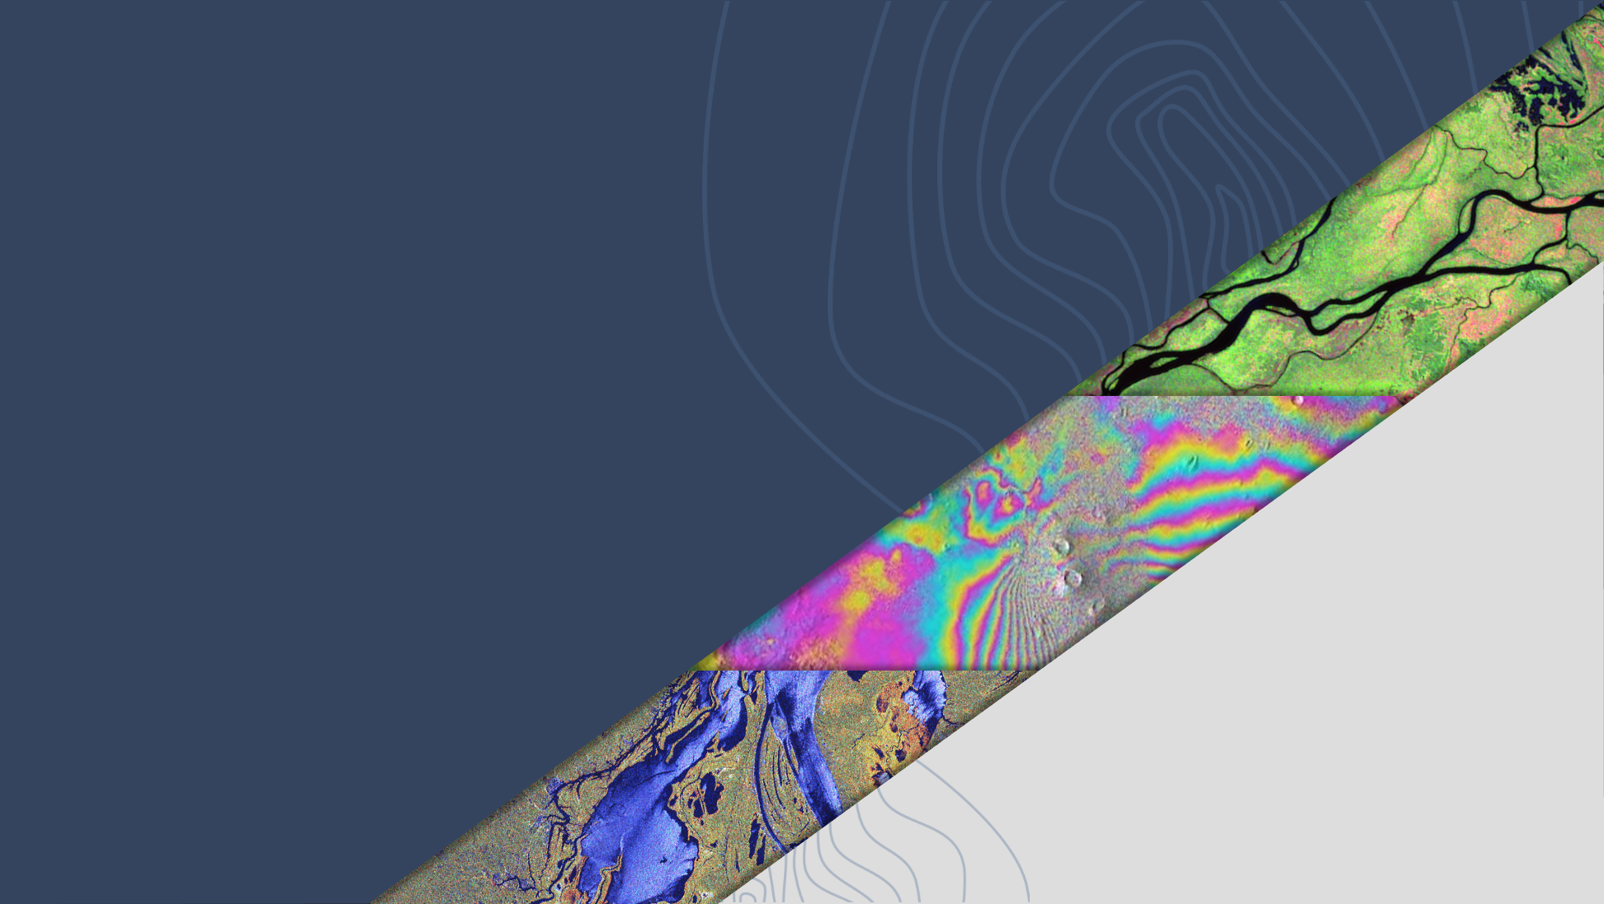
SIT-TW
2024
AFOLU Roadmap Actions and Status
Osamu Ochiai, JAXA
Agenda Item 7.1
SIT Technical Workshop 2024
Sydney, Australia
18th - 19th September 2024

Slide 2
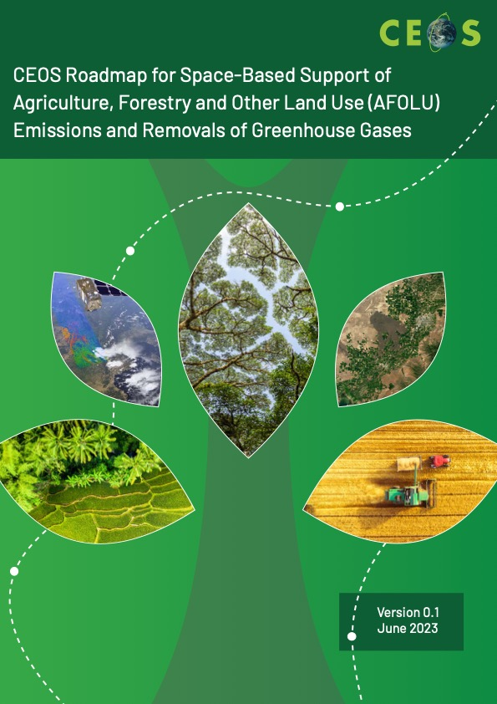
AFOLU Roadmap - Status
AFOLU Roadmap approved by CEOS Plenary Nov 2023
Draft actions presented at SIT 39 in April 2024
Updated High level initial actions are set out in slides below

Slide 3
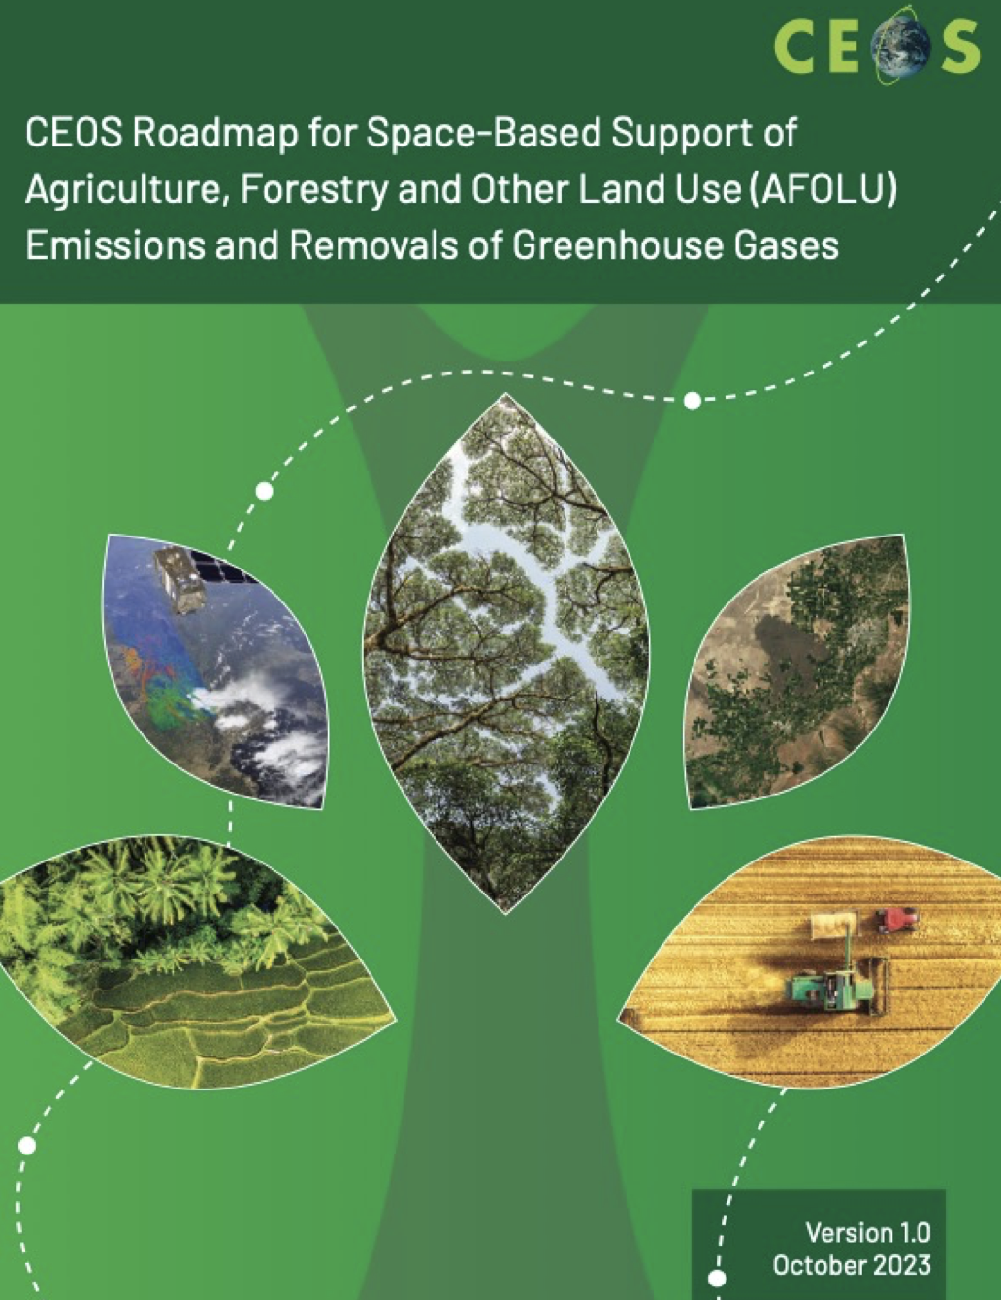
AFOLU Roadmap
A framework for long-term coordination of agency programmes in support of the needs of society for Agriculture, Forestry and Other Land Use (AFOLU)-related information, with a particular focus on the needs and ambition cycle of the Global Stocktake of the 2015 Paris Climate Agreement.
A guiding vision for long-term space agency coordination around AFOLU.
An effective means for communicating the intentions of CEOS
Address basic observation continuity and necessary agency coordination to achieve goals of sustained land-imaging of land-use and land cover change and biomass estimates

Slide 4
Three Classes of actions
Actions across all Recommendations broadly fall into three categories:
Those pertaining to presently available data to support AFOLU procedures as in the 2006 IPCC Guidelines for National GHG Inventories vol.4, and their 2019 Refinement.
Actions to develop new or improved products that would allow more accurate and/or easier implementation of the Guidelines
Actions to facilitate greater interaction with the GHG Roadmap and hence improve characterisation of land management emissions through MVS based on satellite-based atmospheric inversions.
- at this stage the focus is on the first two action classes above due to technical reasons related to MVS integration
Notes:
- focus at this stage on two action classes above for technical reasons on MVS integration)

Slide 5
Recommendations - Summary
Recommendations from AFOLU Roadmap:
Universal access to satellite data needed for national reporting
Continuity and backward compatibility for missions providing activity data and emission factors
Improve data use in UNFCCC reporting and IPCC Guidelines
Enable dialogue between inventory practitioners and CEOS community
Reconcile bottom-up, top-down, and inventory estimates of GHG emissions and removals
Systematically target activities to support IPCC Land Cover classes
Work with New Space to provide comprehensive coverage for national GHG inventories
Consistency of AFOLU and GHG Roadmaps for integrated national GHG inventory system, GHG+.
Notes:
- focus at this stage on two action classes above for technical reasons on MVS integration)

Slide 6
Actions (examples with the work behind)
Action 2.2: Coordination with IPCC TFI through meetings, workshops, regular COP/SBSTA participation and side events for engagement. Establish agreed IPCC-consistent land cover definitions based on satellite data with other actors. Explore possibility of a systematic and comprehensive approach to submission of CEOS agency datasets to the IPCC Emission Factors Database
Notes:
- focus at this stage on two action classes above for technical reasons on MVS integration)

Slide 7
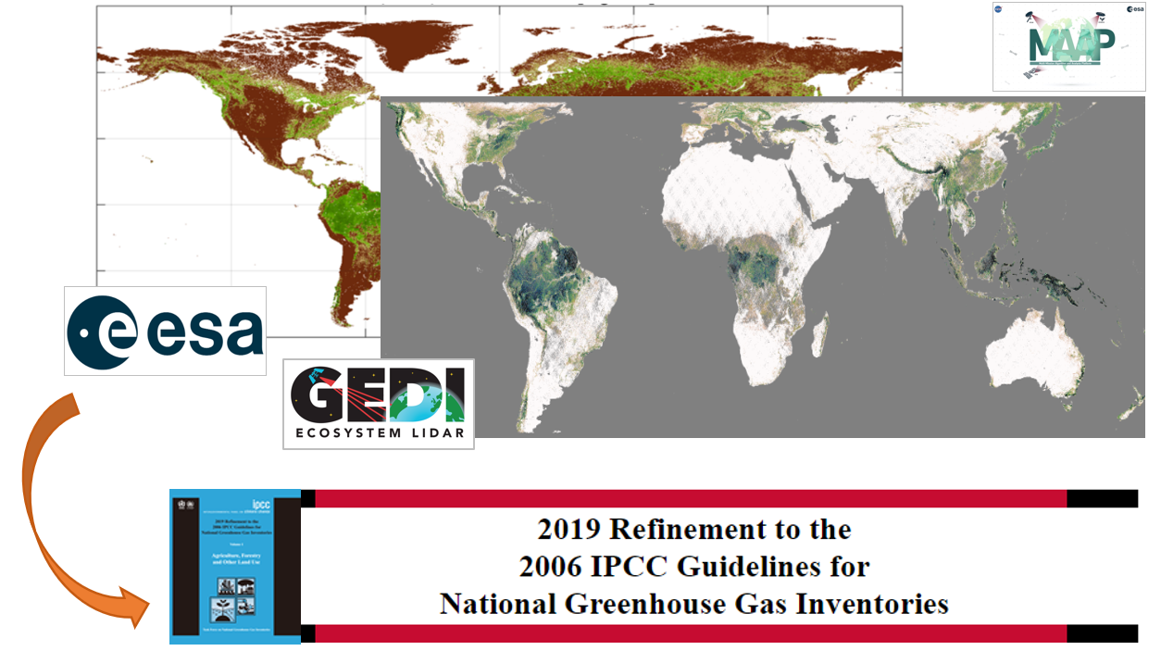
Biomass Harmonization: IPCC EFDB
The research generates natural forests biomass estimates in the format of Intergovernmental Panel on Climate Change (IPCC) Tier 1 values
The approaches leverage strengths of various EO-derived datasets, compiled in a transparent, open-science framework
The dataset will be regularly updated as biomass maps improve in accuracy
Request for this to be a CEOS submission to the IPCC EFDB
Pre-print available
Notes:
This submission to Emissions factors database is hpp

Slide 8
Actions
Action 2.3: Following the model of GFOI MGD practice, establish an agreed methodology for use of AGB in emissions inventories.
Upcoming GFOI workshop: Informed use of biomass maps in MRV procedures
23-25 October, Potsdam, Germany
Organized by GFOI R&D Component, GFZ and ESA
Objectives:
Provide an updated perspective of the country needs and developments related to improving forest aboveground biomass estimations
Develop a draft of a supporting Biomass Module for GFOI guidance on the use of space-based biomass estimates for MRV purposes
Identify next steps in country engagement for research activities
Participants: MRV specialists, NFMS country teams, and biomass map experts
More information: martin.herold@gfz-potsdam.de , daniela.requena.suarez@gfz-potsdam.de
Notes:
- GFOI methods and guidance module for biomass map and NFI inte

Slide 9
Actions
Action 2.5: Biomass harmonisation group to work with GEO-TREES to implement validation of CEOS biomass products with GEO-TREES data.
Notes:
- focus at this stage on two action classes above for technical reasons on MVS integration)

Slide 10
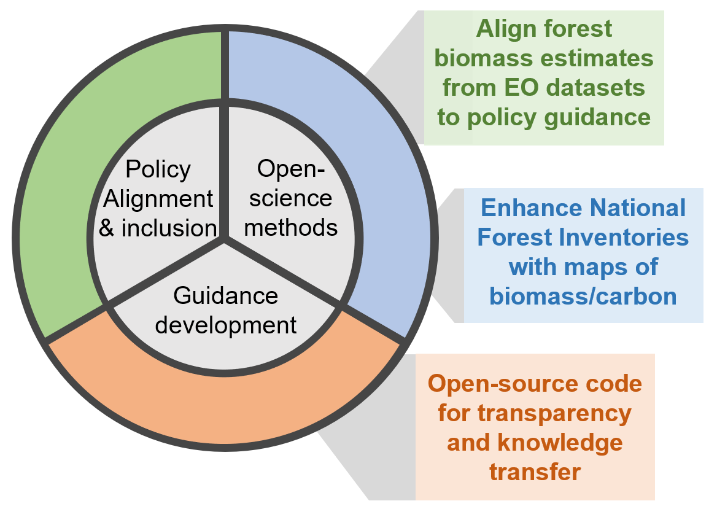
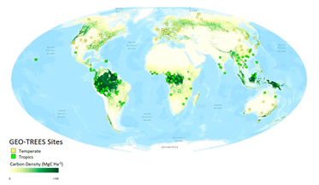
Biomass Harmonization
Under CEOS Biomass Harmonization, there are ongoing country case-studies on the improvement of GEDI biomass estimates and integration with NFIs
Generally, there is an increasing interest of NFI and EO integration techniques from countries
GEO-TREES will provide a global biomass reference network - this an action toward biomass product validation
CEOS Biomass Harmonization planning a submission of forest biomass estimates to IPCC Emission Factors Database (EFDB)
Notes:
This submission to Emissions factors database is hpp

Slide 11
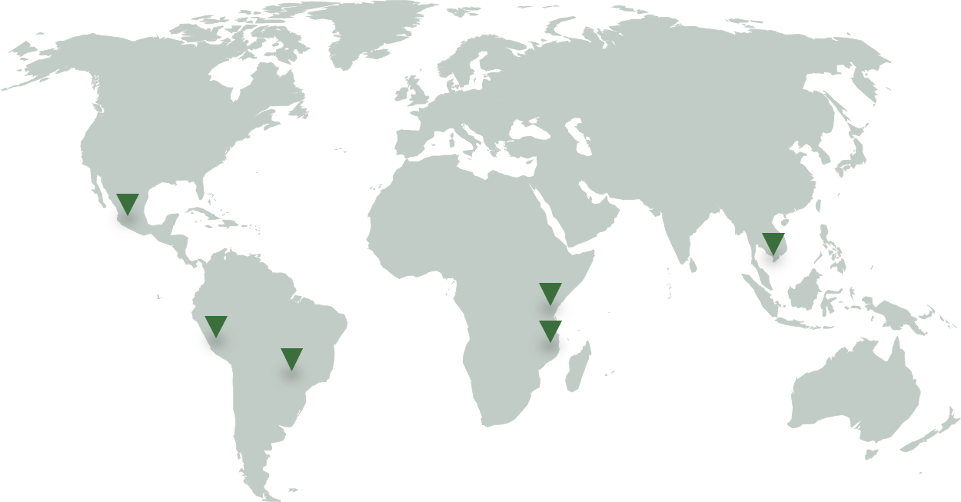
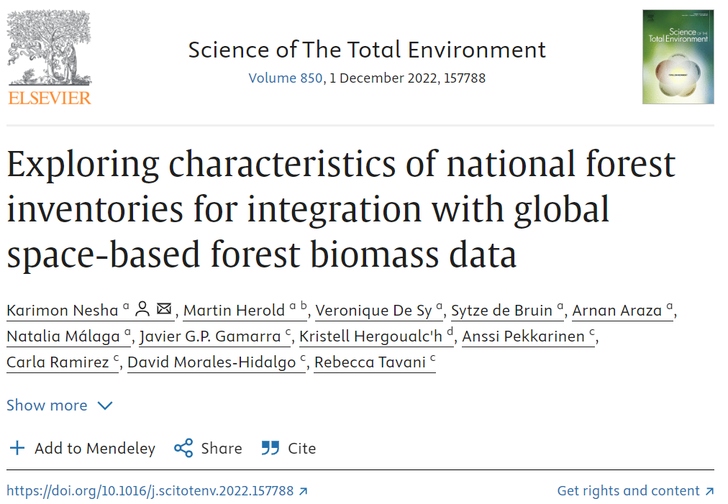
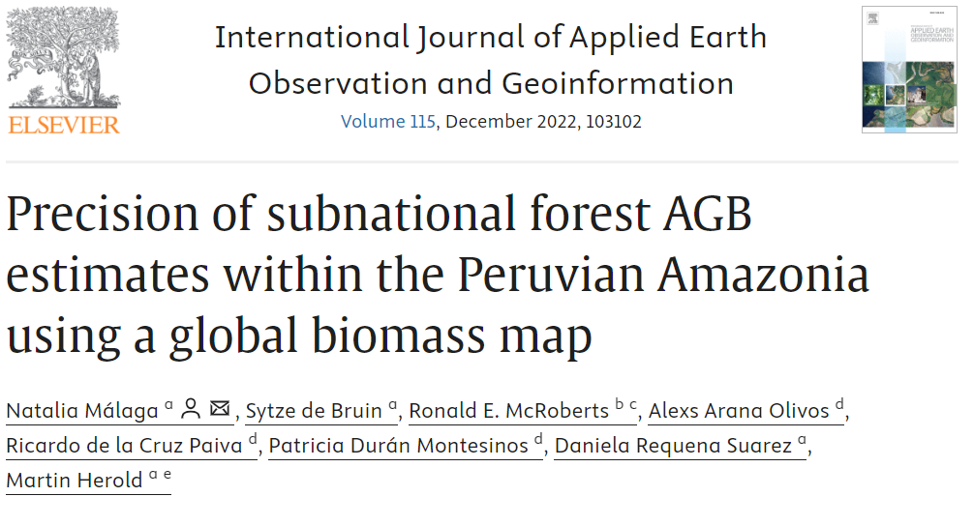
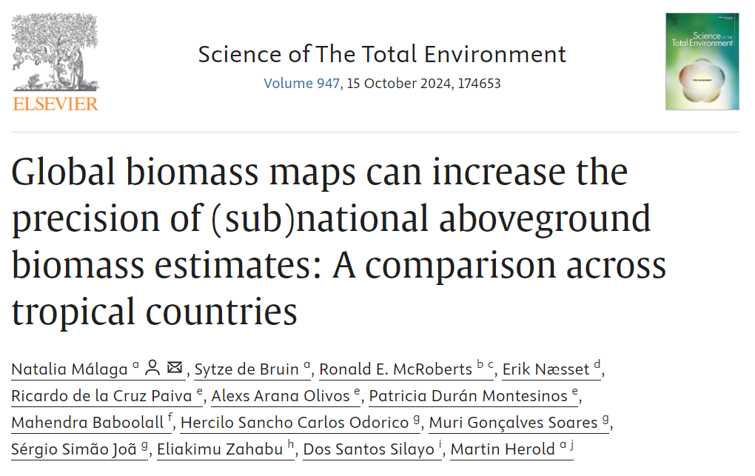
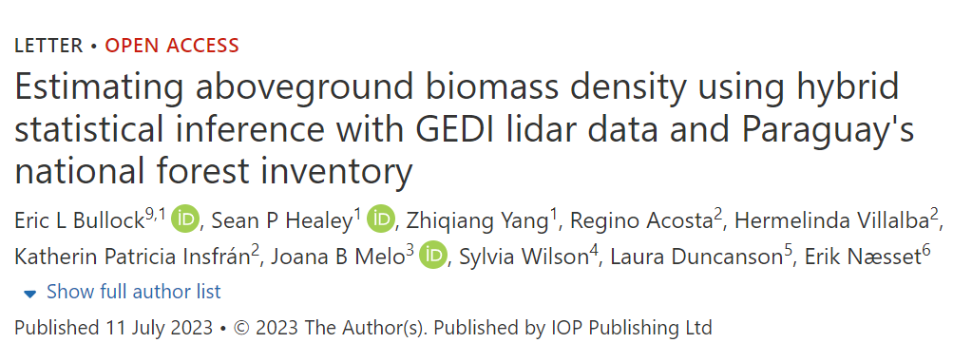
Actions
Action 3.1 Dedicated country demonstrations / field campaigns for better ground/space data integration
Facilitating and disseminating research in partnership with national organizations with the purpose of leveraging National Forest Inventory (NFI) data in combination with EO to enhance the estimation of forest biomass
Notes:
- Several case studies with country NFI agencies are ongoing to demonstrate different technical approaches for varying country circumstances - more case studies needed (more engagement with NFI agencies), comparison using different space-based biomass datasets …

Slide 12
Actions
Rec 3 block: Enable dialogue between inventory practitioners and CEOS community, recognizing that different countries have various requirements to support their system for reporting
Notes:
- focus at this stage on two action classes above for technical reasons on MVS integration)

Slide 13
AREAS OF IMPACT FROM CEOS
1. Mangroves mapping and carbon estimation using global datasets 2. Biomass estimation and improving emission factors using space data
PILOT COUNTRIES WITH RESULTS
LatinAmerica: Paraguay, Guatemala
South East Asia: Cambodia, Laos, Thailand
Africa: Gabon
Pacific Islands: Vanuatu, Fiji

Slide 14
Actions
Recommendation 4: Support efforts to reconcile bottom-up, top-down, and inventory estimates of GHG emissions and removals
Action 4.1: Develop guidance and datasets to support the consistent comparison and assessment of bottom-up and top-down methodologies with national GHG inventories.
Notes:
- focus at this stage on two action classes above for technical reasons on MVS integration)

Slide 15
Bottom-up & top-down approaches
3 different approaches can be used to monitor GHG budgets:
1. Top-down (TD) estimates from atmospheric inversions based on atmospheric GHG measurements from in-situ monitoring networks or satellites with atmospheric transport models.
2. Bottom-up (BU) approaches based on process-based or bookkeeping models for natural and anthropogenic fluxes.
3. Bottom-up approaches using activity statistics combined with emission factors, or empirical or process-based modelling.
The first two approaches are used in GHG budgets by the GCP, while most NGHGI follow the third type of bottom-up approach, with different levels of details based on different Tiers defined by IPCC guidelines.
Notes:
GHG - AFOLU - Aquatic carbon (from Ben, [...] trade and aquatic carbon flows helps reconcile TD and BU at state levels.”

Slide 16
ESA RECCAP2: reconcile TD & BU

Slide 17
History of ESA RECCAP2

Slide 18
Immediate Actions
Only updates to Recommendations / Actions (R.a) addressed at SIT-39 are reported here (refer to underlying spreadsheet of all current efforts).
Recommendation 0: ensure data access…
ACTION 0.3 develop relevant high-level products (initially AGB, consistent land cover) for easy use by Parties
SIT 39 Action: Support work of 4 thematic AFOLU teams (AGB, Land Cover, Wetlands and Mangroves and Agriculture) in LSI-VC F&B SG
see land cover comparison work
summary of AGB harmonization progress on next slide

Slide 19
Immediate Actions
AFOLU RM Recommendation 1: long term continuity of data…
Recommendation 1.a: Support continuation of remote sensing missions and derived products that provide Activity Data and biomass change information so that countries can safely embed these data streams into their inventory workflows and guidance documents.
SIT Action: All CEOS Members to maintain information flow on new mission characteristics through CEOS MIM database - ongoing
Recommendation 1.b Explore harmonization and integration activities that generate temporal continuity and provide complete and consistent spatial coverage of activity data and biomass estimates.
SIT Action: NASA, ESA et al to support ongoing research areas such as NASA Biomass Harmonization work,, ESA CCI Biomass- ongoing
Update here on AGB progress

Slide 20
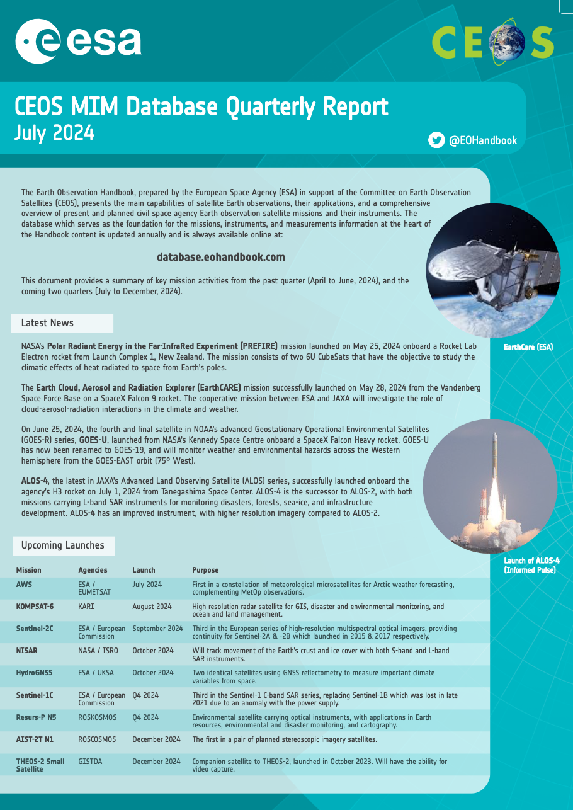
Immediate Actions
AFOLU RM Recommendation 1: Ensure long term continuity of data…
Recommendation 1.c: Evaluate the planned program of record to identify mission gaps and to define future missions, including backward compatibility of next-generation missions, to support activity
SIT Action: All CEOS Members to maintain information flow on new mission characteristics through CEOS MIM database - ongoing
Notes:
(Add screenshot of MIM - Mission information

Slide 21
Immediate Actions
AFOLU RM Recommendation 2: Improve use of Earth observation data in UNFCCC reporting and IPCC Guidelines
Recommendation 2.0: Ensure good communications with UNFCCC Sec and Parties throughout GST process in terms of data and product availability …
SIT Action: lessons learned from GST1 Lessons learned from GST1 (review of EO data, recommendations for GST2) to inform JAXA SIT Chair priorities–
SIT Chair action reported here
AFOLU RM Recommendation 2.a: Formalise a dialog between CEOS GST activities and the UNFCCC regarding the systematic use of EO to inventory guidelines and reporting, as part of systematic reporting to COP/UNFCCC Sec
SIT Action: report on status of progress with IPCC TFI, TSU and RSO/SBSTA (with WGClimate) – SIT Chair
Current status:?

Slide 22
Immediate Actions
AFOLU RM Recommendation 2.b: Develop best practice guidance on use of EO…
Action: Develop demonstration studies with individual country GHG and forest Inventory agencies, jointly with GFOI workshops – GFOI leads, CEOS LPV biomass co-leads, SilvaCarbon
Expert workshop on uptake of biomass maps for policy reporting (March 20-22, 2024), organized by UMD, Silvacarbon and GFOI R&D, follow on country specific workshops in Ghana and Cambodia
AFOLU RM Recommendation 2.c: Enable international activities such as the establishment of Forest Biomass Reference Measurement in-situ long-term monitoring plots (e.g. GEO-TREES) to ensure space-derived data are of the highest quality, uncertainties are well characterized EO…
Action: Coordinate with GFOI MGD, data and R&D component and NFI efforts, active support for GEOTREES, MAAP and FRM4BIOMASS (Jerome Chave)
NASA contribution to GEOTREES, AFRISAR-2 Airborne Campaign collecting new Lidar and SAR data over GEOTREES sites in Gabon and Ghana

Slide 23
Immediate Actions
AFOLU RM Recommendation 2.d: Align terminology and analytical frameworks for AGB and uncertainty assessments consistent with IPCC Guidelines.
Action: Implement expert meetings to improve country guidance on NFI and forest regrowth emissions and removals – GFOI team, AFOLU AGB team
Ongoing GFOI/GEOGLAM work
AFOLU Recommendation 2.e: Develop traceability and flexibility for different land activity definitions to be consistent with national definitions used in GHG inventories.
Action: undertake a concrete study on intercomparison of land activity definitions with those used in GHG:
inventories – LSI-VC, AFOLU LC team. New initiative proposed at SIT
Ongoing intercomparison work

Slide 24
Immediate Actions
AFOLU RM Recommendation Recommendation 3: Enable dialog between inventory practitioners and CEOS community…
AFOLU RM Recommendation 3.a: national inventory team training
Action: invest in local training of inventory agencies, aligned between CEOS and GFOI Capacity Building – GFOI CB team, AFOLU TF Leads
Support efforts to reconcile bottom-up, top-down, and inventory estimates of GHG emissions and removals
AFOLU RM Recommendation 4.a: develop guidance and datasets to compare bottom-up and top-down methods of emission estimates in cooperation with GHG TF, including through Amazonas 2024 campaign (ESA, INPE, NASA, …))
Action: work with GHGTF, WMO G3S, EU CO2MVS, USCMS, NEIS (Japan) and others to ensure consistency - GHG TTF Chair, AFOLU Leads.
Campaign postponed to mid -2025 for logistic reasons

Slide 25
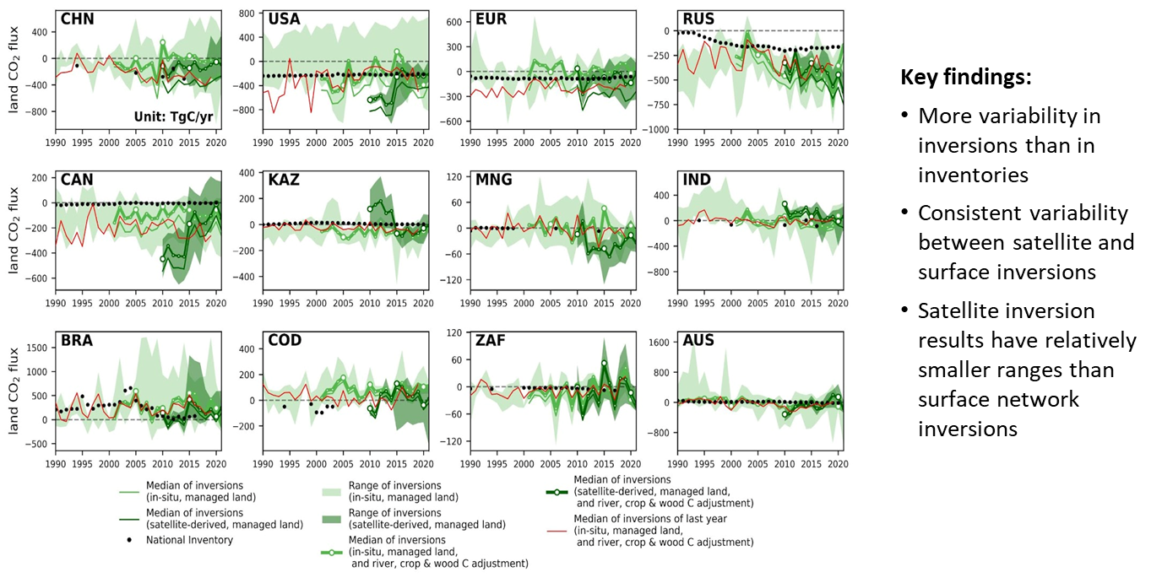
ESA RECCAP2: reconcile TD & BU

Slide 26
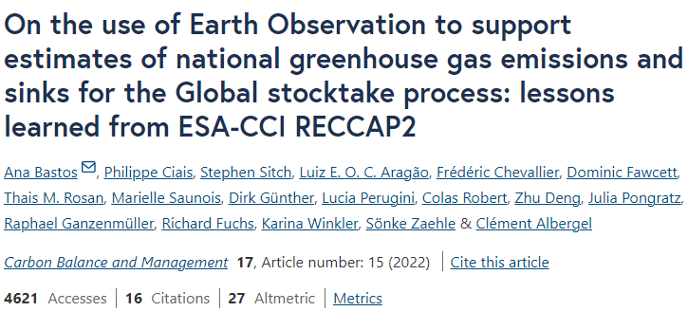
ESA RECCAP2
Key scientific achievements
Notes:
This was also made possible thanks to the participation of several National Emission Inventory agencies that helped us a lot

Slide 27
ESA RECCAP2 : New phase
Harness satellite based ECV for reducing the uncertainty on the emissions and sinks of CO2, and CH4 over key land regions, and attributing them to anthropogenic and global change drivers
The project will integrate bottom-up and top-down methods and compare their results with inventories for 6 case study land regions that are of key importance for global budgets and where uncertainties on current CO2, and CH4 fluxes remain very large: Europe, Siberia, Amazon and Arctic
These regional case studies are completed by the collection and analysis of global (EO-based) ECVs aiming to reduce the uncertainty on the global biomass carbon change and methane budgets

Slide 28
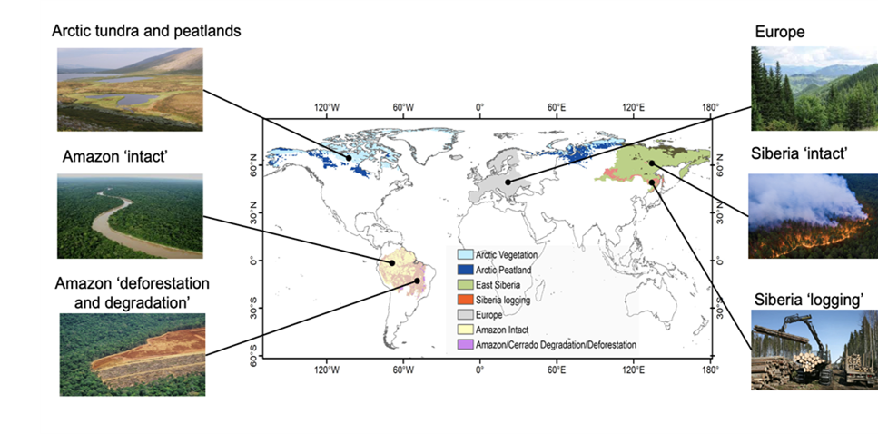
ESA RECCAP2 : New phase
3 Case study regions where GHG budgets are dominated by anthropogenic drivers arising from changes in land use and management (e.g. South Eastern Siberia & logging), 3 case study regions where they are primarily controlled by environmental factors arising from climate changes (Arctic peatland)
Notes:
●Assessment of GHG gross and net fluxes for six case study regions
●Top down and bottom-up estimates using EO will be compared and reconciled with inventories.
●These regional case studies are completed by the collection and analysis of global ECVs aiming to reduce the uncertainty on the global biomass carbon change and methane budgets
●This project integrates across CCI ECVs

Slide 29
ESA RECCAP2 : New phase

Slide 30
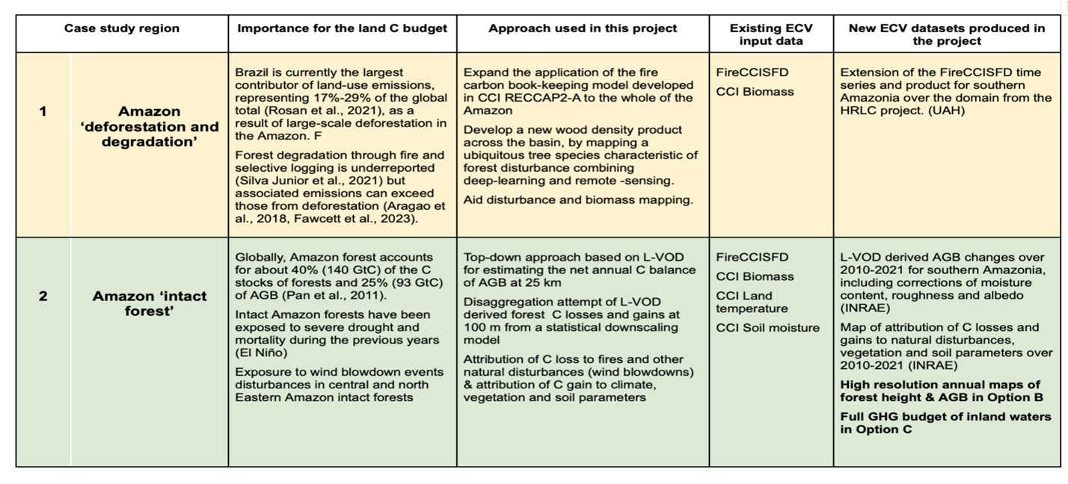
Case studies : Amazon
Notes:
Just to say that new products will be generated

Slide 31
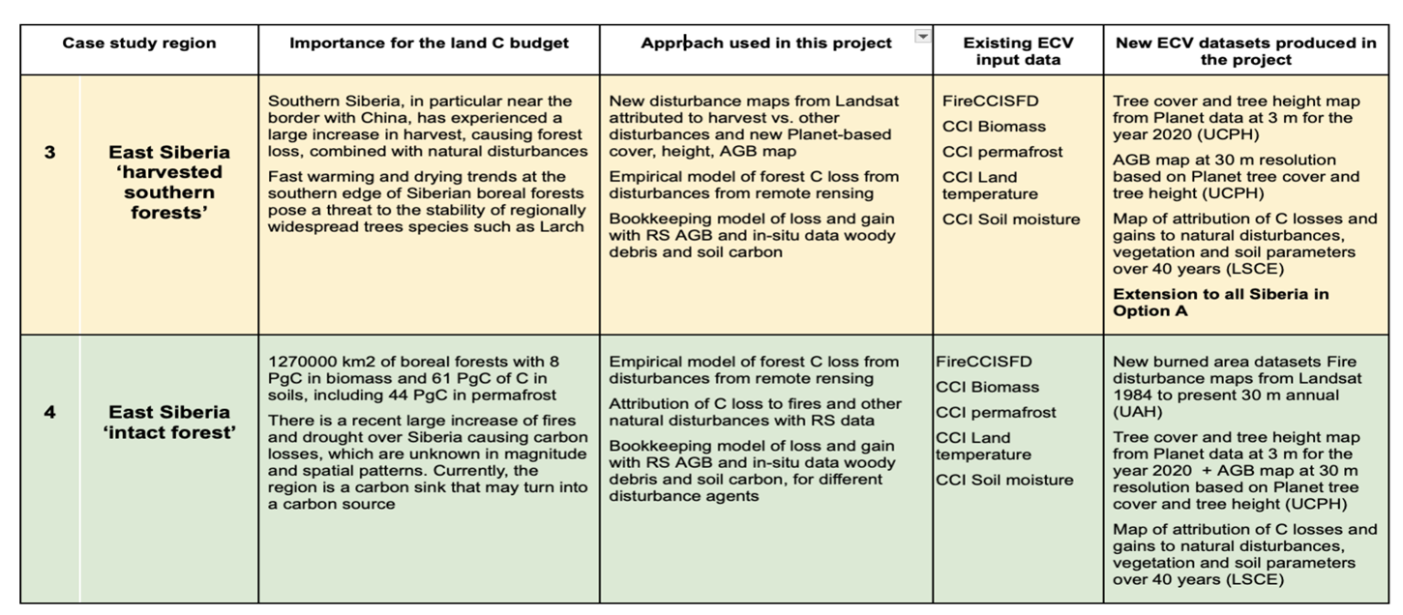
Case studies : Siberia
Notes:
Just to say that new products will be generated

Slide 32
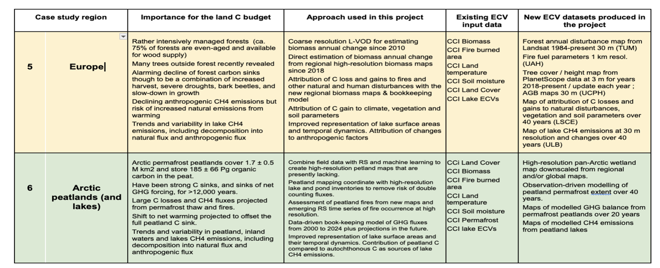
Case studies : Europe & N Peatland
Notes:
Just to say that new products will be generated

Slide 33
ESA RECCAP2 : New phase
The project will also keep a global perspective by:
Developing / improving their global framework to make EO-based estimates of bottom-up and top-down CO2, and CH4 fluxes comparable with national inventories.
Using global inversion results to update top-down CO2 fluxes over managed lands and anthropogenic CH4 emissions and compare them to national inventories and
Updating annually and analyse global AGB changes derived from L-band passive microwave satellite vegetation optical depth (L-VOD) to quantify and understand annual anomalies of the land carbon budget across different regions over most countries.
Notes:
●Assessment of GHG gross and net fluxes for six case study regions
●Top down and bottom-up estimates using EO will be compared and reconciled with inventories.
●These regional case studies are completed by the collection and analysis of global ECVs aiming to reduce the uncertainty on the global biomass carbon change and methane budgets
●This project integrates across CCI ECVs

Slide 34
Immediate Actions
AFOLU RM Recommendation 4.a: develop guidance and datasets to compare bottom-up and top-down methods of emission estimates in cooperation with GHG TF, including through Amazonas 2024 campaign (ESA, INPE, NASA, …))
Action: work with GHGTF, WMO G3S, EU CO2MVS, USCMS, NEIS (Japan) and others to ensure consistency - GHG TTF Chair, AFOLU Leads.
CARBONARA campaign: flights foreseen September 2025, ground instruments send to Brazil Nov.2025, expedition permit being submitted by INPE to CNPq
(CLement trying to add this video on counting carbon form the CCI RECCAP2 project: ESA - Counting carbon)

Slide 35
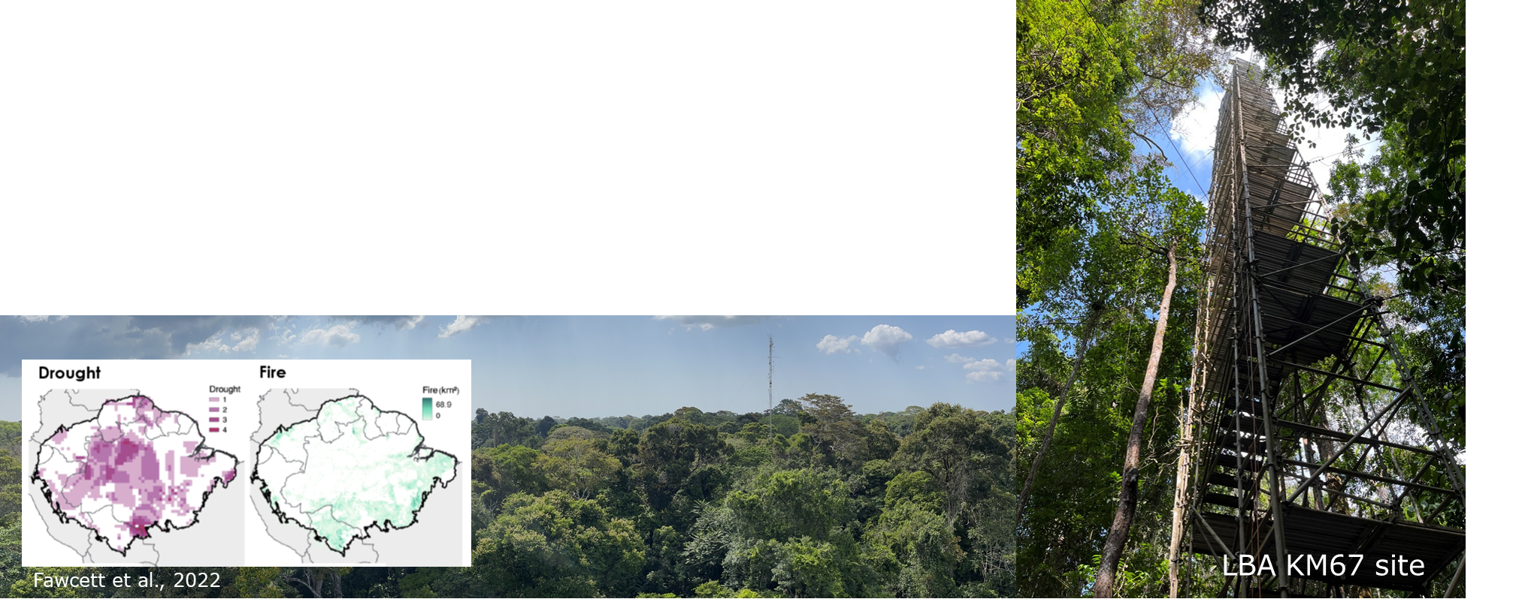
ESA-INPE Campaign

Slide 36
Actions
5.1: Provide demonstration studies (nationally/regionally but also globally) that illustrate and demonstrate capacity to generate IPCC classes through amalgamation of mapped FAO LCCS classes, given the latter can be mapped directly from Earth observation data or reconstructed from existing land cover products.
Notes:
- focus at this stage on two action classes above for technical reasons on MVS integration)

Slide 37
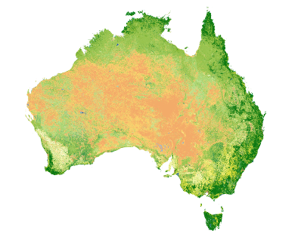
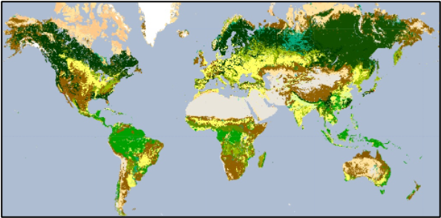
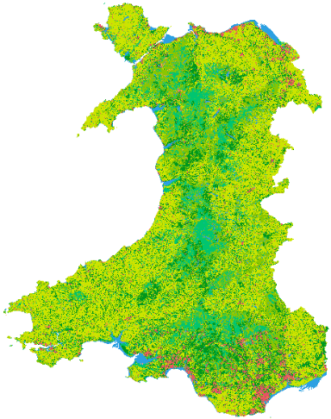
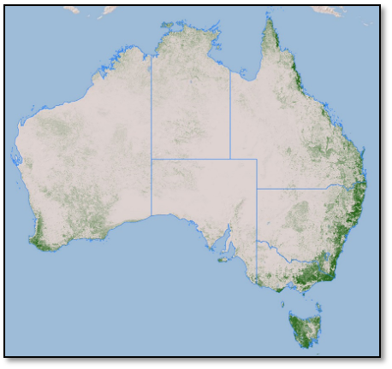
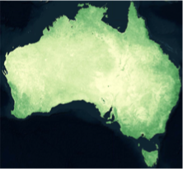
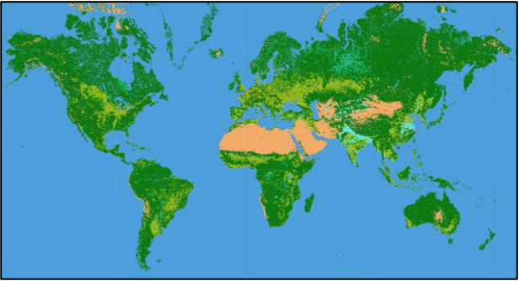
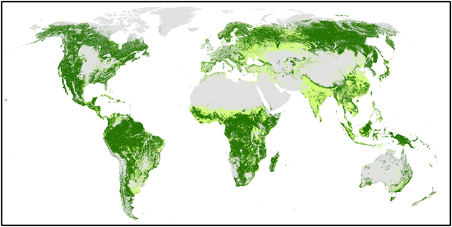
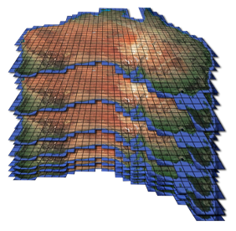
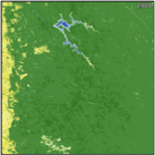
Review of land cover mapping
The IPCC AFOLU utilises 6 broad land cover classes that cannot be easily classified from Earth observation data.
By contrast, classes of the Food and Agriculture Organisation’s (FAO) Land Cover Classification System (LCCS) can be constructed from environmental descriptors a) retrieved or classified separately from Earth observation data or b) deconstructed from existing (often machine-learned) land cover products, with 10 able to be combined to give the 6 AFOLU classes.
The use of EDs with predefined units (e.g., m, %, time) or categories ensures scalability across space and time and hence applicability from local to global scales.
The FAO LCCS classes can be translated to the AFOLU classes but not vice versa.
Hence, the proposal is to establish capacity to use of the FAO LCCS as an optional standard for providing more detail than the existing IPCC AFOLU classes.
FAO LCCS MAPS CONSTRUCTED FROM ENVIRONMENTAL DESCRIPTORS RETRIEVED OR CLASSIFIED FROM EARTH OBSERVATIONS
DECONSTRUCTED FROM EXISTING LAND COVER MAPS AND RECONSTRUCTED INTO THE FAO LCCS
Time 1
Time n
Digital Earth Australia
Living Wales
EXAMPLE:
ESA CCI Land Cover
(300 m)
EXAMPLES OF EDs (AUSTRALIA)
DECONSTRUCTED EDs (GLOBAL)
+
Lifeform: Woody/ Herbaceous Fractions
Canopy cover (%)
FAO LCCS Level 3
Lifeform: Woody (Tree/Shrub)/Herbaceous
FAO LCCS
IPCC
1988-2024
Mining, Western Australia
TIME-SERIES COMPARISONS OF THE FAO LCCS PROVIDES MORE DETAILED TRANSITION MATRICES.
TIME-SERIES COMPARISONS OF LAND COVERS AND EDs PROVIDES EVIDENCE FOR CHANGE IMPACTS ~ PRESSURES
*Woody lifeform needs to be separated into trees and shrubs

Slide 38
Actions
5.3: Review and consolidate current approaches to characterising, mapping and monitoring Blue Carbon Ecosystems (BCEs) and establish approaches that are consistent globally and across scales, including the detection of change and links between terrestrial and aquatic environments.
5.4: Explore the development of new CEOS initiatives on wetlands mapping and monitoring. Ensure new CEOS missions consider wetlands amongst their mission goals, recognising the heterogeneity of wetlands and the need for multi-sensor approaches.
5.4: Establish closer collaboration with the Ramsar Convention Secretariat and Scientific and Technical Review Panel (STRP).
Notes:
- focus at this stage on two action classes above for technical reasons on MVS integration)

Slide 39
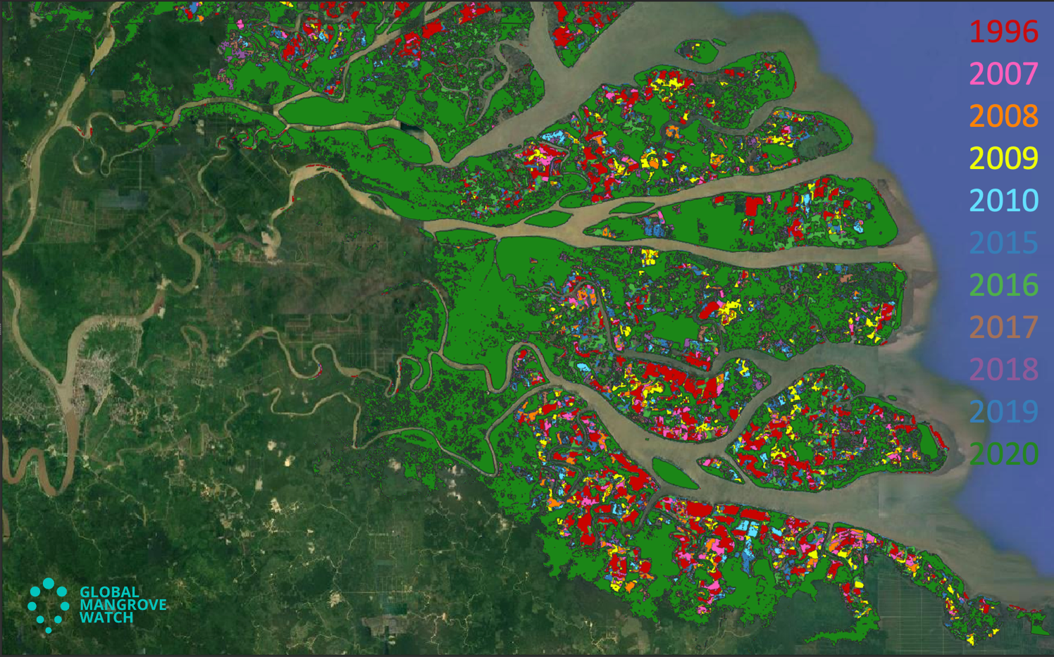
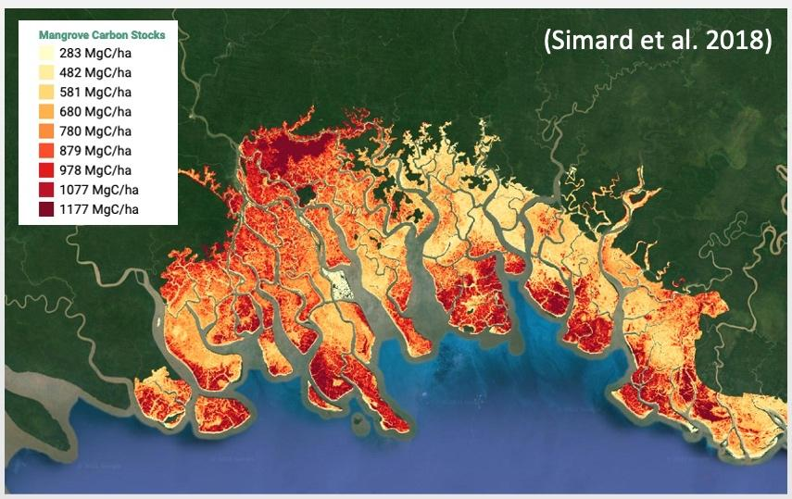
Other Land Use - Wetlands
MANGROVES (Forest / OLU-Wetlands)
Activity Data: Global Mangrove Watch (JAXA Kyoto & Carbon (K&C))
Global maps of mangrove area and annual changes at 25 m derived from L-band SAR and optical data 1996 - 2020.
New baseline map for 2020 at 10 m developed. Open access in public domain (Zenodo.org). 1996–2023 change maps available by Q1/2025
* GMW constitutes the default mangrove layer used by UNEP for reporting on SDG Indicator 6.6.1 (Mapping wetland extent and change over time)
Emission Factors: LCLUC Global Mangrove Mapping (NASA JPL/GSFC)
Global maps of mangrove Height, AGB and Total Biomass.
New 2015 baseline at 12 m from TanDEM-X DEM and GEDI finalized, Methods paper in review and data publicly available on NASA ORNL Data Archive.
(Bunting et al. 2022)
Notes:
- focus at this stage on two action classes above for technical reasons on MVS integration)

Slide 40
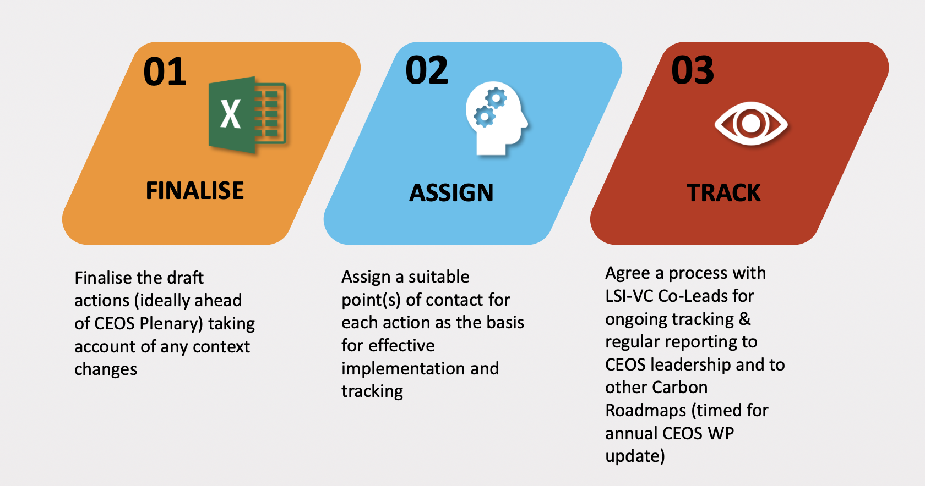
Next Steps in RM Implementation
More work on actions for completeness, consistency and solid representation of agency activities and outlook
CEOS Lead POC needed for each one
Ensure robust and reliable tracking process - to feed in annually to CEOS WP update
Notes:
- focus at this stage on two action classes above for technical reasons on MVS integration)

Slide 41
Immediate Actions
AFOLU RM Recommendation Recommendation 5: Systematically target activities to support IPCC Land Cover classes
AFOLU RM Recommendation 5.a: Support activities to compare IPCC and FAO/LCCS land cover classes
Action: Review approaches for providing consistent mapping of land covers relevant to the IPCC AFOLU, including adoption of more detailed but relevant taxonomies (including the FAO LCCS) and demonstration from local to global scales.
Action: Demonstrate capacity for using the resulting time-series of land cover maps to generate consistent mapping and quantitative descriptions of change relevant to the IPCC at local to global scales.
AFOLU RM Recommendation 5.c: Consider how best to include Blue Carbon Ecosystems (BCEs) in inventories
Action: Review and consolidate current approaches to characterising, mapping and monitoring Blue Carbon Ecosystems and establish approaches that are consistent globally (and ideally across scales) and facilitate detection and description of change and links between terrestrial and aquatic environments. - JAXA, ESA lead
NASA-ESA ISSI Blue Carbon Workshop in May 2024, GMW updated version, NASA mangrove canopy height v.2

Slide 42
AFOLU RM Recommendation 5.d: improve mapping of wetlands including managed/unmanaged stratification
Action: support new wetlands mapping work (including Global Mangrove Watch) and ensure future missions take this into account - JAXA, ESA lead, NASA
NASA-ESA ISSI Blue Carbon Workshop in May 2024, NASA AFRISAR-2 SAR/Lidar campaign over mangroves and forested wetlands in Gabon as well as new data collection over Cuvette Centrale /Congo Basin

Slide 43
Immediate Actions
AFOLU RM Recommendation 6 (a, b, c): consider how New Space Missions can support GHG inventories through improved AFOLU information:
Action: take outputs of NSTT report to understand how best to cooperate in relevant areas – AFOLU TF, LSI_VC
NSTT report from CEOS taken into account and ongoing cooperation with non-Agency data providers
AFOLU RM Recommendation 7 (see also Action 4.1): Ensure consistency of AFOLU and GHG RMs to support an integrated GHG+ inventory system
(Action: support ongoing discussions with WMO on design and implementation of G3S – GHGTF Chair, AFOLU leads, ESA)
Defer this specific action until greater clarification of role of managed land inputs as priorities for inversion modelling of emissions

Slide 44
Outlook

