Slide 1

POST-2025 GEO Work Programme
Dr. Justyna Nicinska (NOAA, US), PB Co-Chair
on behalf of the GEO Programme Board Co-chairs and Members
September 2024
CEOS 2024 SIT Technical Workshop

Slide 2



Drivers for Post-2025 GWP
STRATEGIC FOCUS & EVOLUTION
INTEGRATION & INNOVATION
EFFICIENCY & SUSTAINABILITY
Call for high-level thematic Focus Areas to guide GEO’s work.
Call for a transformative GWP to support GEO evolution.
Strengthened focus on inclusivity and user needs including regional impacts
Need for better integration and prioritization across activities.
Strengthened integration between EO, AI, and socioeconomic data.
Focus on Earth Intelligence for All.
Need for manageable and sustainable GWP size and scope.
Greater emphasis on resource mobilization.
Notes:
- Co-produce transformative programmes that deliver actionable information for users and stakeholders while incorporating multidisciplinary approaches to enable clear social and environmental decisions.
-- Focus in integrated solutions with clearly communicated goals and impact
- Increase equity through access to Earth Intelligence- focus on access, inclusion, transparency and co-developed solutions with communities
- Provide meaningful and participatory engagement for youth, Indigenous communities and marginalized groups
Leverage new technologies and innovation in provision of Earth Intelligence solutions: focus and promote open data and open knowledge

Slide 3
Steps to Date
FOCUS AREAS
MAPPING & ANALYSIS
WORK PROGRAMME STRUCTURE
Consultations with the GEO Community
Notes:
Each area would include relevant GEO activities, WGs, Nexus projects, and Regional GEOs;
Activities,WGs, Regional GEOs may be split between review areas
This would resemble the ET approach, but focus on a more representative breakdown of topic areas
Goal is to enable thematic or focal area mapping across activities and regions with a reference to engagement priorities, as relevant
this breakdown will also help to indicate the best organizational structure to use for the next GWP
Two cross-cutting areas would be included

Slide 4
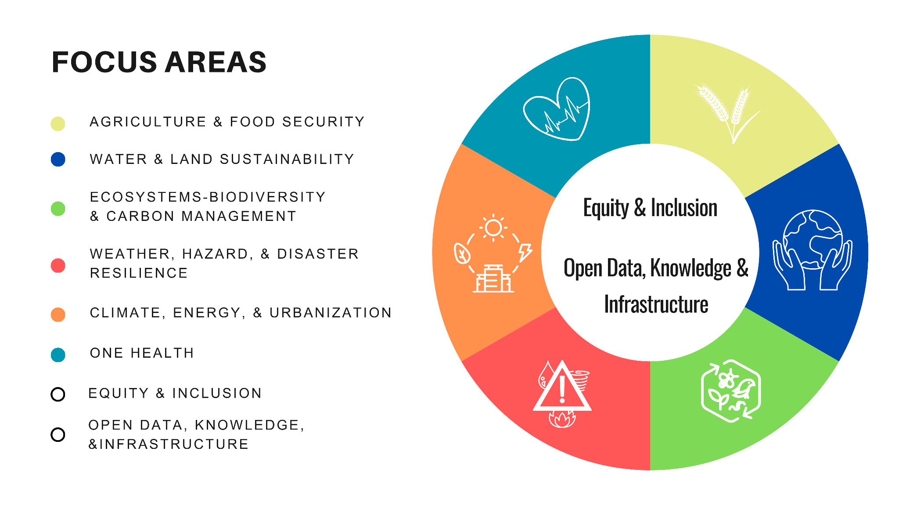
Focus Areas to define high-level objectives and integration across GEO
Notes:
This structure proposes to organize activities and respective foundational tasks into thematic groups or focus areas. This approach will enhance the framework for collaboration across GEO, promote greater alignment with global priorities, and facilitate the development of innovative nexus resulting from cross-GEO collaboration and innovation.
Based on current GWP mapping, links with global policy and international bodies/stakeholders
The initial prioritization exercise resulted in six thematic focus areas: (1) Agriculture and Food Security, (2) Water and Land Sustainability,(3) Ecosystem, Biodiversity and Carbon Management, (4) Weather and Disaster Resilience, (5) Climate, Energy and Urbanization, and (6) One Health.
More detailed narrative summaries on each thematic area, connections across GEO, and justification will be developed

Slide 5





Post-2025 GWP Structure
Mature Flagships
GEO Conveners: (CoPs, WGs, etc)
Flagships
Operation Expansion
Research to Operations (R2O)
Pipeline
Monitoring and Evaluation
Accelerators
Initiatives
Prototype
Sustainability
Pilots
Idea
R&D
Enabling Mechanisms
(Infrastructure, Funding, etc)
Notes:
Conveners: activities, outside of R2O process, that serve, implement, and promote the convening power of GEO; include WGs.
Activities: Mature Flagships; Flagships Initiatives; Initiatives; Pilots
Clear criteria and M&E
Clear R2O evolution process
Accelerators: fast-track R2O activities; to replace Incubators​
Enabling Mechanisms: to horizontally support Activities and Conveners and promote cross-cutting aspects of GEO’s implementation; include FTs
“Ever green” programme cycle​ to replace the 3-year cycle
A transparent yet flexible prioritization approach, enabled through various entry points and advancement stages​
Focus Areas as an integral GWP component, to facilitate coordination to help achieve GEO’s strategic goals, identify priorities and opportunities, and maximize user impact
Regional GEOs to be embedded in the GWP as implementation drivers within Activities​ to reflect regional priorities and connect with local users; to remain in the governance structure

Slide 6
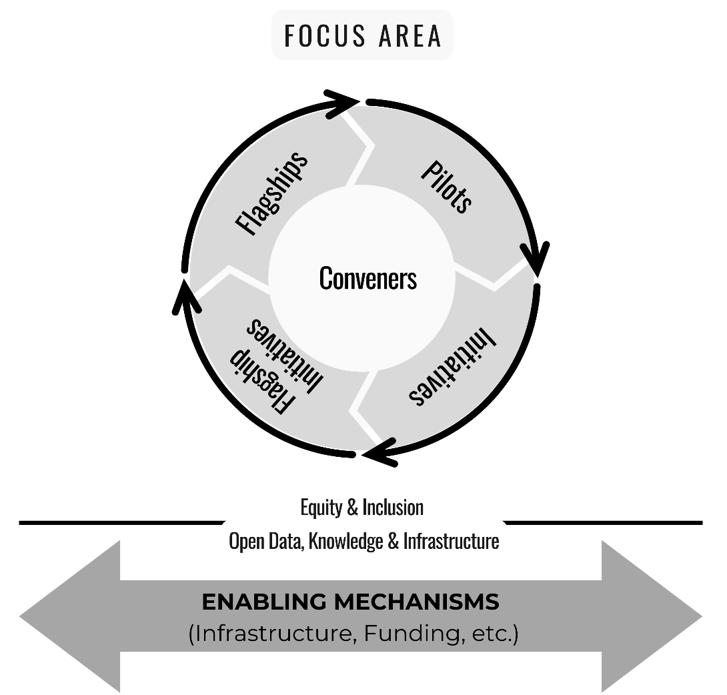

Slide 7
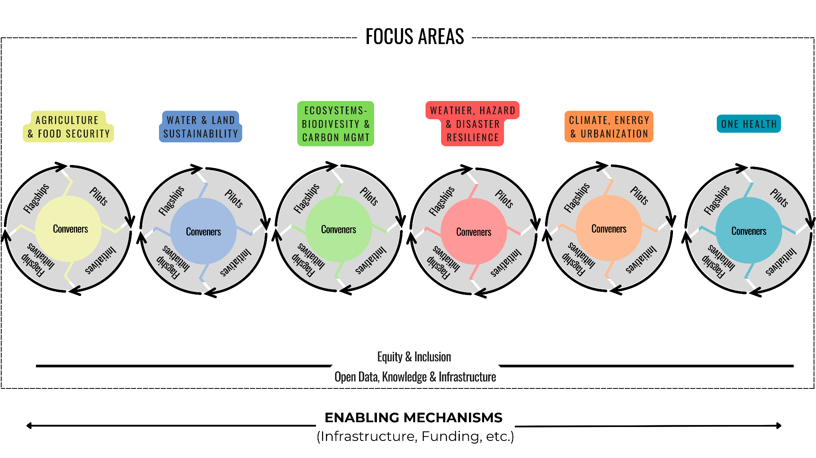
Notes:
Initial focus areas- meant to foster integration and innovation across the GWP, demonstrate where GEO delivers impact (with 2 cross cutting themes and enabling mechanisms as a supportive function)

Slide 8

POST-2025 GEO WORK PROGRAMME
CALL FOR PROPOSALS
  Launched: Sept 16
  Applications deadline: Oct 31
  Open to current and new activities- all interested must submit a proposal either as a Convener or part of the R2O pipeline
    The call includes descriptions of new GWP categories along with the templates
  Focus Areas will help with prioritization and coordination
  A Monitoring & Evaluation Framework will be a key element of the new GWP as well as impact for users, where Regional GEOs play a key role

Slide 9

POST-2025 GEO WORK PROGRAMME IMPLEMENTATION PLANS & CRITERIA
Implementation Plan Core Elements - to reflect the new GWP structure and criteria:
  Anticipated impact
  Service/application description
  Targeted users (key role for Regional GEOs)
  Necessary partnerships
  Plans for data management, equity & inclusion, and sustainability
Implementation Plan Process
  The Earth Intelligence Matrix - an assessment tool with reference criteria for the R2O pipeline, will help activities and the PB to assess placement
  Selected Activities to deliver detailed work plans based on monitoring and evaluation criteria set by the PB
  Evergreen process with annual reporting

Slide 10
GWP Development Process
Mid Sept 2024
Call for Proposals
Early Nov 2024
Proposals Due
IP Review Begins
Dec 2024
Reviews Due
Jan 2025
Post-2025 V1 Issues
Early Mar2025
Post-2025 V2 Issues
23-26 Sept
GEO Symposium
27 Sept
PB Meeting
Feb 2025
PB Meeting
Mar 2025
Plenary Docs Due
May 2025
GEO Global Forum
IP System Development
IP Proposal Submission
IP Review
Post-2025 GWP Summary Docs Development
Principal Consultation
Finalizing GWP Content & Prioritization
Community Consultations
Regional GEOs Consultations

Slide 11

OPPORTUNITIES TO ENGAGE IN POST-2025 GEO WORK PROGRAMME
R2O pipeline activities
Guide priorities for Focus Areas
Serve as a driver for a GEO Convener or Enabling Mechanism
  Providing important support functions to the R2O pipeline activities by enhancing
    Data sharing
    Satellite systems interoperability and applications
    EO integration
    GWP and CEOS collaboration

Slide 12

Announcements
GEO-LDN Dialogue Forum for Pacific Small Island Developing States (PSIDS) 2025
Applications are open until the end of September
GEO-LDN seeks partnerships with countries to address complex challenges in Integrated Land Use Planning and using earth observation data and geospatial technologies.
Successful applicants will join the Dialogue Forum in Q2 2025 for peer-to-peer exchange.

Slide 13
Thank you!
Q&A
Justyna.Nicinska@noaa.gov

