Slide 1
GST Lessons Learned - Recommendations
Discussion
Osamu Ochiai
JAXA SIT Chair team
Agenda Item 5.3
SIT Technical Workshop 2024
Sydney, Australia
18th - 19th September 2024

Slide 2
Objectives
Refine and sharpen recommendations emerging from the GST Lessons Learned Exercise
Organise our thoughts for effective communication to Principals at Plenary
As the basis for our strategy and priorities going forward in this key area for CEOS agencies
Allow time for brainstorming and multiple views

Slide 3
LL Categories from WGClimate
Recommendations to Improve GHG Products for Science Application
Recommendations for GHG Product Development and User Engagement
Recommendations for Space Agencies for the Second GST
Recommendations on UNFCCC Engagement and Collaboration within RSO
Recommendations for Engagement with Other Organizations
Communication Gaps to Address

Slide 4
Proposed discussion topics (3 only)
Assuming we continue to prioritise UNFCCC/SBSTA/COP engagement..
What should we do different regarding that engagement?
Nature of the engagement with UNFCCC SEC?
Other stakeholders and possible partners (Parties, WMO, GCP….)

Slide 5
Proposed discussion topics
Do we have enough clarity on the GST2 process to design a strategy?
If not, how do we?
What are our priorities?
What inputs do we target and with/for whom?

Slide 6
Proposed discussion topics
Do we think that closer collaboration with IPCC will help improve our impact?
Which groups and processes are most relevant?
What are the opportunities?

Slide 7
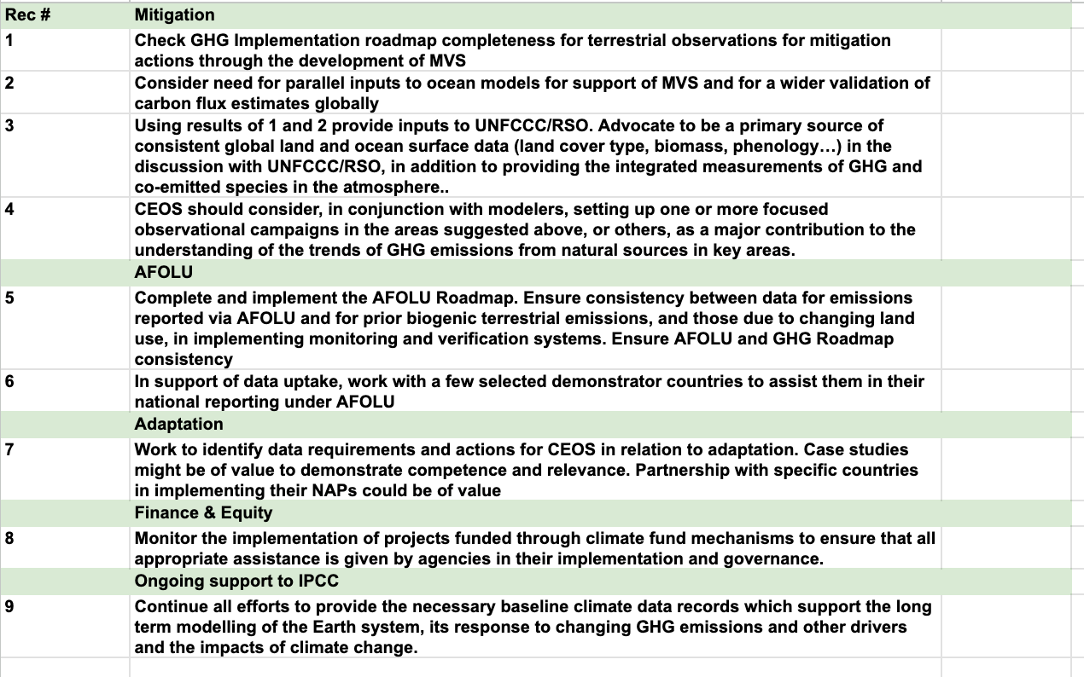
CEOS GST Strategy (abbreviated)

Slide 8
GST Strategy update
SIT Chair Team undertakes to update the strategy in 2025 to reflect on GST Lessons Learned exercise and our operating context
Needs good support from WGClimate, AFOLU & GHG Roadmap teams, SilvaCarbon etc

Slide 9
SIT Term Overview
2024
2025
SIT-39
SIT-TW
Plenary
Canada
SIT-40
SIT-TW
Plenary
UK
COP-30
GST STRATEGY
GST 1 LESSONS LEARNED
GST STRATEGY UPDATE
Draft
Draft & CEOS WP actions
CARBON ROADMAPS
GHG ROADMAP UPDATE
Draft
AFOLU ROADMAP ACTIONS
SIT CHAIR TO ENSURE LINKAGES NEEDED
AQUATIC CARBON ROADMAP DEVELOPMENT
IMEO & G3W
INTERFACES
PROGRESS IMEO & G3W TOPICS/challenges
GHG Best Practices
CEOS GHG BEST PRACTICES
UKSA COP-30 actions
Draft
Final
GCOS IP
CEOS RESPONSE
Mid-2025 for CEOS & CGMS
ECV INVENTORY
VERSION 5
VERSION 6
STRATEGIC TOPICS
NEW PATHWAYS/TARGETS
NEW CEOS WP ACTIONS RE GST2
INTEGRATED PLANNING FOR COP & SBSTA
NATIONAL ENGAGEMENT

