Slide 1
Working Group Leadership Changes expected at CEOS Plenary 2024
Hironori Maejima, JAXA SIT Chair, on behalf of Eric Laliberté, CSA CEOS Chair
Agenda Item 4.5
SIT TW 2024 Sydney, Australia
18th - 19th September 2024

Slide 2
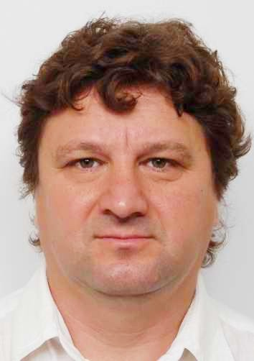
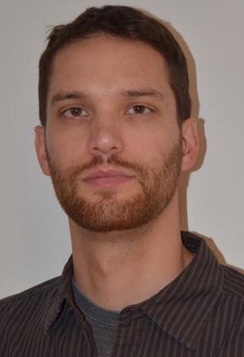
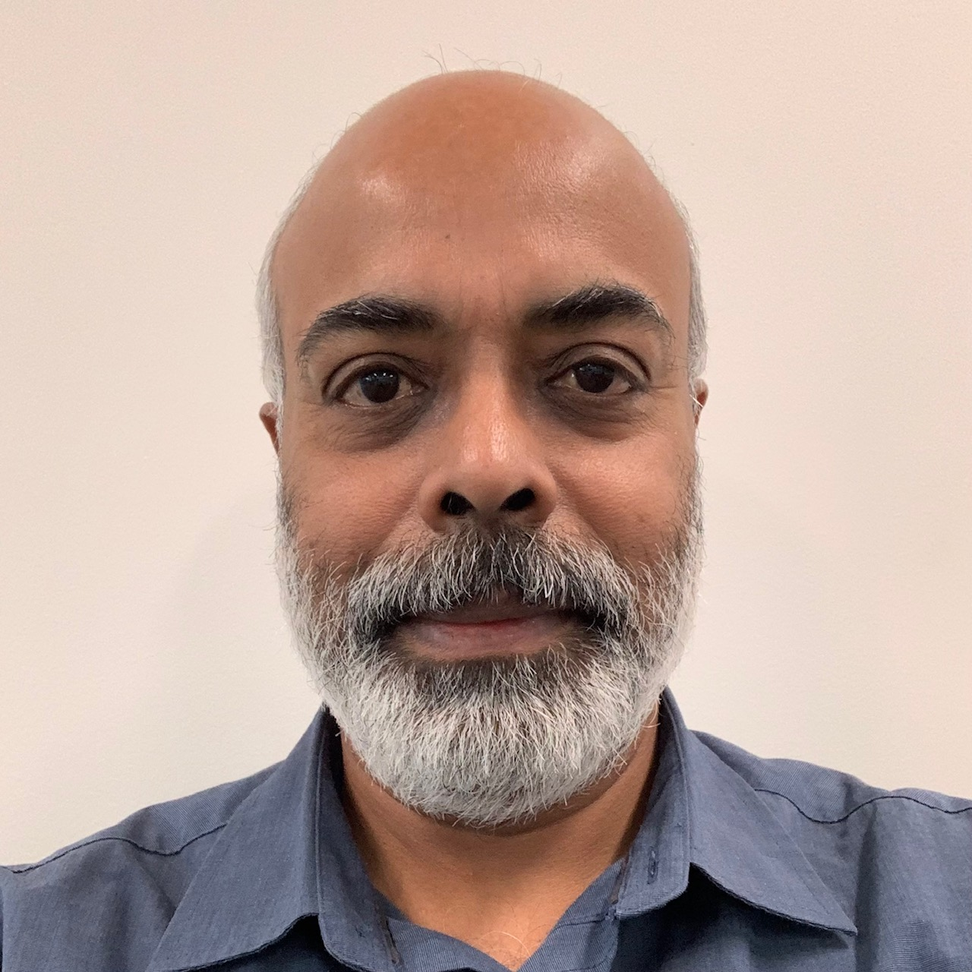
WGCV
Philippe Goryl (ESA) will step down as WGCV Chair after two years in the role
Cody Anderson (USGS) will transition from WGCV Vice Chair to WGCV Chair at CEOS Plenary
A nomination has been received from Geoscience Australia for Medhavy Thankappan to take on the role of Vice-Chair for 2025-2026, and subsequently Chair for 2027-2028.
Medhavy has been an active member of WGCV for many years and contributes to numerous areas of WGCV activity, such as RadCalNet, CEOS-ARD assessments, the SITSat Task Team, and many more
  References: Nomination letter, Presentation, CV
Philippe Goryl (ESA, outgoing WGCV Chair)
Cody Anderson (USGS, incoming WGCV Chair)
Medhavy Thankappan (GA)

Slide 3
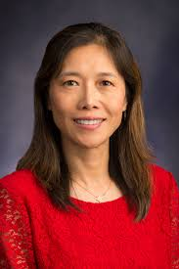
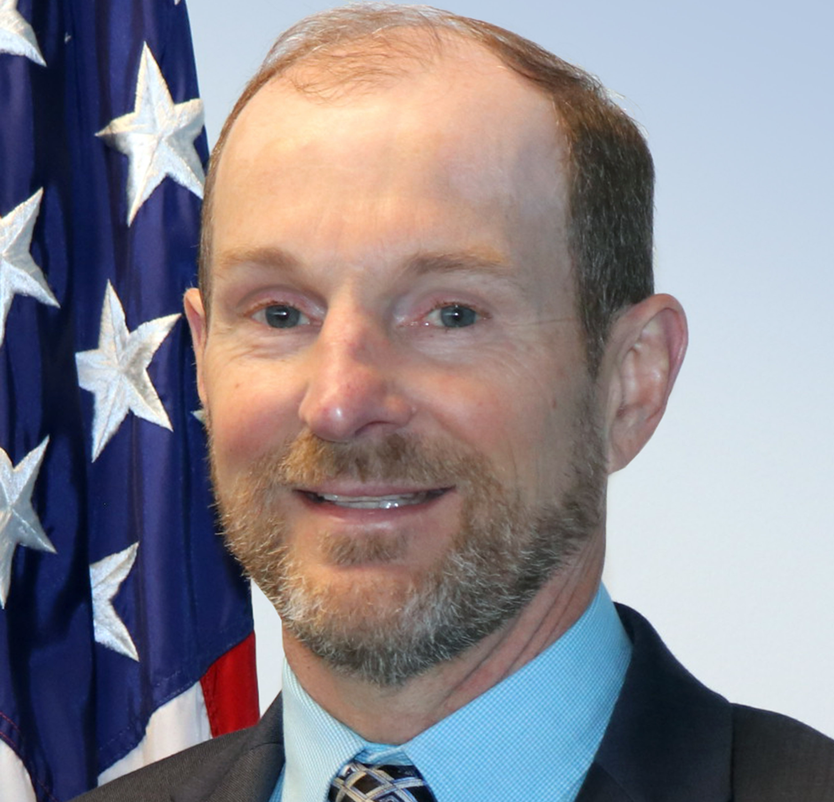
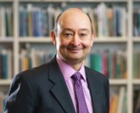
WGClimate
Jeff Privette (NOAA) will step down as WGClimate Chair after two years in the role
Wenying Su (NASA) will transition from WGClimate Vice Chair to WGClimate Chair at CEOS Plenary
A nomination has been received from ECMWF for Vincent-Henri Peuch to take on the role of Vice-Chair for 2025-2026, and subsequently Chair for 2027-2028.
Vincent-Henri has been active in WGClimate and CEOS for a few years, with a long track record in using EO for climate and atmosphere monitoring in the context of Copernicus. Has supported GCOS and GHG monitoring and insures close liaison with WMO.
References: Nomination letter, Presentation, CV
Jeff Privette (NOAA, outgoing WGClimate Chair)
Wenying Su (NASA, incoming WGClimate Chair)
Vincent-Henri Peuch (ECMWF)

