Slide 1
WGClimate’s GCOS IP Response, Inventory, Gap Analysis Report and Coordinated Action Plan Agenda item 4.4
Jeff Privette, NOAA
Wenying Su, NASA
SIT Technical Workshop
17 September 2024
Sydney, Australia

Slide 2
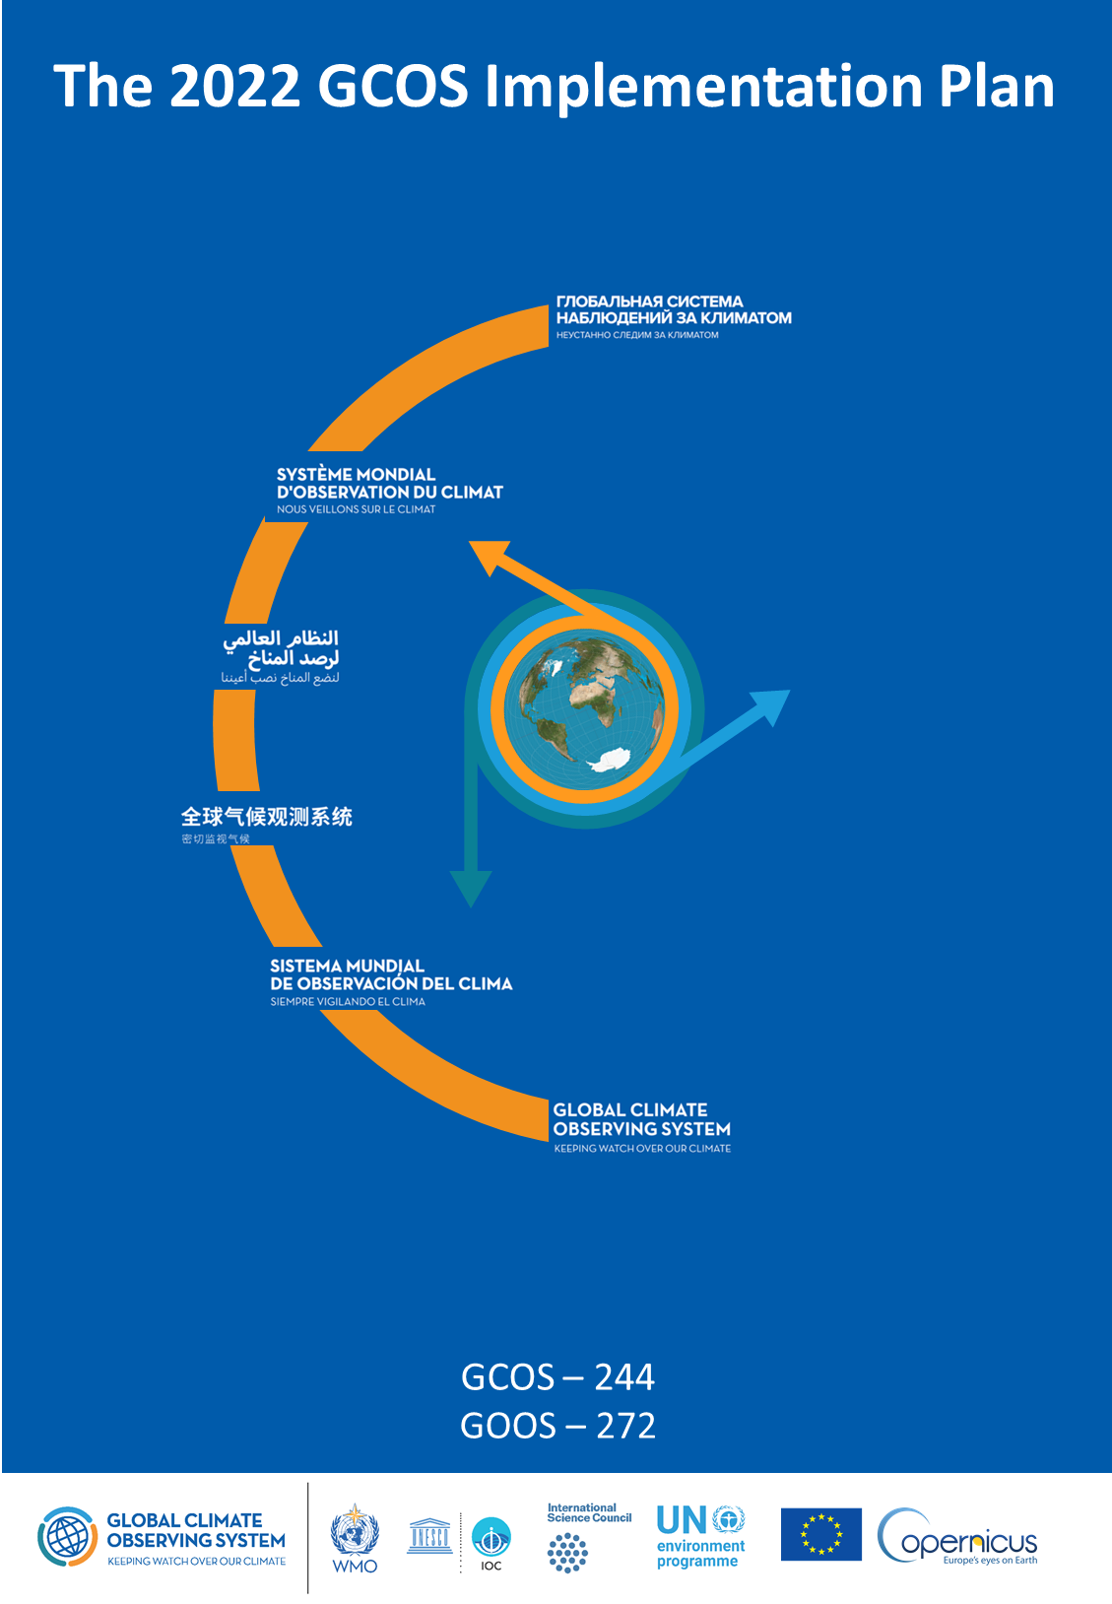
Agency Response to GCOS IP (2022)
Purpose
Describes needs/gaps in Global Climate Observing System
Produced every 5-6 years
2022: GCOS provided 16 Actions, each with multiple Activities
WGClimate addressing with a two-phase response
Completed 21 Activities in 2023 (more straightforward)
Addressing similar number in 2024 (more complex)
Status
Most contributions are in
On schedule for 2025 review and endorsement, per CEOS Work Plan

Slide 3
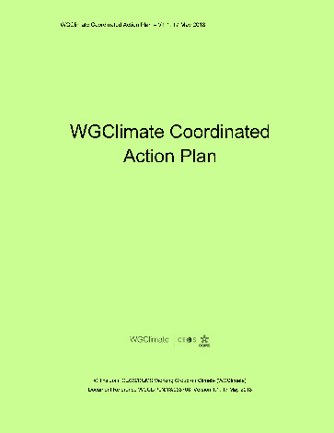
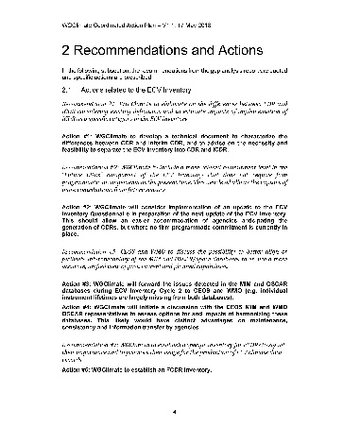
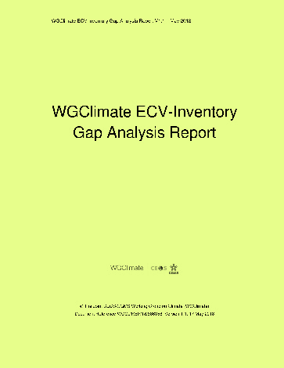
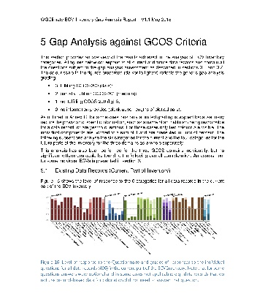
WGClimate’s Overarching Workflow
ECV Inventory
WGClimate
Climate Experts
Improved CDRs
Gap Analysis
Data producers
Improved observing system
Coordinated Action Plan
WGClimate
CEOS / CGMS

Slide 4
WGClimate’s Overarching Workflow
ECV Inventory
WGClimate
Climate Experts
Improved CDRs
Gap Analysis
Data producers
Improved observing system
Coordinated Action Plan
WGClimate
CEOS / CGMS

Slide 5
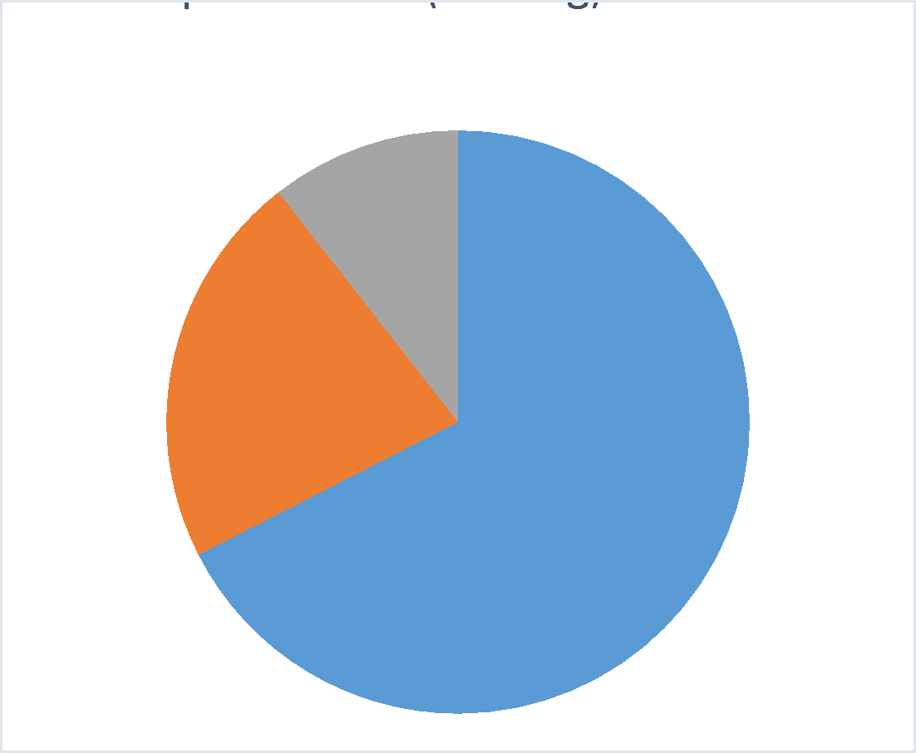
Evolution of ECV Inventory
Purpose
The only international compendium of current and future CDR metadata
Used internally to determine space architecture requirements to sustain CDRs
Used by CDR application and research community as authoritative one-stop CDR library
Accessible at https://www.climatemonitoring.info
History
V2.0: October 2017
V3.0: August 2020
V4.0: October 2021
V4.1: November 2022 (CDR entries: 870 existing, 381 planned)
Next
V5.0: ~November 2024
- Adds 45 previously-submitted records

Slide 6
Redesigned Inventory Coming in 2025
Simplified structure 🡪 easier for providers, maintainers, reviewers
WGClimate informed new design
EUMETSAT building, hosting, populating and maintaining
Features
Preview in Q1.2025, first release in Q2.2025
Public database continuously updated, reference versions issued as needed
Enhanced user experience (search, visualisation, filtering)
Improved reporting capabilities
New onboarding process will reduce workload
Will be renamed to indicate it contains CDRs (i.e., ECV Products), not ECVs

Slide 7
Other Inventory Considerations
Inventory structure and content tied to GCOS ECVs and ECV Products
Adapting to ECV Products in 2022 GCOS Implementation Plan
October consultation on new GCOS ECV binning structure (GCOS: Products won’t change)
Monitoring GCOS ECV rationalisation activity

Slide 8
WGClimate’s Overarching Workflow
ECV Inventory
WGClimate
Climate Experts
Improved CDRs
Gap Analysis
Data producers
Improved observing system
Coordinated Action Plan
WGClimate
CEOS / CGMS

Slide 9
Gap Analysis: Purpose
Purpose
Identify shortcomings for climate monitoring in the current and future space architecture
Identify opportunities to improve CDR production supporting GCOS ECVs and Fundamental CDRs
Informs WGClimate’s Coordinated Action Plan designed to address gaps and weaknesses
2024 Gap Analysis Report undergoing internal review
Based on Inventory v3 and 4.1
Addresses 16 ECVs related to the energy, water and carbon cycles
Identifies missing CDR records, potential architecture gaps and CDR production gaps and opportunities
Assesses completeness
Assesses the current and future CDR status and availability for all ECVs
Release to Agencies: ~October 1

Slide 10
WGClimate’s Tools, Activities & Workflow
ECV Inventory
WGClimate
Climate Experts
Improved CDRs
Gap Analysis
Data producers
Improved observing system
Coordinated Action Plan
WGClimate
CEOS / CGMS

Slide 11
Coordinated Action Plan: Key Needs
Based on 2024 Gap Analysis Report and prior Action Plan
1 | GCOS panels to continue improvements on the requirements framework towards a more physical approach that leads to time and space scale dependent requirements. This might be achieved by dedicated research projects.
2 | GCOS to continue the consolidation of the GCOS ECV Products into physical quantities that match WMO OSCAR physical quantities to allow a seamless use of OSCAR and the ECV Inventory.
3 | CEOS and WMO to continue activities for a better interoperability of the MIM and OSCAR/Space databases to ensure seamless use of both.
4 | GCOS to attempt a simplification of the ECV focusing on creating ECVs for fluxes between Earth’s surface and atmosphere.
5 | GCOS to improve interactions with specialist groups when creating new GCOS Implementation Plans or updates of requirements.
6 | Agencies with interest in the Above Ground Biomass ECV shall operationalize the production of this ECV inclusive of comprehensive validation of resulting data records.
7 | Agencies with interest in soil moisture to support L-band passive microwave and SAR missions and to plan for the generation of L-band based ECV soil moisture data records based on the data collected by instruments on missions such as SMOS, SMAP, CIMR, SAR-L, and ROSE-L utilizing an ensemble of algorithms.
8 | Agencies operating altimeters suitable for sea level estimates shall consider operational climate data record production including past sensors.

Slide 12
Thank you
jeff.privette@noaa.gov

Slide 13
Backups

Slide 14
16 Actions in GCOS IP Space Agency Supplement
Most Actions have multiple Activities
Space agencies play minor role in 3 additional Actions
Space agencies collaborate with others on 2 additional Actions

Slide 15
Inventory Evolution Since 2017
Publication timeline:
V2.0: October 2017
V3.0: August 2020
V4.0: October 2021
V4.1: November 2022
V5.0: planned for Q4.2024 (mostly backlog since V4.1)
Domain | Version | Total | Existing | Planned
All | V2.0 | 913 | 496 | 417
 | V3.0 | 1137 | 766 | 371
 | V4.1 | 1251 | 870 | 381
Atmosphere | V2.0 | 658 | 376 | 282
 | V3.0 | 801 | 535 | 266
 | V4.1 | 851 | 587 | 264
Land | V2.0 | 135 | 56 | 79
 | V3.0 | 203 | 141 | 62
 | V4.1 | 262 | 191 | 71
Ocean | V2.0 | 120 | 64 | 56
 | V3.0 | 133 | 90 | 43
 | V4.1 | 138 | 92 | 46
Process for 2025 and beyond:
Agency Focal Points identify CDR access points (e.g., Copernicus Climate Data Store)
EUMETSAT derives the needed information; updates Inventory with draft records
EUMETSAT provides draft Inventory records back to Focal Points for verification
Focal Points provide corrections, fill gaps as needed
EUMETSAT updates online inventory on rolling basis (not episodic versions)
Notes:
Caveat I: on numbers is that they contain also interim CDRs (mostly for domain atmosphere) and particularly from V3 to V4 some have been redefined by data providers leading to more individual quantities records.
Caveat II: Some records were still left out from V4.1, e.g., from C3S, because information arrived too late to be verified. Thus a next version will see more records. It also further increases the imbalance of provision of records to Europe
Caveat III: We were generous in letting data records in applying a rule of thump on 10 year length as a minimum, also opting for taking a record that is not a CDR if there is no other, but certainly some content does not qualify to be in the Inventory
Number of records has increased from version to version mostly indicating more completeness and some competed records (mostly from Europe) and some new planning
Biggest increase is in domain atmosphere, mostly on provided not on planned, which either points to the periodicity of plans, e.g., ESA and EUMETSAT new programmes or to a lack of responses. One cannot decide what the reason is, maybe both
For the land domain we see a big increase in the existing, which is mostly due to the fact we covered more. High fluctuation in planned, which is related to the level of response.

Slide 16
History of Inventory Gap Analyses
2018 Report
Inventory v2.0, 8 ECVs addressed in 2018 report
Atmosphere: CO2*, CH4*, and other GHG*, Precipitation
Land: LST, LAI*, AGB*
Ocean: SST, SSS
2024 Report
Inventory v3.0, 10 ECVs addressed:
Atmosphere: Aerosols, Surface winds, Upper-Air Winds, Water Vapour
Land: Fire*, Land Cover*, Soil Moisture
Ocean: Sea Level, Sea State, and Ocean Surface Heat Flux
Inventory v4.1, 9 ECVS:
Atmosphere: Greenhouse Gases (GHGs)
Land: Anthropogenic GHG fluxes, Above ground Biomass (AGB), Land cover, Leaf Area Index (LAI), Fraction of Absorbed Photosynthetically Active Radiation (FAPAR), Fire, Permafrost
Ocean: Ocean Colour
*readdressed in 2022 with V4.1

Slide 17
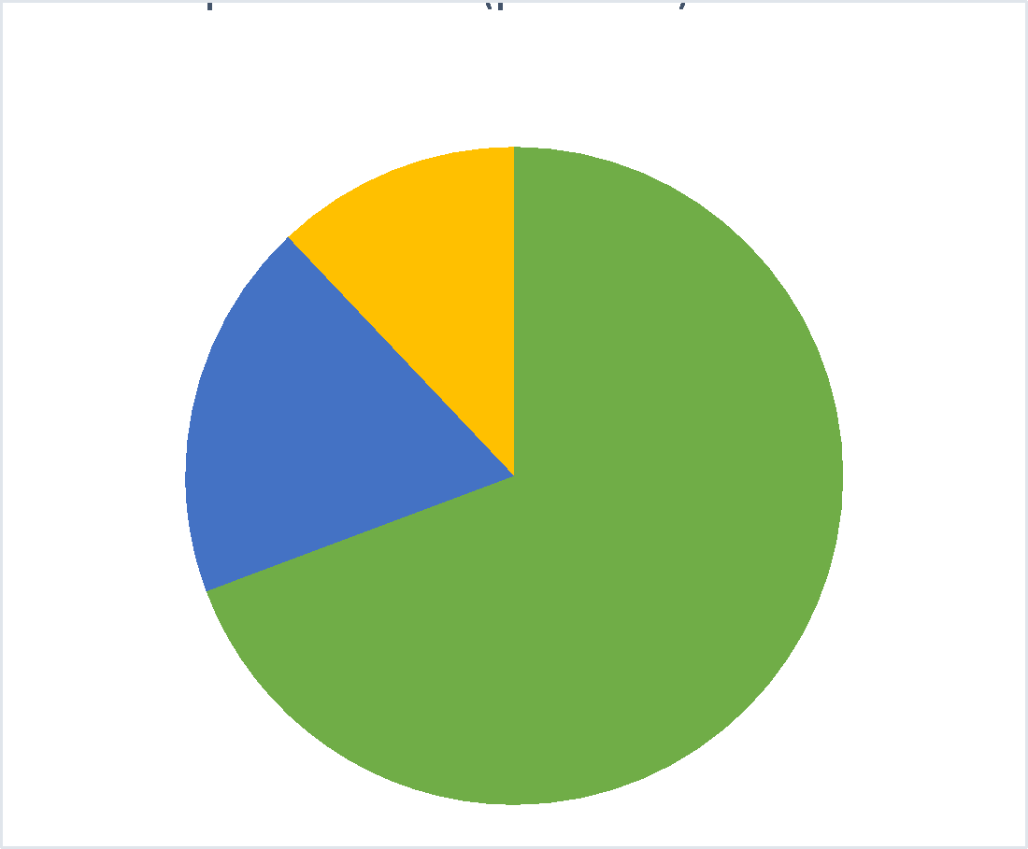
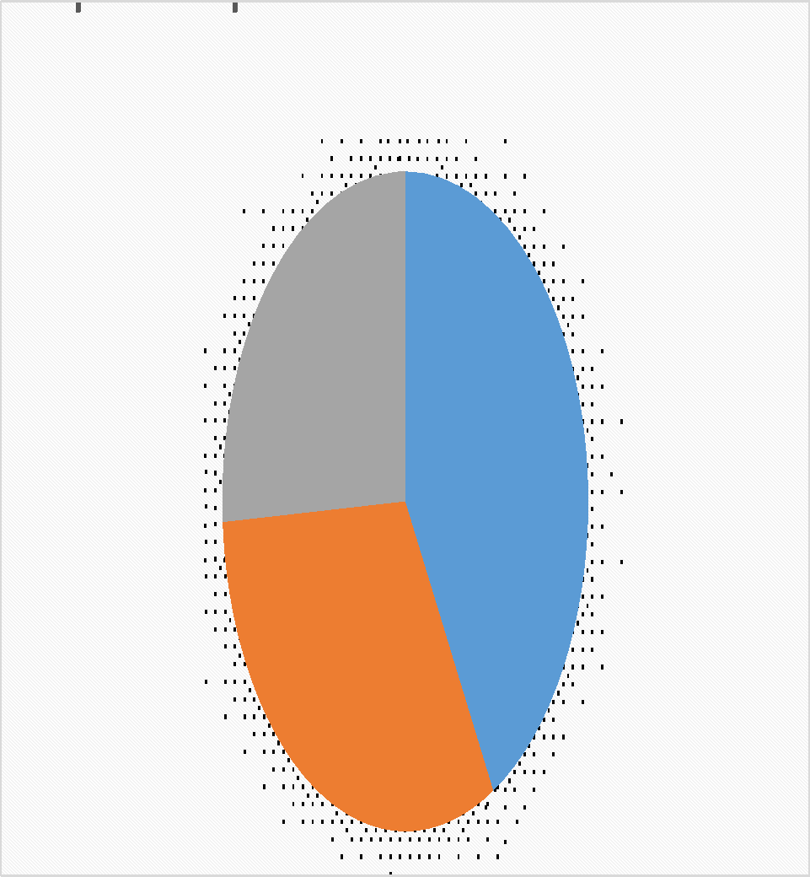
Data records per domain (V4.1)
CDR Population vs. Product Fraction
Notes:
Notes:
-overwhelming amount of atmospheric ECVs compared to other domains
-Ocean has the most non feasible from space
-transition from existing to planned keeps relations – thus many are continued in the future
ECVs per domain is from GCOS IP 2022 and added more ECV products particularly for land domain, e.g., on sea ice.

Slide 18
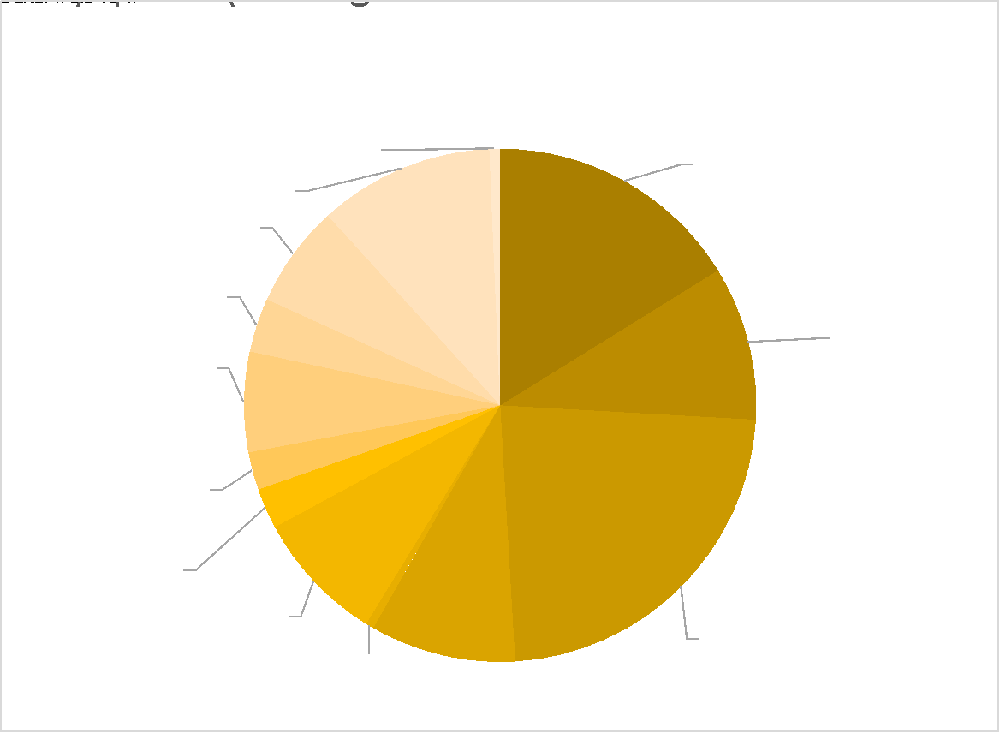
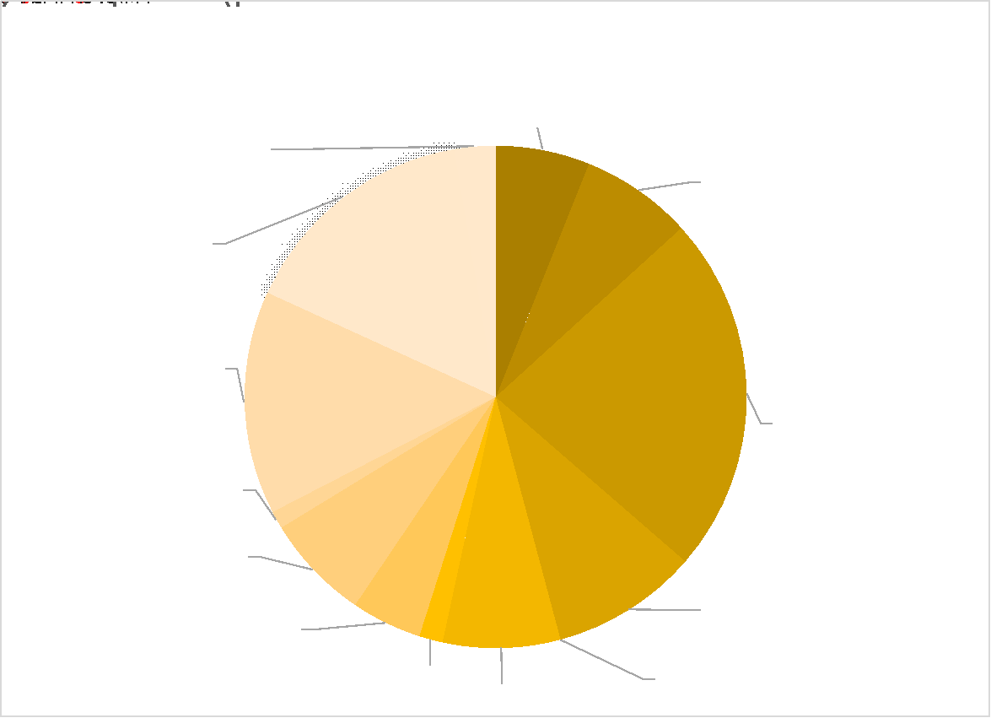
CDR Product Fractions: Atmosphere
Notes:
Notes:
still low number of precipitation compared to its importance
very few upper air winds
missing in planning is lightning although new sensors, particularly in geostationary orbit are in space

Slide 19
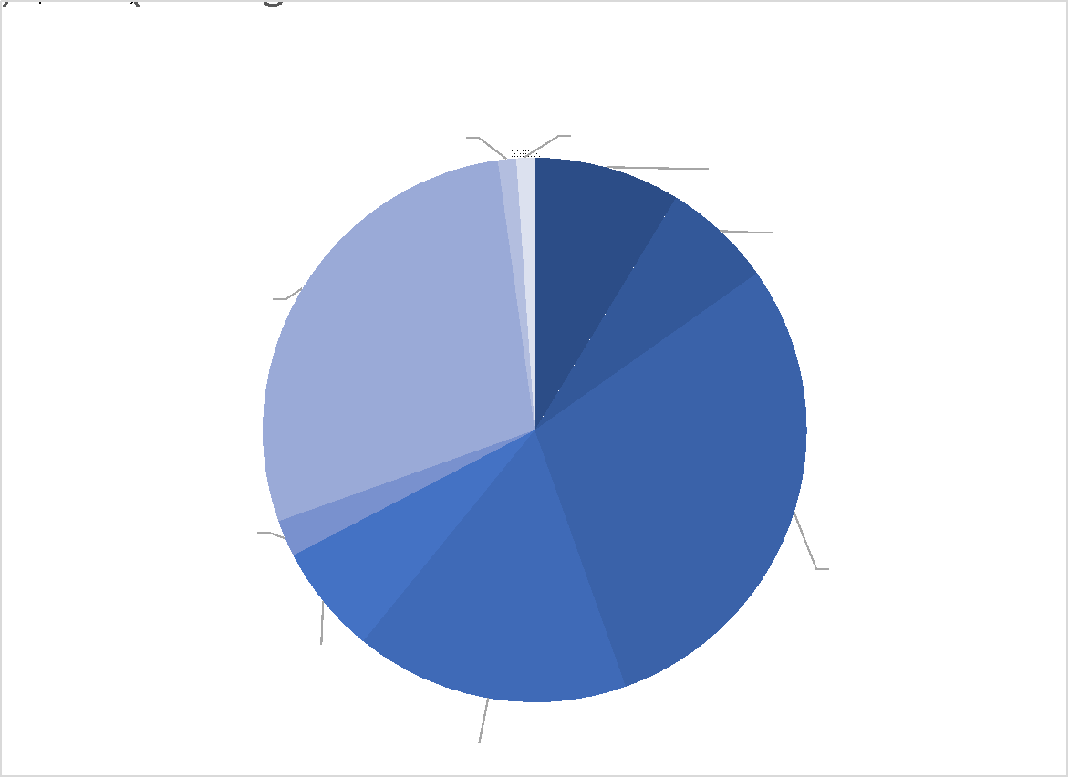
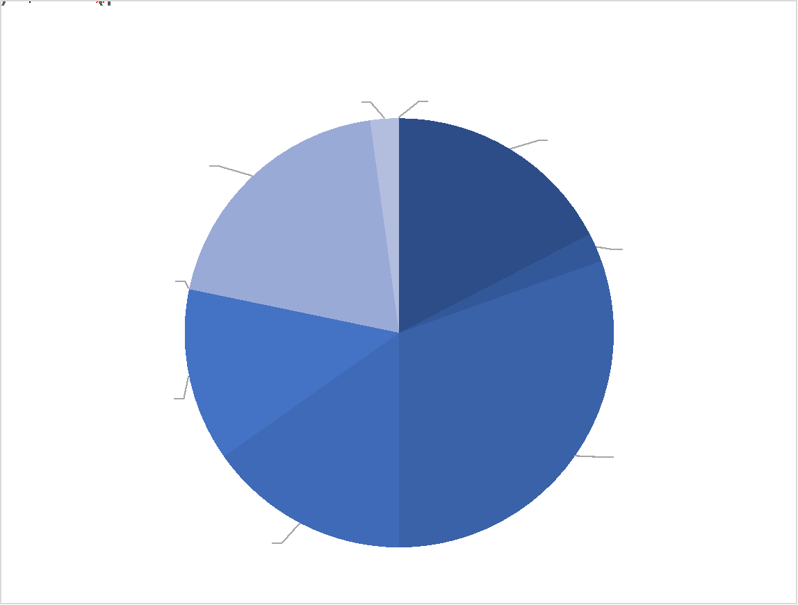
CDR Product Fractions: Ocean
Notes:
no gaps in terms of ECVs
some gaps in plans, but this is the status end of 2022

Slide 20
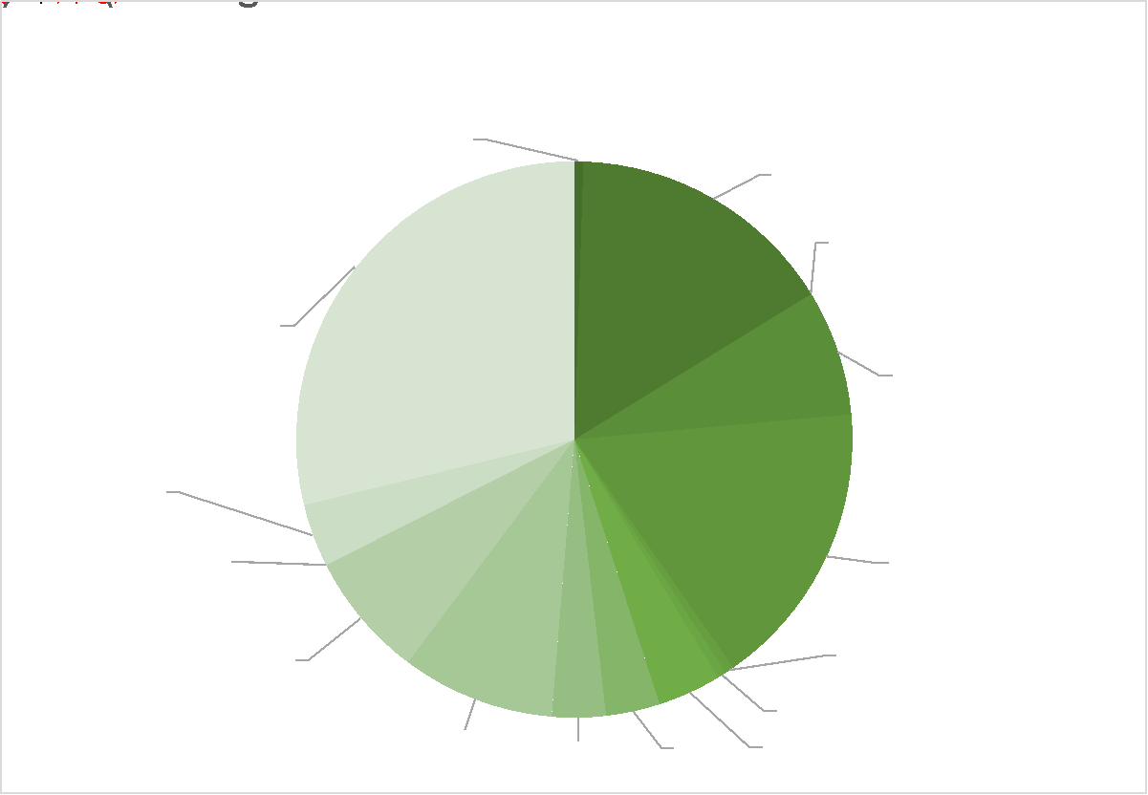
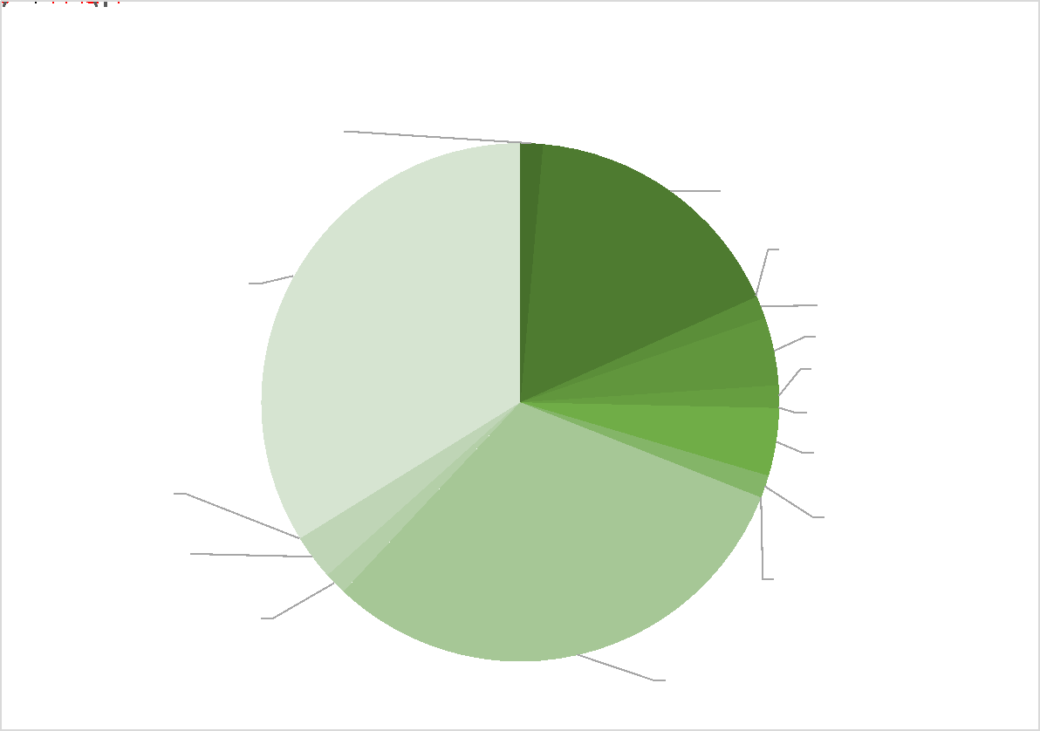
CDR Product Fractions: Land
Notes:
gaps in inventory on permafrost – know that NH data exist from ESA – next update
still information missing on planned data sets, demonstrating the limits of the ECV inventory process

