Slide 1
SIT Technical Workshop 2024
CEOS Interoperability Handbook 2.0
Nitant Dube & Tom Sohre,
WGISS
Agenda Item #
SIT Technical Workshop 2024
Sydney, Australia
18th - 19th September 2024

Slide 2
CEOS Interoperability Handbook V 2.0
Objective
CEOS Interoperability Handbook Version 2.0 should provide guidance to the organizations for development of Interoperable Data and Services and help them in measuring their maturity level
Interoperability Handbook
Maturity Matrix

Slide 3
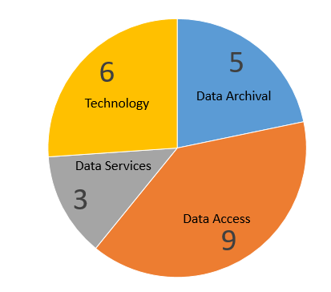
Handbook V 1.0 and V 2.0
Version 1.0
(Summary of Recommendations)
Version 2.0

Slide 4
Interoperability Framework : Factors

Slide 5
CEOS Initiatives linked to Factors
Factor | Vocabulary (Semantics) | Architecture | Interface (Accessibility) | Quality | Policy
CEOS Initiatives | CEOS Common Online Dictionary Cal-Val Terms and Definitions Long term Preservation of Earth Observation Space Data : Glossary of Acronyms and Terms | CEOS-ARD (Guidelines) CEOS Persistent Identifiers Best Practices Data preservation and Management Best Practices WGISS Data Management and Stewardship Maturity Matrix | WCDA, FedEO, CWIC, IDN CEOS Open Search Best Practices STAC Best Practices CEOS Service Discovery Best Practices | CEOS CALVAL & QA4EO FRM Assessment Framework ESA-NASA EO mission Quality Assessment Framework | Data Purge Alert Open Data

Slide 6
CEOS Contributors
Factor | Vocabulary (Semantics) | Architecture | Interface (Accessibility) | Quality | Policy
WGISS | Katrin Molch, (DLR) | DSIG: Mirko & Iolanda (ESA) TEIG: | DAIG: | Nitant Dube (ISRO) | Tom Sohre (USGS)
WGCV | Peter Strobl (EU commission) |  |  | *
LSI-VC |  | *
WGCapD | *
CEOS-COAST |  |  |  | Prasanjit Dash (NOAA)
SEO/CEO |  |  |  |  | *
Agency | Ryan Berkheimer (NOAA)

Slide 7
Handbook Chapter Layout
Chapters
Chapter-1 : Introduction
Requirements/Need, Scope, Audience
Chapter-2: Interoperability Framework
Genesis of the Factors, Brief overview of the factors
Chapter-3: Vocabulary (Semantics)
Chapter-4: Architecture
Product Formats (ARD, Cloud Compatibility); Data Stewardship; Data Dissemination
Chapter-5: Interface (Accessibility)
Discovery: Metadata, STAC; Access: API, https; Authentication
Chapter 6: Quality
Quality Evaluation and Tags, Calibration, Validation
Chapter 7: Policy
Open Data Policy, Open Science, Open Source Science
Chapter 8: Conclusion and Future Scope
Annexures

Slide 8
Vocabulary Recommendations
Recommendations are primarily based on work done and paper published by Peter Strobl , Woolliams and Katrin Molch.
Standards
ISO 25964-1, 2011 Thesauri for information Retrieval
ISO 25964-2, 2013 Interoperability with other vocabularies
CEOS
CEOS Cal/Val Portal, Terms and Definitions
CEOS Interoperability Terminology
CEOS WGISS EO Data Stewardship Glossary of Acronyms and Terms
Review of Chapter in Progress

Slide 9
Interoperability Demonstrator
(Earth Observation Plug and Play)
Development of Plug and Play modules to demonstrate interoperability best practices
Discovery and access of Earth observation data
Data Analytics
Possible collaboration with CEOS Analytics Lab (CAL)
CEOS Common Online Dictionary
Development of CEOS thesaurus access and management Software for CEOS controlled vocabularies to demonstrate Vocabulary interoperability best practices
Possible collaboration with WGCV and LSI-VC

Slide 10
Challenges
Mechanism for involvement of commercial/ New Space entities for Handbook
Voluntary involvement of Contributors within CEOS

Slide 11
Way Forward
Discussion on Quality Factor during Joint WGISS and WGCV meeting at Sioux Falls, USA
Discussions on Architecture during LSI-VC-16
Development of Interoperability Maturity Matrix to be initiated
Development of Interoperability Demonstrators to be taken up after completion of Handbook

Slide 12
Thanks nitant@sac.isro.gov.in tsohre@usgs.gov

