Slide 1
Early Warnings for All (EW4All)
CEOS Engagement with the UN’s Initiative
Osamu Ochiai
JAXA SIT Chair Team
Agenda Item 4.1
SIT Technical Workshop 2024
Sydney, Australia
18th - 19th September 2024

Slide 2
Action SIT-39-11
SIT-39-11 | SIT Chair to confer with WGDisasters Chair and Vice Chair regarding potential CEOS contributions to the UN’s Early Warnings for All (EW4All) initiative. | SEC-321
 | Rationale: The objective is to identify potential CEOS contributions to the EW4All to be communicated to the UN and through WMO.

Slide 3
What is Early Warnings for All?
Launched in 2022 by UN Secretary-General, António Guterres
Early Warnings for All is striving for global early warning coverage by 2027
Includes hazardous weather, water, and climate events

Slide 4
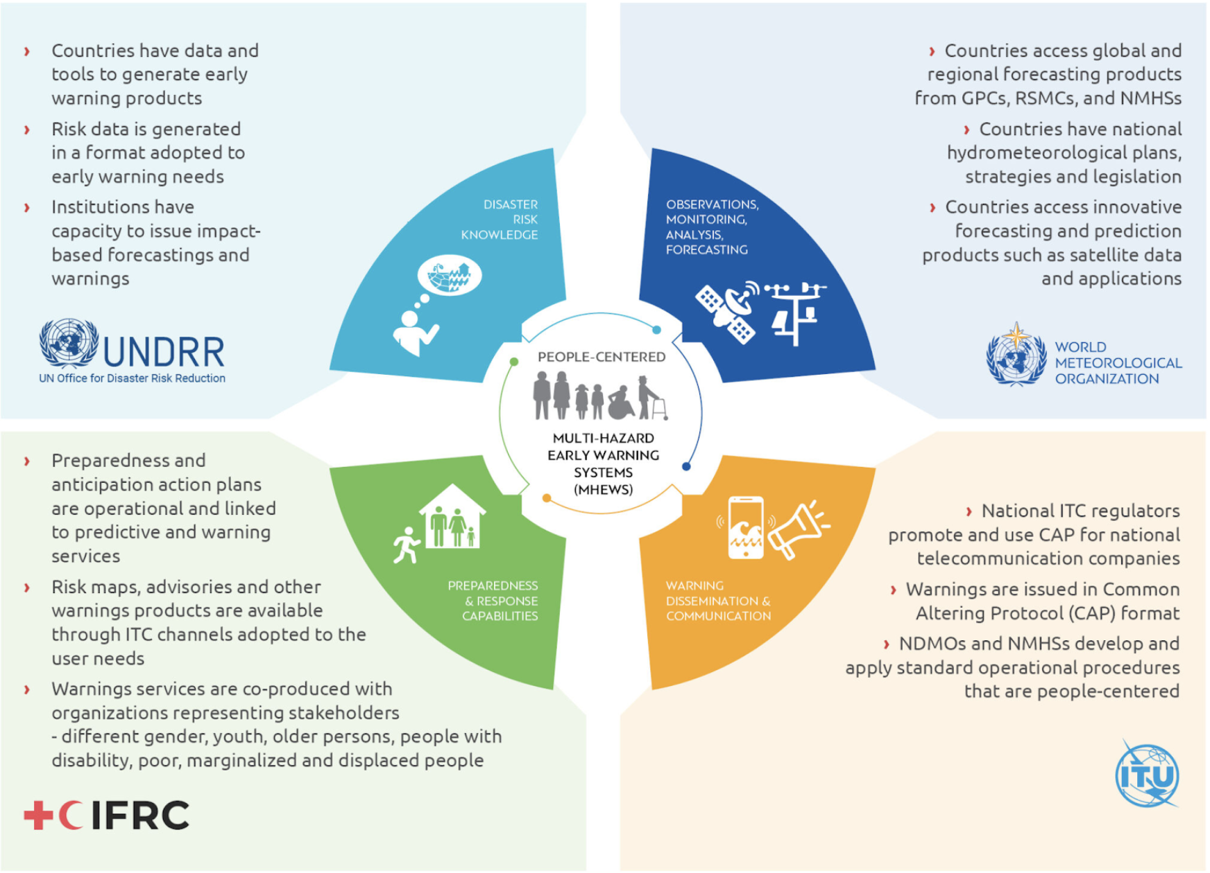
EW4All - The Four Pillars
Disaster risk knowledge and management (led by UNDRR)
Detection, observation, monitoring, analysis, and forecasting (led by WMO)
Warning dissemination and communication (led by ITU)
Preparedness and response capabilities (led by IFRC)

Slide 5
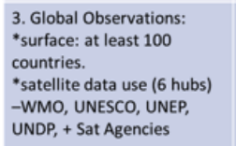
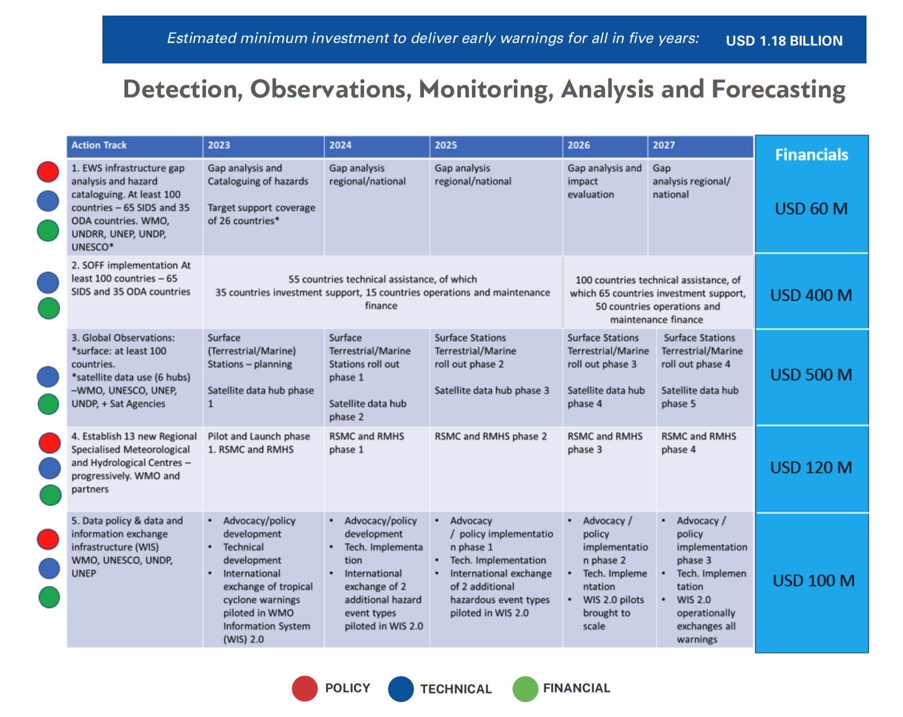
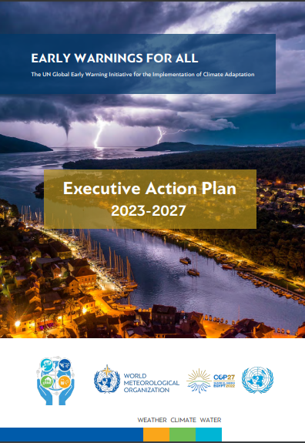
Pillar 2: Detection, Observations, Monitoring, Analysis & Forecasting
Key Action Area 1B:
Enhance the timely access to, and use of satellite observations and of advanced technologies (radar, lightning detection) to build up detection and forecasting capabilities: action: establish satellite nowcasting facilities in Africa and South America.
Key Action Area 2B:
Close ocean and cryosphere observation gaps in hot spots (coastal areas, high mountains, etc.)

Slide 6
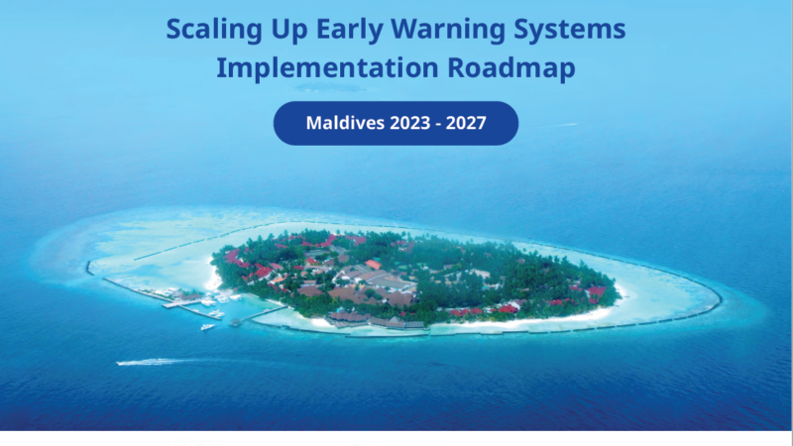
30 countries for the first phase of the initiative
The UN Secretary-General has sent a letter to heads of state and government of an initial group of countries to receive coordinated and targeted support.
Asia and Pacific: Bangladesh, Maldives, Nepal, Lao (People’s Democratic Republic), Cambodia, Kiribati, Samoa, Solomon Islands, Fiji, Tonga
Africa: Djibouti, Somalia, Sudan, Chad, Comoros, Ethiopia, Liberia, Madagascar, Mauritius, Mozambique, Niger, South Sudan, Uganda
Latin America and Caribbean:
Guyana, Haiti, Barbados, Antigua Barbuda, Guatemala, Ecuador
Central Asia:
Tajikistan​​
Countries are formulating EW4ALL national roadmap

Slide 7
WGDisasters Status
Early warning is directly relevant to WG Disasters scope and mandate, so it was identified as "entry point" for the relationship between CEOS and the relevant Pillars
In an initial review of the WGs current demonstrators and pilots, it was observed that there is no clear EW component in many of them, although there are some activities that can be related to the initiative:
Some new activities are directly relevant and may seek EW4All funding, such as the Tonga Preparedness Pilot presented at Pacific Islands Forum late August
Many WG Disasters activities are relevant to risk information, a key component of pillar 1
WG Disasters has existing relations with key EW4All implementing organizations (WMO, UNDRR)
A first meeting was held with WMO and SIT Chair Team to discuss how to address the topic within the WG and to coordinate across CEOS
A subgroup was created, with a dozen members, and the topic will be discussed in detail at WG Disasters 22, 2 October

Slide 8
Discussion
What is the opportunity for CEOS to engage with EW4All?
Which pillars CEOS should engage?
Should CEOS engage with countries?

