Slide 1
Biodiversity
Ecosystem Extent Task Team
Shaun Levick, CSIRO
Gary Geller, NASA
Sandra Luque, INRAE/CNES
Roger Sayre, USGS
Agenda item 3.1
SIT Technical Workshop 2024
Sydney, Australia
18th - 19th September 2024
(c) 2024 California Institute of Technology. Government sponsorship acknowledged.

Slide 2
Agenda
EETT overview and overall status
Two deliverables
Overview of demonstrators
Hudson Bay Lowlands (Wapusk NP), Canada
Great Western Woodlands, Australia
Tropical Forests, Costa Rica
Discussion

Slide 3
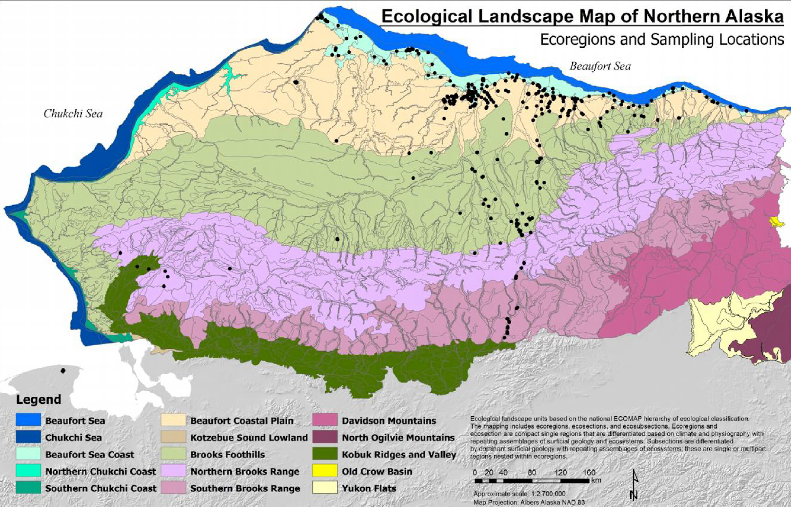
Task Team Basics
Purpose
Assess the utility for mapping Ecosystem Extent using current and new space-based observations that will become available in the next 10 years
Two Deliverables
White Paper
Demonstrator
Notes:
White Paper (delivered November 2023)
Demonstrator (HBL-Wapusk NP wrapping up)

Slide 4
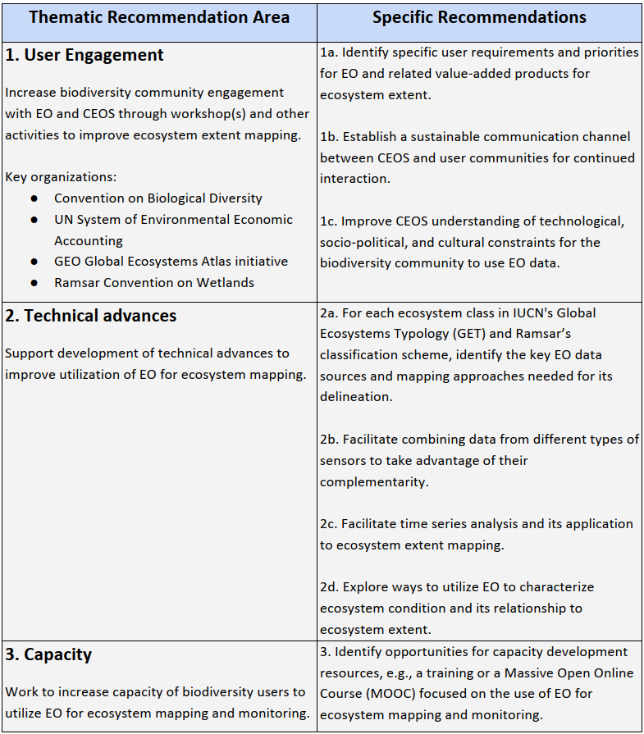
White Paper Outcome
Eight recommendations
User engagement (3)
Technical advances (4)
Capacity (1)

Slide 5
Demonstrator
EETT was tasked to deliver one demonstrator but had three opportunities
(1) Hudson Bay Lowlands
ECCC had relevant work underway
Offered to develop a demonstrator on Wapusk National Park
Now wrapping up (broader HBL work will continue)
(2) & (3) Great Western Woodlands & Tropical Forests
Shaun Levick (CSIRO) and Sandra Luque (INRAE/CNES) submitted proposals to their funding agencies
Successful - funding available near end of 2023
Work still underway - will present results-to-date

Slide 6
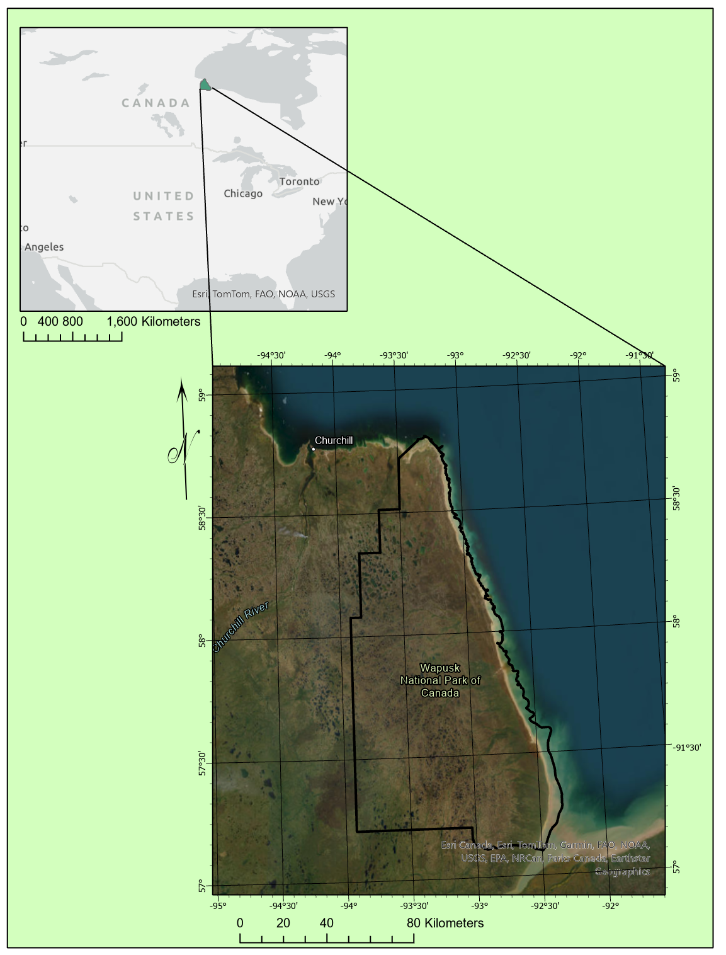
Hudson Bay Lowlands
Jason Duffe
Laura Dingle Robertson
Marie-Bé Leduc
Kasun Hiripitiyage
Emily Ogden
Jason Beaver
Taylor Biccum
Demonstrator focus:
Wapusk National Park

Slide 7
Ecotype Mapping for Biodiversity Monitoring
Overall objectives: Hudson Bay Lowlands & Canadian Ecotype Mapping (Ongoing)
Develop standardized ecotype mapping approach with machine learning, AI, cloud computing & EO to operationally monitor biodiversity across HBL & eventually all of Canada
Standardizing vegetation ecotypes to the IUCN 2.0 Typology, a comprehensive hierarchical classification framework for Earth's ecosystems. Committed to mapping all of Canada to Level 3 – Functional Groups by 2026
Objectives for Wapusk National Park (EETT Demonstrator Site)
Determine what sensors contribute most to the discrimination of ecotypes for biodiversity monitoring
Determine & resolve roadblocks for utilizing datasets in an operational capacity
Notes:
CEOS (Committee on Earth Observation Satellites) Biodiversity Demonstrator
This is an ongoing project to standardize ecotype mapping across the Hudson Bay Lowlands and Canada
The Objective is to develop standardized ecotype mapping approach using machine learning, AI, cloud computing and earth observation to operationally monitor biodiversity
Landcover classes were standardized and are looking to mimic the IUCN 2.0 typology
Hudson Bay Lowlands, particularly the Wapusk National Park is the testing site -- home of diverse flora and fauna which include Polar Bears, Cariboo and Moose; all photos here were taken from helicopter in August 2024
Taking what we learn and extending the ecotype classifications throughout the Hudson Bay Lowlands and then throughout Canada
Employed various machine learning and deep learning algorithms such as Random Forest, Convolutional Neural Network, and U-Net architectures for the purpose of ecotype classification with field based training data & various earth observation data
Worked with CSIRO and an updated cloud-based Digital Earth data cube to classify

Slide 8
Data sets & testing scenarios
EO data has been received and/or accessed & processed throughout 2024 with the latest data sets coming Summer 2024
Training & validation data were initially generated from older (2014) Wapusk field data
Field campaigns commenced 2024 in Hudson Bay Lowlands using helicopter transects, air calls & ground plot sampling to supplement older field data
Datasets: | ESA Sentinel 1 & Sentinel 2 | CSA RCM | JAXA ALOS2-PalSAR2 | DLR ENMAP | DLR TanDEM-X
Classification Methods: RandomForest (RF), UNET, & Convolutional Neural Network (CNN) | S1 EW - HH, HV intensity 2022, 2023 64 Images S2 Composites & individual images | 30m Compact Pol – Intensity, mChi Decomp (2023 & 2024 – 51 Images) | Dual Polarimetric Dual pol HH, HV intensity processed (2023 & 2024 31 images) | 2 Strips (7 and 4 images – July 2024) Surface Reflectance 238 bands | 12 m X-band DEM – 11 images Elevation, Slope, Aspect, Dissection
CEOS Cube | Sentinel 2 Spring, Summer, Fall Composite Bands + NDVI & EVI
Notes:
Have received several datasets over Wapusk National Park within Hudson Bay Lowlands from JAXA and DLR including 31 ALOS2-PalSAR-2 L-band SAR images, 11 EnMAP hyperspectral images and 11 TanDEM-X 12 m X-band and have accessed via the CSA 51 RADARSAT Constellation Mission C-band compact polarimetry images and many via ESA Sentinel-2 optical imagery and C-band dual polarimetric Sentinel-1 images. Using NASA Landsat time series created Fourier Transformations and utilized the amplitude, phase of the time series curves. Utilizing the Digital Earth data cube provided by CSIRO and Sentinel 2 datasets including spring, summer and fall composites.
Field data includes older in situ observations from 2014 and in addition field campaigns were undertaken in 2024 over the Wapusk National Park including helicopter transect sampling with vegetation calls, and some ground based plots.

Slide 9
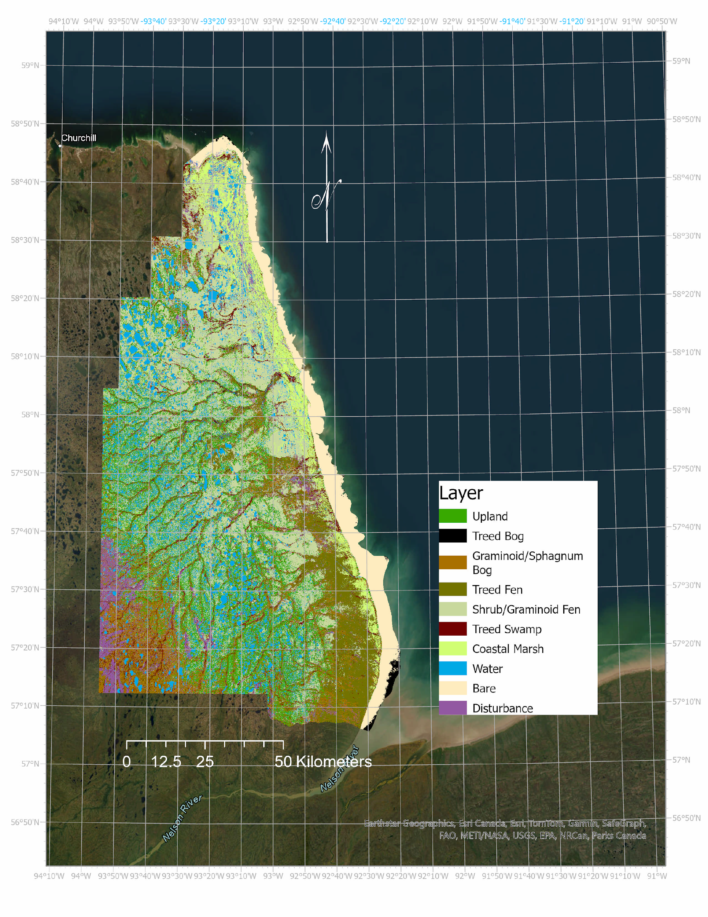
Findings to date & Next Steps (1)
Accuracy: 59-75% (for individual EO stacks – mixing should help)
Optical datasets had the highest accuracies
CSIRO data cube w/ 3 years Sentinel 2 data
AND with 2 July dates in 2024 of ENMAP data
Specific sensors improved particular ecotype classes’ accuracies:
RADARSAT Constellation Mission 30m Compact Polarimetry data improved Treed Fen and Upland classes
ALOS-2 PalSAR-2 Dual Polarimetric data improved Treed Bog class
Sentinel-1 Dual Polarimetric data improved Upland class
Wapusk NP 2024 Ecotype Classification
Notes:
To data the preprocessing and analysis of particular data derivatives have been completed and classifications of the specific datasets have been completed for 10 ecotypes over Wapusk National Park. The far figure shows the highest accuracy achieved classification using the CSIRO data cube and optical Sentinel 2 data. The next steps to improve the classification include stacking multiple data types together – particularly it was seen that optical imagery provides good results for mud flats and shrub/graminoid fens, the SAR imagery provided good results for Treed ecotypes such as treed fen, treed bog and upland.
Some issues with data quality and processing techniques
E.g. EnMAP example: clear north-south gradient with decreasing reflectance values with northerly images
Some data lack consistent coverage (spatially & temporally)
Lack of consistent coverage makes it difficult to make direct comparison and evaluation of results

Slide 10
Findings to date & Next Steps (2)
It is expected that combining data types (e.g. optical and SAR or different SAR frequencies) will improve overall classification accuracies AND individual class accuracies.
Next step for the HBL work
Data quality & processing issues, e.g.
ENMAP: Northerly images had north-south reflectance gradient
Some data lack consistent coverage (spatially & temporally)
Lack of consistent coverage makes direct comparison difficult
Wapusk NP 2024 Ecotype Classification
Notes:
To data the preprocessing and analysis of particular data derivatives have been completed and classifications of the specific datasets have been completed for 10 ecotypes over Wapusk National Park. The far figure shows the highest accuracy achieved classification using the CSIRO data cube and optical Sentinel 2 data. The next steps to improve the classification include stacking multiple data types together – particularly it was seen that optical imagery provides good results for mud flats and shrub/graminoid fens, the SAR imagery provided good results for Treed ecotypes such as treed fen, treed bog and upland.
Some issues with data quality and processing techniques
E.g. EnMAP example: clear north-south gradient with decreasing reflectance values with northerly images
Some data lack consistent coverage (spatially & temporally)
Lack of consistent coverage makes it difficult to make direct comparison and evaluation of results

Slide 11
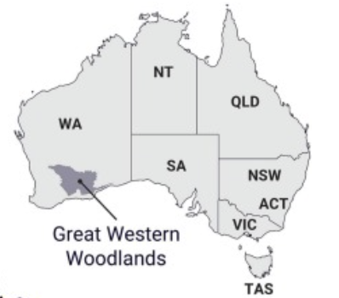
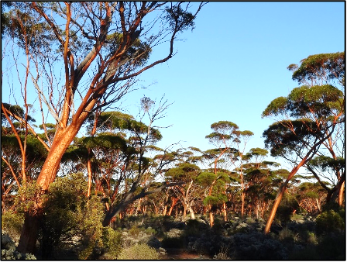
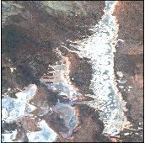
Great Western Woodlands
Biodiversity hotspot in Western Australia
Distinguishing vegetation assemblages and stand ages is critical for effective land management and conservation
Ecosystem extent mapping underway using CSIRO’s EASI platform
Testing the fusion of Sentinel-1, ALOS-2, Sentinel-2 and Landsat-5/-7/-8/-9

Slide 12
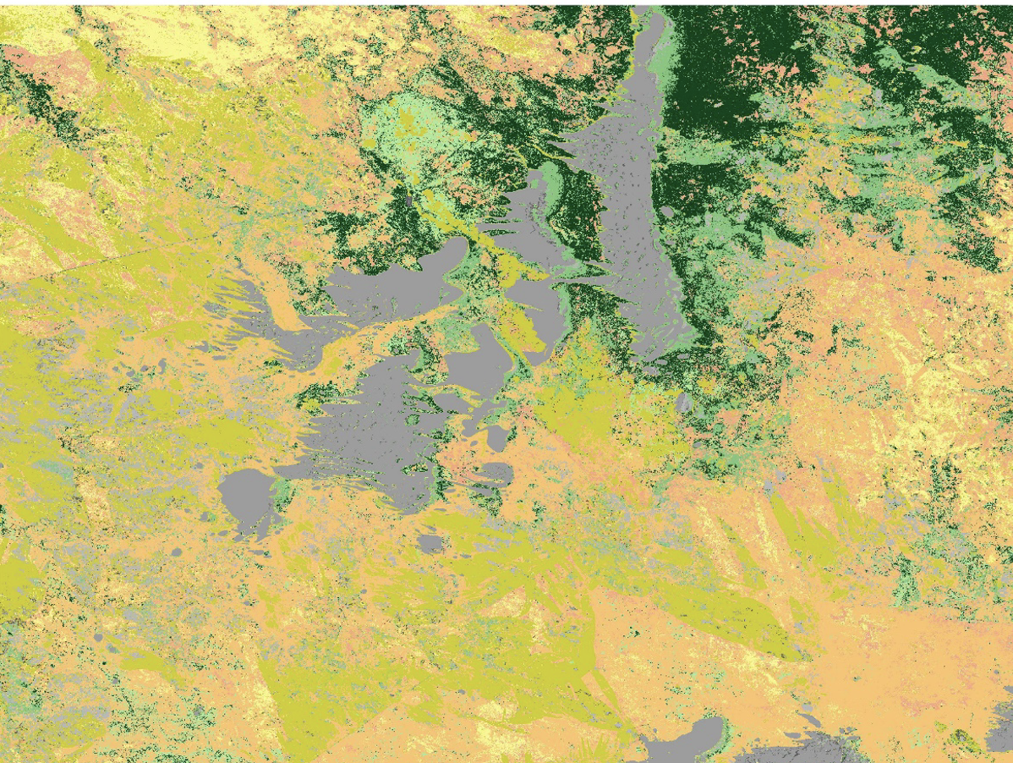
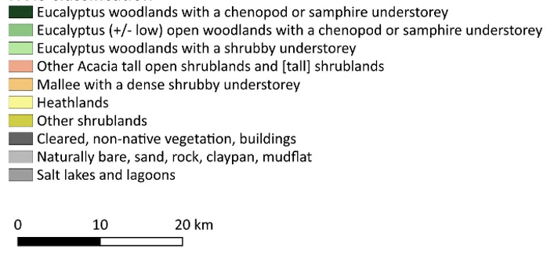
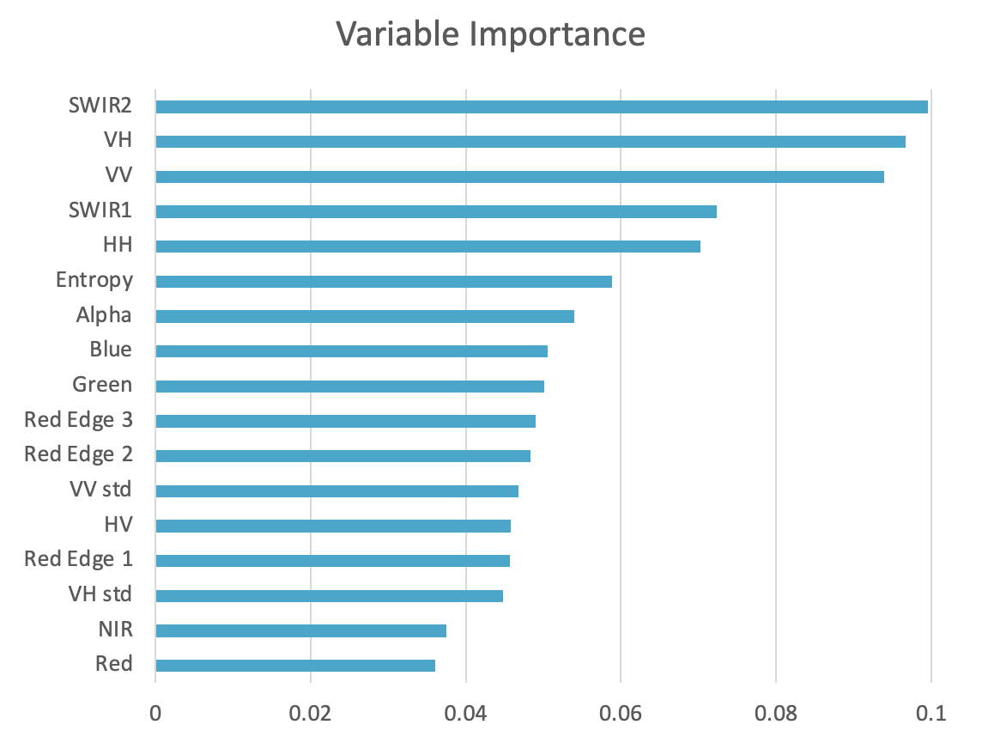
Great Western Woodlands
Current model with both optical and SAR data achieves an overall accuracy of 81.2%
Results - Adriana Parra Ruiz (CSIRO)

Slide 13
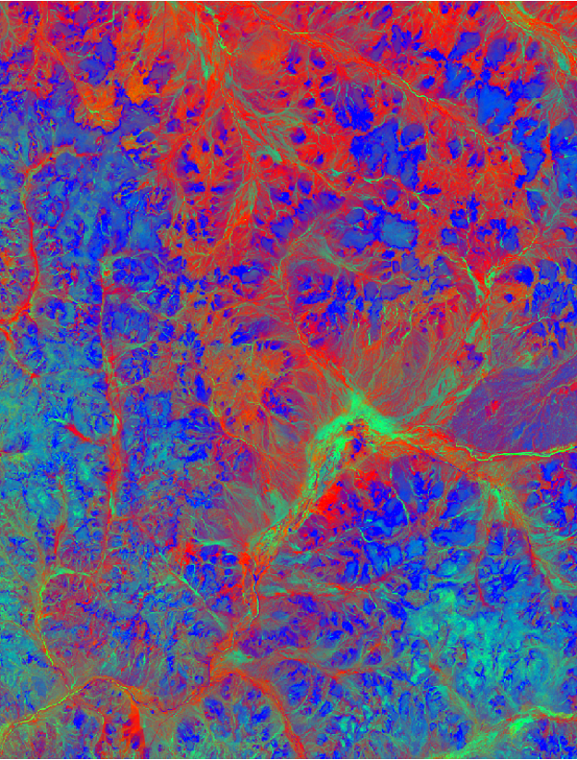
Great Western Woodlands
Key learnings to date
The value of multi-sensor / multi-agency imagery
The efficiency of EASI/ODC
The importance of ARD
The need for large sample sizes of field data/labelling
Next steps
Utilization of the full Landsat archive (-5/-7/-8/-9) for:
Fire history mapping
Fractional cover mapping
Utilization of GEDI for training wall-to-wall height canopy height model
❖Updates at Montreal Plenary Side Meeting

Slide 14
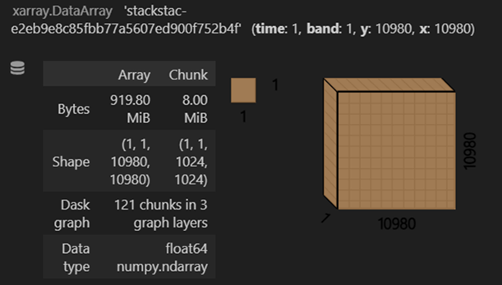
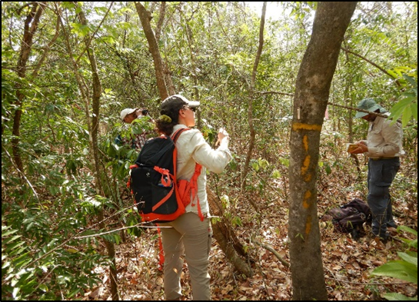
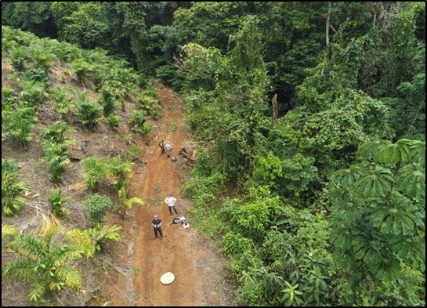
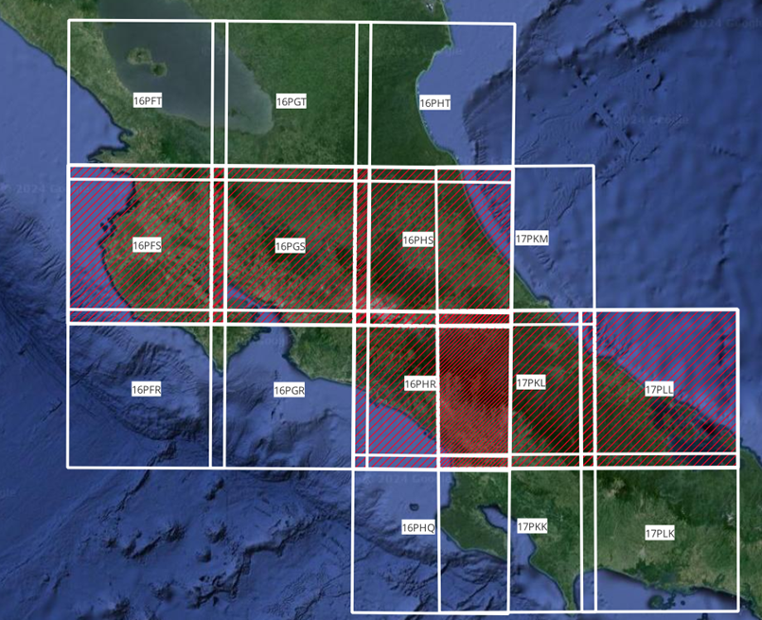
Tropical Forests – Costa Rica
Data Cube architecture operational
Earth Observation and in situ data from monitoring across
scales - collaboration with local Institutions and experts
Use of Sentinel-2 Data
Seasonal Spectral Indices calculated (CCCI, EVI, NDWI, SAVI, NDVI, mNDVI)
Vegetation Diversity Indices
Validation with Species Assemblage Network analysis (in progress)

Slide 15
EETT Wrap Up
The EETT completed the tasks it was given and is nearing the end of its two year timeline
White paper delivered (November 2023)
Demonstrators:
Hudson Bay Lowlands: Wapusk National Park (completing)
Work will continue
Broader HBL - Canada
Great Western Woodlands - Australia
Tropical Forests - Costa Rica
At Plenary, co-leads will invite interventions acknowledging for the record successful completion of the tasks given to the EETT

Slide 16
Thank you

