Slide 1
Ecosystem Extent Task Team
Side Meeting - Demonstrator Updates
Shaun Levick, CSIRO
Gary Geller, NASA
Sandra Luque, INRAE/CNES
Roger Sayre, USGS
Agenda item 3.1
SIT Technical Workshop 2024
Sydney, Australia
17th September 2024
(c) 2024 California Institute of Technology. Government sponsorship acknowledged.

Slide 2
Introduction
Purpose
  Provide updates on EETT Demonstrators
  Hear your thoughts and suggestions
Agenda
  Brief EETT overview
  Hudson Bay Lowlands (Jason Duffe, ECCC) - remote presentation
  Great Western Woodlands (Shaun Levick, CSIRO) - in person presentation
  Costa Rica Forests (Sandra Luque; INRAE/CNES) - brief update

Slide 3
EETT History
~2012: Biodiversity Activity initiated
~2020: Informal discussions on increasing engagement
    Triggered by biodiversity crisis
    Goal: Long term engagement
2021 (35th Plenary): “Discussion Group” initiated
2022 (CEOS Plenary): Ecosystem Extent Task Team established
2023 (CEOS Plenary): EETT White Paper endorsed
Notes:
Biodiversity Discussion Group was to begin increased CEOS engagement with biodiversity

Slide 4
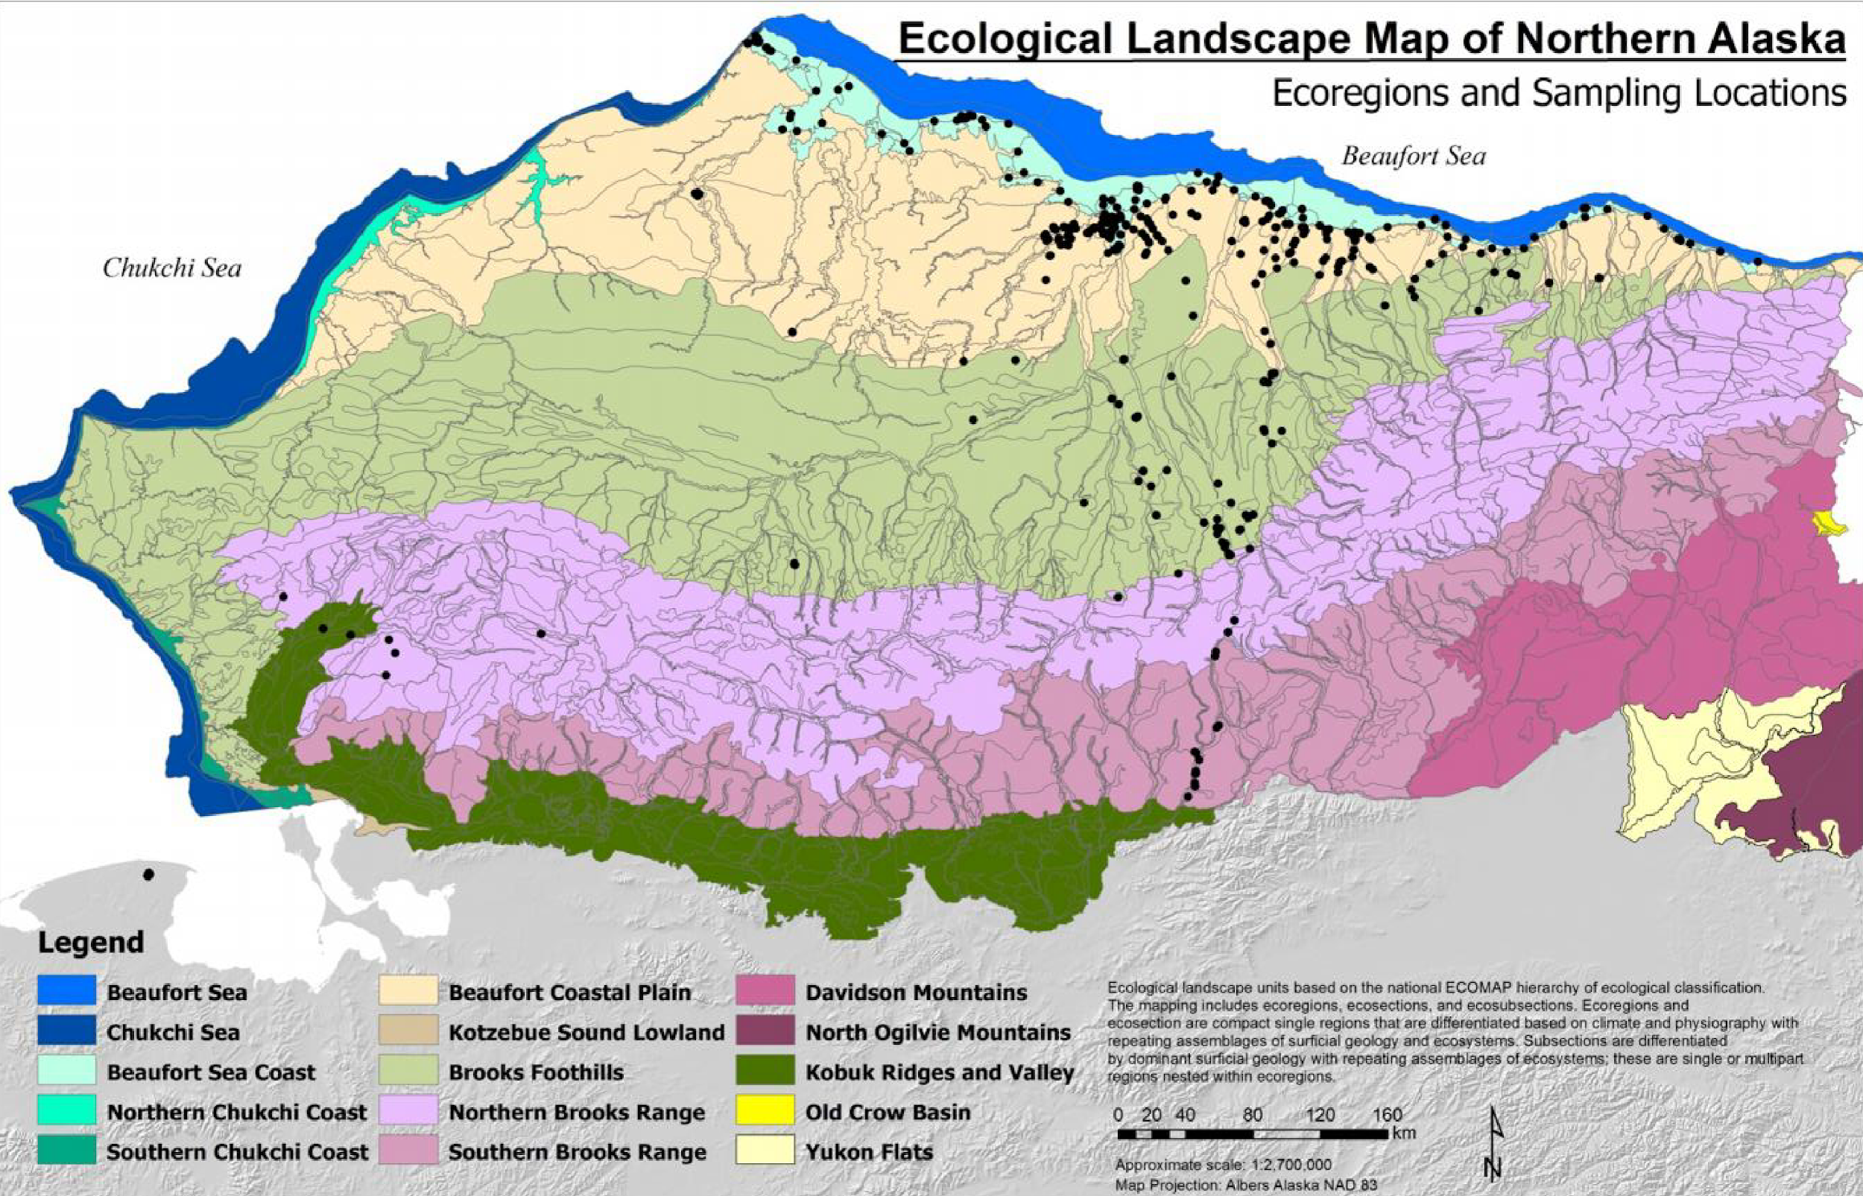
Task Team Basics
Purpose
  Assess the utility for mapping Ecosystem Extent using current and new space-based observations that will become available in the next 10 years
Two Deliverables
  White Paper
  Demonstrator studies
Notes:
White Paper (delivered November 2023)
Demonstrator (HBL-Wapusk NP wrapping up)

Slide 5
Three Demonstrator Studies
EETT was tasked to deliver one demonstrator but had three opportunities
(1) Hudson Bay Lowlands
  ECCC had relevant work underway
  Offered to develop a demonstrator on Wapusk National Park
  Now wrapping up (broader HBL work will continue)
(2) Great Western Woodlands (Australia) & (3) Tropical Forests (Costa Rica)
  Shaun Levick (CSIRO) and Sandra Luque (INRAE/CNES) submitted proposals to their funding agencies
  Successful - funding available near end of 2023
  Work still underway - will present results-to-date

Slide 6

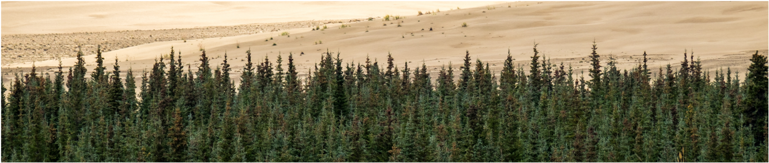
Ecosystem Characteristics
Physical environment
Physical structure
Taxonomic composition
Functions & processes
Demonstrators measure these to discriminate ecosystem classes
Notes:
Characteristics” = “features”
For nice discussion on the conceptual basis of classification, see:
https://www.fao.org/3/X0596E/x0596e01f.htm There, features are discriminated using “classifiers”. The discussion includes the FAO Land Cover Classification System, though it seems to not include ecosystem functions/processes
Composition: Species…or level of biodiversity
Environment: climate, slope, aspect, elevation
Structure: height, vertical biomass distribution
Functions & processes: GPP, ET, nutrient retention…
FAO Land Cover Classification System
USGS Global Ecosystem Land Units
IUCN Ecosystem Typology V2.0

Slide 7

Demonstrator 1
Hudson Bay
Jason Duffe, Laura Dingle Robertson, Marie-Bé Leduc, Kasun Hiripitiyage, Emily Ogden, Jason Beaver & Taylor Biccum

Slide 8
Remote presentation

Slide 9

Demonstrator 2
Great Western Woodlands (Australia)
Shaun Levick & Adriana Parra Ruiz
Zheng-Shu Zhou, Matt Paget, Matt Garthwaite, Amy Parker

Slide 10
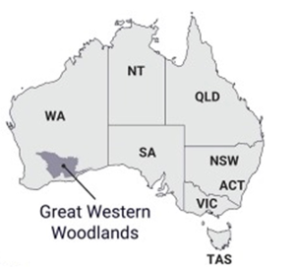
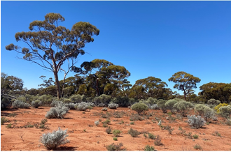
Great Western Woodlands
Largest remaining area of temperate woodlands on Earth with significant biodiversity and cultural values.
Under growing pressure from climate change and land-use intensification
High-quality maps of ecosystem extent are needed to inform conservation, restoration, and adaptation strategies.
Key questions to be addressed.
  Can the spatial delineation of vegetation types be improved with multi-wavelength SAR?
  Can stand age be reliably mapped from multi-sensor satellite imagery?
  Can historic stand growth rates be derived from time-series imagery?

Slide 11
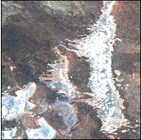
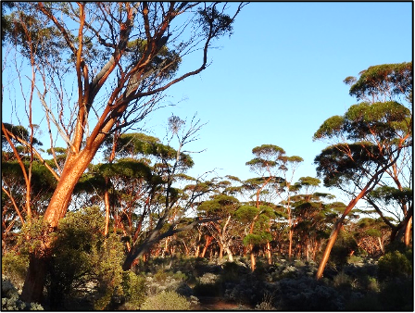
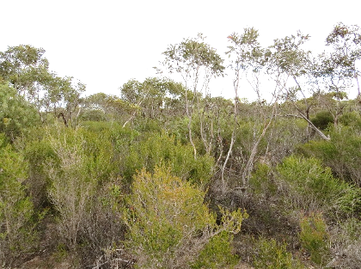


Great Western Woodlands
Distinguishing vegetation assemblages and stand ages is critical for effective land management and conservation
  Conversion of obligate-seeder eucalyptus woodlands into base resprouting mallee stands.
  Ecosystem extent mapping underway using CSIRO’s EASI platform
  Testing the fusion of Sentinel-1, ALOS-2, Sentinel-2 and Landsat-5/-7/-8/-9

Slide 12
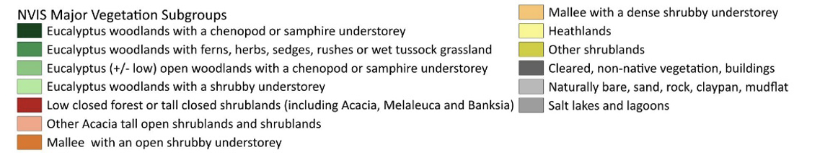
Great Western Woodlands
Classification scheme according to the IUCN Global Ecosystem Typology (GET) 2.0, Terrestrial realm:
  T.4. Savannas and Grasslands - biome
  T.4.4. Temperate Woodlands - ecosystem functional group
Finer scales we evaluated available National level datasets and received feedback from collaborators working in the GWW region.
  National Vegetation Information System (NVIS) classification scheme
  Integration of the NVIS classification scheme with lower levels of the GET will be evaluated in future work.

Slide 13
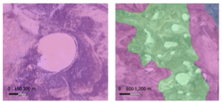
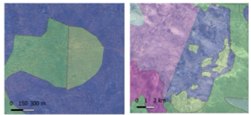
Great Western Woodlands
Training data and labelling
  NVIS has high thematic resolution, but coarse spatial resolution, which results in omission errors for small features.
  NVIS dataset relies in data generated by different agencies, so data integration can result in inconsistent boundaries between ecosystems
NVIS omission errors
NVIS arbitrary split errors

Slide 14
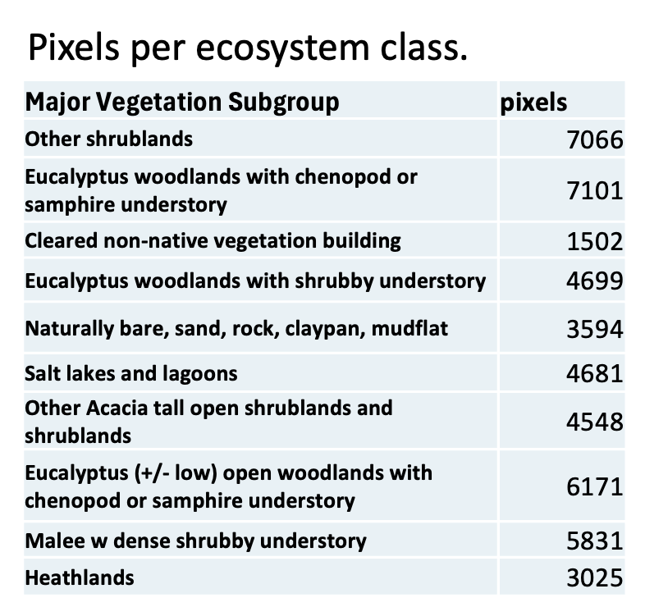
Great Western Woodlands
Training and validation dataset
  300 polygons of 100x100 m were randomly located within each of the 10 major vegetation classes
  The polygons were visually evaluated using the base imagery, and the Sentinel-2 median composite for 2021
  Polygons were manually checked for accurate representation of underlying classes (2710 remained)
  Each 20 m S2 pixel within each polygon was used as training and validation data for the classification process
  A total of 48218 pixels

Slide 15
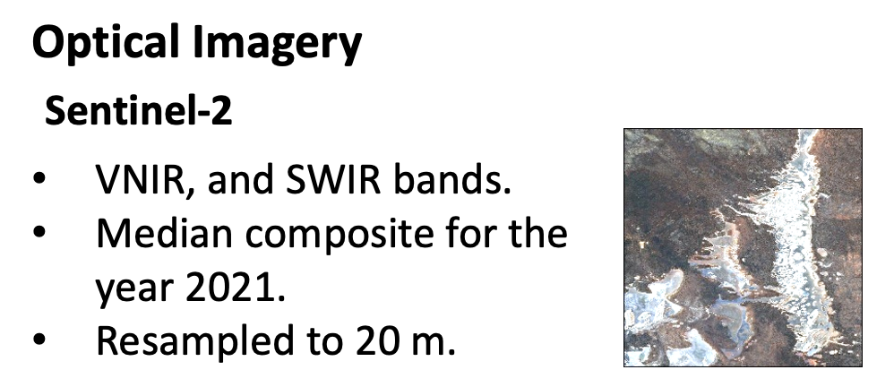
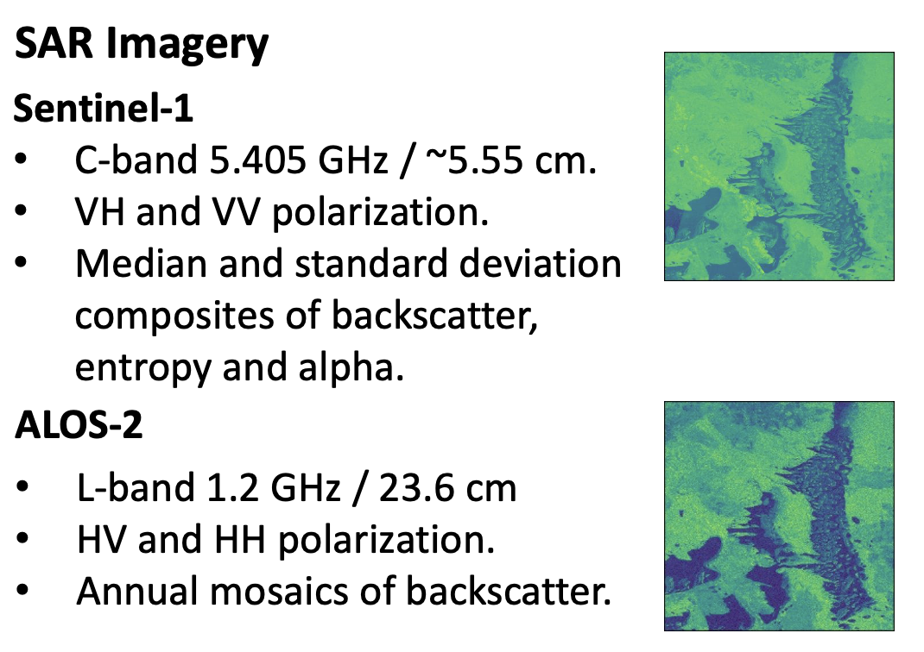
Great Western Woodlands
Input satellite data
  Initially focused on the year 2021 as all the instruments have available data for this year

Slide 16

Great Western Woodlands

Slide 17


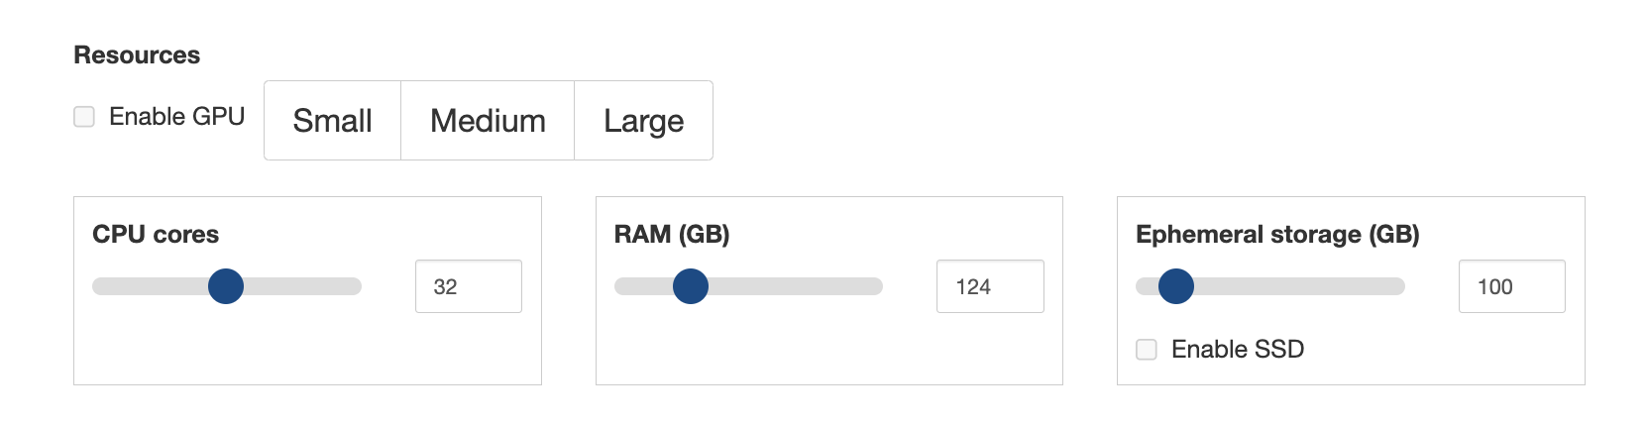
Great Western Woodlands

Slide 18
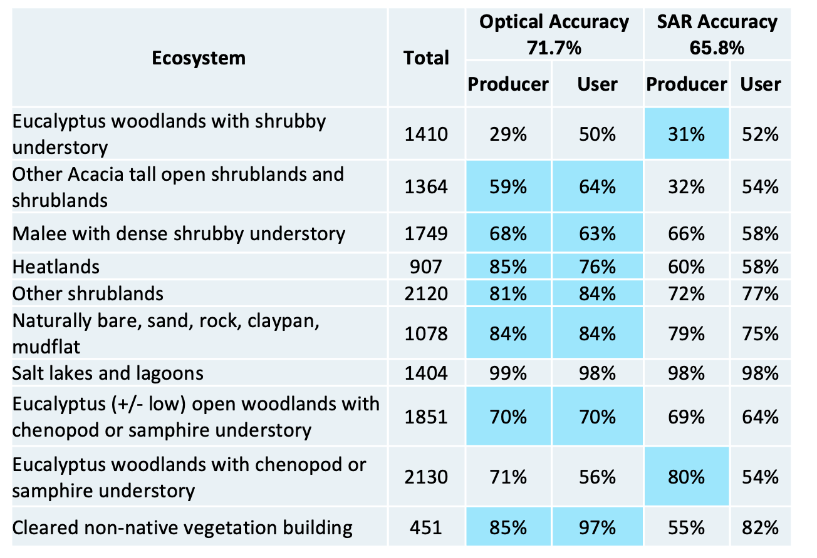
Great Western Woodlands
Notes:
SAR helps mostly with the Eucalypt woodland classes

Slide 19
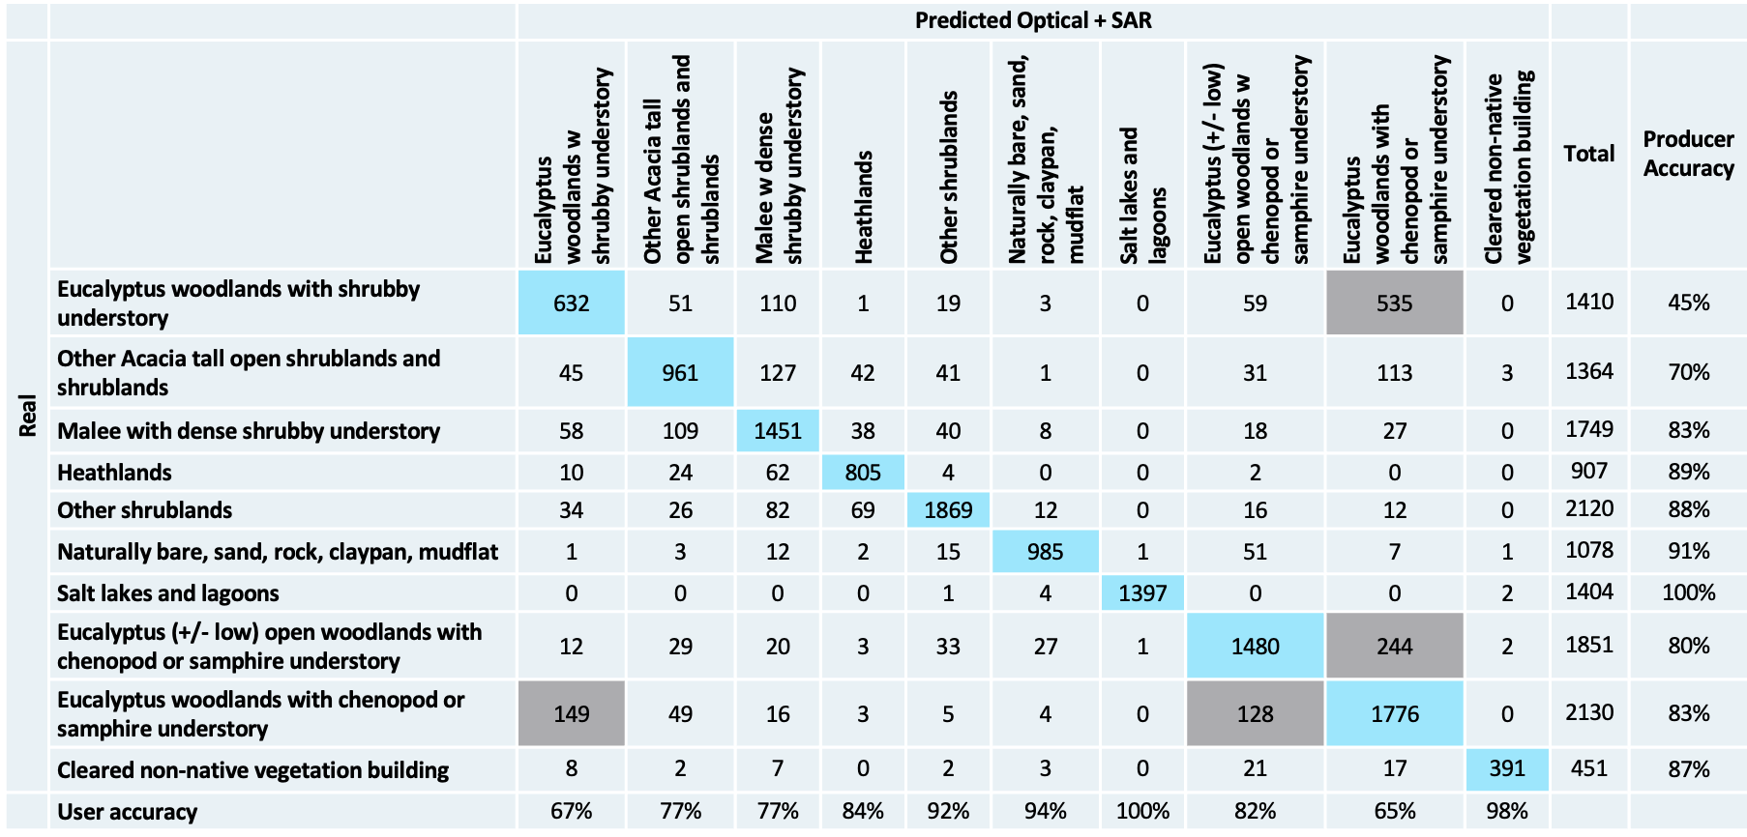
Great Western Woodlands

Slide 20
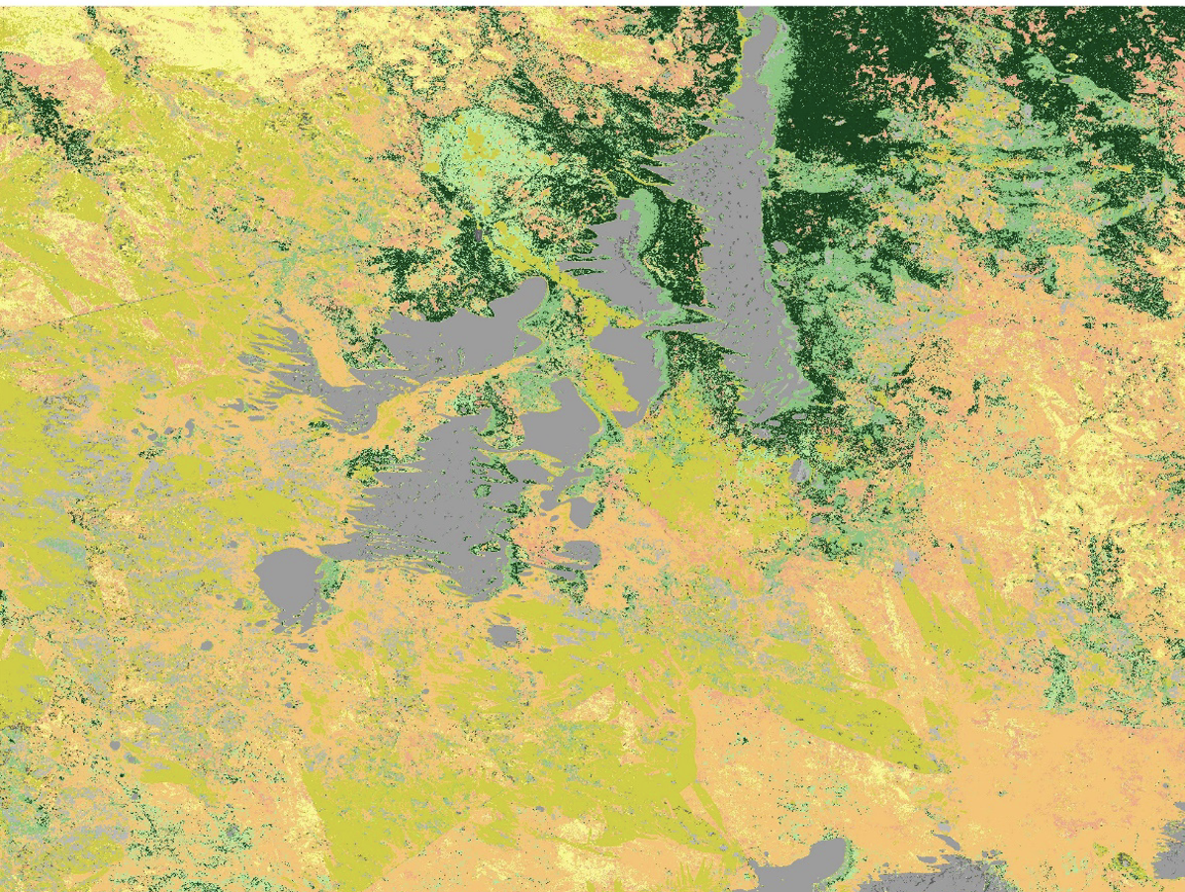
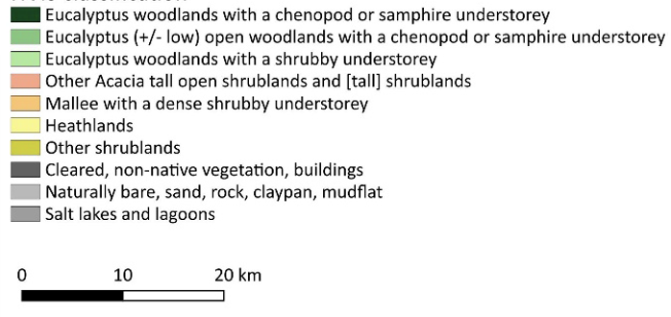
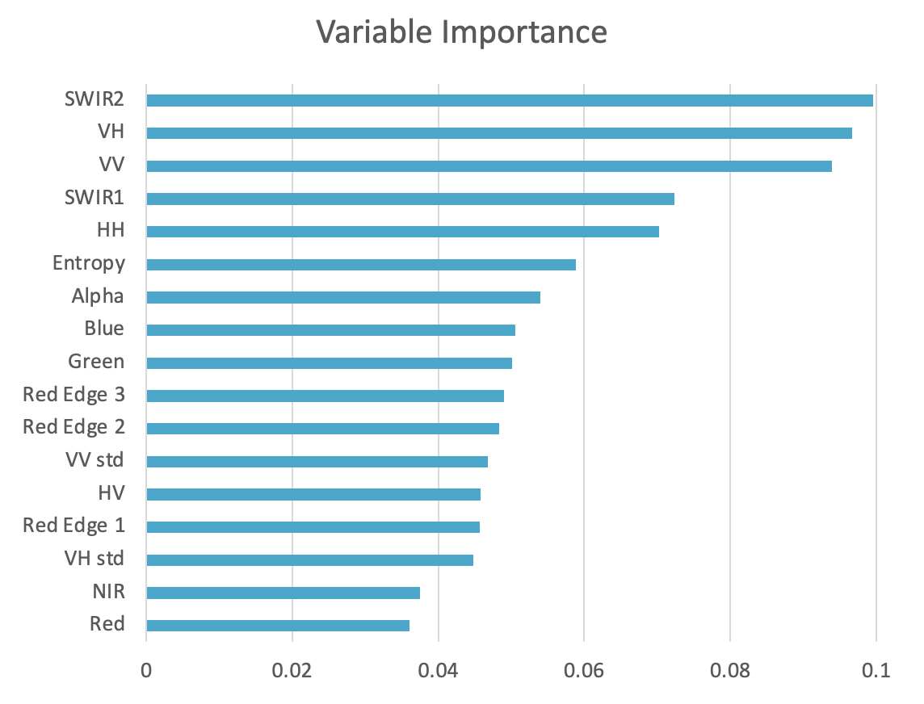

Great Western Woodlands
Current model with both optical and SAR data achieves an overall accuracy of 81.2%
Results - Adriana Parra Ruiz (CSIRO)

Slide 21
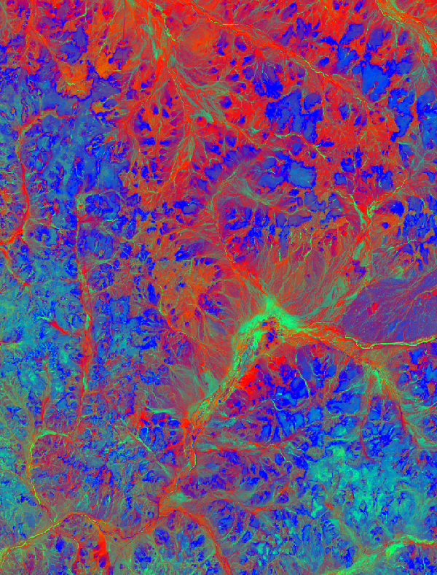
Great Western Woodlands
Key learnings to date
  The value of multi-sensor / multi-agency imagery
  The efficiency of EASI/ODC
  The importance of ARD
  The need for large sample sizes of field data/labelling
Next steps
  Utilisation of the full Landsat archive (-5/-7/-8/-9) for:
    Fire history mapping
    Fractional cover mapping
  Utilization of GEDI for training wall-to-wall height canopy height model
Updates at Montreal Plenary Side Meeting

Slide 23



Demonstrator 3
Tropical forest (Costa Rica)
Sandra LUQUE, Mona Bonnier, Remi Cresson, Samuel Alleaume, Florian de Boissieu, Jean Baptiste Feret, Mairi Souza-Oiveira (PhD candidate)

Slide 24
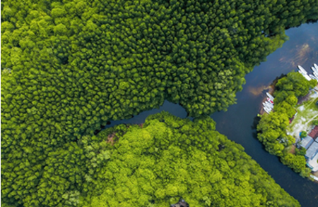
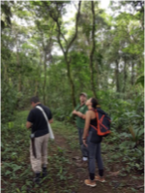
Tropical Forest - Costa Rica
Costa Rica accounts for only 0.03 percent of the earth's surface. However it contains nearly 6 percent of the world's biodiversity
Objectives
  Map Forested Ecosystems and provide indicators of condition
  Assess the ecological integrity of secondary forests in human-modified tropical landscapes to support biodiversity conservation
Key questions
  How to operationalize forest ecosystem extent mapping to assess a set of biodiversity indicators (RS-EBV’s)
  Can the conservation potential of forests be assessed using information from multi-sensor satellite imagery?
  Can we assess the conservation potential of forests ecosystems based on the mapping of α and β diversity predicted directly and indirectly from spectral information?

Slide 25
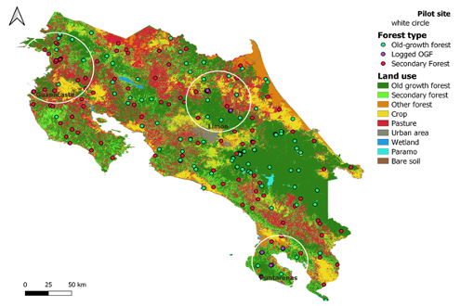
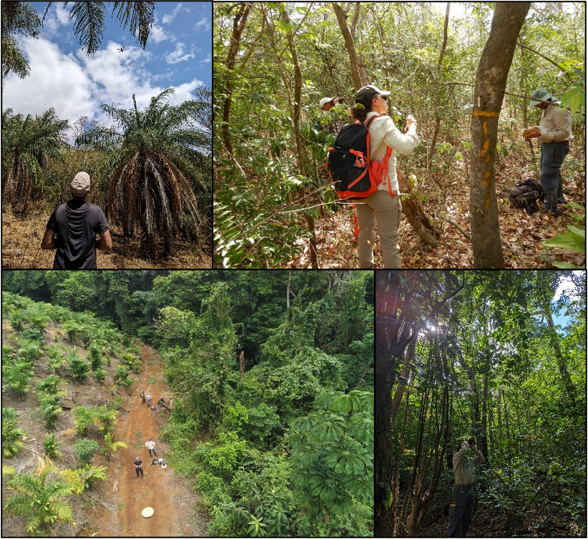
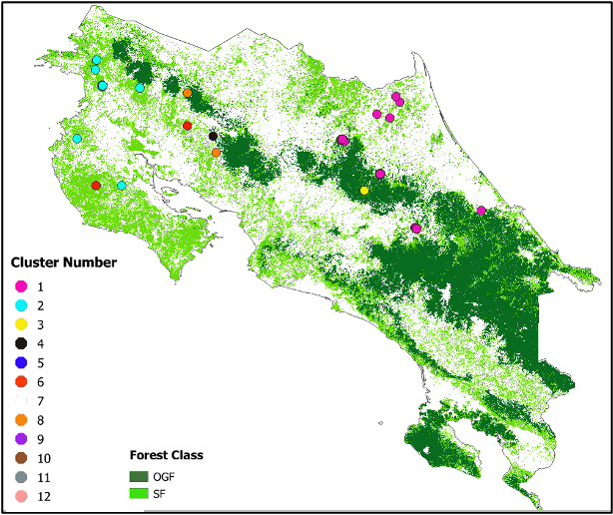
Tropical Forest - Costa Rica
Validation of the species assemblages obtained and verification of successional stages and ecosystem type
LULC Costa Rica (Predroni et al. 2015)
Field work on NFI plots April (2024) working with local experts (SINAC, CATIE)
Source : M. Souza Oliveira et S. Alleaume

Slide 26
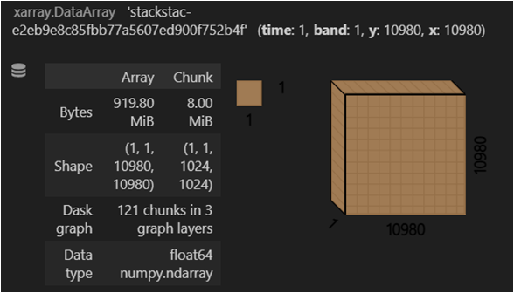
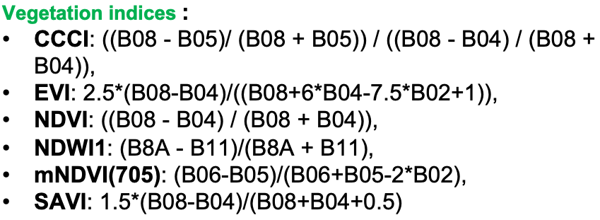
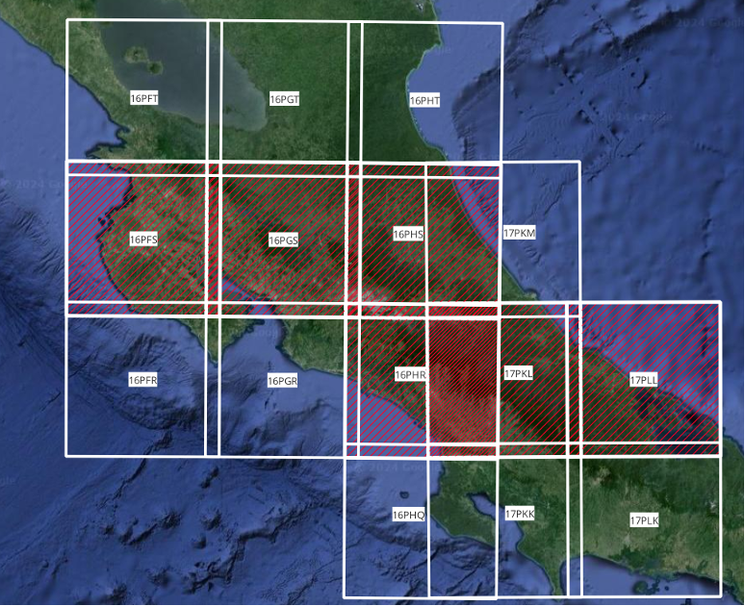
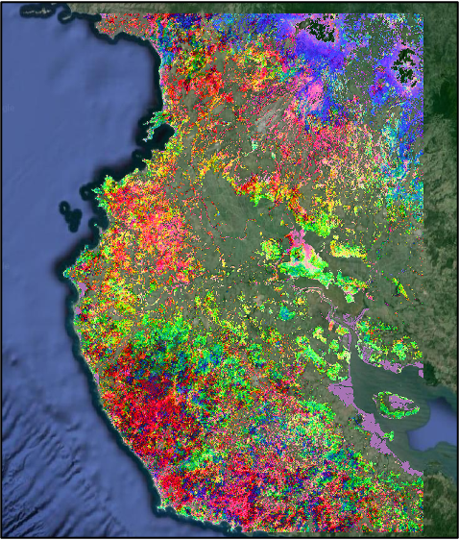
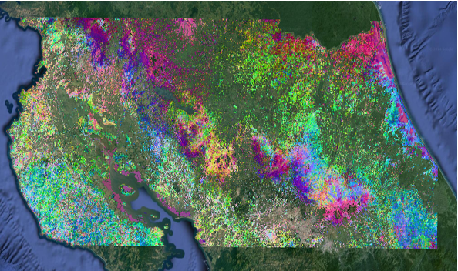


Tropical Forest - Costa Rica
Costa Rica Ecosystems: Data Cube
Spectral b-diversity
Féret & De Boissier 2020

Slide 28
Thank you

