Slide 1
SIT Technical Workshop 2024
Session 2.5: Other discussion topics
Hiroshi SUTO, JAXA
Agenda Item 2
SIT Technical Workshop 2024
Sydney, Australia
18th - 19th September 2024

Slide 2
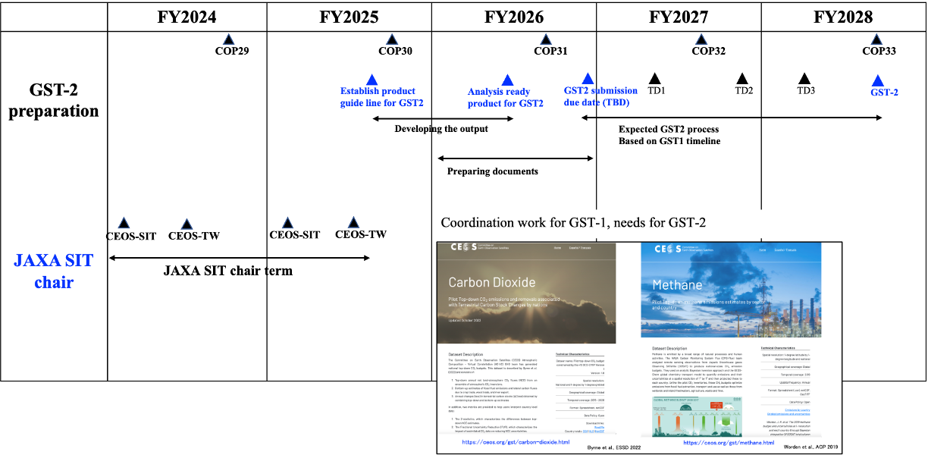
Milestones towards GST-2 (tentative & expected)

Slide 3
Other discussion topics
Soliciting contributions to activities needed to prepare CEOS GST2 products
  Clearly defining stakeholder needs (e.g., fluxes @ 1 x 1 degree for G3W, NRT for IMEO MARS)
  Identifying ongoing efforts within CEOS agencies that meet those needs
  Identifying gaps (L1 to L4)

Slide 4
Stakeholders’ Needs
Space-based GHG measurements could provide transparent, traceable, independent assessments of emissions and collective progress toward the mitigation and adaptation goals of the Paris agreement
Different stakeholders have different requirements
  UNFCCC - Sector-specific annual/biennial national-scale inventories of emissions
    High accuracy & traceability to internationally-recognized standards (e.g., IPCC-TFI)
  UNEP IMEO Methane Alert Response System, MARS
    Low-latency alerts to large CH₄ emissions from fossil fuel extraction, transport, use
  WMO Global Greenhouse Gas Watch
    Global 1° x 1° gridded estimates of GHG concentrations and fluxes at monthly intervals
  Carbon cycle science community
    Climate forcing by greenhouse gases and response of the natural carbon cycle to human activity and climate change

Slide 5
Ongoing efforts within CEOS (1 of 2)
CEOS Strategic Implementation Team (SIT)
  Coordinate overall effort across CEOS organizations
Working Group on Climate GHG Task Team (WGClimate GHG TT)
  Implement GHG Roadmap actions to foster transition from science to operations
  Manage interfaces with WMO GGGW, IMEO, UNFCCC and other stakeholders
Working Group on Calibration and Validation (WGCV)
  Identify on-orbit radiometric, spectroscopic and geometric calibration standards and traceability of space-based observations to these standards to facilitate the development of interoperable GHG observations
  Coordinate campaigns to cross calibrate public and private sector sensors against available standards
  Share the results via the portal site

Slide 6
Ongoing efforts within CEOS (2 of 2)
Atmospheric Composition Virtual Constellation (AC-VC)
  Track sensor capabilities and mission timelines to identify opportunities and gaps
  Coordinate retrieval algorithm and emission flux model intercomparisons with L1-L4 gap analysis
  Define use-case-dependent concentration and flux validation standards and coordinate campaigns to cross validate public and private sector concentration and flux products against these standards
Agriculture, Forestry and Other Land Use Task Team (AFOLU TT)
  Coordinate efforts to refine activity and emission factors for agriculture and forestry to facilitate the combined use of top-down & bottom-up emissions data
Working Group on Capacity Building and data Democracy (WGCapdD)
  Coordinate development of materials to educate and foster interactions between the space-based GHG and stakeholders communities

Slide 7
Milestone and goal setting
Guideline for CEOS GST2 products and collaborators
  GST2 will start later 2026 (after COP31?) with guiding questions.
  Available data: until 2026
  Improve the L2-L4 products though the AC-VC and WGCV activities
  Engage with multi-agencies activities (e.g., OCO2-MIP, CAMS, )
  Need collaborators and guideline (e.g., OCO2-MIP protocol for GST-1 products. )

Slide 8

CEOS WG/VC portal update
Information on CEOS WG/VC site update
  The accuracy and consistency of spectral radiances among multiple satellite sensors is essential to retrieve the spatial-temporal bias free products among the sensors
  JAXA launched the new portal for multi-spectral radiance comparison dataset
  It will contribute to enhance our knowledge of multi- satellite spectral radiance

Slide 9
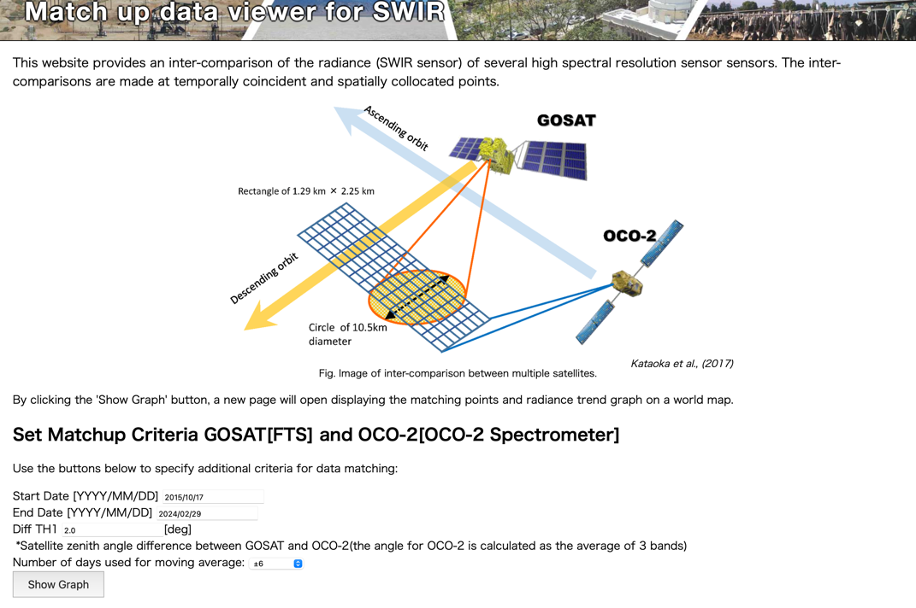
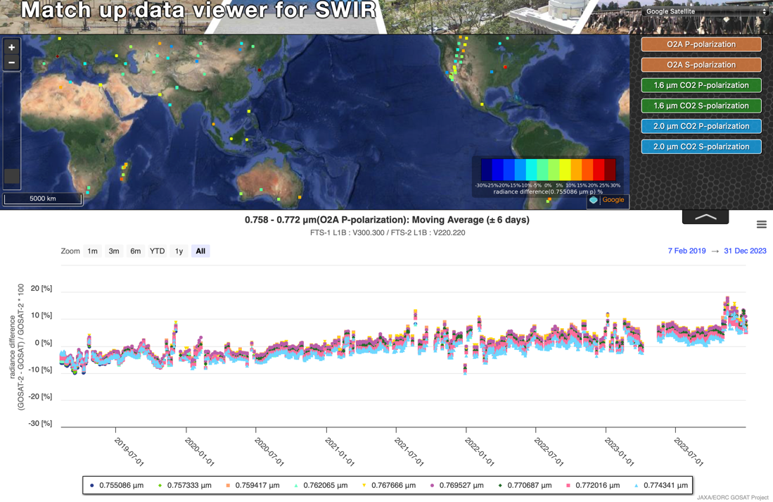
Multi-spectral radiance comparison site
Under developing:
Both SWIR and TIR sensors are enclosed.
Old version of L1B

