Slide 1
CEOS Greenhouse Gas Portal
2024 Update
Libby Rose
SIT Chair Team
Agenda Item 2.4
SIT Technical Workshop 2024
Sydney, Australia
18th - 19th September 2024

Slide 2
The CEOS GHG Portal
Supporting JAXA SIT Chair Priority
ceos.org/ghg

Slide 3
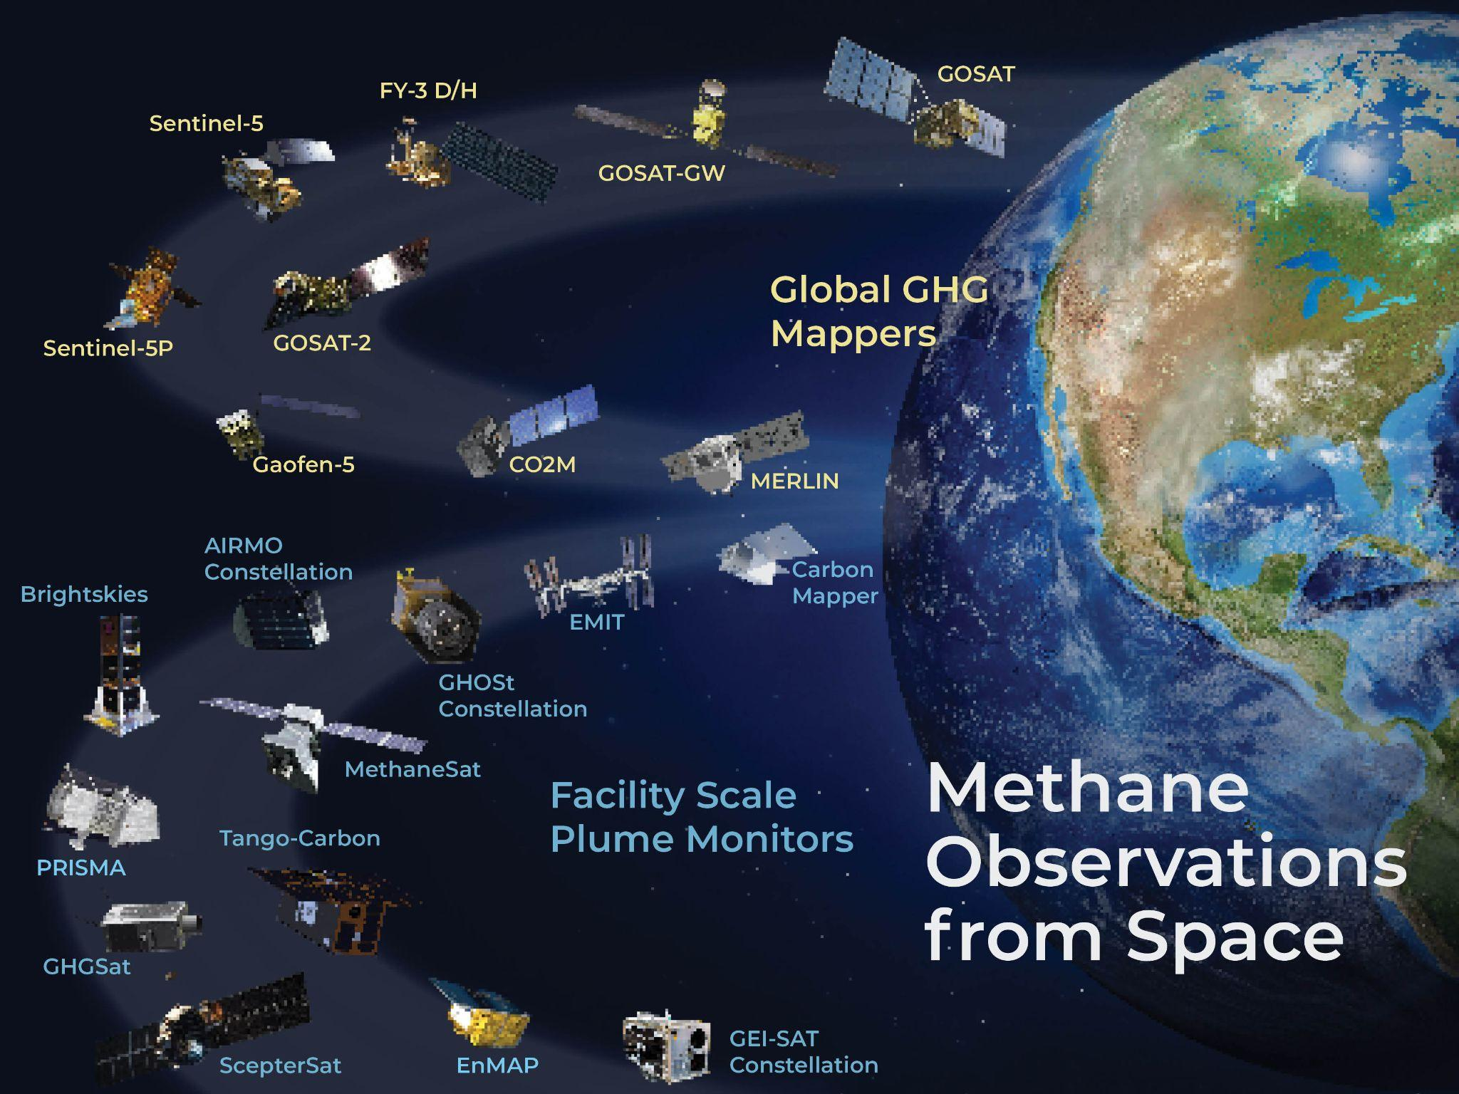
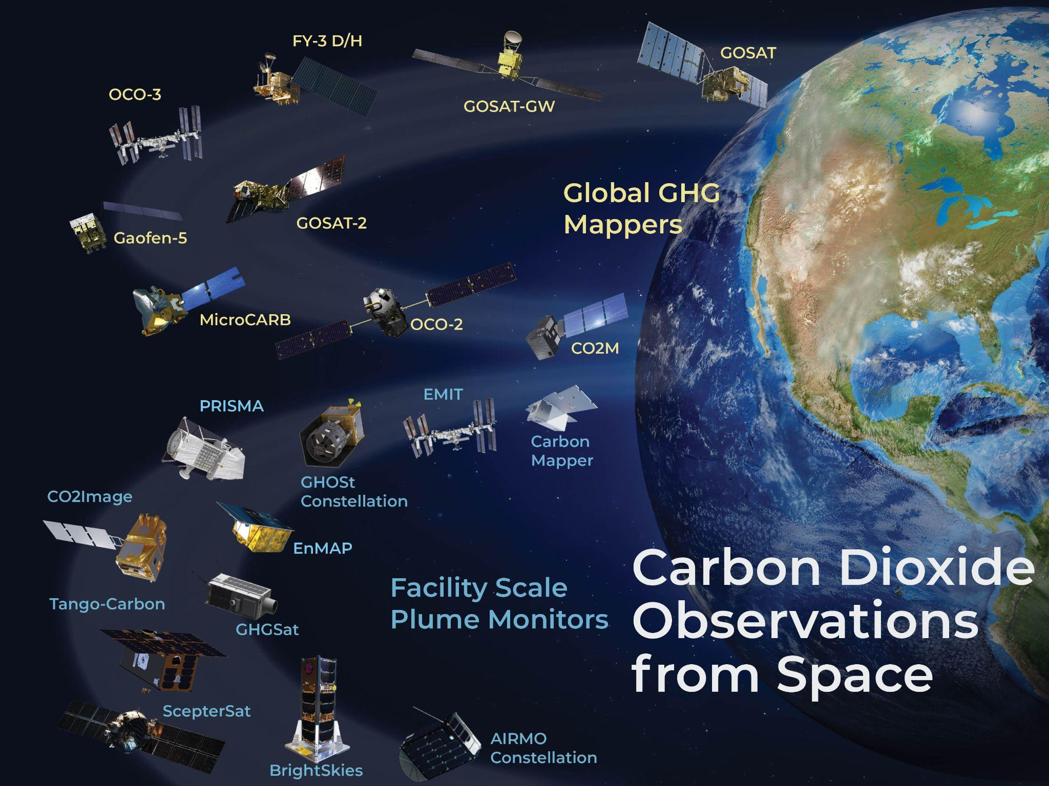
2024 Updates
Contacted all commercial companies for updates on their missions
Thanks to all who helped provide contact details!
Missing responses from BrightSkies and Orbital Sidekick
CEOS Mission updates covered by the annual MIM Survey
New missions:
Desktop research
Call out on social media
Assessing UVSQ-Sat NG (LATMOS, France)
JPSS series to be added to sounders
SWIR mission capabilities

Slide 4
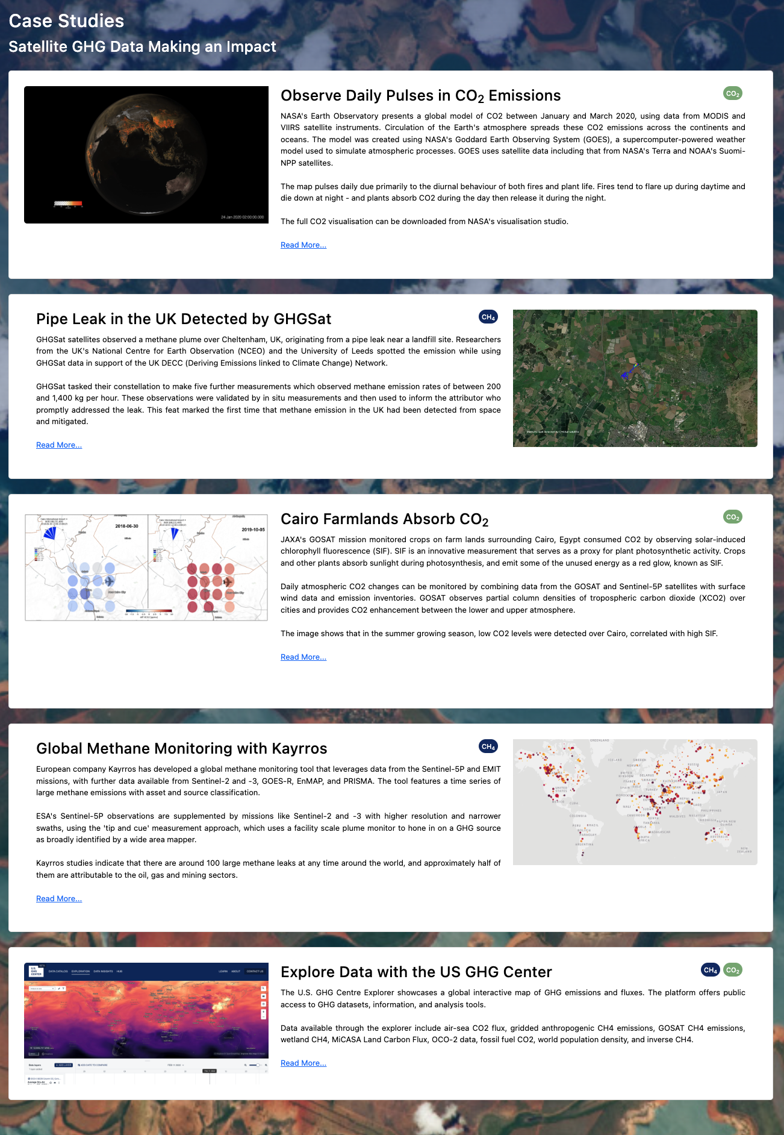
New additions - Case studies
Adding a case studies section
Links to web stories showing the impact of satellite GHG data
More suggested case studies welcome!
Coming online soon

Slide 5
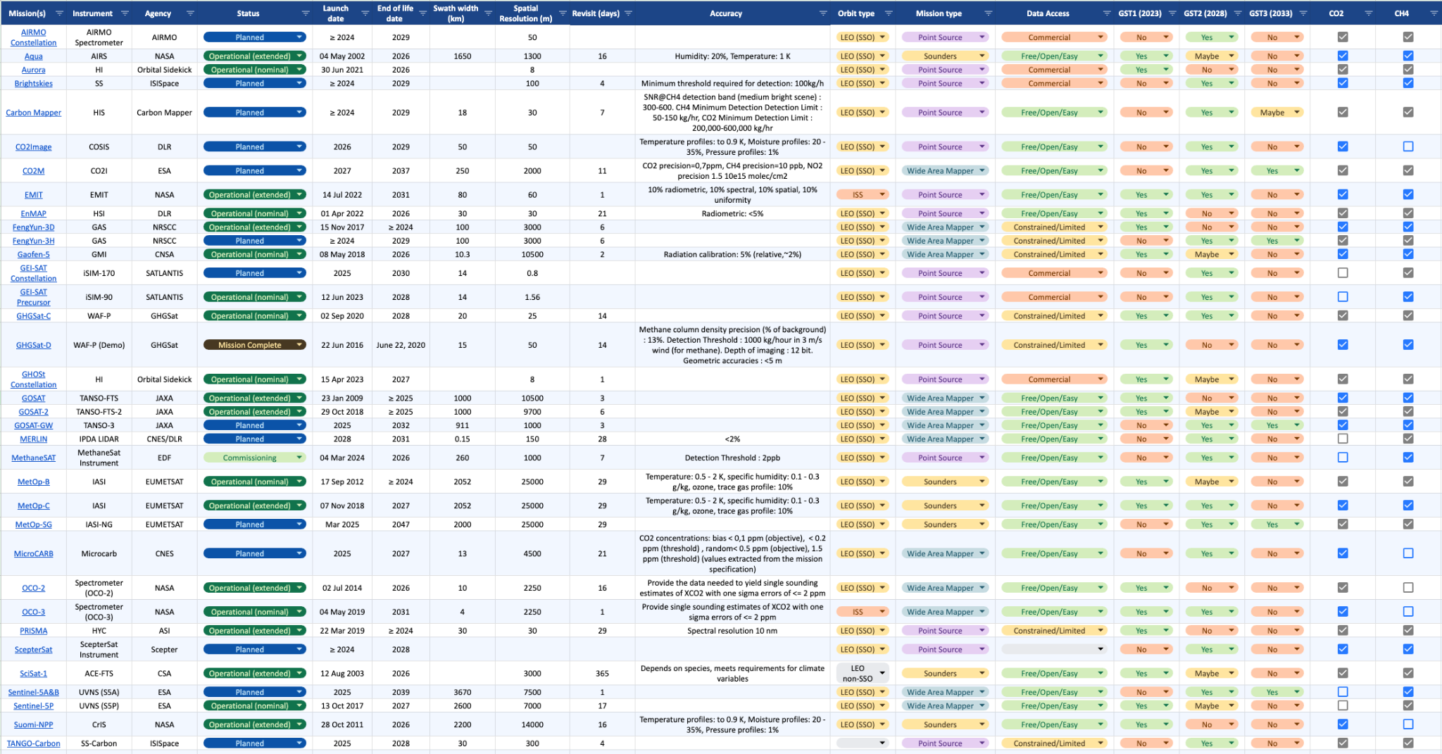
New additions - Constellation builder
GHG Constellation builder spreadsheet now available
Select requirements using filter functionality to build a constellation of satellites to suit specific applications
GHG Constellation Builder

Slide 6
Flyer for UNFCCC COP?
Would a small postcard flyer linking to the GHG Portal be of use to agencies attending COP-29 (and other events)?
Can print and distribute to agencies at CEOS Plenary

Slide 7
Thank You!

