Slide 1
GHG Roadmap
Issue 2
Yasjka Meijer, ESA GHG Task Team Lead
Wenying Su, NASA WGClimate Vice Chair
Agenda Item 2.2
SIT-TW, Sydney 18th – 19th September 2024

Slide 2
GHG Task Team - Recall
Greenhouse Gas Task Team (GHG TT) is part of joint CEOS-CGMS WG on Climate
Responsible for maintaining and implementation of the GHG Roadmap
Coordinates GHG related activities across various (CGMS &) CEOS WGs: WG-Climate, WG-CalVal, AC-VC, WG-CapD, NewSpace Task Team, etc
Actively ensure representation of CEOS and CGMS bodies
Issue 1 of GHG Roadmap is from March 2020 and followed from GHG White Paper

Slide 3
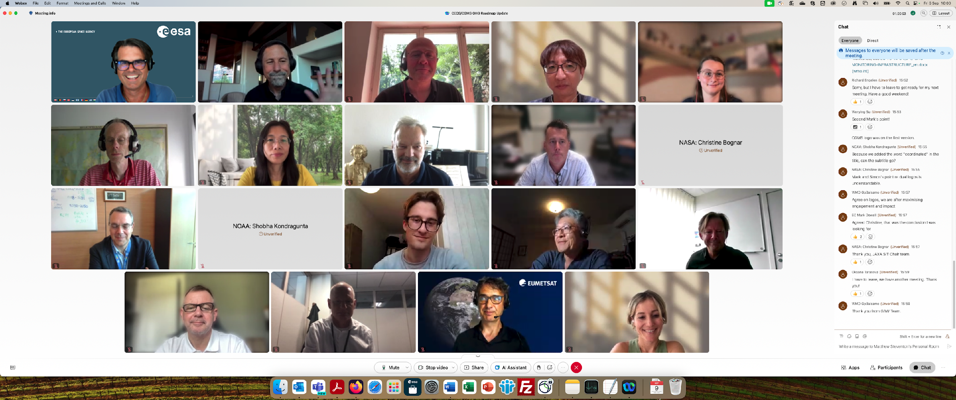
GHG Roadmap Update
Decision at SIT-39 to update GHG Roadmap, now today for discussion (Action SIT-39-12)
Since Tokyo, an outline was drafted and then followed with biweekly GHG TT meetings
In June, we coordinated with CGMS WGs
At CGMS-52, Simon Elliott was appointed as CGMS PoC to coordinate input for the update of the GHG Roadmap
A real team effort and until the last telecon well attended 🡪
Special thanks to Dave Crisp & Libby Rose for drafting issue 2
CEOS SIT-39 DECISION 03 | SIT-39 agreed that an update of the CEOS GHG Roadmap should be completed for discussion at the SIT Technical Workshop in preparation for potential endorsement at 2024 CEOS Plenary. Note that the document will need to be made available in advance for CEOS Agency review.

Slide 4
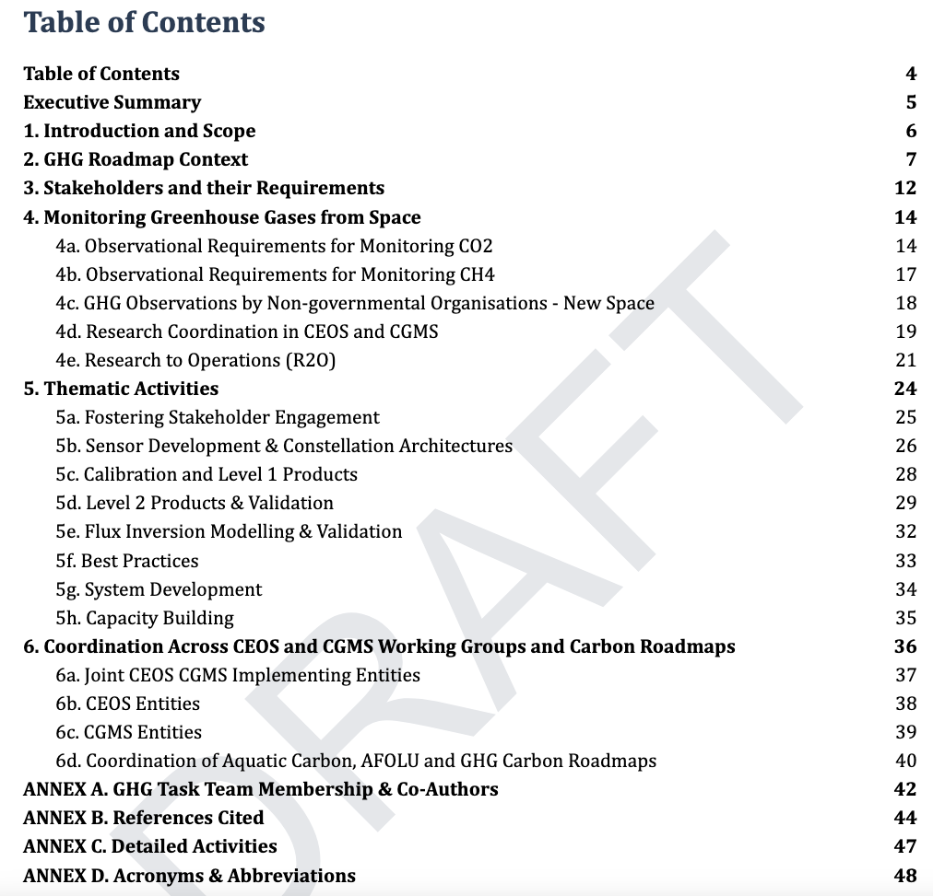
GHG Roadmap – Issue 2
Includes (1-page) executive summary
This version has been expanded in its scope to support the rapid evolution of the international GHG science, policy and regulatory communities. The updated Roadmap describes specific thematic areas where CEOS and CGMS are working with (new) stakeholders and partners to develop improved, fit-for-purpose space-based GHG products. As in issue 1, detailed activities and action items which are continuously evolving, are described in an Annex. With these changes, the GHG Roadmap should foster the coordination of space-based GHG products that better address the needs of an increasingly diverse stakeholder community and be more resilient to the future evolution of this rapidly evolving field.
Table of contents 🡪
Specific detailed actions tracked in Annex C and maintained online (living document)

Slide 5
GHG Roadmap – Issue 2
Draft issue 2 circulated on 9 Sep (CEOS & CGMS)
Feedback latest by 25 September
Final version needed by 8th October
Endorsement of issue 2 due for CEOS Plenary
Wenying Su will present at plenary

Slide 6
GHG Roadmap – Stakeholder
Action SIT-39-13: The GHG Task Team of the Joint CEOS-CGMS WGClimate was asked to reflect the requests from UNEP IMEO in the 2024 update of the CEOS GHG Roadmap. (For Information)
Issue 2 has specific focus on supporting and coordinating activities with stakeholders
Section 3 covers “Stakeholders and their Requirements”, which explicitly includes WMO G3W and UNEP’s IMEO
Section 5a describes the thematic activity for “Fostering Stakeholder Engagement”
Draft issue 2 has also been shared for comments with IMEO
Draft issue 2 has been established in coordination with G3W
John Worden (NASA) is the GHG TT PoC vis-à-vis IMEO
Vincent-Henri Peuch (ECMWF) is the GHG TT PoC vis-à-vis G3W
Coordination and collaboration with IMEO is part of planned activities and in issue 2

Slide 7
GHG TT – G3W & IMEO
Collaboration with WMO G3W:
G3W director was involved in establishing issue 2
Incoming deputy GHG TT lead, Vincent-Henri Peuch, is in G3W advisory board
Need for making GHG monitoring operational, which is also covered in issue 2 via R2O and a clear role as well for CGMS
Collaboration with UNEP IMEO:
Chat on collaboration took place on 6 Sep. Agreed to reinstate some IMEO WGs, e.g. use case WG
Intention to have a follow-up meeting of the joint CEOS-IMEO Harvard meeting “International Coordination Workshop on Detection of Anthropogenic Methane Emissions from High-resolution Satellites”, which was held in June 2023
Need for coordination of aircraft / ground release measurements
Need for an automated system to process (public agency) hyperspectral data over specific region (supporting MARS)
Need to automatically report methane plumes (low latency) and initiate tip-and-cue (MARS)

Slide 8
Time for questions,
discussion and
your feedback

