Slide 1
SIT Technical Workshop 2024
Session 2: Introduction
Hiroshi SUTO, JAXA
Agenda Item 2
SIT Technical Workshop 2024
Sydney, Australia
18th - 19th September 2024

Slide 2
Presentations in this Session
Yasjka Meijer (WGClimate GHG-TT Lead) and Wenying Su (WGClimate Vice Chair) will present the update of the GHG Roadmap as well as the update on collaboration with UNEP’s IMEO and WMO’s G3W.
John Worden (AC-VC GHG Lead) will report the draft document of best practices for (facility scale) space-based CH₄ observations
Libby Rose (SIT Chair Team) will presents the CEOS Greenhouse Gas Satellite Missions Portal 2024 update

Slide 3
Update of the GHG Roadmap
The need an update to the GHG Roadmap was discussed and approved at SIT-39
Incorporate lessons learned from first Global Stocktake (GST)
Accommodate interactions with new partners, including WMO G3W and UNEP IMEO and other changes in rapidly evolving GHG community
Since SIT-39, the WGClimate GHG task team completed an updated draft of the GHG Roadmap that is ready for review at in 2024 CEOS plenary.
This draft was included in the shared folder for this meeting
The updated draft of the GHG Roadmap will be presented by Yasjka Meijer (WGClimate GHG-TT Lead) and Wenying Su (WGClimate Vice Chair)
To finalize the updated GHG Roadmap (GHG Roadmap 2024), the remaining concerns will be discussed and actions will be identified.

Slide 4
Greenhouse Gas Best Practices
Global Mappers, Facility-scale Plume Monitors as well as Operational Sounders are listed in the CEOS Greenhouse Gas Satellite Missions Portal 2024 update.
Presented by Libby Rose (SIT Chair Team)
Recently, a growing number of Facility Scale Plume Monitors have been deployed by both public sector and NewSpace organizations to detect intense CH₄ plumes
There is a growing need for standards and best practices governing the entire the observation and analysis process (L1 to L4) to produce transparent, interoperable products
A draft of best practices document for CH₄ observations (facility scale) has been produced and is summarized (Led by John Worden (AC-VC GHG Lead) and Paul Green (UKSA) )
The next steps in the development and approval of this document will be discussed in the session.

Slide 5
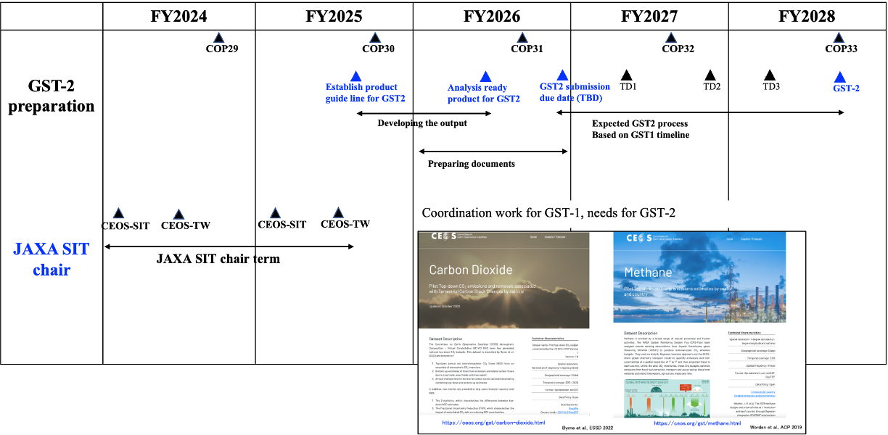
Other discussion topics
Soliciting contributions to activities needed to prepare CEOS GST2 products
Clearly defining stakeholder needs (e.g., fluxes @ 1 x 1 degree for G3W, NRT for IMEO MARS)
Identifying ongoing efforts within CEOS agencies that meet those needs
Identifying gaps (L1 to L4)
Milestones towards GST-2 (tentative & expected)

