Slide 1
CEOS Chair Nominations
Hironori Maejima
JAXA SIT Chair
Agenda Item 9.2
SIT Technical Workshop 2024
Sydney, Australia
18th - 19th September 2024

Slide 2
CEOS Chair Nominations
Year | Region | Agency | Status
2025 | Europe / Africa |  | Approved
2026 | Asia / Oceania |  | Nomination received - TBC at Plenary
2027 | Americas | TBA
2028 | Europe / Africa | TBA

Slide 3
SIT Technical Workshop 2024
Closing Remarks
Hironori Maejima
JAXA SIT Chair
Agenda Item 9.3
SIT Technical Workshop 2024
Sydney, Australia
18th - 19th September 2024

Slide 4
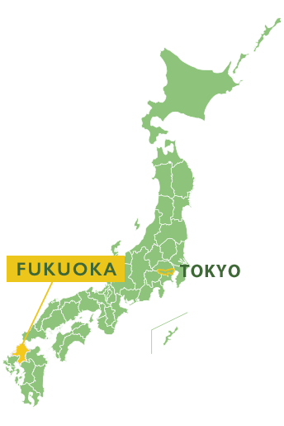
Upcoming CEOS Meetings
38th CEOS Plenary 2024: 22-24 October, 2024
Montreal, Canada
https://ceos.org/meetings/38th-ceos-plenary/
SIT-40: 8-10 April, 2025
Fukuoka, Japan
2025 SIT Technical Workshop: 9 - 11 September, 2025
Darmstadt, Germany
Thank you EUMETSAT for hosting!
39th CEOS Plenary: 4 - 6 November, 2025
Bath, UK

