Slide 1
CEOS Plenary 2024
Objectives & Planning
Eric Laliberté, CSA
Agenda Item 1.2
SIT Technical Workshop 2024
Sydney, Australia
18th - 19th September 2024

Slide 2
Some Headline Themes
CEOS Plenary 2024
Proposal for a sustained presence of an entity to address biodiversity within CEOS
JAXA SIT Chair priorities: Climate Policy Impact and Greenhouse Gas Observation Coordination
  2024 update of the CEOS Greenhouse Gas Roadmap; AFOLU Roadmap actions
Working Groups and Virtual Constellation updates to CEOS Principals
  WGClimate and WGCV Vice Chair nominations
  Merged Gap Analysis and Coordinated Action Plan for ECV Inventory analyses
  CEOS-CGMS Statement to UNFCCC COP 29 SBSTA 61.
  Updated WGISS Terms of Reference.
  COAST: Enhancing remote sensing + United Nations’ Ocean Decade
  CEOS-ARD Strategy 2024
SDG Coordination Group: Invigorating support for SDGs; UNCCD approach to CEOS
Welcome the United Kingdom Space Agency (UKSA) as 2025 CEOS Chair
2026 CEOS Chair nomination
Highlight the 40th anniversary of CEOS !
Full statement of objectives here

Slide 3
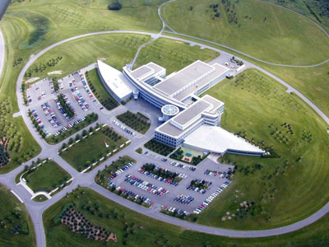
Meeting Logistics
** Please make sure to register **
Where: CSA HQ, Montreal, Canada
When: October 22-24, 2024
Deadline to provide passport copies to CSA/Carmen Marcu: September 27th
Deadline for Sandman hotel booking:
September 21st
Meeting website: https://ceos.org/meetings/38th-ceos-plenary/

Slide 4
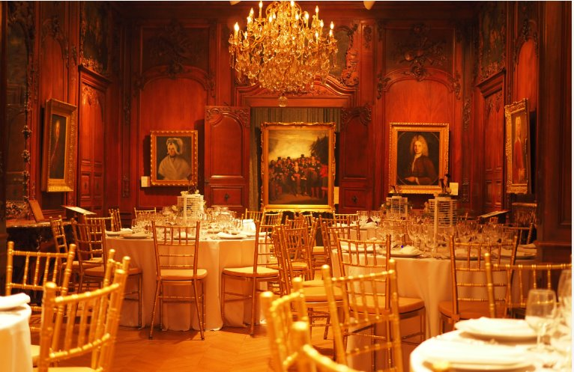
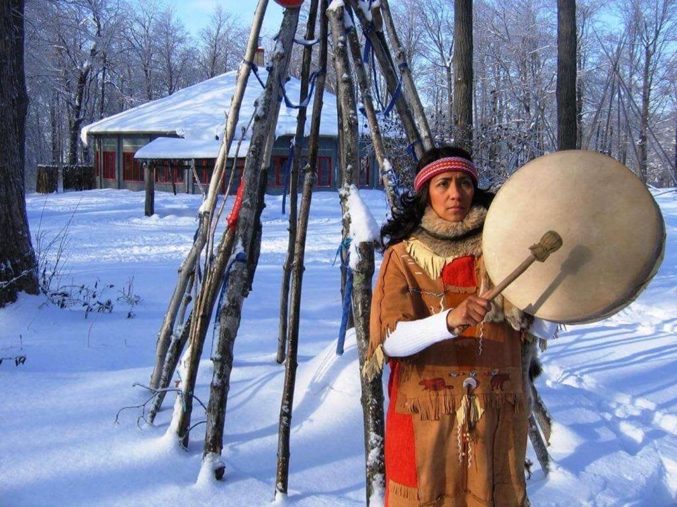
Social programme
Tuesday, 22 October – 18h00 to 21h00​
Welcome cocktail at “La maison autochtone”, located at the foot of the Gault reserve, designated the first Canadian Biosphere Reserve as part of UNESCO's Man and the Biosphere Program, in 1978. ​
Program: Indigenous campfire welcome, Indigenous music artist, Riopelle Art Gallery tour, mocktail bar and food, gift shop.
Wednesday, 23 October – 19h00 to 22h00​
CEOS 40th Celebration at Château Ramezay - Historic Site and Museum of Montréal, the first building classified as a historic monument in the province of Quebec. ​
Programme - Salle de Nantes, with its magnificent 18th century mahogany panelling and its crystal chandeliers that impart an air of refined elegance; welcome guide/Nouvelle France; background music; mocktails & bites.

