Slide 1
SIT Technical Workshop 2024
Welcome
Hironori Maejima
JAXA SIT Chair
Alex Held
CSIRO and GA (local hosts)
Agenda Item 1.1
SIT Technical Workshop 2024
Sydney, Australia
18th - 19th September 2024

Slide 2
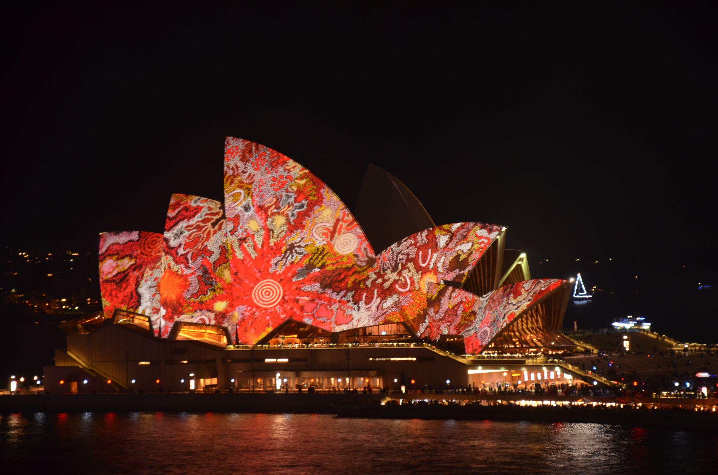
Acknowledgment of Country
Nina Marni.​
By welcoming you all here, I would like to begin by acknowledging the Gadigal people of the Eora Nation, the Traditional Owners of the land and waters that we’re meeting on today, and pay my respect to their Elders past and present

Slide 3
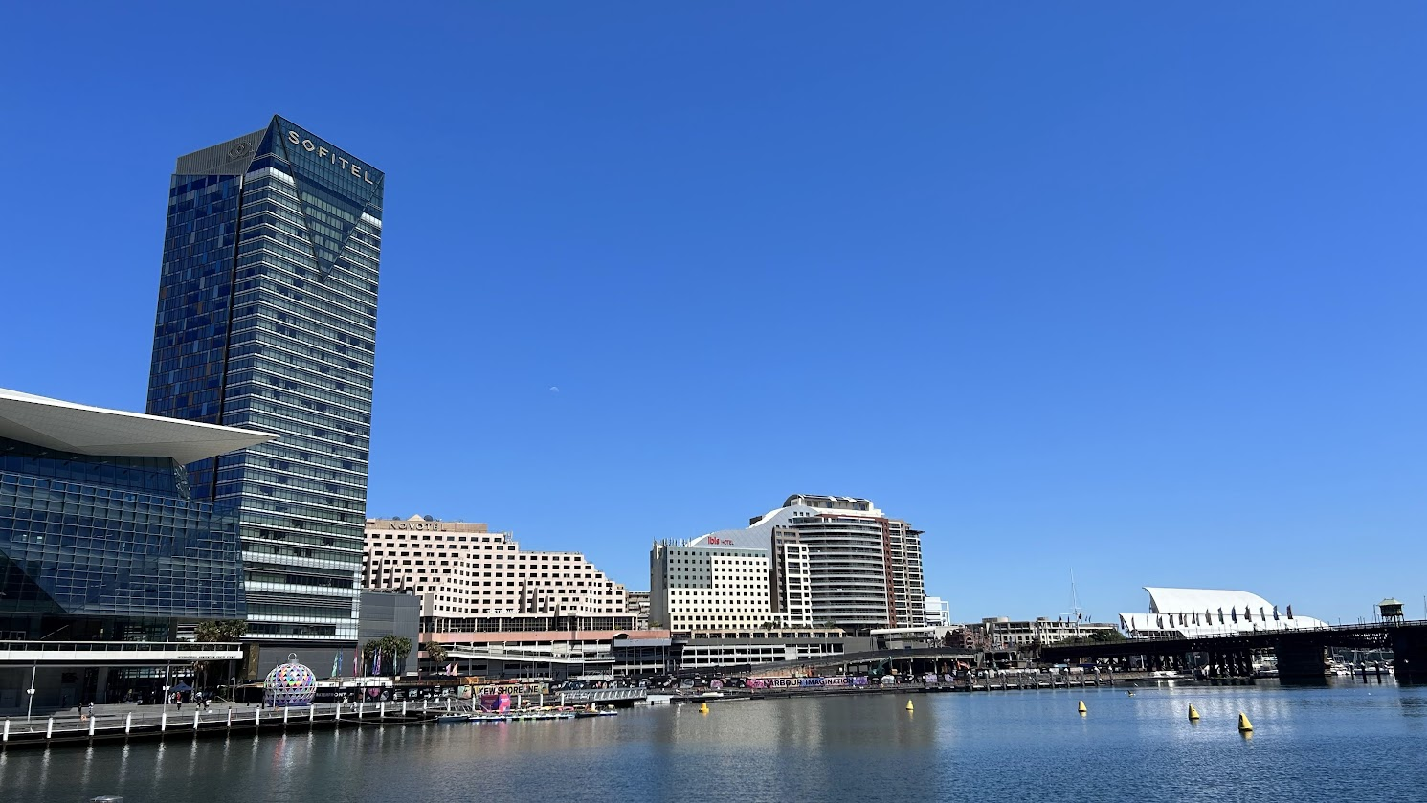
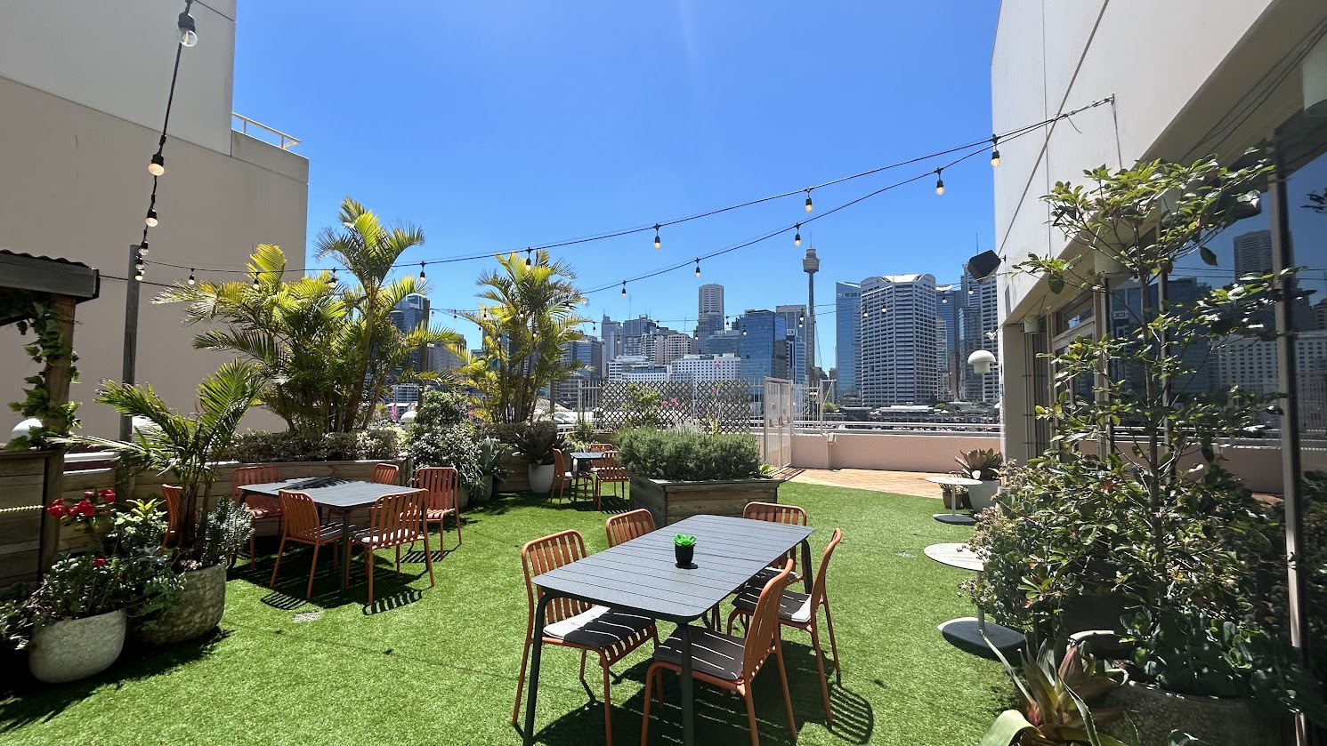
Welcome and logistics
Any issues or questions? Contact Flora or Andreia
From CSIRO and GA… Welcome to Australia: congratulations, you made it!
Meeting at Novotel Sydney on Darling Harbour, Sydney, Australia 100 Murray St, Pyrmont 2009
Lunches provided over 3 days: Buffet area next to Hunter Room
Morning tea and Afternoon Tea served outside the Hunter Room: please make the most of the outdoor area as well ….
Group photo at 10.50… a photographer is coming
Cocktail reception: today Wednesday 18th at 6pm, Chemney Lounge area, level 1
Wi-Fi: “Accor” - Access code “Conferenceroom”
Enjoy being in Sydney!
Notes:
Jonathan Ross sends his apologies as he is unable to make it to Sydney as he is attending personal family matters

Slide 4
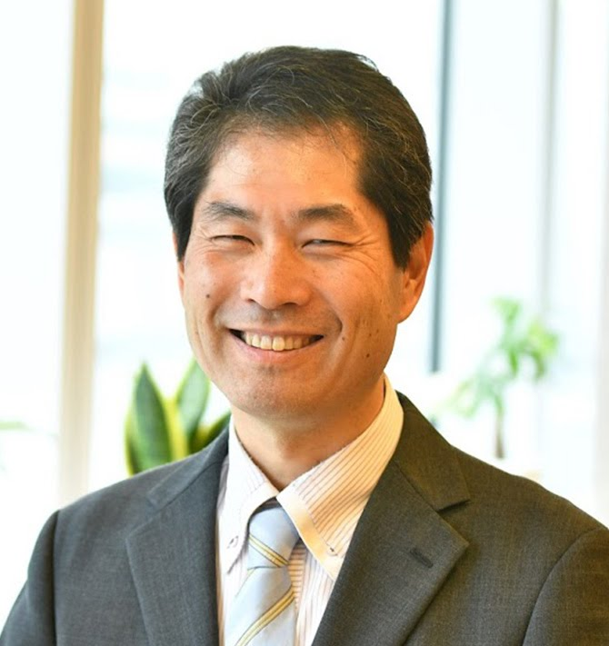
Welcoming Remarks
Hironori Maejima
CEOS SIT Chair 2024-2025
Senior Chief Officer of Earth
Observation Missions
JAXA
Hironori Maejima
JAXA SIT Chair
Agenda Item 1.1
SIT Technical Workshop 2024
Sydney, Australia
18th - 19th September 2024

Slide 5
Outline of Agenda: SIT Chair Priority
Climate Policy Impact
UNFCCC Global Stocktake (GST) lessons learned study and consider the impact on the CEOS GST Strategy for GST#2.
Cohesion of the three individual CEOS Carbon Roadmaps (AFOLU, GHG, Aquatic).
Greenhouse Gas Observation Coordination
The CEOS-CGMS Greenhouse Gas Roadmap (for endorsement at CEOS Plenary)
The Greenhouse Gas Best Practices document
Agriculture, Forestry and Other Land Use (AFOLU)
Progress on the CEOS AFOLU Roadmap; the finalisation of the action supplement, action assignments, and the LSI-VC framework for tracking the actions

Slide 6
Outline of Agenda: CEOS Chair Priority
Biodiversity
Outcomes of the Ecosystem Extent Task Team (EETT) Demonstrator activities (ahead of their presentation at CEOS Plenary 2024)
Findings regarding the potential role of a CEOS entity to address biodiversity (Ref: Action SIT-39-03)
The draft ‘CEOS Montréal Plenary Statement on Biodiversity’ (ahead of CEOS Plenary)
Proposal for a sustained presence of biodiversity in CEOS.

Slide 7
Outline of Agenda: WG and VC
Working Group Priority Topics
WG Disaster: CEOS collaboration with EW4All
WGISS: Progress on 2nd edition of CEOS Interoperability Handbook
WG Climate: Draft CEOS-CGMS Statement to UNFCCC COP 29 SBSTA 61
Working Group Vice Chair nominations (WGCV, WGClimate)
Virtual Constellation Priority Topics
Ocean Surface Topography (OST-VC): User Requirements Document Update
Precipitation (P-VC): International Precipitation Working Group (IPWG) meeting and continuity for passive microwave radiometer measurements; Precipitation CEOS-ARD
Coastal Observations Applications Services and Tools (COAST-VC): United Nations’ Ocean Decade activities
Sea Surface Temperature (SST-VC): Joint SST-VC and COAST-VC statement
Ocean Colour Radiometry (OCR-VC): Progress on the CEOS Aquatic Carbon Roadmap

Slide 8
Outline of Agenda: Others
Other Business
External requests from UNCCD
Status of CEOS support for the SDG Coordination Group (Ref: Action SIT-39-15)
CEOS-ARD Strategy 2024 (for endorsement at CEOS Plenary)
CEOS interaction with the GEO Post-2025 Work Programme
The 2025 United Nations Ocean Conference (UNOC)
AquaWatch Australia Programme
The 2025 CEOS Chair themes and CEOS Chair nominations for 2026+

Slide 9
Tour de Table
Round table introduction by Principals of members of their delegation (in person and online)

Slide 10
Hybrid Meeting Protocols
Both in room and online presenters should join the WebEx and share screen to present
If you cannot present via webex, please arrange with SIT Chair Team ahead of your item
Presentations should be self-uploaded here. (default view only, ask SIT Chair Team for edit access as required)
https://drive.google.com/drive/folders/1lR4NQrsJKSJs5pOn33eRPds427Nm1OQD
Online Participants
https://ceos.my.webex.com/meet/ceoswebex1
Please do not activate your webcam unless you are presenting
If your bandwidth is slow while presenting, please turn off your webcam
Please mute if you are not presenting or making an intervention
If you want to intervene, please, send a message in the chat

