Slide 1
The U.S. Greenhouse Gas Center (US GHG Center)
Argyro Kavvada, Ph.D.
U.S. GHG Center Manager
Earth Science Division,
Science Mission Directorate
NASA
Notes:
Background Image:
NASA's Scientific Visualization Studioz: https://svs.gsfc.nasa.gov/5110
Atmospheric Carbon Dioxide
This visualization is based on the following papers:Weir, B., Ott, L. E., Collatz, G. J., Kawa, S. R., Poulter, B., Chatterjee, A., Oda, T., and Pawson, S.: Bias-correcting carbon fluxes derived from land-surface satellite data for retrospective and near-real-time assimilation systems, Atmos. Chem. Phys., 21, 9609–9628, https://doi.org/10.5194/acp-21-9609-2021, 2021.

Slide 2
Background
The U.S. GHG Center: What is it?
The US GHG Center is a multi-agency effort to facilitate coordination across federal and non-federal, domestic and international entities to integrate and enhance GHG data and modeling capabilities from the USG and non-USG sources for scalable impact. Together, such measurements can provide unique, multi-scale information about GHG that is valuable for both research and applications, serving user needs and providing societal benefits.
Managed by NASA Headquarters, Earth Science Division.
Implementing partners: NASA, EPA, NIST, and NOAA.
GHG Center Portal
The portal will provide a curated collection of GHG datasets, workflows and visualizations, reflecting transparency and open source science principles in both data and methods. Capabilities will include:
A prototype data catalogue
Exploratory data analysis capabilities
A collaborative science environment for data analysis and exploration
An interactive visual interface for storytelling

Slide 3
Overall Approach to Addressing GHG
Support implementation of the National GHG Strategy, following an iterative approach with expectation to integrate additional Federal and non-Federal capabilities in the future
End-user driven, reliable delivery of mature GHG monitoring products and tools, enhanced support for stakeholder engagement
Build off strong heritage of disciplinary programs, with strong focus on integrating atmospheric and surface measurements, representing human and natural processes that exchange carbon between atmosphere and surface biosphere, and including relationship with other gases (e.g., air pollutants)
Leverage multiple vantage points and integrate results/knowledge through models to verify hypotheses & create products for community use
Engage domestically and internationally (e.g., CEOS, WMO G3W, IG3IS, IMEO) through bilateral and multi-lateral engagement in measurement, modeling, research and stakeholder engagement

Slide 4
US GHG Center: VISION, MISSION, GOALS
VISION
Inspire and accelerate the use of Earth science data and information to increase confidence in setting, assessing, and meeting climate mitigation goals.
MISSION
Extend accessible and integrated GHG data and modeling capabilities from U.S. Government and non-public sources for scalable impact.
PURPOSE
Develop and enhance GHG data products that meet user needs;
Foster collaboration with networks of interagency, international, intergovernmental and private sector partners to co-develop and increase adoption of impactful applications;
Promote scientific innovation and transparency by leveraging advanced data systems capabilities and open source science principles; and,
Establish bidirectional knowledge transfer and engagement with federal, state, local and tribal governments, researchers, and the general public.

Slide 5
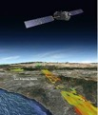
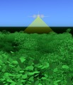
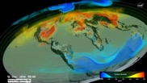
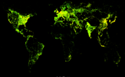
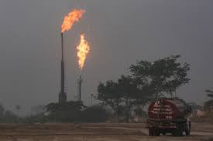
U.S. GHG Center Stakeholder Driven • Sustained Impact • Leverages Mature Capabilities across Partner Agencies
Data, Modeling Capabilities and Needs from Partner Agencies*
GHG Data and Information System
Demonstration Areas
Gridded Anthropogenic Emissions
Research &
Applications
End User System
(Front End)
Earth Observations
Modeling
Leverages ESDS/ VEDA capabilities
Test bedding of modeling, integration approaches
Standards & processes for thorough evaluation of new observations before transition
Advanced users
Leverages ESDS/VEDA
Public-facing
Curated, mature products representing consensus view
Science and
non-science users
Enhanced help desk support
Natural GHG Emissions
Detecting and Tracking High Emission Events
Improvement of modeling, observing techniques
* Representative, but not comprehensive list
Incorporation of stakeholder needs and feedback

Slide 6
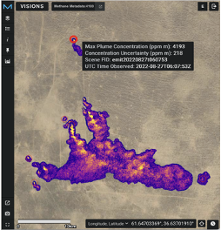
U.S. Greenhouse Gas Center
Upcoming Milestones
Fall 2023: Soft launch of Center, beta portal release
Nov. 28, 2023: Targeted Stakeholder Workshop
(hybrid virtual / in-person, Washington, D.C.
Dec. 4: Side Event at COP28
Use Cases
Credit: Maasakkers et al., Env. Sci. and Tech., 2016
Credit: Weir et al., Env. Res. Lett., 2022
Credit: EMIT Interim Open Data Portal
Improve access and latency to gridding of anthropogenic CH₄
Inventory
Complement anthropogenic GHG emissions with natural GHG emissions and fluxes
Identify, and quantify estimates from super emitting events, leveraging aircraft and satellite data.

Slide 7
DEMONSTRATION AREAS
Demonstration Area: Human emissions, cyberinfrastructure
Demonstration Area: Natural sources/sinks, modeling and data assimilation
Demonstration Area: Large emission events, Advancing measurement technology and cal/val
Use Case 2. Complement anthropogenic GHG emissions with natural GHG emissions and fluxes
Add. Interagency Opportunities. Collaboration on quasi-operational modeling, development of consensus GHG products
Use Case 3.
Identify and quantify emissions from large CH₄ leak events leveraging aircraft and satellite data
Add. Interagency Opportunities. Collaboration on cal/val standards, coordinated measurement deployments
Use Case 1. Improve access and latency to, gridding of anthropogenic CH₄ inventory
Add. Interagency Opportunities.
Collaboration on low latency GHG, AQ emissions (e.g., through GRA²PES)
International. Make gridding tools open source, support capacity building in other countries, collaborating with State Department.
International. Contribute to CEOS Strategy to Support the Global Stocktake and WMO IG3IS and Global Greenhouse Gas Watch initiatives.
International. Explore contributions to UNEP IMEO/MARS initiatives to enable timely access of satellite plume mapping data for large/transient emissions detection and inter-comparison of plume mapping instruments with emissions release.
REGIONAL
GLOBAL
LOCAL

Slide 8
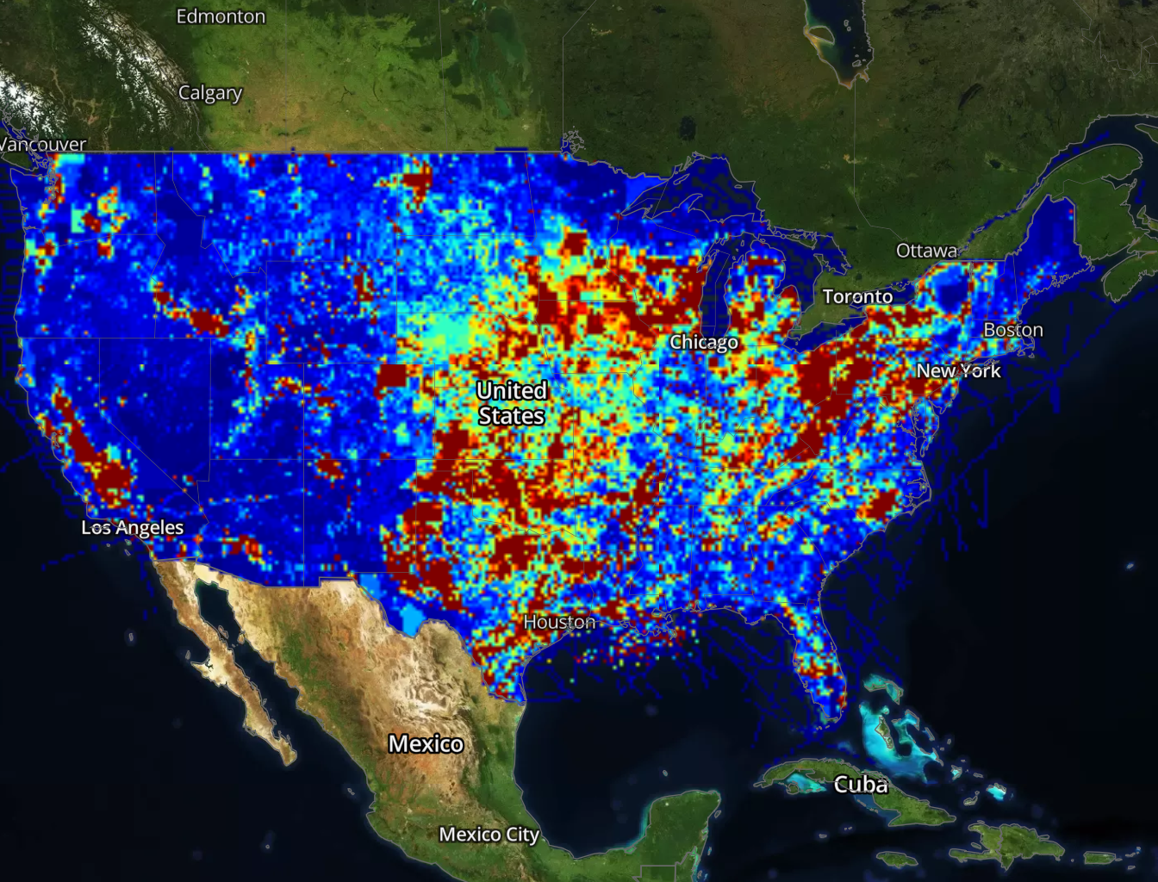
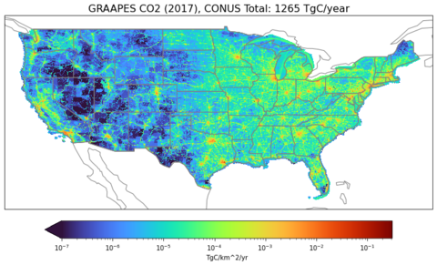
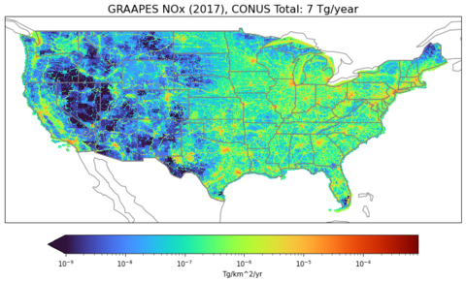
Demonstration Area 1: Human Emissions, Cyberinfrastructure
The gridded EPA U.S. anthropogenic methane greenhouse gas inventory includes gridded maps of annual anthropogenic methane emissions (0.1°×0.1°) for the contiguous United States.
Mapping human-caused sources of methane across the U.S. provides insight into source and emission trends. This geographic representation enables new comparisons between emission locations and includes methane estimates informed by atmospheric observations. The aim is to improve national and state-level methane emission estimates.
Collaboration on low latency GHG, AQ emissions (e.g., through GRA²PES)
EPA Gridded Express 2020 - Total Methane Emissions
Credit: Colin Harkins, NOAA / CIRES

Slide 9
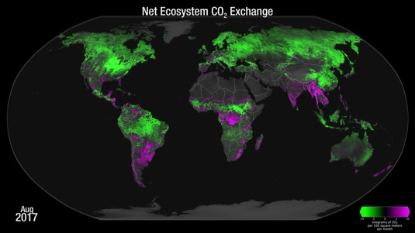
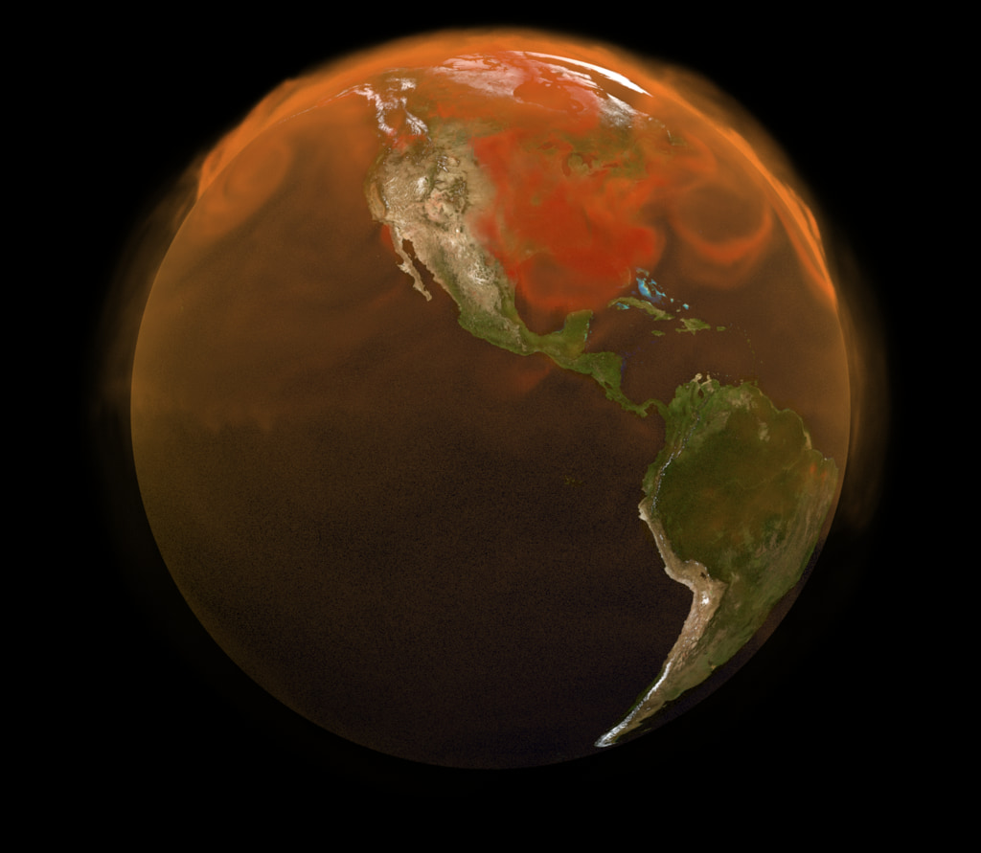
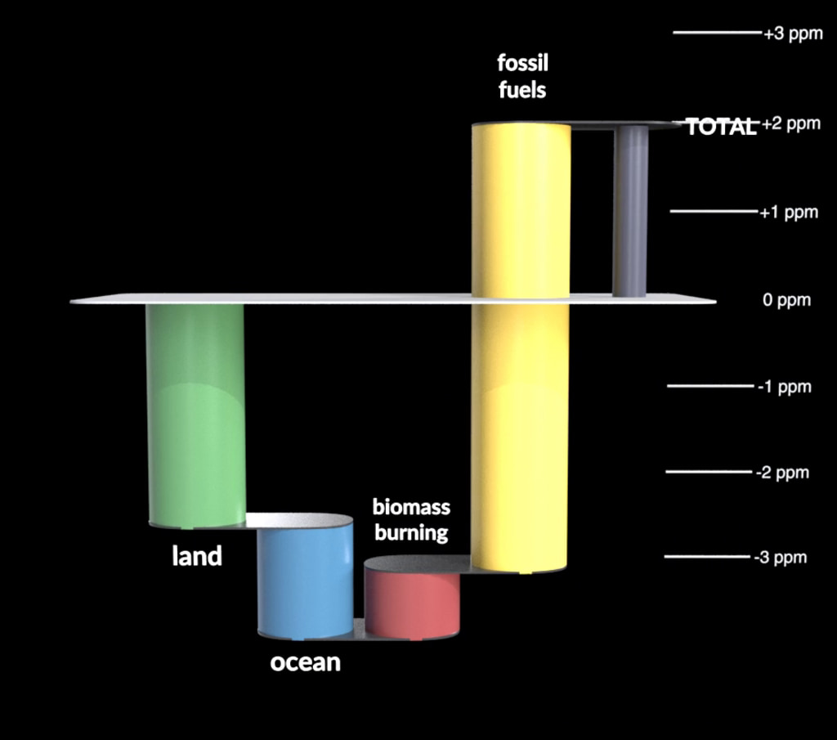
Demonstration Area 2: Natural Sources and Sinks, Modeling and Data Assimilation
Improved bottom-up estimates
Refinement through atmospheric DA
Improved GHG budgets
1. Improved delivery, quality, and resolution of natural source and sink estimates
2. Monitoring and early warning of changes in sources and sinks
3. Evaluation and refinement of source and sink observations using top-down constraints
4. Contribution to coordinated standards for model intercomparison and evaluation
5. Develop future workforce to ensure sustainability of model-based products

Slide 10
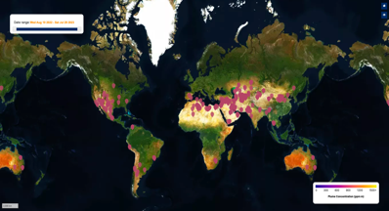
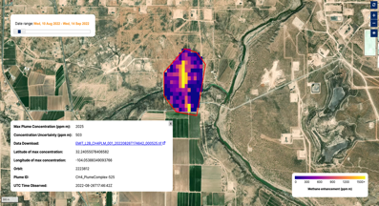
Demonstration Area 3: Large Emission Events, Expanding GHG Cal/Val
Locations of methane plumes observed with EMIT
Stakeholders will be able to access methane plume results using the US GHG Center portal

Slide 11
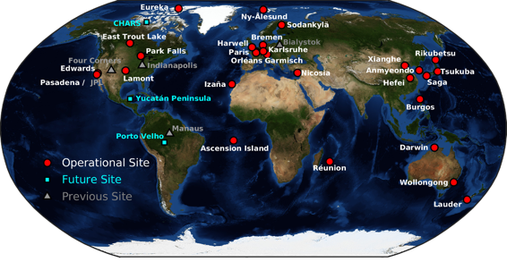
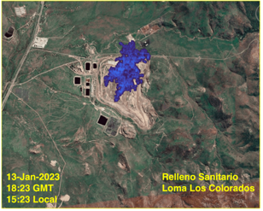
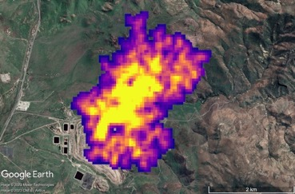
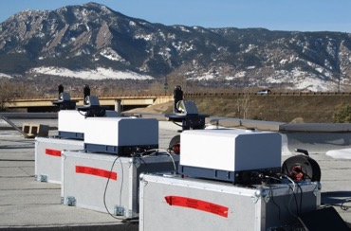
Demonstration Area 3: Large Emission Events, Expanding GHG Cal/Val
AVIRIS-NG CH₄ from landfill (1/13/23)
Direct comparison of EMIT results with near coincident measurements from airborne surveys (e.g., AVIRI-NG, AVIRIS-3)
TCCON network
EMIT GHG validation efforts
EMIT CH₄ from same landfill (1/19/23)
Portable EM27/Sun Instruments
Relleno Sanitario
Loma Los Colorados
Santiago, Chile
Opportunities for interagency & international collaboration on expanded ground-based GHG cal/val network, expanding workforce through collaboration with MSIs
‹#›

Slide 12
US GHG Center Stakeholders
Partner: An organization that actively co-develops the capability to achieve sustained use and sustained benefit from greenhouse gas observations and modeling for the US GHG Center.
Implementing Partners
Discussions with Stakeholders *
Future targeted engagement*
*Representative examples

Slide 13
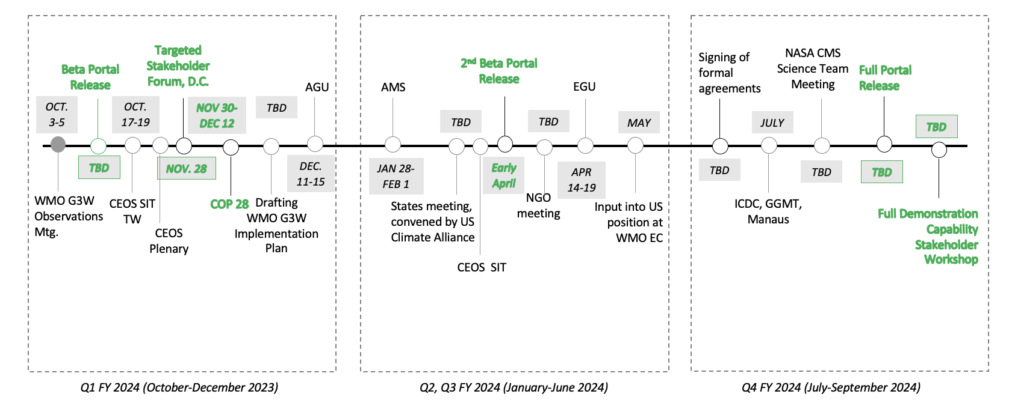
[DRAFT] U.S. Greenhouse Gas Center: Public-Facing Milestones, FY24

Slide 14
The U.S. Greenhouse Gas Center (US GHG Center)
Thank you!
Argyro.Kavvada@nasa.gov
Notes:
Background Image:
NASA's Scientific Visualization Studioz: https://svs.gsfc.nasa.gov/5110
Atmospheric Carbon Dioxide
This visualization is based on the following papers:Weir, B., Ott, L. E., Collatz, G. J., Kawa, S. R., Poulter, B., Chatterjee, A., Oda, T., and Pawson, S.: Bias-correcting carbon fluxes derived from land-surface satellite data for retrospective and near-real-time assimilation systems, Atmos. Chem. Phys., 21, 9609–9628, https://doi.org/10.5194/acp-21-9609-2021, 2021.

