Slide 1
CEOS Ecosystem Extent Task Team:
Side Meeting
17 October 2023
Gary Geller
NASA Jet Propulsion Laboratory
California Institute of Technology
Shaun Levick, CSIRO
Sandra Luque, CNES/INRAE
Roger Sayre, USGS
CEOS SIT Technical Workshop
17-19 October 2023, Frascati
(c) 2023 California Institute of Technology. Government sponsorship acknowledged.

Slide 2
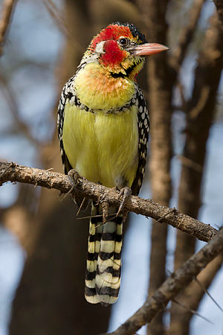
Agenda
Welcome
Introduction & EETT context
White Paper
Recommendations
  Discuss one-by-one
Demonstrator update
Conclusions and wrap up
Wikimedia Commons

Slide 3
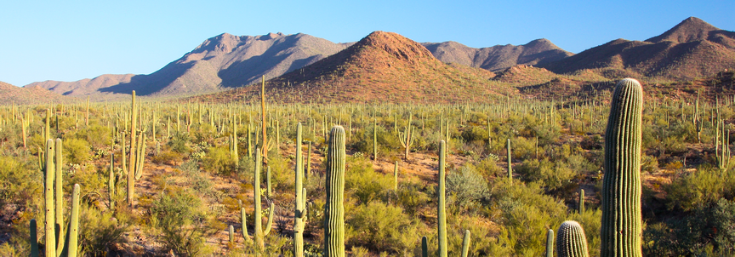
Meeting Goals
Inform: progress and status
Get feedback
  White paper
  Recommendations
Joe Parks from Wikimedia

Slide 4
Task Team History
2012: Biodiversity Activity
2021/SIT-36: one slide intro
2021/Plenary: “Discussion Group” initiated
2022/Tech Workshop: Ecosystem Extent TT proposed
2022/Plenary: Ecosystem Extent TT approved
Overarching goal: Sustainable CEOS engagement with biodiversity

Slide 5
From the ToR…
Purpose: To assess the utility for mapping Ecosystem Extent using current and new space-based observations that will become available in the next 10 years.
Objectives:
  Develop a white paper that will provide an integrated international perspective on how space-based Earth observations can be used to support ecosystem mapping and monitoring with a focus on ecosystem extent.
  Develop specific ideas to further the concepts in the white paper.
  Explore and propose an initiative to demonstrate the use of EO for ecosystem extent mapping and monitoring.

Slide 6
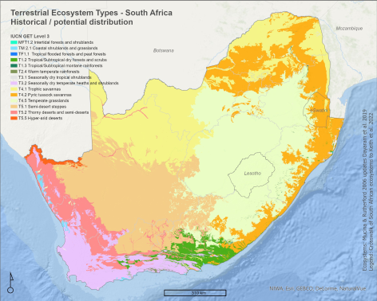
Ecosystem Extent
Essential Biodiversity Variable
"Headline indicator” in CBD GBF Monitoring Framework
Ecosystem Account in UN SEEA
EO is the primary input
Andrew Skowno, SANBI

Slide 7
White Paper

Slide 8
Purpose
Explain & convey value of EO for ecosystem extent
  …in 25 pages or less
Audience
  CEOS agencies and their Principals
  Biodiversity community
    Parties to UN Convention on Biological Diversity
    UN System of Environmental Economic Accounting

Slide 9
Author Composition
Co-leads: Gary Geller (NASA), Shaun Levick (CSIRO), Sandra Luque (CNES), Roger Sayre (USGS)
60-70% of other authors are not from CEOS agencies
  Excellent scientists
  Unfamiliar with CEOS
Notes:
Non-co-lead authors
Andreas Brink, Nicholas Coops, Sylvie Durrieu, Judith Ewald, Hannes Feilhauer, Jean-Baptiste Feret, Simon Ferrier, Miroslav Honzák, Dino Ienco, Amanda Koltz, Veronica Lance, Nikhil Lele, Shea Lombardo, Miguel Mahecha, Carsten Meyer, Marc Paganini, Duccio Rocchini, Amy Rosenthal, Maria J. Santos, Lucie Viciano
CEOS Agencies: European Commission, DLR, NASA, NOAA, ISRO, ESA, CSA

Slide 10
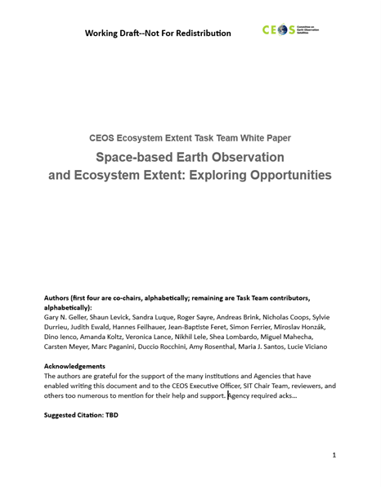
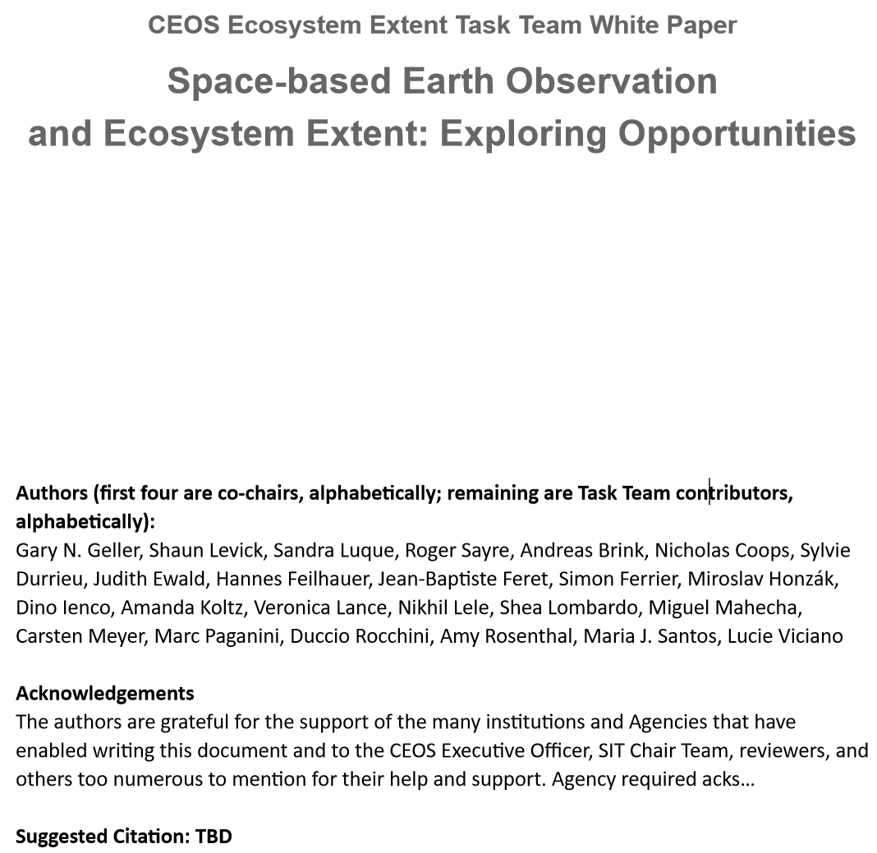
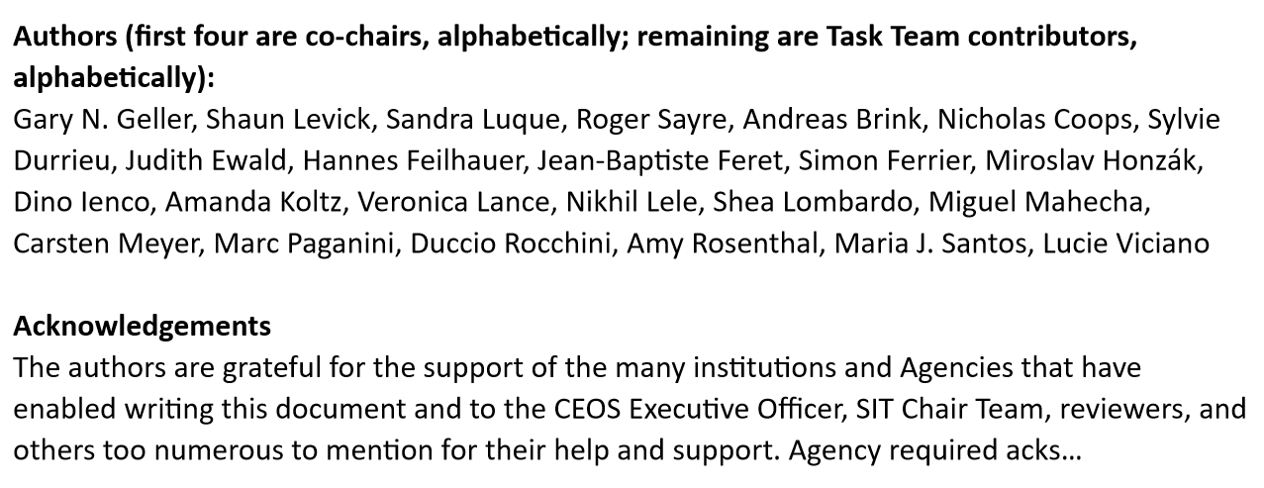
White Paper

Slide 11
Development Process
Form Task Team
Dec ‘22-Feb ‘23
Co-leads draft outline, refine with full TT
TT members (“authors”) contribute text
Co-leads consolidate contributions
Comments provided
Co-leads incorporate comments, prepare V0.9
V0.9
(TW)
Jan-Mar 2023
March-June
June-July
Mid-August
August-September
October
Journal Paper
Concept
Many iterative steps not shown

Slide 12
Outline
Executive Summary
1 Introduction
1.1 Biodiversity Policy Anchors and Users
2 Mapping Ecosystems
  2.1 Land Cover as a Proxy for Ecosystems
  2.2 Mapping Ecosystems from Imagery
  2.3 Ecosystem Characteristics Useful for Mapping
  2.4 Ecosystem Mapping Typologies
3 Space-based Earth Observations for Mapping and Monitoring Ecosystem Extent
  3.1 Types of Sensors
  3.2 Sensor Complementarity and Synergy
  3.3 Opportunities
  3.4 Challenges
4 Conclusions and Recommendations

Slide 13
“Composition, Function, Structure”
Sensor type | Key Ecosystem Characteristics
Optical - Multispectral | Composition (coarsely) Functional traits (coarsely)
Optical - Hyperspectral | Composition Functional traits
Radar | Physical structure Height
Lidar | Physical structure Vertical structure
Sensors of different types provide complementary measurements

Slide 14
Opportunities
Combining data from different types of sensors
Use of hyperspectral data
Time series analysis
Artificial intelligence and machine learning
Data cubes

Slide 15
Challenges
Combining data from different types of sensors
Limited availability of value-added products
EO data usability and technical capacity of users
Ecosystem condition
Reference data for training and validation

Slide 16
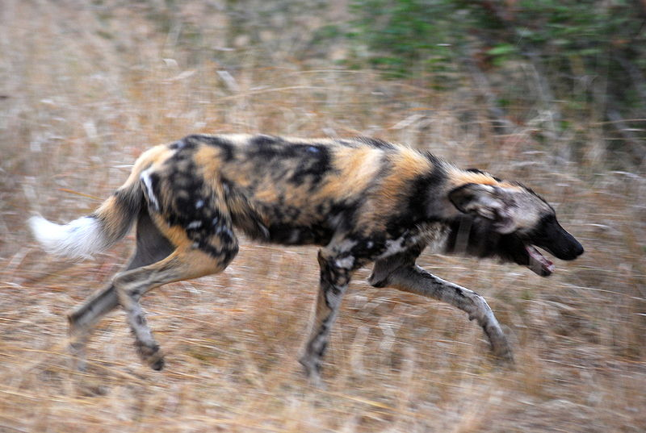
WP Comments & Discussion
WP provided as information document to solicit comments
  With the request to bring your comments to the TW
Now: open for your questions and comments
Martin Wegmann

Slide 17
Recommendations
(for discussion)

Slide 18
Recommendation 1
Discussion areas:
  Combining data from different types of sensors (White Paper section 3.2)
  Denser time series (3.3.2 & Rec #4)
  Use biodiversity variables instead of spectra (3.3.2 & 3.4)
  End-user constraints
  Capacity building
  Forthcoming EO capabilities
Workshop
It is recommended that CEOS, in synergy with CBD, GEO BON, UN SEEA, and the GEO Global Ecosystem Atlas initiative plan a joint workshop to advance the use of space-based EO for ecosystem extent mapping.
Notes:
Discussion areas: All are from White Paper (“opportunities” or “challenges”)
Outcomes include:
Engagement with these organizations (currently, very limited visibility with them)
Improved understanding of their needs and constraints
Potential for further discussion

Slide 19
Recommendation 2
Key data for each ecosystem type
Across different domains (e.g., terrestrial, freshwater, coastal) it is recommended that CEOS Members and Associates develop an assessment to identify the most suitable types of EO imagery for delineating the extent of IUCN GET Level 3 ecosystems (Functional Groups). Approaches for filling gaps and otherwise improving quality (e.g., via data fusion techniques, AI/ML advances, and new missions) should be considered.
A similar assessment for delineating the Ramsar wetland types is also recommended.
Value:
Prioritization of needed data
Guides data acquisition strategy
Analogous to sensitivity analysis
Direct benefit to:
Ecosystem map creators
CBD GBF & Monitoring Framework
UN SEEA Ecosystem Accounts
GEO Global Ecosystem Atlas
Notes:
IUCN GET is the Global Ecosystem Typology—a standard classification scheme of about 100 ecosystem classes.
This recommendation suggests identifying the data most needed to discriminate each ecosystem class.

Slide 20
Recommendation 3
Barriers to use
It is recommended that CEOS Members and Associates develop a report to identify barriers to the use of space-based EO for mapping ecosystem extent.
Multiple barriers impede use of EO by many countries
Often those with highest biodiversity
Direct benefit to CBD GBF:
Indicator A.2 (Ecosystem extent)
Target 1 (decrease biodiversity loss)
Target 20 (capacity building)
Target 21 (knowledge sharing)

Slide 21
Recommendation 4
Denser time series
To more fully exploit ecosystem seasonality patterns for mapping ecosystem extent it is recommended that CEOS Members and Associates increase the temporal resolution of time series.
For example: increase resolution by harmonizing data from similar sensors (e.g., Landsat-Sentinel-2 HLS; ESA Sen2Like framework) or expanding acquisitions.
Seasonal timing: key ecosystem characteristic to discriminate ecosystems (3.3.2)
Monitor abrupt changes in ecosystem extent (3.4)

Slide 22
Recommendation 5
Capacity
In support of CEOS's commitment to data democracy and capacity development, it is recommended that a Massive Open Online Course (MOOC) focused on generating Ecosystem Extent maps from space-based EO data is developed.
Capacity limits many countries from generating their own maps of ecosystem extent
Direct benefit to CBD GBF:
Indicator A.2 (Ecosystem extent)
Target 20 (capacity building)

Slide 23
Recommendation 6
Ecosystem Condition
As an extension of the work done by the CEOS EETT on ecosystem extent, it is recommended that CEOS Members and Associates should assess the opportunities and challenges to use space-based EO to enhance the assessment of ecosystem condition.
Ecosystem extent depends on condition
Condition is a CBD GBF indicator
Condition is a UN SEEA ecosystem account

Slide 24
Demonstrator Update

Slide 25
Demonstrator
Objective: To demonstrate…
  Use of EO for ecosystem extent mapping & monitoring
  Importance and value of EO
    Biodiversity community
    CEOS agencies and Principals
Delivery: Plenary 2024
Approach
  Leverage partner initiatives
  Several opportunities

Slide 26
Opportunities
Hudson’s Bay Lowlands (Environment & Climate Change Canada)(Jason Duffe)
Costa Rica (CNES/INRAE)(Sandra Luque)
Australia Great Western Woodlands (CSIRO)(Shaun Levick)

Slide 27
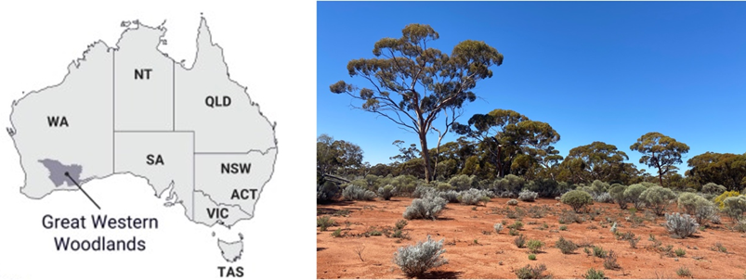


Great Western Woodlands
Largest remaining area of temperate woodlands on Earth
  Significant biodiversity and cultural values
  Pressure from climate change and land-use intensification
  Ecosystem extent maps needed to guide planning and management
CSIRO postdoc position for three years
  Interviews underway
  Collaboration: CSIRO, Dept of Biod & Conservation Attractions (DBCA), Uni Bristol
Key questions
  Can the delineation of vegetation types be improved with multi-wavelength SAR?
  Can stand age be reliably mapped from multi-sensor satellite imagery?
  Can historic stand growth rates be derived from time-series imagery?

Slide 28
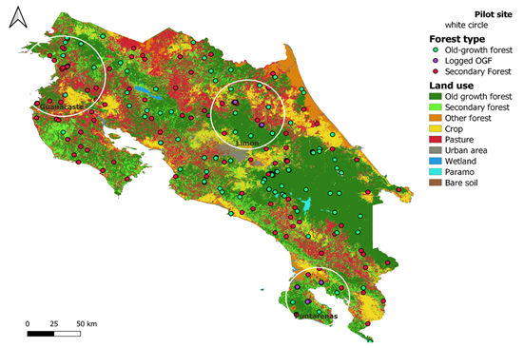
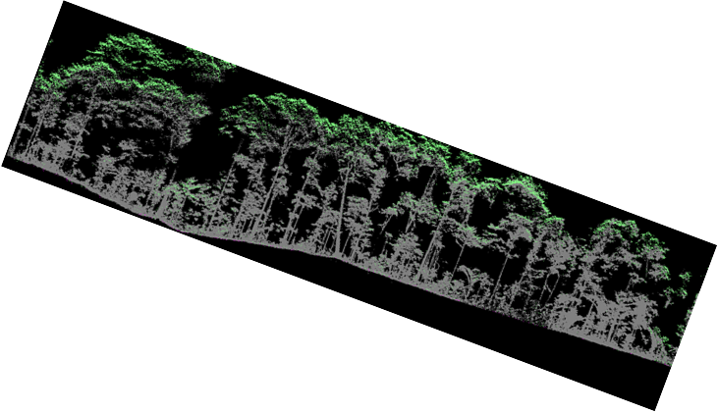

Tropical Forests – Costa Rica
Costa Rica accounts for only 0.03 percent of the earth's surface. However it contains nearly 6 percent of the world's biodiversity
Objectives
  Assess conservation potential of secondary forests in human-modified landscapes
  Compare conservation potential of intact and disturbed forests
    CNES/INRAE Data Analyst /ecologist position for 12 M (just hired)
    Develop data cube for analyzing biodiversity data and trends
Key questions
  How to operationalize forest ecosystem extent mapping
  How to assess conservation potential of secondary forests using multi-sensor satellite imagery?
  How to assess secondary forests using α and β diversity predicted directly and indirectly from spectral information?

Slide 29
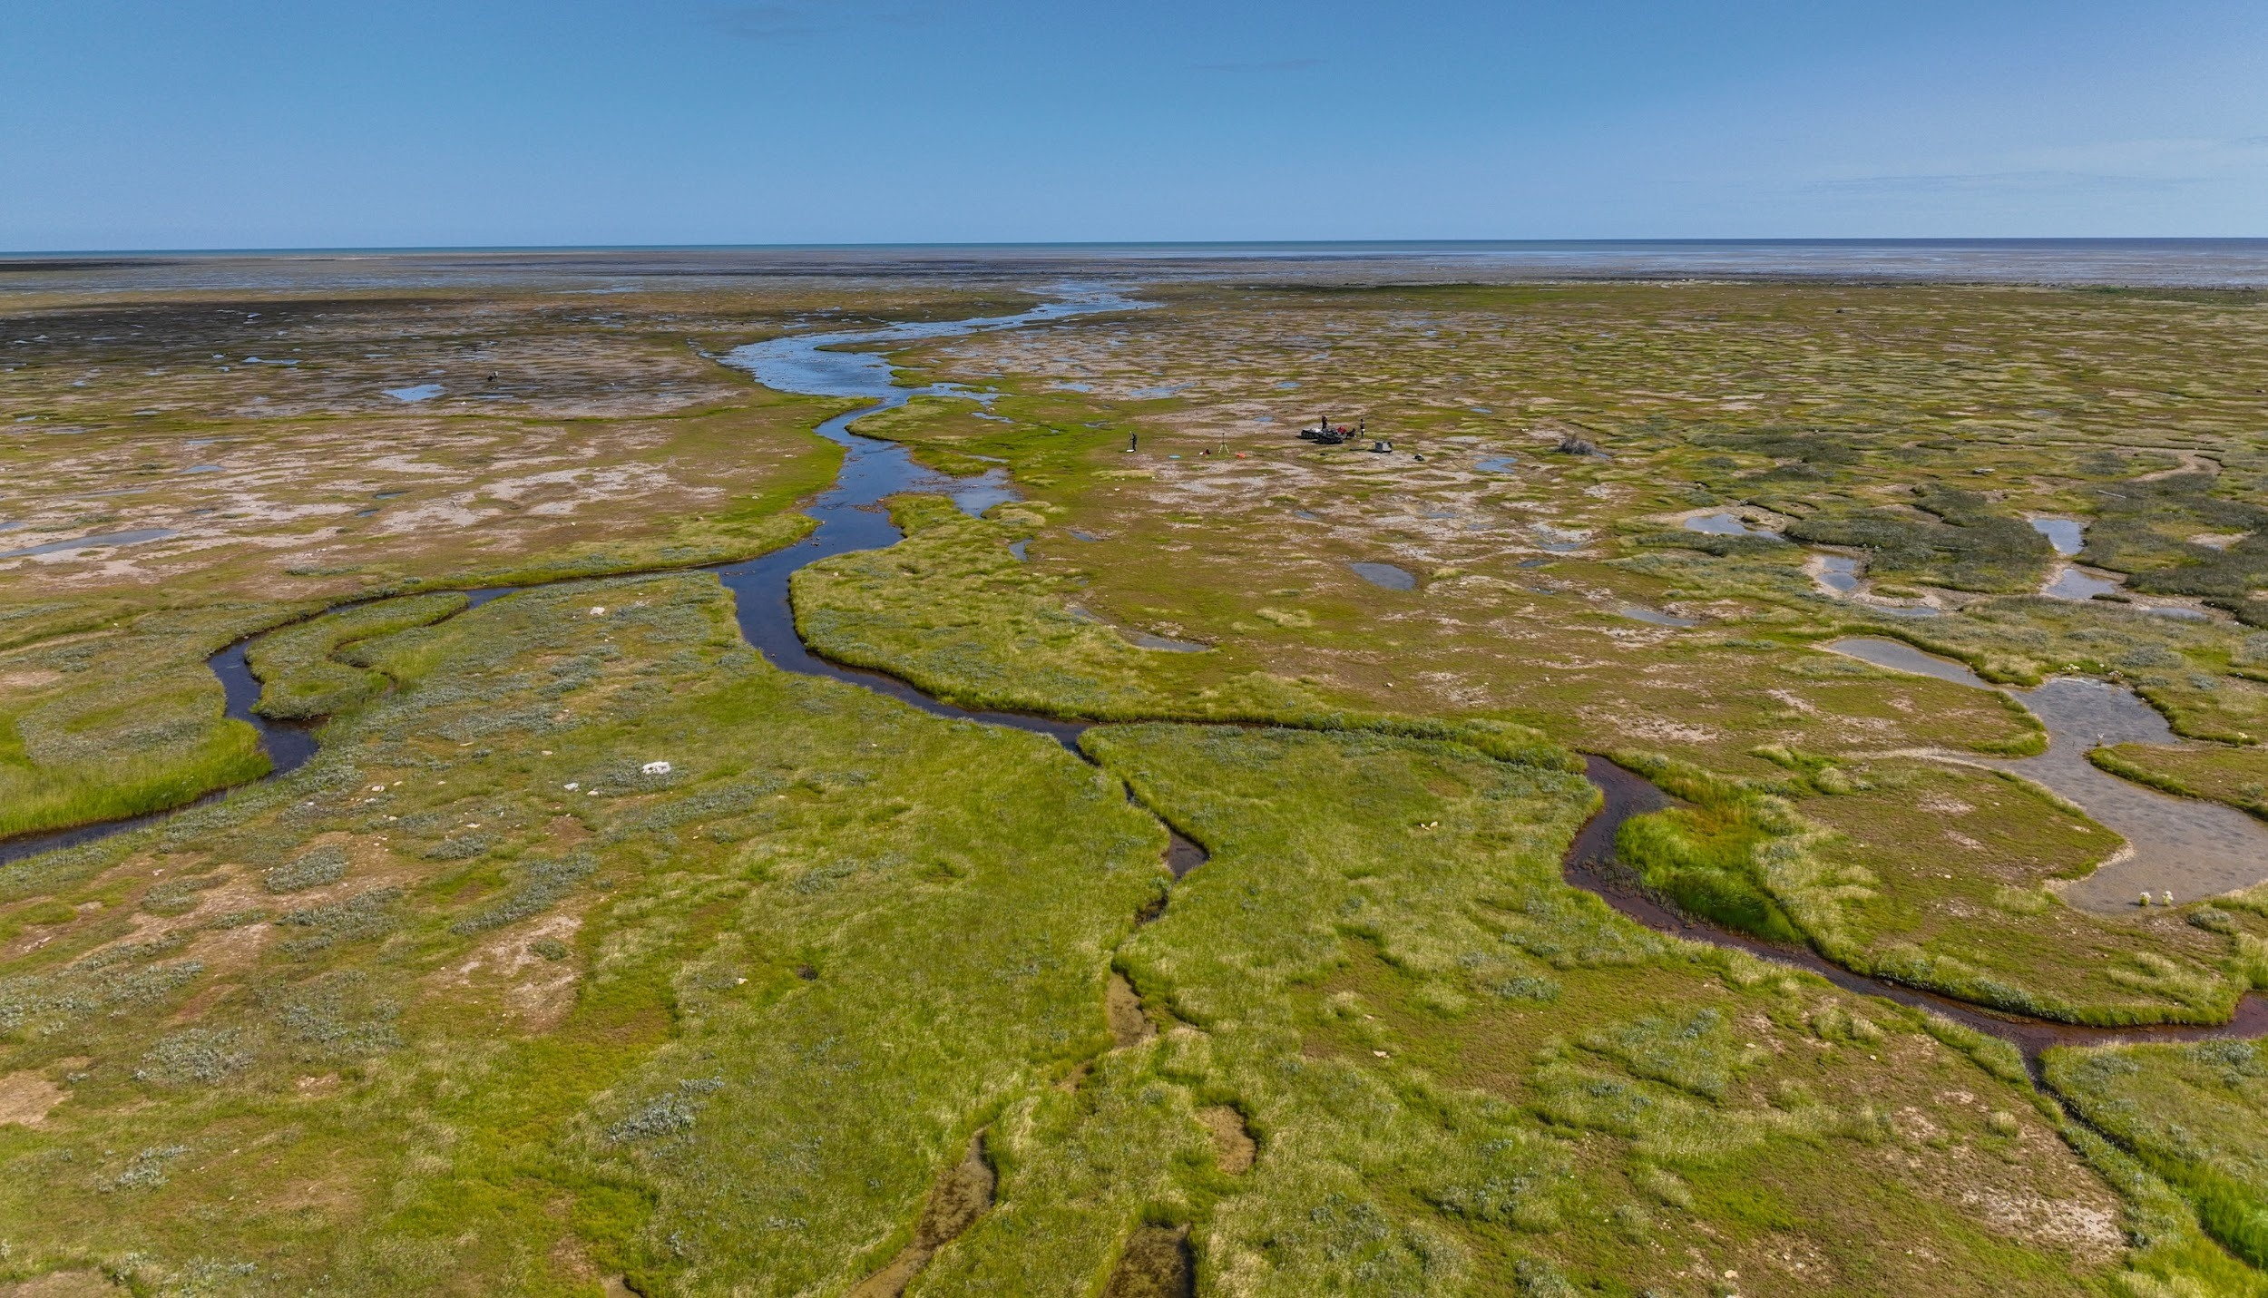
Hudson’s Bay Lowlands
CEOS EETT Demonsrator
Environment and Climate Change Canada

Slide 30
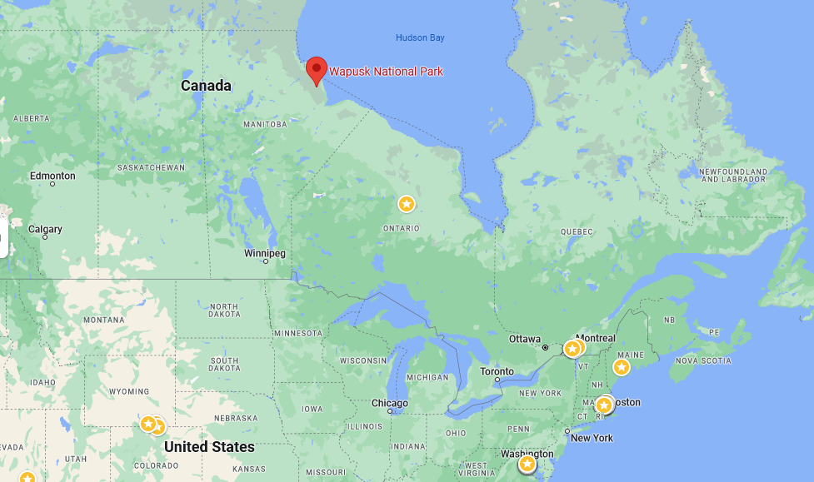
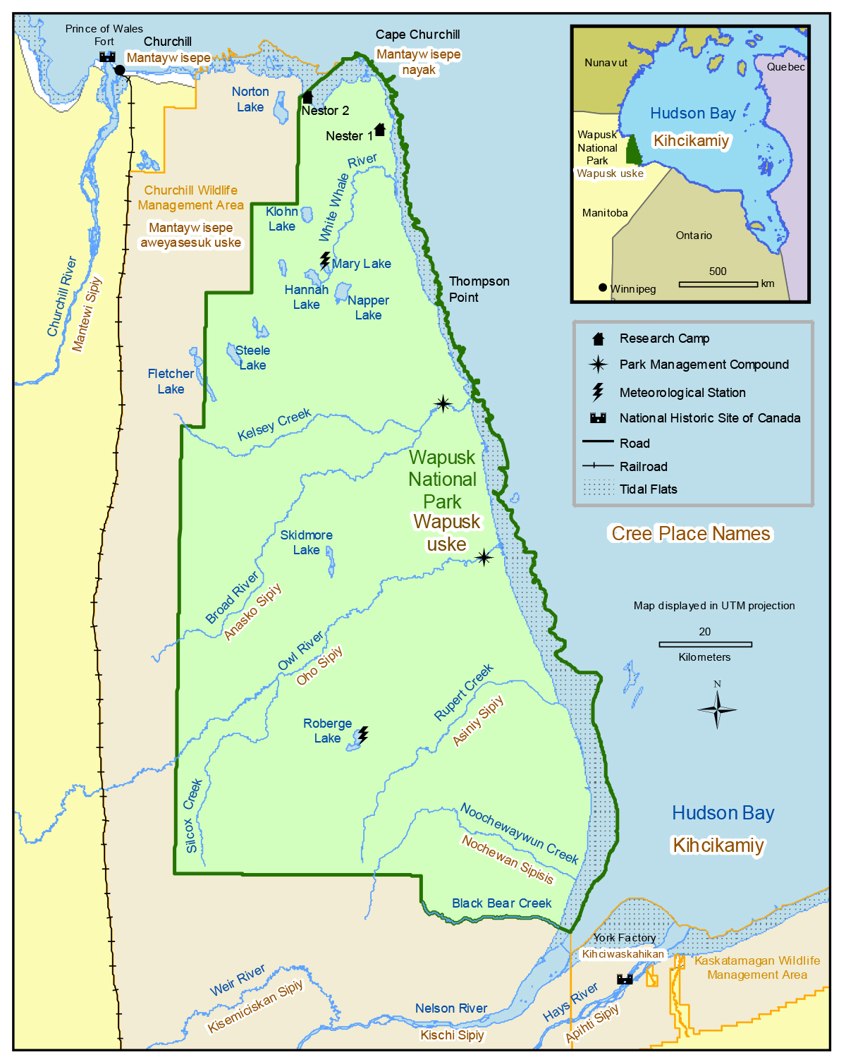
Background
HBL: Global importance for biodiversity & carbon storage
Demonstrator: focuses on Wapusk NP
Objectives:
  Produce detailed map of Wapusk NP
  Move from 5 classes (current) to 11

Slide 31
Approach
  Combine data from several EO sensors, in situ data, and other sources
  Use advanced ML Classifiers, AI algorithms and other methods
  Utilize the CEOS Analytics Laboratory
  Developed by the CEOS System Engineering Office
  Data cube

Slide 32
Progress
CEOS SEO / ECCC staff introductory meeting (Sept 2023)
  CAL provides wide range of standard datasets
  Working on ingest approach for L-band (and hyperspectral)
Staff hired
  Ecosystem scientist
  AI/ML expert
In progress: Obtaining core datasets for CAL for Wapusk National Park
  ALOS L-Band
  Hyperspectral satellite data (ENMAP)
  TerraSAR-X data
  JAXA and DLR assisting with obtaining the data

Slide 33
Challenges and Opportunities
Challenges
New sensor platforms
    ECCC has expertise in hyperspectral EO but not with ENMAP
Combining hyperspectral and SAR using neural networks
    Cutting edge activity
  Opportunities
  Increase ability to discriminate wetland ecosystems
  Explore ways to move from 5 to 11 classes
  Provide insights into which sensors are most important for mapping wetlands (sensitivity analysis)
    Assess role of hyperspectral data
  Demonstrate role of new EO sensors for ecosystem extent mapping
  Cutting edge activity

Slide 34

Current
Schedule
ASAP: Confirmation of data availability (JAXA, DLR)
December 2023: CEOS Analytics Lab Data Cube prepared
Winter/Spring/Summer 2024: Analysis and Write up
November 2024: demonstration and delivery at CEOS Plenary

Slide 35
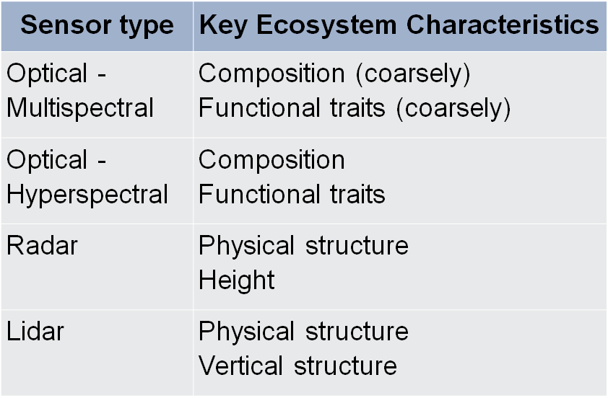
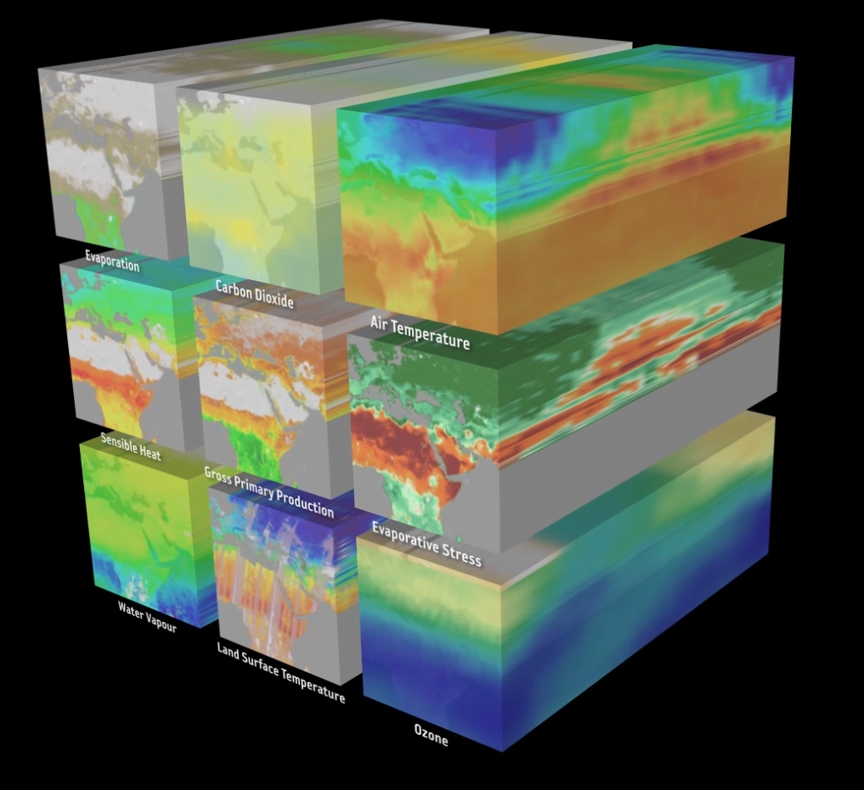
Demonstrator Notes
All three
  Designed around data cubes
  Combine data from different sensors
  Are “cutting edge” activities

Slide 36
Questions for You

Slide 37
Questions
How can sustainable resources be provided for future CEOS work on biodiversity?
  Most agencies do not have a biodiversity person on staff
Any additional guidance for the EETT?

Slide 38
Have we met the objective?
Purpose: To assess the utility for mapping Ecosystem Extent using current and new space-based observations that will become available in the next 10 years.
Objectives:
  Develop a white paper that will provide an integrated international perspective on how space-based Earth observations can be used to support ecosystem mapping and monitoring with a focus on ecosystem extent.
  Develop specific ideas to further the concepts in the white paper.
  Explore and propose an initiative to demonstrate the use of EO for ecosystem extent mapping and monitoring.

Slide 39
Conclusions & Wrap Up

Slide 40
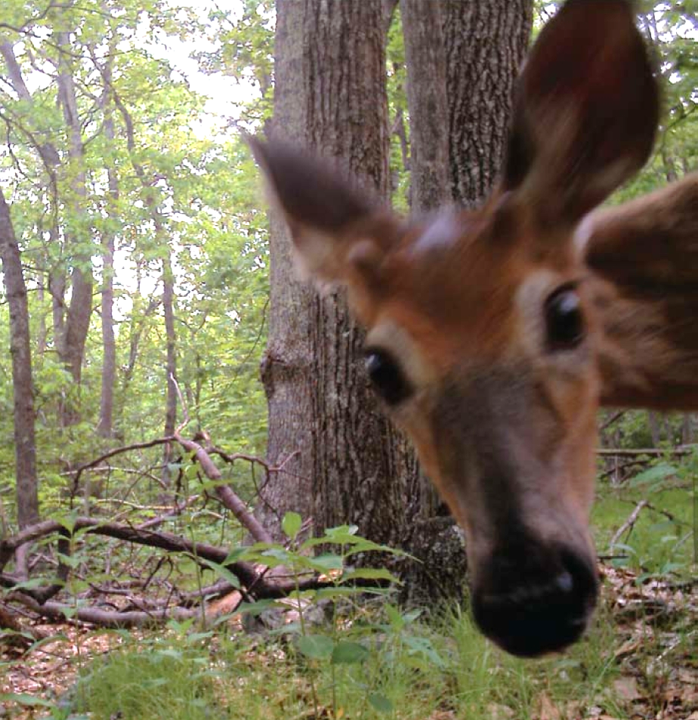
Wrap up
Summary of Action Items
Key outcomes
Next steps
US FWS

