Slide 1
GHG Observation Coordination
Session Context & Intro
Yasjka Meijer
GHG TT Lead (ESA)
Agenda Item 2
SIT Technical Workshop 2023
18th - 19th October 2023, ESA/ESRIN

Slide 2
Context
GHG Observations from space of crucial importance to Paris Climate Agreement and Stocktake
CEOS efforts directed by the GHG Roadmap
Increasing activity in the commercial and NGO sectors for CO2 and CH4
CEOS actively engaging with International Methane Emissions Observatory (UNEP) for 2-3 years
WMO emerging with Global Greenhouse Gas Watch initiative
Considerable new investment across CEOS agencies and their governments
GHG Observation Coordination identified by incoming SIT Chair (JAXA) as a headline priority for 2024-2025

Slide 3
Session Objectives
Update the community on several key activities and relationships
  GHG Roadmap
  IMEO
  WMO
  New GHG Mission portal from ESA MIM and JAXA SIT teams
National reports of interest - US GHG Center
Discuss some new activities
  Best Practices for GHG Emissions from Space - supporting new space
Hear from JAXA as to their plans and priorities in this area

Slide 4
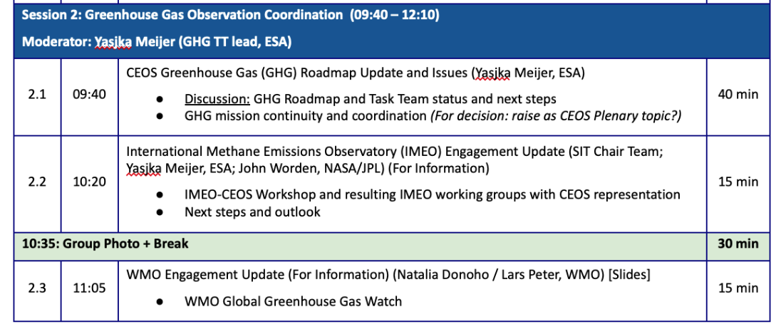
Agenda

Slide 5
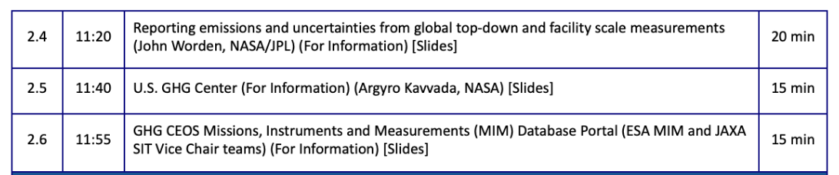
Agenda

