Slide 1
Thailand CEOS Plenary Details
Pakorn Apaphant, GISTDA
Agenda Item #9.2
SIT Technical Workshop 2023
18th - 19th October 2023, ESA/ESRIN

Slide 2
2023 CEOS Plenary
Hybrid meeting, allowing both in-person (encouraged) and remotely via teleconference.
14 November 2023, Tuesday
Side Meetings
Side Event Seminar (09:00hrs - 12:00hrs)
Welcome reception (18:00hrs - 20:00hrs)
15-16 November 2023, (Wed-Thurs)
CEOS Plenary 2023
Dinner reception (16 November (18:00hrs - 21:00hrs))
17 November 2023, Friday
CEOS 2023 “Unseen Space” Exploration
(08:30hrs - 18:00hrs)

Slide 3
Week at a Glance
Tuesday, November 14 | Wednesday, November 15 | Thursday, November 16
Side Meetings: Special Side Event: Satellite Earth Observation & Carbon Accounting SDG Coordination Group CEOS Secretariat (314) Methane Analysis Standards Framework SIT Chair Handover (closed) | Welcome and Core Business Special Topics Carbon, Climate, GHG CEOS Working Groups GEO Topics CEOS Virtual Constellations CEOS Agency Reports | New Space Biodiversity Oceans and Coasts Other Business CEOS Agency Reports CEOS Leadership Transitions and Closing Business

Slide 4
Week at a Glance
14 NOV 2023 (18:00hrs - 20:00hrs) - Welcome Reception
16 NOV 2023 (18:00hrs - 21:00hrs) - Hosted Dinner
17 NOV 2023 (08:30hrs - 18:00hrs) - CEOS 2023 “Unseen Space” Exploration

Slide 5
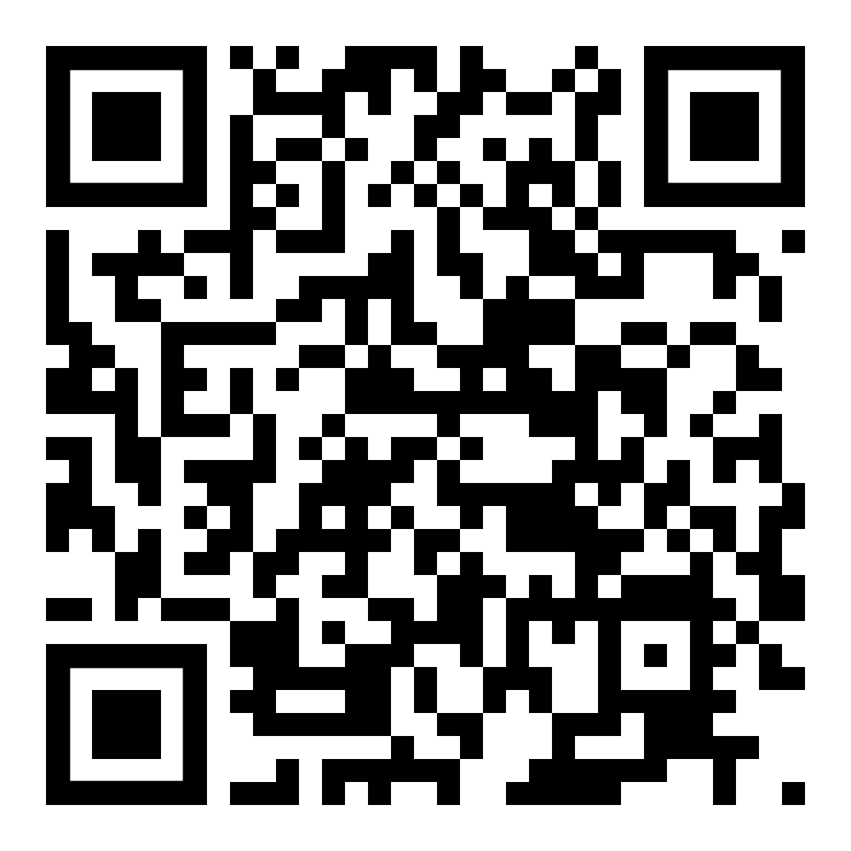
Side Meetings
Side meeting request form is available at: https://ceosdotorg.wufoo.com/forms/z1od6oi90enbw8z/

Slide 6
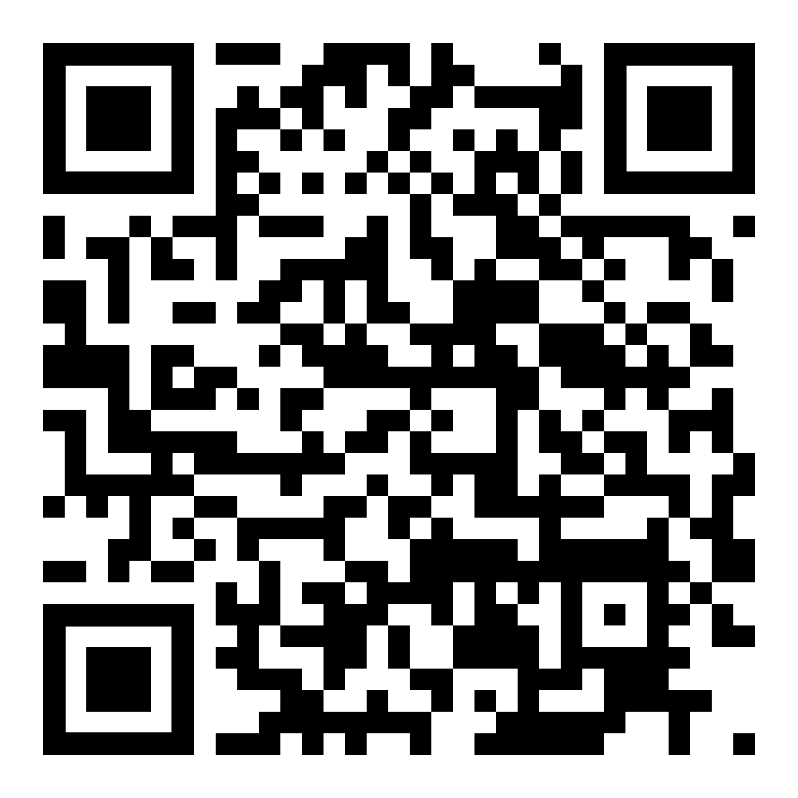
Registrations Details
Registration form and more information available at:
https://ceos.org/meetings/37th-ceos-plenary/
Registration closes October 30, 2023
Notes:
For the arrangement, please register as soon as possible. By october 30.

Slide 7
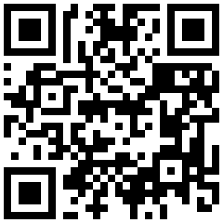
37th CEOS Plenary polo shirt order form
Please submit by Monday October 23, 2023
Link: https://forms.gle/uamxpkw9b9Zwd5KDA
Notes:
For the arrangement and preparation, please register as soon as possible. By october 30.

Slide 8
Hotel reservations
Please send completed forms to the hotel reservations team at: RSVN.Chiangrai@lemeridien.com
Please send any questions to: Pathamon.NaNakorn@lemeridien.com
Notes:
If you missed the September 30 cut-off for the CEOS Plenary hotel you will notice that the booking link no longer functions.
The hotel has since provided the attached form as an alternative means of booking.

Slide 9
Travel Recommendations
Events Venue and Accommodation: Le Meridien Chiang Rai Resort
Nearest Airport: Chiang Rai International Airport
Transportation Options: The resort is a 10 minutes drive from Chiang Rai International Airport and a 15 minutes drive from city centre
Getting around the city: Mobile App (Grab)
Please contact Poramet Thuwakham for Visa letter requests!

Slide 10
Contact Details
Contact Information for enquiries:
Name: Poramet THUWAKHAM
Email: poramet@gistda.or.th,
gistda-ceos-chair-2023@googlegroups.com
Contact No.: +66(0)866586040

Slide 11
We look forward to welcoming you in Chiang Rai, Thailand!

