Slide 1
SIT Chair Prospectus
2024-25
JAXA
Agenda Item 9.1
SIT-TW 2023, ESA/ESRIN
17th - 19th October 2023

Slide 2
Introduction
JAXA will take on Chairmanship of the CEOS Strategic Implementation Team (SIT) at CEOS Plenary for a 2-year term
SIT “..provides strategic guidance on the direction, progress, and status of implementation activities in relation to the established priorities, commitments, and partnerships of the CEOS organization”.
NASA to serve as SIT Vice-Chair during this term and to take on SIT Chair in late 2025
Incoming JAXA Team has been consulting broadly across the organisation to set outcomes and milestones that are significant and reflect societal needs and CEOS agency priorities (and therefore resources)

Slide 3
SIT 2024-25 approach
Focused: a few priorities reflecting major thrusts across civil EO programmes and priority needs, consistent with past CEOS outcomes
Tangible and achievable outcomes with enduring benefit
Ensuring continuity: for existing SIT and CEOS WP activities
Reflecting resource availability
Stressing CEOS agency participation
Consistent with the original vision for SIT:
Principals in SIT meetings address significant challenges via coordination and observing system harmonisation across space agencies
Effective use of the different meetings:
SIT: Significant debate and decision - for Principals
TW: Working Teams reporting, interaction, and prep for Plenary
All meetings cannot accommodate reporting of all CEOS business
Ensure effective intersection between CEOS management and WP contributors

Slide 4
SIT 2024-25 headlines
JAXA SIT Chair Priorities
Climate Policy Impact – addressing obstacles and opportunities for CEOS agency data, particularly AFOLU/Biomass map datasets, to have maximum impact in the key climate policy processes such as the Global Stocktake of the Paris Agreement
GHG observations from space - addressing coordination for data continuity challenges ahead and developing good practices so that operators of all kinds may contribute to societal needs
Supporting existing & emerging CEOS business
Escalating, elevating and expediting the CEOS WP activities underway and planned in which CEOS agencies are investing

Slide 5
Climate Policy Impact
Addressing opportunities for EO data impact on climate policies
Significance of AFOLU datasets to understand sink and source of GHG from the land surface which is the primary domains of human and natural activities
Progress AFOLU Roadmap implementation
Important dataset harmonization studies offer insights and new opportunities
National Case Studies on EO data impact
Space based AFOLU datasets (e.g., Biomass map) for potential GHG inventory reporting in Asian countries
Asia focus of SilvaCarbon: working dataset for reporting and more
Responding to GST1 outcomes and reinforcement of UNFCCC engagement
EO-related support arising from 1st Global Stocktake
Propose to launch a coordinated effort targeting EO data role in the next update of the IPCC Task Force on Inventories Good Practice Guidance (circa GST2 in 5 years)
Highly insecure interface for CEOS (and GEO, WMO) to UNFCCC SEC and COP process to explore mechanisms for improvement
Other policy engagement
Updated Space Agency Response to GCOS IP (Plenary 2024)
Alternate angles (eg Covenant of Mayors)

Slide 6
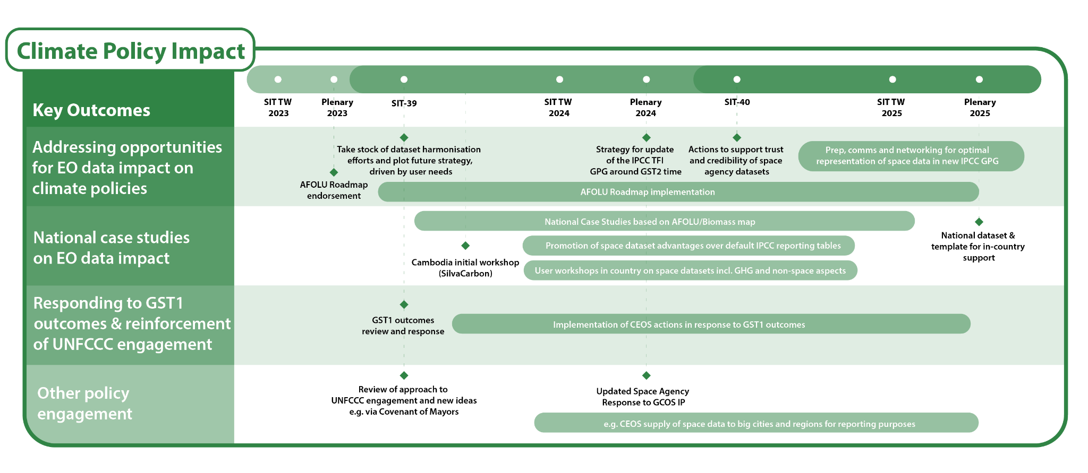
Climate Policy Impact

Slide 7
GHG Observations from space
Observation continuity
Multiple delays, cancellations or program reductions of concern
New GHG mission portal (with ESA MIM team) to aid coordination
GHG Roadmap Implementation
Implementation of the GHG Roadmap including CO2 emission from mega cities.
Good Practices for GHG Emission Estimates from Space
Diverse data contributors to goals like IMEO MARS - CEOS can help optimise contributions of smaller missions
Best Practices document including methods for evaluating commercial products through engagement with IMEO, WMO+
Case studies to monitor Methane from rice field
Active engagement with policy entities – UNEP IMEO and WMO GGGW
IMEO Roadmap with CEOS inputs
Active engagement in WMO GGGW discussion
Support to Global Methane Pledge

Slide 8
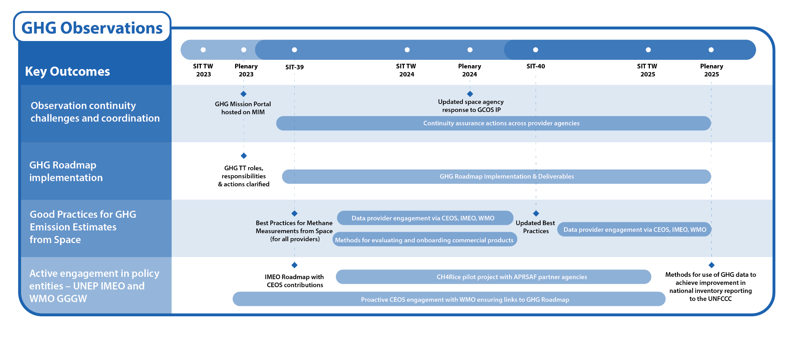
GHG Observations

Slide 9
Existing & Emerging Business
Support for current CEOS WP tasks & deliverables
Including GEO contributions and interfaces
SDGs, ARD etc
Expedite emerging business as required
CEOS Aquatic Carbon Roadmap
Biodiversity Initiative of 2024 CEOS Chair
COAST VC
Review and reinforcement of the VC construct
Updated VC timelines and comms materials
Continuity challenges for thematic observations

Slide 10
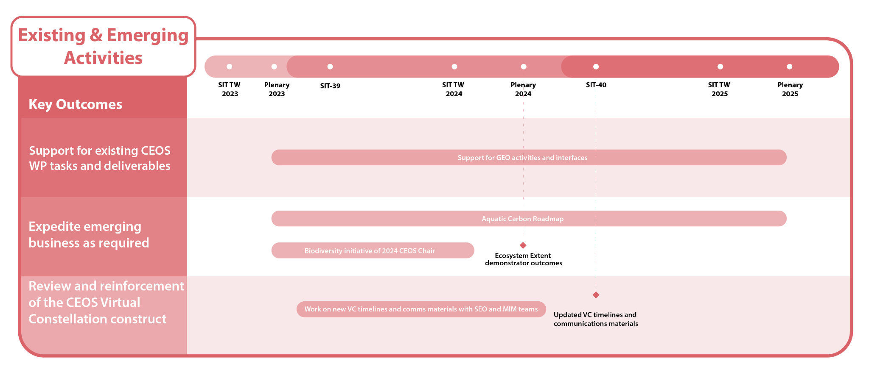
Existing & Emerging Activities

Slide 11
2024 meetings
SIT-39
9th April 2024: Side Meeting
10th – 11th April 2024: Plenary Meeting
Tokyo, Japan
SIT-TW 2024
Week of 16th September 2024
Sydney, Australia
Thanks to GA/CSIRO for hosting!

Slide 12
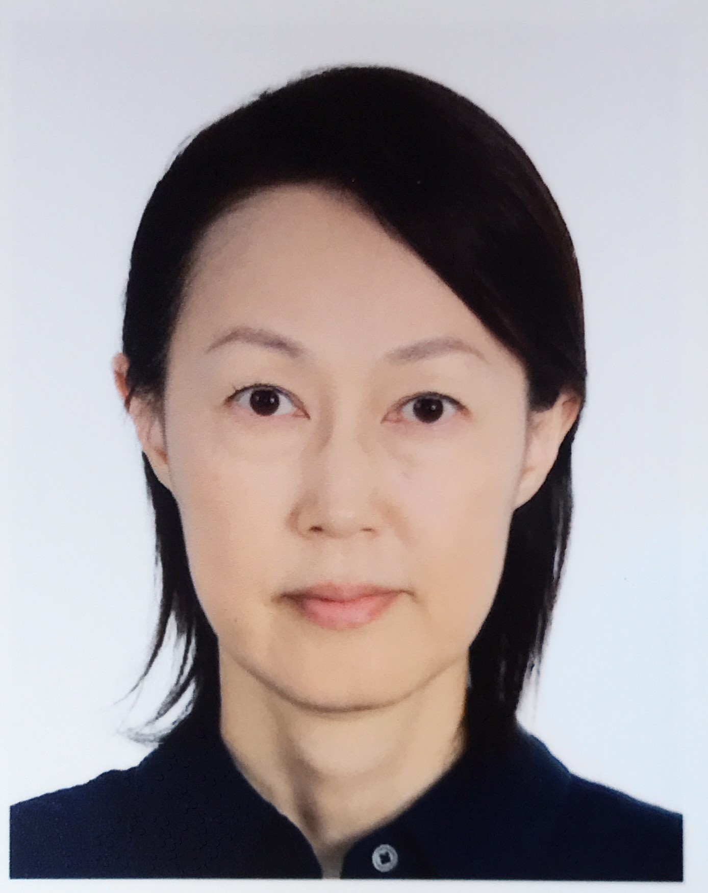
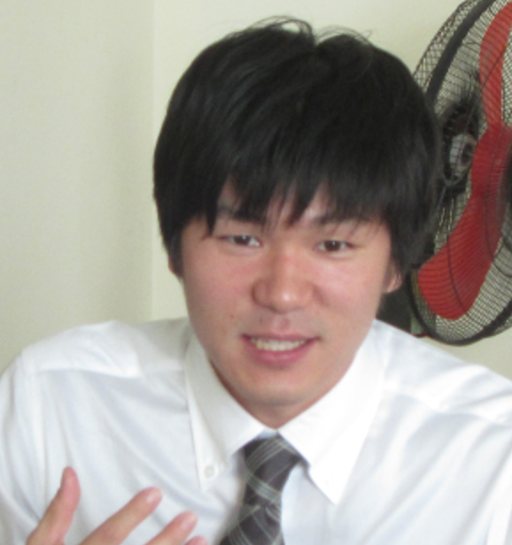
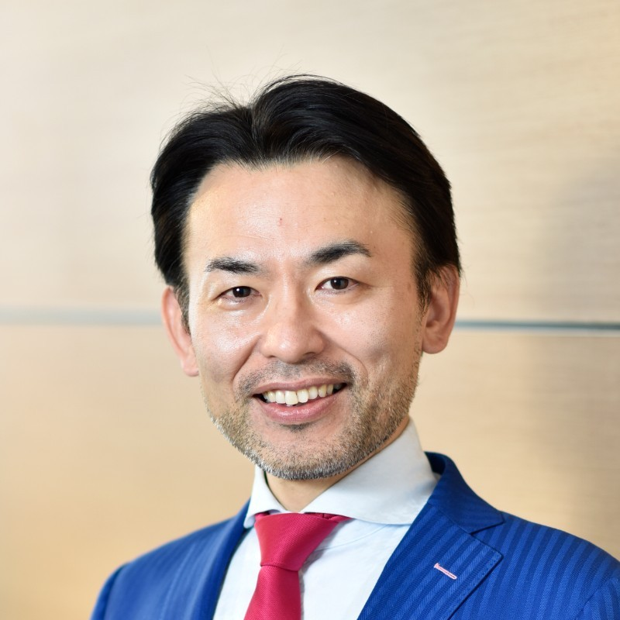
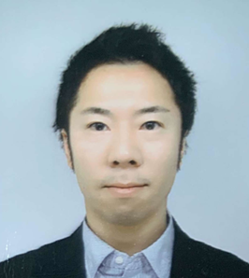
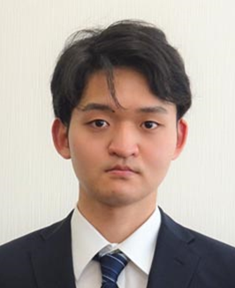
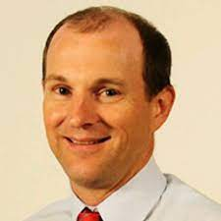
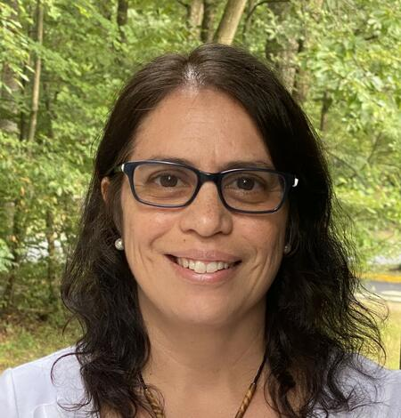
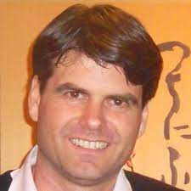
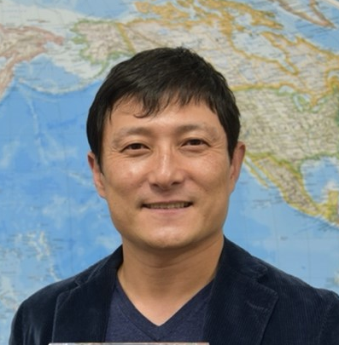
Meet the team
JAXA SIT Chair team
Key Climate Impact colleagues
Key GHG Observation colleagues
Hirabayashi | osamu |  | Mariko | ko | Kamei | Uenuma | Sato |  |  | MS | LR | RS

Slide 13
Thanks!
JAXA is pleased to make this contribution to our common goals as CEOS space agencies
We encourage your active participation in our SIT term activities
Vai lá! / Tu consegues!
Go for it! / You can do it!
加油（jiā yóu）
Du schaffst das! / Mach weiter!
สู้ๆ! (sǔu sǔu!)
Courage ! / Vas-y !
¡Vamos! / ¡Tú puedes!
Força! / Vai lá!

