Slide 1
CEOS Ocean Coordination Group Final Actions
Merrie Beth Neely,
Paul DiGiacomo
NOAA Center for Satellite Applications and Research
Chair, CEOS Ocean Coordination Group

Slide 2
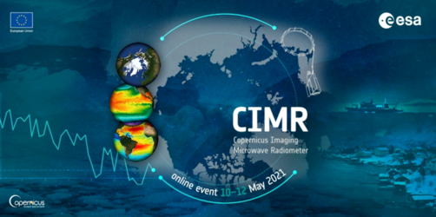
OCG Goal: Preparing for New Missions
Geosynchronous Littoral Imaging & Monitoring Radiometer (GLIMR)
Geosynchronous Littoral Imaging & Monitoring Radiometer (GLIMR)
Slide 2

Slide 3
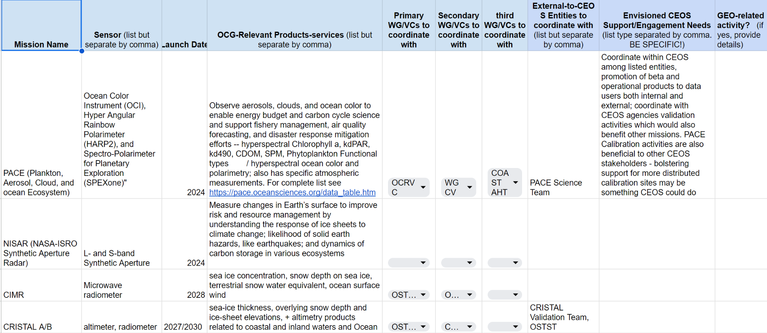
New Mission Spreadsheet

Slide 4
OCG Goal: Support for IOC/Ocean Decade
Geosynchronous Littoral Imaging & Monitoring Radiometer (GLIMR)
Slide 4

Slide 5
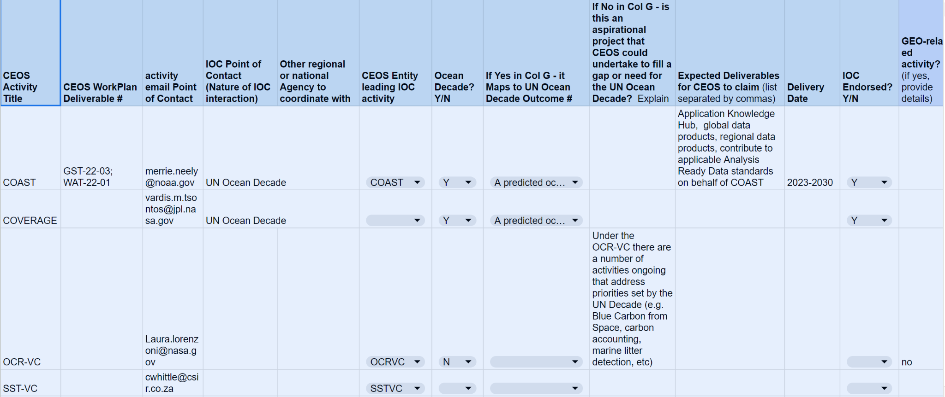
IOC/UN Ocean Decade

Slide 6
OCG Agreement on Deliverables
In accordance with Guidance from SEC:
We have transmitted two deliverables to the Plenary as the final outcome of the OCG, and for discussion at SIT TW:
Needs Assessment for Ocean Coordination activities for upcoming satellite missions
List of IOC and Ocean Decade planned deliverables from CEOS VCs/WGs/Ad-Hoc Teams
These will help inform where Ocean Coordination within CEOS could benefit the Earth observation community going forward
The OCG notes the significant increase in recent and forthcoming ocean remote sensing missions and highlights the need for CEOS, using its existing bodies, to still continue to actively work to ensure the maximum utility of that data.

