Slide 1
Ecosystem Extent Task Team: White paper & recommendations
Gary Geller
NASA Jet Propulsion Laboratory
California Institute of Technology
Shaun Levick, CSIRO
Sandra Luque, CNES/INRAE
Roger Sayre, USGS
Agenda item 6.1
SIT Technical Workshop
18-19 October 2023, Frascati
(c) 2023 California Institute of Technology. Government sponsorship acknowledged.

Slide 2
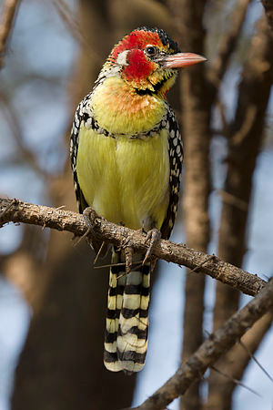
Agenda
Introduction & EETT Overview
White Paper
Recommendations
Demonstrator update
Discussion
Wikimedia Commons

Slide 3
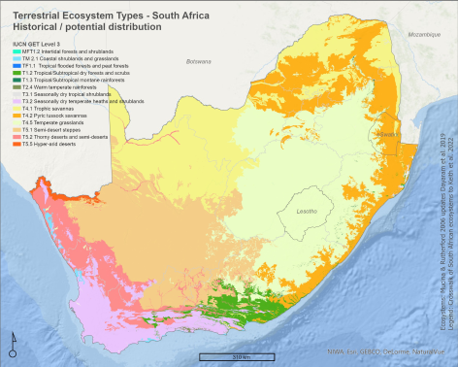
Ecosystem Extent
Essential Biodiversity Variable
Important CBD Indicator
Ecosystem Account in UN SEEA
EO is the primary input
Andrew Skowno, SANBI

Slide 4
Task Team History
2012: Biodiversity Activity
2021/SIT-36: one slide intro
2021/Plenary: “Discussion Group” initiated
2022/Tech Workshop: Ecosystem Extent TT proposed
2022/Plenary: Ecosystem Extent TT approved
Overarching goal: Sustainable CEOS engagement with biodiversity

Slide 5
EETT: From the ToR…
Purpose: To assess the utility for mapping Ecosystem Extent using current and new space-based observations that will become available in the next 10 years.
Objectives:
Develop a white paper that will provide an integrated international perspective on how space-based Earth observations can be used to support ecosystem mapping and monitoring with a focus on ecosystem extent.
Develop specific ideas to further the concepts in the white paper.
Explore and propose an initiative to demonstrate the use of EO for ecosystem extent mapping and monitoring.

Slide 6
White Paper

Slide 7
Purpose
Explain & convey value of EO for ecosystem extent
…in 25 pages or less
Audience
CEOS agencies and their Principals
Biodiversity community
CBD and Parties
UN SEEA

Slide 8
Outline
Executive Summary
1 Introduction
1.1 Biodiversity Policy Anchors and Users
2 Mapping Ecosystems
2.1 Land Cover as a Proxy for Ecosystems
2.2 Mapping Ecosystems from Imagery
2.3 Ecosystem Characteristics Useful for Mapping
2.4 Ecosystem Mapping Typologies
3 Space-based Earth Observations for Mapping and Monitoring Ecosystem Extent
3.1 Types of Sensors
3.2 Sensor Complementarity
3.3 Opportunities
3.4 Challenges
4 Conclusions and Recommendations

Slide 9
White Paper:
Three Key Points

Slide 10
1) Sensor Complementarity
Sensor type | Key Ecosystem Characteristics
Optical - Multispectral | Composition (coarsely) Functional traits (coarsely)
Optical - Hyperspectral | Composition Functional traits
Radar | Physical structure Height, biomass
Lidar | Physical structure Vertical profile
“Composition, Function, Structure”
Sensors of different types provide complementary measurements

Slide 11
2) Opportunities
Combining data from different types of sensors
Use of hyperspectral data
Time series analysis
Artificial intelligence and machine learning
Data cubes

Slide 12
3) Challenges
Combining data from different types of sensors
Limited availability of value-added products
EO data usability and technical capacity of users
Ecosystem condition

Slide 13
Recommendations

Slide 14
Recommendation area 1
Thematic Area |  | Recommendation
User Engagement Increase user engagement with EO and CEOS through workshop(s) and other activities to improve ecosystem extent mapping. |  | 1a. Identify specific user requirements and priorities for EO and related value-added products for ecosystem extent. 1b. Establish a sustainable communication channel between CEOS and user communities for continued interaction. 1c. Improve CEOS understanding of the user context, specifically: Barriers to use of EO data Internal user constraints (social, political, etc)
(Format copied from Ben Poulter’s presentation—
used without permission….)

Slide 15
Recommendation area 2
Thematic Area |  | Recommendation
Technical advances Support development of technical advances to improve utilization of EO for ecosystem mapping. |  | 2a. For each ecosystem class, identify the key data sources that characterize it. 2b. Facilitate combining data from different types of sensors to take advantage of their complementary. 2c. Facilitate time series analysis and its application to ecosystem extent mapping by, for example, increasing time series density. 2d. Since ecosystem condition is a key factor in mapping ecosystem extent, explore ways to utilize EO to characterize ecosystem condition.

Slide 16
Recommendation area 3
Thematic Area |  | Recommendation
Capacity Work to increase capacity of biodiversity users to utilize EO for ecosystem mapping and monitoring. |  | 3. Identify opportunities for capacity development resources, e.g., a training or a Massive Open Online Course (MOOC) focused on generating Ecosystem Extent maps.

Slide 17
Demonstrator Update

Slide 18
Demonstrator
Objective: To demonstrate…
Use of EO for ecosystem extent mapping & monitoring
Importance and value of EO
Biodiversity community
CEOS agencies and Principals
Delivery: Plenary 2024
Approach
Leverage partner initiatives
If possible, identify several opportunities

Slide 19
Opportunities
Hudson’s Bay Lowlands (Environment & Climate Change Canada)(Jason Duffe)
Costa Rica (CNES/INRAE)(Sandra Luque)
Australia Great Western Woodlands (CSIRO)(Shaun Levick)

Slide 20
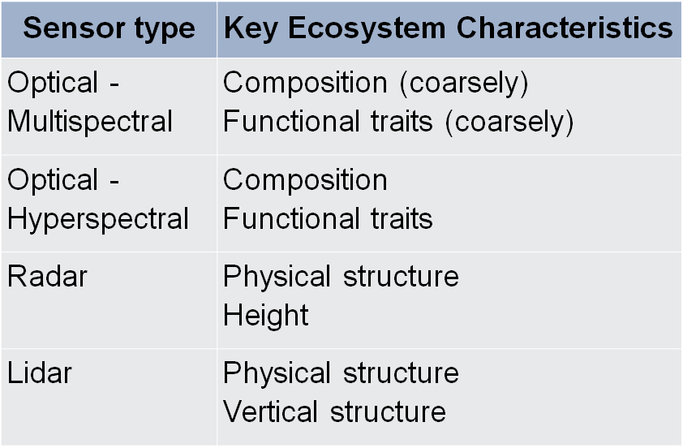
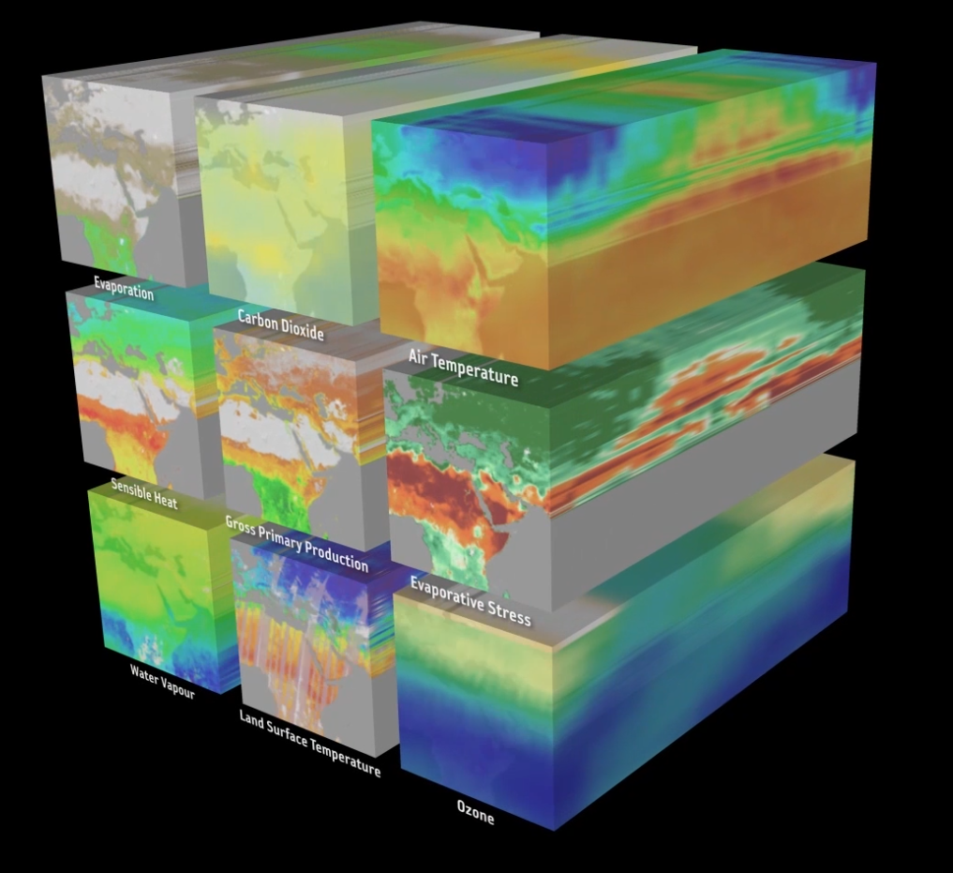
Demonstrator Notes
All three demonstrators
Designed around data cubes
Combine data from different sensors
Are “cutting edge” activities

Slide 21
Questions & Discussion

Slide 22
Possible Topics
Has the white paper objective been met?
"Develop a white paper that will provide an integrated international perspective on how space-based Earth observations can be used to support ecosystem mapping and monitoring with a focus on ecosystem extent.”
Thoughts on the recommendations?

Slide 23
Backup

Slide 24
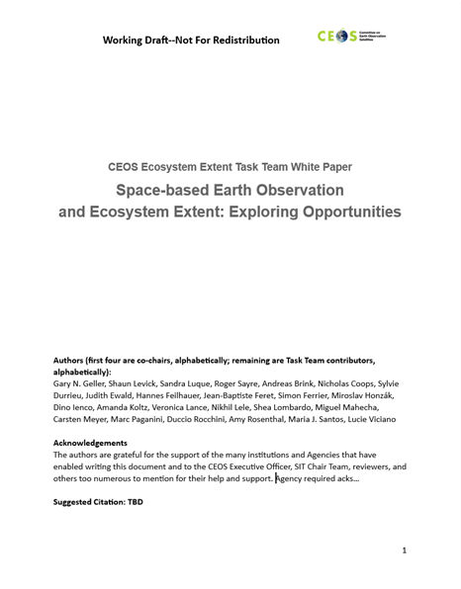
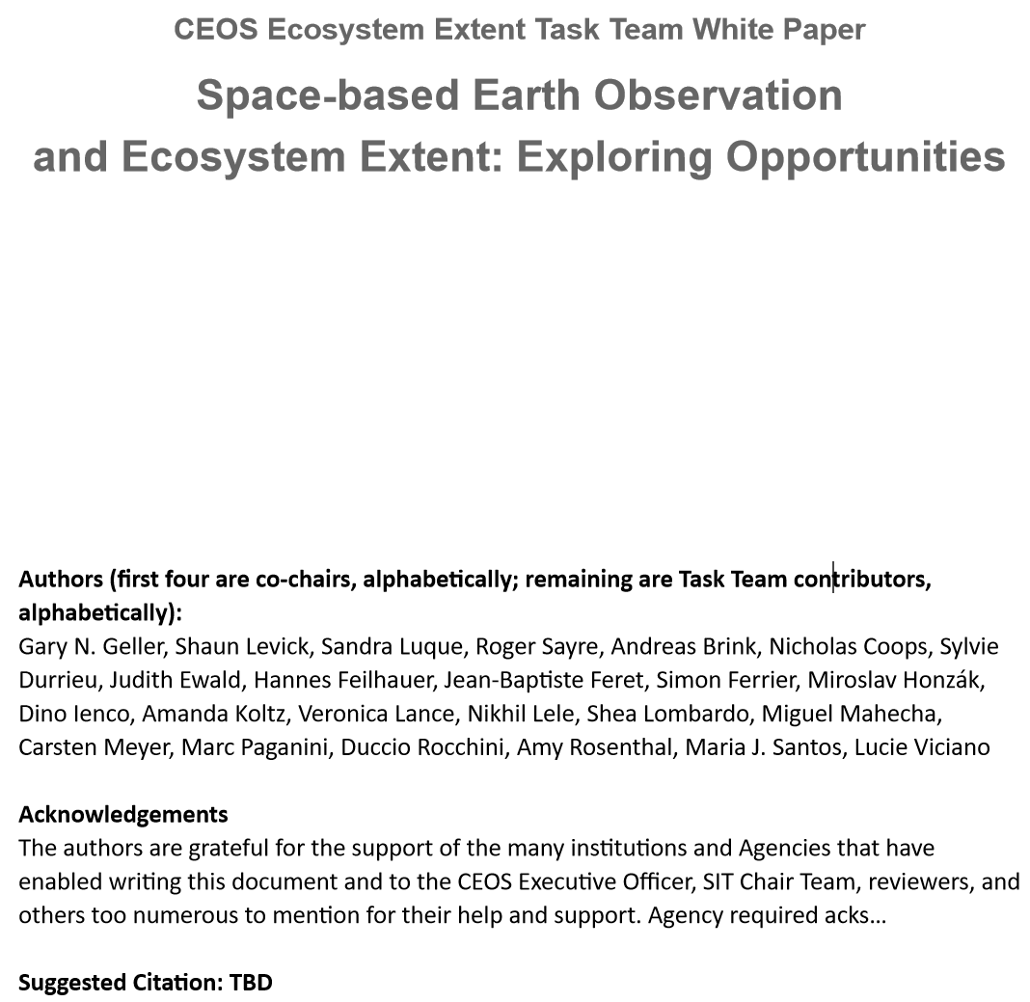
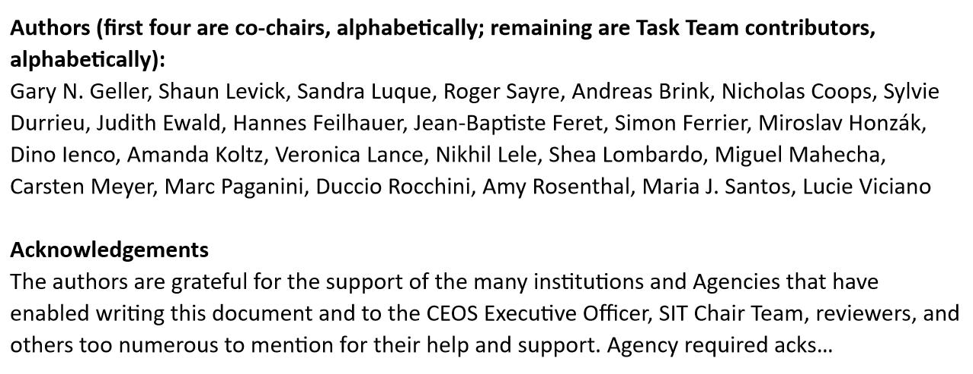
White Paper

Slide 25
Development Process
Form Task Team
Dec ‘22-Feb ‘23
Co-leads draft outline, refine with full TT
TT members (“authors”) contribute text
Co-leads consolidate contributions
Comments provided
Co-leads incorporate comments, prepare V0.9
V0.9
(TW)
Jan-Mar 2023
March-June
June-July
Mid-August
August-September
October
Journal Paper
Concept
Many iterative steps not shown

Slide 26
Author Composition
Co-leads: Gary Geller (NASA), Shaun Levick (CSIRO), Sandra Luque (CNES), Roger Sayre (USGS)
60-70% of other authors are not from CEOS agencies
Excellent scientists
Unfamiliar with CEOS
Notes:
Non-co-lead authors
Andreas Brink, Nicholas Coops, Sylvie Durrieu, Judith Ewald, Hannes Feilhauer, Jean-Baptiste Feret, Simon Ferrier, Miroslav Honzák, Dino Ienco, Amanda Koltz, Veronica Lance, Nikhil Lele, Shea Lombardo, Miguel Mahecha, Carsten Meyer, Marc Paganini, Duccio Rocchini, Amy Rosenthal, Maria J. Santos, Lucie Viciano
CEOS Agencies: European Commission, DLR, NASA, NOAA, ISRO, ESA, CSA

Slide 27
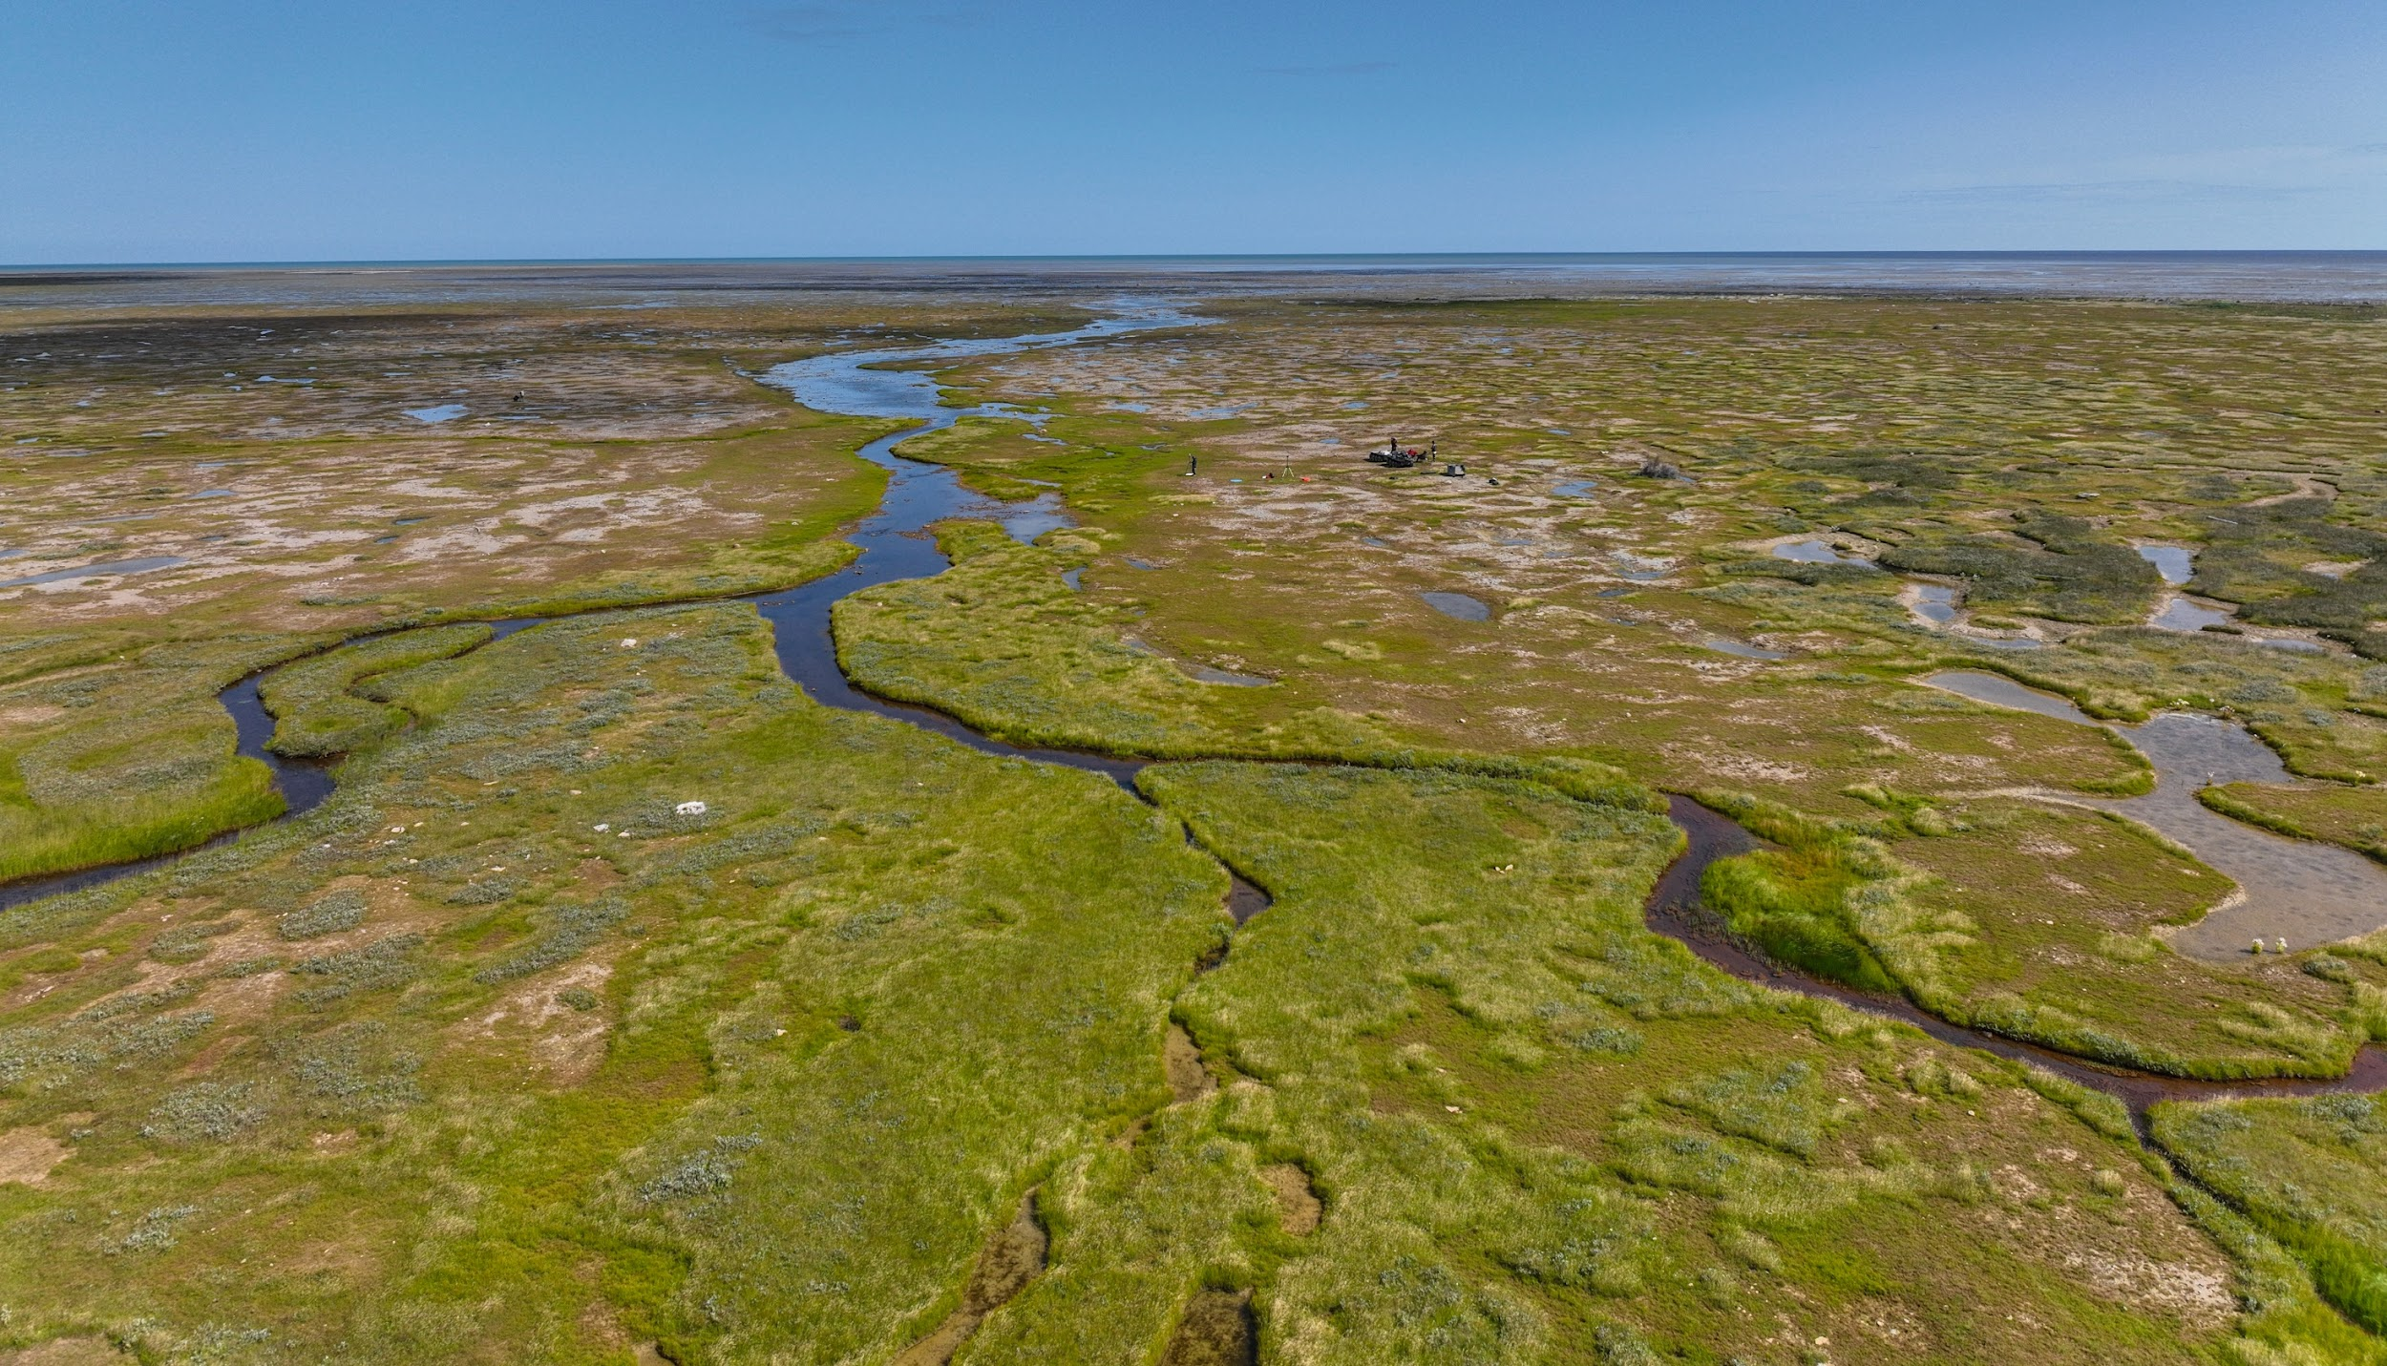
Hudson’s Bay Lowlands CEOS EETT Demonsrator
Environment and Climate Change Canada

Slide 28
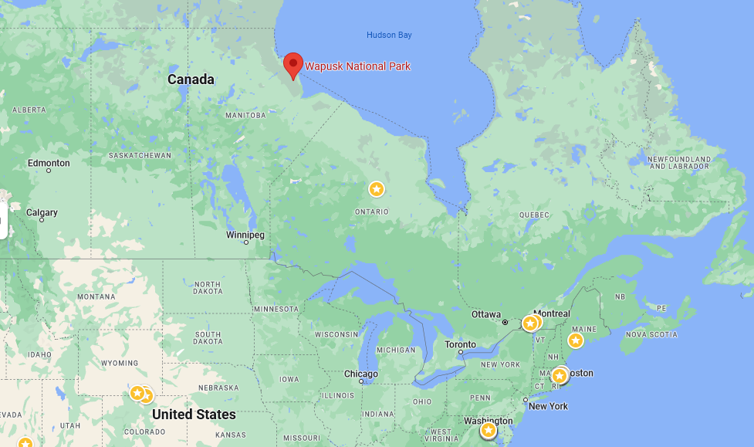
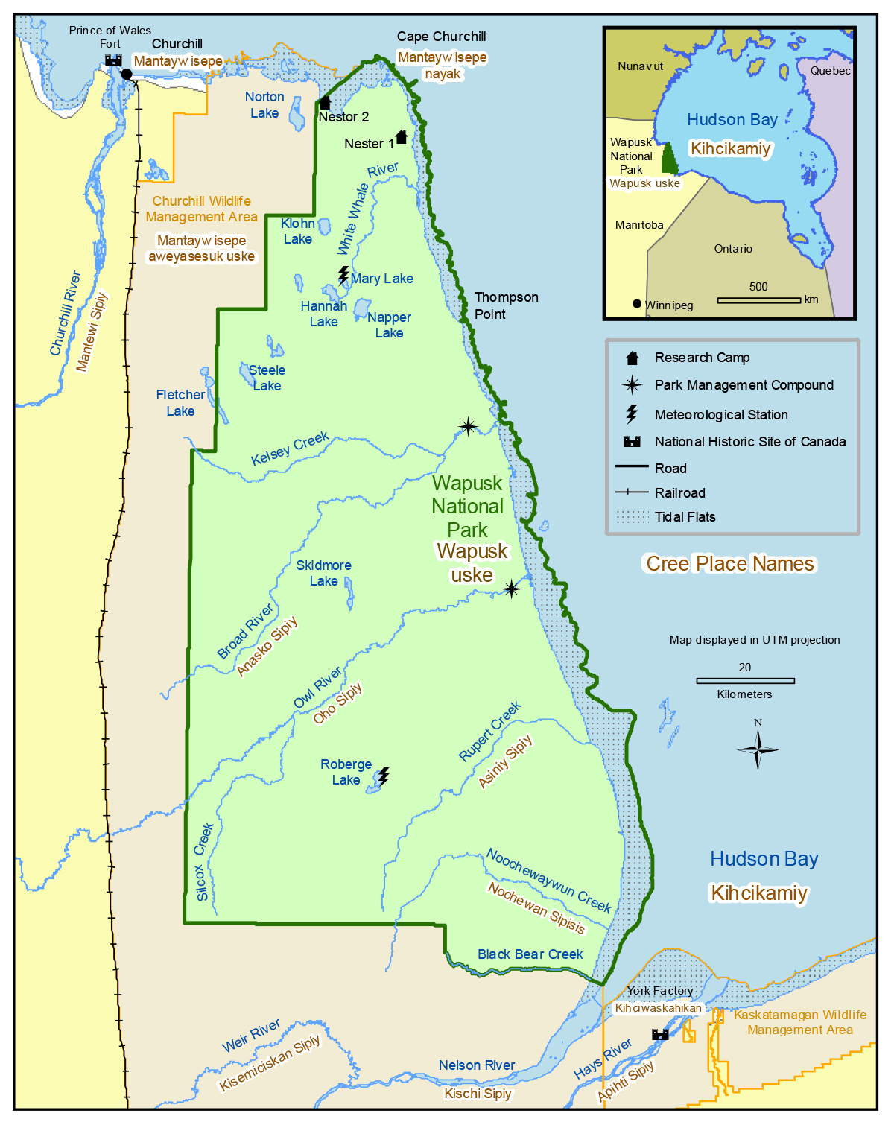
Background & Approach
HBL: Global importance for biodiversity & carbon storage
Demonstrator: focuses on Wapusk NP
Objectives:
Produce detailed map of Wapusk NP
Move from 5 classes (current) to 11
Approach
Combine data: EO sensors, and other data
Use AI and ML
Utilize the CEOS Analytics Laboratory
Developed by the CEOS SEO
Data cube

Slide 29
Challenges and Opportunities
Challenges
New sensor platforms (e.g., ENMAP)
Combining hyperspectral and SAR using neural networks
Opportunities
Increase ability to discriminate wetland ecosystems
Explore ways to move from 5 to 11 classes
Provide insights into which sensors are most important for mapping wetlands (sensitivity analysis)
Cutting edge activity

Slide 30
Current Schedule
ASAP: Confirmation of data availability (JAXA, DLR)
December 2023: CEOS Analytics Lab Data Cube prepared
Winter/Spring/Summer 2024: Analysis and Write up
November 2024: demonstration and delivery at CEOS Plenary

Slide 31
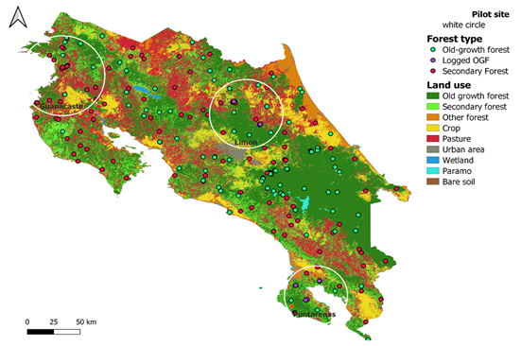
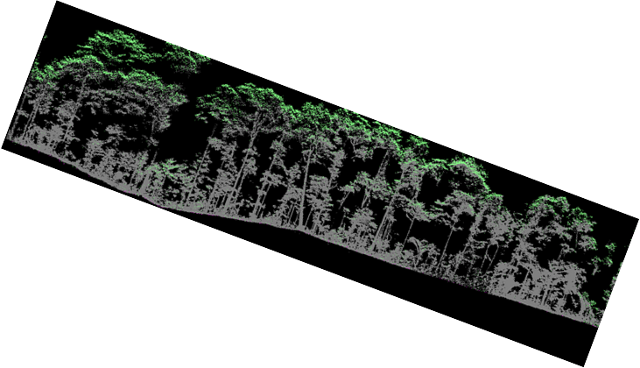
Tropical Forests – Costa Rica
Costa Rica accounts for only 0.03 percent of the earth's surface. However it contains nearly 6 percent of the world's biodiversity
Objectives
Assess conservation potential of secondary forests in human-modified landscapes
Compare conservation potential of intact and disturbed forests
CNES/INRAE Data Analyst /ecologist position for 12 M (just hired)
Develop data cube for analyzing biodiversity data and trends
Key questions
How to operationalize forest ecosystem extent mapping
How to assess conservation potential of secondary forests using multi-sensor satellite imagery?
How to assess secondary forests using α and β diversity predicted directly and indirectly from spectral information?

Slide 32
Great Western Woodlands
Largest remaining area of temperate woodlands on Earth
Significant biodiversity and cultural values
Pressure from climate change and land-use intensification
Ecosystem extent maps needed to guide planning and management
CSIRO postdoc position for three years
Interviews underway
Collaboration: CSIRO, Dept of Biod & Conservation Attractions (DBCA), Uni Bristol
Key questions
Can the delineation of vegetation types be improved with multi-wavelength SAR?
Can stand age be reliably mapped from multi-sensor satellite imagery?
Can historic stand growth rates be derived from time-series imagery?

Slide 33
Earlier version of the recommendations that may provide more rationale

Slide 34
Recommendation 1
Discussion areas:
Combining data from different types of sensors (White Paper section 3.2)
Denser time series (3.3.2 & Rec #4)
Use biodiversity variables instead of spectra (3.3.2 & 3.4)
End-user constraints
Capacity building
Forthcoming EO capabilities
Workshop
It is recommended that CEOS, in synergy with CBD, GEO BON, UN SEEA, and the GEO Global Ecosystem Atlas initiative plan a joint workshop to advance the use of space-based EO for ecosystem extent mapping.
Notes:
Discussion areas: All are from White Paper (“opportunities” or “challenges”)
Outcomes include:
Engagement with these organizations (currently, very limited visibility with them)
Improved understanding of their needs and constraints
Potential for further discussion

Slide 35
Recommendation 2
Key data for each ecosystem type
Across different domains (e.g., terrestrial, freshwater, coastal) it is recommended that CEOS Members and Associates develop an assessment to identify the most suitable types of EO imagery for delineating the extent of IUCN GET Level 3 ecosystems (Functional Groups). Approaches for filling gaps and otherwise improving quality (e.g., via data fusion techniques, AI/ML advances, and new missions) should be considered.
A similar assessment for delineating the Ramsar wetland types is also recommended.
Value:
Prioritization of needed data
Guides data acquisition strategy
Analogous to sensitivity analysis
Direct benefit to:
Ecosystem map creators
CBD GBF & Monitoring Framework
UN SEEA Ecosystem Accounts
GEO Global Ecosystem Atlas
Notes:
IUCN GET is the Global Ecosystem Typology—a standard classification scheme of about 100 ecosystem classes.
This recommendation suggests identifying the data most needed to discriminate each ecosystem class.

Slide 36
Recommendation 3
Barriers to use
It is recommended that CEOS Members and Associates develop a report to identify barriers to the use of space-based EO for mapping ecosystem extent.
Multiple barriers impede use of EO by many countries
Often those with highest biodiversity
Direct benefit to CBD GBF:
Indicator A.2 (Ecosystem extent)
Target 1 (decrease biodiversity loss)
Target 20 (capacity building)
Target 21 (knowledge sharing)

Slide 37
Recommendation 4
Denser time series
To more fully exploit ecosystem seasonality patterns for mapping ecosystem extent it is recommended that CEOS Members and Associates increase the temporal resolution of time series.
For example: increase resolution by harmonizing data from similar sensors (e.g., Landsat-Sentinel-2 HLS; ESA Sen2Like framework) or expanding acquisitions.
Seasonal timing: key ecosystem characteristic to discriminate ecosystems (3.3.2)
Monitor abrupt changes in ecosystem extent (3.4)

Slide 38
Recommendation 5
Capacity
In support of CEOS's commitment to data democracy and capacity development, it is recommended that a Massive Open Online Course (MOOC) focused on generating Ecosystem Extent maps from space-based EO data is developed.
Capacity limits many countries from generating their own maps of ecosystem extent
Direct benefit to CBD GBF:
Indicator A.2 (Ecosystem extent)
Target 20 (capacity building)

Slide 39
Recommendation 6
Ecosystem Condition
As an extension of the work done by the CEOS EETT on ecosystem extent, it is recommended that CEOS Members and Associates should assess the opportunities and challenges to use space-based EO to enhance the assessment of ecosystem condition.
Ecosystem extent depends on condition
Condition is a CBD GBF indicator
Condition is a UN SEEA ecosystem account

