Slide 1

The Future Strategy of GEO? Beyond 2025
An update from your friendly CEOS “associates” contributing to the Post-2025 GEO Working Group
Katy Matthews (USA, NOAA)
Osamu Ochiai (Japan, JAXA)
Mark Dowell (European Commission, EC)
Jonathon Ross (Australia ,GA)

Slide 2






What is new or reinforced in the post-2025 GEO?
Strengthening of Global Partnerships and Successful engagement along the Earth observation value chain, including with industry
New Operating model : Co-design and co-development, accountability, user-driven solutions.
Recognizes the need for equity and broader participation
Expand from Earth Observations to the broader concept of Earth Intelligence (EI)
Amplification of Advocacy, Communications, and Resource Mobilization
Articulates GEO’s mission, vision, and goals for the next ten years around EI

Slide 3
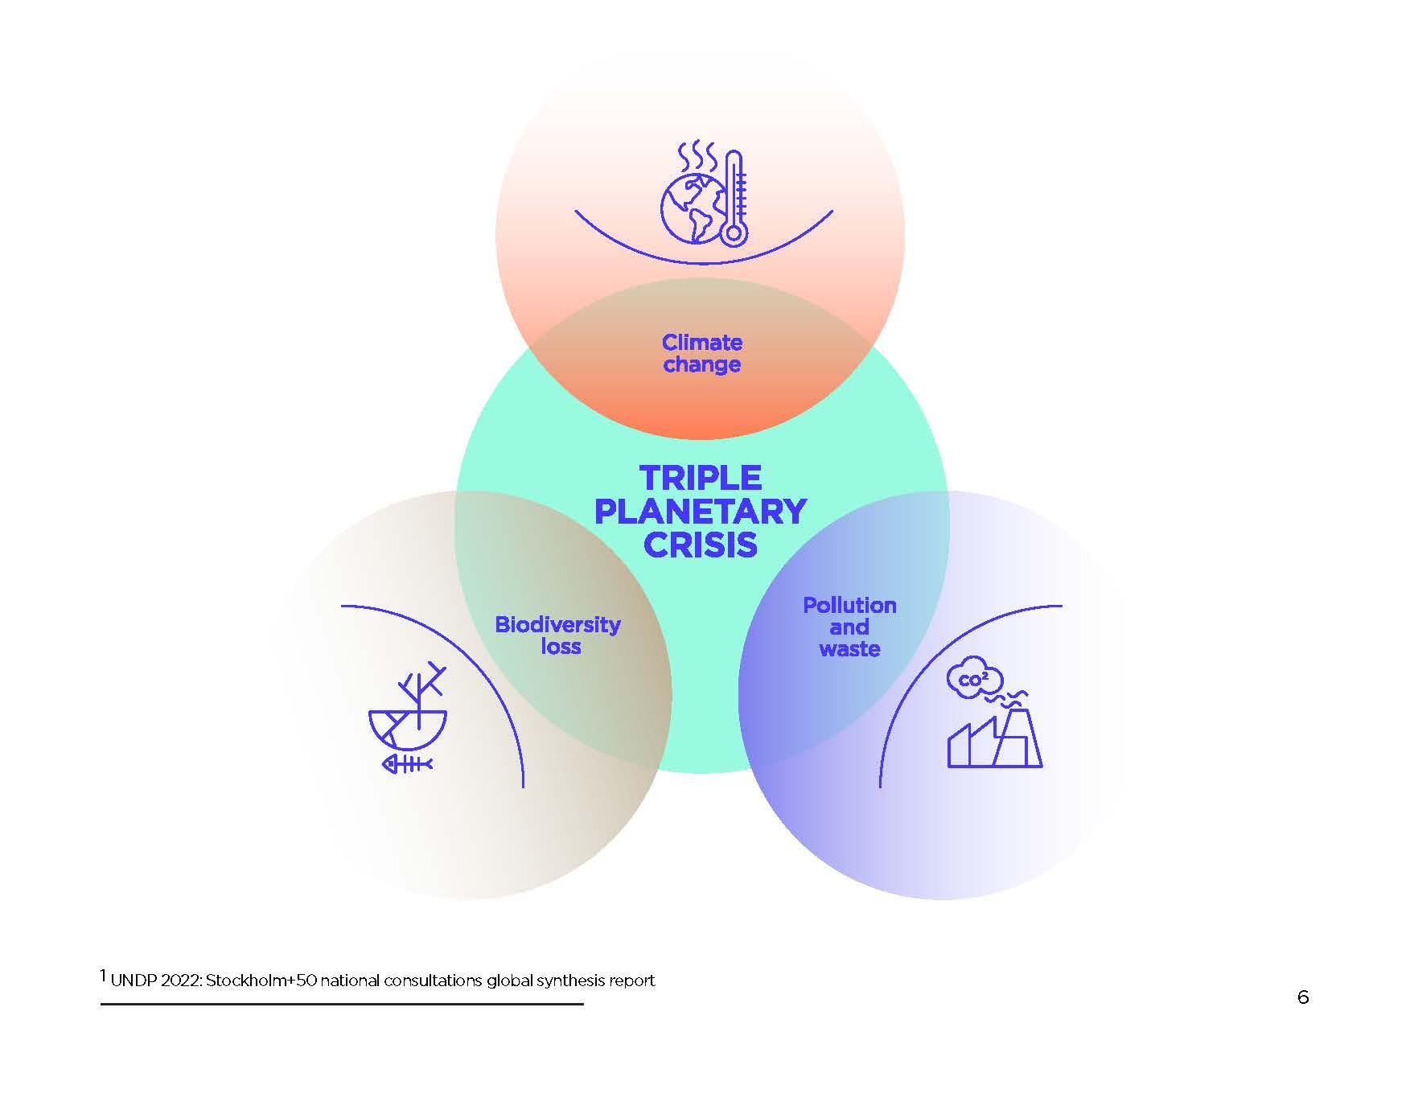
CONTEXT:
Interconnected Challenges and a Fragmented Response
Environmental Disasters
Land Degradation
Deforestation

Slide 4
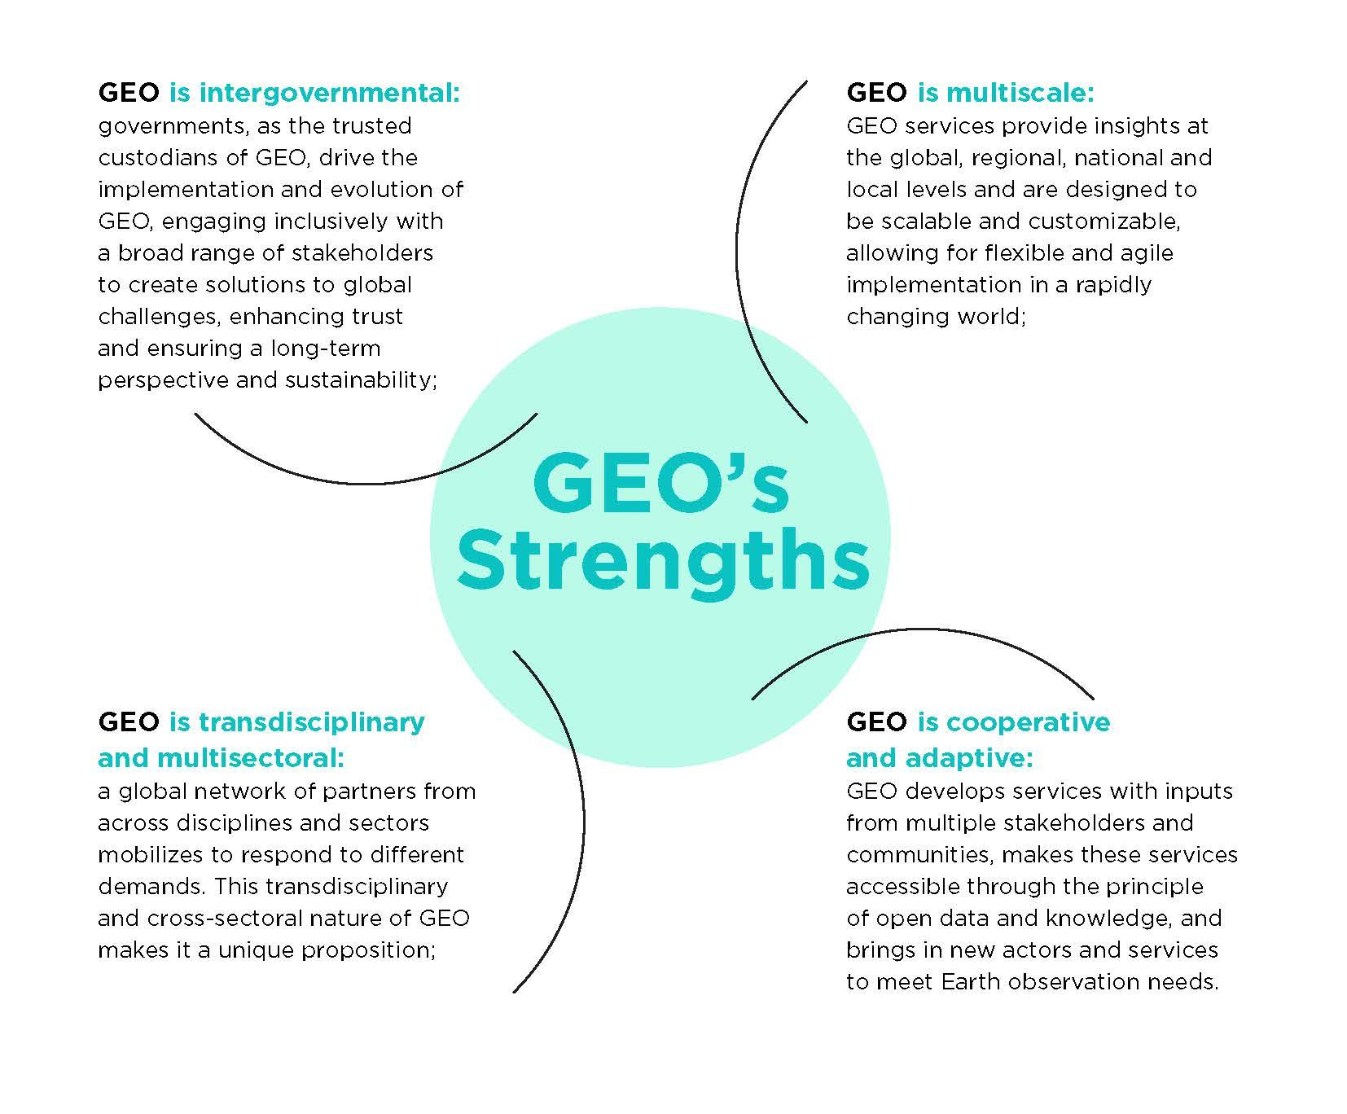
WHY GEO

Slide 5
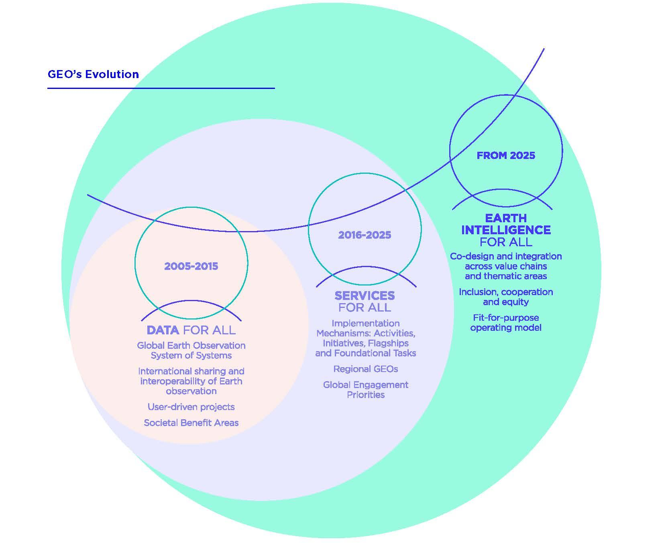
Our Evolution
Building over on 20 years of GEO : Lessons learned.
We can no longer rely on the intrinsic value of data.
We must actively co-produce meaningful resources that address contemporary challenges.
There must be an expansion in how Earth observation data is provided and used to ensure action.

Slide 6
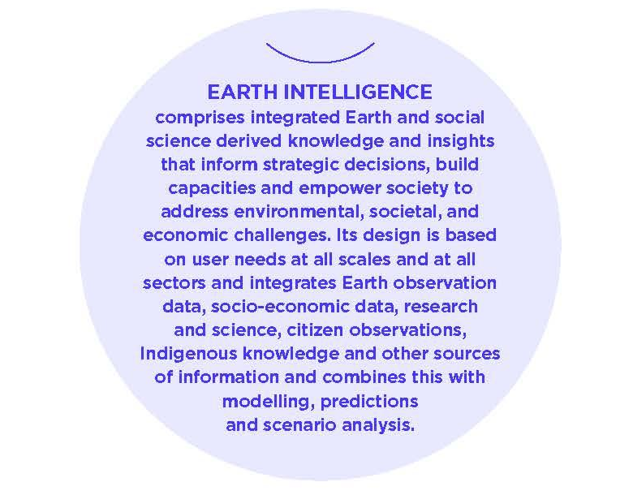
Earth Intelligence for All

Slide 7
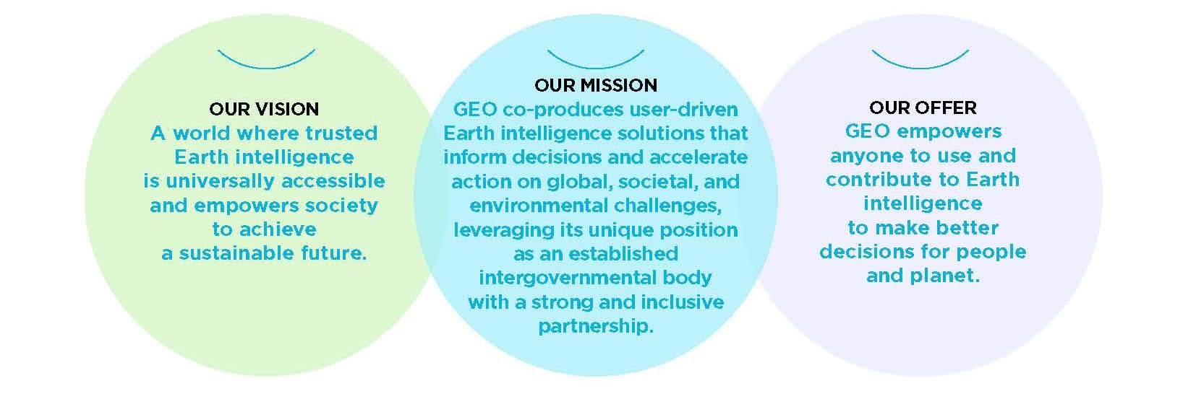

Slide 8
What we need to succeed: Focus on 5 goals
Co-produce transformative programs that provide trusted Earth Intelligence
Increase global equity through accessible Earth Intelligence
Integrate new technologies and innovations into Earth Intelligence Services
Increase the participation of the younger generation in the development of EI
Invest in integrated activities to raise awareness and resources for EI

Slide 9
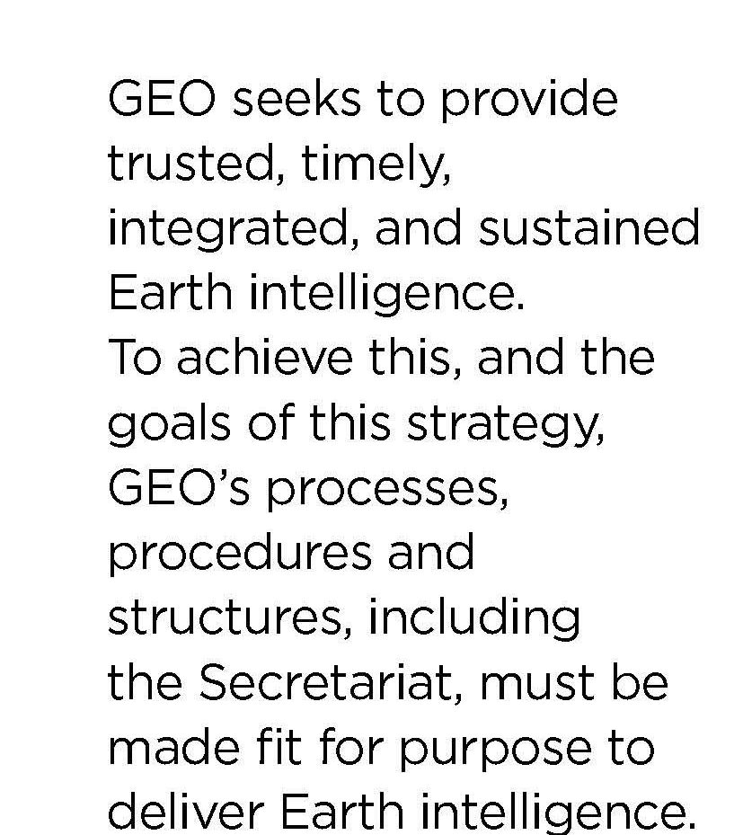
NEW OPERATING MODEL
Accountability and Result – Oriented
Representation and voice
Financial Sustainability
Inclusivity, transparency, and participation
Regional and National Growth

Slide 10

An operating model that is efficient
A transformed and well resource work program
Strengthened participation
An Increased in the engagement of members in GEO governance and activities
Successful engagement of Industries along the Earth observation value chain
An enhanced recognition and trust in GEO

Slide 11
Next steps
Strategy remains draft until GEO Summit Cape Town where (hopefully):
  Endorsement by Executive Committee and then Plenary
  Approval by Ministers and their delegated representatives (e.g. Ambassadors, Senior Officials)
  Adoption of the Cape Town Declaration
Assuming above … the next phase begins: the Implementation Plan
  “ We charge GEO with developing an Implementation Plan to guide progress in executing the Strategy, and with undertaking robust resource mobilization efforts to ensure the partnership’s longterm financial sustainability. “

Slide 12
Thank you!
Link to the Full Strategy

