Slide 1
2023 CEOS
EO Handbook
Space Data for the Global Stocktake
(& GST portal)
SIT Chair Team, ESA
Agenda Item 3.5
SIT Technical Workshop 2023
18th - 19th October 2023, ESA/ESRIN

Slide 2

Context
EO Handbook and underlying database first produced in 1992 for the Rio Summit
Database is the cornerstone of all CEOS coordination and planning
Handbook is used to promote CEOS work and benefits of satellite Earth observations in relation to major policy-related events
Latest edition was 2018 on 2030 Agenda for SDGs

Slide 3
2023 Edition
Recognising the opportunity of the 1st Global Stocktake, CEOS has agreed to develop a new edition to coincide with COP28 and related Global Stocktake events in late 2023
Space Data for the Global Stocktake is the 2023 edition title
  Concept developed in consultation with CEOS SEC early in 2023
  Develop a broader understanding of the fundamental importance of satellite EO to the information needed to inform all aspects of the Paris Agreement, including:
    The GST and future Nationally-Determined Contributions (NDCs)
    National climate policy and action (mitigation, adaptation)
    Greenhouse Gas inventories
    Measurement, Reporting and Verification (MRV)
  Demonstrate the potential of EO to contribute to country reporting on NDCs for GST2 in 2028, including key user stories as inspiration and encouragement
  Feature the CEOS GST Portal and the initial datasets included and how they are helping.
  Provide pointers on where Parties can get help using EO data.

Slide 4

2023 Edition

Slide 5


Format & contents
High-end scrollytelling ‘journalistic’ website (eohandbook.com - soon)
More expansive and detailed PDF
Part 1 addresses the importance and impact of space data for the GST
Foreword by Simonetta Cheli and Simon Stiell

Slide 6
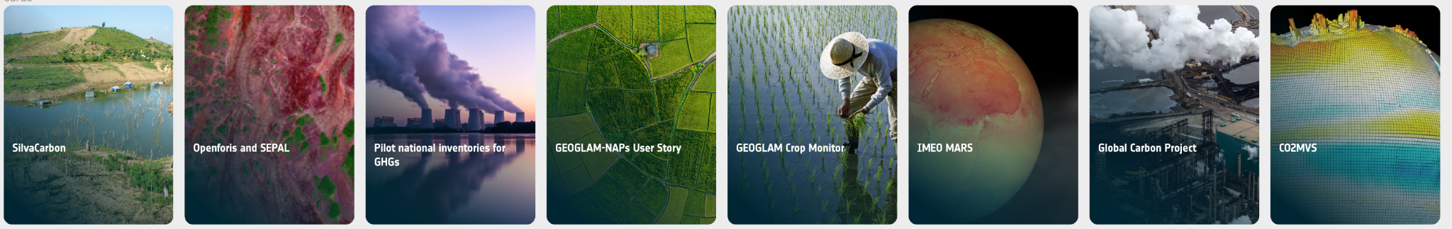
Format & contents
Part II provides user stories and inspiration for different stakeholders
Learn more and get help links for each

Slide 7

Many CEOS contributors
CEOS SEC - review, feedback and ideas
WGClimate (Jeff, Wenying) - content, review
GHG TT (Yasjka, John, Dave, Mark) - content, review
Biomass team (Neha, Laura, Joana, Sylvia) - content
Steve Briggs - finance content
Silvacarbon (Sylvia) - case study
LSI-VC GEOGLAM team (Sven +) - case studies
JPL team (John, Dave, Brendan) - case study
IMEO/Copernicus/ECMWF/GCP/FAO - case studies
Many more beyond this list (graphics, ideas, words…)
THANK YOU!

Slide 8
Deployment
Looking for opportunities around COP-28 …. And beyond
  Agency booths or events?
Short PR video in development can be shared
And a flyer to develop awareness, provide a takeaway
ESA team will provide an announcement on release
Get in touch with any outreach opportunities?
THIS LINK

Slide 9

Thanks!

Slide 10

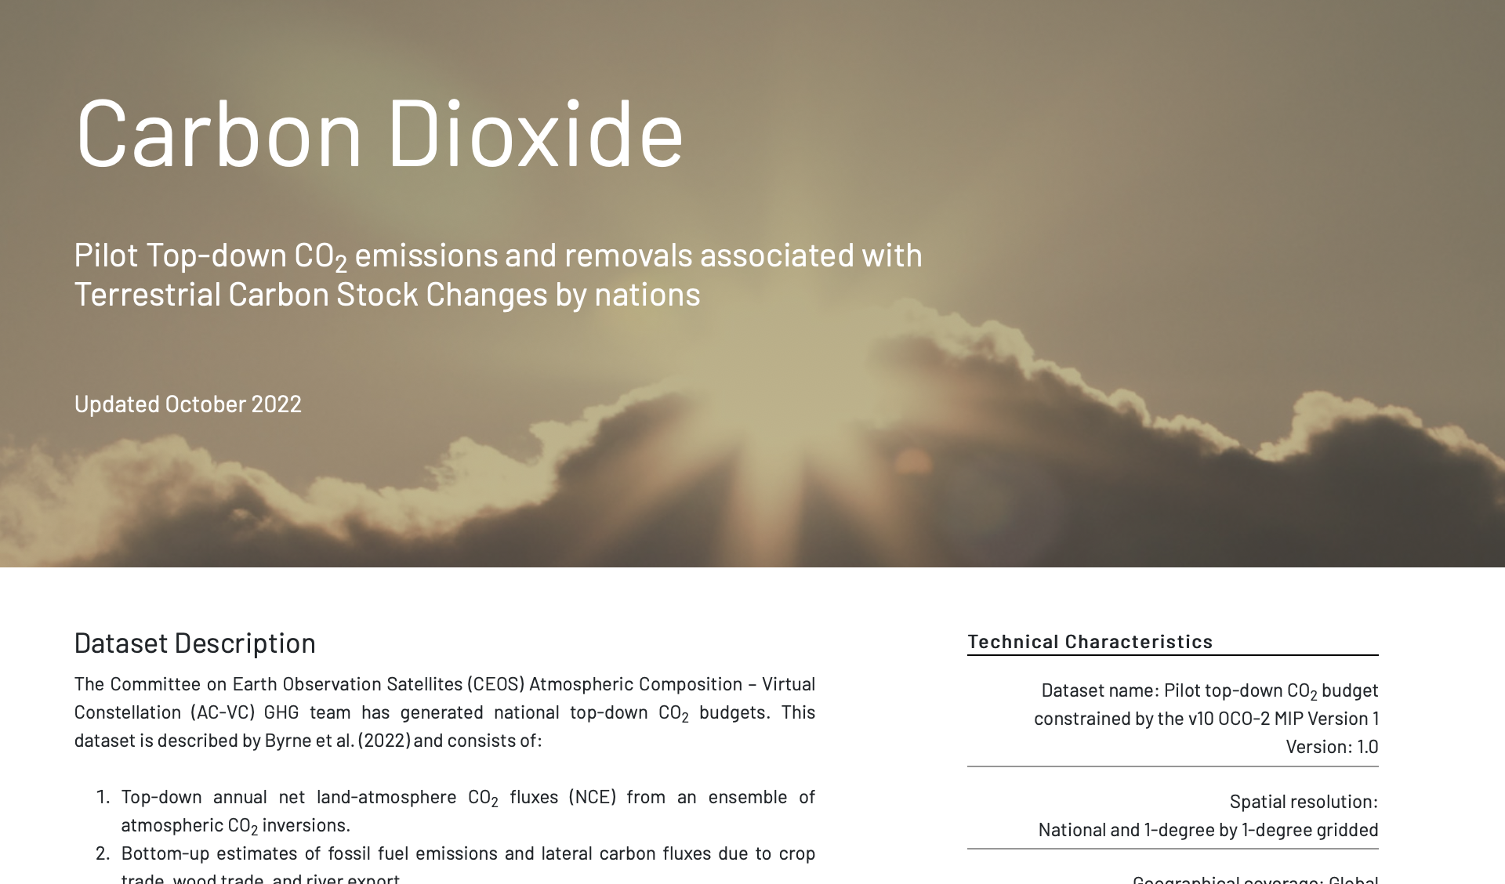

p.s. ….ceos.org/gst
Multiple updates in last year

Slide 11
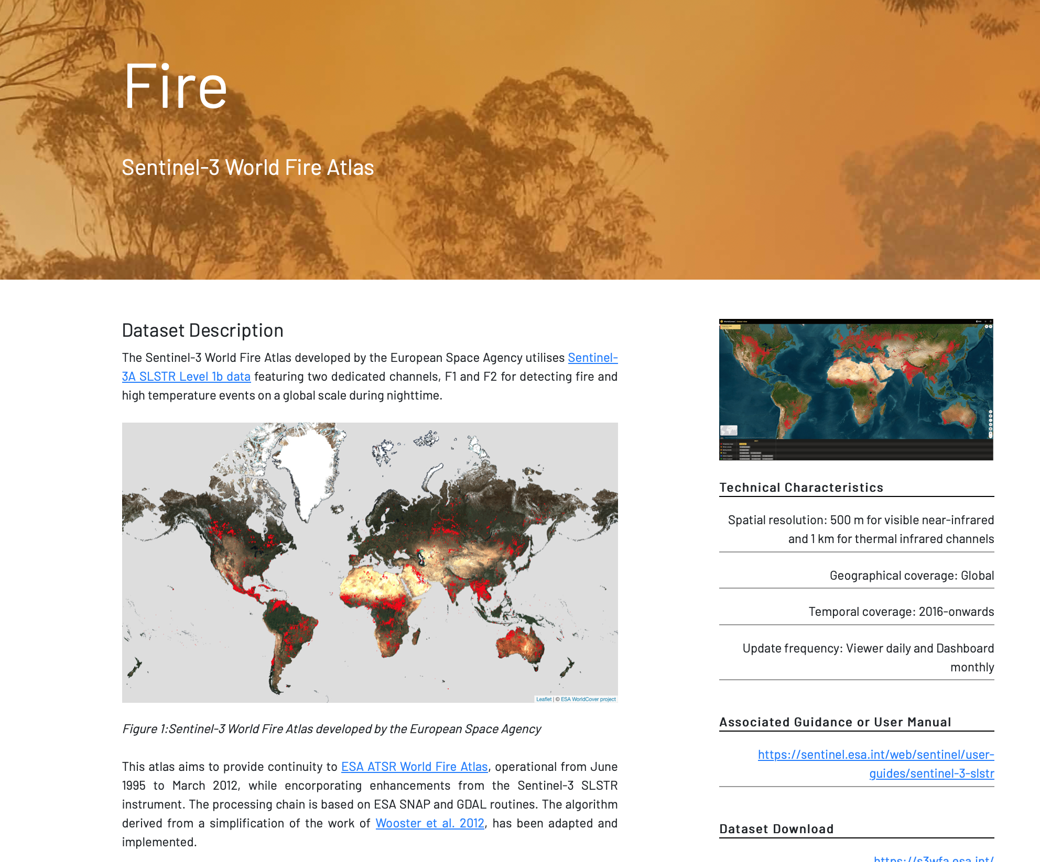
ceos.org/gst
New category - fire

Slide 12

ceos.org/gst
Updates & additions - PLEASE GET IN TOUCH!

