Slide 1
SIT Technical Workshop 2023
Proposal for a CEOS Aquatic Carbon Roadmap
Marie-Helene Rio, ESA
Agenda Item 3.3
SIT Technical Workshop 2023
18th - 19th October 2023, ESA/ESRIN

Slide 2
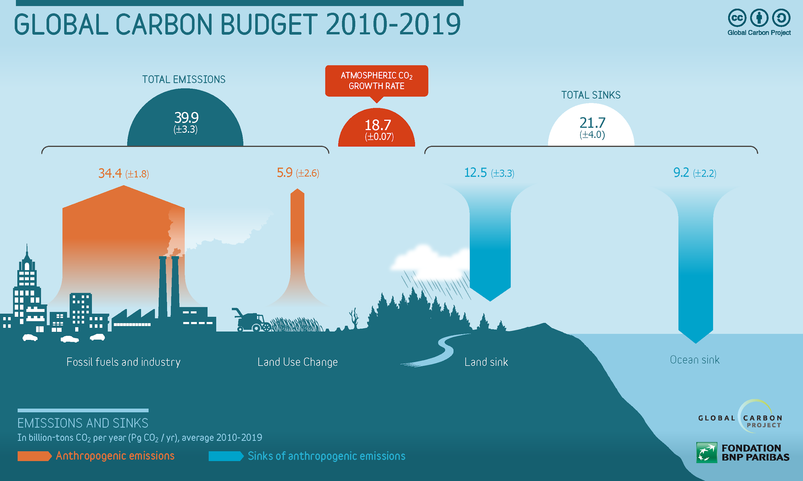
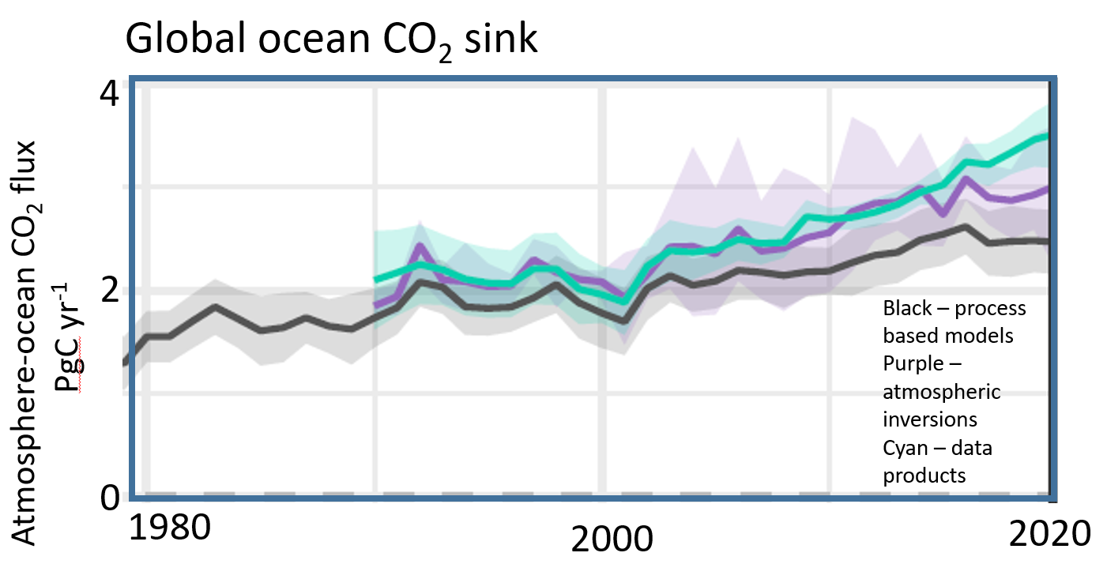
Ocean carbon: a key constraint to the Global Carbon Budget
Oceans play a major role in the Global Earth Carbon Cycle
They have absorbed over 25% of all anthropogenic CO2 released in the atmosphere.
The global land sink is currently impossible to observe, so its modelled estimate relies upon ocean & atmosphere data.
Ocean and atmosphere are the two observational constraints on global carbon budgets.
Improving ocean carbon estimates will improve the land carbon budget and global carbon assessment!
Despite the GCB ocean component now has a greater reliance on observations than models, discrepancies exist between observations and model
good estimates
poor estimates
good observations
Modelled or calculated using all other components
measured
Friedlingstein et al, 2022
Notes:
Each year, the global carbon budget is assessed to track how well, or not, humanity is achieving any reductions in greenhouse gas emissions.
The huge variations in land cover, vegetation, terrain and their year-to-year variations mean that it is currently very difficult to measure the total global land sink accurately. Solving this issue is complex and complicated. However, it can be estimated indirectly.
By absorbing increased carbon dioxide from the atmosphere, the ocean reduces the warming impact of these emissions were they to remain in the atmosphere. However, carbon dioxide dissolved into the ocean causes seawater to acidify,

Slide 3
Ocean carbon: a changing component of the global system
Not only ocean carbon is a key constraint to the global carbon budget, but its monitoring is also essential as increasing anthropogenic CO2 emission are reducing the pH of oceans (ocean acidification)
Global ocean pH stripe, determined using satellite data and illustrating how global carbon emissions are making the oceans more acidic. Data: Gregor & Gruber, (2021).
With direct impact on
Phytoplankton
CaCO₃ and O₂ cycles
biodiversity
Higher trophic levels
So far the ocean sink has increased with emissions. But its future response is not known (can the sink continue to increase, or how will biology change and influence it?)
Including a reduction of the oceans capacity to continue to provide this service

Slide 4
Toward an Aquatic Carbon Roadmap
CEOS Global Stocktake strategy paper
-> demonstrate the value of Earth Observation satellite datasets to support the Global Stocktake process
CEOS Aquatic Carbon Roadmap?

Slide 5
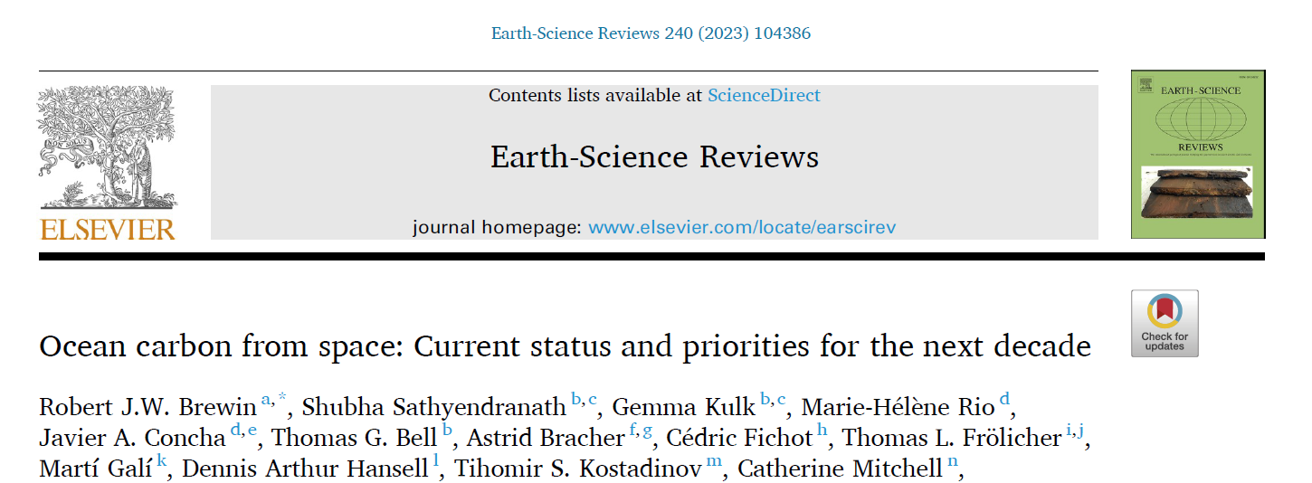
OCR-VC contribution to the CEOS Workplan
2020-2023
2023-2025

Slide 6
Aquatic Carbon Roadmap Objectives
Deliverable VC-23-01
To provide a framework and serve as a guiding vision for long term (~ 15+ years) coordination of CEOS agency observing programmes in support of the needs for Aquatic carbon related information* in the context of the CEOS carbon strategy. This includes (not exhaustive list):
Satellite-based aquatic carbon products and associated uncertainties to constrain models better, and through enhanced integration with field observations and models, to reduce uncertainties in carbon fluxes and in the global carbon budget
Satellite-based mapping of the extent of blue carbon ecosystems at the global scale, and through enhanced integration with field observations, of blue carbon ecosystems carbon content.
Satellite-based Tools/Products/Indicators to support policy needs with a main focus on the needs and ambition cycle of the Global Stocktake of the Paris Climate Agreement.
To characterize the needs, gaps and challenges, regarding the required products, services and applications and the observing systems that can support, including the needs to plan for ground segment, space segment and services.
To address basic observation continuity and the necessary agency coordination to achieve it.
To serve as an effective means for communicating our intentions to society, UNFCCC, national inventory community

Slide 7
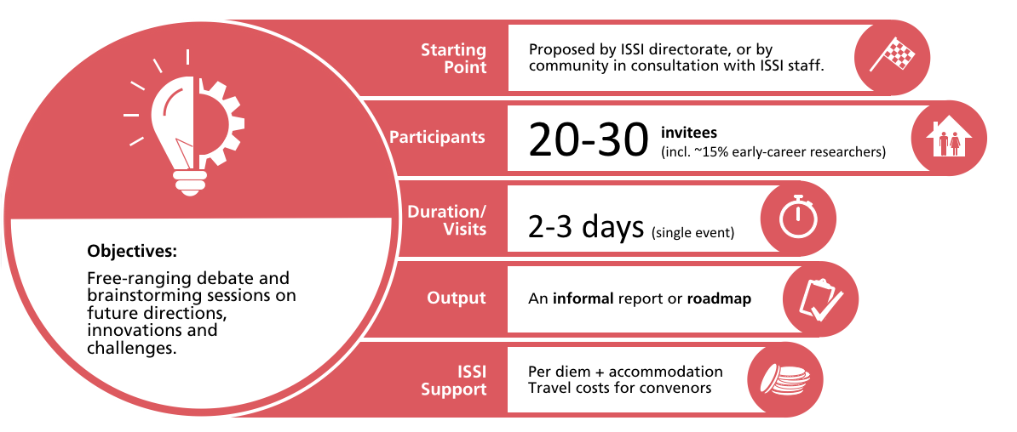
The ISSI Blue Carbon From Space Forum Deliverable VC-23-02
When? 14-17 May 2024
Where? ISSI (International Space Science Institute), Bern, Switzerland
Main topics:
Session 1- Observing system : EO capabilities to map BC ecosystems extent/carbon stock/change: status, gaps, observing system requirements to fill gaps – including in-situ/airborne observations gaps
Session 2 - Impact of external drivers : Further understanding and predicting the impact of external drivers on BC ecosystems (climate change, hurricane, aquaculture, agriculture, mangrove forest exploitation, terrestrial and marine sources of pollution and industrial and urban coastal development )
Session 3- Coastal Blue Carbon restoration and preservation as a Nature-Based climate change Mitigation : To what extent Blue Carbon ecosystem represents a nature-based solution for mitigating the impact of climate change ? What is the impact of ecosystems restoration and preservation actions on mitigation and how EO can support its quantification?
Session 4- Economic value of blue carbon ecosystems / Carbon Credits / MRV
Session 5 - Tools/Products/Indicators to support policy needs with a main focus on the needs and ambition cycle of the Global Stocktake of the Paris Climate Agreement -> what is needed to support the Global Stocktake 2028.
Each topic will be covered during dedicated sessions and recommendations will be collected with the final objective to draft a white paper as an outcome of the Forum.
-> Direct inputs to the Aquatic Carbon Roadmap

Slide 8
Toward an Aquatic Carbon Roadmap – Role assignment
The development of an Aquatic Carbon roadmap is a very timely, needed, but at the same time very ambitious commitment
The contribution and coordination from IOCCG/CEOS OCR-VC agencies will be essential to work towards actual deliverables. Most of these agencies have carbon related activities on which the roadmap will build on.
Laura Lorenzoni (NASA), Marie-Helene RIO (ESA) and Hiroshi Murakami (JAXA) have been identified as potential coordinators for the roadmap. => CEOS Principals to confirm commitment
At IOCCG level, an IOCCG Aquatic Carbon from Space Task Force is being initiated (led by Jamie Shutler, University of Exeter, UK and Cecile Rousseaux, NASA GSFC, US) and also a Working Group on Primary Production (chaired by Robert Brewin, University of Exeter, UK), which could both support the production of the roadmap.
Jamie Shutler, Bob Brewin and Cecile Rousseau have been identified as Scientific leaders of the roadmap writing.
The Aquatic Carbon Roadmap will also likely require a degree of coordination and collaboration with AFOLU Roadmap and the GHG Roadmap, in particular for what regards Blue Carbon ecosystems (Wetland/mangroves are part of the AFOLU roadmap) => CEOS support needed to coordinate between the three roadmaps

Slide 9
Toward an Aquatic Carbon Roadmap – Plenary preparation
A 2-3 pages paper is being prepared to support CEOS Principals discussion at the upcoming CEOS plenary in November.
Planned delivery: November 1st
This paper will include the following items:
Why is there a need for an aquatic carbon roadmap to accompany the GHG and AFOLU Roadmaps
What it will seek to achieve
What is the timeframe for completion
External stakeholder connections, events, milestones, etc.
Who (which agencies and missions, etc.) would be the main contributors
First roadmap outline with potential contributors for each section.
The specific decisions Principals will need to debate and agree.

Slide 10
Decisions sought at Plenary
CEOS Principals are asked to decide at Plenary whether they are willing to provide representation and resources going forward to support the development of a full CEOS Aquatic Carbon Roadmap, as the aquatic component of the CEOS Carbon strategy to support the Global Stocktake process.
This includes in particular the commitment by NASA, ESA and JAXA to provide the required representation and resources to coordinate the development of the roadmap.
CEOS Principals are asked to decide at Plenary on CEOS providing support to coordinate the Aquatic Carbon Roadmap development with the GHG and AFOLU roadmap activities.

