Slide 1
AFOLU Roadmap meeting
Sylvia Wilson
US Geological Survey
SIT Technical Workshop 2023
17th October 2023, ESA/ESRIN

Slide 2
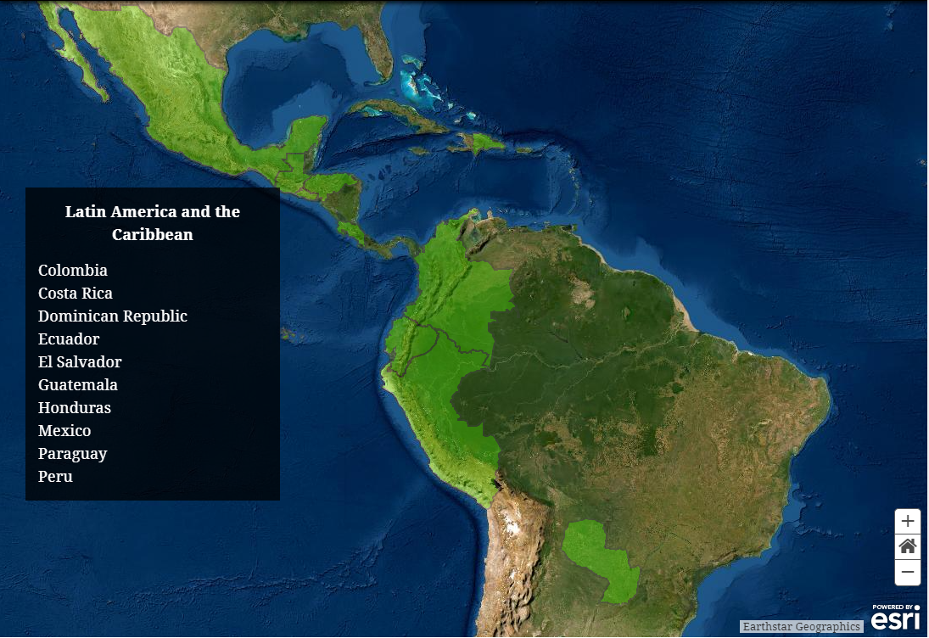
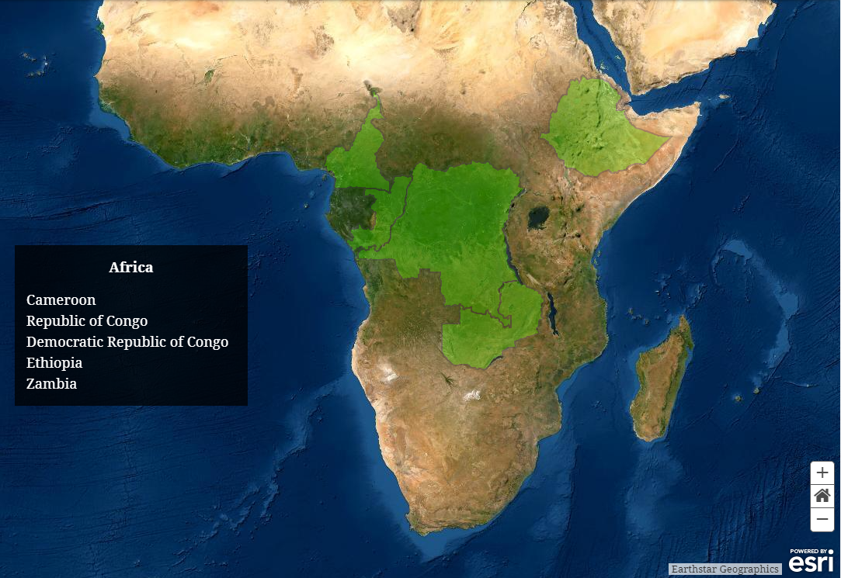
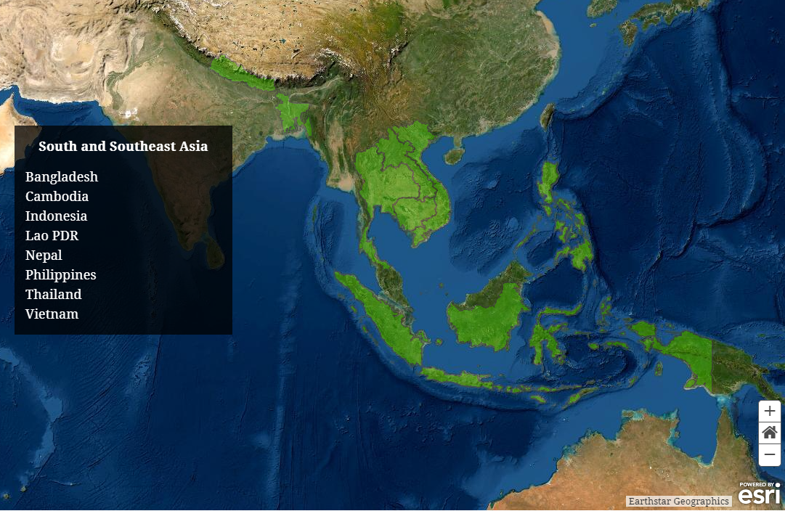
National User Engagement
Overarching Goals
Demonstration of uptake of satellite-based data and derived products in country reporting to the UNFCCC
Contribution with data and input from countries to the Biomass effort
Provide national feedback on, and contribute to the refinement of, available products derived from satellite-data (land cover and biomass).
Solomon Islands
Notes:
The overarching goals of the national user engagement effort are to demonstrate the uptake of space data and derive products in a way that is useful to guide country reporting to the UNFCCC. This is not easy, there is a lot of work and tweaking that needs to be done to datasets to fit specific country requirements. Also, is not a new problem, there have been many datasets distribute for free and available to all for a long time, but not being utilize, and the reason is that the uptake require specific work to adjust the dataset to each country definitions and classifications, but also there is a capacity building component to get the data ready to use it. If this capacity component is not set in place then the country will resource to what they know, and the data they have been using.
The next goals are to validate a harmonize biomass map with ground base data from countries and to provide national feedback to improve the data available, and this can be done by calibrating existing datasets with country-based data. This is a two-way benefit here. If we use country data to calibrate global products, the maps will be more accurate, and more likely to get use.
To fullfill these goals we have embark in many activities, so in the next slide I will explain what we have been doing, and other next steps.

Slide 3
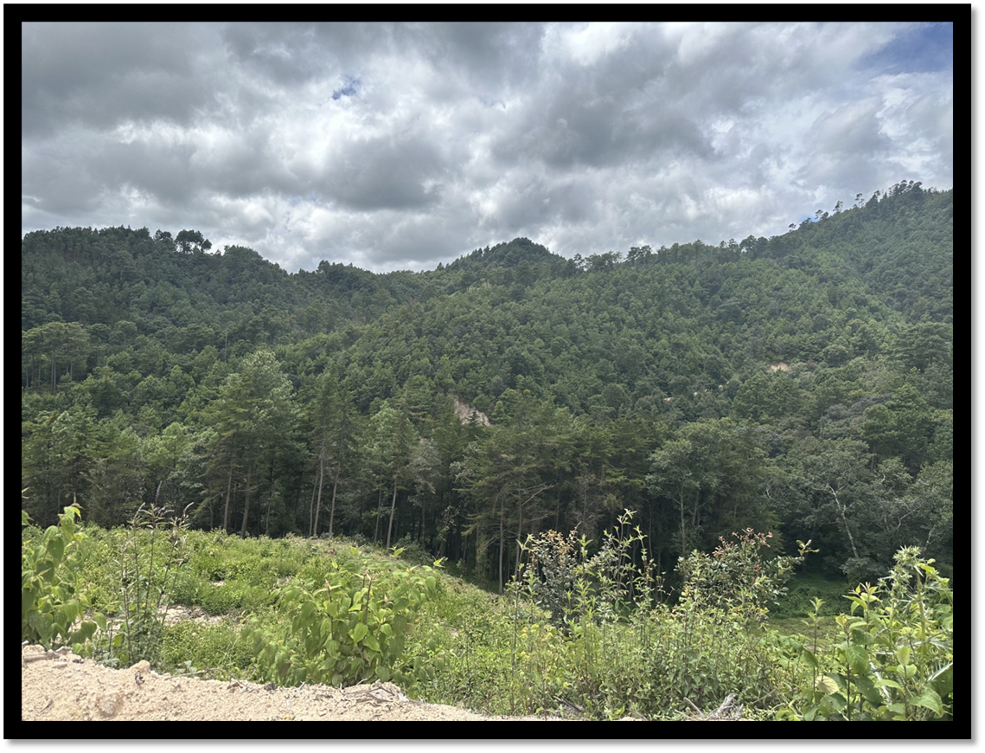
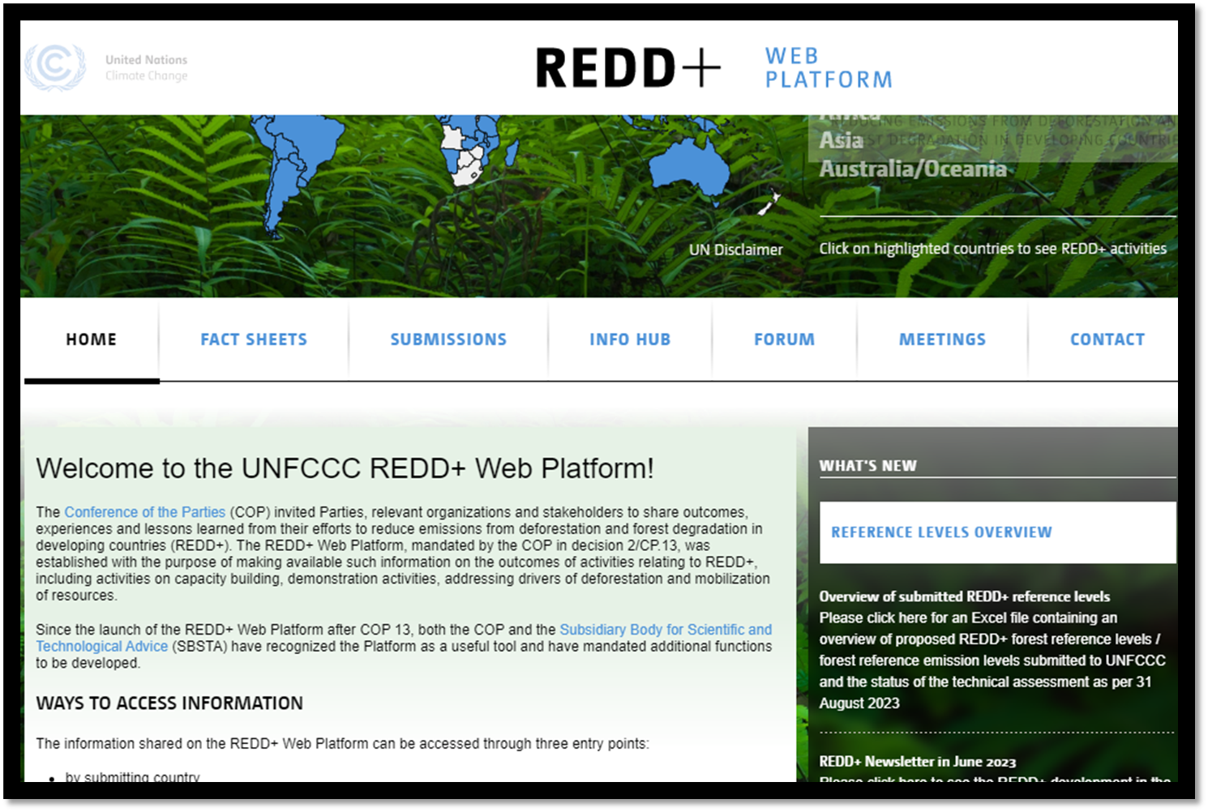
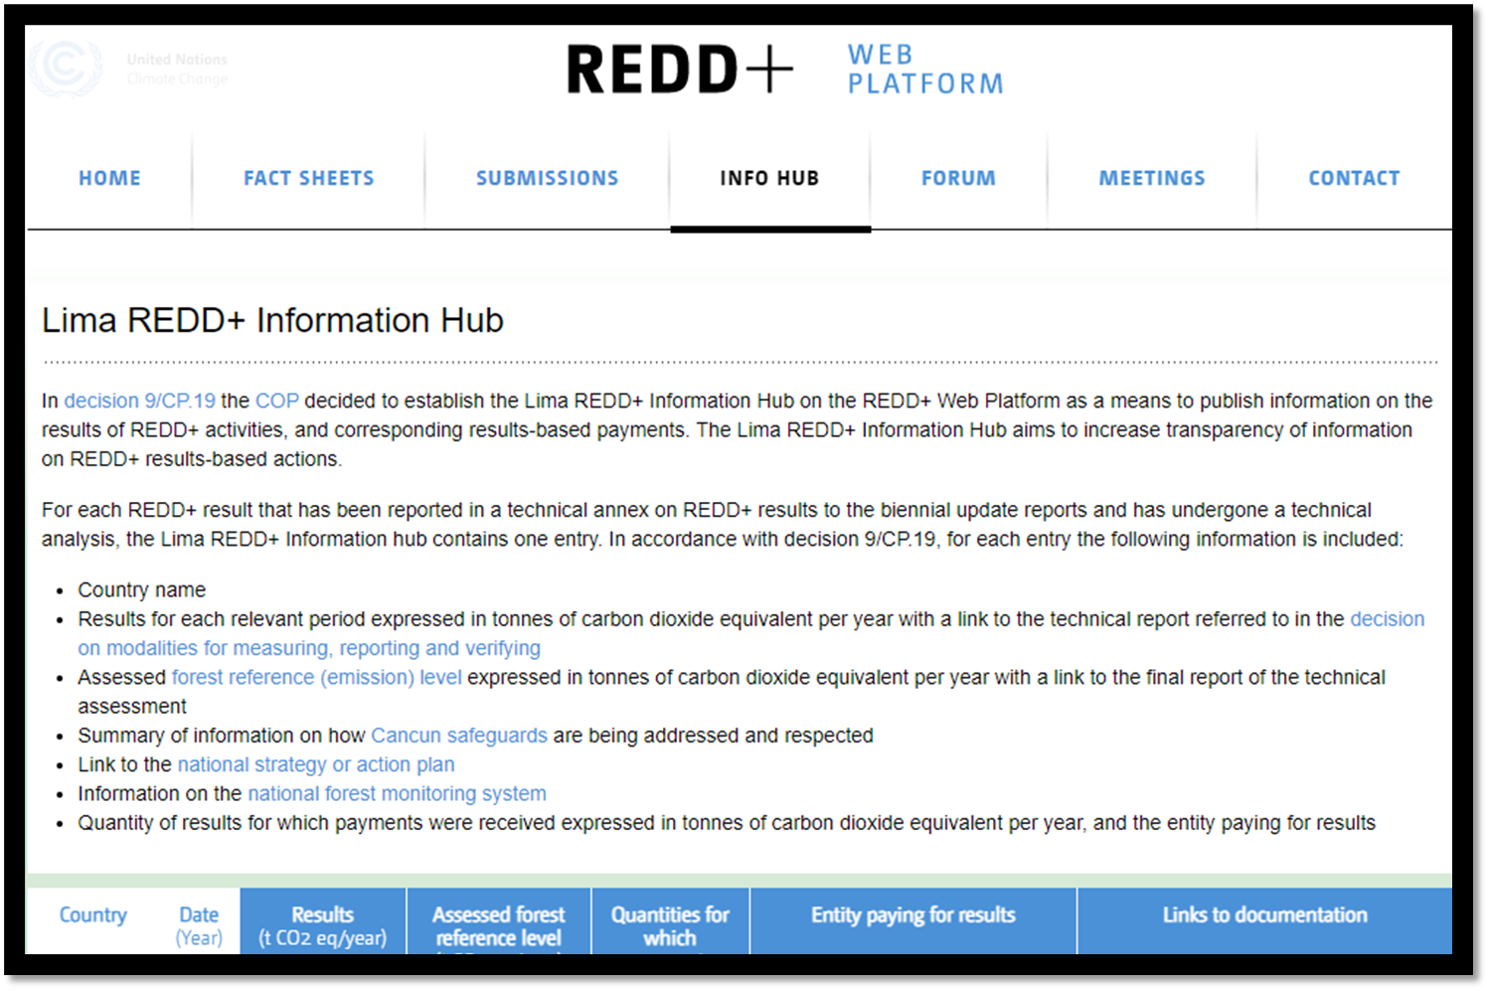
REDD+ Process
REDD+ Activities
Reducing emissions from deforestation
Reducing emissions from forest degradation
Conservation of carbon stocks
Sustainable management of forest
Enhancement of forest carbon stocks
Five Requirements
REDD+ Strategy
Forest Reference Level
National Forest Monitoring Systems
Addressing social and environmental safeguards.
Results
REDD+ Lima Info Hub
Transparency
Trust
Action
Notes:
Our main goal is to support the generation of reliable and transparent data for reporting to REDD+, and for the countries to enter the carbon markets. So, here is a little bit about the REDD+ process.
To reduce carbon emissions REDD+ call 5 activities
REDD+ happens in 3 different phases, the readiness which is the preparation, the implementation, and the results.
Five requirements to enter REDD+
Results are measured against the Forest Reference levels and they go thru two rigorous review processes, the technical assessment and the technical analysis.
Then reports are posted in a web hub. The Lima redd hub is used to publish information on results based activities and increase transparency on payments, actions, and methods to receive finance.

Slide 4
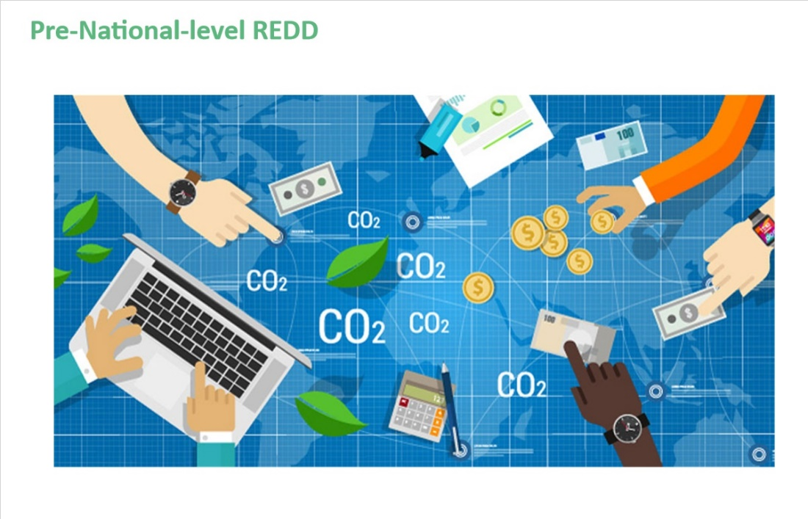
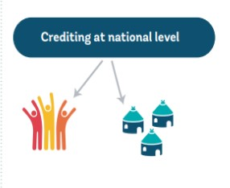
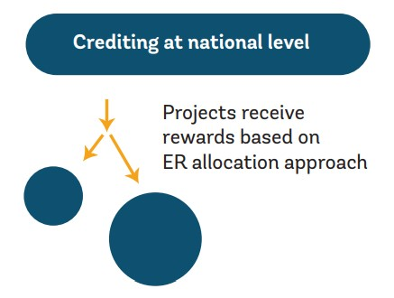
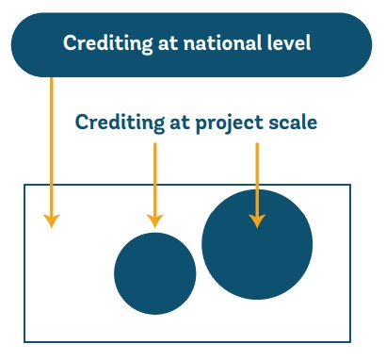
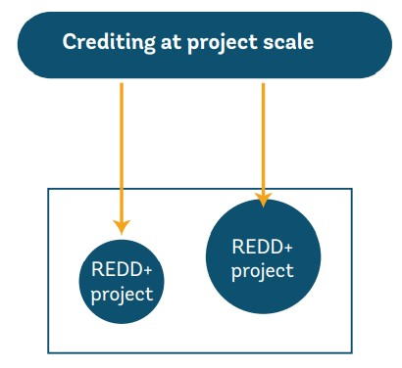
Geo for Good Summit Presentation Template
Geo for Good Summit 2023
Notes:
The redd+ process have been adopted with multiple designs and is not uncomplicated. But I am going to talk a bit about a jurisdictional approach, and show you a case studies of the jurisdiction approach for reduction of emissions.
Pre-national level redd, where countries embarked on finer scale carbon projects, individually carbon projects, where verification and reporting are independent of a national level.
Project level is difficult to account for deforestation leakage, and integration into a national level to not double count emission reductions is difficult.
Nested is when redd+ activities occur at multiple administratives scales, but it’s a harmonized system, that is the main difference from a project level. There is a better monitoring of leakage
The jurisdictional level, it is the largest scale, usually country, state or province. The main difference is that it needs to include all the jurisdiction in the baseline. The big advantage is that by including all the jurisdiction they align with international reporting standards, and methods, and leakage is immediately accounted for.
As there are different scales of REDD+ projects, there are also different scales on how REDD+ finance flows.
Independently on the scale of REDD, there are baselines that need to be set as requirement, as I mentioned in the previous slide.
Story about GEE support jurisdictial, project level redd+ was easier in the past than a jurdistiction
al level. How do you handle space data without the cloud infrastructure, this was very difficult to achieve in the past for countries for a jurisdictional level.

Slide 5
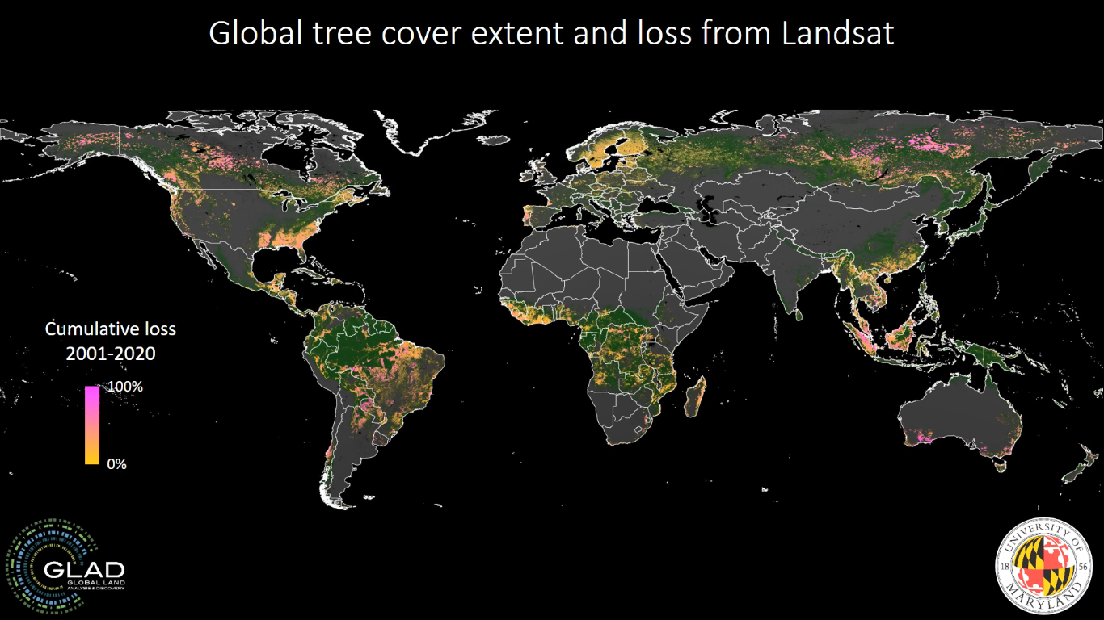
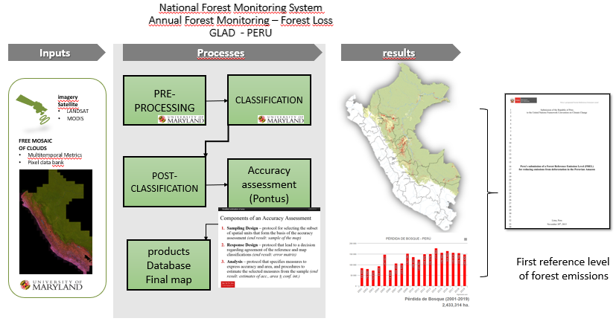
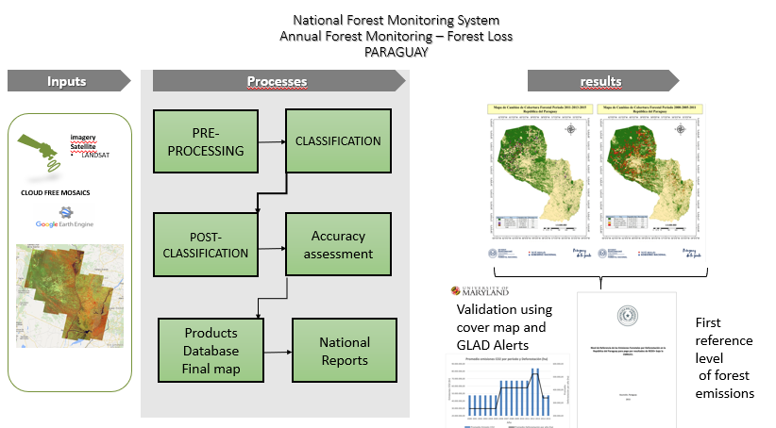
LAND COVER: FOREST COVER AND ALL LAND TRANSITIONS

Slide 6
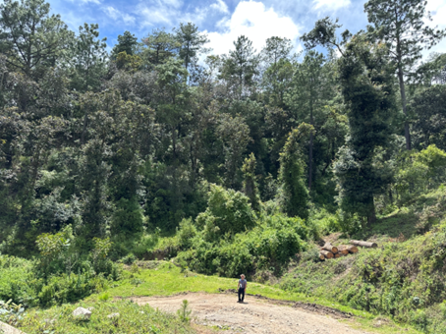
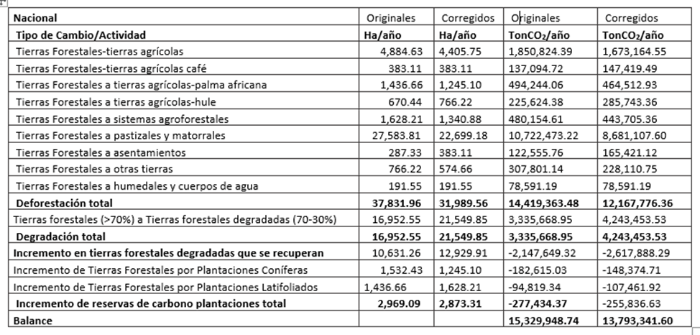
GUATEMALA
2006-2016
2017-2021
2006-2016
2017-2021
Forest Reference Levels Results
Notes:
The first reference level is from 2006 – 2016, and the second one is 2016 – 2021. They improved because they have access to Google Earth Engine algorithms, but also NICFI High resolution data through GEE from SEPAL and Collect earth

Slide 7
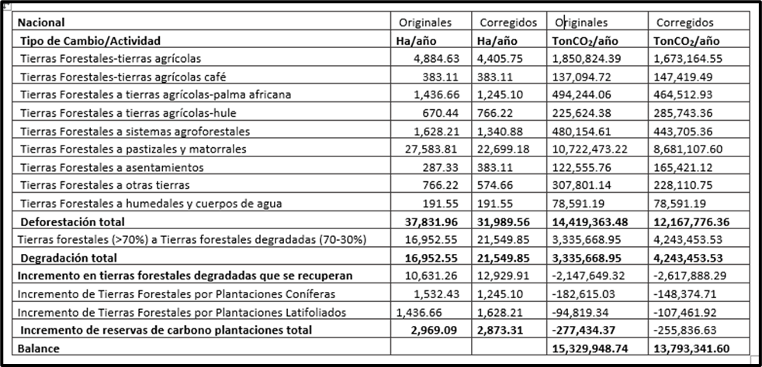
GUATEMALA
2006-2016
2017-2021
2006-2016
2017-2021
Forest Reference Levels Results
Notes:
Total deforestation decrease by a total of about 2.3 millions of tons of CO2 per year

Slide 8
GUATEMALA
2006-2016
2017-2021
2006-2016
2017-2021
Forest Reference Levels Results
Notes:
Total degradation increased, more accurate data by using HR data from planet. Degradation increased by 0.9 million tons of CO2 per year

Slide 9
GUATEMALA
2006-2016
2017-2021
2006-2016
2017-2021
Forest Reference Levels Results
Notes:
The last activity enhancement of carbon stocks also decreased. The Tons of CO2 sinks were less in the second period by about 0.2 million tons of CO2 capture.

Slide 10
GUATEMALA
2006-2016
2017-2021
2006-2016
2017-2021
Forest Reference Levels Results
Notes:
The total balance for emission was positive, so they will get payments for results based on a positive balance of emission reductions of about 1.6 millions of tons of C02 per year

Slide 11
Classification of Mangroves

Slide 12
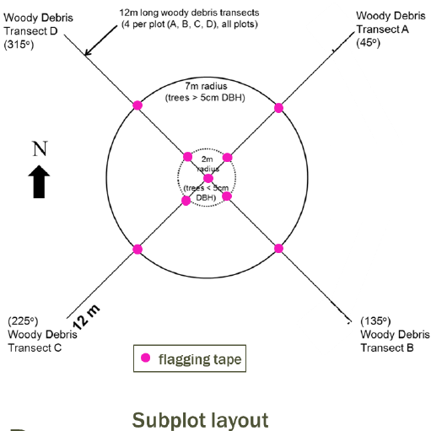
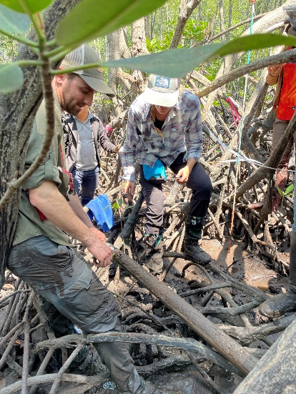
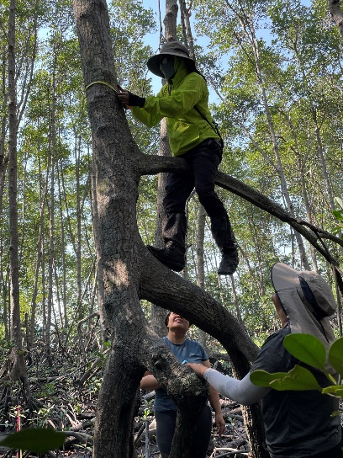
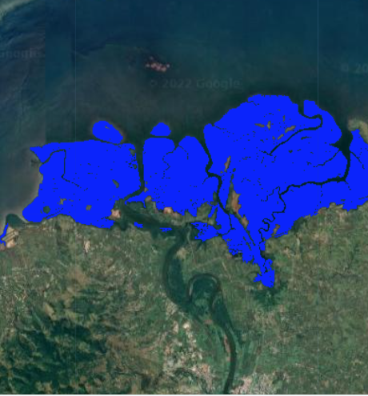
Mangroves included in REDD+
1. Background: Role of mangroves in carbon storage, sequestration, emissions. Disproportionate impact. Unique characteristics. REDD+ vs. Blue Carbon.
3. Field surveys: Use SWAMP protocol to measure C stocks in 4 pools – AGB, BGB, soils, downed woody debris. Cross-plot design. Data processing to compute Mg C/ha.
2. Remote sensing component: EE scripts and GUIs to map extent, canopy height, and estimate AGB (calibrated with field data).
4. Integration: How to combine RS and field data into emissions estimates (REDD+). Unbiased map areas. Approaches and tiers.
Lola Fatoyinbo
Notes:
Field surveys with partners – SWAMP, CIFOR, Academia

Slide 13
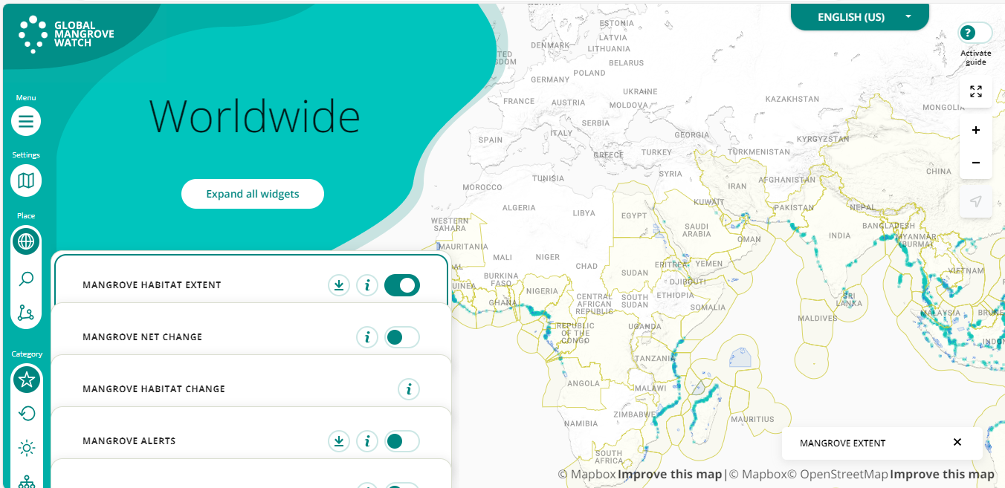

Slide 14
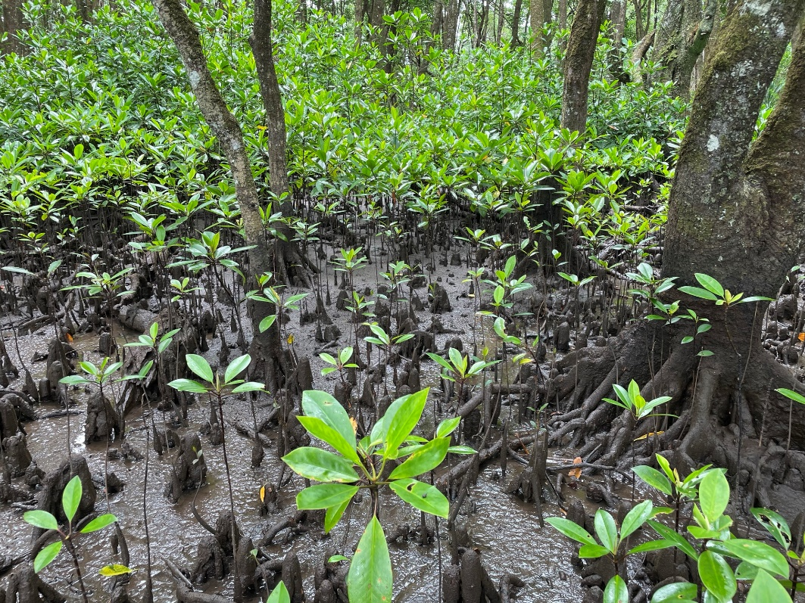
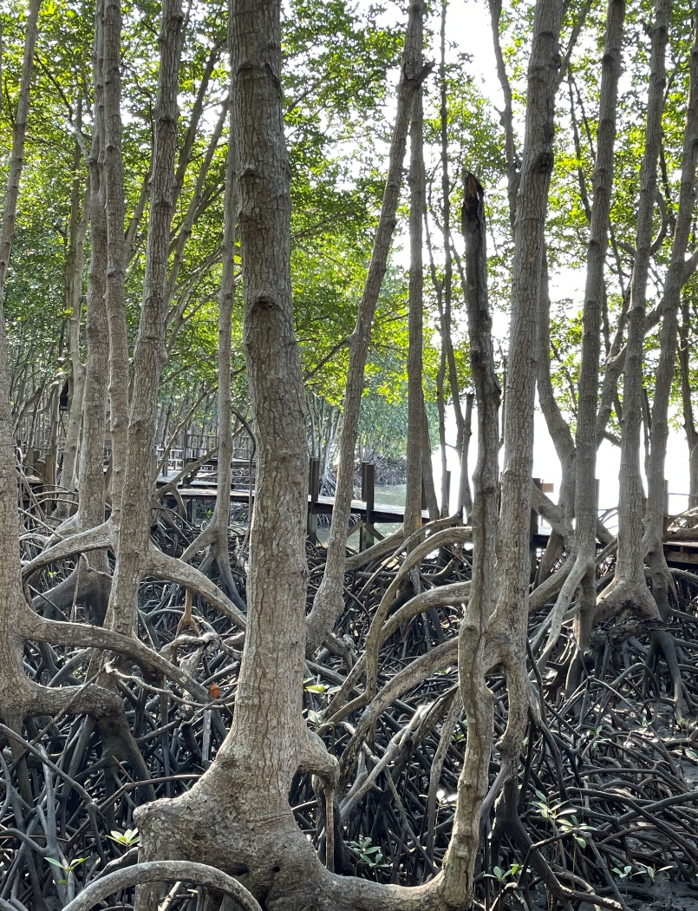
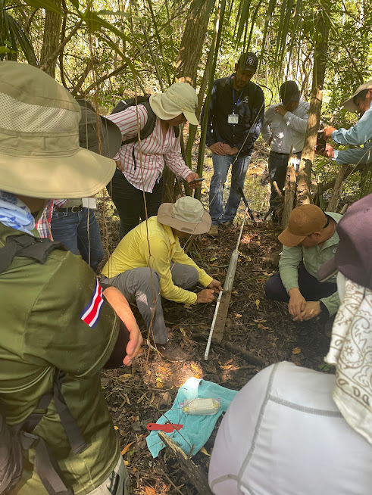
MANGROVE MAPPING AND MONITORING
Recent workshops:
Suva, Fiji: October 5–11, 2022
Chanthaburi, Thailand:
February 26 – March 1, 2023
Manchon Guamuchal, Guatemala:
August 15 - 30, 2023

Slide 15
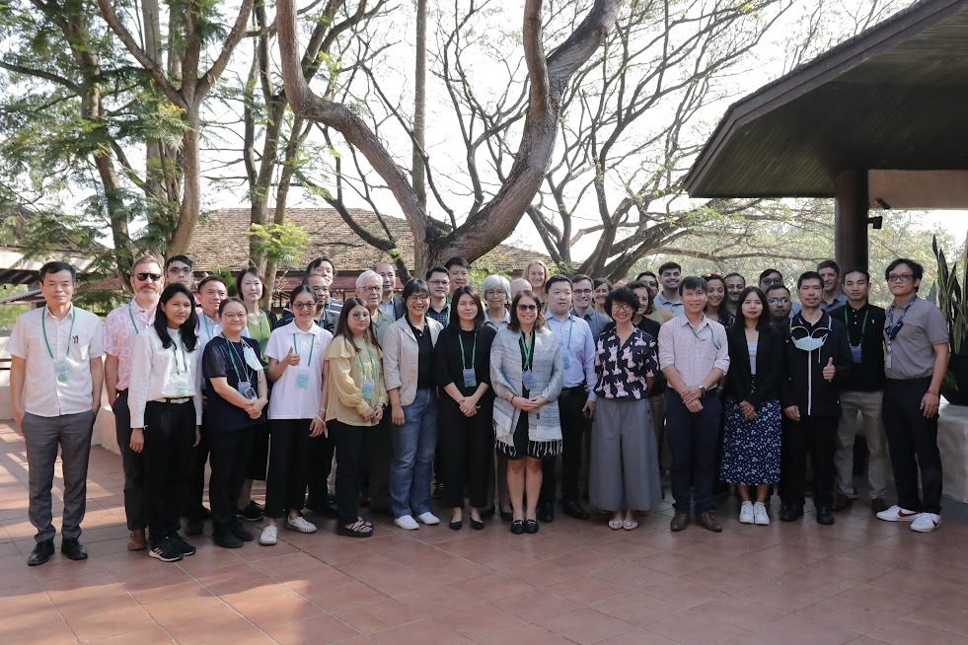
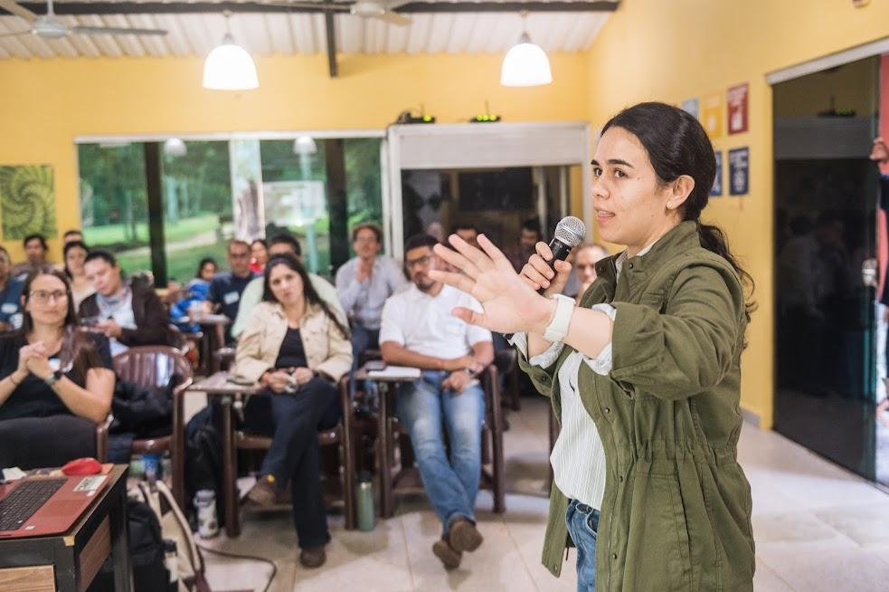
BIOMASS MAPPING
Recent workshops:
Chanthaburi, Thailand:
February 26 – March 1, 2023
Paraguay: June 6 - 11, 2023

Slide 16
In conclusion and moving Ahead….
Cambodia (USGS and JAXA) initiative
Jurisdictional approach for mangroves datasets in Guatemala
Biomass and mangroves mapping in Peru (November 2023)
Engagement with Google, FAO, Mapbiomass, and UCLA
GFOI chapter on remote sensed assisted emission factors
Thanks!
Sylvia Wilson
snwilson@usgs.gov
Notes:
We are not stopping this initiative now. We have raised interest from many countries now and as a next steps we are requesting inventory data from 27 countries to improve biomass global and pantropical maps. We will also include case studies in the NASA Biomass Dashboard. We will move forward with understanding the uptake of other CEOS datasets in all SilvaCarbon countries. Last, we will join forces with other partners to have a greater impact. Thank you!

