Slide 1
GHG Mission Portal
Powered by the CEOS MIM Database
ceos.org/ghg
S Ward (ESA MIM Team) Agenda Item 2.4
SIT Technical Workshop 2023
18th - 19th October 2023, ESA/ESRIN

Slide 2
Context
Need for greater awareness of current and planned missions to ensure continuity and coordination
IMEO Roadmap
GHG Task Team
ESA MIM Team cooperation with incoming SIT Chair team (JAXA) to develop a portal that summarises all known CO2 and CH4 observing missions - public, private and NGO
Builds on the IMEO and JPL spreadsheets
Technical support from GHG TT - thanks! (Dave, Mark, John, Yasjka…)

Slide 3
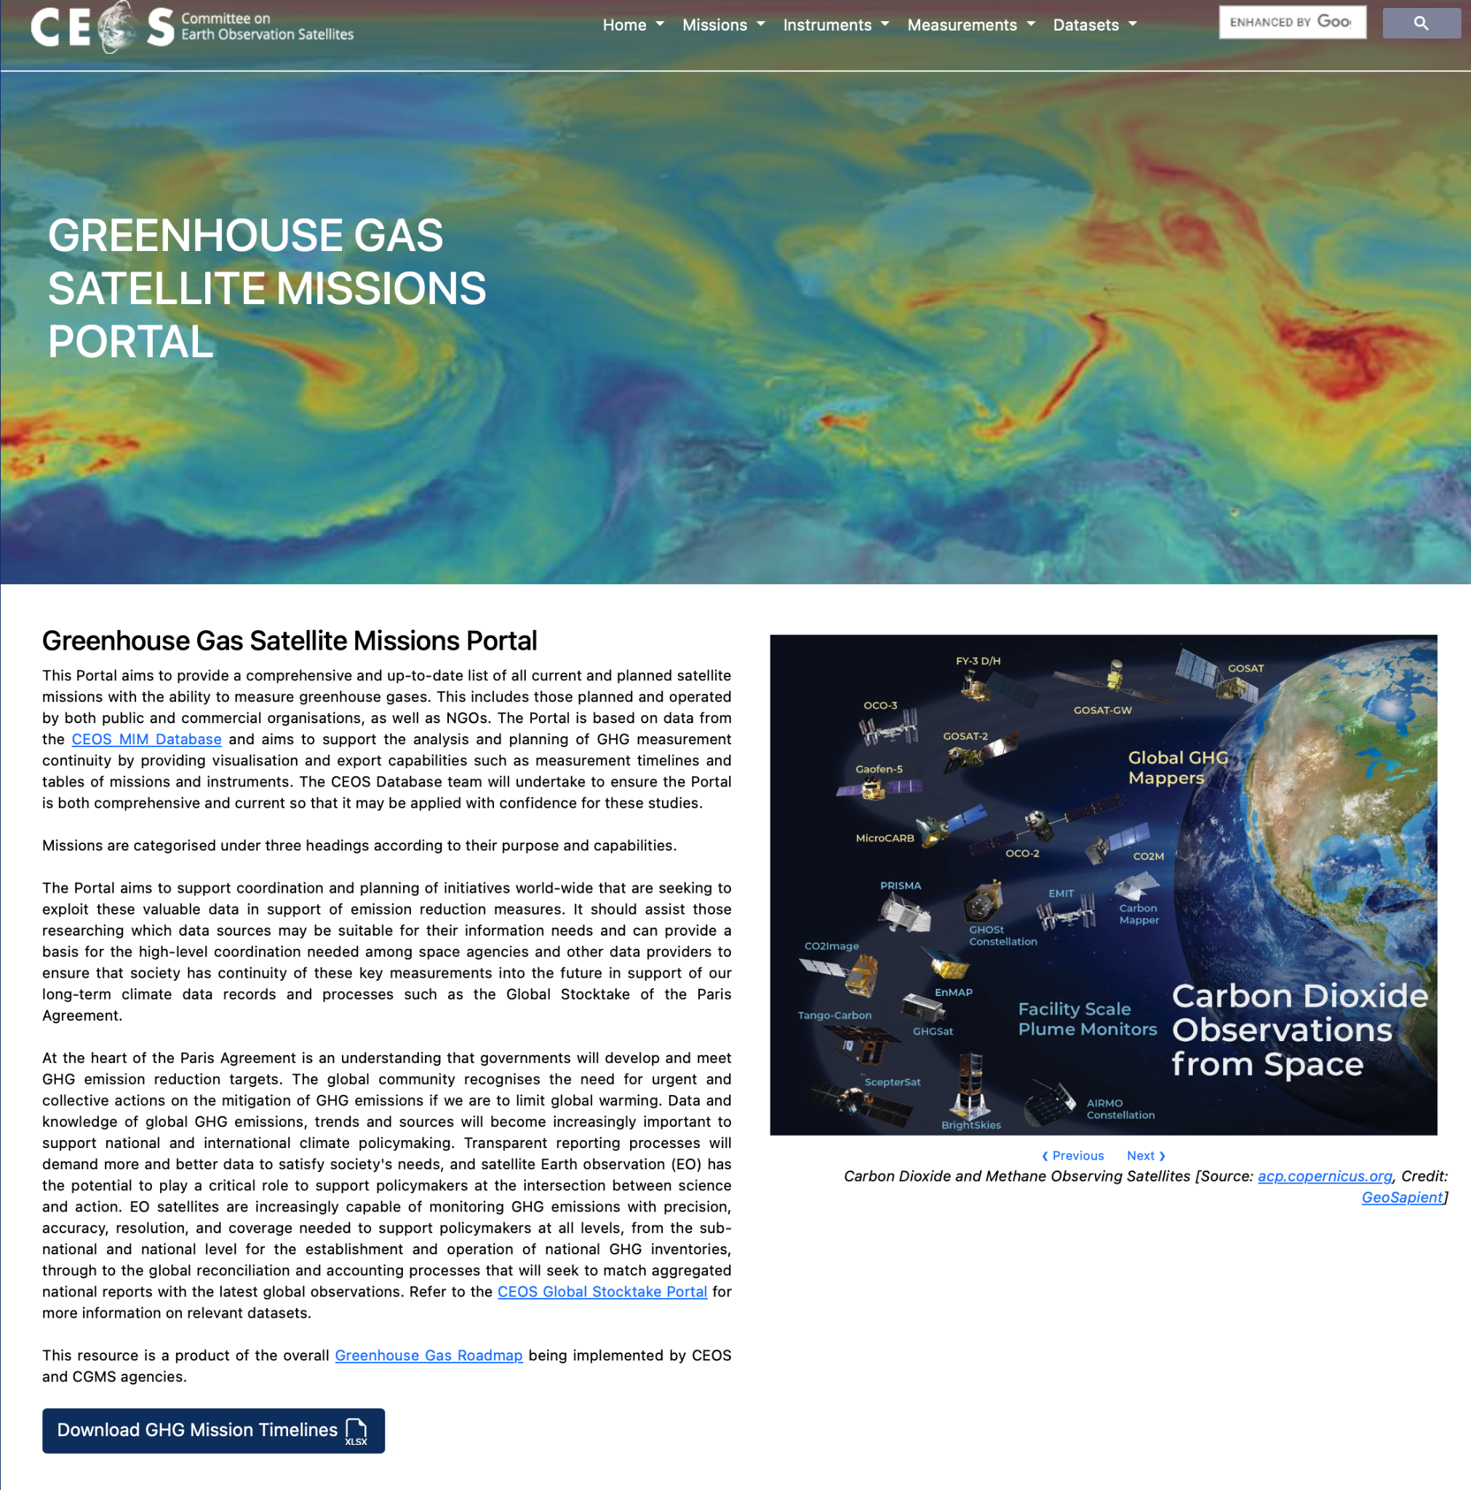
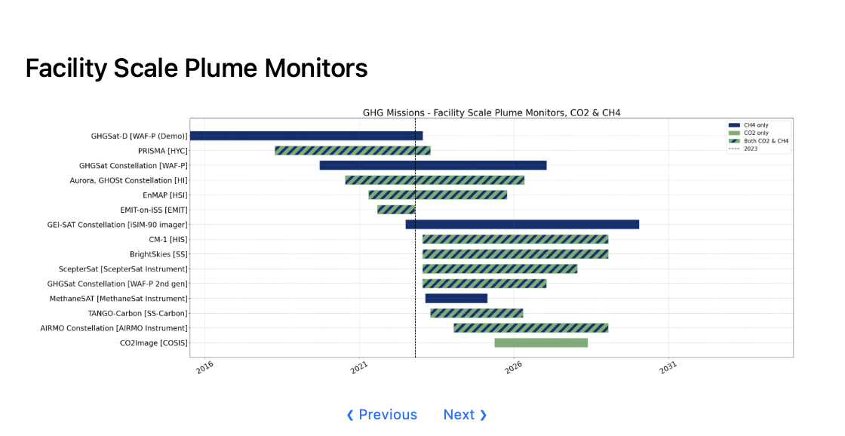
ceos.org/ghg

Slide 4
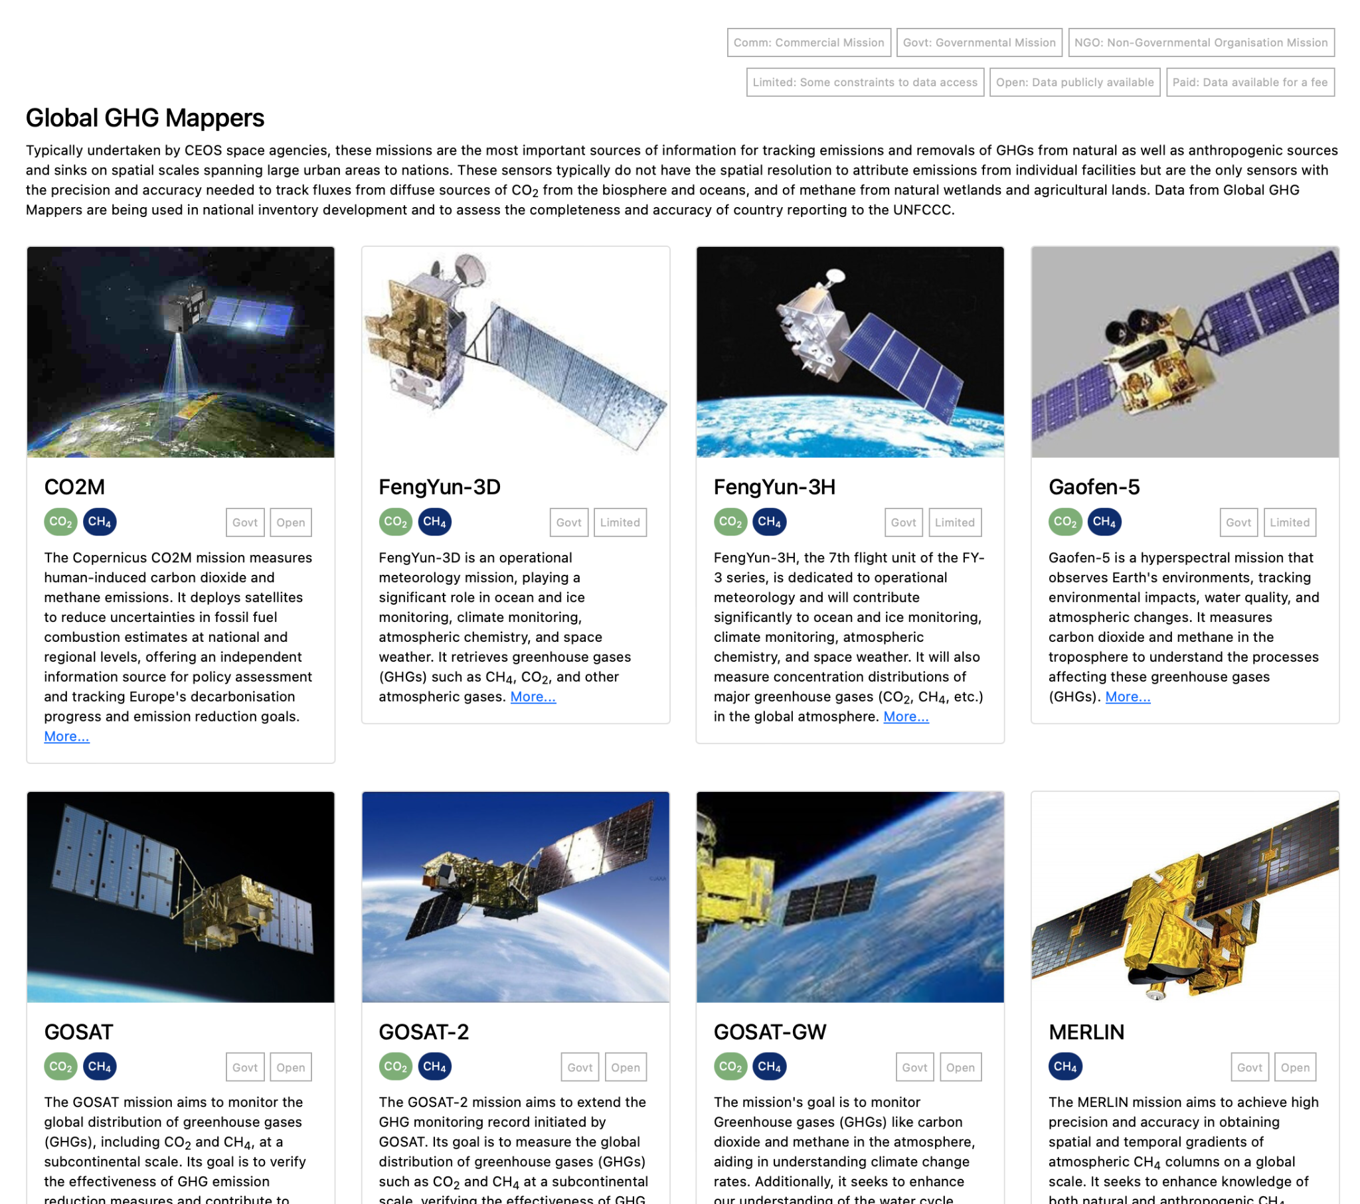
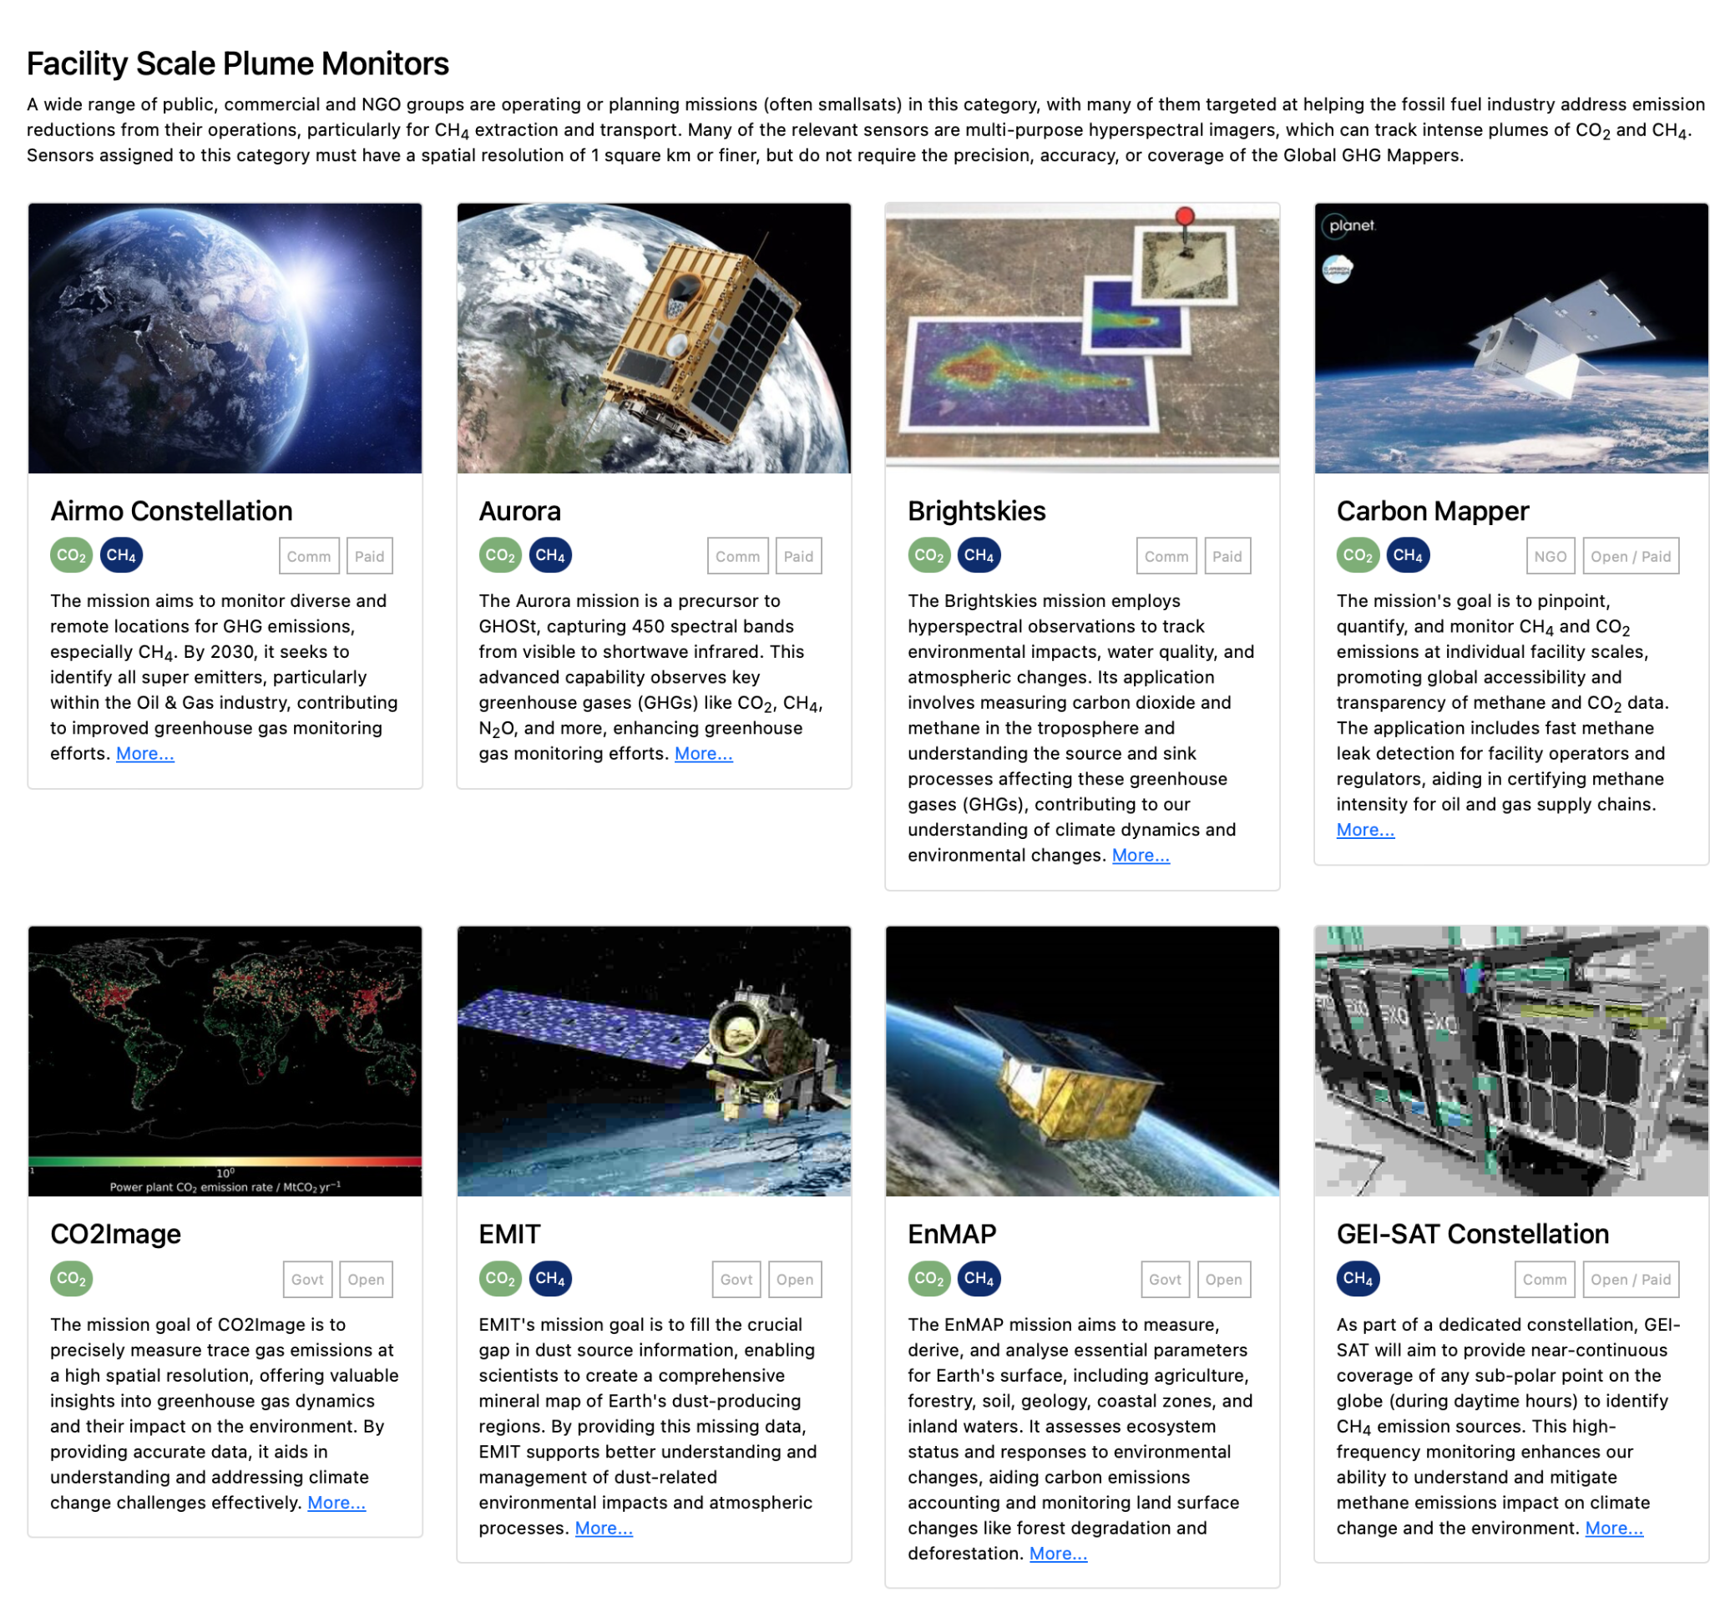
ceos.org/ghg

Slide 5
ceos.org/ghg
Global GHG Mappers (usually public)
Facility Scale Plume Monitors (mixed)
Operational Sounders
Links through to MIM profile for each

Slide 6
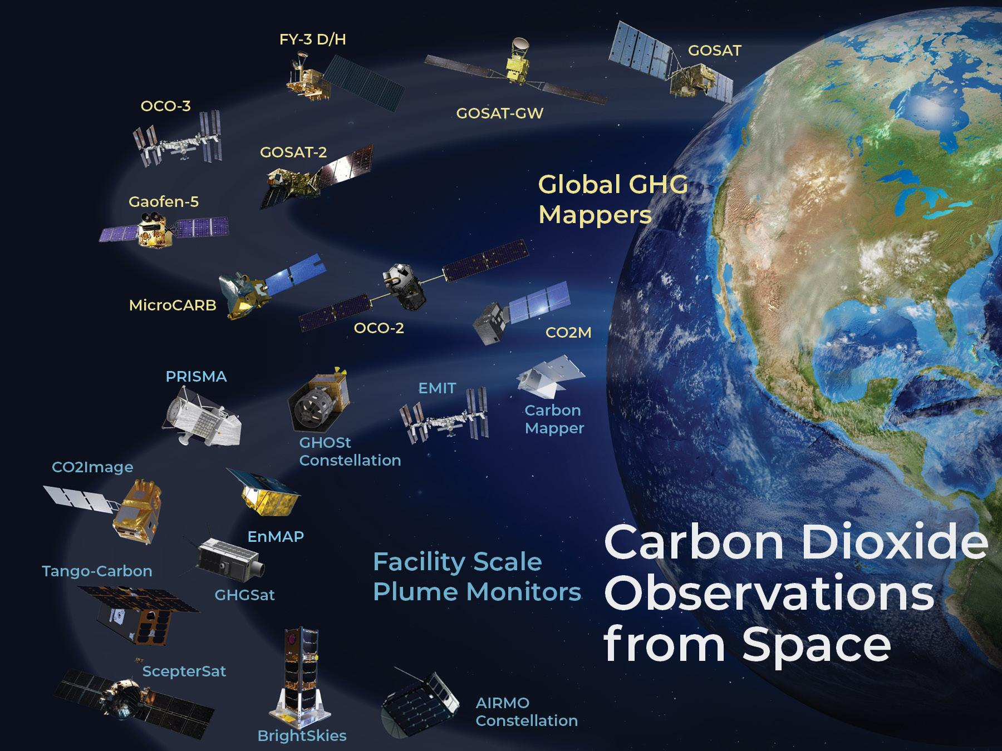
Already in use!
Being deployed in the IMEO Roadmap document
Great feedback from GHG TT - already reflected
Further comments and updates welcome
Ready to demo at COP-28 and beyond
Seeks to help explain the role of different mission types and the CEOS missions in particular in context of public/NGO missions
ceos.org/ghg

Slide 7
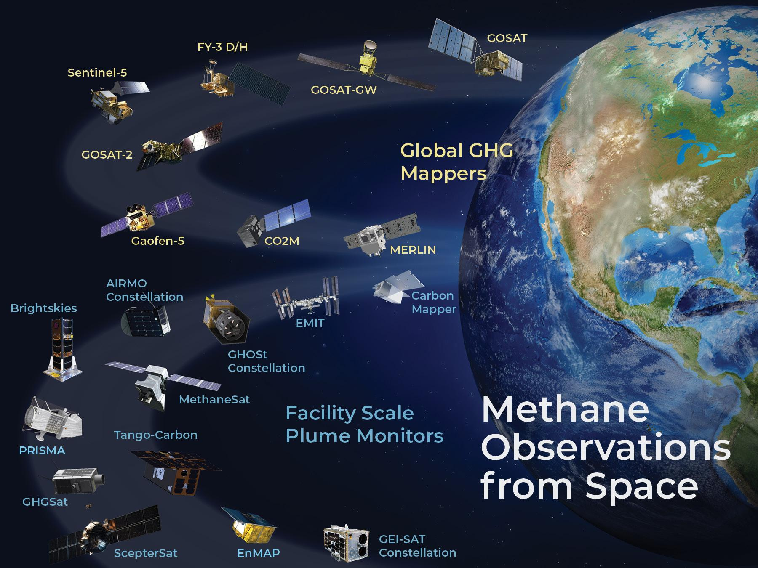
Thanks!
ceos.org/ghg

